Slide 1


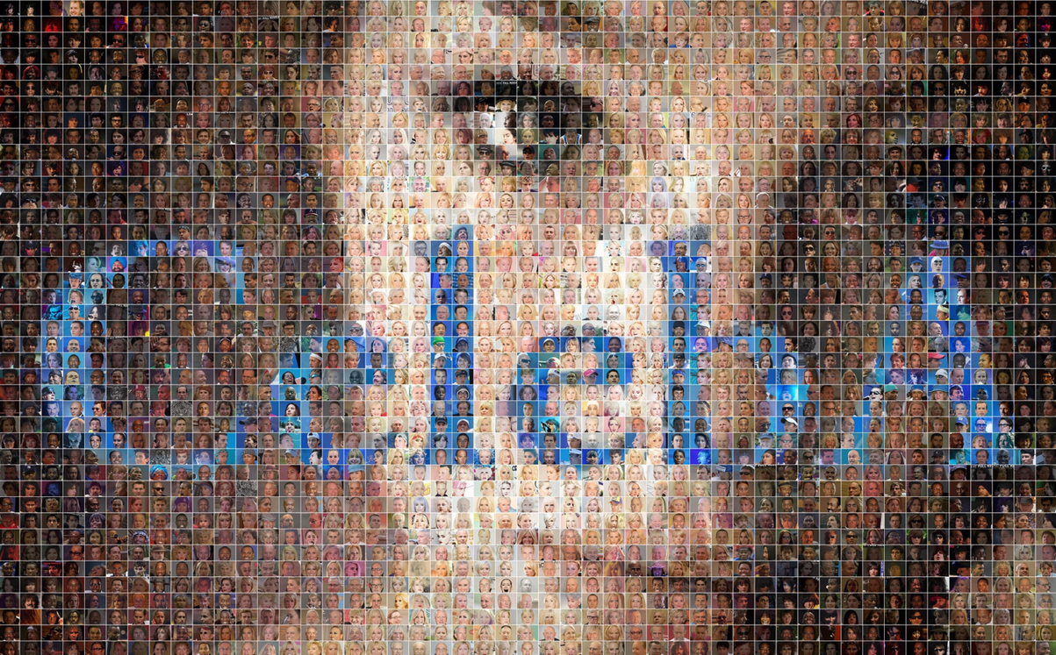



Attr2Face

Slide 2

INTRODUCTION
Conditional GAN for Attribute-Controlled Face Generation
Using CelebA Dataset (Subset) + PyTorch

Slide 3

What Problem Are We Solving?
Generating realistic human faces with controlled attributes is challenging.
Traditional GANs:
  Generate random faces
  No control over output characteristics
Our Goal
Build a model that can generate faces based on:
  Smiling
  Wearing Glasses
  Gender (Male/Female)
Example:
Input → “Smiling Male with Glasses”
Output → Matching synthetic face

Slide 4

Real World Applications
  Avatar Generation
  Gaming Character Creation
  Movie / VFX Industry
  Data Augmentation
  Privacy Preserving Synthetic Identity Generation
  AI Content Creation Tools
Industry Relevance
Conditional image generation is core to:
  Stable Diffusion pipelines
  Text-to-Image models
  Personalization AI systems

Slide 5

Dataset Used: CelebA (Subset)
Original Dataset:
  200K+ celebrity face images
  40 facial attributes
Project Subset:
  5K – 20K images
  Image size → 64 × 64
  Normalized → [-1, 1]
Selected Attributes
  Smiling
  Eyeglasses
  Male

Slide 6
ARCHITECTURE
Model Type: Conditional GAN
Components:
Generator
  Input → Noise + Attribute Vector
  Output → Synthetic Face Image
Discriminator
  Input → Image + Attribute Vector
  Output → Real / Fake Score
Model learns:
P(Image | Attributes)

Slide 7
PROJECT PIPELINE
1 — Dataset Loader
  Load images + attributes
  Batch visualization
2 — DCGAN Baseline
  Generator + Discriminator CNN
  Baseline training
3 — Conditional GAN Training
  Attribute conditioning added
4 — Inference Demo
  Attribute → Generated Face

Slide 8
Training Setup
Baseline DCGAN:
  Epochs → 5 to 10
Conditional GAN:
  Epochs → 10 to 20
Loss Monitoring
  Generator Loss
  Discriminator Loss
Stabilization Techniques
  Learning rate tuning
  Label smoothing
  Batch size tuning

Slide 9
RESULTS
Model Successfully Learned
✔ Facial structure generation
✔ Attribute conditioning
✔ Realistic texture patterns
Observations
  Smiling attribute learned fastest
  Glasses required more epochs
  Gender separation learned well

Slide 10
FUTURE IMPROVEMENTS
  Add more attributes
  Use StyleGAN architecture
  Add text-to-attribute encoder
  Higher resolution generation (128×128 / 256×256)

Slide 11
THANK YOU

