Slide 1
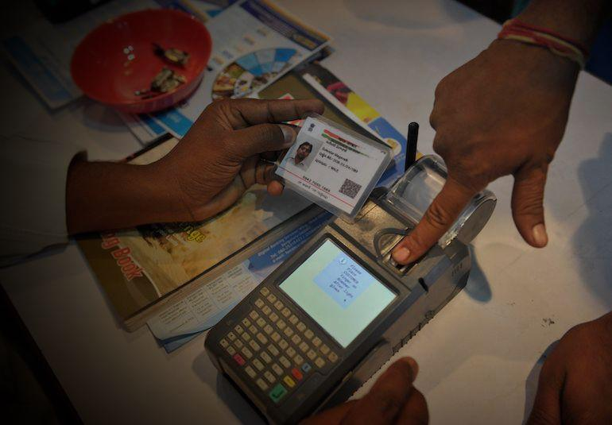
Decentralization of_x0001_ Aadhar using Ethereum and_x0001__x0001_ Raspberry Pi

Slide 2
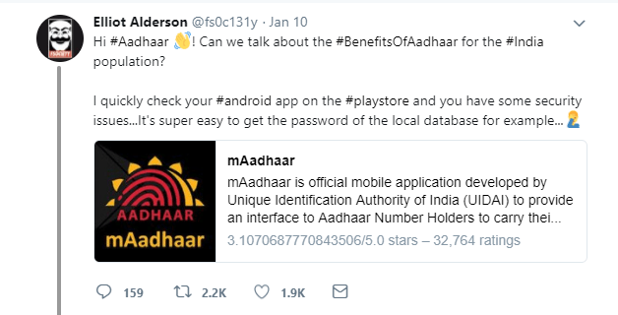
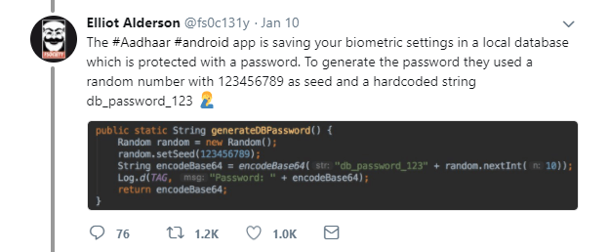
The Genesis, where it all began

Slide 3
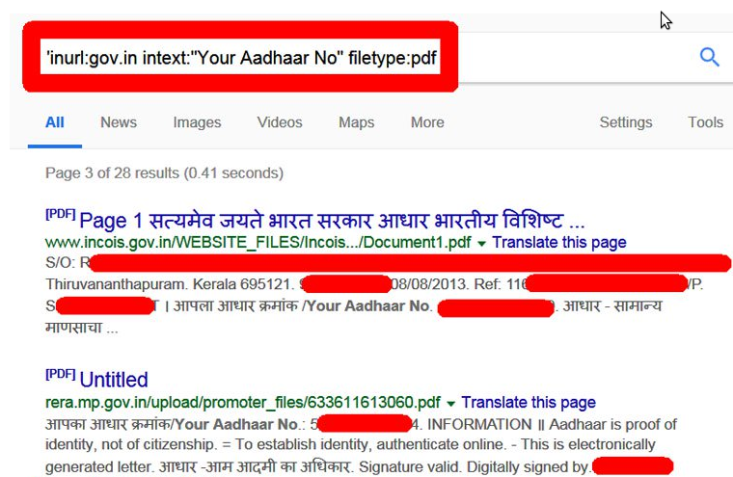
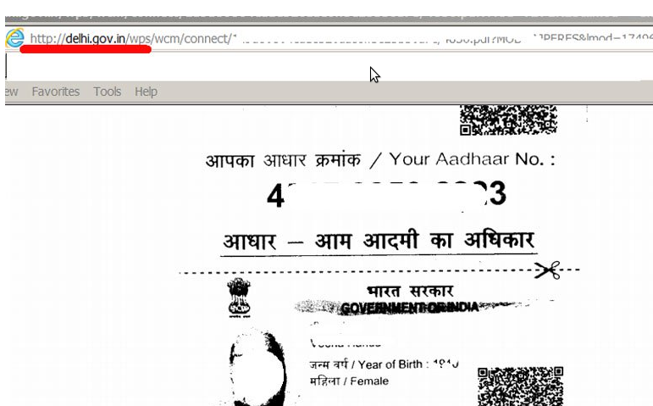
Further more, a single google search can reveal lot of information.

Slide 4
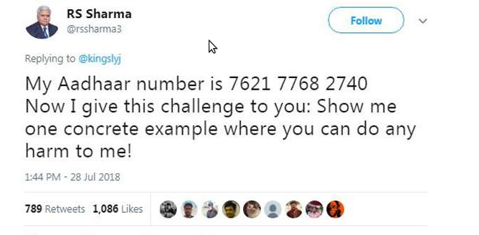
We all know what happened next.

Slide 5
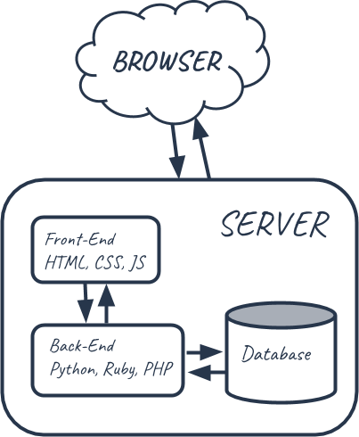
So, the traditional system

Slide 6
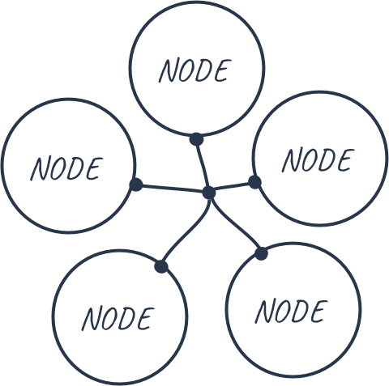
Blockchain
All the data is shared across nodes.
All the datas are secured by cryptographic
hashing.
All the blocks(datas) are validated by a
consensus algorithm.

Slide 7
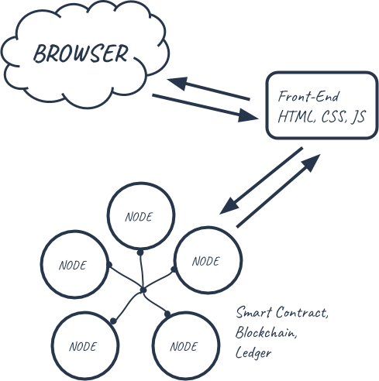
Smart Contracts
Smart contracts are where all the business logic of our application lives.
This is where we’ll actually code the decentralized portion our app.
Smart contracts are in charge of reading and writing data to the blockchain
It is written using a language called Solidity

Slide 8
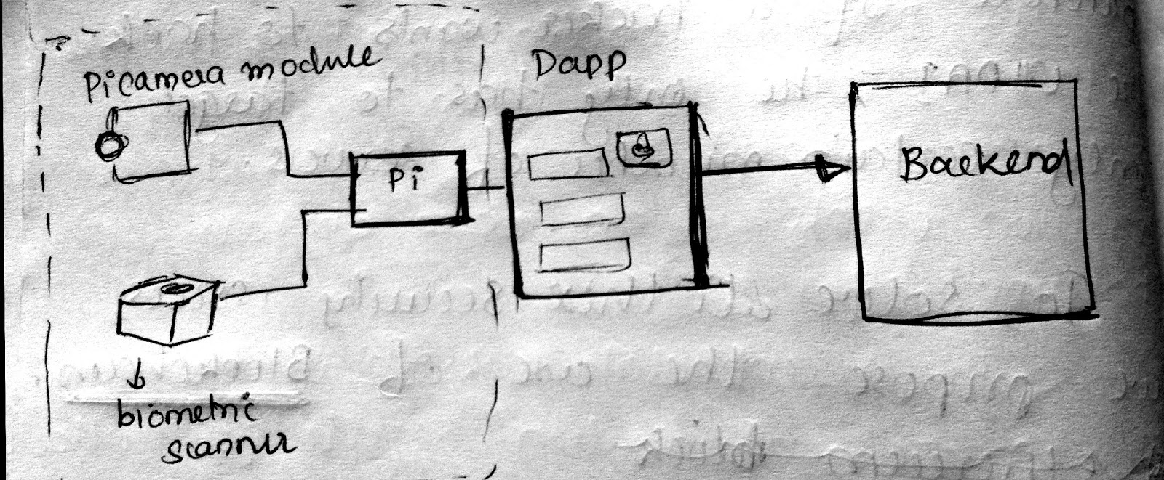
What we built.

Slide 9
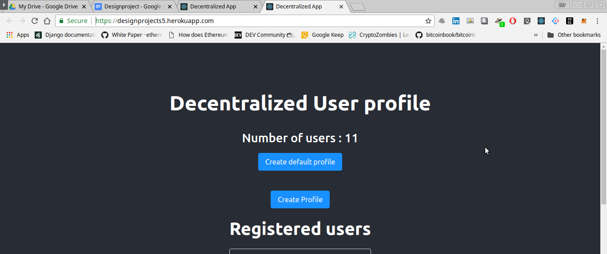
Live version.
https://designprojects5.herokuapp.com/

Slide 10
How to access the site
Install metamask on browser
For android, from firefox install metamask addon

Slide 11
Technologies used
React - Frontend
Solidity - Smart Contract
Python - for interacting with dapp
Web3 - Interacting with React and Blockchain

