Slide 1
Claim Submission Types, Life Cycle & Process Flow

Slide 2
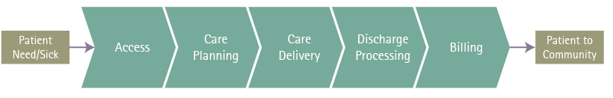
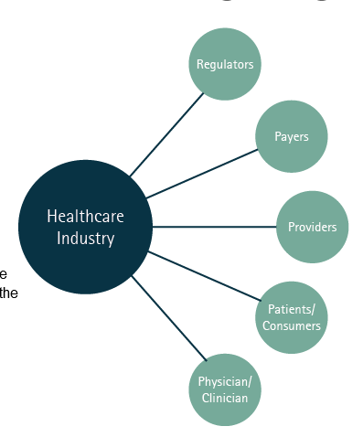
Healthcare Flow & Co-Ordination

Slide 3
Healthcare Claims
What is a Claim?
A claim is a bill created by a medical provider (doctor, hospital, and ambulance company) that lists all the medical services that were provided to a specific patient on specific days. The claim also shows how much the medical provider is charging (in dollars and cents) for each of the medical services listed
Sometimes claims are accompanied by additional documents such as Emergency Room reports from hospitals or operative reports from surgeons. These reports supply additional details that are sometimes needed to accurately evaluate a claim for payment
In US healthcare we have two different types of claims,
Professional claims
Institutional claims
Professional claims/billing is used by the by physicians, suppliers and other non-institutional providers for both outpatient and inpatient services. Professional claims are billed on a standardized claim format developed by Health care Financing Administration, called CMS-1500 form (Paper version). The electronic version of the CMS-1500 is called the 837-P, P stands for professional format.

Slide 4
Healthcare Claims
Institutional claims/billing is responsible for the billing of claims generated for work performed by hospitals, skilled nursing facilities, and other institutions for outpatient and inpatient services including the use of equipment and supplies, laboratory services, radiology services, and other charges. Institutional charges are billed on a standardized claim format called UB-04. The electronic version of the UB-04 is called the 837-I, I stands for institutional format.

Slide 5
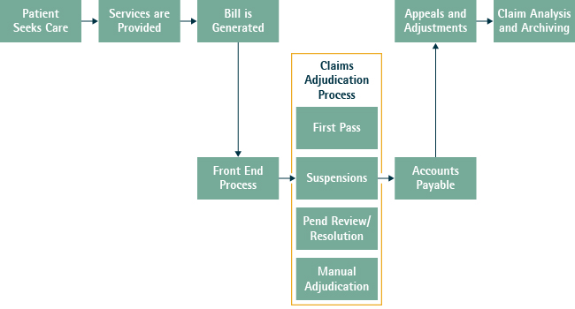
Claims Life Cycle:

Slide 6
Claim Terminologies
Suspended -A claim that cannot pay or deny until data is supplied or corrected. Claims which could not be processed during an initial or previous submission cycle.
Pended- When claim status is down as 'Pended', it means the insurer is seeking more information on the claim from your representative before it can continue processing the claim.
Rejected claim is an electronically submitted claim that is unprocessable due to missing or invalid information required by the payer. The claim is "returned" or not be accepted electronically in the claims processing system

Slide 7
Clearing House
In healthcare, companies that function as intermediaries who forward claims information from healthcare providers to insurance payers are known as clearinghouses.
In claims language it is called as claims scrubbing, clearinghouses check the claim for errors and verify that it is compatible with the payer software.

Slide 8
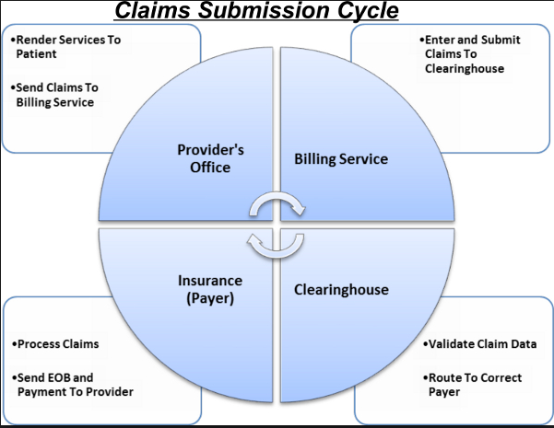
Claims Submission Cycle

Slide 9
Claims Submission Types
Electronic Claims Submission
Claims sent electronically may be received in an electronic file form and loaded automatically from a clearinghouse or from a provider. Or they may be received from a provider through the Internet.
Electronic claims are 837 Electronic Data Interchange (EDI) transactions. These transactions must follow standards established in the Health Insurance Portability and Accountability Act (HIPAA) regulations.
Paper Claims Submission
Paper claims are usually submitted by rural doctors, small and/or rural hospitals, and other ancillary providers of medical care. Paper claims must be submitted on a standard claim form, either the CMS1500 (professional) or the UB04 (facility). They are usually received daily in the payer’s mail room where they are opened, date stamped, sorted, imaged, and routed for claims processing.

Slide 10
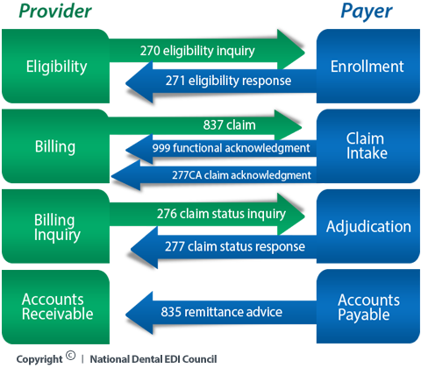
EDI Transactions

Slide 11
EDI Transactions
Other EDI Transactions:
278: Services Request for Review & Response
820 :To Make Premium for Insurance Products
834: Benefit Enrollment and Maintenance
EDI Present Version: ASC X12 Version 5010
Paper Claims Submission:
Paper claims are almost always scanned to generate an electronic image to facilitate processing and research. The imaged claims data must be entered into the claims processing system using one of two methods:
• Optical Character Recognition (OCR) Scanning Software: Reads the data on a claim and populates the claims processing system with all of the data elements from the claim.
• Manual Data Entry: Entry level or clerical personnel enter all of the claim data into the claims processing system manually.

Slide 12
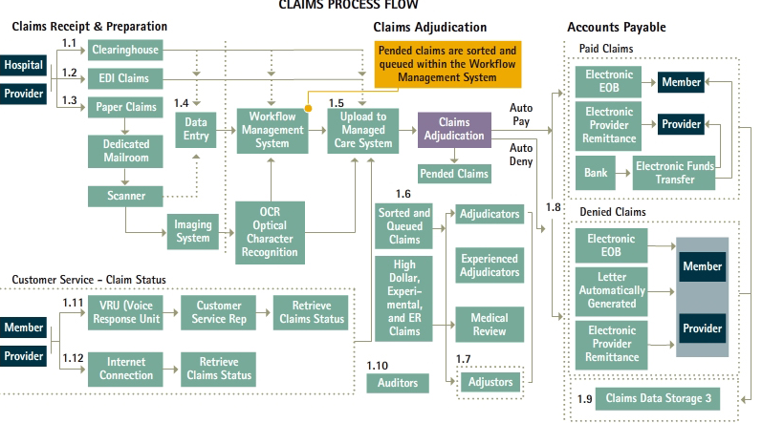
Claims Process Flow

Slide 13
Claims Adjudication
Claims Adjudication is the major step of the claims payment process. Within the Claims Adjudication step, many actions occur including determining if and how the services on a claim should be paid or denied based on a series of factors. These factors include:
• The member's product type and benefits
• The terms of the provider's contract with the payer & The payer's policies
In some cases, a claim cannot be adjudicated by the claims processing system. This type of claim requires manual adjudication.
Two examples of situations which may require manual adjudication include:
• Fall Out: A claim that “falls out” of the claims adjudication process generally cannot be resolved to pay or deny by the system. A person must manually go through the process of applying the claims edit hierarchy, or some parts of it, in order to pay or deny the claim. Fall out is generally rare.
• Complex Claims: Some claims are very challenging to resolve. Most of the challenges relate to correctly applying the provider payment terms (also known as “pricing”). In some cases, the pricing of claims is so complex that it cannot be done in the system. Some examples of complex claims include: high cost drug claims, transplant claims, and high dollar claims (generally $100,000 or more).

Slide 14
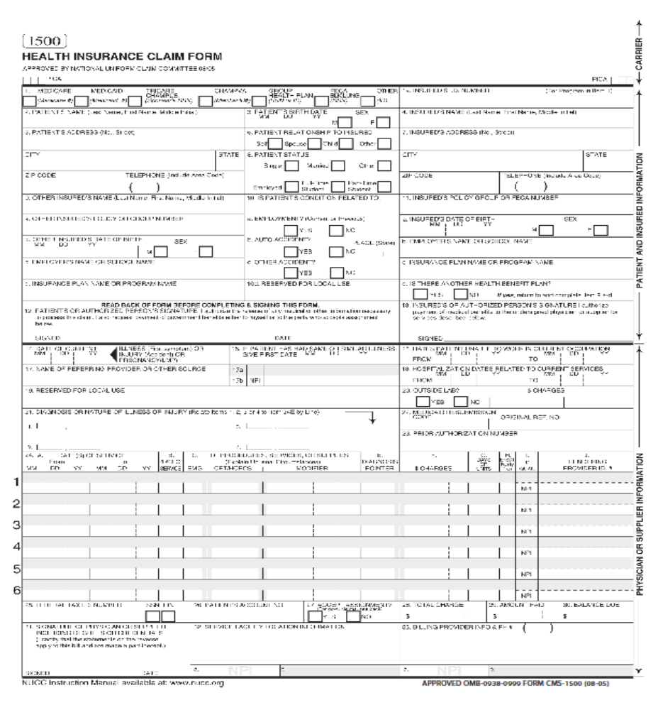
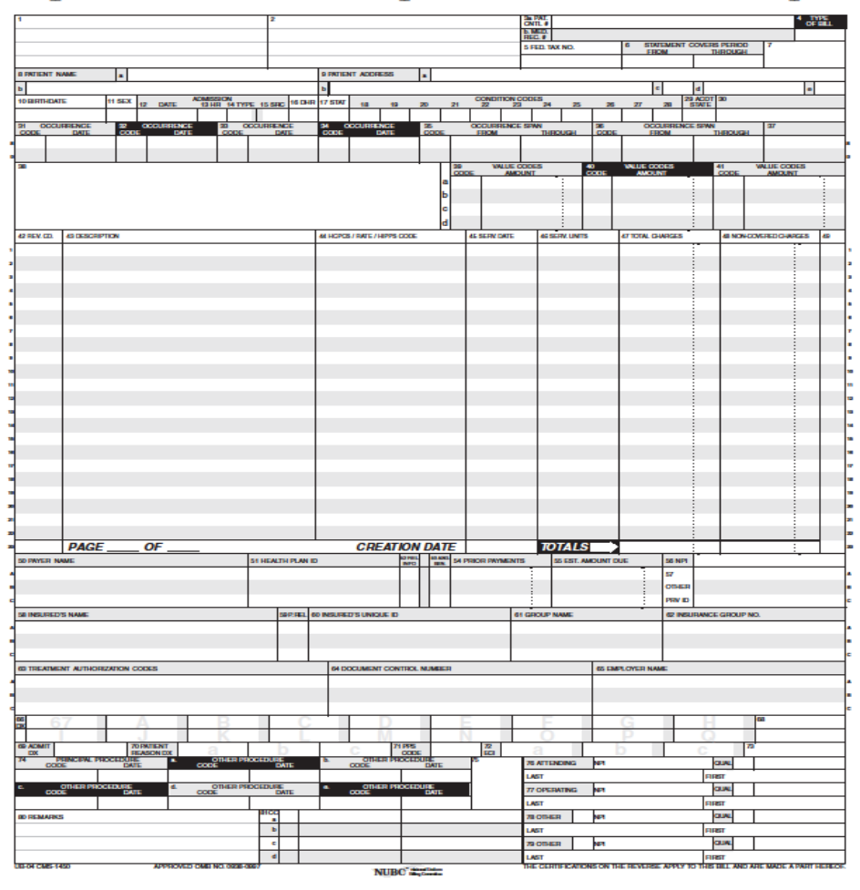
Claim Forms
CMS -1500 UB-04

