Slide 1

# Data Analysis on AMCAT dataset

Slide 2
About me
Qualification : B.Tech
I want to learn data science as I want to learn a new technology and I found data sciene to be booming now and has a great future.
I am currently a Fresher.
LinkedIn : Asit Kumar Behera | LinkedIn
Github : asit-behera09 (Asit Kumar Behera) (github.com)

Slide 3
Data Cleaning:
There are actually no null or duplicate values to be cleaned.
There are few outliers in the data which are dealt according to the column usage and analysis requirement.

Slide 4
Univariate Analysis:
Conducted univariate analysis of few columns and the insights are:
Average age of employee is : 32.70985492746373
Marks scored by the employees in 10th and 12th classes has a distribution close to normal distribution.
Analysis done on job_city column showed that most people are employed in metropolitan city.
We can observe that most people are working as Software Engineer in IT Sector.
Most of the working professionals are Male.
Major employees education background was from CBSE and State Board.

Slide 5
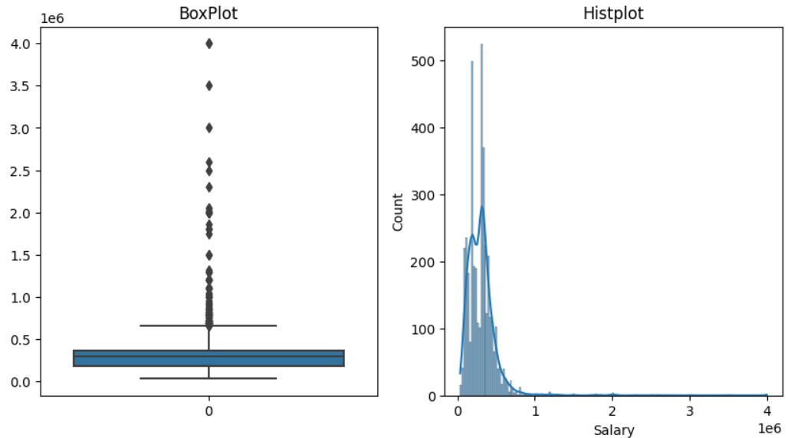
Observation : Salary column doesn’t follow a normal distribution having a right skewed distribution
and has wide range of outliers .

Slide 6
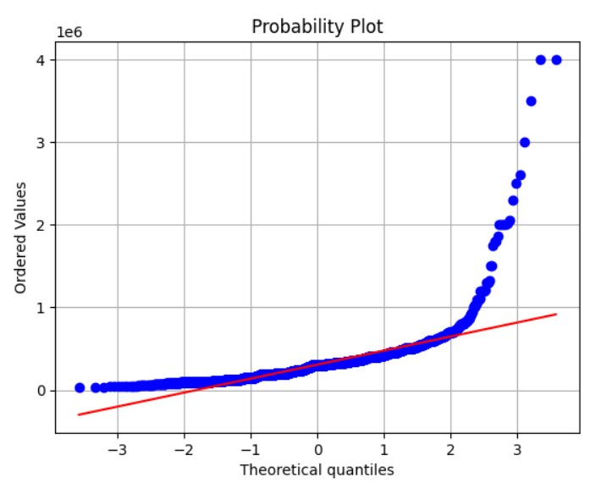
QQ plot for salary:
Observation : We can observe that this column doesn’t follow a normal distribution.

Slide 7
Bivariate Analysis:

Slide 8
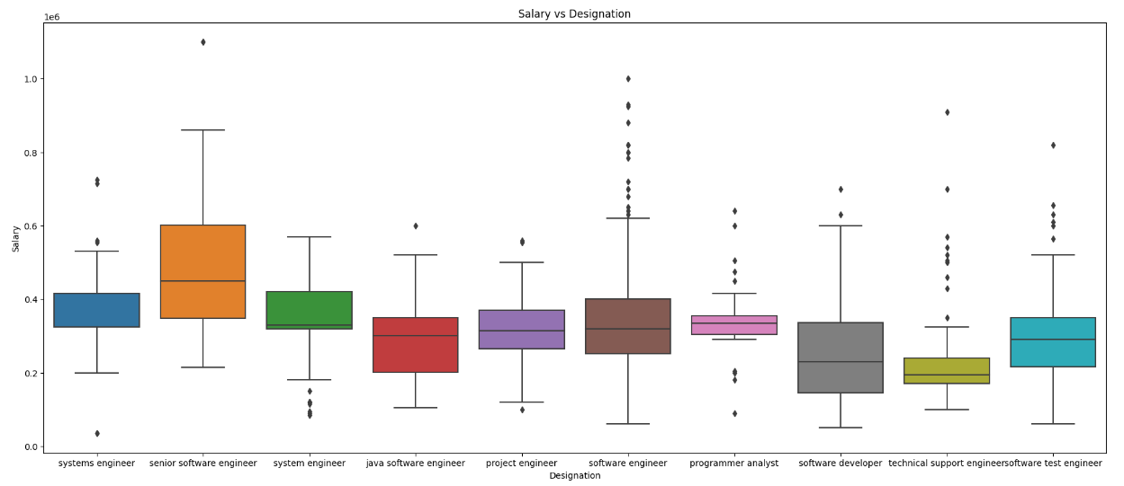
We can see that senior software engineer on an average earns comparatively more than any other designation.

Slide 9
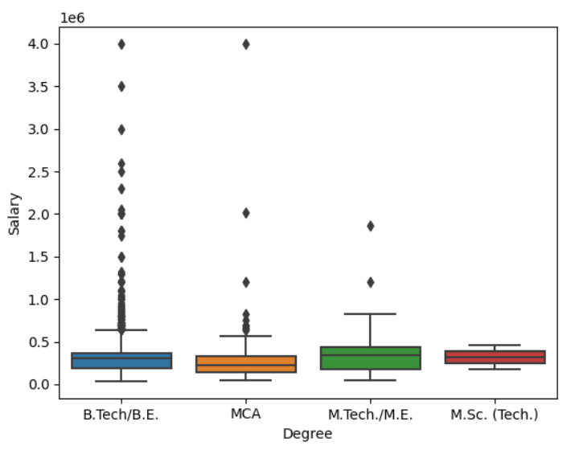
We can see that employees have the same average salary irrespective of different degree, while employees who
pursued B.Tech degree earns higher packages.
Performed Hypothesis testing and found out to have no significant difference between the groups.

Slide 10
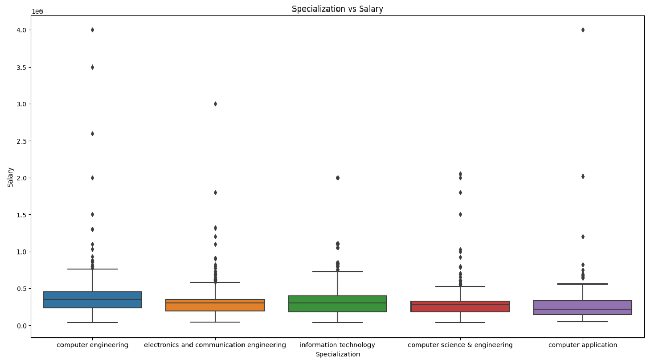
Performed hypothesis testing and found out there is no significant difference between the groups.
We can observe that employee having any of the above specialization earns similar salary.
These are the top 5 specializations which most employees have done.

Slide 11
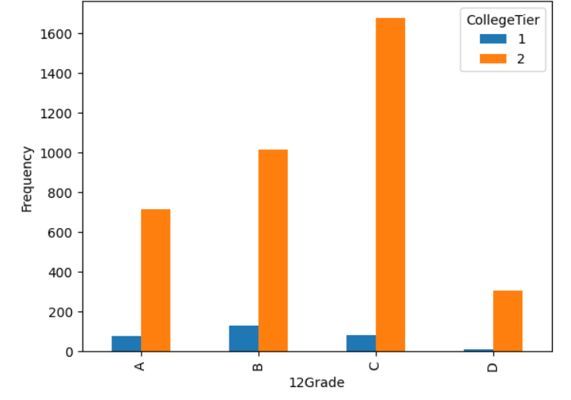
We can observe that college tier depends on how much u have scored in 12th and
this is proved by chi-square test for independence.

Slide 12

THANK YOU

