Slide 1

Flat Price Analysis
By:
Asit Kumar Behera
Qualification: B.Tech (CSE)
Vijaya Krishna Chunduri
Qualification: M.Tech (Structural Engineering)

Slide 2
Problem Statement:
Analysing flats based on type of BHK, Facing, Price Per Sqft, Sqft, Total price of the flat for different cities and localities.

Slide 3
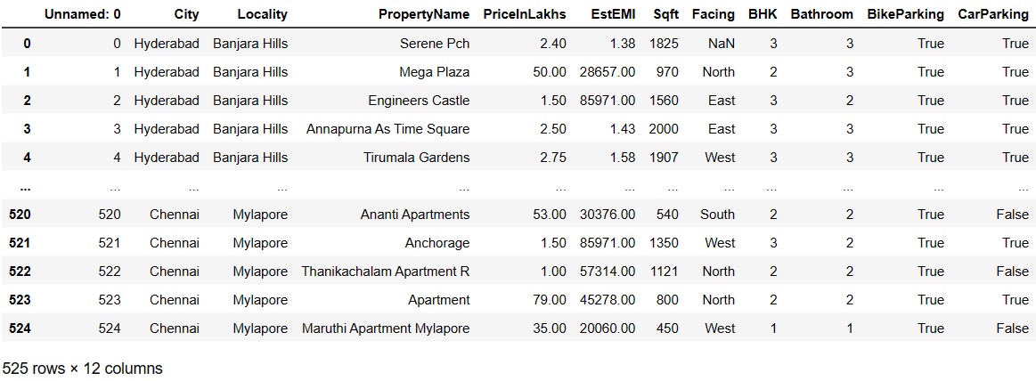
DATASET
Insights : From this Data we have 525 rows and 12 columns with unnamed column, Null values in Property Name ,Facing, and
Booleans in Parking Details.

Slide 4
Data Cleaning & Data Manipulation Steps
Removed Unnamed Column.
Filling the missing values with the Mode Values for the categorical data.
Converting the values from ‘Str’ to int in PriceInLakhs column.
Added a new column – PricePerSqft.
Encoded bike and car parking details.

Slide 5
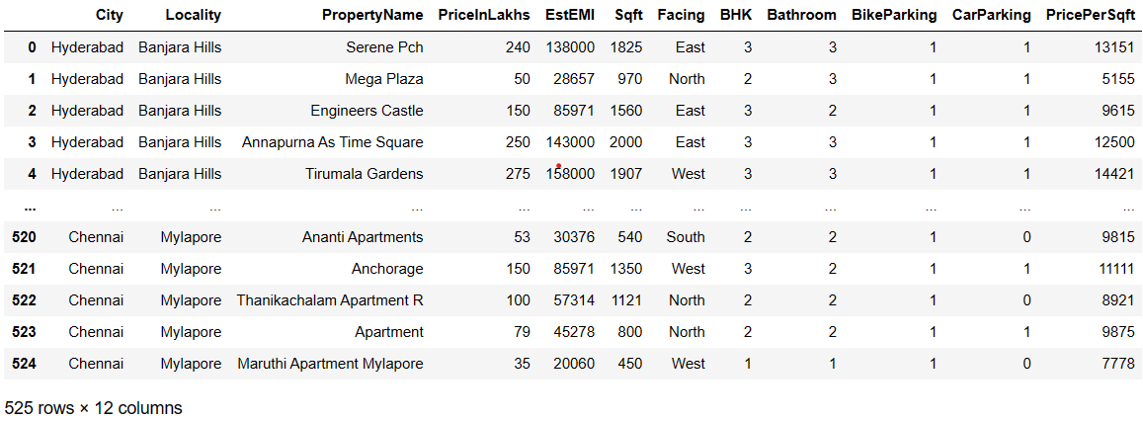
CLEANED DATASET
Insights : From this Data we have 525 rows and 12 columns in which unnamed column was removed and added an extra column [‘PricePerSqft’], replaced Null values with Mode and Encoded Booleans in Parking Details with Numerical Values [1/0].

Slide 6
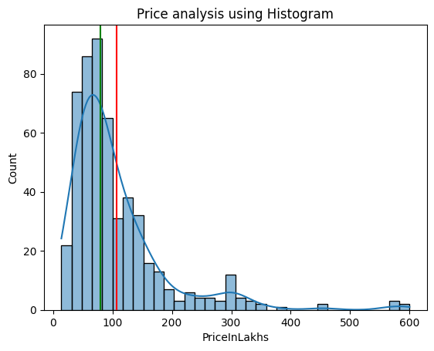
Univariate Analysis on Price
Insights :
From this fig, the price for most of the flats lies between 60L to 80L.
Here the Green Line represents Median and Red line represents the Mean of Flat prices from the dataset.

Slide 7
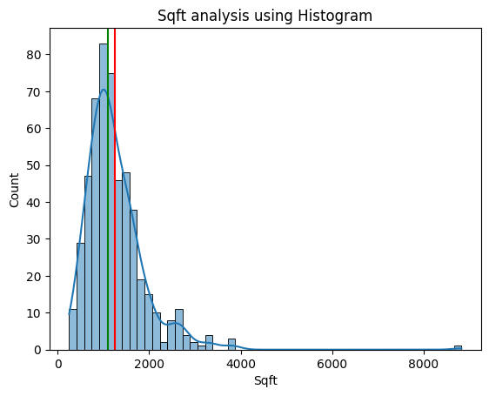
Univariate Analysis on Sqft
Insights :
From this fig, the Sqft for most of the flats lies between 800 Sqft to 1200 Sqft.
Here the Green Line represents Median and Red line represents the Mean of the Sqft of a Flats from the dataset.

Slide 8
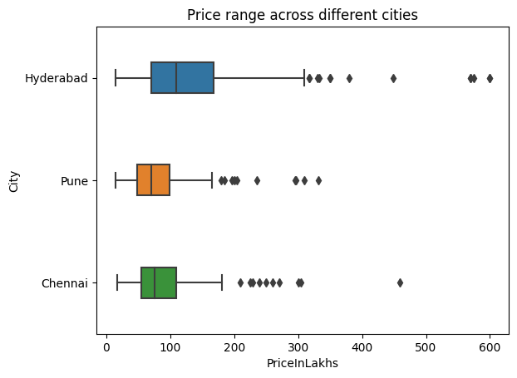
ANALYSIS BETWEEN CITY AND PRICE
Insights :
From this plot, we observed that the average price of the flats in Hyderabad city is more when compared to other two cities.

Slide 9
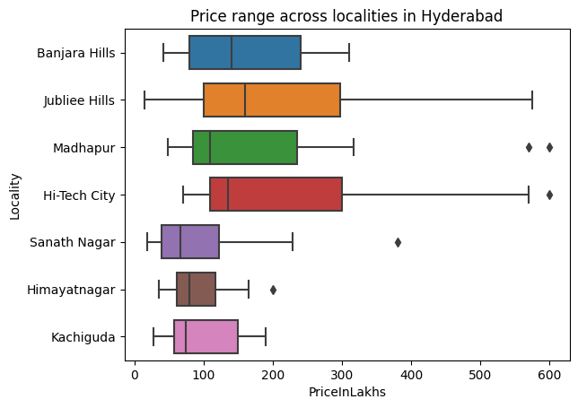
ANALYSIS BETWEEN PRICE AND EACH LOCALITY IN HYDERABAD
Insights :
From this plot, we observed how the prices of the flats are varying for each locality in Hyderabad City.
Highest Avg price of flats are in Jubliee Hills Locality.
Lowest Avg price of flats are in Sanath Nagar Locality.

Slide 10
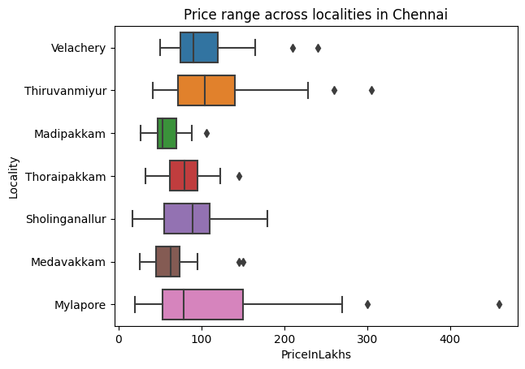
ANALYSIS BETWEEN PRICE AND EACH LOCALITY IN CHENNAI
Insights :
From this plot, we observed how the prices of the flats are varying for each locality in Chennai City.
Highest Avg price of flats are in Thiruvanmiyur Locality.
Lowest Avg price of flats are in Madipakkam Locality.

Slide 11
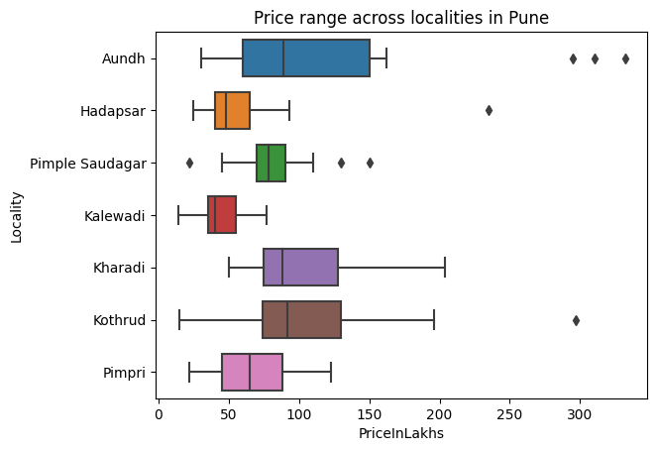
ANALYSIS BETWEEN PRICE AND EACH LOCALITY IN PUNE
Insights :
From this plot, we observed how the prices of the flats are varying for each locality in Pune City.
Highest Avg price of flats are in Kothrud Locality.
Lowest Avg price of flats are in Kalewadi Locality.

Slide 12
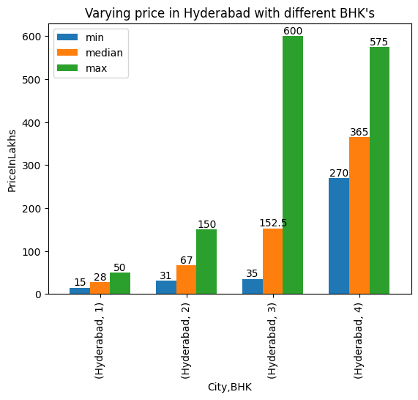
ANALYSIS BETWEEN PRICE AND EACH BHK IN HYDERABAD
Insights :
From this plot, we observed how the prices of the flats are varying w.r.t the type of BHK’s in Hyderabad City.

Slide 13
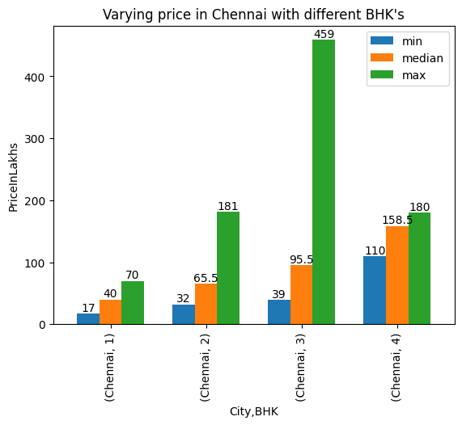
ANALYSIS BETWEEN PRICE AND EACH BHK IN CHENNAI
Insights :
From this plot, we observed how the prices of the flats are varying w.r.t the type of BHK’s in Chennai City.

Slide 14
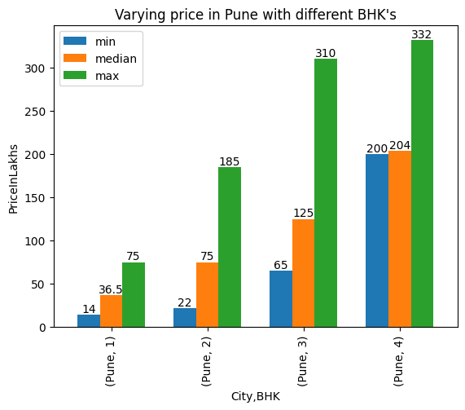
ANALYSIS BETWEEN PRICE AND EACH BHK IN PUNE
Insights :
From this plot, we observed how the prices of the flats are varying w.r.t the type of BHK’s in Pune City.

Slide 15
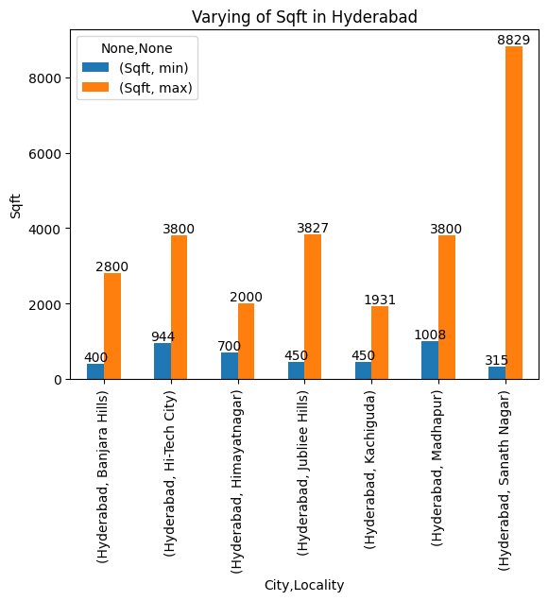
ANALYSIS BETWEEN SQFT IN EACH LOCALITY OF HYDERABAD
Insights :
From this plot, we observed the min & max, Sqft available for each locality in Hyderabad City.

Slide 16
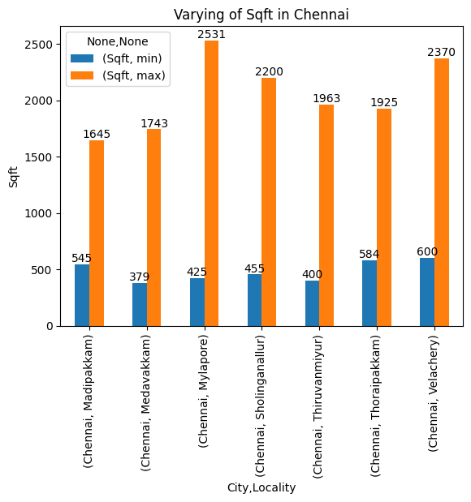
ANALYSIS BETWEEN SQFT IN EACH LOCALITY OF CHENNAI
Insights :
From this plot, we observed the min & max, Sqft available for each locality in Chennai City.

Slide 17
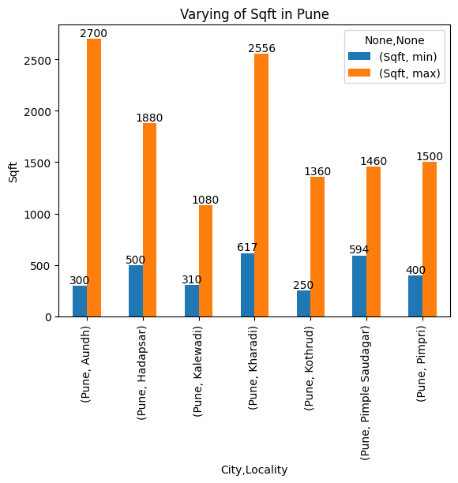
ANALYSIS BETWEEN SQFT IN EACH LOCALITY OF PUNE
Insights :
From this plot, we observed the min & max, Sqft available for each locality in Pune City.

Slide 18
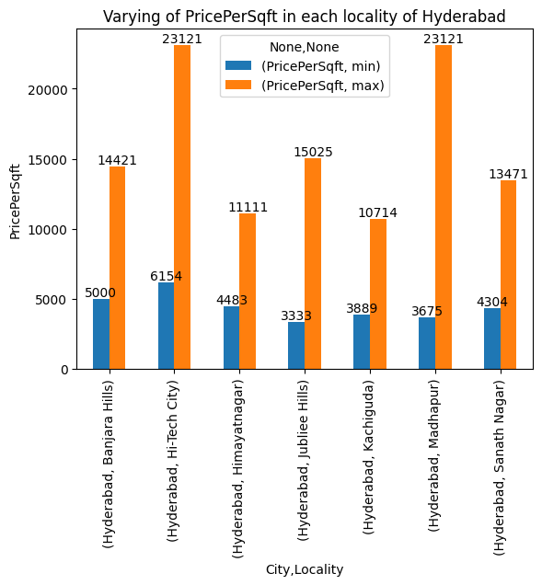
ANALYSIS BETWEEN PRICE PER SQFT IN EACH LOCALITY OF HYDERABAD
Insights :
From this plot, we observed the min & max, Price Per Sqft available for each locality in Hyderabad City.

Slide 19
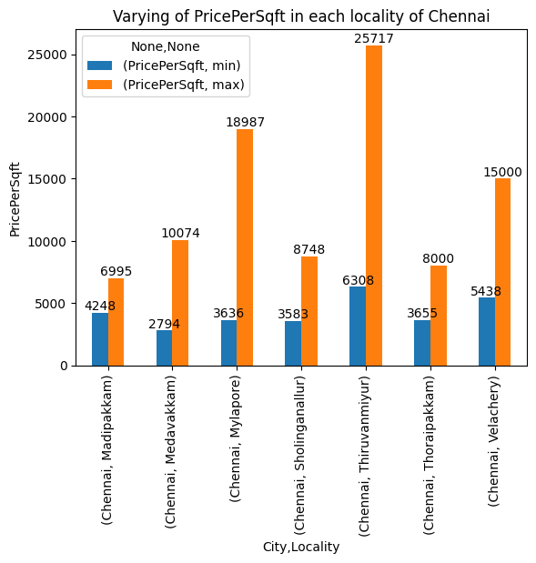
ANALYSIS BETWEEN PRICE PER SQFT IN EACH LOCALITY OF CHENNAI
Insights :
From this plot, we observed the min & max, Price Per Sqft available for each locality in Chennai City.

Slide 20
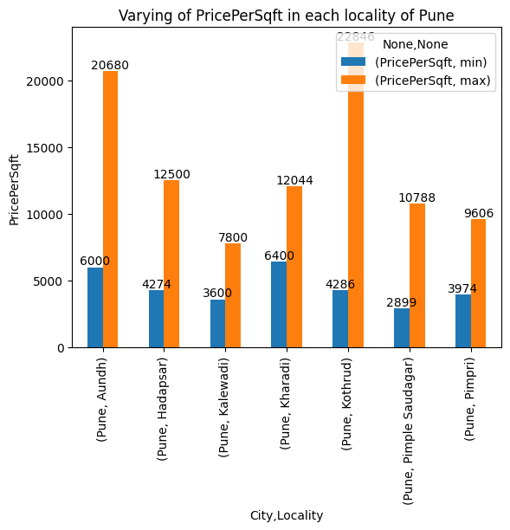
ANALYSIS BETWEEN PRICE PER SQFT IN EACH LOCALITY OF PUNE
Insights :
From this plot, we observed the min & max, Price Per Sqft available for each locality in Pune City.

Slide 21
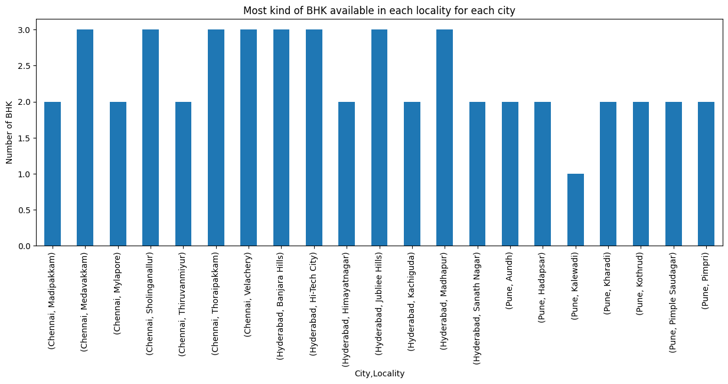
ANALYSIS ON MOST AVAILABLE BHK FROM EACH LOCALITY
Insights :
From this plot, we can observe what are the most available BHK’s in each locality from each city.

Slide 22
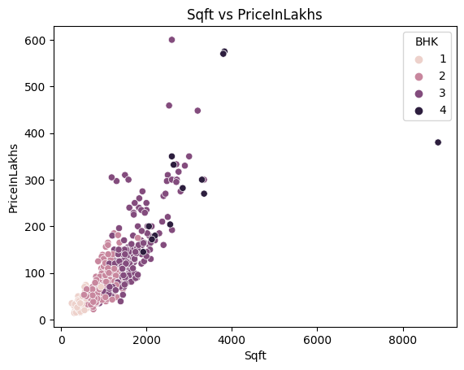
ANALYSIS BETWEEN SQFT AND PRICE FOR DIFFERENT BHK
Insights :
From this plot, we can observe that price is increasing with increment of Sqft for each type of BHK.

Slide 23
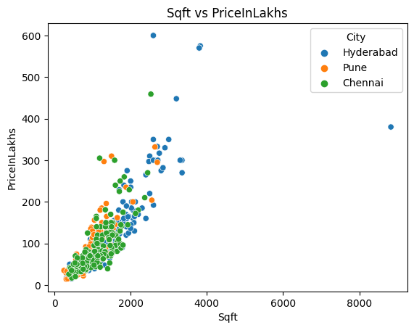
ANALYSIS BETWEEN SQFT AND PRICE FOR DIFFERENT CITIES
Insights :
From this plot, we can observe that price is increasing with increment of Sqft for each city.

Slide 24
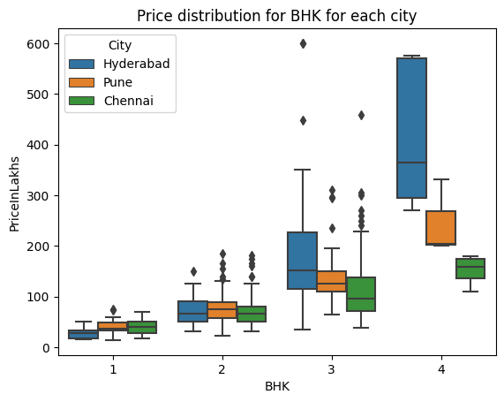
ANALYSIS BETWEEN BHK AND PRICE FOR EACH CITY
Insights :
From this plot, we can observe how price is varying for each type of BHK from a particular city.

Slide 25
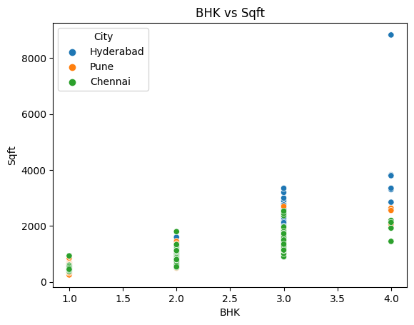
ANALYSIS BETWEEN BHK AND SQFT FOR EACH CITY
Insights :
From this plot, we can observe that Sqft changes when there is change in the type of BHK .

Slide 26
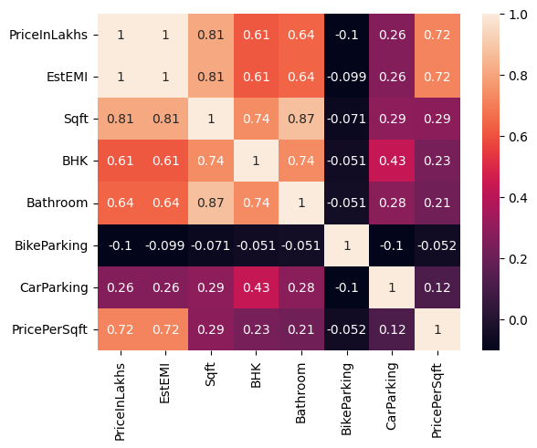
CORRELATION AMONG DIFFERENT VARIABLES
Insights :
From this plot, we can observe the correlation of each column wrt other columns.

Slide 27
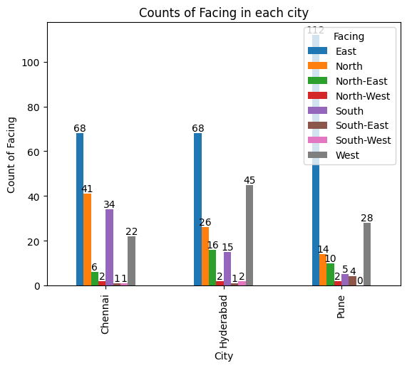
ANALYSIS ON FACING
Insights :
From this plot, we can observe what are the most preferred facing flat in each city.

Slide 28
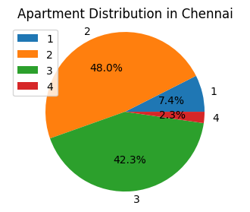
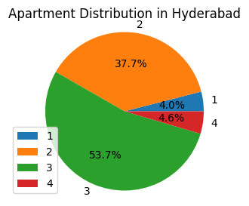
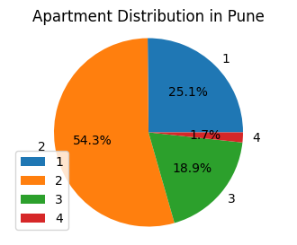
ANALYSIS ON EACH CITY WITH RESPECT TO THEIR APARTMENT DISTRIBUTION ON EACH BHK
Insights :
From this plot, we can observe how BHK is distributed across each city.

Slide 29
Conclusion :
From this analysis we observed the following :
East facing flats are most available in all the three cities.
2 BHK flats are most available.
Out of three cities pune has low cost of living overall.

Slide 30
THANK YOU

