Slide 1
VEHICLE DENT DETECTION
AN INTERNSHIP PROJECT UNDERTAKEN BY iNEURON

Slide 2

PROBLEM STATEMENT
DEVICE A DEEP NEURAL NETWORK MODEL
CLASSIFICATION TASK
DETECT
DENT
SCRATCH
DAMAGE

Slide 3

PREVIOUS FINIDNGS
DATA COLLECTION
TENSORFLOW 1 EXPERIENCE
DETECTRON 2 MODEL

Slide 4
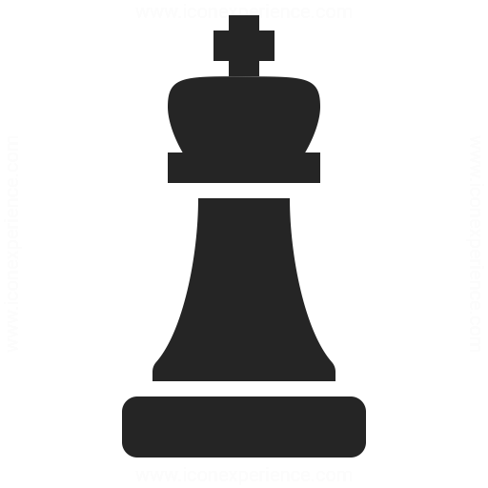
OUR APPROACH
SUB-TEAM FOR DIFFERENT MODELS
DOCUMENT THE FINDINGS
TRI-WEEKLY MEETINGS

Slide 5
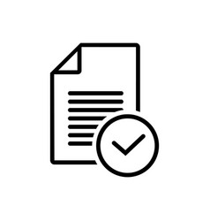
TASKS
RESEARCH ON SEPARATE MODELS
YOLO ACT
UNET
MASK RCNN
DOCUMENTATION
RE-ORDER FOLDER STRUCTURE
DATA CONVERSION
FLASK BACKEND
USER INTERFACE
MODEL IMPLEMENTATION AND TRAINING
INTEGRATING MODEL WITH USER INTERFACE

Slide 6

DOCUMENTATION
NO PREVIOUS DOCUMENTATION
NO DOCUMENTATION OF IPYNB NOTEBOOKS
KNOWLDEGE TRANSFER
UNDERSTAND HLD AND LLD
UNDERSTANDING DATASET
UNDERSTANDING FOLDER STRUCTURE OF GITHUB REPO AND GITHUB REPO
DOCUMENT THE ABOVE FINDINGS

Slide 7

FOLDER RESTRUCTURING
NO STRUCTURE WAS FOLLOWED ON GITHUB REPO
VAGUE STRUCTURE IN GOOGLE DRIVE

Slide 8
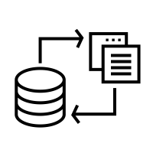
DATA CONVERSION
DATA WAS PRESENT IN JSON FORMAT
PREPROCESSING DATA TO BE FIT FOR ANY MODEL
SCRIPTS TO CONVERT ANY ANNOTATED DATA TO:
UNET FORMAT
MASK RCNN FORMAT
SEPARATE IMAGE AND ANNOTATION DATA

Slide 9
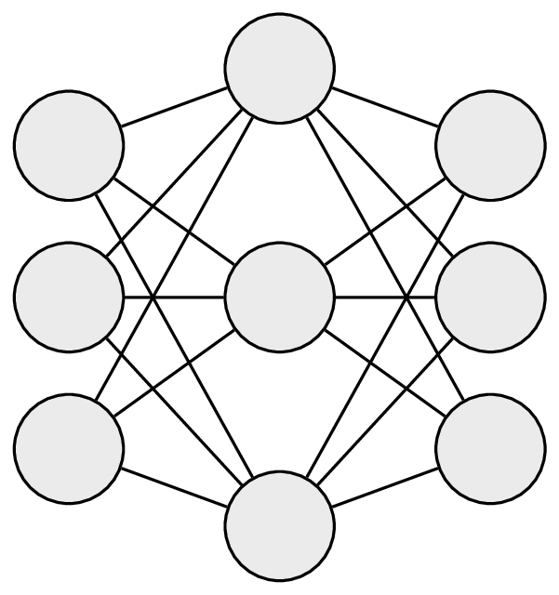
UNET
IMPLEMENTING UNET MODEL
TRAINING ON PRESENT DATASET
HYPERPARAMETER TUNING
LEARNING RATE
OPTIMIZERS
REDUCING LR ON FLY

Slide 10
MASK RCNN
SETTING UP TFOD IN COLAB
TRAINING
INFERENCE

Slide 11

FLASK APPLICATION
BASIC APPLICATION SETUP
INTEGRATING WITH UNET
DESIGNING PROTOTYPE
IMPLEMENTING THE DESIGN
INTEGRATING MASK RCNN

Slide 12

ROADBLOCKS
NO DOCUMENTATION
CONFUSING FOLDER STRUCTURE
MISSING DATA

Slide 13

WORKING DEMO

Slide 14


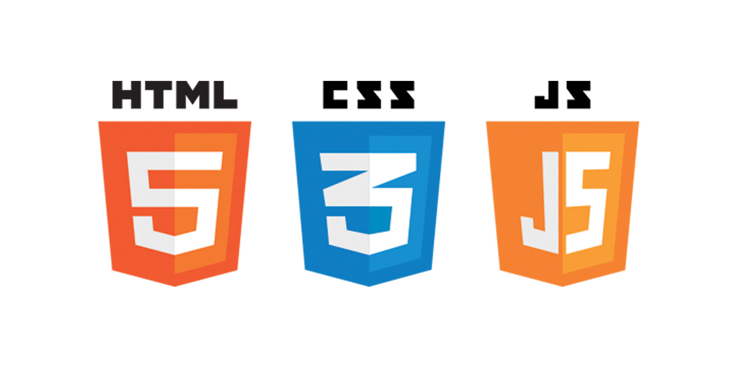

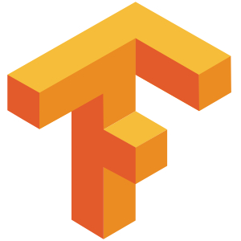
TECHNOLOGIES
FLASK FRAMEWORK TENSORFLOW GOOGLE COLAB HTML,CSS,JAVASCRIPT

Slide 15

FURTHER IMPROVEMENTS
ADDING DETECTRON 2 MODEL TO APPLICATION
MORE MODELS
YOLO ACT
UNET++
MORE ANNOTATED DATA
BETTER DATA VARIANCE
PRODUCTIONIZING THE APPLICATION

Slide 16
QUESTIONS?

Slide 17
THANK YOU

