Slide 1
End-to-End Observability Stack
Real-time Insights with Prometheus, Grafana, Tempo, Pyroscope & More

Slide 2
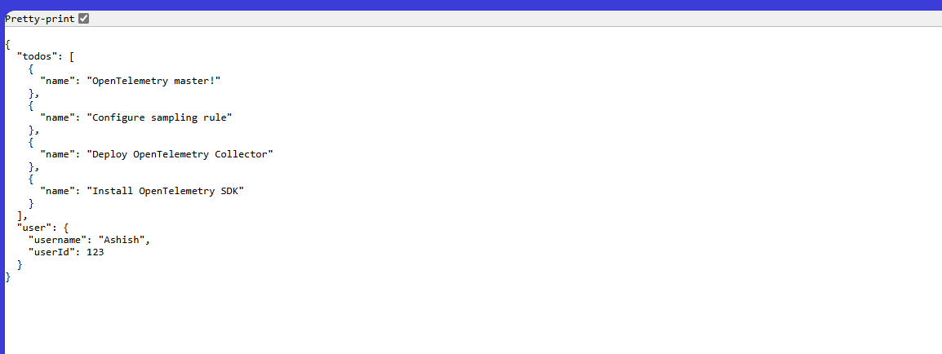
Overview of the Observability Stack

Slide 3
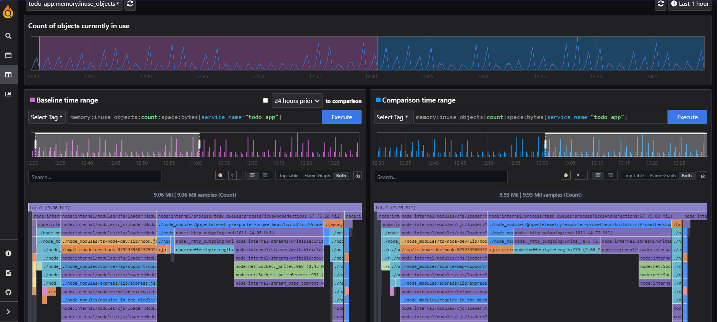
Grafana Dashboards
Grafana used for unified visualization, pulling from Prometheus, Tempo, Pyroscope.

Slide 4
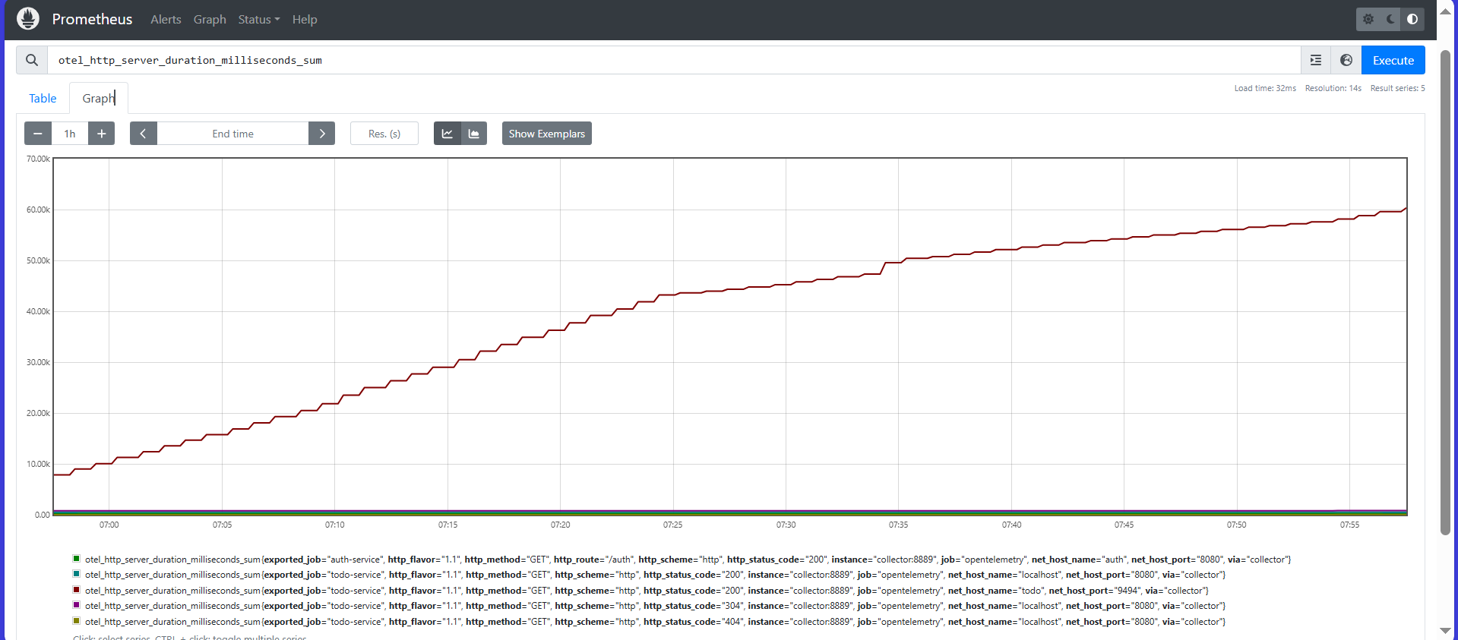
Prometheus for Metrics
Prometheus scrapes metrics, integrated with Alertmanager.

Slide 5
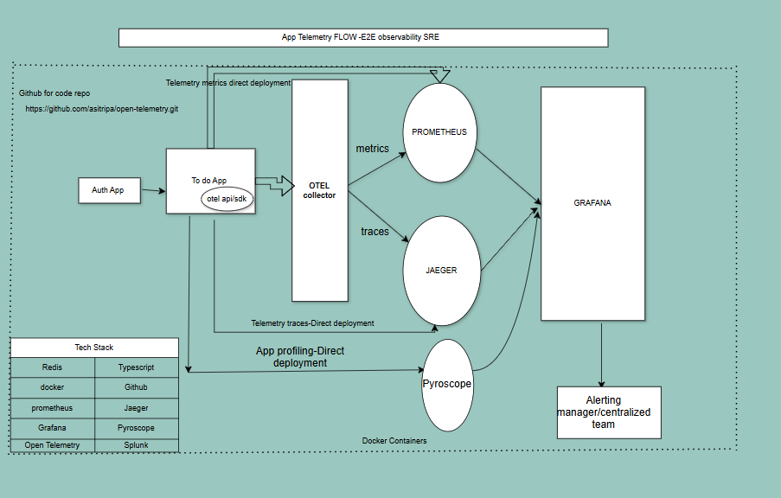
Distributed Tracing with Tempo
Tempo collects traces, visualized via Jaeger or Grafana UI.

Slide 6
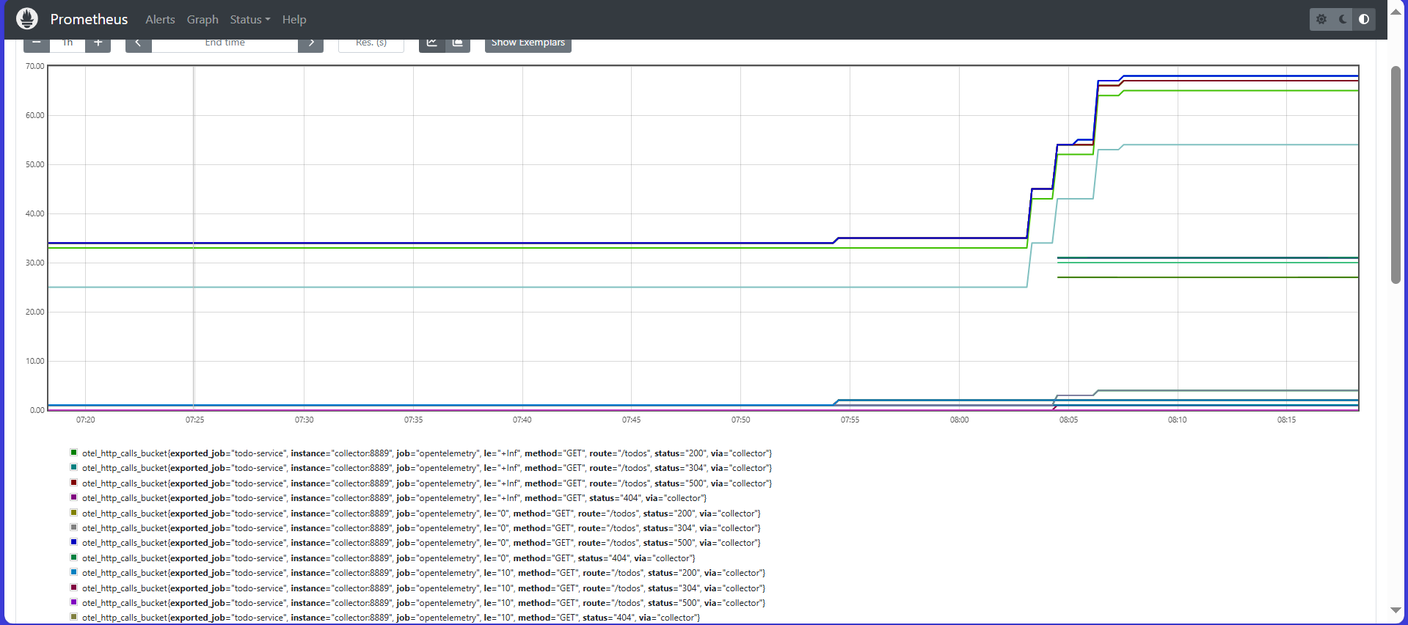
Continuous Profiling with Pyroscope
Pyroscope shows continuous profiling data to detect performance bottlenecks.

Slide 7
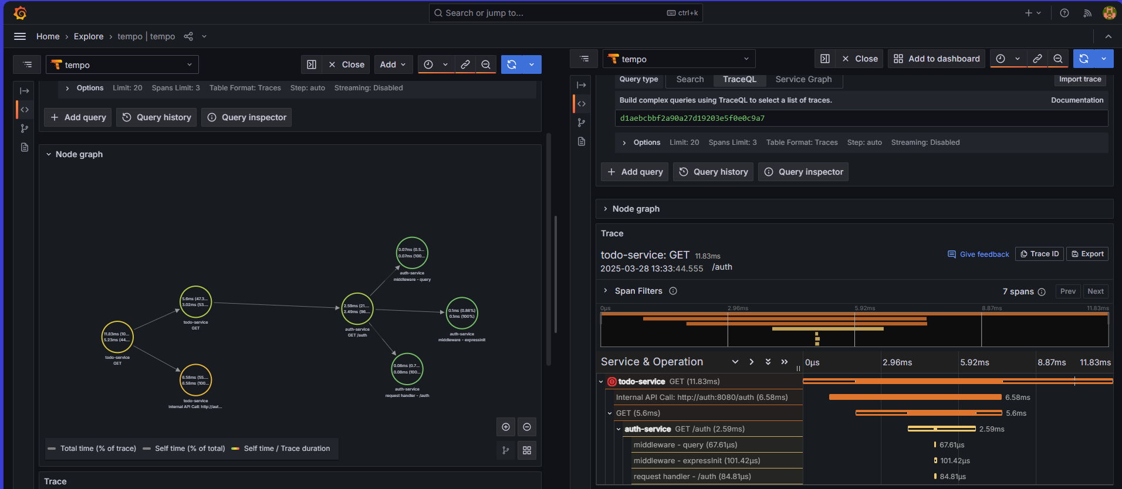
OpenTelemetry Collector
OpenTelemetry Collector processes and exports telemetry data.

Slide 8
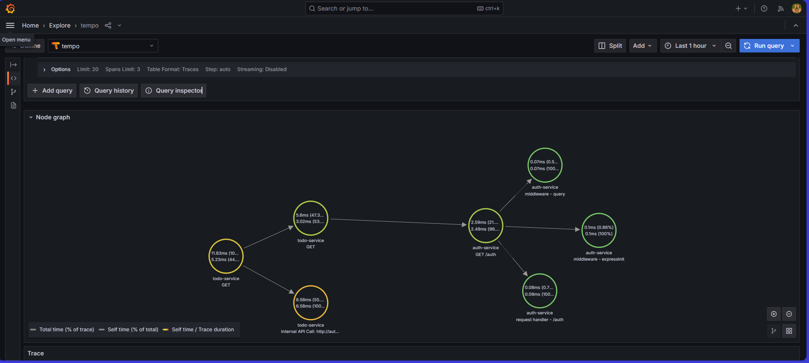
Monitoring Custom Services
Custom services like `auth`, `todo` instrumented for observability.

Slide 9
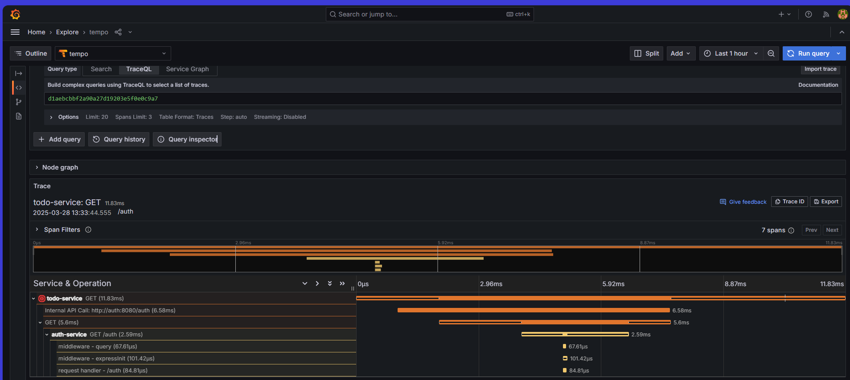
Jaeger for Deep Dive Traces
Jaeger visualizes deep service-to-service latency traces.

Slide 10
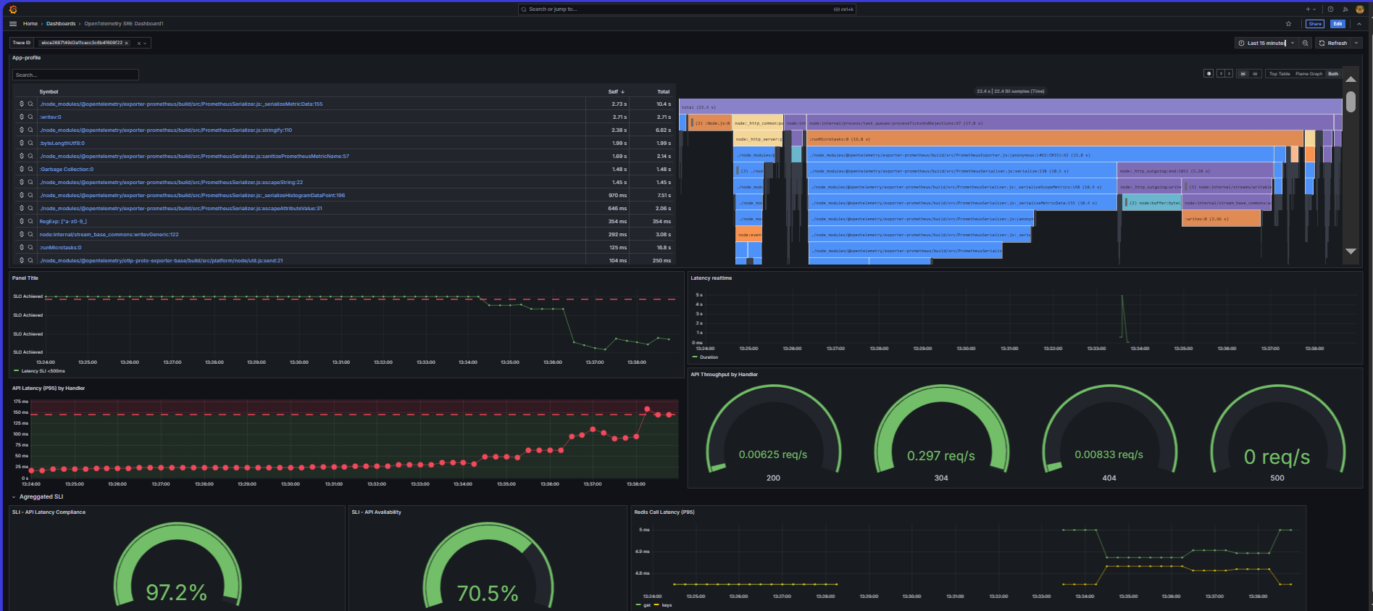
Splunk Integration
Splunk used for log analysis and trace correlation.

Slide 11
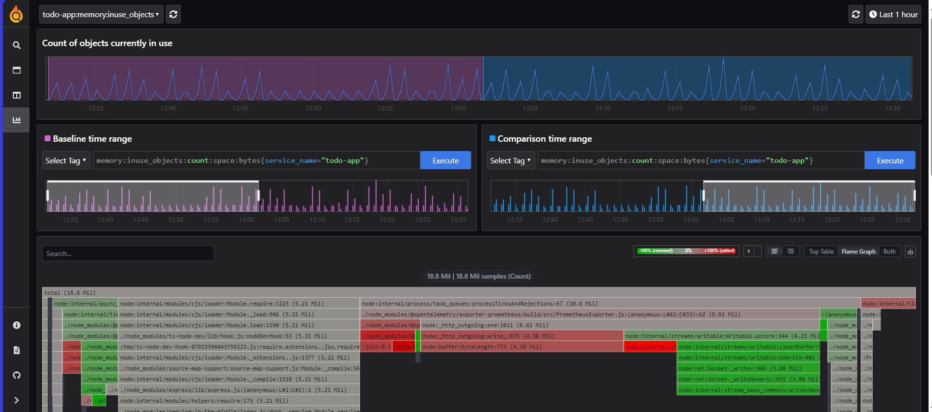
Redis + Node Exporter Metrics
Redis and Node Exporter metrics scraped by Prometheus.

Slide 12
Summary & Benefits
- Unified view across metrics, traces, logs, and profiles
- Faster root cause analysis
- Full visibility via custom instrumentation
- Scalable and modular observability setup

