Slide 1
NutShell: Scalable Whittled Proxy Execution for Low-Latency Web over Cellular Networks
ACM MobiCom 2017
Ashiwan Sivakumar*, Chuan Jiang*, Yun Seong Nam*, Shankaranarayanan P. N.^, Vijay Gopalakrishnan^, Sanjay Rao*, Subhabrata Sen^, Mithuna Thottethodi*, T. N. Vijaykumar*
* Purdue University, ^AT&T Labs - Research
Notes:
Hello. yes believe me folks, this is the last talk for today, so please bear with me for few more mins. What is this talk about? Yesterday in the banquet fun session, we heard a radical proposal to reduce cellular latencies by moving devices inside data centers. Today, I will present another acceptable solution to reduce Web latencies in cellular.

Slide 2




Faster is Better
Attracts more visitors
Generates more revenue
“>3 second for one page load, 57% mobile users visit another e-commerce site”….
“Every 100ms delay costs 1% in sales”…
“1 second could cost $1.6 Billion in annually”…
Reducing Web latency is important
Notes:
Needless to say, performance of Web sites is critical because (one) Faster Websites have low attrition rates. A study from Akamai found about 57% of mobile users tolerate a page load of less than 3 seconds before abandoning the site. (two) Faster Websites make more money. Amazon reports every 100ms end-to-end delay causes 1% loss in sales revenue and 1 second is equivalent to $1.6 Billion in their annual sales. What is the performance of Web access in cellular that we see today?

Slide 3
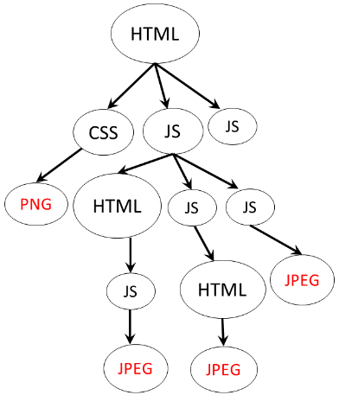








Web Access over Cellular 6X Slower than Wired
The
The
Page load process -> Lots of requests-responses in high RTT cellular link
Web latency-bound unlike video streaming
Lots of small objects; many domains and dependency among object fetches in JavaScript (JS)
The
2
Cellular Network
3
1
2
4
5
Notes:
Our observation based on page load measurements show cellular page loads are 6 orders of magnitude slower than wired. The reason is today’s page load process is not suitable for cellular networks since it leads to lots of reqs-responses in the high RTT cellular last mile. Further, even though recent protocols like HTTP/2 allow multiplexing of requests in parallel, in real-world modern Web pages have object dependencies that makes it ineffective.

Slide 4



Proxy Execution to Lower Web Latencies
Emerging trend – move execution to the cloud
Proxy execution: quickly fetch objects using faster network and proactively push
Why execution in the proxy for push?
Personalization in Webpages with JS execution (E.g. >30% of pages have >50% of objects not common across users)
CELL NETWORK
INTERNET
CLOUD PROXY
Notes:
There is tremendous interest in moving execution of browsing functionality to the cloud. The idea is a proxy connected using a faster network can executes code to quickly fetch objects for a client and proactively push them to minimize the round-trips in the last mile. Since Web pages are increasingly personalized today, execution of code in the proxy is required to identify all objects for a user. To quote a stat from our analysis over 30% of pages have more than 50% of objects not common across users.

Slide 5
Challenge with Proxy Execution Proposals
Scale execution in the proxy for carrier workload
Where is the bottleneck?
In traditional Web proxies – Network
Execution-based proxies – Bottleneck shifts to Compute
E.g. Our measurements indicate ~500 servers (32cores, 128Gig) needed to support execution for 1M users ($2.5M CAPEX only assuming $5000/server)
Reducing proxy compute critical
What dominates compute overhead? “JavaScript execution” (80% for a median page)
Notes:
Even though execution-based proxies have tremendous potential to lower Web latencies, a key challenge with such proposals is the scalability of the proxy that must support Millions of users. If we look at where the bottleneck is, unlike traditional Web proxies which are designed to saturate the network interfaces, the bottleneck quickly shifts to compute in execution-based proxies. E.g. our measurements indicate…… Thus it is critical to reduce the compute in the proxy

Slide 6
Contributions and Key Results
First work to scale execution-based Web proxies
Develop Whittling to eliminate JS code not needed for object fetches
Design NutShell, a system incorporating Whittling
Key Results:
Relative to prior execution-based proxies [PARCEL – CoNEXT’14, Cumulus – ATC’15]
NutShell supports 27% more user reqs/sec
NutShell preserves and sometimes enhances latency savings
Whittling is computationally efficient (re-usable across users and time)

Slide 7
Outline
Overview of existing execution approaches
Our system
Evaluation results

Slide 8

Existing Proxy Execution Approaches
Two classes – Redundant and Non-redundant execution
Non-redundant execution
Redundant execution
[Parcel – CoNEXT’14, Cumulus – ATC’15]
[OperaMini, SkyFire, Shandian NSDI’16]
Device
Proxy
Device
Proxy
Eliminates client compute fully or partially
Hurts performance during interaction or complex state management
Proxy execution only to quickly identify objects and push while client executes again normally
Minimizes network round trips (provides best of both worlds)
Notes:
Need to make wording and slide better (contrast qualitatively – we are better)

Slide 9

Opportunity Provided by Redundant Execution
Solve in redundant execution (RedEx) context
Why redundant execution?
Reduces network delays – dominant portion of page load times in cellular networks
E.g. >50% of page load time is network for >53% of pages
How to reduce compute in redundant execution context?
Proxy execution solely to identify objects to fetch
Client executes again normally
In the proxy – execute code only needed for object fetches and skip other code

Slide 10
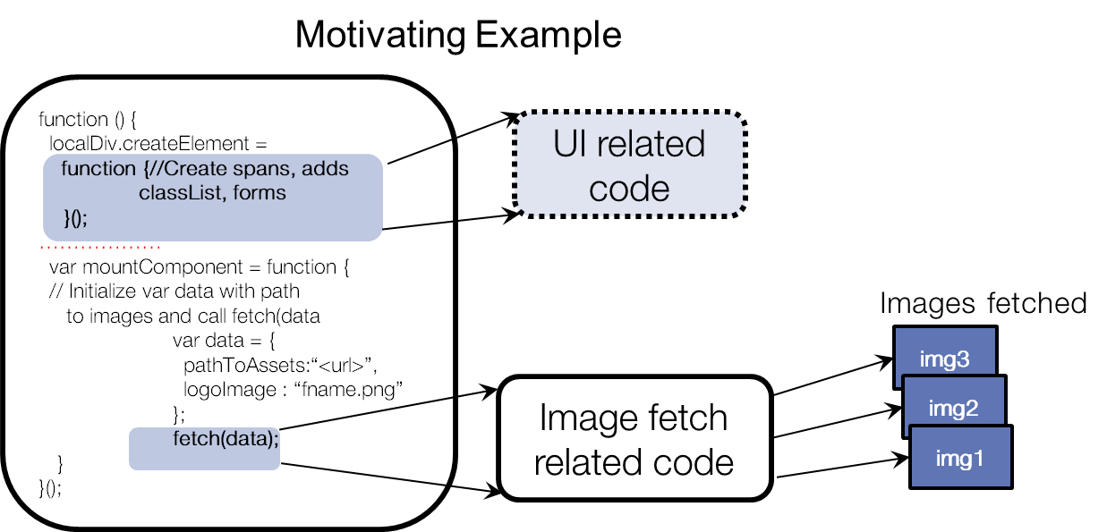
Example to Show Feasibility of the Idea
JavaScript (JS) code for object fetches (‘backward slice’ in Programming Languages terminology)
Notes:
Remind client is going to execute everything again.

Slide 11
How to Find JS Code for Object Fetches?
Static JS slicing tools exist [WALA, JSAI, FrankTip’95]
Generally considered hard
Traditional concern - cannot miss dependent code in slice
Application – Software debugging
May need to be conservative resulting in large slice
function() {
}
function() {
}
Original
A
B
C
A
B
C
Slice
D
E
D
E

Slide 12
How to Find JS Code for Object Fetches?
In contrast, our application – slicing only in the redundant proxy execution
If dropped relevant code,
Proxy does not push some objects, but
Client’s full execution ensures correctness
Insight : Slice need not be accurate
function() {
}
function() {
}
Original
A
B
C
A
B
C
Slice
D
E
D
E

Slide 13
Our Whittling Technique
Can whittle
F: Full JS
function() {
<inner func. A>
<UI block B>
<fetch data C> }
P: Partial JS
function() {
<inner func. A>
<UI block B>
<fetch data C> }
Learning granularity
F
=
P
Cannot whittle
F
!=
P
Entire JS file
Individual statement
Functions
Minimal benefits
High overhead
Notes:
Two if and else – confusing
Add ‘F’ and ‘P’ version near yellow boxes,
Change code from ‘if’ ‘else’ to (UI, fetch data)

Slide 14
System Design Issues We Address
How many functions to test?
How to handle function dependencies?
How often should we whittle?
Notes:
When incorporating whittling into an end-to-end system we address a few design issues. Let us look at them briefly.

Slide 15
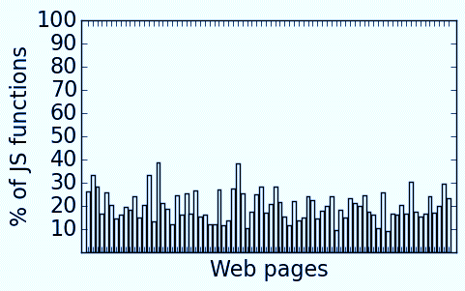
How Many Functions to Test?
Time-consuming to test all functions
100s – 1000s of JS functions in Web pages
Observation : (20% functions contribute to 80% CPU)
Test Heavy-hitters (good benefits with low overhead)
80% compute time
Notes:
Testing all functions is time consuming and Web pages have 100s to 1000s of JavaScript function. We profiled the JavaScript compute times of the Alexa top 100 Web pages using V8 profiler and found that on average, 20% of functions contribute to 80% of the compute time. Thus testing only the heavy functions is sufficient to provide good benefits.

Slide 16
Function Dependencies in Real Pages
Individually functions can be whittled, when tested together misses objects
Optimal set of independent functions to whittle is time consuming
Greedy whittling algorithm (please see paper)
X
X
f2
f1
f2
f1
f2
f1
Example dependency –
Redundant code path
X
X
JQuery Init()
JQuery Init()
X
X
URL fetches
URL fetches
Notes:
Animation is broken …(fix f1, f2 turned off)

Slide 17


How Often Should We Whittle?
Longitudinal study
Recorded pages every hour
Result : Whittle JS code at T=0 version applied to page recorded at T=3, fetches all objects from T=3 version
Insight : Objects in a page change over time, but code is relatively stable
One time whittling overhead – (213 sec/page on an average), amortized over 3 hour window
T = 0
T = 3hr
T = 24hr
The
The
The
…………
Notes:
We did a longitudinal study.. Whittle learnt from T=0 fetches all objects when fetching T=3… (See time and decide)

Slide 18
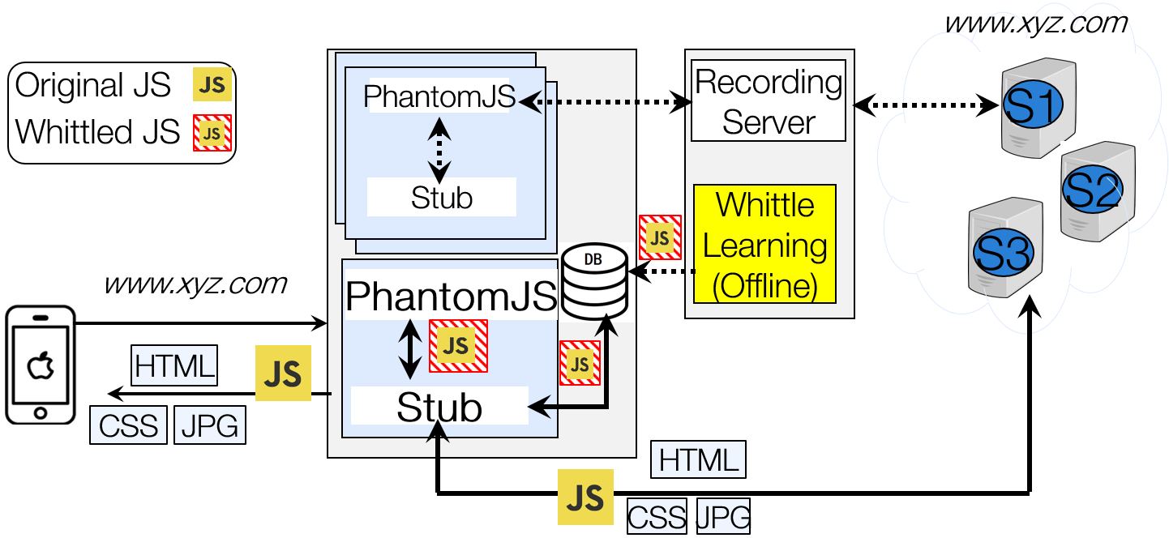
Prototype Implementation
Proxy using PhantomJS (a popular headless rendering engine)
A Webview based Android browser application
Notes:
Can be dropped (add a new slide (Greedy whittling – see paper for details)

Slide 19
Evaluation – Workload and Setup
Evaluation goals
Measure scaling benefits (improvement in user req/sec) with NutShell over RedEx
Study impact of NutShell on client latency savings
Test set
Alexa top 100 pages mobile versions (recently pages tailor content for screens using CSS3)
Recorded versions for repeatability
Notes:
We evaluate Nutshell using a test set of the Top 100 Alexa mobile pages. For repeatability, we record the pages and replay them in our experiments. We use a phone to record the pages so that we get the mobile version of the pages. Note that most pages do not have a separate mobile version and they tailor their content to different screens using CSS3 media queries. In our final evaluation, we use 78 pages because we discarded a few pages that did not trigger onLoad consistently and also caused some browser inter-operability issues.

Slide 20


Setup to Measure Scaling Benefits
Loaded proxy (CPU at 100%) for both NutShell and RedEx
www.xyz.com
www.xyz.com
www.xyz.com
˸
Proxy inst. 1
˸
˸
S1
Proxy inst. n
www.xyz.com
www.xyz.com
˸
Proxy inst. 1’
˸
˸
Proxy inst. n’
˸
˸
˸
˸
˸
˸
˸
˸
˸
Notes:
Multiple simultaneous clients issue request to load the same page to multiple proxy instances running on the same machine. Each client issues the page load request in a loop for a long time..

Slide 21
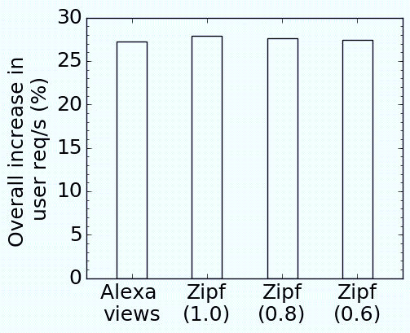
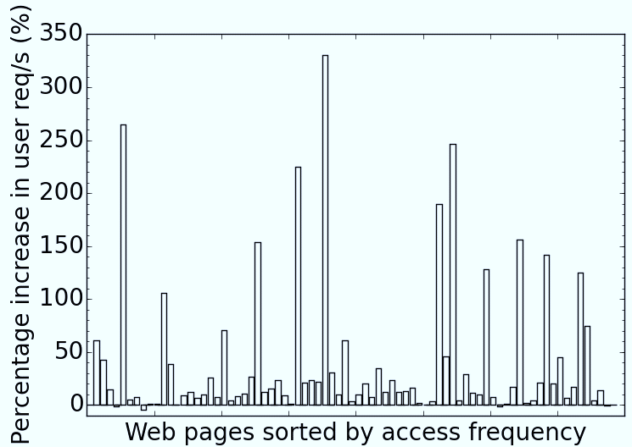
Scaling Benefits of Nutshell
Individual pages
12% savings for the Median page; >34% savings for 25% of the pages (100-300% for some pages)
Includes other overheads (e.g. HTML/CSS, networking)
Overall 27% based on page popularity (Alexa views, Zipf [Bresalau INFOCOM’99, Almeida DIS’96])
Notes:
We find that the average increase in user reqs/sec ranges from 27.2% to 28% consistently across all the page popularity models. Next we look at why we get benefits?

Slide 22
Benefits Correlated to JS Compute Savings
How much JS compute did we save with Whittling?
Speedup in JS compute (JS_{RedEx}/JS_{NutShell}) 1.33X for median page (2X- 4X in some)
Whittle away >50% of all tested functions
Do scaling benefits correlate to JS compute savings?
Good benefits for pages heavy on JS
Scaling benefits mostly upper bounded by JS compute savings
E.g. For facebook.com 50% reduction in JS → 43% increase in user reqs/sec
Notes:
Don’t need to explain speedup

Slide 23
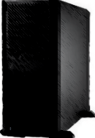
Setup to Evaluate Latency Impact
Lightly-loaded proxy to evaluate latency impact of whittling
PROXY
www.xyz.com
Live LTE Network
Notes:
Drop schemes?

Slide 24
Impact of Nutshell on Client Latency
Compared to baseline SPDY (HTTP/2 now)
1.5X speedup for a median page (>2sec reduction in page load time for 45% of the pages)
Compared to push subset by parsing main HTML (similar to HTTP/2 L1 push)
1.24X speedup for a median page (pushing all objects beneficial)
Compared to RedEx
Better for 15% of pages (1.2X speedup), similar otherwise (Proxy work reduction leads to pushing objects earlier)
Benefits hold for other metrics (SpeedIndex)

Slide 25
Other Results (user study)
How stable is JavaScript content across users?
Conducted a small-scale user study (8 users)
80% of JS files have same content across users (can re-use whittling for these files)

Slide 26
Related Work
Solution Class | Systems | Contrast to NutShell
Proxy-based execution (covered earlier) | PARCEL CoNEXT’14, Cumulus ATC’15, Opera Mini, Shandian NSDI’16 | Solves common scaling challenge
Optimizations like prioritization and compression | Klotski [NSDI’15], Polaris [NSDI’16], FlyWheel [NSDI’15], FlexiWeb [MobiCom’15], WebGaze [NSDI’17] | Orthogonal NutShell can work with these
Other techniques to push objects | HTTP/2 push, Vroom Sigcomm’17 | NutShell pushes more objects due to proxy execution

Slide 27
Conclusion
NutShell: First work to scale execution-based proxies
Automatically identifies JS code only needed for object fetches in the proxy
Improves scalability : 27% more user reqs/sec (less servers) compared to RedEx
Lowers latency : Enhances benefits for some pages compared to RedEx and similar otherwise
Notes:
Repeat contribution and result numbers (change the wording, punchier)

Slide 28
Thank you
asivakum@purdue.edu
http://web.ics.purdue.edu/~asivakum/

