Slide 1

Crawling the data files
NC File
Data
Type: gdal
Fields to be added to the TSV ile
NC filename
Data crawled into TSV file
crawl.sh
Create a list of *.nc files; Runs ‘gsky-crawl
crawl_pipeline.sh
-_g_data2_tc43_modis-fc_v310_tiles_8-day_cover.filelist
- _g_data2_tc43_modis-fc_v310_tiles_8-day_cover_gdal.tsv.gz
Environment variables
PATH | CRAWL_DIR | CRAWL_OUTPUT_DIR | CRAWL_CONC_LIMIT | LD_LIBRARY_PATH | PGUSER | PGDATA | GPATH | SHARD
/local/gsky/bin:/local/gsky/share/mas:/local/gsky/share/gskycr
/g/data2/tc43/modis-fc/v310/tiles/8-day/cover/
/home/900/avs900/crawl_outputs
2
/usr/local/lib
Postgres
/usr/local/pgsql/data
/g/data2/tc43
tc43

Slide 2
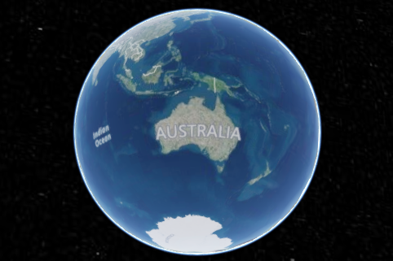
Ingestion into MAS
Materialized views
TSV File
in_json
in_type
Fields created from *.nc files
directories
in_path
Tables
di_hash | di_parent | di_name | di_ctime | di_mtime | di_atime | di_mode | di_inode | di_uid | di_gid | di_user | di_group | di_count | di_size
ta_hash | ta_count | ta_size
055ec5de-6554-e594-8a5c-e13507336d04 | 5 | 4096
3bd50de5-2ae0-e0a0-4ea4-e4a7fb3ba59b | 6 | 8192
54228a91-ae5c-70d4-3cae-2636f74f4848 | 7 | 12288
8e3a9b64-c866-8b77-ee2f-1a9e9fe70ca5 | 8 | 16384
34165e3c-6722-8c77-94ac-670a9a49580b | 9 | 20480
de66a1b3-29bc-fad4-1996-ac08d4dbac77 | 10 | 24576
d835f4d1-b7a9-9857-5fe4-166118e91ded | 11 | 28672
399ab…b2d3f | | g | | | | | | | | | | 0 | 0
d835f…91ded | 399af…b2d3f | data2 | | | | | | | | | | 11 | 28672
de66a…bac77 | d835f…91ded | tc43 | | | | | | | | | | 10 | 24576
34165…9580b | de66a…bac77 | modis-fc | | | | | | | | | | 9 | 20480
8e3a9…70ca5 | 34165…9580b | v310 | | | | | | | | | | 8 | 16384
54228…f4848 | 8e3a9…70ca5 | tiles | | | | | | | | | | 7 | 12288
3bd50…ba59b | 54228…f4848 | 8-day | | | | | | | | | | 6 | 8192
055ec…36d04 | 3bd50…ba59b | cover | | | | | | | | | | 5 | 4096
ingest.sh
tallies
pa_hash | pa_ingested | pa_type | pa_path | pa_parents
mas:ingest
- e2a71936-e060-3431-e0af-c4c1e0d7a926
- 2018-11-22 13:40:47.980522+11
- null
- /g/data2/tc43/…/FC.v310.M...h1...2018.006.nc
- {399ab314-4e5e-e928-7ec4,…}
paths
polygons
po_hash | po_stamps | po_min_stamp | po_max_stamp | po_name | po_pixel_x | po_pixel_y | po_polygon
md_hash | md_ingested | md_type | md_json
metadata
- bd788deb-fa0d-ebea-1dac-a2c5999a364c
- 2018-11-21 15:01:34.395869+11
- gdal
- {"filename": "/g/data2/tc43…”… -1]}]}
ed289005-7578-3180-3b86-8b20a3d9c755 | {"2017-01-01 11:00:00+11”,…} | 2017-01-01 11:00:00+11 | 2017-12-27 11:00:00+11 | bare_soil | 463.50584396298467 | -463.50584396298467 | 0103000…9734941
Trigger functions add data to other tables
NOTE:
The process flows are approximate and shows the overall process. For example, paths are not created entirely from metadata. See the document for details.

Slide 3




Default Scenario Setup
Unknown/Unused
EnvMap
??
117
# of fields required for each
57
BioCASe
Texpress/Oracle
eFlora
Data importing gate is not wide enough to get all data in.
Data Exporting Gate
No data in, No data out !

Slide 4
Ingestion into MAS
TSV File
in_json
in_type
Fields created from *.nc files
in_path
Data ingestion into the MAS database
ingest
tallies
pa_hash | pa_ingested | pa_type | pa_path | pa_parents
paths
md_hash | md_ingested | md_type | md_json
metadata
Trigger functions add data to other tables

