Slide 1
Slide 1 of 4
Install and test GSKY server
TL;DR
Setup a Virtual Machine
scp ‘build_all.sh’ to the home directory
chmod 755 build_all.sh
sudo ./build_all.sh
Slide show will begin in 5 seconds !
It will take 6 minutes to run through this demo. If too fast or too slow, then open the editable *.pptx file and manually run the slideshow.
This is a quick overview of the process. See the README document for details.
Copyright © 2018 by NCI. Created on 28 Nov 2018. Contact: Arapaut.Sivaprasad@anu.edu.au

Slide 2
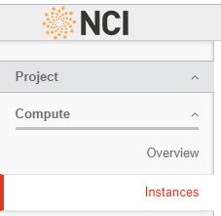

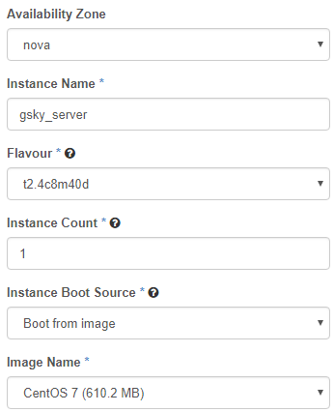
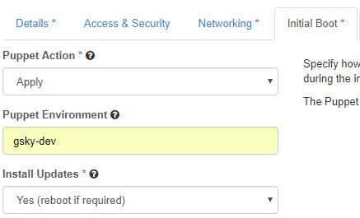

Slide 2 of 4
Setup a Virtual Machine
(If not using a dedicated server)
This will setup a virtual machine on ‘tenjin’
https://tenjin.nci.org.au/dashboard/project/instances/
scp build_all.sh130.56.242.xx:/home/900/user
ssh user@130.56.242.xx
chmod 755 build_all.sh
sudo ./build_all.sh
Next: Setup GSKY server

Slide 3
Slide 3 of 4
Install GSKY server Process flow and code snippets
Git
Dev
Deps
JPEG
Open
JPEG
GEOS
PROJ
Zlib
PostgreSQL Database
Next Slide
GO
PostGIS
HDF4
‘source /home/900/user/build_all.sh’
Pre-install dependencies
All dependencies
JPEG software
OPENJPEG Library
GEOS - Geometry Engine
Cartographic Projection Procedures
Zlib Data Compression Library
Hierarchical Data Format HDF4
Hierarchical Data Format HDF5
Network Common Data Form (NetCDF )
XML C parser
JSON implementation in C (JSON-C)
GDAL with OpenJPEG support
PostGIS extension to PostgreSQL Database
GO Language
Build GSKY
Copy files
Setup MAS database
Config file
Start the OWS server
Test the OWS server on Terria MAP
Single command to setup a VM and install GSKY server.
Git clone the repository.
git clone https://github.com/nci/gsky.git
yum -y groupremove "Development Tools"
yum -y groupinstall "Development Tools"
yum -y remove wget
yum -y install wget
yum -y remove cmake
yum -y install cmake
yum -y remove python-devel
yum -y install python-devel
yum -y install readline-devel
Test the running GSKY server online.
View the data on the map.
v=5.1.0
vd=1.7
set -xeu
wget -q http://download.osgeo.org/proj/proj-${v}.tar.gz
tar -xf proj-${v}.tar.gz
wget -q http://download.osgeo.org/proj/proj-datumgrid-${vd}.zip
unzip proj-datumgrid-${vd}.zip -d proj-${v}/nad/
cd proj-${v}
./configure --prefix="$prefix"
make -j4
make install
prefix=/local/gsky
export GOROOT=$prefix/go
export GOPATH=$prefix/gopath
export PATH="$PATH:$GOROOT/bin"
export PKG_CONFIG_PATH=/usr/local/lib/pkgconfig
go get github.com/${repo}/gsky
rm -rf $GOPATH/src/github.com/${repo}/gsky
git clone https://github.com/${repo}/gsky.git $GOPATH/src/github.com/${repo}/gsky
cd $GOPATH/src/github.com/${repo}/gsky
./configure
make all
prefix=/local/gsky
export GOPATH=$prefix/gopath
mkdir -p $prefix/share/gsky; mkdir -p $prefix/share/mas
cp -f $GOPATH/src/github.com/${repo}/gsky/concurrent $prefix/bin/concurrent
cp -f $GOPATH/bin/api $prefix/bin/api
cp -f $GOPATH/bin/gsky $prefix/share/gsky/gsky
cp -f $GOPATH/bin/grpc-server $prefix/share/gsky/grpc_server
cp -f $GOPATH/bin/gdal-process $prefix/share/gsky/gsky-gdal-process
cp -f $GOPATH/bin/crawl $prefix/share/gsky/gsky-crawl
cp -f $GOPATH/src/github.com/${repo}/gsky/crawl/crawl_pipeline.sh $prefix/share/gsky/crawl_pipeline.sh
cp -f $GOPATH/src/github.com/${repo}/gsky/mas/db/* $prefix/share/mas/
cp -rf $GOPATH/src/github.com/${repo}/gsky/*.png $prefix/share/gsky/
cp -rf $GOPATH/src/github.com/${repo}/gsky/templates $prefix/share/gsky/
cp -rf $GOPATH/src/github.com/${repo}/gsky/static $prefix/share/gsky/
mkdir -p /local/gsky_temp; chown -R nobody:nobody /local/gsky_temp
prefix=/local/gsky
export GOPATH=$prefix/gopath
export MAS=$prefix/share/mas
export LD_LIBRARY_PATH="/usr/local/lib:${LD_LIBRARY_PATH:-}"
ldconfig
export PGUSER=postgres
export PGDATA=/usr/local/pgsql/data
export PGHOST=${PGHOST:-''}
export PGPORT=${PGPORT:-5432}
cp $GOPATH/src/github.com/$repo/gsky/mas/api/mas.sql $MAS
cd $MAS
psql -v ON_ERROR_STOP=1 -A -t -q <<EOD
\\i schema.sql
\\i mas.sql
EOD
input=$home/gsky/install/config.json
ip=`curl ifconfig.me`
while IFS= read -r var
do
line=${var/OWS_IP_ADDRESS/$ip}
echo "$line" >> /usr/local/etc/config.json
done < "$input"
ln -s /local/gsky/share/gsky /usr/local/share/gsky
export LD_LIBRARY_PATH=/usr/local/lib:/usr/lib
pid=`ps -ef | grep gsky | grep -v grep | awk '{split($0,a," "); print a[2]}'`
if [ $pid ]
then
kill $pid
fi
/local/gsky/share/gsky/gsky -p 80&
v=2.3.1
set -xeu
wget -q http://download.osgeo.org/gdal/${v}/gdal-${v}.tar.gz
tar -xf gdal-${v}.tar.gz
cd gdal-${v}
./configure --with-geos=yes --with-netcdf --with-openjpeg=$include
make -j4
make install
mkdir -p /var/lib/pgsql
mkdir -p /usr/local/pgsql/data
chown postgres /usr/local/pgsql/data
su - postgres -c '/usr/local/pgsql/bin/initdb -D /usr/local/pgsql/data; /usr/local/pgsql/bin/postgres -D /usr/local/pgsql/data >/tmp/logfile 2>&1 &’
JPEG Software
OPENJPEG Library
GEOS - Geometry Engine
Cartographic Projection Procedures
Zlib Data Compression Library
HDF4 and HDF5
NetCDF
XML C parser
JSON-C
GDAL with OpenJPEG support
PostGreSQL
PostGIS
GO
GSKY
v=1.2.8
set -xeu
wget -q ftp://ftp.unidata.ucar.edu/pub/netcdf/netcdf-4/zlib-${v}.tar.gz
tar -xf zlib-${v}.tar.gz && cd zlib-${v}
./configure --prefix="$prefix"
make -j4
make install
v=4.2.13
set -xeu
wget -q https://support.hdfgroup.org/ftp/HDF/HDF_Current/src/hdf-${v}.tar.gz
tar -xf hdf-${v}.tar.gz
cd hdf-${v}
./configure --enable-shared --disable-fortran --prefix="$prefix"
make -j4
make install
v=1.8.13
set -xeu
wget -q ftp://ftp.unidata.ucar.edu/pub/netcdf/netcdf-4/hdf5-${v}.tar.gz
tar -xf hdf5-${v}.tar.gz && cd hdf5-${v}
./configure --enable-shared --enable-hl --prefix="$prefix"
make -j4
make install
v=4.1.3
set -xeu
wget -q http://www.unidata.ucar.edu/downloads/netcdf/ftp/netcdf-${v}.tar.gz
tar -xf netcdf-${v}.tar.gz && cd netcdf-${v}
./configure --enable-netcdf-4 --enable-shared --enable-dap --prefix="$prefix"
make -j4
make install
v=2.9.8
set -xeu
wget -q ftp://xmlsoft.org/libxml2/libxml2-${v}.tar.gz
tar -xf libxml2-${v}.tar.gz
cd libxml2-${v}
./configure --prefix="$prefix"
make -j4
make install
v=0.13.1
set -xeu
wget -q https://s3.amazonaws.com/json-c_releases/releases/json-c-${v}.tar.gz
tar -xf json-c-${v}.tar.gz
cd json-c-${v}
./configure --prefix="$prefix"
make -j4
make install
v=2.3.1
set -xeu
wget -q http://download.osgeo.org/gdal/${v}/gdal-${v}.tar.gz
tar -xf gdal-${v}.tar.gz
cd gdal-${v}
./configure --with-geos=yes --with-netcdf --with-openjpeg=$include
make -j4
make install
v=2.4.4
set -xeu
wget -q https://download.osgeo.org/postgis/source/postgis-${v}.tar.gz
tar -xf postgis-${v}.tar.gz
cd postgis-${v}
./configure --with-pgconfig=/usr/local/pgsql/bin/pg_config
make -j4
make install
ln -s /usr/local/lib/libgdal.so.20 /usr/local/pgsql/lib/libgdal.so.20
prefix=/local/gsky
mkdir -p $prefix
mkdir $prefix/gopath
mkdir $prefix/bin
C_INCLUDE_PATH=$(/usr/bin/nc-config --includedir)
export C_INCLUDE_PATH
wget -q -O go.tar.gz https://dl.google.com/go/go1.10.3.linux-amd64.tar.gz
tar -xf go.tar.gz
mv go $prefix/go
v=9c
wget -q http://www.ijg.org/files/jpegsrc.v${v}.tar.gz
tar -xf jpegsrc.v${v}.tar.gz
cd jpeg-${v}
./configure --prefix="$prefix"
make -j4
make install
v=2.3.0
set -xeu
wget -q -O openjpeg-v${v}.tar.gz https://github.com/uclouvain/openjpeg/archive/v${v}.tar.gz
tar -xf openjpeg-v${v}.tar.gz
cd openjpeg-${v}
mkdir build
cd build
cmake .. -DCMAKE_BUILD_TYPE=Release -DCMAKE_INSTALL_PREFIX="$prefix"
make -j4
make install
v=3.6.2
prefix=${PREFIX:-/usr}
set -xeu
wget -q http://download.osgeo.org/geos/geos-${v}.tar.bz2
bunzip2 geos-${v}.tar.bz2
tar -xf geos-${v}.tar
cd geos-${v}
./configure --prefix="$prefix"
make -j4
make install
Terria MAP
GSKY
Postgre
SQL
HDF5
acceptance_tests/ CITATION.md config_json.md configure* | install/ LICENSE-2.0.txt Makefile.in mas/ | static/ templates/ testsuite/ utils/
configure.ac crawl/ data_unavailable.png docker/ | ows.go ows_test.go processor/ README.md | worker/ zoom.png
OWS
COPY
GDAL
NetCDF
CONFIG
MAS
JSON-C
XML-C

Slide 4

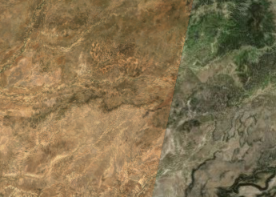
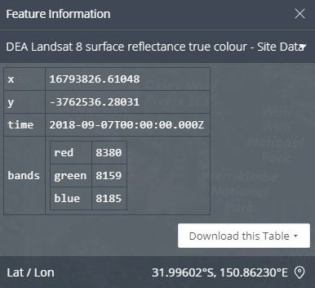
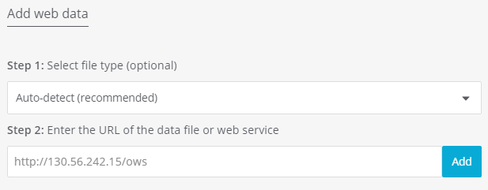
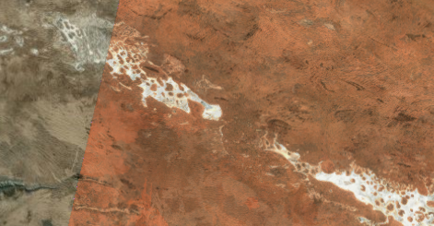
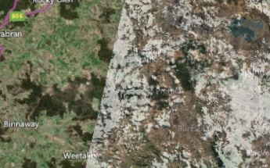



View on Terria JS Web-based Geospatial Catalogue Explorer
Slide 4 of 4
Add Data
My Data
Add Web Data
GSKY Server
Title
Click

