Slide 1
ArcGIS Pro Essentials
Basics of ArcGIS from Desktop Tutorials. MUST be viewed as a slideshow to see the process flow. Run it Auto or with the timings turned off. (Slide Show | Use Timings)
Ref: http://learn.arcgis.com/en/projects/get-started-with-arcgis-pro/
ACKNOWLEDGEMENT
This presentation is derived from the above page, with navigation and explanations added to simplify the learning process. While the presentation in its entirety remains the property of NCI, the knowledge base and some graphics in the above URL are owned by ESRI
Copyright © 2019 by National Computational Infrastructure, Canberra, ACT, Australia. Author: Dr. Arapaut V Sivaprasad.
10 January, 2018

Slide 2
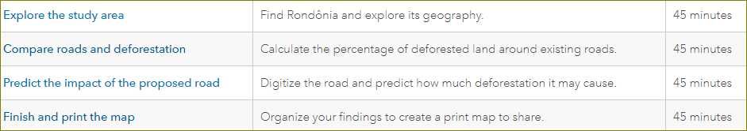
Lesson Plan
In this lesson, you'll use ArcMap to create a map of deforestation in the Brazilian state of Rondônia. Then, you'll predict how much deforestation would be caused by a road proposed to be built across the state. Your workflow requires a wide variety of data, feature editing, and analysis tools. You'll also learn how to share your results as an informative print map.

Slide 3
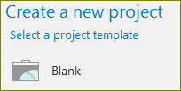
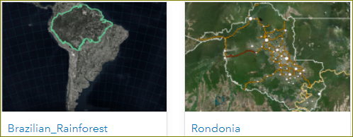
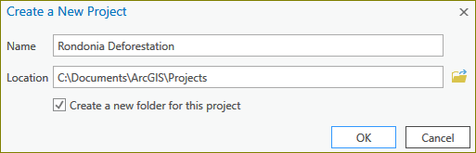
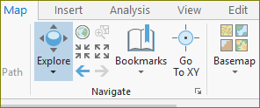


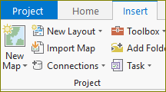
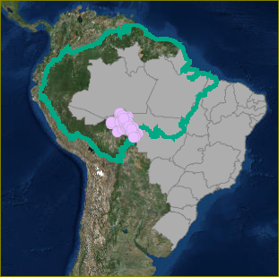
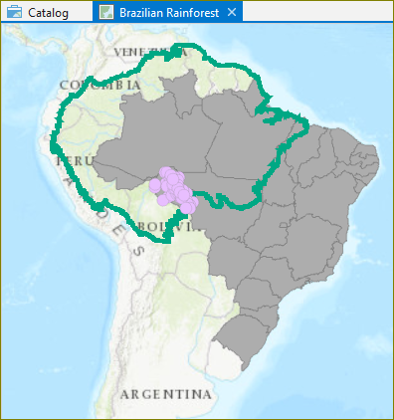
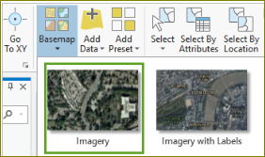


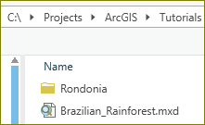



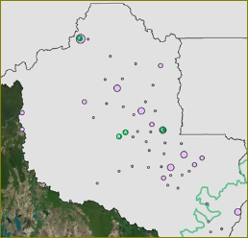
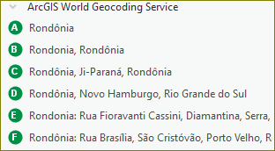
Explore the study area
Before you can make a map, you must first create a project. A project stores the maps, databases, toolboxes, styles, and other folders that may be useful when making your map. Then you'll import a map document with some of the data you need to start the map.
1. Go to the Get Started with ArcGIS Pro group.
2. Download and save the Brazilian_Rainforest.mxd file.
3. Download and save the Rondonia.zip file.
4. Open ‘Start | ArcGIS Pro’ desktop program.
5. Start a new project, ‘Rondonia Deforestation.aprx’
6. Import a map
7. Change the base map
8. Locate ‘Rondonia’
9. Save the project.
Next: Organise and symbolise data

Slide 4
Summary
NOTHING HERE AT THE MOMENT!
Will be updated after all modules have been described.

Slide 5






Acknowledgements

