Slide 1
GSKY as OPeNDAP service
Tutorial and Techical Details
INTRODUCTION
This is a collection of thoughts, ideas, code snippets and working examples to demonstrate the intended service. It is an evolving document and will change considerably over time.
To test these you will need:
An SSH tunnel to 130.56.242.15 (see slide 5)
A config file to load the data (e.g. geoglam.json; content is given in slide 6)
A VDI login session.
Copyright © 2019 by National Computational Infrastructure, Canberra, ACT, Australia. Author: Dr. Arapaut V. Sivaprasad
20 Feb, 2019

Slide 2
INTRODUCTION
The OPeNDAP service in GSKY is very similar to WCS.
How the OPeNDAP service works now (prototype):
GSKY client (e.g. TerriaMap) sends BBox and time (among other things).
GSKY finds the data from several data files and saves as a NetCDF file.
The NetCDF file is opened in Panoply, iPython, QGIS, etc. under desktop or VDI.
How the OPeNDAP service should work in production:
OPeNDAP client (e.g. iPython, Panoply, Ferret, etc.) will send lat/lon as in e.g. below.
http://localhost:8080/thredds/dodsC/gsky/gsky_test.nc?Band1[0:1:0][0:1:0]
GSKY converts the above into a BBox.
Call the service=WCS (or similar) to get the slice from different files in the data set.
Create and send a combined NetCDF.
The OPeNDAP client interprets and/or plots the data.
Things to consider:
There should be two sets of lat/lon to form a bounding box.
Thredds server can send only a range (true?)
The BBox must be converted into meters from degrees.
Already know the formula to convert lat/lon to meters.
Must insert it as a function in GSKY.
Python and Panoply do not like the format of the URL sent by thredds.
They do not accept the lat/lon values as sent by thredds.
Must find out or devise a new input URL.
The same may apply to other clients.
Will there be a TerriaMap-like client for OPeNDAP ?
Do we make them?
HTTP-based interface is very easy to do.
Will Panoply or other such software be useful?
Next: Background

Slide 3

Background
The generated NetCDF file can be examined with iPython Notebok, Panoply or QGIS.
Python Notebook:
File can be specified as PATH…
#path = '/g/data2/rs0/datacube/002/LS8_OLI_NBART/-10_-28/LS8_OLI_NBART_3577_-10_-28_2013_v1493805443.nc’
path = '/home/900/avs900/OpenDAP/aggregate_netcdf.nc’
Or as URL…
url = 'http://dapds00.nci.org.au/thredds/dodsC/rs0/datacube/002/LS8_OLI_NBART/-10_-28/LS8_OLI_NBART_3577_-10_-28_2013_v1493805443.nc'
f = Dataset(path, ‘r’)
f
<type 'netCDF4._netCDF4.Dataset'>
root group (NETCDF4_CLASSIC data model, file format HDF5):
Conventions: CF-1.5
GDAL: GDAL 2.3.1, released 2018/06/22
history: Wed Feb 20 10:54:50 2019: GDAL Create( /tmp/raster_029080650, ... )
dimensions(sizes): lon(1024), lat(785)
variables(dimensions): int8 Band1(lat,lon), |S1 crs(), float64 lat(lat), float64 lon(lon)
groups:
Next: Contd…

Slide 4
BACKGROUND
Running the DAP-GSKY service and creating the NetCDF file.
An example GSKY call URL:
http://localhost:8080/ows/geoglam?service=WCS&request=GetCoverage&version=1.0.0&format=GeoTIFF&crs=EPSG:4326&width=1024&height=782&coverage=global:c6:monthly_anom_frac_cover&bbox=111.97265625000001,-44.02442151965934,156.44531250000003,-10.055402736564236&time=2018-10-01T00:00:00.000Z
The above call creates a NetCDF file on the VM that runs GSKY server: /tmp/aggregate_netcdf.nc
Creates a NetCDF/GeoTIFF file on local PC: global-c6-monthly_anom_frac_cover.2018-10-01T00_00_00.000Z.nc
Path is accepted as a NetCDF file.
Must be on the VDI login machine (i.e. in a directory on raijin)
The *.nc file is created on the VM that runs GSKY server as well as on your local PC.
How to get it across to the VDI ?
rsync /tmp/aggregate_netcdf.nc avs900@vdi-n24.nci.org.au:/home/900/avs900/OpenDAP
How to specify a URL to point to the NetCDF ?
THREDDS server can do it.
More about it later…
How to use the service:
Setup a port forwarding from your PC (slide 5)
Create a config file on your PC (slide 6)
Open TerriaMap website (slide 7).
Open the above config as ‘My Data | Local Data’
Load the layer
How to use the service (Contd…):
Click ‘Export’
Shift drag to draw an outline.
Save the NetCDF on your PC and use with Panoply or QGIS (slides 8,10)
FTP to your VDI home dir.
Open with VDI/Panoply or VDI/QGIS (slides 9,11)
Code changes and info for programmers (slides 12-14)
Next: Setup Environments

Slide 5
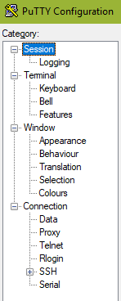
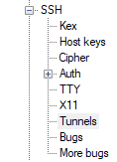
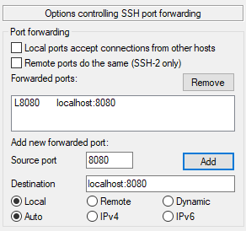
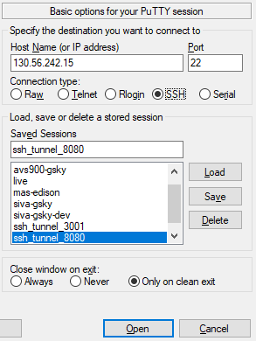

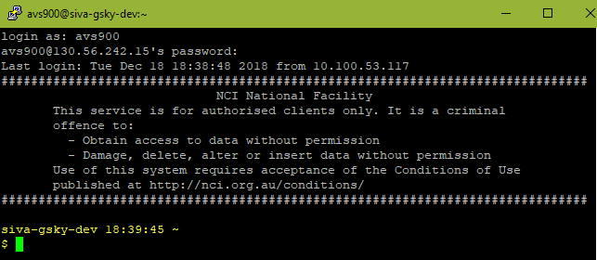
Setup Environment
Setup Port forwarding
GSKY server listens on port 8080, but this port is not open to the outside network. You will need an SSH tunnel to access the server.
See instructions below to setup the tunnel.
Start Putty
Setup an SSH tunnel as below.
Add new forwarded port:
Source port: any free port on your local PC
Destination: localhost:port
Best to use the same number for both
Click Add
Save the session as e.g. ssh_tunnel_8080
Login to the GSKY/Thredds server at 130.56.242.19
e.g. xxx900@130.56.242.19
Leave the login shell running.
Next: Contd…

Slide 6
Setup Environment
2. Create a configuration file
A local file is used as configuration in the version of DAP-GSKY described here. This file should reside on your local PC/Mac.
File name: geoglam.json
CONTENTS of geoglam.json:
{
"catalog": [
{
"name":"GEOGLAM",
"type": "wms",
"url": "http://localhost:8080/ows/geoglam",
"layers": "global:c6:monthly_anom_frac_cover",
"linkedWcsUrl": "http://localhost:8080/ows/geoglam",
"linkedWcsCoverage": "global:c6:monthly_anom_frac_cover"
}
]
}
Create a plain text file, e.g. c:\gsky\geoglam.json, with the above content.
Locate and load this file when GSKY starts.
Next: DAP-GSKY Operation

Slide 7






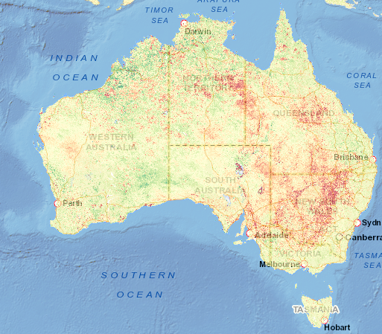


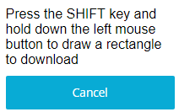
DAP-GSKY Operation
Start TerriaMap: http://130.56.242.16/terria/
Creating an aggregate NetCDF file for a chosen region on the map will be as follows:
Open a local data file in TerriaMap.
Click ‘Export’.
Shift-drag an area.
Save the file as ‘filename.nc’
Choose File format as ‘All Files (*.*)
The resulting file can be treated as both NetCDF and GeoTIFF.
The *.nc file alone can be opened in Panoply.
Both *.nc and *.tiff can be opened in QGIS.
Next: View in Panoply on Desktop

Slide 8

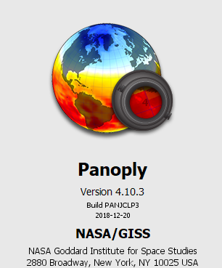


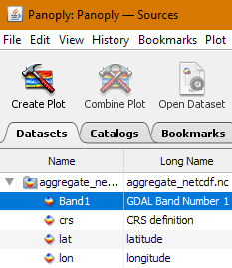
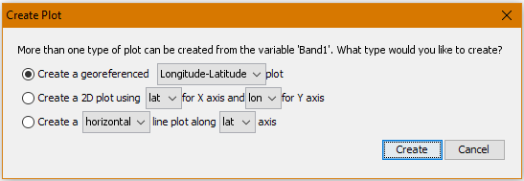
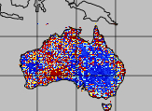
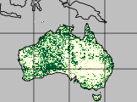

View in Panoply (desktop)
Start Panoply on desktop
Panoply by NASA is a Java-based program that runs on Windows, Mac and Linux. There is a VDI-integrated version, if you do not have a desktop version. Viewing the NetCDF file is exactly the same way on both.
Next: View in Panoply under the VDI

Slide 9
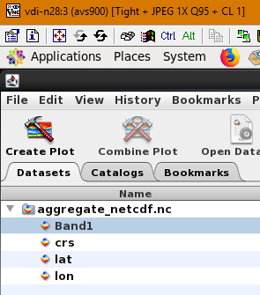
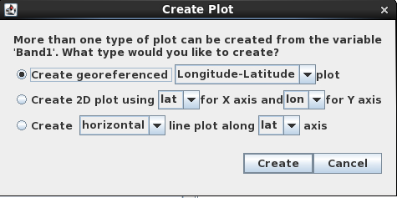
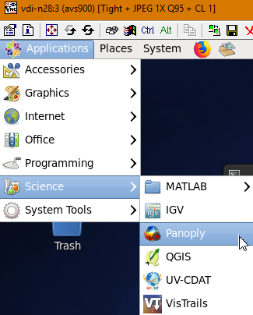

View in Panoply (VDI)
FTP the saved NetCDF file to your home dir on VDI
Start Panoply under VDI
Next: View in QGIS

Slide 10

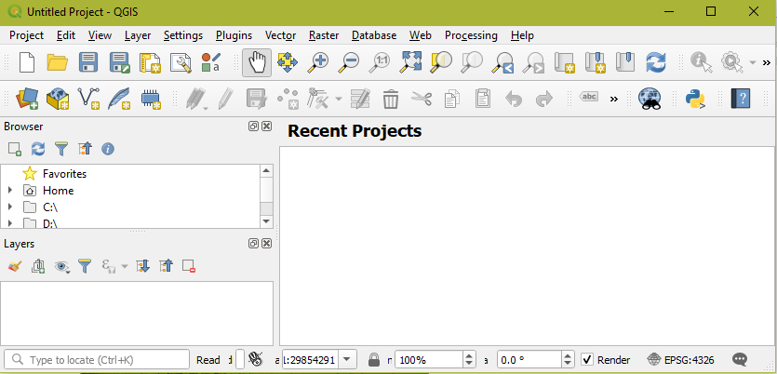
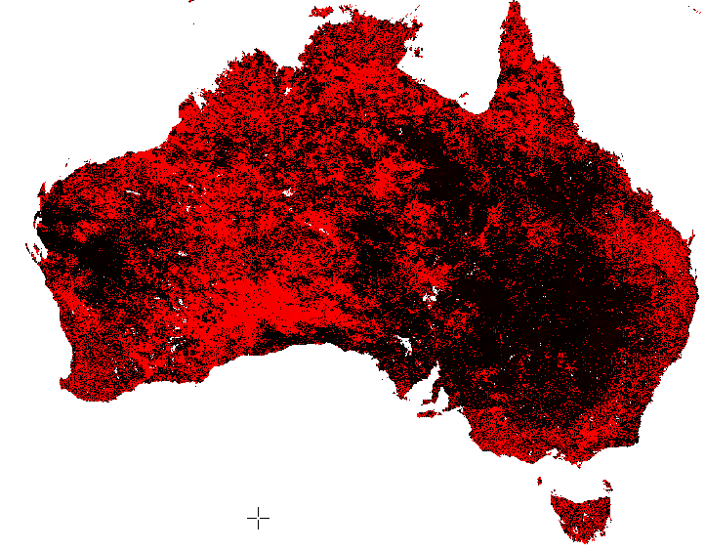
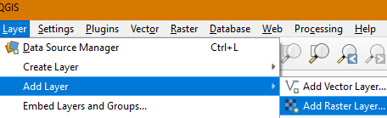
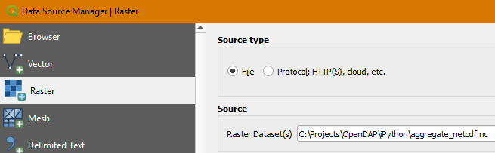
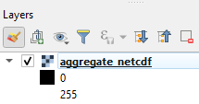
View in QGIS (desktop)
For QGIS, the file can be saved in either *.nc or *.tiff format.
Next:

Slide 11
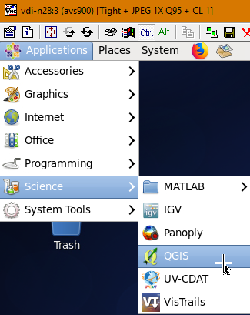




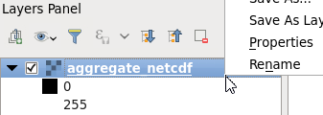
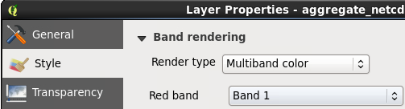

View in QGIS (VDI)
FTP the saved NetCDF or TIFF file to your home dir on VDI
Start QGIS under VDI
Next: Technical and Code Change

Slide 12
Technical and Code Change
This section is the information for programmers!
The DAP-GSKY service adapts the code for WCS Coverage.
A call like below is processed and the output is saved in NetCDF format.
e.g.
http://localhost:8080/ows/geoglam?service=WCS&request=GetCoverage&version=1.0.0&format=GeoTIFF&crs=EPSG:4326&width=1024& height=782&coverage=global:c6%3Amonthly_anom_frac_cover&bbox=lon1,lat1,lon2,lat2&time=2018-10-01T00:00:00.000Z
`gdalinfo aggregate_netcdf.nc`
Driver: netCDF/Network Common Data Format
This can be opened in both QGIS and Panoply.
The output file can also be saved and used as *.tiff, in which case the driver is different.
`gdalinfo aggregate_netcdf.tiff`
Driver: HDF5Image/HDF5 Dataset
This can be opened in QGIS but not in Panoply.
CODE Changes:
func generalHandler:
case "WCS":
1312: query["format"][0] = "netcdf" // AVS: Save the file as NetCDF (*.nc) on the server and as HDF5Image/HDF5 on PC (*nc or *.tiff)
params, err := utils.WCSParamsChecker(query, reWCSMap)
func serveWCS:
case "GetCoverage":
1006: os.Rename(masterTempFile, "/home/900/avs900/OpenDAP/aggregate_netcdf.nc") // AVS: Save as NetCDF for use within VDI
1007: _ = os.Chmod("/home/900/avs900/OpenDAP/aggregate_netcdf.nc", 0644)
//os.Rename(masterTempFile, "/usr/local/tds/apache-tomcat-8.5.35/content/thredds/public/gsky/gsky_test.nc") // AVS: For use with THREDDS
Next: Contd…

Slide 13
Technical and Code Change
This section is the information for programmers!
The DAP-GSKY service adapts the code for WCS Coverage.
A call like below is processed and the output is saved in NetCDF format.
e.g.
http://localhost:8080/ows/geoglam?service=WCS&request=GetCoverage&version=1.0.0&format=GeoTIFF&crs=EPSG:4326&width=1024& height=782&coverage=global:c6%3Amonthly_anom_frac_cover&bbox=lon1,lat1,lon2,lat2&time=2018-10-01T00:00:00.000Z
`gdalinfo aggregate_netcdf.nc`
Driver: netCDF/Network Common Data Format
This can be opened in both QGIS and Panoply.
The output file can also be saved and used as *.tiff, in which case the driver is different.
`gdalinfo aggregate_netcdf.tiff`
Driver: HDF5Image/HDF5 Dataset
This can be opened in QGIS but not in Panoply.
Code changes in /local/gsky/gopath/src/github.com/nci/gsky/ows.go:
Global:
58: dap = flag.Bool("dap", true, "For DAP-GSKY Service.")
func generalHandler:
case "WCS":
if (*dap) {
query["format"][0] = "netcdf")
}
func serveWCS:
case "GetCoverage":
1037: Save_aggregate_netcdf (masterTempFile)
Next: Contd…

Slide 14
Technical and Code Change
This section is the information for programmers!
Code changes in /local/gsky/gopath/src/github.com/nci/gsky/ows.go:
func Save_aggregate_netcdf (masterTempFile string) {
source, err := os.Open(masterTempFile)
defer source.Close()
dst := "/tmp/aggregate_netcdf.nc"
destination, err := os.Create(dst)
defer destination.Close()
nBytes, err := io.Copy(destination, source)
}
End of Slides

Slide 15






Acknowledgements

