Slide 1
Connecting GSKY with THREDDS
Thoughts on creating TerriaMap-GSKY-THREDDS communication
Best viewed as a ‘Slide Show’ from the top menu.
Turn off the “Use Timings” to run it at your own pace.
Copyright © 2018 by National Computational Infrastructure, Canberra, ACT, Australia.
Prepared by: Arapaut V. Sivaprasad on 12 December, 2018

Slide 2
Background
This is the content of email from Kelsey on 5 Dec., 2018.
(Ref: Email from Kelsey on 5/12/2018: Subject: “GSKY OPeNDAP/Subsetting thoughts”)
Summary around DAP-like gsky service:
GSKY currently offers OGC options (WMS, WCS) that allow a user to view/discover data through a map request (WMS) and then also select that same data for download (WCS).
However, there is a gap that (currently) neither our GSKY or THREDDS server can meet in terms of data access options:
GSKY is great for discovering and downloading predefined products and does the complex/time-consuming spatial aggregation behind the scenes. But it is lacking in terms of allowing more flexible queries to the lower-level data contained in the dataset (such as they would from working with it direct on the filesystem or through our THREDDS server). Accessing the netcdf or tiff contents means a user has more options, can compute their own composites, etc.
THREDDS is basically the opposite case. It allows a user to access the contents but only in a file based manner but lacks the complex aggregation GSKY offers. (Though it should be noted it does do aggregation across time fairly well in most cases but terrible with spatial aggregations, can't do it in the way needed.)
GSKY could potentially fill this gap by offering a DAP-like service to an endpoint that acts like the aggregated "file" for the dataset. Similar to how our THREDDS aggregated endpoints work. E.g., http://dapds00.nci.org.au/thredds/catalogs/rr9/collection/dataset/ANUClimate_v1-0_rainfall_daily_0-01deg_1970-2014.html?dataset=ANUClimate_v1-0_rainfall_daily_0-01deg_1970-2014_agg
For example, with a DAP endpoint a user can access contents of this aggregated "file" remotely from many tools just as though they were working direct on the filesystem. You feed the endpoint into tools in the exact manner as you were inputing a file path.
Here's a very simple example of using DAP from a python notebook: https://nbviewer.jupyter.org/github/nci/Data-Training/blob/master/NCI_Autumn_Training/05_Python_Data_Examples_I/Python_DataAccessBasics.ipynb
For a collection like DEA, this could be really useful because it would allow users to work more natively with the actual band data vs having to use the predefined composites. It's a super easy way to subset/extract data compared with WCS. No special query needed or "middleman" tool needed to construct the query to then call it like you need to do with WCS.
THREDDS also offers another service very similar to DAP- the Netcdf Subset Service (NCSS). NCSS starts to look more similar to a WCS request as it allows for the query to be in lat/lon/time units vs index-based ones. I think it's a bit more flexible than WCS personally, probably because it's not part of a standardised body like OGC.
To see the format of DAP and NCSS requests, follow these notebooks to make a request through the webpage form. It'll then display what the format looks like:
Basic DAP request thru webpage interface: https://nbviewer.jupyter.org/github/nci/Data-Training/blob/master/NCI_Autumn_Training/01_Data_Services/THREDDS_OPeNDAP.ipynb
Basic NCSS request thru webpage interface: https://nbviewer.jupyter.org/github/nci/Data-Training/blob/master/NCI_Autumn_Training/01_Data_Services/NetcdfSubset_Examples.ipynb
Lastly, possible pro of following the DAP protocol standard is that it would work across heaps of netcdf-based tools/packages. Depending on goals/aims of gsky this could be beneficial. Would certainly set ourselves up well for tackling climate-based data collections. (And I'm sure there are cons that we'll think of too but will leave it to this for now! ;))
Some additional Python versions of these services:
https://nbviewer.jupyter.org/github/nci/Data-Training/blob/master/NCI_Autumn_Training/05_Python_Data_Examples_I/Python_Siphon_I.ipynb
https://nbviewer.jupyter.org/github/nci/Data-Training/blob/master/NCI_Autumn_Training/05_Python_Data_Examples_I/Python_NetcdfSubset_Examples.ipynb

Slide 3
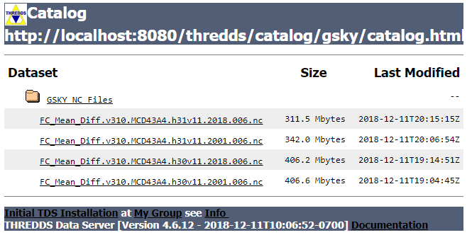
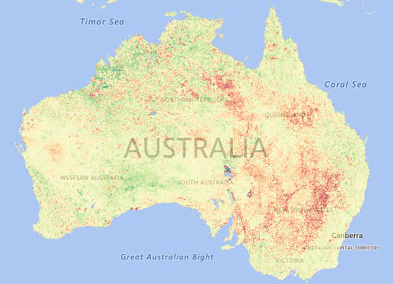
Objective
From the very preliminary discussions with Ben and Kelsey, I understand that there is a need to provide data files through THREDDS in a way that combines the power of GSKY. Instead of just showing the aggregate tiles on screen, it would be useful if the component files in the aggregation could be downloaded via THREDDS as in the picture below.
GSKY/THREDDS
Plan
Display a layer through GSKY/TerriaMap
Create a list of the component NetCDF files from such display.
Create soft links to the NC files in the Thredds content directory.
Send the Thredds URL to TerriaMap for display.
GSKY/TerriaMap
DISCLAIMER
My understanding about the objective is very patchy, and the solution I propose could be way off target. If I am right, however, there appears to be very little work to achieve it. I have documented the GSKY service and the GSKY/TerriaMap conversation after studying the codes for both. It appears that minimal changes in TerriaJS and GSKY codes will enable us to get the list of files that go into the aggregate map. TerriaJS is open source, but perhaps TerriaMap is copyrighted. I have played with TerriaJS and believe that after sorting out some server issues it can be installed locally and then be able to change the code to suit. This, however, has not been tested. I am reasonably confident to change the GSKY code. My current knowledge about Thredds is minimal too and, hence, there may be logical errors in the proposal.

Slide 4
Plan of action
View GSKY_User_Guide.ppsx or GSKY_Developer_Guide.ppsx to run GSKY/TerriaMap to display something like below.
How GSKY works now
Process flow
Let us say, we want the files that make up the square area in the map on right.
When drawing the square, with “Shift-mouse drag”, several calls go to the GSKY server.
http://130.56.242.15/ows/geoglam?time=2... &service=WMS&request=GetMap&layers=g…&bbox=15…
http://130.56.242.15/ows/geoglam?time=2... &service=WMS&request=GetMap&layers=g…&bbox=15…
http://130.56.242.15/ows/geoglam?time=2... &service=WMS&request=GetMap&layers=g…&bbox=15…
Each call aggregates the data from several source (*.nc) files and sends as a PNG image.
By modifying the GSKY code, we can get the list of files gathered by each call.
How to connect GSKY with Thredds
Plan outline
Create a Thredds server with a ‘catalog.xml’ that points to a directory.
This needs to be done only once.
Get a list of NC files that make up the tile(s) in a ‘request=GetWMS’ call.
Create soft links to the NC files in the Thredds directory or a sub-dir within it.
Use the URL of the Thredds server to view/downlod the NC files.

Slide 5
Prototyping
A quick way to try it out without modifications to Terria…
Keep everything the same as of now.
Setup a Thredds server on the same VM as the GSKY.
Change the ows.go and its packages alone.
Use the ‘request=GetMap’ call from TerriaMap.
It will send the map data as of now, plus process the results for Thredds.
Parse the results returned from the MAS server to get a file-list.
Create soft links the NC files in the directory pointed to by Thredds catalog.
Test it manually.
Benefits
Quick and easy.
Can work out bugs and pitfalls.
No interference with third party software (Terria).
Next steps
Install Terria on the VM.
Modify Terria code to just add a link to view the Thredds catalog.
It can be like the ‘Export’ link, but using a Thredds URL.
It should take only minimal changes (I hope) in Terria.
Work out a way to push the catalog to the NCI Thredds server.
Must also be able to delete the catalog after the user session ends.

Slide 6
Technical
Code changes required for a minimal function...
In ows.go: (to delete previous sets of soft links in the Thredds directory. Line numbers are approximate)
Line 58: var ThreddsDataDir = "/usr/local/tds/apache-tomcat-8.5.35/content/thredds/public/gsky/"
Line 188: empty_thredds()
Line 167:
func empty_thredds() {
thredds_last := ThreddsDataDir + "thredds_last"
thredds_nc := ThreddsDataDir + "*.nc"
last, _ := ioutil.ReadFile(thredds_last)
old, _ := strconv.Atoi(string(last))
et := time.Now().Unix() - int64(old)
if (et > 2) {
f, _ := os.Create(thredds_last)
defer f.Close()
now := strconv.FormatInt(time.Now().Unix(), 10)
f.WriteString(now)
rm_thredds_nc := "rm -f " + thredds_nc
exec.Command("/bin/sh", "-c", rm_thredds_nc).CombinedOutput()
}
}
In processor/tile_indexer.go: (to collect the NC file list and create soft links in Thredds directory)
Line 18: var ThreddsDataDir = "/usr/local/tds/apache-tomcat-8.5.35/content/thredds/public/gsky/" Line 149:
for _, ds := range metadata.GDALDatasets {
nameSpace := ds.NameSpace
file := strings.Replace(ds.DSName, ":", "", -1)
file = strings.Replace(file, "\"", "", -1)
file = strings.Replace(file, "NETCDF", "", -1)
file = strings.Replace(file, nameSpace, "", -1)
exec.Command("ln", "-s", file, ThreddsDataDir).CombinedOutput()
Still to be worked out:
Display the Thredds URL as a link on TerriaMap.
Identify the user and keep the files separate for each user.
Any copyright issue(s) with modifying Terria or TerriaMap?

Slide 7
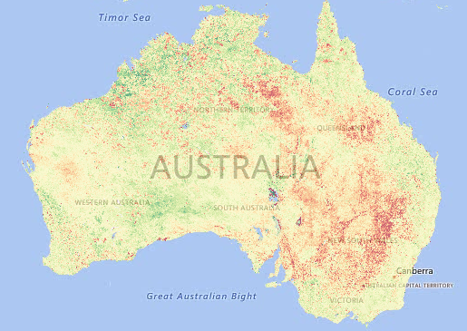

Outcome
If on the right track with expectations, below is how it should go.
Time estimates (if plan is acceptable)
2 days for the prototype
10 days to v1.0.0
Load a layer and get to this display
Draw a square (Shift-drag)
Pass the ‘request=GetMap’ calls to GSKY by Terria
http://130.56.242.15/ows/geoglam?time=2... &service=WMS&request=GetMap&layers=&bbox=15…
Get the list of NC files
"files": [
"/g/data2/tc43/modis-fc/v310/tiles/monthly/anomalies/FC_Mean_Diff.v310.MCD43A4.h31v10.2018.006.nc",
"/g/data2/tc43/modis-fc/v310/tiles/monthly/anomalies/FC_Mean_Diff.v310.MCD43A4.h31v11.2018.006.nc", ]
Thredds catalog.xml
<?xml version="1.0" encoding="UTF-8"?>
<catalog name="Thredds Data Server for GSKY" xmlns="http://www.unidata.ucar.edu/namespaces/thredds/InvCatalog/v1.0" xmlns:xlink="http://www.w3.org/1999/xlink"
xmlns:xsi="http://www.w3.org/2001/XMLSchema-instance" xsi:schemaLocation="http://www.unidata.ucar.edu/namespaces/thredds/InvCatalog/v1.0
http://www.unidata.ucar.edu/schemas/thredds/InvCatalog.1.0.6.xsd">
<service name="all" base="" serviceType="compound"><service name="odap" serviceType="OpenDAP" base="/thredds/dodsC/" />
<service name="http" serviceType="HTTPServer" base="/thredds/fileServer/" /></service>
<datasetScan name="GSKY NC Files" ID="gsky" path="gsky" location="content/gsky"><metadata inherited="true"><serviceName>all</serviceName><dataType>Grid</dataType></metadata>
<filter><include wildcard="*.nc"/></filter></datasetScan>
</catalog>
Symbolic links to the NC files in Thredds directory
ln -s /g/dat…/FC_...006.nc /usr/local/…/thredds/public/gsky
URL to Terria: http://localhost:8080/thredds/catalog.html
Thredds
User clicks a link to see the GSKY/Thredds catalog
Delete the NC symlinks when the user session ends

Slide 8
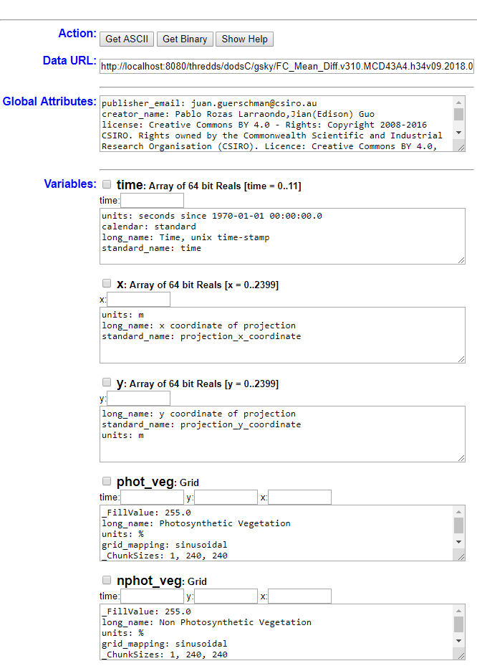

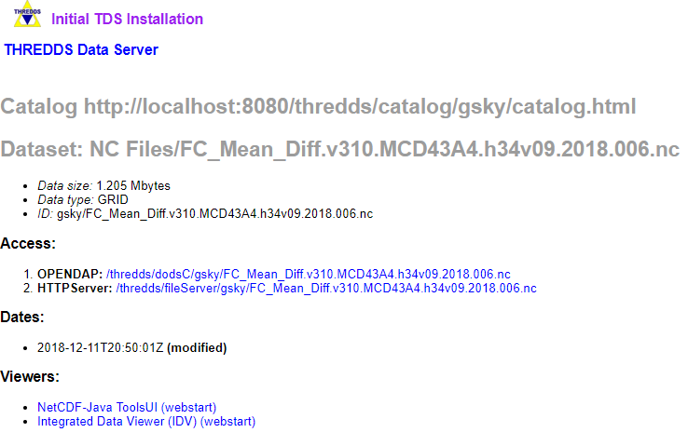
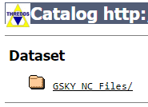
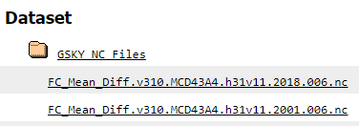

Working Prototype
A working prototype has been created on the server: 130.56.242.15
Follow the instructions below to test it in action. (see GSKY_User_Guide.ppsx for details)
1. Bring up TerriaMap and load the GEOGLAM config
URL: http://130.56.242.16/terria/
Add data
My Data
Add Web Data
http://130.56.242.15/ows/geoglam
GEOGLAM Anomaly Fractional Cover C6
Add to the map
All the NC files would be made available to the Thredds server when the map appears. Drawing a rectangle or zooming will replace the NC files with the new relevant ones. They will appear as links on the Thredds website as shown below.
2. View and/or download the component NC files on Thredds server
http://localhost:8080/thredds/catalog.html*
* Thredds server listens on port 8080 which is not open to the outside. Must do a “port forwarding” to use the above link. See next slide on how to do it. In the production version we must devise a way to interact with a public server.

Slide 9
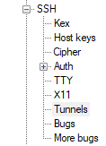
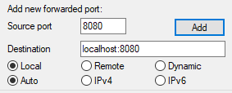
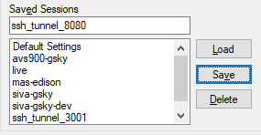
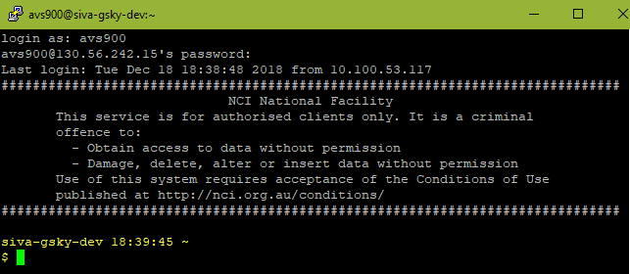

Port Forwarding to use Thredds
Setup Port forwarding: Only the port 80 is open on the VM, and that too within the NCI network. Tomcat, which is required for Thredds, listens on port 8080. We need to setup a port forwarding so that a call to http://localhost:8080 will display the Tomcat browser. To do it, we must use an SSH session to the server where Tomcat is running. Given below are the instructions.
Start Putty
Setup an SSH tunnel as below.
Add new forwarded port:
Source port: any free port on your local PC
Destination: localhost:port
Best to use the same number for both
Click Add
Save the session as e.g. ssh_tunnel_8080
Login to the GSKY/Thredds server at 130.56.242.15
e.g. xxx900@130.56.242.15
Leave the login shell running.
http://localhost:8080/thredds/catalog.html will open the Thredds server.

Slide 10






Acknowledgements

