Slide 1
QGIS Essentials
For efficient use of QGIS
Copyright © 2018 by National Computational Infrastructure, Canberra, ACT, Australia.
Date Month, 2018

Slide 2



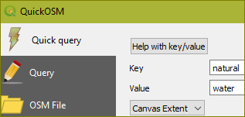
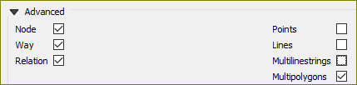
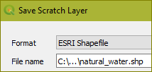
Download OSM Data
QuickOSM is a plugin that allows you to find and download data layers corresponding to a large variety of things such as water ways, roads, land use, buildings, public transport and many more. You must be zoomed into an area that has data corresponding to the layer to be added. For example, zooming to the centre of Australia and asking to add buildings layer will return empty. [Ref]
Manage and Install Plugins
STEPS
Install the QuickOSM plug-in
Plugins | Manage and Install Plugins
All | Search… | QuickOSM | Install
Add a layer
Zoom into the area (e.g. Canberra)
Vector | QuickOSM | QuickOSM…
Key = natural, Value = water
In: Canvas Extent
Advanced: Multipolygons
Run Query
Save as shape file
Click the save icon next to the layer name
Choose Format: ESRI Shapefile
Save in a directory.
Will create several files, including a *.shp
NOTE: You have to download a layer for each of the zoom views. Thus, water bodies outside the area will not be filled.

Slide 3
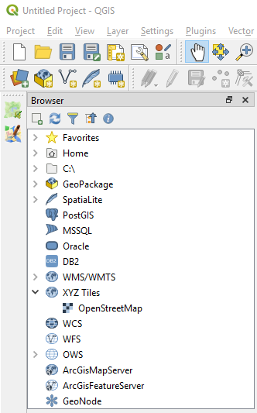
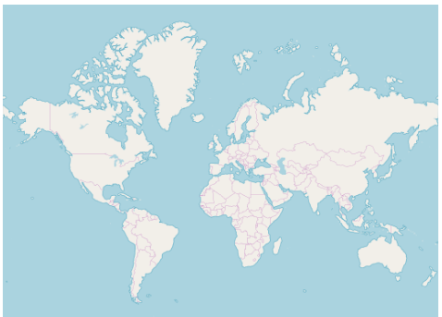
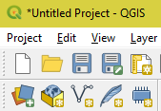
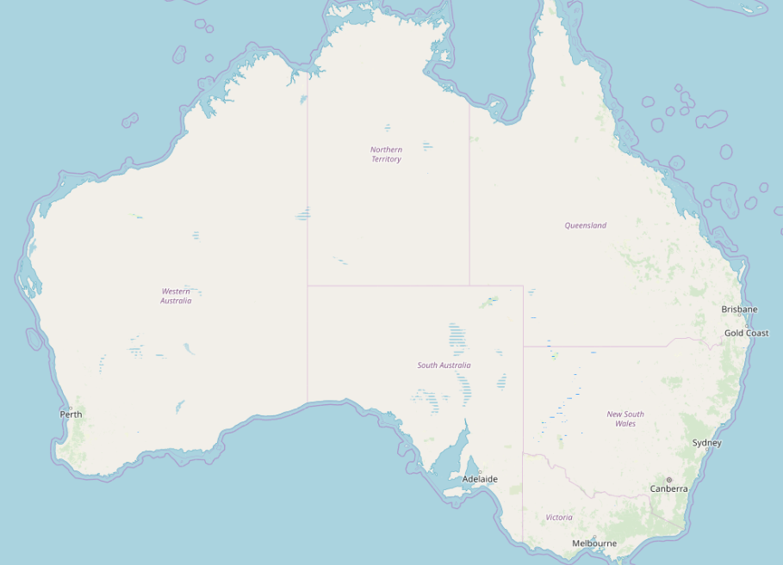
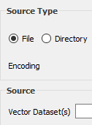
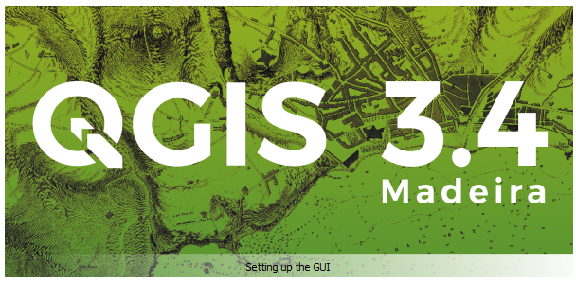
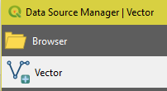
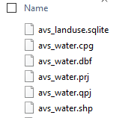
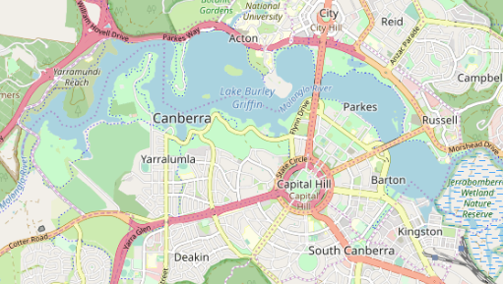
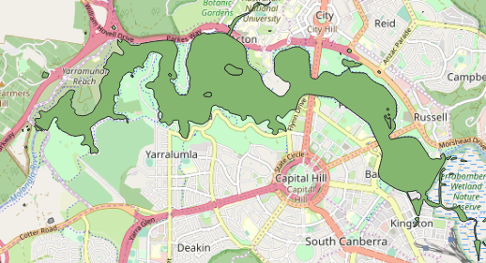
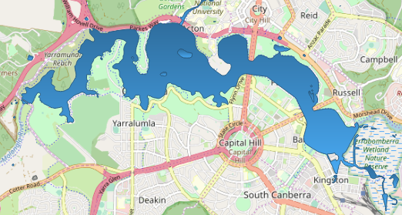

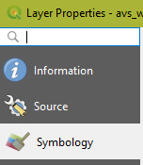
Add Layers
https://download.qgis.org/
Download QGIS for your platform. Binary packages (installers)
STEPS
Download, install and launch QGIS v 3.4 or higher.
Add a map layer. This must always be the last item in the Layers panel.
Browser | XYZ Tiles | OpenStreetMap
Zoom in to a small region (e.g. Canberra)
Add a water layer
Layer | Data Source Manager | Vector | File | Vector Datasets
Open a saved shape file (* See slide #n for saving a file)
Change layer color
Double click on the layer name (e.g. avs_water)
Symbology | Color or pick from displayed colors
Next: Scale based visibility

Slide 4
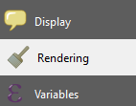
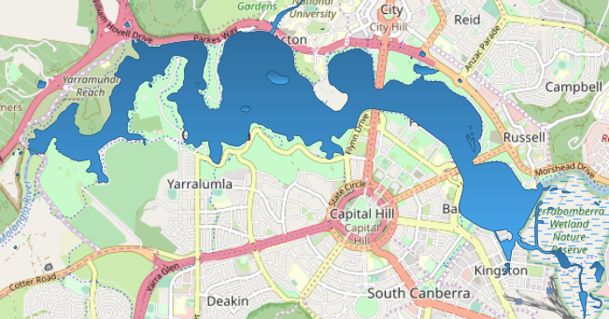
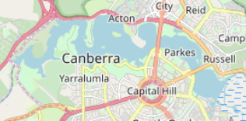


Scale-based Visibility
Sometimes you will find that a layer is not suitable for a given scale. For example, a dataset of all the continents may have low detail, and not be very accurate at street level. When that happens, you want to be able to hide the dataset at inappropriate scales. By setting a minimum scale for visibility, a layer will be masked when the zoom level is lower.
The water layer will only be visible when the zoom level is 100,000 or lower.

Slide 5


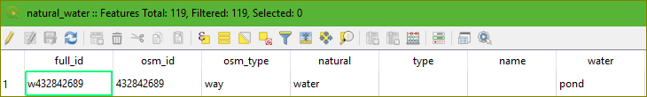
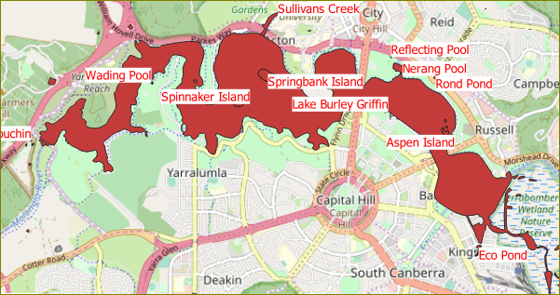
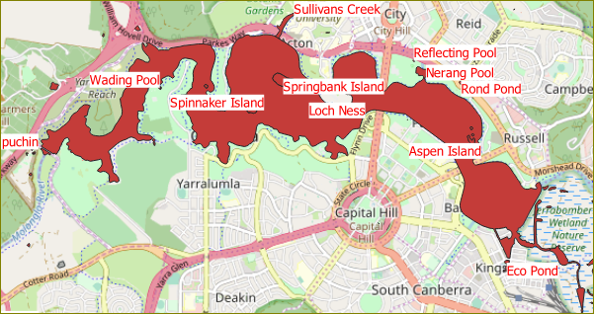
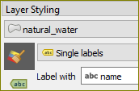

Attribute Data and Labelling
All the objects that are visible on the map also have attributes. Maps in a GIS aren’t just pictures. They represent not only objects in locations, but also information about those objects. ^{[Ref]} The attribute data has info like ID, name, type, etc. for each feature. e.g. Lake Burley Griffin. These can be added to the map for clarity and information.
STEPS
View the attributes
Select the layer
Click the ‘Open Attribute Table” or F6
Add Labels from the attributes
Select the layer
Click the “abc” icon in the Label Toolbar and again on the window
Choose ‘Single Lables”
Choose “abs Name” under “Label With”
Choose a color under “Stroke Color”
Edit labels
Bring up the attributes table as in (1)
Click the edit icon and type in the changes
Save

Slide 6






Acknowledgements

