Slide 1
Setting up Thredds Server
To setup Tomcat and Thredds server on the VM
Copyright © 2018 by National Computational Infrastructure, Canberra, ACT, Australia.
Date Month, 2018

Slide 2
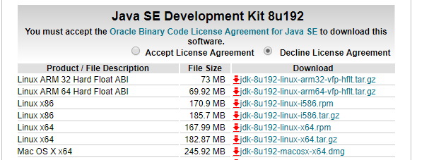
Install Java SE Development kit 8
Install Java SE Development kit 8
https://www.oracle.com/technetwork/java/javase/downloads/jdk8-downloads-2133151.html
rpm install jdk-8u192-linux-x64.rpm
Fix a bug in jdk8 so that Tomcat wil run:
cd /usr/java/latest/jre/lib/security
vi java.security
Change
117: securerandom.source=file:/dev/random
to: securerandom.source=file:/dev/./urandom

Slide 3
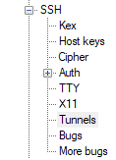
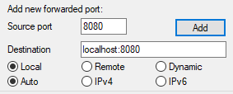




Install Tomcat
Ref: https://www.unidata.ucar.edu/software/thredds/v4.6/tds/tutorial/GettingStarted.html
Install Tomcat for THREDDS
Download current version of the Tomcat 8 servlet container.
Transfer to /usr/local/tds
Untar
cd /usr/local/tds/apache-tomcat-8.5.35/bin
Start Tomcat:
./startup.sh
Stop Tomcat:
./shutdown.sh
Setup Port forwarding: Only the port 80 is open on the VM, and that too within the NCI network. Tomcat listens on port 8080. In order to test, we need to setup a port forwarding so that a call to http://localhost:8080 will display the Tomcat browser. In order to do it, we must use an SSH session to the server where Tomcat is running.
Start Putty
Add an SSH tunnel as below.
Source port: any free port on your local PC
Destination: localhost:port
Best to use the same number for both
Click Add
Save the session as e.g. ssh_8080
Login as normal
e.g. avs900@130.56.242.15
Leave the login shell running.
Now, http://localhost:8080 will open the Tomcat browser.

Slide 4
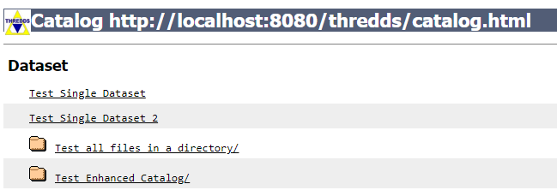
Install Thredds Server
Download the TDS WAR file from Unidata's web site.
Put ‘thredds.war’ in the Tomcat webapps directory.
/usr/local/tds/apache-tomcat-8.5.35/webapps
Start Tomcat if it is not already running.
/usr/local/tds/apache-tomcat-8.5.35/bin/startup.sh
# ps -ef | grep tomcat | grep -v grep
root 4805 1 1 09:34 pts/2 00:01:03 /usr/java/jdk1.8.0_192-amd64/bin/java -Djava.util.logging.config.file=/usr/local/tds/apache-tomcat-8.5.35/conf/logging.properties -Djava.util.logging.manager=org.apache.juli.ClassLoaderLogManager -Dtds.content.root.path=/usr/local/tds/apache-tomcat-8.5.35/content -d64 -Xmx4096m -Xms512m -server -ea -XX:+HeapDumpOnOutOfMemoryError -Djava.awt.headless=true -Djava.util.prefs.systemRoot=/usr/local/tds/apache-tomcat-8.5.35/content/thredds/javaUtilPrefs -Djava.util.prefs.userRoot=/usr/local/tds/apache-tomcat-8.5.35/content/thredds/javaUtilPrefs -Djdk.tls.ephemeralDHKeySize=2048 -Djava.protocol.handler.pkgs=org.apache.catalina.webresources -Dorg.apache.catalina.security.SecurityListener.UMASK=0027 -Dignore.endorsed.dirs= -classpath /usr/local/tds/apache-tomcat-8.5.35/bin/bootstrap.jar:/usr/local/tds/apache-tomcat-8.5.35/bin/tomcat-juli.jar -Dcatalina.base=/usr/local/tds/apache-tomcat-8.5.35 -Dcatalina.home=/usr/local/tds/apache-tomcat-8.5.35 -Djava.io.tmpdir=/usr/local/tds/apache-tomcat-8.5.35/temp org.apache.catalina.startup.Bootstrap start
Wait a few seconds for thredds.war to be unpacked by Tomcat
ls -l /usr/local/tds/apache-tomcat-8.5.35/webapps:
drwxr-x---. 8 root root 4.0K Dec 17 09:40 thredds
-rw-r--r--. 1 root root 63M Dec 17 09:40 thredds.war
Access Thredds: http://localhost:8080/thredds/catalog.html

Slide 5
GSKY to Thredds
Config file: /usr/local/tds/apache-tomcat-8.5.35/content/thredds/catalog.xml
<?xml version="1.0" encoding="UTF-8"?>
<catalog name="THREDDS Server Default Catalog : Thredds Data Server for GSKY" xmlns="http://www.unidata.ucar.edu/namespaces/thredds/InvCatalog/v1.0" xmlns:xlink="http://www.w3.org/1999/xlink" xmlns:xsi="http://www.w3.org/2001/XMLSchema-instance" xsi:schemaLocation="http://www.unidata.ucar.edu/namespaces/thredds/InvCatalog/v1.0 http://www.unidata.ucar.edu/schemas/thredds/InvCatalog.1.0.6.xsd">
<service name="all" base="" serviceType="compound">
<service name="odap" serviceType="OpenDAP" base="/thredds/dodsC/" />
<service name="http" serviceType="HTTPServer" base="/thredds/fileServer/" />
</service>
<datasetScan name="NC Files" ID="gsky" path="gsky" location="content/gsky">
<metadata inherited="true">
<serviceName>all</serviceName>
<dataType>Grid</dataType>
</metadata>
<filter>
<include wildcard="*.nc"/>
</filter>
</datasetScan>
</catalog>
Notes:
The ‘dodC’ and ‘fileserver’ are unchangeable.
Soft links to the *.nc files in ‘/g/data…’ are to be made in ‘/usr/local/tds/apache-tomcat-8.5.35/content/thredds/public/gsky’
Or, the files can be copied to that dir.
Any syntax error in the config file will crash Tomcat.
After changing the config file, Tomcat must be stopped and restarted.
/usr/local/tds/apache-tomcat-8.5.35/bin/shutdown.sh
/usr/local/tds/apache-tomcat-8.5.35/bin/startup.sh
How to work:
Create and place the catalog.xml in the right directory. e.g. /usr/local/tds/apache-tomcat-8.5.35/content/thredds/catalog.xml
Stop and restart Tomcat.
Copy the *.nc files or create soft links in the gsky directory.
Access the Thredds catalog at: http://localhost:8080/thredds/catalog.html
No need to restart Tomcat or reload the thredds catalog. The added files will be automatically picked up.

Slide 6






Acknowledgements

