Slide 1
Connecting GSKY with THREDDS
Some thoughts on creating TerriaMap-GSKY-THREDDS communication
Best viewed as a ‘slideshow’ from the top menu
Copyright © 2018 by National Computational Infrastructure, Canberra, ACT, Australia.
Prepared by: Arapaut V. Sivaprasad on 12 December, 2018

Slide 2
Background
This is the content of email from Kelsey on 5 Dec., 2018.
(Ref: Email from Kelsey on 5/12/2018: Subject: “GSKY OPeNDAP/Subsetting thoughts”)
Summary around DAP-like gsky service:
GSKY currently offers OGC options (WMS, WCS) that allow a user to view/discover data through a map request (WMS) and then also select that same data for download (WCS).
However, there is a gap that (currently) neither our GSKY or THREDDS server can meet in terms of data access options:
GSKY is great for discovering and downloading predefined products and does the complex/time-consuming spatial aggregation behind the scenes. But it is lacking in terms of allowing more flexible queries to the lower-level data contained in the dataset (such as they would from working with it direct on the filesystem or through our THREDDS server). Accessing the netcdf or tiff contents means a user has more options, can compute their own composites, etc.
THREDDS is basically the opposite case. It allows a user to access the contents but only in a file based manner but lacks the complex aggregation GSKY offers. (Though it should be noted it does do aggregation across time fairly well in most cases but terrible with spatial aggregations, can't do it in the way needed.)
GSKY could potentially fill this gap by offering a DAP-like service to an endpoint that acts like the aggregated "file" for the dataset. Similar to how our THREDDS aggregated endpoints work. E.g., http://dapds00.nci.org.au/thredds/catalogs/rr9/collection/dataset/ANUClimate_v1-0_rainfall_daily_0-01deg_1970-2014.html?dataset=ANUClimate_v1-0_rainfall_daily_0-01deg_1970-2014_agg
For example, with a DAP endpoint a user can access contents of this aggregated "file" remotely from many tools just as though they were working direct on the filesystem. You feed the endpoint into tools in the exact manner as you were inputing a file path.
Here's a very simple example of using DAP from a python notebook: https://nbviewer.jupyter.org/github/nci/Data-Training/blob/master/NCI_Autumn_Training/05_Python_Data_Examples_I/Python_DataAccessBasics.ipynb
For a collection like DEA, this could be really useful because it would allow users to work more natively with the actual band data vs having to use the predefined composites. It's a super easy way to subset/extract data compared with WCS. No special query needed or "middleman" tool needed to construct the query to then call it like you need to do with WCS.
THREDDS also offers another service very similar to DAP- the Netcdf Subset Service (NCSS). NCSS starts to look more similar to a WCS request as it allows for the query to be in lat/lon/time units vs index-based ones. I think it's a bit more flexible than WCS personally, probably because it's not part of a standardised body like OGC.
To see the format of DAP and NCSS requests, follow these notebooks to make a request through the webpage form. It'll then display what the format looks like:
Basic DAP request thru webpage interface: https://nbviewer.jupyter.org/github/nci/Data-Training/blob/master/NCI_Autumn_Training/01_Data_Services/THREDDS_OPeNDAP.ipynb
Basic NCSS request thru webpage interface: https://nbviewer.jupyter.org/github/nci/Data-Training/blob/master/NCI_Autumn_Training/01_Data_Services/NetcdfSubset_Examples.ipynb
Lastly, possible pro of following the DAP protocol standard is that it would work across heaps of netcdf-based tools/packages. Depending on goals/aims of gsky this could be beneficial. Would certainly set ourselves up well for tackling climate-based data collections. (And I'm sure there are cons that we'll think of too but will leave it to this for now! ;))
Some additional Python versions of these services:
https://nbviewer.jupyter.org/github/nci/Data-Training/blob/master/NCI_Autumn_Training/05_Python_Data_Examples_I/Python_Siphon_I.ipynb
https://nbviewer.jupyter.org/github/nci/Data-Training/blob/master/NCI_Autumn_Training/05_Python_Data_Examples_I/Python_NetcdfSubset_Examples.ipynb

Slide 3
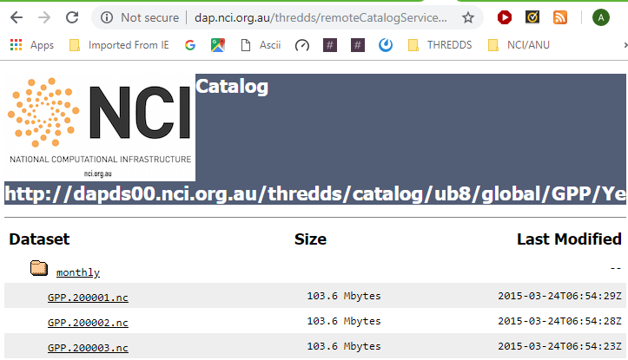
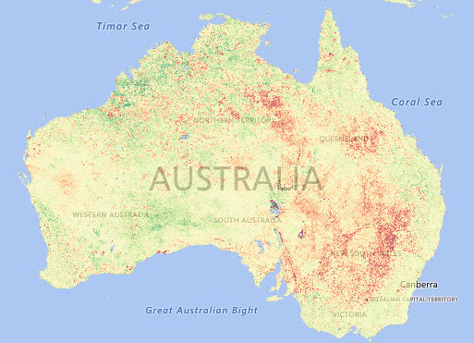
Objective
High level objective
From the very preliminary discussions with Ben and Kelsey, I understand that there is a need to provide data files through THREDDS in a way that combines the power of GSKY. Instead of just showing the aggregate tiles on screen, it would be useful if the component files in the aggregation could be downloaded via THREDDS as in the picture below.
DISCLAIMER
My understanding about the objective is very patchy, and the solution I propose could be way off target. If I am right, however, there appears to be very little work to achieve it. I have documented the GSKY service and the GSKY/TerriaMap conversation after studying the codes for both. It appears that minimal changes in TerriaJS and GSKY codes will enable us to get the list of files that go into the aggregate map. TerriaJS is open source, but perhaps TerriaMap is copyrighted. I have played with TerriaJS and believe that after sorting out some server issues it can be installed locally and then be able to change the code to suit. This, however, has not been tested. I am reasonably confident to change the GSKY code. My current knowledge about Thredds is minimal too and, hence, there may be logical errors in the proposal.
Action Plan
Create aggregates through GSKY/TerriaMap
Create a list of the component NetCDF files from such display.
Auto-generate the THREDDS catalog.
Open a new window to display it.

Slide 4
Plan of action
View GSKY_User_Guide.ppsx or GSKY_Developer_Guide.ppsx to run GSKY/TerriaMap to display something like below.
How GSKY works now
Process flow
Let us say, we want the files that make up the square area in the map on right.
When drawing the square, with “Shift-mouse drag”, several calls go to the GSKY server.
http://130.56.242.15/ows/geoglam?time=2... &service=WMS&request=GetMap&layers=g…&bbox=15…
http://130.56.242.15/ows/geoglam?time=2... &service=WMS&request=GetMap&layers=g…&bbox=15…
http://130.56.242.15/ows/geoglam?time=2... &service=WMS&request=GetMap&layers=g…&bbox=15…
Each call aggregates the data from several source (*.nc) files and sends as a PNG image.
By modifying the GSKY code, we can get the list of files gathered by each call.
How to connect GSKY with Thredds
Plan outline
Change the request=xxx in TerriaMap from ‘GetMap’ to ‘GetThredds’
http://130.56.242.15/ows/geoglam?time=2... &service=WMS&request=GetThredds&layers=&bbox=15…
Implement “case GetThredds” in “func serveWMS” in GSKY (ows.go)
Perhaps it must be added under “func serveWCS”, but I am not yet sure how it works from the web data.
Change or add the following call (example) to the MAS server:
http://10.0.1.210:8888/g/data2/tc43/modis-fc/v310/tiles/monthly/anomalies?intersects&metadata=gdal&time... &wkt=POLYGON&namespace=…
Parse the return JSON object to get the array, “files”.
Create a Thredds catalog using the file list and save it for external access.
Send it as a URL to TerriaMap for display as a link or show its output overlaid on the map.
It should display, as shown on the right, the links to download the *.nc files.
See next slides for thoughts on coding.

Slide 5
Technical Challenges
It doesn’t look like there are too many hurdles, but some learning curve is involved.
Compiling and installing Terria webserver on the Tenjin VM.
Already know how to compile and install TerriaJS.
Not yet sure how to access Terria from a web browser on the VM.
Successfully built it on my personal server (well, with errors!): http://www.webgenie.com/TerriaMap/
Changing the code in Terria
In TerriaJS-specs.js:
58026: function UrlTemplateImageryProvider(options){
57999: url : 'this.url?tiled=true&…&service=WMS&version=1.1.1&request=GetMap&
Still to work out how it handles the returned data.
Changing the code in GSKY
In ows.go: case "GetMap": geoReq := &proc.GeoTileRequest{ case res := <-tp.Process(geoReq, *verbose): out, err := utils.EncodePNG(norm, styleLayer.Palette)
Still to work out:
Get the raw data as a JSON.
Store the Thredds catalog.
Where is the Thredds server? If not on VM, how to upload the catalog?
Or, build a Thredds server on the VM ?
Display it as a link on Terria.
Display the return data from Thredds in a new window.
Distinguish a WMS service from the Thredds service.
Perhaps use the same method as in WCS, but work it out for web data url.
Or, use the WMS request to do both the display and Thredds.
Any copyright issue(s) with modifying Terria or TerriaMap?
New (proposed) name: TerriaGSKY or TerriaNCI ?

Slide 6
Prototyping
A quick way to try it out without modifications to Terria…
Keep everything the same as of now.
Change the ows.go and its packages alone.
Use the ‘request=GetMap’ call from TerriaMap.
It will send the map data as of now, plus process the results for Thredds.
Parse the results returned from the MAS server to get a file-list.
Create the Thredds catalog and save it somewhere.
Test it manually.
Pre-requisites
Thredds server on the VM.
Benefits
Quick and easy.
Can work out bugs and pitfalls.
No interference with third party software (Terria).
Next steps
Install Terria on the VM.
Modify Terria code to just add a link to view the Thredds catalog.
It can be like the ‘Export’ link, but using a Thredds URL.
It should take only minimal changes (I hope) in Terria.
Work out a way to push the catalog to the NCI Thredds server.
Must also be able to delete the catalog after the user session ends.

Slide 7
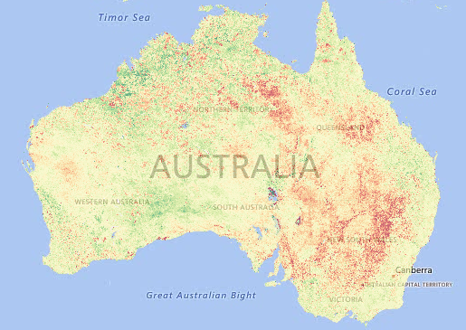

Outcome
If on the right track with expectations, below is how it should go.
Time estimates (if plan is approved)
5 working days for the prototype.
10 more days to the deployment of v1.0.0
Load a layer and get to this display
Draw a square (Shift-drag)
Pass the ‘request=GetThredds’ to GSKY by Terria
http://130.56.242.15/ows/geoglam?time=2... &service=WMS&request=GetThredds&layers=&bbox=15…
Get the list of files
"files": [
"/g/data2/tc43/modis-fc/v310/tiles/monthly/anomalies/FC_Mean_Diff.v310.MCD43A4.h31v10.2018.006.nc",
"/g/data2/tc43/modis-fc/v310/tiles/monthly/anomalies/FC_Mean_Diff.v310.MCD43A4.h31v11.2018.006.nc", ]
Create a Thredds catalog, with multiple datasets, and save as ‘sessionID.xml’
<?xml version="1.0" ?>
<catalog xmlns="http://dap.nci.org.au/namespaces/thredds/InvCatalog/v1.0" >
<service name="odap" serviceType="OpenDAP" base="/geoglam/user/" />
<dataset name="GEOGLAM Anomaly Fractional Cover C6" serviceName="odap"
urlPath=“/tc43/modis-fc/v310/tiles/monthly/anomalies/FC_Mean_Diff.v310.MCD43A4.h31v10.2018.006.nc" ID=“20181212.nc"/>
</catalog>
Construct a URL
http://dap.nci.org.au/thredds/remoteCatalogService?catalog=http://dapds00.nci.org.au/thredds/catalogs/gsky/sessionID.xml
Send the URL back to Terria
Thredds
User clicks a link to see the NCI Thredds catalog
Delete the catalog when the user session ends

Slide 8






Acknowledgements

