Slide 1
GSKY Demos
Jupyter notebook demos
Created on 18 Oct, 2019 by Arapaut V. Sivaprasad, NCI.
Notes:
Notes regarding NCI’s PP template for 2019 (remove these before presenting). If in doubt, contact the comms team.
Maintain design, colours etc throughout. The headline font is Titillium and the body copy font is Roboto.
Use the wide variety of slide templates that are available in this file. There are many to choose from with different layouts provided.
Use high-resolution photos or images wherever possible. Blurry images look even worse when blown up on a projector.
Have ONE main idea per slide. There’s nothing wrong with using multiple slides to explain something more complicated.
Too much text in your slides works against you and your presentation. Speak to the slide, not from the slide.
The notes section on PowerPoint is where all the spoken detail should go, with the minimum amount of information on the slide itself to support your notes.

Slide 2
introduction
There are several demo notebooks by DEA to illustrate the data retrieval and display. They all use the datacube to get the data which is then manipulated by various functions written by DEA. These functions are probably available in public Git repos.
We intend to convert the datacube-driven notebooks into GSKY-driven.
This document is a collection of steps involved in setting up and running Notebooks on local PC (Windows and Mac) and under VDI.

Slide 3
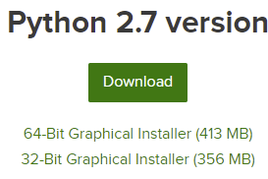

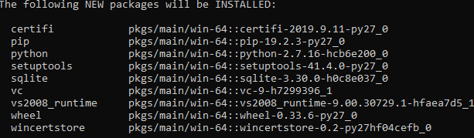

Install anaconda
Download Anaconda for Windows or Mac: https://www.anaconda.com/distribution/#download-section
Choose the Python 2.7 version and install as per the usual prompts.
Setup the environments (Note: Only the Windows’ steps are described here. Must add Mac steps)
Start | Anaconda:
Setup an environment:
conda create --name gsky python=3.7
conda activate gsky | conda deactivate

Slide 4
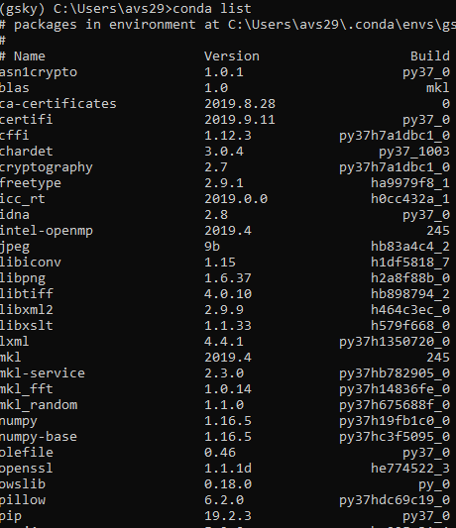
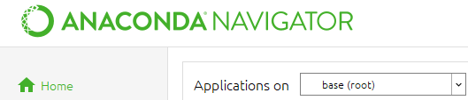


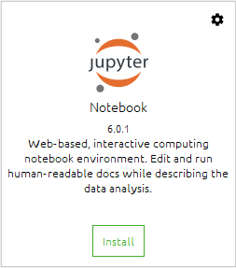

Install anaconda
Install packages
conda install OWSlib
conda install matplotlib
conda list
Start | Anaconda Navigator
Select the environment
Applications | gsky
For once:
Install Jupyter Notebook
Launch Jupyter Notebook
Click any *.ipynb file to edit
Located in: c:\users\avs29\gsky-demos

Slide 5


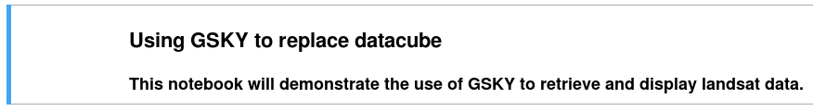
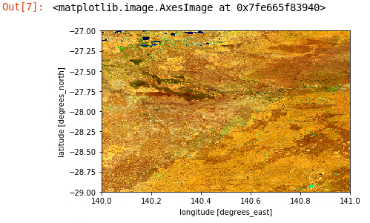
Run the notebooks on local pc
See slides 2-3 to install and configure Anaconda
This slide explains the specific use of the example notebooks
Install these packages
conda install OWSlib
conda install matplotlib
conda install netCDF4
conda install scipy
conda install xarray
Launch ‘Anaconda Navigator | Jupyter Notebook’
Open
gsky-demos/DEA_to_GSKY_Example_1.ipynb
gsky-demos/DEA_to_GSKY_Example_2.ipynb
gsky-demos/DEA_to_GSKY_Example_3.ipynb
Press Shift-Return on each cell.

Slide 6
Run the notebooks under vdi
Load the following modules. Maybe included in your ~/.bashrc
module use /g/data/v10/public/modules/modulefiles
module load dea
Transfer these files to the home dir on VDI (not to Raijin).
gsky-demos/DEA_to_GSKY_Example_1.ipynb
gsky-demos/DEA_to_GSKY_Example_2.ipynb
gsky-demos/DEA_to_GSKY_Example_3.ipynb
gsky-demos/Scripts
Run:
jupyter notebook&
Open:
gsky-demos/DEA_to_GSKY_Example_1.ipynb
gsky-demos/DEA_to_GSKY_Example_2.ipynb
gsky-demos/DEA_to_GSKY_Example_3.ipynb
Press Shift-Return on each cell.

