Slide 1

Capstone Project:
Analytical CRM Development for a Bank
Reducing Churn and Enhancing Customer Satisfaction
Asiya Shaikh

Slide 2

Agenda
Introduction to CRM
Problem Statement
Data Overview
Project Goals
Methodology
Analytical Approach
Key Insights & Findings
Dashboards
Conclusion & Recommendations
Reference

Slide 3
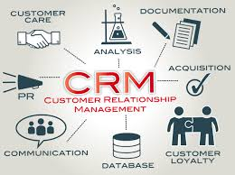
Introduction to CRM
Customer Relationship Management (CRM) refers to strategies and tools used to manage and analyze customer interactions.In banking, CRM plays a crucial role in improving service delivery, enhancing satisfaction, and reducing customer churn.Analytical CRM focuses on extracting insights from customer data to support strategic decisions.
This project develops an Analytical CRM system using SQL for data preparation and Power BI for dashboard creation.The goal is to help the bank understand customer behavior, predict churn, and improve retention.Datasets include customer demographics, transactions, churn history, and active profiles.

Slide 4

Problem Statement
You are an analytical CRM (Customer Relationship Management) specialist hired by a bank to extract meaningful insights from various customer- related datasets. The bank aims to reduce customer churn, improve service delivery, and enhance customer satisfaction. They have provided you with datasets including customer demographics, transaction details, customer exit information, and active customer profiles.

Slide 5

Data Overview
CustomerId: Unique identifier for each customer. CreditScore: Numerical value of customer's creditworthiness.
Excellent: 800–850
Very Good: 740–799
Good: 670–739
Fair: 580–669
Poor: 300–579
GeographyID: Numeric code representing the customer's region or country.
GenderID: Categorical ID for gender (e.g., 1 = Male, 2 = Female).
Age: Age of the customer.
Tenure: Number of years the customer has been with the bank.
Balance: Current account balance of the customer.
NumOfProducts: Total number of bank products used by the customer.

Slide 6

Data Overview(Cont…)
HasCrCard: Credit card ownership status.
1 = Has Credit Card
0 = Does Not
IsActiveMember: Activeness status based on usage.
1 = Active
0 = Inactive
EstimatedSalary: Customer’s estimated annual income.
Exited: Indicates churn status.
0 = Retained
1 = Exited
Bank DOJ: Date the customer joined the bank.

Slide 7

Project Goals
To analyze customer behavior and identify patterns that influence customer churn and retention. To develop a data-driven CRM dashboard using Power BI for visual storytelling and insight extraction. To help the bank reduce churn, enhance customer satisfaction, and optimize engagement strategies. To segment customers based on demographics, credit behavior, and activity for personalized services. To provide actionable insights for improving decision-making in marketing, service delivery, and risk management.

Slide 8

Methodology
Analyzed the problem statement and cleaned the data. Used SQL for data preparation and analysis (SELECT, JOIN, GROUP BY, ORDER BY, window functions, UPDATE, etc.). Performed data modeling and created measures using DAX in Power BI. Designed interactive dashboards using charts, slicers, and conditional formatting. Fixed data issues, such as correcting the IsActiveMember column using a calculated column with IF logic.

Slide 9
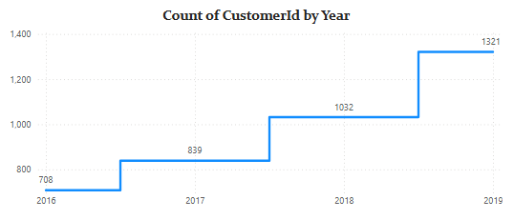
Customer Acquisition Over the Years
Customer count rose from 708 in 2016 to 1,321 in 2019, showing consistent year-on-year growth.There was a notable spike between 2018 and 2019, with 289 new customers added.This upward trend indicates successful customer acquisition strategies during this period.The growth suggests increasing trust and engagement with the bank’s services.Such trends could be influenced by improved digital banking, offers, or customer service.Monitoring these strategies could help replicate this success in future years.It is important to analyze acquisition costs and retention rate alongside this growth.

Slide 10
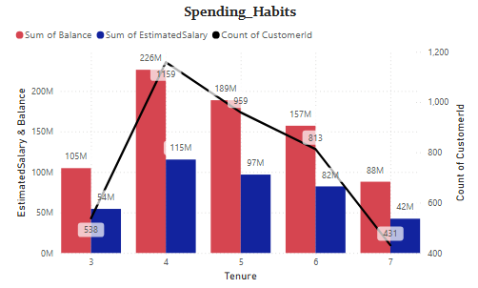
Customer Behavior Analysis (Spending Habits by Tenure)
Customers with 3 to 5 years of tenure show the highest spending capacity, with peak balances and estimated salaries. The highest balance (226M) is observed at tenure 4, alongside the highest customer count (1,159).
After tenure 5, both customer count and spending decline steadily.
This indicates mid-tenure customers (3–5 years) are more financially engaged.
Recommendation: Focus retention strategies and personalized offers on mid-tenure customers to maximize value and reduce churn.

Slide 11
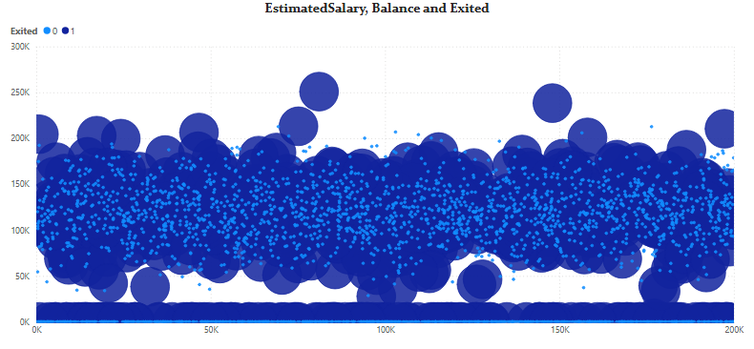
Balance vs Salary (Exit Analysis)
There is no clear correlation between estimated salary and balance.
Customers who exited (larger dots) are scattered across all salary and balance ranges.
This indicates that salary alone is not a strong predictor of churn.
Some high-balance customers also exited, signaling a potential service or engagement issue.
Recommendation: Focus on enhancing engagement and satisfaction across all income levels rather than segmenting purely by salary.

Slide 12
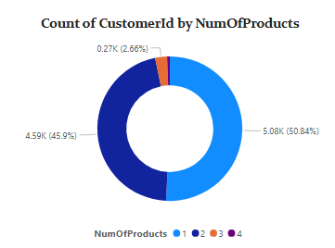
Customer Segmentation by Number of Products
The chart shows that a majority of customers (over 96%) have either 1 or 2 products with the bank:
50.84% have 2 products
45.9% have 1 product
Very few customers (less than 4%) hold 3 or more products
This indicates an opportunity to promote additional products to customers with only 1 or 2 products, enhancing both product penetration and customer value.

Slide 13
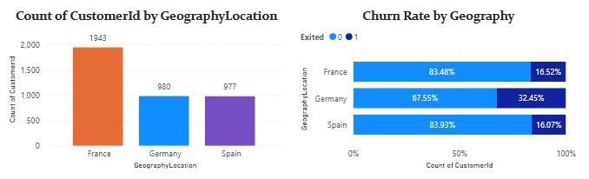
Geographic Marketing Trends & Churn Insights
France has the highest number of customers (1,943), followed by Germany and Spain.However, Germany shows the highest churn rate (32.45%), which is nearly double that of France and Spain.Despite a lower customer base, Spain and France maintain stronger retention (churn rates around 16%).
Insight: Germany poses a high churn risk and requires targeted retention strategies, while France and Spain show more stable customer bases and can be leveraged for cross-selling or upselling opportunities.

Slide 14
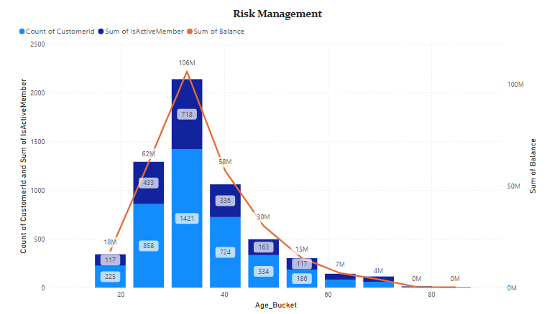
Risk Management by Age Bucket
Customers aged 20–40 hold the highest balances (peaking at 106M) and make up the largest segment of the customer base.
A significant portion of customers in this age group are inactive, indicating higher financial risk due to disengagement.
Balance and customer count decline sharply after age 40, reducing potential risk in older age groups.
Age group 30–40 stands out with both high balance and high inactivity, warranting targeted retention strategies.

Slide 15
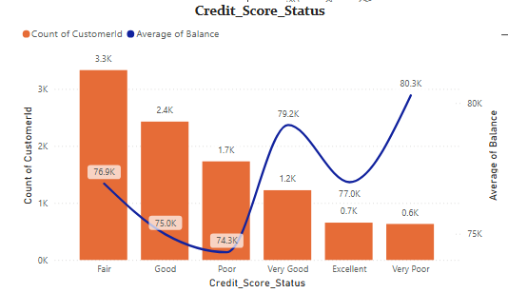
Customer Segmentation by Credit Score
The chart categorizes customers into six credit score segments: Very Poor, Poor, Fair, Good, Very Good, and Excellent.
Most customers fall within the Fair and Good credit score ranges, indicating a balanced risk profile for the bank.
Interestingly, Very Poor and Poor segments maintain competitive average balances and estimated salaries, challenging traditional assumptions about creditworthiness.
The Excellent and Very Good credit groups show slightly higher salaries but not drastically different balances.

Slide 16
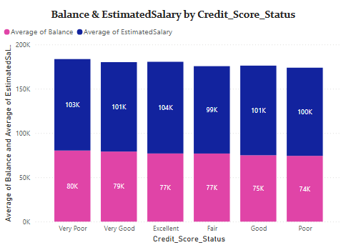
Financial Profile by Credit Score Status
Customers across all credit score categories maintain a consistent estimated salary (~100K), with the “Very Poor” category slightly higher at 103K.
The average balance remains fairly stable across segments, ranging from 74K (Poor) to 80K (Very Poor).
Interestingly, customers with lower credit scores do not necessarily have lower balances, suggesting that credit score alone isn’t a strong predictor of financial value.

Slide 17
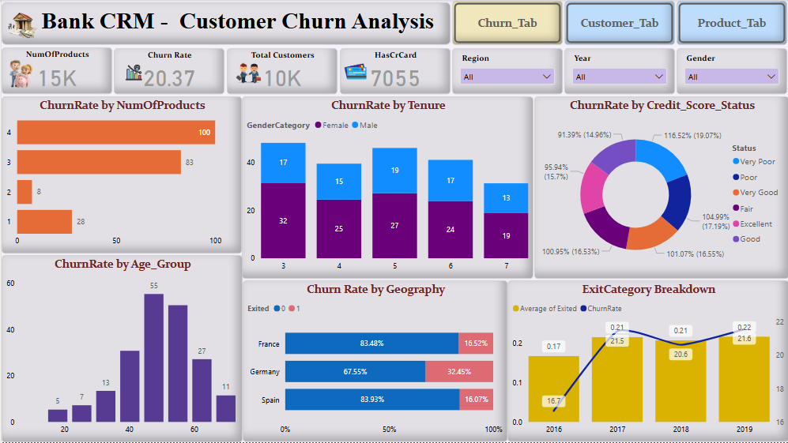
Customer Churn Analysis Dashboard(1)

Slide 18
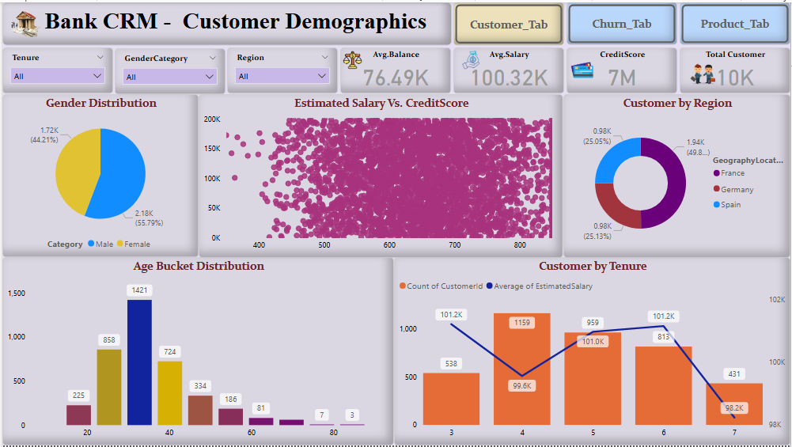
Customer Demographics Dashboard(2)

Slide 19
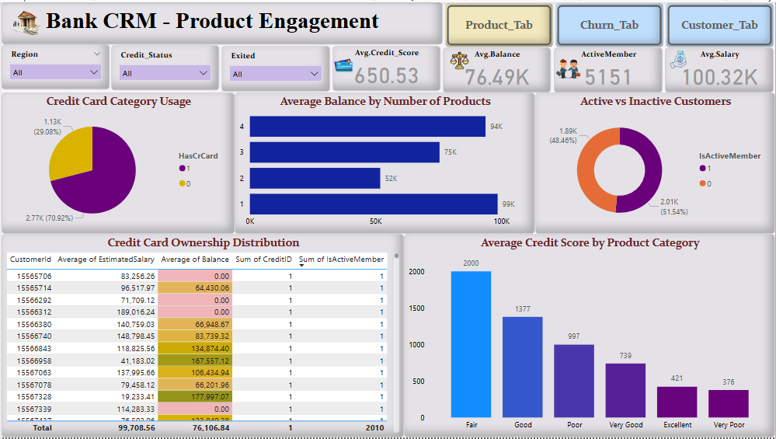
Product Engagement Dashboard(3)

Slide 20
Conclusion & Recommendations
Key Findings:
Higher churn observed in Germany, among inactive customers, and those with 0–5 years of tenure.
Most customers belong to the Fair and Good credit score segments, but balance doesn’t always align with credit score.
Young customers with high balances pose both opportunity and churn risk.
Recommendations:
Implement targeted retention strategies for high-risk segments (e.g., young, inactive, German customers).
Promote product bundling and reward programs to increase customer engagement.
Continuously monitor churn trends and refine marketing efforts by geography and credit segment.

Slide 21

References & Tools Used
Data Source: ➤ Dataset provided by Newton School
Applications Used: ➤ MySQL – For data querying and analysis ➤ Power BI – For visualization and dashboard creation ➤ MS Word – For documentation ➤ MS PowerPoint – For presentation building

Slide 22


