Slide 1

CIS 476 Term Project
Asiyah Shoeb

Slide 2
High-Level Architecture
FRONTEND LAYER
HTML, JavaScript, CSS
index.html, login.html, dashboard.html, app.js, styles.css
REST CONTROLLER LAYER
BaseController, AuthController, CarController, BookingController PaymentController, UserController, MessageController
SERVICE / BUSINESS LAYER
UserService, NotificationService, PaymentService (Design Patterns)
REPOSITORY LAYER
Spring Data JPA interfaces
UserRepository, CarRepository, BookingRepository MessageRepository, WatchlistRepository
DATA LAYER
database tables mapped to JPA entity classes
User, Car, Booking, Message, Watchlist

Slide 3
SOFTWARE
DESIGN
PATTERNS

Slide 4
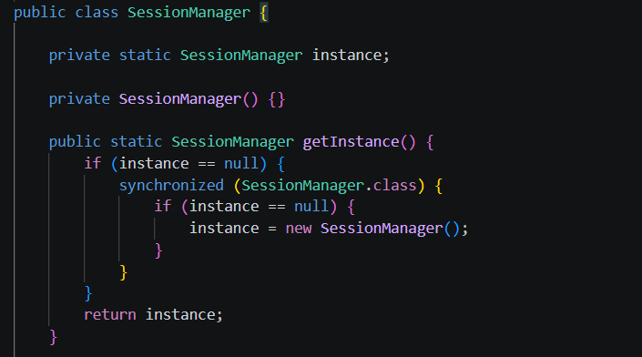
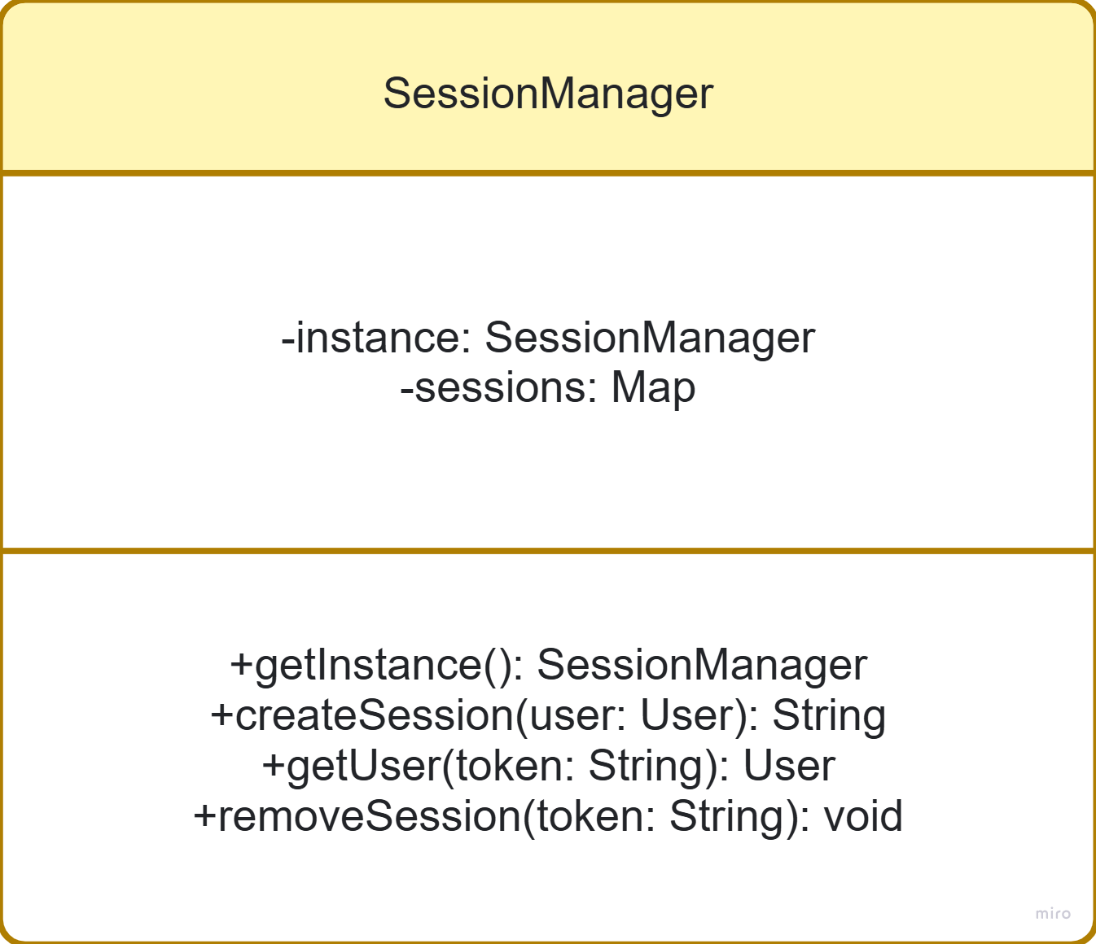
Singleton Pattern

Slide 5

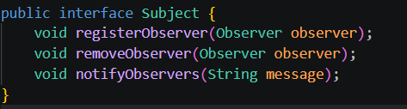
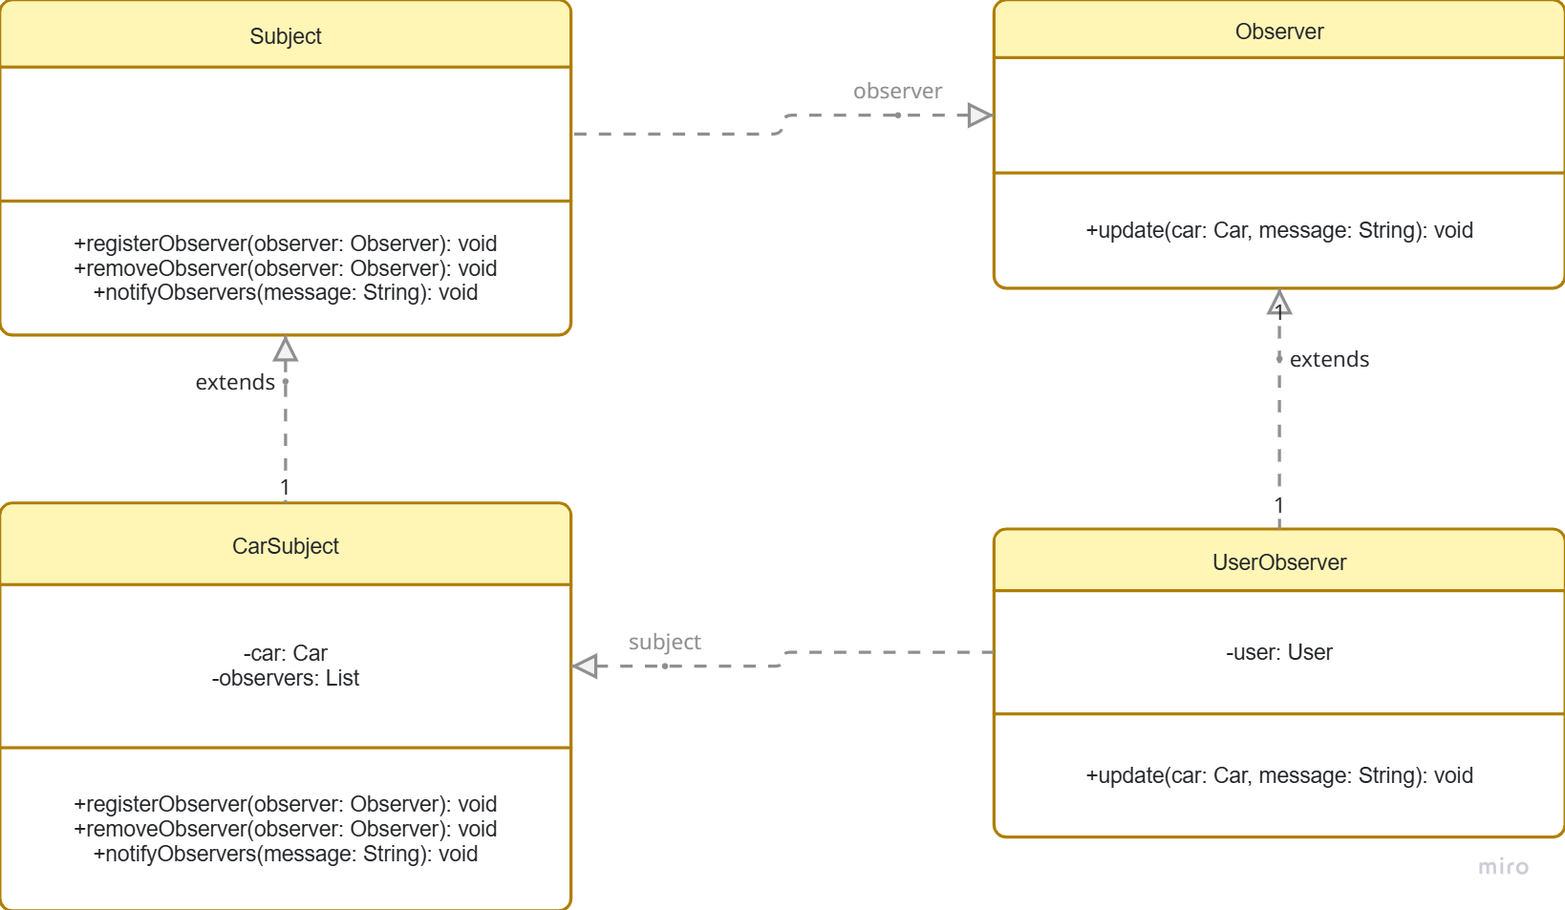
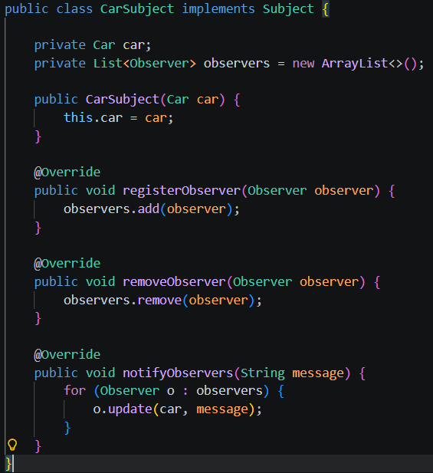
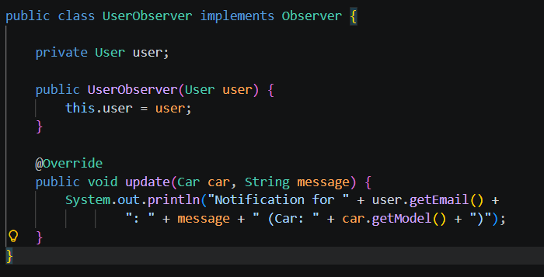
Observer Pattern

Slide 6
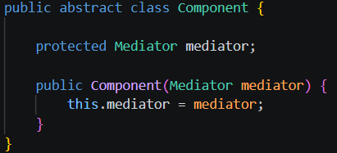
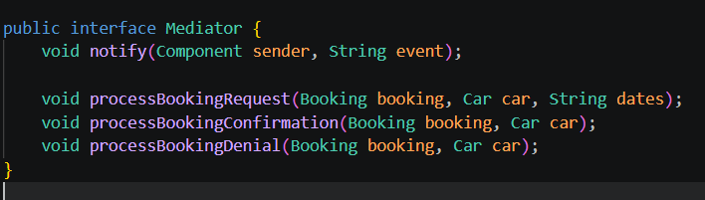
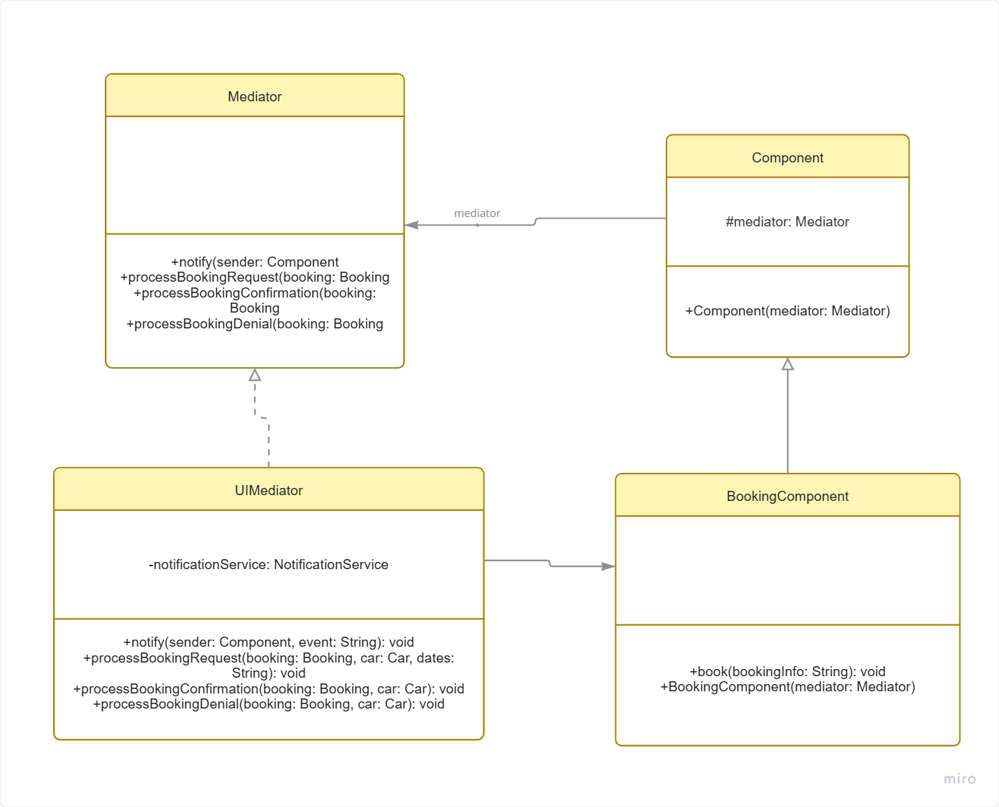
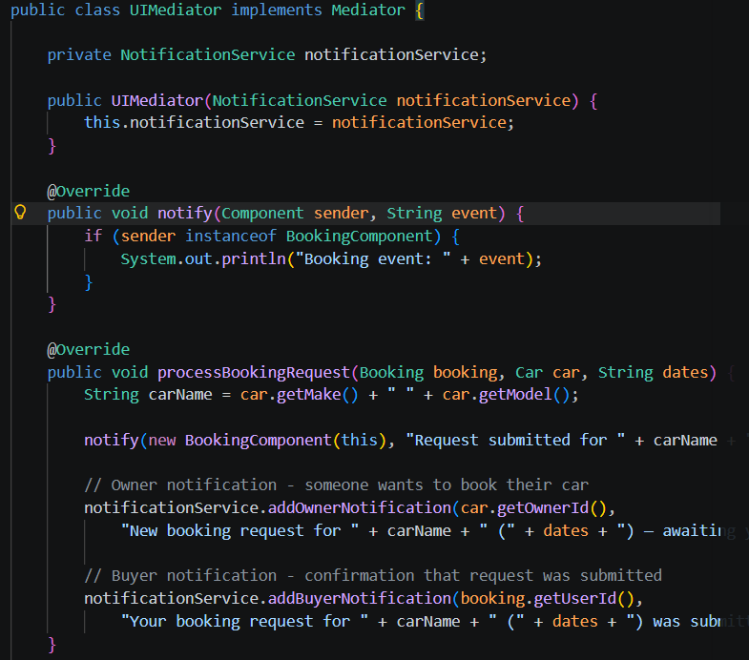
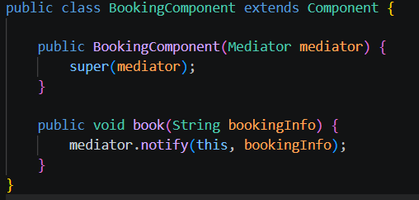
Mediator Pattern

Slide 7
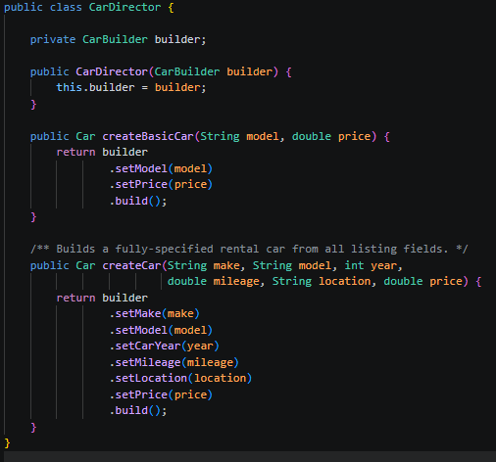
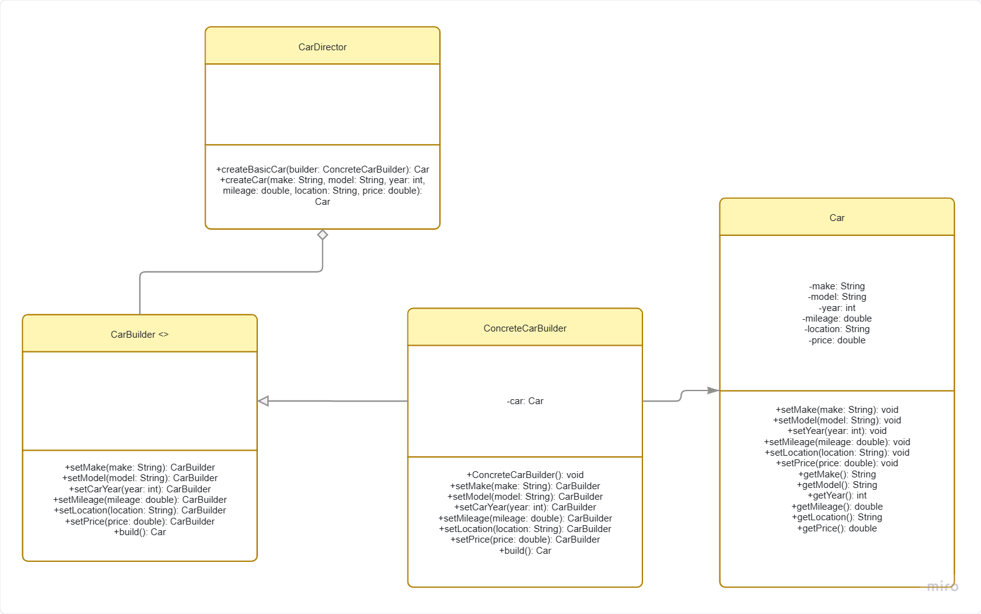
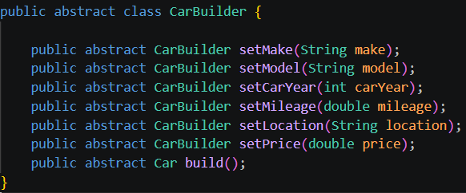
Builder Pattern

Slide 8
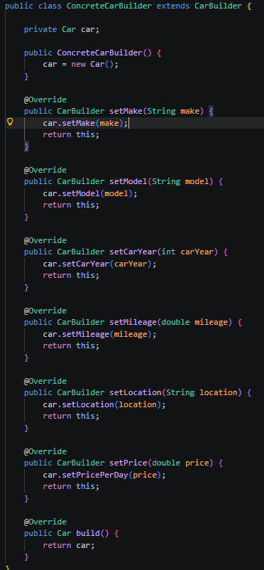
Builder Pattern

Slide 9
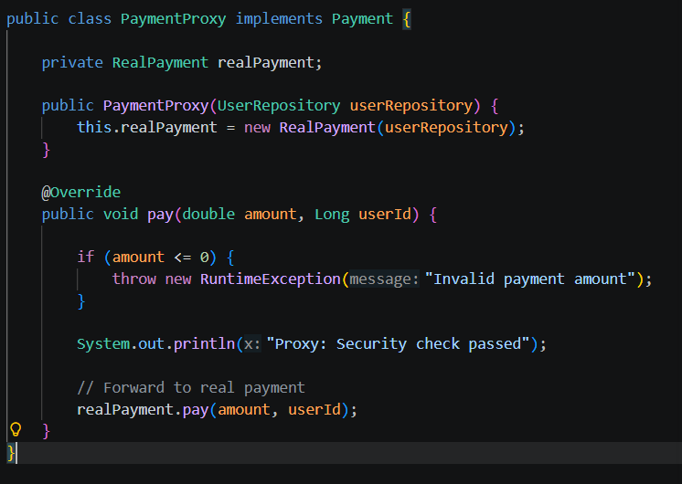

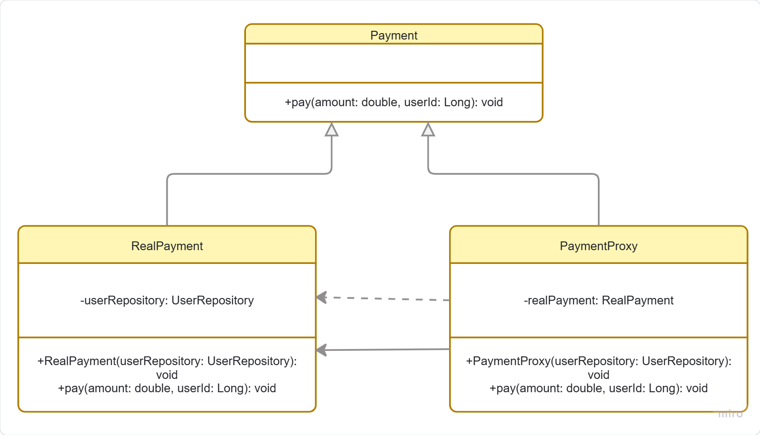
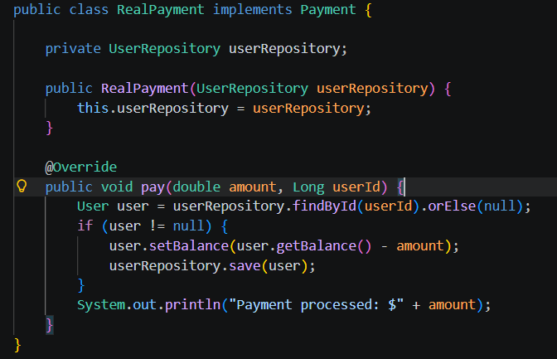
Proxy Pattern

Slide 10
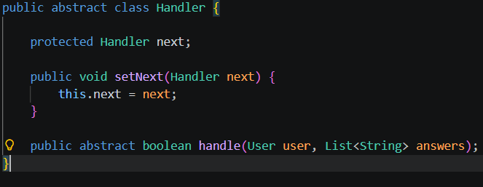
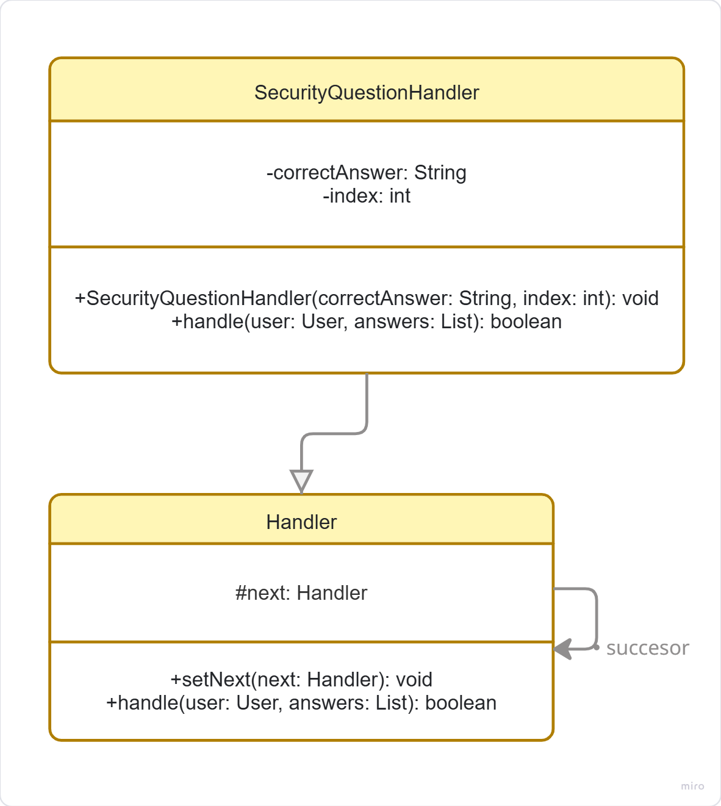
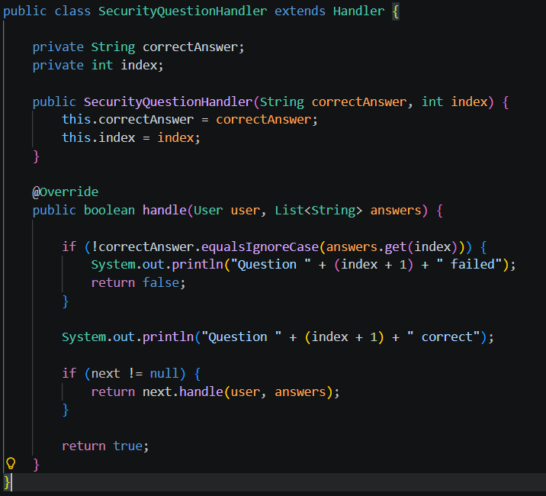
Chain of Responsibility Pattern

Slide 11
Thank You!

