Slide 1
DATABEL TELECOM LTD
Customer Churn
Analysis
Strategic insights & retention recommendations for Product & Commercial teams
Prepared by: Asiya Nizam | Data Source: DataCamp — Databel Dataset | Tools: Power BI · Power Query · DAX · MS Excel

Slide 2
What We'll Cover Today
01
02
03
Business Context
Key Findings
Deep Dive Analysis
Why churn matters & project scope
Top churn drivers across all segments
Competition, Demographics, plans, payments & service calls
04
05
Recommendations
Next Steps
11 actionable strategies for retention
Owners, timeline & expected impact

Slide 3
SECTION 01
Business Context
Understanding why churn matters in the telecom industry

Slide 4
The Business Problem
📉
Revenue Erosion
💸
High Acquisition Cost
Every churned customer represents immediate lost recurring revenue and the cost of replacement acquisition.
Acquiring a new customer costs 5–7× more than retaining an existing one, making churn disproportionately expensive.
📣
Brand & Loyalty Risk
🏆
Competitive Pressure
Churned customers often cite poor experience — damaging brand reputation and reducing referral potential.
Telecoms face fierce competition. Any gap in value — pricing, devices, data — gives rivals an opening to poach customers.

Slide 5
The Objective
01
🔍 Analyse Churn Patterns
02
⚠️ Identify High-Risk Segments
Examine churn behaviour across 6,687 customers spanning demographics, contracts, plans, and service usage.
Pinpoint the specific customer groups, behaviours, and characteristics most strongly associated with churn.
03
📊 Evaluate Plans & Contracts
04
✅ Deliver Actionable Recommendations
Assess the impact of contract types, payment methods, international plans, and add-on services on retention.
Translate findings into concrete, prioritised strategies that the Product & Commercial teams can act on.
Audience: Product & Commercial Strategy Teams

Slide 6
SECTION 02
Key Findings
Top churn drivers identified across all customer segments

Slide 7
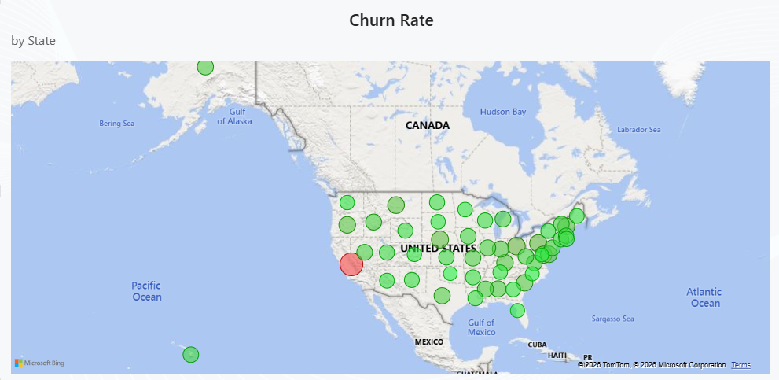
At a Glance — Key Metrics
6,687
1,796
26.86%
63.24%
Total Customers
Churned Customers
Overall Churn Rate
CA Churn Rate
Dataset scope
Lost customers
Industry avg ~20%
Highest state

Slide 8
SECTION 03
Deep-Dive Analysis
Competition, Demographics, contracts, payments, plans & service calls

Slide 9
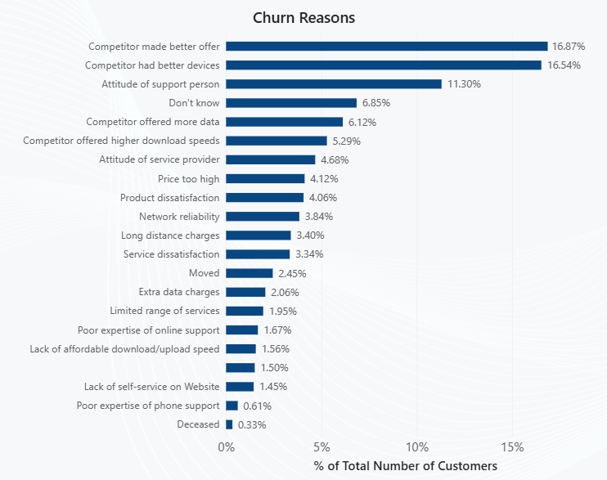
Why Are Customers Leaving?
~45%
churned due to
competitor reasons
11.30%
due to poor attitude
of support staff
Implication
Pricing & device upgrades are the fastest wins to stop competitor-driven churn.

Slide 10
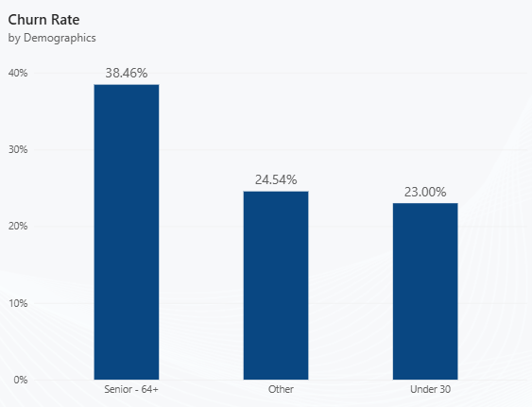
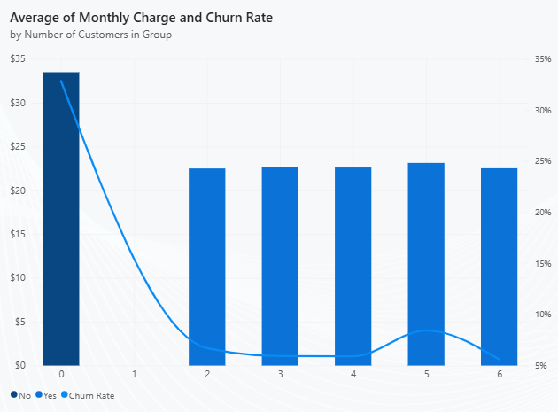
Demographics & Group Plans
Key Insight: Senior customers churn at 38.46% — 12pp above average. Customers outside group plans churn at 32.85%. Both segments need targeted retention strategies.

Slide 11
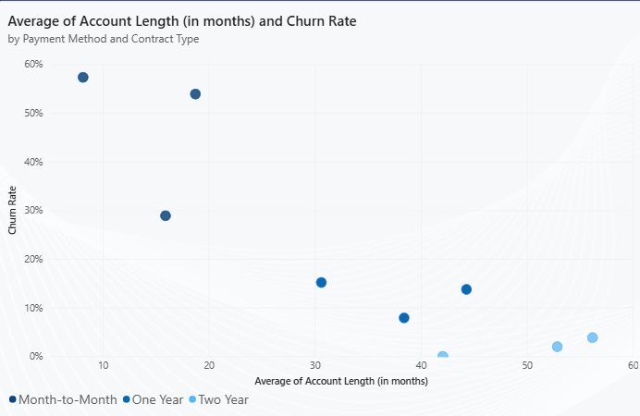
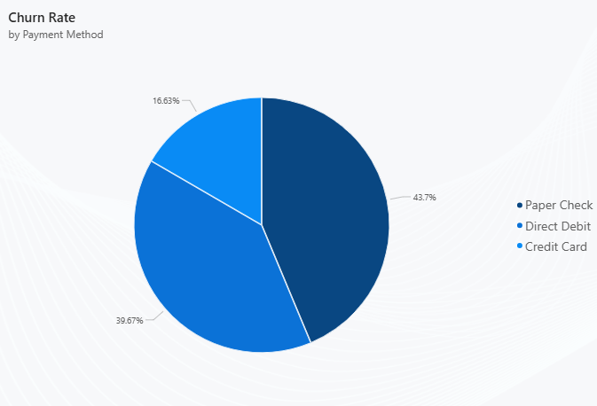
Payments & Contracts
Monthly contract customers have a churn rate of 46.29% and also have the lowest average account length.
Direct debit users churn at just 16.63% — paper check users at 43.70%. Payment method is a key loyalty signal.

Slide 12
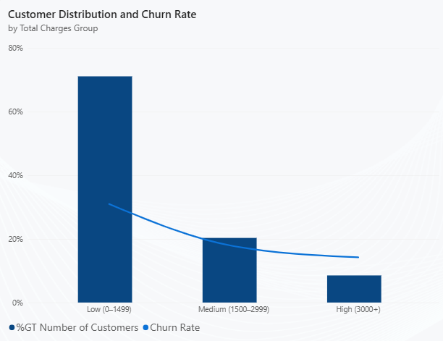
International Plans & Charges
Churn Rate - Intl Active vs Intl Plan
Intl Active | No Plan | Has Plan
Active User | 40.34% | 7.59%
Not Active | 20.01% | 71.19%
Critical Finding: 71% of customers are in the Low charge tier and churn at 30.98%. Customers having an international plan with zero international usage represent the single highest-risk group at 71.19% churn.

Slide 13
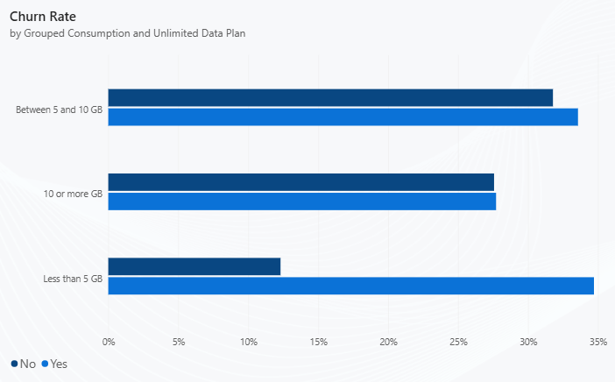
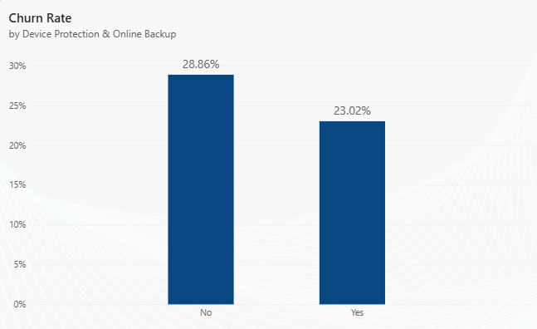
Unlimited Data Plan & Service Add-ons
Customers with an unlimited data plan and below 5GB of data usage have the highest churn rate of ~35%.
Customers without a device protection & online backup plan have a higher churn rate.

Slide 14
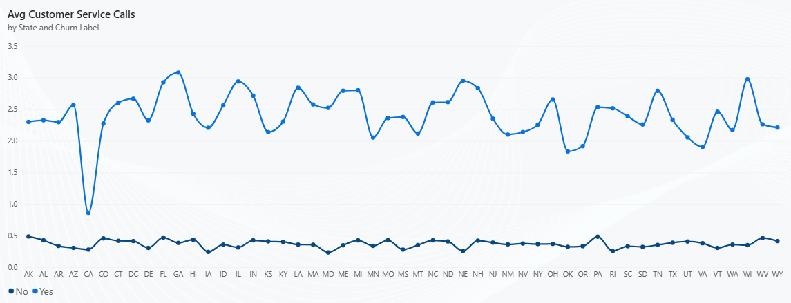
Customer Service as a Churn Predictor
6,123
0.37
2.4
Total Service Calls
Avg Calls (Non-Churned)
Avg Calls (Churned)
Critical Finding: Churned customers made 2× more service calls than retained ones — unresolved issues are the #1 early warning signal of churn.

Slide 15
SECTION 04
Recommendations
11 strategic actions mapped directly to each finding

Slide 16
Strategic Recommendations
1 of 2
REC 01
REC 04
California Retention Programme
Drive Group Plan Adoption
Regional audit + targeted campaigns & dedicated account managers for high-value CA customers.
Targeted campaigns to individual subscribers + referral incentives for existing group members.
REC 02
REC 05
Strengthen Competitive Value
Convert Monthly to Long-Term
Competitive benchmarking cycle + proactive loyalty upgrades with device offers & price-matching.
Incentive-based migration — discounted rates, bonus data or free add-ons for annual commitments.
REC 03
REC 06
Senior Customer Strategy
Migrate to Automated Payments
Senior-specific plan with simplified pricing, priority support & dedicated trained agents.
Bill credits or discounts to switch paper check users to direct debit — reduces interruptions & churn.

Slide 17
Strategic Recommendations
2 of 2
REC 07
Optimise International Plans for Non-Users
Auto-trigger outreach after 60–90 days of zero Intl usage — offer downgrade or credit proactively.
REC 08
Proactive Engagement: Low-Spend Customers
Structured onboarding journey + milestone-based rewards to build value before churn risk peaks.
REC 09
Re-evaluate Unlimited Plan Positioning
Usage-based segmentation — guide low-usage customers to better-fit plans; reposition for heavy users.
REC 10
Bundle Add-on Services
Integrate device protection & online backup into mid-tier plans + free trial campaign for existing customers.
REC 11
Early Warning System — Service Calls
Flag customers with 3+ calls in 90 days; auto-escalate to senior retention specialist for outreach.

Slide 18
SECTION 05
Next Steps
Prioritised actions, ownership & expected impact

Slide 19
Next Steps & Ownership
Immediate
(0–30 days)
Short-term
(1–3 months)
Medium-term
(3–6 months)
Ongoing
Launch CA retention task force
Identify Intl plan non-users for outreach
Flag high service-call customers for escalation
Roll out monthly → annual contract incentive
Begin group plan adoption campaign
Pilot direct debit migration with bill credit offer
Launch senior customer dedicated plan
Integrate add-ons into standard mid-tier plan
Build churn risk scoring model on service call data
Competitive benchmarking cycle (quarterly)
Monitor unlimited plan churn by usage cohort
Review low-spend customer engagement metrics
Owner: Product & Commercial Strategy — in collaboration with Customer Experience, Marketing, and Technology teams

Slide 20
Reducing churn is not
a single fix —
it's a system of signals,
responses, and relationships.
Asiya Nizam
asiyanizam01@gmail.com · linkedin.com/in/asiya-nizam-8a0387176
Data Source: DataCamp — Databel Fictional Dataset · Tools: Power BI · Power Query · DAX · MS Excel

