Slide 1
STAAR Math Task Cards
Grade 3 | 32 TEKS-Aligned Questions
Teach4Texas

Slide 2
#1 TEKS 3.4A
What is the sum of 347 + 285?
A) 532
B) 622
C) 632
D) 612

Slide 3
#2 TEKS 3.4A
Marcus has 463 baseball cards. He gets 278 more. How many baseball cards does Marcus have now?
A) 731
B) 741
C) 641
D) 185

Slide 4
#3 TEKS 3.4A
What is 804 − 356?
A) 458
B) 448
C) 548
D) 452

Slide 5
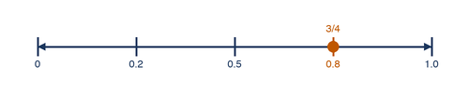
#4 TEKS 3.4K
Which point on the number line best represents 3/4?
A) Point A
B) Point B
C) Point C
D) Point D

Slide 6

#5 TEKS 3.3A
What fraction of the bar is shaded?
A) 2/6
B) 3/6
C) 4/6
D) 5/6

Slide 7

#6 TEKS 3.3A
Which fraction model shows 2/4?
A) 1 part shaded out of 4
B) 2 parts shaded out of 4
C) 3 parts shaded out of 4
D) 4 parts shaded out of 4

Slide 8
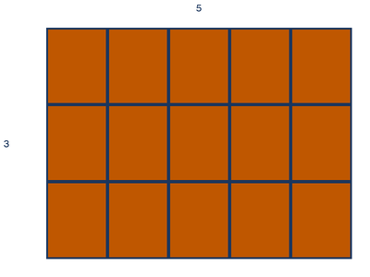
#7 TEKS 3.4D
What multiplication fact does this array show?
A) 3 × 4 = 12
B) 4 × 5 = 20
C) 3 × 5 = 15
D) 2 × 6 = 12

Slide 9
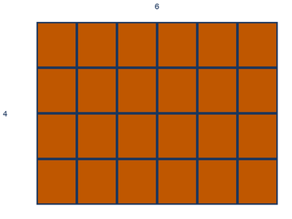
#8 TEKS 3.4D
There are 4 rows of desks with 6 desks in each row. How many desks are there in all?
A) 10
B) 20
C) 24
D) 28

Slide 10
#9 TEKS 3.4F
Sarah has 5 bags of apples. Each bag has 7 apples. How many apples does Sarah have in all?
A) 12
B) 30
C) 35
D) 40

Slide 11
#10 TEKS 3.4F
What is 8 × 6?
A) 42
B) 46
C) 48
D) 54

Slide 12
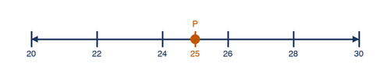
#11 TEKS 3.4K
Which number is located at point P on the number line?
A) 24
B) 25
C) 26
D) 27

Slide 13
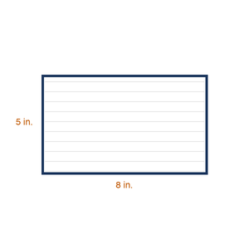
#12 TEKS 3.5A
What is the perimeter of a rectangle that is 8 inches long and 5 inches wide?
A) 13 inches
B) 26 inches
C) 40 inches
D) 21 inches

Slide 14
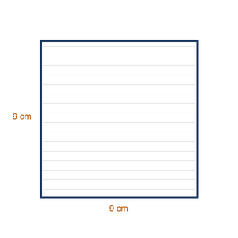
#13 TEKS 3.5A
What is the perimeter of a square with sides that are 9 cm?
A) 18 cm
B) 27 cm
C) 36 cm
D) 81 cm

Slide 15
#14 TEKS 3.6A
Which shape has exactly 4 equal sides and 4 right angles?
A) Rhombus
B) Rectangle
C) Square
D) Trapezoid

Slide 16

#15 TEKS 3.6A
How many sides does a hexagon have?
A) 4
B) 5
C) 6
D) 8

Slide 17
#16 TEKS 3.7B
What time does the clock show if the hour hand is between 3 and 4, and the minute hand is on 6?
A) 3:06
B) 3:30
C) 6:15
D) 6:03

Slide 18
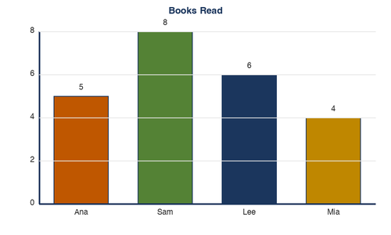
#17 TEKS 3.8A
The bar graph shows how many books students read. How many more books did Sam read than Ana?
A) 2
B) 3
C) 4
D) 5

Slide 19
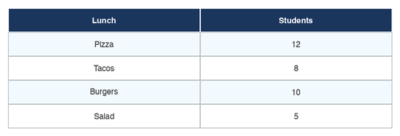
#18 TEKS 3.8A
Use the table. How many students chose pizza as their favorite lunch?
A) 8
B) 10
C) 12
D) 14

Slide 20
#19 TEKS 3.4G
There are 18 markers shared equally among 3 students. How many markers does each student get?
A) 5
B) 6
C) 7
D) 9

Slide 21
#20 TEKS 3.4G
What is 32 ÷ 4?
A) 6
B) 7
C) 8
D) 9

Slide 22
#21 TEKS 3.4E
Which fact is in the same fact family as 6 × 7 = 42?
A) 42 − 7 = 35
B) 42 ÷ 6 = 7
C) 7 + 6 = 13
D) 42 + 6 = 48

Slide 23

#22 TEKS 3.3H
Which fraction is greater: 2/4 or 3/4?
A) 2/4
B) 3/4
C) They are equal
D) Cannot tell

Slide 24
#23 TEKS 3.3F
Which fraction is equivalent to 1/2?
A) 2/3
B) 2/4
C) 3/4
D) 1/4

Slide 25
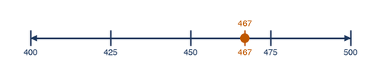
#24 TEKS 3.4B
Round 467 to the nearest hundred.
A) 400
B) 460
C) 470
D) 500

Slide 26
#25 TEKS 3.4B
Round 835 to the nearest ten.
A) 830
B) 835
C) 840
D) 900

Slide 27

#26 TEKS 3.4D
The area model shows the product of two numbers. What is the product?
A) 12
B) 15
C) 16
D) 20

Slide 28

#27 TEKS 3.5B
A teacher wants to find the area of a bulletin board that is 6 feet long and 4 feet wide. What is the area?
A) 10 sq ft
B) 20 sq ft
C) 24 sq ft
D) 28 sq ft

Slide 29
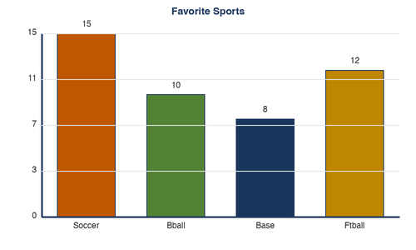
#28 TEKS 3.8A
Use the bar graph. Which sport is the most popular?
A) Soccer
B) Basketball
C) Baseball
D) Football

Slide 30
#29 TEKS 3.7A
Which coin combination equals 76 cents?
A) 3 quarters and 1 penny
B) 7 dimes and 6 pennies
C) 2 quarters, 2 dimes, and 6 pennies
D) All of the above

Slide 31
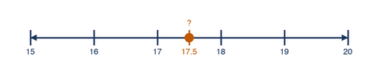
#30 TEKS 3.7C
Maria measures a pencil. It is between 17 cm and 18 cm. What is the best estimate of its length?
A) 15 cm
B) 17 cm
C) 17.5 cm
D) 20 cm

Slide 32
#31 TEKS 3.6B
Which pair of shapes are congruent?
A) A small square and a large square
B) Two squares the same size
C) A square and a rectangle
D) A triangle and a square

Slide 33
#32 TEKS 3.4H
Emma has 3 bags of oranges. Each bag has 9 oranges. She gives 5 oranges to her friend. How many oranges does Emma have left?
A) 17
B) 22
C) 27
D) 32

