Slide 1
STAAR Math Task Cards
Grade 5 | 32 TEKS-Aligned Questions
Teach4Texas

Slide 2
#1 TEKS 5.2A
The distance from San Antonio to Houston is 197.26 miles. What is the value of the digit 2 in 197.26?
A) 2 ones
B) 2 tens
C) 2 tenths
D) 2 hundredths

Slide 3
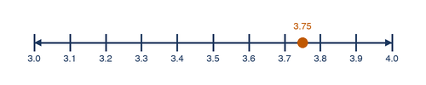
#2 TEKS 5.2B
Which number line shows the location of 3.75?
A) Between 3.6 and 3.7
B) Between 3.7 and 3.8
C) Between 3.8 and 3.9
D) Between 3.4 and 3.5

Slide 4
#3 TEKS 5.2C
A baker uses 2.408 pounds of flour for bread and 2.48 pounds for cookies. Which statement correctly compares these amounts?
A) 2.408 > 2.48
B) 2.408 < 2.48
C) 2.408 = 2.48
D) Not enough information

Slide 5
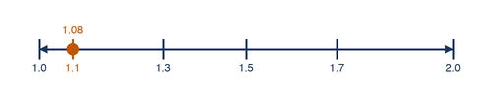
#4 TEKS 5.2C
Look at the number line. Which list shows the decimals in order from least to greatest?
A) 1.3, 1.08, 1.5, 1.72
B) 1.08, 1.3, 1.72, 1.5
C) 1.08, 1.3, 1.5, 1.72
D) 1.72, 1.5, 1.3, 1.08

Slide 6
#5 TEKS 5.3A
Maria ran 3/4 of a mile on Monday and 2/3 of a mile on Tuesday. What is the total distance Maria ran on both days?
A) 5/7 mile
B) 5/12 mile
C) 1 5/12 miles
D) 1 1/2 miles

Slide 7

#6 TEKS 5.3A
The fraction bar shows 5/8 of a pizza that was eaten. If 1/4 of the whole pizza was eaten by Carlos, what fraction was eaten by others?
A) 1/8
B) 4/8
C) 3/8
D) 1/4

Slide 8
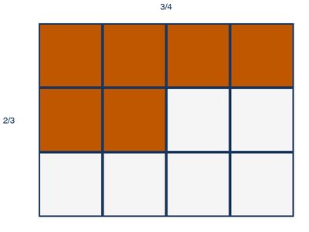
#7 TEKS 5.3B
A recipe calls for 2/3 cup of sugar. If Damon wants to make 3/4 of the recipe, how much sugar does he need?
A) 5/7 cup
B) 6/12 cup
C) 1/2 cup
D) 2/4 cup

Slide 9
#8 TEKS 5.3B
A garden plot is 3/5 of a yard long and 1/2 of a yard wide. What is the area of the garden plot in square yards?
A) 4/7 sq yd
B) 3/10 sq yd
C) 1 1/10 sq yd
D) 3/7 sq yd

Slide 10
#9 TEKS 5.3D
A water jug holds 3/4 of a gallon. Each cup holds 1/8 of a gallon. How many cups can be filled from one full jug?
A) 3 cups
B) 4 cups
C) 6 cups
D) 8 cups

Slide 11
#10 TEKS 5.3E
A store sells rope for $4.85 per yard. Mrs. Garza buys 3.5 yards of rope. How much does she pay before tax?
A) $16.98
B) $14.55
C) $16.28
D) $16.975

Slide 12
#11 TEKS 5.3G
Which fraction and decimal pair are equivalent?
A) 3/5 = 0.35
B) 7/8 = 0.875
C) 1/3 = 0.30
D) 2/6 = 0.26

Slide 13

#12 TEKS 5.3G
The fraction bar shows 3/4. Which decimal is equivalent to this fraction?
A) 0.34
B) 0.43
C) 0.75
D) 0.80

Slide 14
#13 TEKS 5.4A
A school buys boxes of markers. Each box has 12 markers. Which expression represents the total number of markers in b boxes?
A) 12 + b
B) 12 − b
C) 12 × b
D) 12 ÷ b

Slide 15
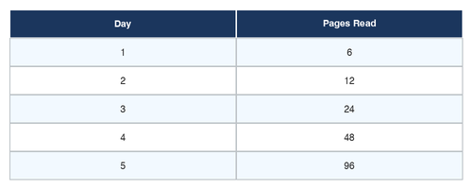
#14 TEKS 5.4B
The table shows the number of pages Lena reads each day. If the pattern continues, how many pages will she read on Day 6?
A) 192
B) 160
C) 128
D) 96

Slide 16
#15 TEKS 5.4E
What is the value of 3 + 5 × (8 − 2)?
A) 48
B) 33
C) 46
D) 18

Slide 17
#16 TEKS 5.4F
Which value of n makes this equation true? 6 × n = 54
A) 7
B) 8
C) 9
D) 48

Slide 18
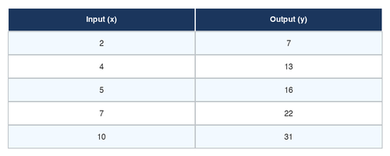
#17 TEKS 5.4C
Look at the input-output table. Which expression describes the rule?
A) Multiply by 3, then add 1
B) Multiply by 4
C) Add 8
D) Multiply by 3, then subtract 1

Slide 19
#18 TEKS 5.5A
Which of the following statements is true about all parallelograms?
A) They have exactly one pair of parallel sides
B) They have four right angles
C) They have two pairs of parallel sides
D) All four sides are equal in length

Slide 20

#19 TEKS 5.5A
A triangle has angles measuring 60°, 60°, and 60°. Which classification best describes this triangle?
A) Right scalene
B) Obtuse isosceles
C) Equilateral acute
D) Right isosceles

Slide 21
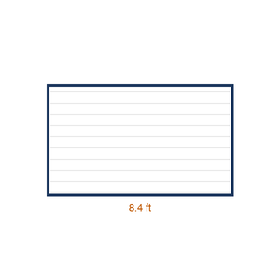
#20 TEKS 5.6A
A rectangular garden is 12.5 feet long and 8.4 feet wide. What is the perimeter of the garden?
A) 20.9 feet
B) 41.8 feet
C) 105 feet
D) 33.4 feet

Slide 22
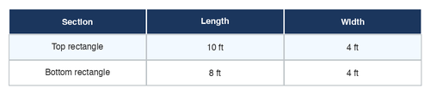
#21 TEKS 5.6B
The diagram shows an L-shaped room. What is the total area of the room?
A) 56 sq ft
B) 64 sq ft
C) 72 sq ft
D) 80 sq ft

Slide 23
#22 TEKS 5.6A
A picture frame has a perimeter of 56 inches. The length of the frame is 16 inches. What is the width?
A) 40 inches
B) 24 inches
C) 12 inches
D) 20 inches

Slide 24
#23 TEKS 5.4H
Jasmine has $20. She buys a notebook for $3.75 and 2 pens that cost $1.50 each. Which expression shows how much money Jasmine has left?
A) 20 − 3.75 + 2 × 1.50
B) 20 − (3.75 + 2 × 1.50)
C) (20 − 3.75) × 2 × 1.50
D) 20 − 3.75 − 1.50

Slide 25
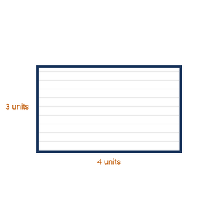
#24 TEKS 5.5B
A rectangular prism has a length of 6 units, a width of 4 units, and a height of 3 units. What is the volume?
A) 13 cubic units
B) 24 cubic units
C) 48 cubic units
D) 72 cubic units

Slide 26
#25 TEKS 5.5B
Marcus is packing a box with small cubes. Each small cube has a side length of 1 inch. The box is 5 inches long, 3 inches wide, and 4 inches tall. How many small cubes will fit in the box?
A) 12 cubes
B) 15 cubes
C) 45 cubes
D) 60 cubes

Slide 27
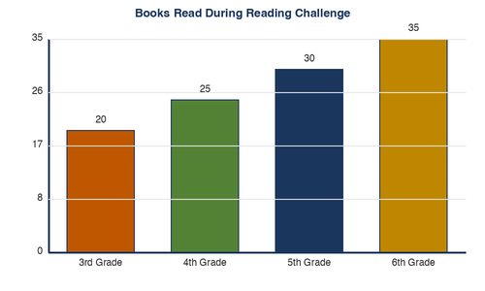
#26 TEKS 5.7A
The bar graph shows the number of books students read during a reading challenge. How many more books did the 5th graders read than the 3rd graders?
A) 5 books
B) 10 books
C) 15 books
D) 20 books

Slide 28
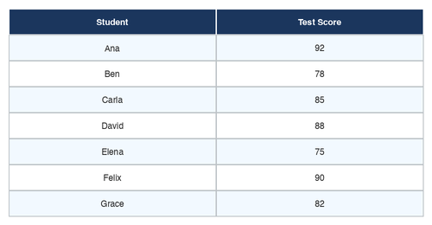
#27 TEKS 5.7A
The data table shows test scores for 7 students. What is the median test score?
A) 78
B) 82
C) 85
D) 88

Slide 29
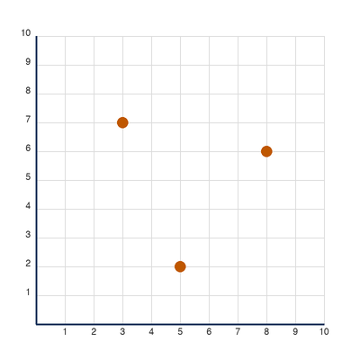
#28 TEKS 5.8A
What ordered pair represents the location of the library on the coordinate grid?
A) (2, 5)
B) (5, 2)
C) (3, 7)
D) (7, 3)

Slide 30
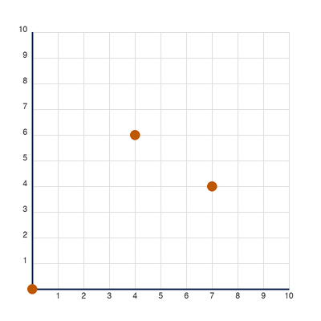
#29 TEKS 5.8B
Starting at the origin (0, 0), Maya walks 4 units to the right and 6 units up. Then she walks 3 more units to the right and 2 units down. What ordered pair describes Maya's final location?
A) (7, 4)
B) (4, 7)
C) (7, 8)
D) (3, 6)

Slide 31
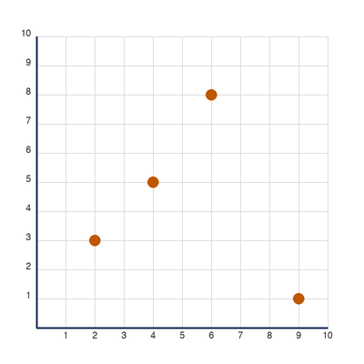
#30 TEKS 5.8C
The coordinate grid shows the locations of buildings in a town. Which building is located at (6, 8)?
A) School
B) Hospital
C) Fire Station
D) Park

Slide 32
#31 TEKS 5.9A
Mateo earns $8.50 per hour mowing lawns. He works 6 hours on Saturday. He wants to save 40% of his earnings. How much money will Mateo save?
A) $17.00
B) $20.40
C) $30.60
D) $34.00

Slide 33
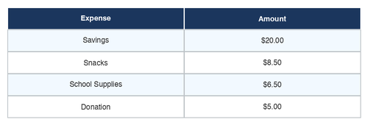
#32 TEKS 5.9B
The table shows Sofia's monthly budget. If she earns $50 per month from chores, how much does she have left after all expenses?
A) $5.00
B) $7.50
C) $10.00
D) $12.50

