Slide 1
STAAR RLA Task Cards
Grade 3 | 32 TEKS-Aligned Questions
Teach4Texas

Slide 2
#1 TEKS 3.6F
Read the passage. Maria looked out the window and saw dark clouds filling the sky. She grabbed her umbrella and rain boots before heading out the door. What can the reader conclude from this passage?
A) Maria is afraid of storms.
B) Maria thinks it will rain soon.
C) Maria does not like going outside.
D) Maria is going to school.

Slide 3
#2 TEKS 3.7C
Read the passage. Dogs make wonderful pets for families. They are loyal, playful, and can even help protect your home. Every family should think about getting a dog. What is the author's purpose for writing this passage?
A) To inform readers about different dog breeds
B) To entertain readers with a funny dog story
C) To persuade readers that dogs are great pets
D) To explain how to train a dog

Slide 4
#3 TEKS 3.9D
Read the passage. Bees are important because they pollinate flowers. When a bee lands on a flower, pollen sticks to its body. The bee carries the pollen to the next flower, which helps new plants grow. What is the main idea of this passage?
A) Bees like to land on flowers.
B) Pollen is sticky.
C) Bees help plants grow by spreading pollen.
D) Flowers need water to grow.

Slide 5
#4 TEKS 3.6F
Read the passage. The fox crept slowly through the tall grass. Its eyes were fixed on the rabbit near the bush. The fox lowered its body and waited for the right moment. What will the fox most likely do next?
A) Fall asleep in the grass
B) Run away from the rabbit
C) Try to catch the rabbit
D) Start digging a hole

Slide 6
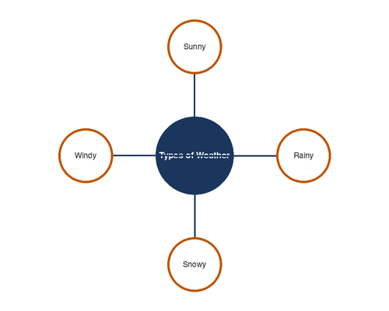
#5 TEKS 3.9D
Which graphic organizer best shows the main idea and supporting details of a passage about types of weather?
A) A Venn diagram
B) A web with the main idea in the center
C) A T-chart
D) A timeline

Slide 7
#6 TEKS 3.11D
Which sentence is written correctly?
A) The children was playing in the park.
B) The children were playing in the park.
C) The children is playing in the park.
D) The children am playing in the park.

Slide 8
#7 TEKS 3.6E
Read the passage. Sam's hands were shaking as he walked to the front of the class. He took a deep breath, looked at his note cards, and began his presentation. How does Sam most likely feel?
A) Angry
B) Nervous
C) Excited
D) Bored

Slide 9
#8 TEKS 3.10D
Read the sentence. The wind whispered through the trees. What does the author mean by the word "whispered"?
A) The wind was talking to the trees.
B) The wind was blowing very hard.
C) The wind was making a soft, quiet sound.
D) The wind had stopped blowing.

Slide 10
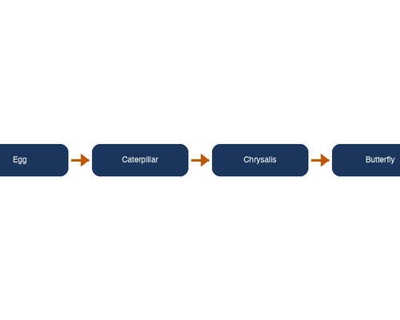
#9 TEKS 3.9E
A student is reading an article about how caterpillars become butterflies. Which graphic organizer would best show this information?
A) A Venn diagram
B) A flow chart showing the steps in order
C) A T-chart
D) A web diagram

Slide 11
#10 TEKS 3.6G
Read the passage. Lily had never been to the ocean before. When she saw the waves crashing on the shore, her eyes grew wide and she ran toward the water, laughing. Which word best describes Lily?
A) Frightened
B) Amazed
C) Confused
D) Angry

Slide 12
#11 TEKS 3.11D
Which sentence uses a comma correctly?
A) I like apples, bananas and grapes.
B) I like apples bananas, and grapes.
C) I like apples, bananas, and grapes.
D) I like, apples bananas and grapes.

Slide 13
#12 TEKS 3.8A
Read the passage. Once upon a time, a clever fox tricked a crow into dropping its cheese. The fox said, "What a beautiful voice you have! Won't you sing for me?" The crow opened its beak to sing, and the cheese fell to the ground. What type of story is this passage?
A) A biography
B) A fable
C) An informational article
D) A poem

Slide 14
#13 TEKS 3.6F
Read the passage. Jake studied his spelling words every night for a week. He practiced writing each word three times. On Friday, he felt ready for the test. Based on the passage, what will most likely happen on the spelling test?
A) Jake will forget all the words.
B) Jake will do well on the test.
C) Jake will be absent from school.
D) Jake will not finish the test.

Slide 15
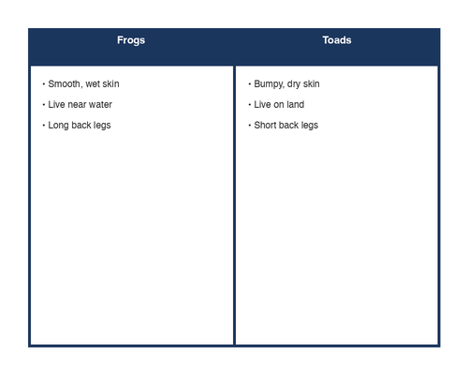
#14 TEKS 3.9D
Use the T-chart below to answer the question. Which sentence best describes the information in the chart?
A) Frogs and toads are exactly the same.
B) Frogs live in water, but toads do not.
C) Frogs and toads have similarities and differences.
D) Toads are better than frogs.

Slide 16
#15 TEKS 3.7D
Read the passage. First, gather your supplies: bread, peanut butter, and jelly. Next, spread peanut butter on one slice of bread. Then, spread jelly on the other slice. Finally, put the two slices together. What text structure does this passage use?
A) Cause and effect
B) Compare and contrast
C) Problem and solution
D) Sequence

Slide 17
#16 TEKS 3.6E
Read the passage. "I can't believe you ate the last cookie!" Mia shouted at her brother. She crossed her arms and stomped out of the kitchen. How does Mia feel?
A) Happy
B) Upset
C) Confused
D) Tired

Slide 18
#17 TEKS 3.10F
Read the sentence. The new student at school was as quiet as a mouse. What does "as quiet as a mouse" mean?
A) The student looked like a mouse.
B) The student was very shy and silent.
C) The student liked mice.
D) The student squeaked when talking.

Slide 19
#18 TEKS 3.11D
Which sentence uses an apostrophe correctly?
A) The dog wagged it's tail.
B) The dogs tail wagged.
C) The dog's tail wagged.
D) The dogs' tail wagged.

Slide 20
#19 TEKS 3.7C
Read the passage. The Alamo is one of the most famous landmarks in Texas. It was built in the 1700s and played an important role in the Texas Revolution. Today, thousands of visitors come to San Antonio each year to see it. What is the author's purpose for writing this passage?
A) To persuade readers to visit the Alamo
B) To inform readers about the Alamo
C) To entertain readers with a funny story
D) To explain how to build a building

Slide 21
#20 TEKS 3.6F
Read the passage. Emma noticed that her plant was drooping. The soil in the pot felt dry and crumbly. She went to get the watering can. Why did Emma get the watering can?
A) She wanted to water the flowers outside.
B) She needed to clean the pot.
C) She realized her plant needed water.
D) She wanted to fill the can with soil.

Slide 22
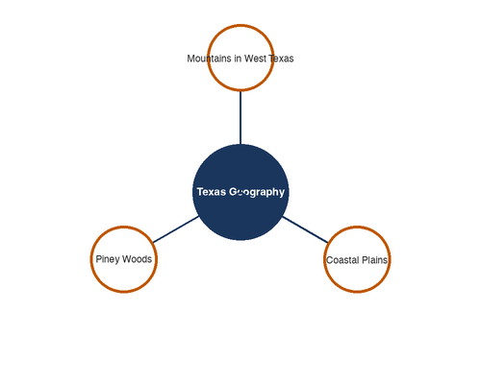
#21 TEKS 3.9D
Look at the web diagram below. Which detail could be added to a branch of this web?
A) The Pacific Ocean is very deep.
B) Dogs can be trained to do tricks.
C) It is important to eat breakfast.
D) Texas has many rivers and lakes.

Slide 23
#22 TEKS 3.11D
Read the sentence. The girl _____ her homework before dinner every night. Which word correctly completes the sentence?
A) finish
B) finishes
C) finishing
D) finished

Slide 24
#23 TEKS 3.6G
Read the passage. Carlos always shared his lunch with anyone who forgot theirs. He helped younger students carry their books. He even stayed after school to help the teacher clean up. Based on the passage, which word best describes Carlos?
A) Lazy
B) Selfish
C) Kind
D) Shy

Slide 25
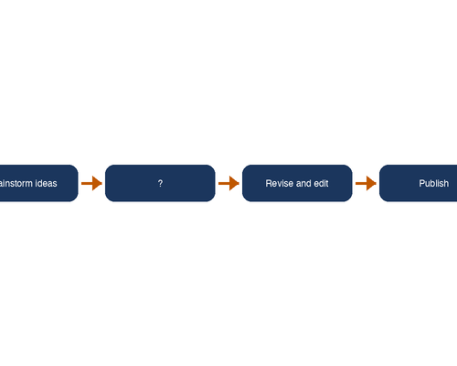
#24 TEKS 3.9E
Look at the flow chart below. What step is missing from the flow chart?
A) Buy new shoes
B) Go to the library
C) Draft your writing
D) Play outside

Slide 26
#25 TEKS 3.7D
Read the passage. The town had a problem with too much litter in the park. The mayor decided to add more trash cans and organize a cleanup day. After the cleanup, the park looked beautiful again. What text structure does this passage use?
A) Compare and contrast
B) Cause and effect
C) Problem and solution
D) Description

Slide 27
#26 TEKS 3.10A
Read the sentence. After walking for hours, the hikers were famished and needed to stop for lunch. What does the word "famished" most likely mean?
A) Very tired
B) Very hungry
C) Very happy
D) Very lost

Slide 28
#27 TEKS 3.8B
Read the passage. Roses are red, Violets are blue, Spring is here, And flowers bloom new. What type of writing is this?
A) A newspaper article
B) A poem
C) A fairy tale
D) A biography

Slide 29
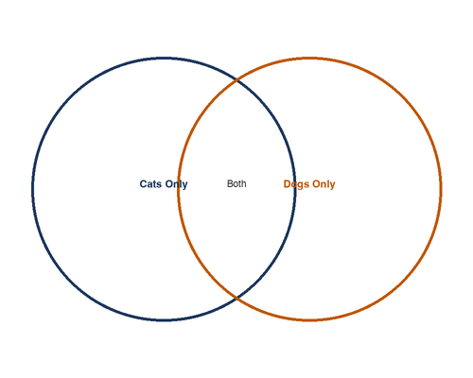
#28 TEKS 3.9D
A student wants to compare and contrast cats and dogs as pets. Which graphic organizer should the student use?
A) A flow chart
B) A timeline
C) A Venn diagram
D) A web diagram

Slide 30
#29 TEKS 3.11D
Which sentence is a complete sentence?
A) Running through the park on Saturday.
B) The tall oak tree in our backyard.
C) Because she wanted to read a book.
D) My sister rides her bike to school.

Slide 31
#30 TEKS 3.6F
Read the passage. The squirrel buried acorns all around the yard during the fall. It hid them under leaves, near tree roots, and beside the fence. Why did the squirrel bury acorns?
A) It was playing a game.
B) It was saving food for winter.
C) It did not like acorns.
D) It wanted to grow oak trees.

Slide 32
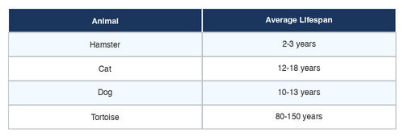
#31 TEKS 3.9D
Use the table below to answer the question. Based on the table, which animal lives the longest?
A) Hamster
B) Cat
C) Dog
D) Tortoise

Slide 33
#32 TEKS 3.10D
Read the passage. The author writes, "The old house groaned and sighed in the wind." Why does the author describe the house this way?
A) To show the house is alive
B) To help the reader imagine the sounds the house makes
C) To explain how houses are built
D) To prove the house is haunted

