Slide 1
STAAR RLA Task Cards
Grade 4 | 32 TEKS-Aligned Questions
Teach4Texas

Slide 2
#1 TEKS 4.6F
Read the passage. The old lighthouse had stood on the cliff for over a hundred years. Its paint was peeling, and the light no longer worked. Still, every evening, Mr. Hendricks climbed the stairs to the top and looked out at the sea. What can the reader infer about Mr. Hendricks?
A) He is afraid of the dark.
B) He has a deep connection to the lighthouse.
C) He is trying to fix the light.
D) He does not like living near the ocean.

Slide 3
#2 TEKS 4.10D
Read the sentence. The dancer floated across the stage like a feather in the breeze. What type of figurative language is used in this sentence?
A) Metaphor
B) Personification
C) Simile
D) Alliteration

Slide 4
#3 TEKS 4.9D
Read the passage. Sea turtles face many dangers. Pollution in the ocean can harm them. Bright lights on beaches confuse baby turtles trying to find the sea. Fishing nets sometimes trap them underwater. What is the main idea of this passage?
A) Sea turtles live in the ocean.
B) Baby turtles are born on beaches.
C) Sea turtles face many threats to their survival.
D) Fishing is dangerous for all animals.

Slide 5
#4 TEKS 4.7C
Read the passage. Every student should have at least thirty minutes of recess each day. Studies show that physical activity helps students focus better in class. Without enough time to play, students become restless and have trouble learning. What is the author's purpose for writing this passage?
A) To describe what happens at recess
B) To entertain readers with a story about recess
C) To persuade readers that students need more recess
D) To inform readers about school schedules

Slide 6
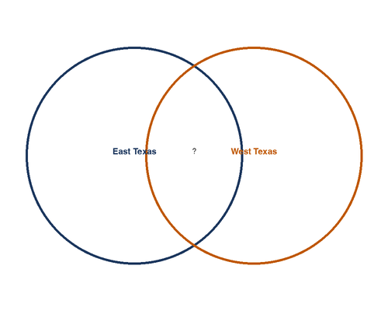
#5 TEKS 4.9E
A student is comparing the climates of two Texas regions. Look at the graphic organizer below. Which detail belongs in the center section?
A) Gets over 50 inches of rain per year
B) Located in Texas
C) Has very little rainfall
D) Covered in pine forests

Slide 7
#6 TEKS 4.11D
Read the sentence. The team celebrated their victory and the fans cheered loudly. Which revision correctly adds a comma to this compound sentence?
A) The team celebrated their victory, and the fans cheered loudly.
B) The team celebrated, their victory and the fans cheered loudly.
C) The team celebrated their victory and, the fans cheered loudly.
D) The team, celebrated their victory and the fans cheered loudly.

Slide 8
#7 TEKS 4.6E
Read the passage. Anna stared at the math test on her desk. She had studied all week, but the numbers swam before her eyes. She took three deep breaths, picked up her pencil, and started with the first problem. Which sentence best describes how Anna feels at the beginning of the passage?
A) She feels confident and prepared.
B) She feels anxious but determined.
C) She feels bored and uninterested.
D) She feels angry at her teacher.

Slide 9
#8 TEKS 4.10A
Read the sentence. The ambassador tried to foster goodwill between the two countries by organizing cultural exchanges. What does the word "foster" mean in this sentence?
A) To prevent
B) To encourage and develop
C) To hide
D) To destroy

Slide 10
#9 TEKS 4.7D
Read the passage. Hurricanes form over warm ocean water. As the warm, moist air rises, it creates an area of low pressure. More air rushes in to fill the space. This cycle continues, and the storm grows stronger. Eventually, the spinning winds can reach speeds over 74 miles per hour. What text structure does this passage use?
A) Problem and solution
B) Compare and contrast
C) Cause and effect
D) Description

Slide 11
#10 TEKS 4.6G
Read the passage. Mrs. Ramirez stayed at the school until 6:00 every evening, tutoring students who needed extra help. She bought supplies with her own money and often called parents to share good news about their children. Which word best describes Mrs. Ramirez?
A) Strict
B) Dedicated
C) Impatient
D) Cautious

Slide 12
#11 TEKS 4.10D
Read the sentence. The thunder grumbled angrily as the storm rolled into town. What type of figurative language is used in this sentence?
A) Simile
B) Metaphor
C) Personification
D) Hyperbole

Slide 13
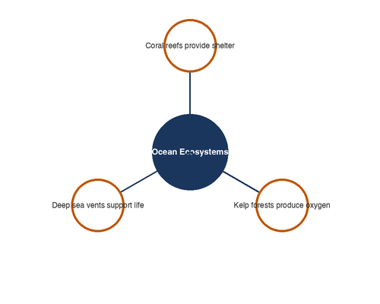
#12 TEKS 4.9D
Look at the web diagram below. Which detail could be added as another branch?
A) Bats use echolocation to find food.
B) The Sahara Desert gets very little rain.
C) Oceans are home to many types of fish.
D) Texas became a state in 1845.

Slide 14
#13 TEKS 4.8C
Read the passage. Sam Houston was born in Virginia in 1793. He later moved to Tennessee, where he became governor. After moving to Texas, Houston led the Texan army to victory at the Battle of San Jacinto in 1836. He went on to serve as the president of the Republic of Texas. What type of text is this passage?
A) A myth
B) A biography
C) A fable
D) Science fiction

Slide 15
#14 TEKS 4.6F
Read the passage. The stray cat had been coming to Grandma's porch for weeks. Each day, Grandma set out a small dish of food. One morning, the cat rubbed against her leg and purred. What can the reader conclude about the cat?
A) The cat is afraid of Grandma.
B) The cat is beginning to trust Grandma.
C) The cat wants to live inside.
D) The cat does not like the food.

Slide 16
#15 TEKS 4.11D
Which sentence correctly uses quotation marks?
A) Mom said, it's time for dinner.
B) Mom said "it's time for dinner."
C) "Mom said it's time for dinner."
D) Mom said, "It's time for dinner."

Slide 17
#16 TEKS 4.7D
Read the passage. Alligators and crocodiles may look similar, but they have important differences. Alligators have wide, U-shaped snouts, while crocodiles have narrow, V-shaped snouts. Alligators prefer freshwater habitats, but crocodiles can live in both fresh and saltwater. What text structure does this passage use?
A) Sequence
B) Problem and solution
C) Compare and contrast
D) Cause and effect

Slide 18
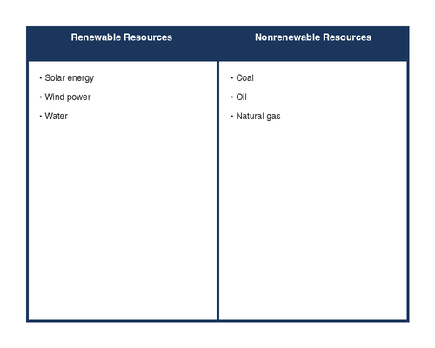
#17 TEKS 4.9E
Look at the T-chart below. Based on the chart, which statement is true?
A) Renewable and nonrenewable resources are the same.
B) Nonrenewable resources can be replaced quickly.
C) Renewable resources will never run out.
D) Renewable resources can be replaced, but nonrenewable resources cannot.

Slide 19
#18 TEKS 4.10A
Read the sentence. The new evidence helped to clarify the mystery that had puzzled detectives for months. What does the word "clarify" mean in this sentence?
A) To make more confusing
B) To hide the truth
C) To make clear or easier to understand
D) To start over

Slide 20
#19 TEKS 4.6F
Read the passage. Lucy packed her telescope, star chart, and a warm blanket into her backpack. She checked the weather forecast one more time -- clear skies all night. She smiled and headed out the door as the sun began to set. What is Lucy planning to do?
A) Go camping with friends
B) Watch the stars
C) Have a picnic
D) Go on a hike

Slide 21
#20 TEKS 4.10D
Read the sentence. Her smile was a ray of sunshine on a cloudy day. What type of figurative language is used in this sentence?
A) Simile
B) Personification
C) Alliteration
D) Metaphor

Slide 22
#21 TEKS 4.7C
Read the passage. The bald eagle was once in danger of disappearing from the United States. In 1972, a harmful pesticide called DDT was banned. Wildlife officials also created protected nesting areas. By 2007, the bald eagle had recovered enough to be removed from the endangered species list. What is the author's purpose for writing this passage?
A) To persuade readers to protect eagles
B) To entertain readers with a story about birds
C) To inform readers about how the bald eagle was saved
D) To explain how pesticides work

Slide 23
#22 TEKS 4.11D
Read the sentence. The students who finished early could read a book or draw quietly. What is the complete subject of this sentence?
A) The students
B) The students who finished early
C) students
D) who finished early

Slide 24
#23 TEKS 4.9D
Read the passage. Texas is home to many different ecosystems. The Piney Woods in East Texas have tall pine trees and lots of rainfall. The deserts in West Texas are hot and dry with very little rain. The Gulf Coast has sandy beaches and marshes where many birds live. Which sentence best states the main idea?
A) The Gulf Coast has sandy beaches.
B) Texas has many different ecosystems.
C) Pine trees grow in East Texas.
D) West Texas is hot and dry.

Slide 25
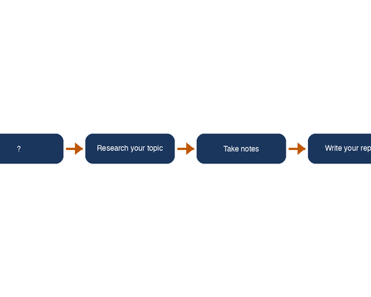
#24 TEKS 4.9E
A student is organizing information about the steps for writing a research report. Look at the flow chart below. What step is missing?
A) Choose a topic
B) Take a nap
C) Play a game
D) Eat a snack

Slide 26
#25 TEKS 4.6E
Read the passage. David had been waiting all year for the science fair. He spent three weeks building his volcano model. When the judges walked by his table, he stood tall and explained every detail with a wide grin. How does David feel about his project?
A) Embarrassed
B) Nervous
C) Proud
D) Disappointed

Slide 27
#26 TEKS 4.8A
Read the passage. Long ago, people believed that a giant named Paul Bunyan created the Great Lakes by dragging his enormous axe across the land. His blue ox, Babe, was said to be so large that its footprints formed lakes in Minnesota. What type of story is this passage from?
A) A historical fiction novel
B) A tall tale
C) A science article
D) An autobiography

Slide 28
#27 TEKS 4.10D
Read the sentence. I've told you a million times to clean your room! What type of figurative language is used in this sentence?
A) Simile
B) Personification
C) Metaphor
D) Hyperbole

Slide 29
#28 TEKS 4.7D
Read the passage. Many schools have replaced sugary drinks in vending machines with water and juice. This change happened because students were consuming too much sugar during the school day. As a result, students are now making healthier choices at lunch. What text structure does this passage use?
A) Description
B) Compare and contrast
C) Cause and effect
D) Sequence

Slide 30
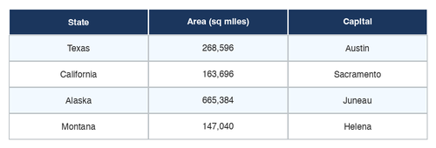
#29 TEKS 4.9D
Use the table below to answer the question. Based on the table, which state has the largest area?
A) Texas
B) California
C) Alaska
D) Montana

Slide 31
#30 TEKS 4.11D
Which sentence correctly uses a possessive noun?
A) The childrens' books were on the shelf.
B) The children's books were on the shelf.
C) The childrens books were on the shelf.
D) The children books' were on the shelf.

Slide 32
#31 TEKS 4.6G
Read the passage. At first, Marcus refused to try the new food at dinner. His mom encouraged him to take just one bite. After tasting it, Marcus asked for a second helping. "This is amazing!" he said. How do Marcus's feelings change in this passage?
A) From happy to sad
B) From excited to bored
C) From reluctant to enthusiastic
D) From angry to frightened

Slide 33
#32 TEKS 4.10F
Read the passage. The author writes: "The city was a beehive of activity. Cars buzzed along the streets while people hurried from place to place." Why does the author compare the city to a beehive?
A) To show that the city has many bees
B) To help the reader picture how busy the city is
C) To explain how beehives are built
D) To describe the shape of the buildings

