Slide 1
STAAR RLA Task Cards
Grade 5 | 32 TEKS-Aligned Questions
Teach4Texas

Slide 2
#1 TEKS 5.6F
Read the passage. The captain stared at the horizon, gripping the wheel with white knuckles. The crew exchanged nervous glances as the dark wall of clouds moved closer. Without a word, the captain turned the ship sharply to the south. What can the reader infer about the captain's decision?
A) The captain is lost and unsure where to go.
B) The captain is trying to avoid the approaching storm.
C) The captain wants to explore a new island.
D) The captain is heading home for the night.

Slide 3
#2 TEKS 5.10D
Read the sentence. Time is money, so we cannot afford to waste a single minute on this project. What type of figurative language is used in the phrase "Time is money"?
A) Simile
B) Hyperbole
C) Metaphor
D) Personification

Slide 4
#3 TEKS 5.9D
Read the passage. The Amazon Rainforest is often called "the lungs of the Earth." It produces about 20 percent of the world's oxygen. The rainforest is also home to more species of plants and animals than any other place on Earth. Scientists estimate that millions of species have yet to be discovered there. What is the main idea of this passage?
A) Scientists work in the Amazon Rainforest.
B) The Amazon Rainforest is vital to Earth and full of biodiversity.
C) The Amazon Rainforest produces oxygen.
D) There are many undiscovered species in the world.

Slide 5
#4 TEKS 5.7C
Read the passage. Plastic bags take hundreds of years to decompose in landfills. They also harm ocean wildlife when they end up in the sea. Reusable bags are inexpensive, sturdy, and better for the environment. It is time for everyone to stop using plastic bags and switch to reusable ones. What is the author's purpose for writing this passage?
A) To inform readers about how plastic is made
B) To entertain readers with a story about shopping
C) To persuade readers to use reusable bags
D) To describe different types of bags

Slide 6
#5 TEKS 5.7D
Read the passage. Before the invention of the printing press, books were copied by hand. This process took months or even years. When Johannes Gutenberg invented the printing press around 1440, books could be produced much more quickly. As a result, more people gained access to books, and literacy rates began to rise across Europe. What text structure does this passage primarily use?
A) Compare and contrast
B) Problem and solution
C) Cause and effect
D) Description

Slide 7
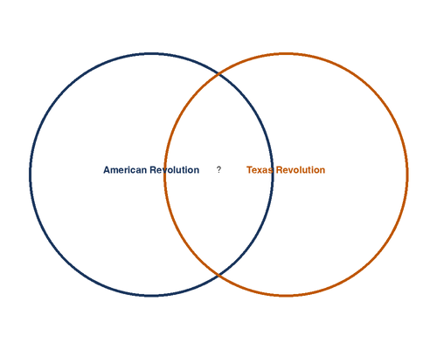
#6 TEKS 5.9E
A student is organizing information about the similarities and differences between the American Revolution and the Texas Revolution. Look at the graphic organizer below. Which detail belongs in the center section?
A) Fought against Great Britain
B) Took place in the 1830s
C) Fought for independence from a larger country
D) Resulted in the creation of a republic that became a U.S. state

Slide 8
#7 TEKS 5.6E
Read the passage. Sophia clutched the acceptance letter to her chest and let out a scream that echoed through the house. She sprinted downstairs, nearly tripping over the last step, and waved the letter at her parents. Her father's eyes widened, and her mother burst into tears. How do the characters most likely feel?
A) Confused and worried
B) Overjoyed and proud
C) Relieved but cautious
D) Surprised and angry

Slide 9
#8 TEKS 5.10D
Read the sentence. The stars danced playfully in the midnight sky. What type of figurative language is used in this sentence?
A) Simile
B) Personification
C) Hyperbole
D) Alliteration

Slide 10
#9 TEKS 5.11D
Read the sentence. Although the test was difficult the students remained calm and finished on time. Which revision correctly punctuates this sentence?
A) Although the test was difficult, the students remained calm and finished on time.
B) Although, the test was difficult the students remained calm and finished on time.
C) Although the test was difficult the students remained calm, and finished on time.
D) Although the test was difficult the students, remained calm and finished on time.

Slide 11
#10 TEKS 5.10A
Read the sentence. The diplomat's shrewd negotiation skills helped the two countries reach a peaceful agreement. What does the word "shrewd" most likely mean?
A) Dishonest
B) Clever and sharp-minded
C) Careless
D) Friendly and warm

Slide 12
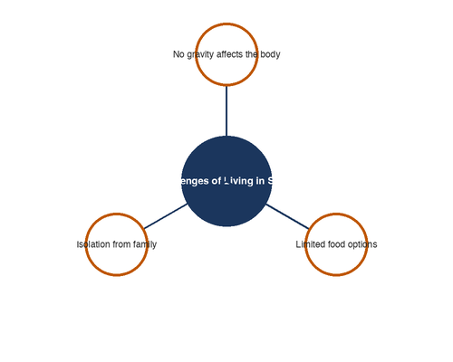
#11 TEKS 5.9D
Look at the web diagram below. Which supporting detail could be added as another branch?
A) The Nile River is in Africa.
B) Astronauts must exercise daily in space to prevent muscle loss.
C) Texas has a large cattle industry.
D) Benjamin Franklin invented bifocals.

Slide 13
#12 TEKS 5.8C
Read the passage. In the time before fire, the people shivered in darkness. Coyote, the trickster, saw their suffering and devised a plan. He crept to the top of the mountain where the Fire Spirits guarded their flames. With a swift grab, Coyote seized a burning stick and raced down to share the fire with the people. What type of story is this passage?
A) A biography
B) A myth
C) Historical fiction
D) A news article

Slide 14
#13 TEKS 5.6G
Read the passage. When Javier first moved to a new school, he sat alone at lunch and spoke to no one. By the end of the first month, he had joined the soccer team. By the end of the semester, Javier had become one of the most well-known students in the school and had a large group of friends. How does Javier change over the course of the passage?
A) He goes from confident to shy.
B) He goes from isolated to social.
C) He goes from athletic to academic.
D) He goes from popular to lonely.

Slide 15
#14 TEKS 5.7D
Read the passage. Many cities face a growing problem with traffic congestion. One solution that some cities have tried is building light rail systems. These train systems reduce the number of cars on the road and help people get to work faster. Cities like Dallas and Houston have expanded their rail systems with positive results. What text structure does this passage use?
A) Cause and effect
B) Sequence
C) Problem and solution
D) Compare and contrast

Slide 16
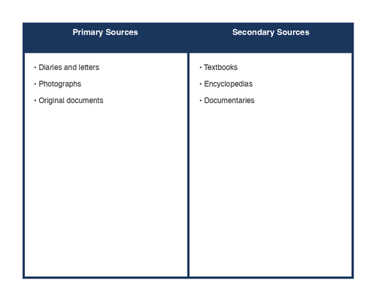
#15 TEKS 5.9E
Look at the T-chart below. Based on the chart, which conclusion can be drawn?
A) Primary sources are more accurate than secondary sources.
B) Secondary sources are never useful for research.
C) Primary sources are original materials, while secondary sources analyze or interpret them.
D) Only historians use primary sources.

Slide 17
#16 TEKS 5.10D
Read the sentence. I'm so hungry I could eat a horse. What type of figurative language is used in this sentence?
A) Metaphor
B) Simile
C) Personification
D) Hyperbole

Slide 18
#17 TEKS 5.11D
Which sentence correctly uses a semicolon?
A) The game was canceled; because of the rain.
B) The game was canceled; the rain was too heavy to play.
C) The game; was canceled because of the rain.
D) The game was; canceled because of the rain.

Slide 19
#18 TEKS 5.6F
Read the passage. Dr. Patel looked at the X-ray and frowned. She turned to the young athlete and said gently, "I know this isn't what you want to hear, but you'll need to rest that ankle for at least six weeks." Marcus looked down at his basketball shoes and said nothing. What can the reader infer about Marcus?
A) He is happy about the news.
B) He is disappointed he cannot play basketball.
C) He does not trust Dr. Patel.
D) He plans to ignore the doctor's advice.

Slide 20
#19 TEKS 5.10A
Read the sentence. The harsh conditions of the desert made the journey arduous for the early settlers. Using context clues, what does the word "arduous" most likely mean?
A) Short and easy
B) Extremely difficult
C) Exciting and fun
D) Calm and peaceful

Slide 21
#20 TEKS 5.7C
Read the two passages. Passage 1: The school board voted to extend the school year by ten days to improve test scores. Passage 2: Students and parents protested the decision, arguing that students need summer break to rest and pursue other interests. How do the two passages differ in their point of view?
A) Passage 1 supports the decision; Passage 2 opposes it.
B) Both passages support extending the school year.
C) Passage 1 opposes the decision; Passage 2 supports it.
D) Both passages are neutral about the decision.

Slide 22
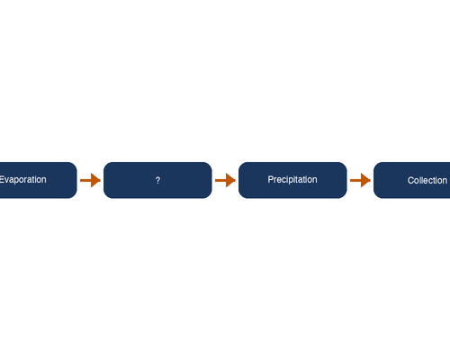
#21 TEKS 5.9E
A student needs to organize the steps of the water cycle. Look at the flow chart below. What step is missing from the flow chart?
A) Water freezes into ice
B) Water vapor rises and forms clouds (condensation)
C) Animals drink the water
D) Plants grow near the water

Slide 23
#22 TEKS 5.11D
Read the sentence. Neither the coach nor the players was ready for the surprise announcement. What is the correct revision of this sentence?
A) Neither the coach nor the players were ready for the surprise announcement.
B) Neither the coach nor the players is ready for the surprise announcement.
C) Neither the coach or the players was ready for the surprise announcement.
D) The sentence is correct as written.

Slide 24
#23 TEKS 5.6F
Read the passage. Grandma Rosa carefully placed the old photograph back in the wooden box. She ran her fingers over the carved lid and whispered, "Some things are worth more than money." She closed the box and returned it to the top shelf of her closet. What can the reader conclude about the wooden box?
A) It contains valuable jewelry.
B) It holds items with sentimental value to Grandma Rosa.
C) Grandma Rosa wants to sell the box.
D) The box was a gift she does not want.

Slide 25
#24 TEKS 5.10D
Read the lines from a poem. She sells seashells by the shining shore, Silver sand slipping through her fingers. What type of figurative language is primarily used in these lines?
A) Metaphor
B) Hyperbole
C) Alliteration
D) Personification

Slide 26
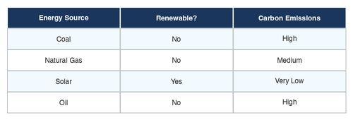
#25 TEKS 5.9D
Use the table below to answer the question. Based on the data, which form of energy produces the least carbon emissions?
A) Coal
B) Natural Gas
C) Solar
D) Oil

Slide 27
#26 TEKS 5.8A
Read the passage. The year was 2157. Mara adjusted her oxygen helmet and stepped onto the red, dusty surface. She had dreamed of visiting Mars since she was a child, and now she was one of the first colonists to call the planet home. What genre is this passage?
A) Realistic fiction
B) Historical fiction
C) Science fiction
D) Biography

Slide 28
#27 TEKS 5.10F
Read the passage. The author describes the abandoned town: "The empty streets stretched out like open arms waiting for visitors who would never come. Dust covered every surface like a blanket of forgotten memories." How does the author's use of figurative language affect the passage?
A) It makes the town sound exciting and fun.
B) It creates a mood of loneliness and sadness.
C) It helps the reader understand how to get to the town.
D) It makes the reader want to visit the town.

Slide 29
#28 TEKS 5.11D
Which sentence uses correct subject-verb agreement?
A) The group of students are going on a field trip.
B) The group of students is going on a field trip.
C) The group of students were going on a field trip.
D) The group of students have going on a field trip.

Slide 30
#29 TEKS 5.7D
Read the passage. Ancient Egypt and Ancient Greece were both powerful civilizations. Egypt was known for its pyramids, pharaohs, and the Nile River. Greece was known for its philosophers, democratic government, and the Olympic Games. Both civilizations made lasting contributions to art, science, and architecture. What text structure does this passage use?
A) Sequence
B) Problem and solution
C) Compare and contrast
D) Cause and effect

Slide 31
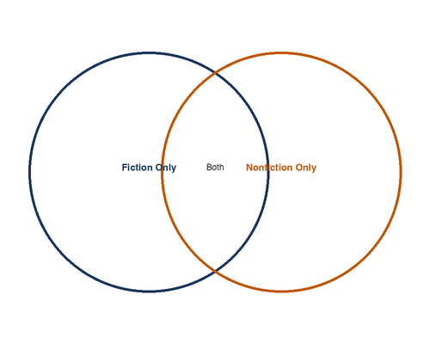
#30 TEKS 5.9E
Look at the Venn diagram below. Which detail belongs in the "Fiction Only" section?
A) Contains facts and evidence
B) Includes made-up characters and events
C) Written by an author
D) Can be found in a library

Slide 32
#31 TEKS 5.6G
Read the passage. At the beginning of the novel, the main character, Elena, believed she could never be brave. When her village was threatened, she was the one who stood up and spoke to the council. By the end of the story, Elena had led her community through the crisis and realized she had been brave all along. What is the theme of this passage?
A) It is important to follow the rules.
B) True bravery comes from within.
C) Villages need strong leaders.
D) Speaking to adults is difficult.

Slide 33
#32 TEKS 5.10D
Read the passage. The poet writes: "Hope is the thing with feathers That perches in the soul, And sings the tune without the words, And never stops at all." In this poem, hope is compared to --
A) a song
B) a feather
C) a bird
D) the soul

