Slide 1
STAAR Science Task Cards
Grade 5 | 32 TEKS-Aligned Questions
Teach4Texas

Slide 2
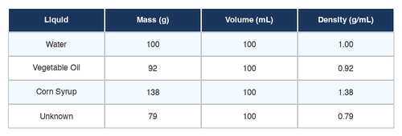
#1 TEKS 5.5A
A student measures the mass and volume of four different liquids. Which property is BEST used to identify an unknown liquid?
A) Density
B) Color
C) Temperature
D) Shape of the container

Slide 3
#2 TEKS 5.5A
A student has a piece of aluminum foil, a wooden block, and a glass marble. Which physical property do all three objects share?
A) They are all the same color
B) They all conduct electricity
C) They are all magnetic
D) They all have mass and take up space

Slide 4
#3 TEKS 5.5B
A student mixes sand, iron filings, and salt together in a bowl. Which method would BEST separate the iron filings from the mixture first?
A) Add water and stir
B) Use a magnet
C) Pour through a filter
D) Heat the mixture

Slide 5
#4 TEKS 5.5B
A student dissolves sugar in warm water and stirs. Which statement BEST describes this mixture?
A) The sugar can be recovered by evaporating the water
B) A new substance has been formed
C) The sugar has been destroyed
D) The sugar changed into a different chemical

Slide 6
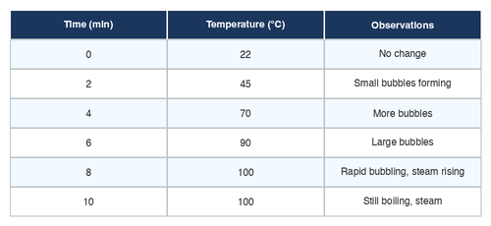
#5 TEKS 5.5C
Students recorded the temperature of water as it was heated. Based on the data, at what temperature did the water begin to boil?
A) 80°C
B) 90°C
C) 100°C
D) 110°C

Slide 7
#6 TEKS 5.5C
Ice cream is left on a kitchen counter on a hot day. Which change of state occurs as the ice cream melts?
A) Gas to liquid
B) Liquid to solid
C) Liquid to gas
D) Solid to liquid

Slide 8
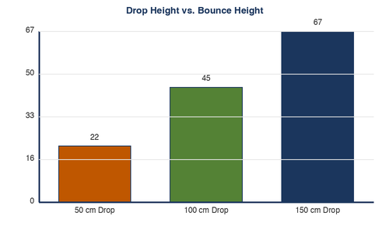
#7 TEKS 5.6A
A student drops a ball from three different heights and measures the bounce height each time. Based on the bar graph, what conclusion can the student make?
A) The ball always bounces to the same height
B) Drop height does not affect bounce height
C) The ball bounces higher when dropped from a greater height
D) The ball bounces lower when dropped from a greater height

Slide 9
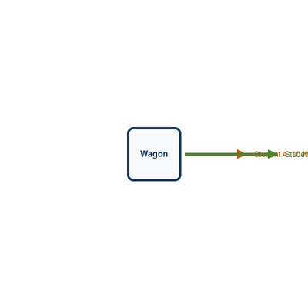
#8 TEKS 5.6A
Two students push a wagon. Student A pushes with a force of 10 N to the right, and Student B pushes with a force of 15 N to the right. What is the net force on the wagon?
A) 5 N to the right
B) 10 N to the right
C) 15 N to the right
D) 25 N to the right

Slide 10
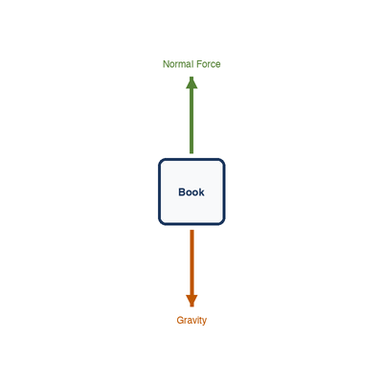
#9 TEKS 5.6A
A book is sitting on a table and not moving. What can you conclude about the forces acting on the book?
A) The forces are balanced
B) No forces are acting on the book
C) Gravity is not acting on the book
D) The forces are unbalanced

Slide 11
#10 TEKS 5.6B
Which of the following is the BEST example of light energy being transformed into heat energy?
A) A flashlight shining on a wall
B) Sunlight warming a dark sidewalk
C) A mirror reflecting a light beam
D) A lamp lighting up a room

Slide 12
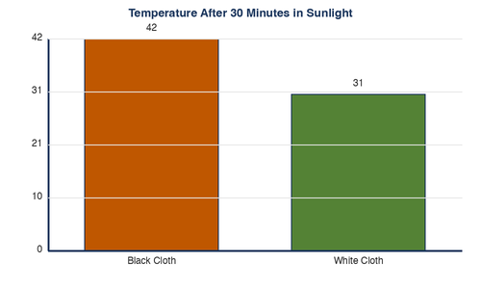
#11 TEKS 5.6B
A student wraps a thermometer in black cloth and another in white cloth, then places both in sunlight for 30 minutes. The bar graph shows the results. Why did the black cloth reach a higher temperature?
A) Black cloth absorbs more light energy and converts it to heat
B) Black cloth reflects more light
C) White cloth produces more heat
D) Black cloth is always hotter than white cloth

Slide 13
#12 TEKS 5.6C
A guitar string vibrates when plucked. What happens to the sound if the string vibrates faster?
A) The sound gets louder
B) The pitch gets higher
C) The sound gets softer
D) The pitch gets lower

Slide 14
#13 TEKS 5.7A
Which step of the water cycle is occurring when water vapor in the atmosphere cools and forms clouds?
A) Evaporation
B) Precipitation
C) Condensation
D) Collection

Slide 15
#14 TEKS 5.7A
A student sets up an experiment with a covered bowl of warm water in sunlight. After 2 hours, water droplets form on the inside of the cover. Which TWO parts of the water cycle does this experiment demonstrate?
A) Precipitation and collection
B) Condensation and precipitation
C) Collection and evaporation
D) Evaporation and condensation

Slide 16
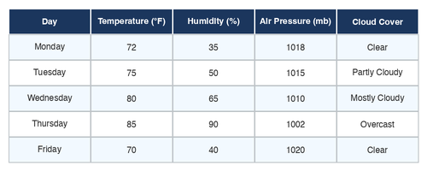
#15 TEKS 5.7B
A weather station recorded data for five days. Based on the table, on which day is a thunderstorm MOST likely?
A) Monday
B) Thursday
C) Tuesday
D) Friday

Slide 17
#16 TEKS 5.7C
A scientist finds a fossil of a fish in rock layers high on a mountain. What does this fossil evidence BEST suggest about this area?
A) Fish once lived on mountains
B) The area was once covered by water
C) The mountain formed underwater recently
D) Someone placed the fish fossil there

Slide 18
#17 TEKS 5.7C
A student examines four rock samples. Which process is responsible for forming sedimentary rock?
A) Melting and cooling of magma
B) Extreme heat and pressure underground
C) Layers of sediment compacting and cementing over time
D) Volcanic eruptions depositing lava

Slide 19
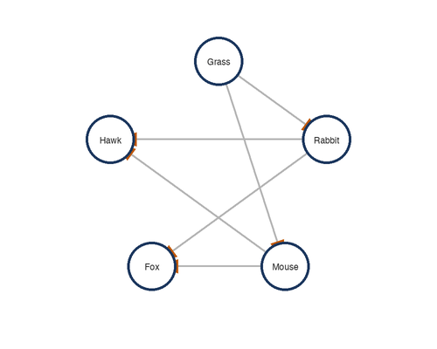
#18 TEKS 5.8A
In the food web shown, what would MOST LIKELY happen to the population of rabbits if the foxes were removed from the ecosystem?
A) The rabbit population would decrease
B) The rabbit population would stay the same
C) The rabbits would leave the ecosystem
D) The rabbit population would increase

Slide 20
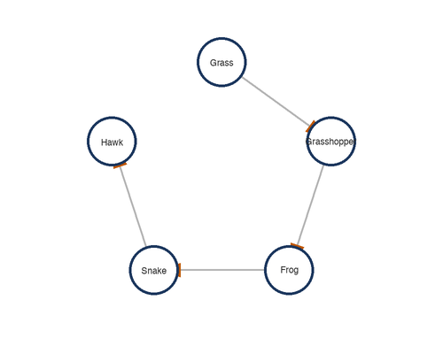
#19 TEKS 5.8A
Look at the food web. Which organism is a producer?
A) Grasshopper
B) Frog
C) Grass
D) Snake

Slide 21
#20 TEKS 5.8A
In a pond ecosystem, algae use sunlight to make food. Small fish eat the algae. Larger fish eat the small fish. Which organism in this food chain is a primary consumer?
A) The sun
B) The algae
C) The small fish
D) The larger fish

Slide 22
#21 TEKS 5.8B
A cactus has thick, waxy skin and stores water in its stem. These characteristics are BEST described as adaptations for surviving in which environment?
A) Desert
B) Tropical rainforest
C) Arctic tundra
D) Freshwater pond

Slide 23
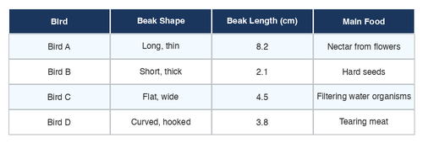
#22 TEKS 5.8B
A scientist measured the beak lengths of four bird species and the types of food they eat. Which bird is BEST adapted for cracking open hard seeds?
A) Bird A — long, thin beak
B) Bird B — short, thick beak
C) Bird C — flat, wide beak
D) Bird D — curved, hooked beak

Slide 24
#23 TEKS 5.8C
Which of the following traits is MOST LIKELY inherited from a puppy's parents?
A) The ability to sit on command
B) A scar on the puppy's ear
C) A preference for a certain toy
D) Fur color and pattern

Slide 25
#24 TEKS 5.8C
A mother plant has red flowers. All of her offspring also have red flowers. A nearby plant of the same species has white flowers. Which statement BEST explains this observation?
A) The soil determines flower color
B) Flower color is an inherited trait passed from parent to offspring
C) All plants of the same species have the same flower color
D) The amount of sunlight determines flower color

Slide 26
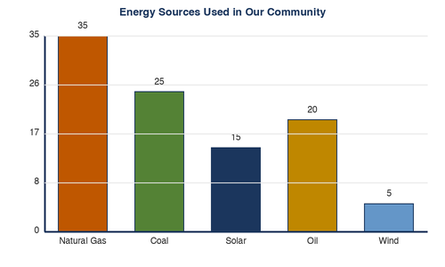
#25 TEKS 5.9A
Students collected data on energy sources used in their community. Based on the graph, which energy source is renewable?
A) Natural gas
B) Coal
C) Solar
D) Oil

Slide 27
#26 TEKS 5.9A
Which of the following is a nonrenewable resource?
A) Wind
B) Natural gas
C) Sunlight
D) Water flowing in a river

Slide 28
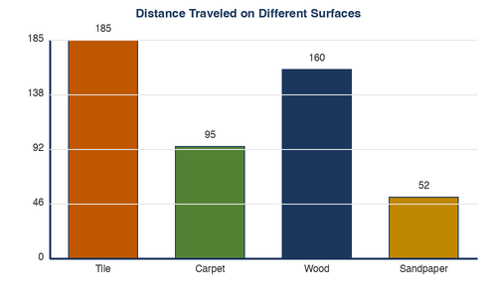
#27 TEKS 5.6A
A student tests how the surface type affects the distance a toy car travels. The results are shown in the graph. Which surface created the MOST friction?
A) Tile
B) Carpet
C) Wood
D) Sandpaper

Slide 29
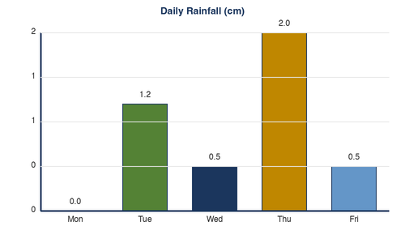
#28 TEKS 5.7A
Students measured rainfall in their schoolyard for one week. Based on the data, what was the total rainfall for the week?
A) 4.2 cm
B) 3.5 cm
C) 2.0 cm
D) 5.0 cm

Slide 30
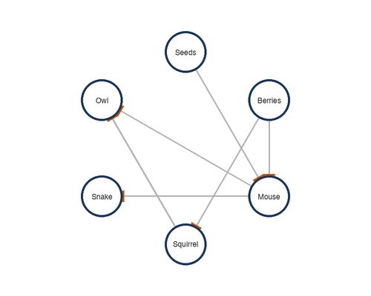
#29 TEKS 5.8A
In a forest food web, a disease kills most of the mice. What will MOST LIKELY happen to the snake population that feeds on mice?
A) The snake population will increase
B) The snake population will not change
C) The snake population will decrease
D) The snakes will become herbivores

Slide 31
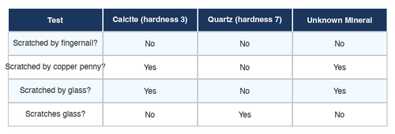
#30 TEKS 5.5A
A student wants to determine whether an unknown mineral is calcite or quartz. She tests both minerals for hardness using a scratch test. Based on the data table, which conclusion is BEST supported?
A) The unknown mineral is quartz because it scratched the glass
B) The unknown mineral is calcite because it scratched the glass
C) The unknown mineral is calcite because glass scratched it
D) The unknown mineral is quartz because nothing scratched it

Slide 32
#31 TEKS 5.6B
A student rubs her hands together quickly. Her hands begin to feel warm. Which energy transformation is taking place?
A) Heat energy to mechanical energy
B) Mechanical energy to heat energy
C) Light energy to heat energy
D) Chemical energy to light energy

Slide 33
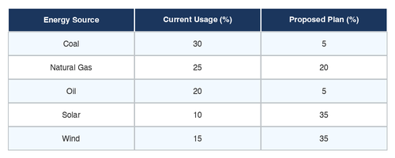
#32 TEKS 5.9A
A town wants to reduce its use of nonrenewable resources. The data table shows their current energy usage and a proposed plan. Which change in the plan would MOST reduce their use of nonrenewable resources?
A) Replacing coal and oil with wind and solar
B) Increasing coal usage
C) Using more natural gas
D) Reducing all energy usage to zero

