Slide 1
STAAR Science Task Cards
Grade 8 | 32 TEKS-Aligned Questions
Teach4Texas

Slide 2
#1 TEKS 8.5A
An element has an atomic number of 12 and a mass number of 24. How many protons, neutrons, and electrons does a neutral atom of this element have?
A) 12 protons, 12 neutrons, 12 electrons
B) 12 protons, 24 neutrons, 12 electrons
C) 24 protons, 12 neutrons, 24 electrons
D) 12 protons, 12 neutrons, 24 electrons

Slide 3
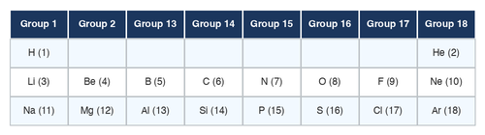
#2 TEKS 8.5A
Use the portion of the periodic table shown. Which two elements would have the MOST similar chemical properties?
A) Lithium (Li) and Beryllium (Be)
B) Lithium (Li) and Sodium (Na)
C) Carbon (C) and Nitrogen (N)
D) Helium (He) and Lithium (Li)

Slide 4
#3 TEKS 8.5B
In the chemical equation 2H₂ + O₂ → 2H₂O, what do the coefficients represent?
A) The number of atoms in each molecule
B) The number of molecules involved in the reaction
C) The atomic mass of each element
D) The speed of the reaction

Slide 5
#4 TEKS 8.5C
A student performs four different tests in the lab. Which observation provides evidence that a chemical change has occurred?
A) Ice melting into water
B) Sugar dissolving in tea
C) A nail rusting when left outside
D) Cutting a piece of paper in half

Slide 6
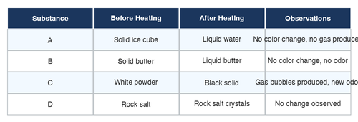
#5 TEKS 8.5C
Students tested four substances and recorded their observations. Which substance MOST LIKELY underwent a chemical change?
A) Substance A
B) Substance B
C) Substance C
D) Substance D

Slide 7
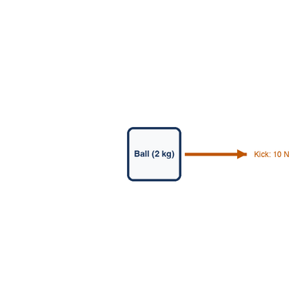
#6 TEKS 8.6A
A 2 kg ball is kicked with a force of 10 N. What is the acceleration of the ball? (Use F = ma)
A) 2 m/s²
B) 5 m/s²
C) 10 m/s²
D) 20 m/s²

Slide 8
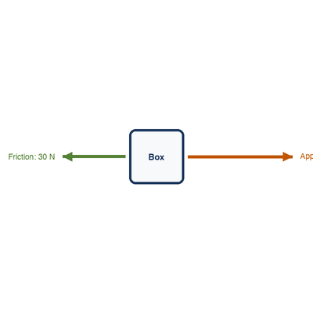
#7 TEKS 8.6A
A box is being pushed to the right with a force of 50 N. Friction pushes back with a force of 30 N. What is the net force and direction of the box's acceleration?
A) 80 N to the right
B) 20 N to the right
C) 20 N to the left
D) 30 N to the left

Slide 9
#8 TEKS 8.6A
According to Newton's Third Law, when a swimmer pushes water backward with her hands, what happens?
A) The water pushes the swimmer forward with an equal force
B) The water pushes the swimmer backward
C) Nothing happens to the swimmer
D) The water disappears

Slide 10
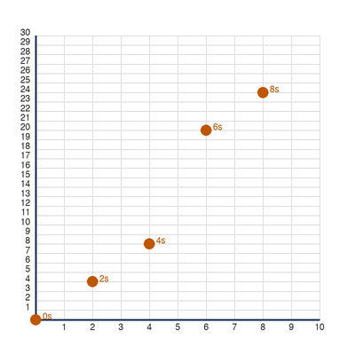
#9 TEKS 8.6B
A student records the position of a toy car every 2 seconds. Based on the graph, during which time interval was the car moving the fastest?
A) 0 to 2 seconds
B) 2 to 4 seconds
C) 4 to 6 seconds
D) 6 to 8 seconds

Slide 11
#10 TEKS 8.6B
A car travels 150 kilometers in 3 hours. What is the average speed of the car?
A) 30 km/h
B) 45 km/h
C) 50 km/h
D) 450 km/h

Slide 12
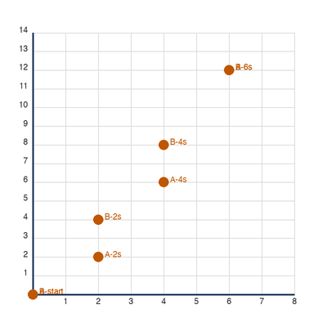
#11 TEKS 8.6B
The graph shows the motion of two runners during a race. Which statement is BEST supported by the data?
A) Runner A had a constant speed the entire race
B) Runner B was faster than Runner A at all times
C) Runner A accelerated during the race while Runner B had constant speed
D) Both runners had the same average speed

Slide 13
#12 TEKS 8.6C
A wave has a frequency of 5 Hz and a wavelength of 3 meters. What is the speed of the wave? (Use v = f × λ)
A) 2 m/s
B) 8 m/s
C) 15 m/s
D) 1.67 m/s

Slide 14
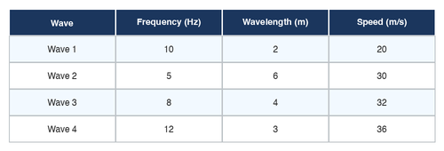
#13 TEKS 8.6C
Students measured the wavelength and frequency of four different waves. Which wave has the GREATEST speed?
A) Wave 1
B) Wave 2
C) Wave 3
D) Wave 4

Slide 15
#14 TEKS 8.7A
Which layer of Earth is responsible for the movement of tectonic plates?
A) Inner core
B) Outer core
C) Mantle (asthenosphere)
D) Crust

Slide 16
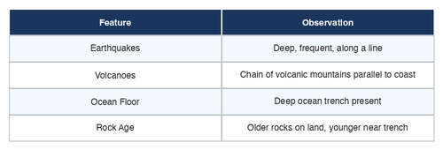
#15 TEKS 8.7A
The map shows the location of earthquakes and volcanoes along a boundary. What type of plate boundary is MOST LIKELY shown?
A) Divergent boundary
B) Convergent boundary
C) Transform boundary
D) No plate boundary exists here

Slide 17
#16 TEKS 8.7B
Which event would MOST LIKELY occur at a divergent plate boundary?
A) A deep ocean trench forms
B) Mountains are pushed upward
C) New ocean floor is created at a mid-ocean ridge
D) One plate slides under another

Slide 18
#17 TEKS 8.7C
Which of the following correctly lists objects in our universe from SMALLEST to LARGEST?
A) Galaxy → Solar System → Star → Planet
B) Planet → Star → Solar System → Galaxy
C) Star → Planet → Galaxy → Solar System
D) Solar System → Planet → Star → Galaxy

Slide 19
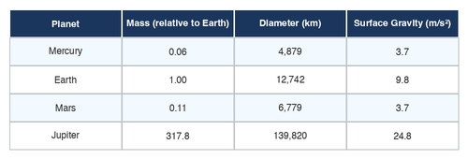
#18 TEKS 8.7C
A student collects data on the planets in our solar system. Based on the data, which planet would have the STRONGEST gravitational pull on an object on its surface?
A) Mercury
B) Earth
C) Jupiter
D) Mars

Slide 20
#19 TEKS 8.8A
Which cell structure is found in plant cells but NOT in animal cells?
A) Cell membrane
B) Nucleus
C) Cell wall
D) Mitochondria

Slide 21
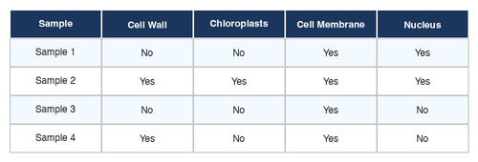
#20 TEKS 8.8A
A student observes cells under a microscope and records the following data. Which sample is MOST LIKELY from a plant?
A) Sample 1
B) Sample 2
C) Sample 3
D) Sample 4

Slide 22
#21 TEKS 8.8B
In humans, brown eye color (B) is dominant over blue eye color (b). A father with genotype Bb and a mother with genotype Bb have a child. What is the probability that the child will have blue eyes?
A) 0%
B) 25%
C) 50%
D) 75%

Slide 23
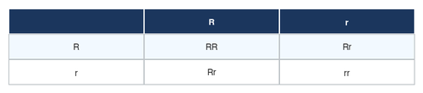
#22 TEKS 8.8B
A Punnett square is used to predict offspring traits. Two parents who are both heterozygous (Rr) for round seed shape are crossed. The data table shows the expected results. What percentage of offspring are expected to have round seeds?
A) 25%
B) 50%
C) 75%
D) 100%

Slide 24
#23 TEKS 8.8C
In an ecosystem, grass captures energy from the sun. Grasshoppers eat the grass. Frogs eat the grasshoppers. Snakes eat the frogs. Which organism in this food chain has the LEAST amount of available energy?
A) Grass
B) Grasshopper
C) Frog
D) Snake

Slide 25
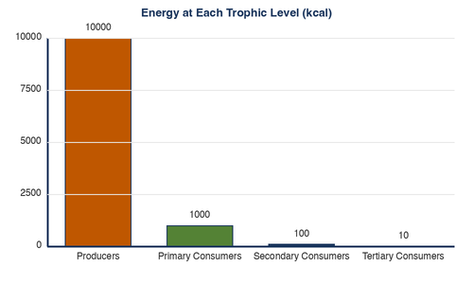
#24 TEKS 8.8C
The bar graph shows the amount of energy available at each trophic level in an ecosystem. Approximately what percentage of energy is transferred from producers to primary consumers?
A) 1%
B) 10%
C) 50%
D) 90%

Slide 26
#25 TEKS 8.8D
A population of beetles lives on a dark forest floor. Some beetles are dark-colored and some are light-colored. Birds eat the beetles they can see. Over many generations, what will MOST LIKELY happen?
A) All beetles will become light-colored
B) The population will have more dark-colored beetles
C) The birds will stop eating beetles
D) The beetles will grow larger to avoid predators

Slide 27
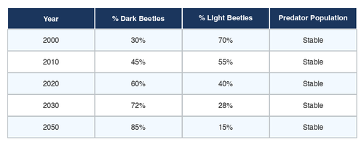
#26 TEKS 8.8D
Scientists tracked a beetle population over 50 years. The data shows the percentage of dark-colored beetles over time. Which concept BEST explains the trend shown?
A) Genetic engineering
B) Selective breeding
C) Natural selection
D) Artificial selection

Slide 28
#27 TEKS 8.9A
Which factor is MOST responsible for the differences in climate between a city near the equator and a city near the North Pole?
A) Altitude
B) Latitude
C) Longitude
D) Distance from a lake

Slide 29
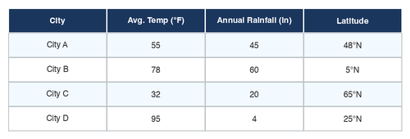
#28 TEKS 8.9A
Students collected average temperature and precipitation data for four cities. Which city MOST LIKELY has a desert climate?
A) City A
B) City B
C) City C
D) City D

Slide 30
#29 TEKS 8.9B
A student tracks the movement of a cold front on a weather map. Which weather conditions would the student MOST LIKELY observe as the cold front passes through their area?
A) Clear skies and rising temperatures
B) Heavy rain, thunderstorms, then cooler temperatures
C) Fog and steady drizzle for several days
D) No change in weather conditions

Slide 31
#30 TEKS 8.9C
A factory releases large amounts of carbon dioxide into the atmosphere. Which long-term effect is this MOST LIKELY to contribute to?
A) Stronger magnetic field
B) Increase in average global temperatures
C) Decrease in ocean levels
D) More earthquakes

Slide 32
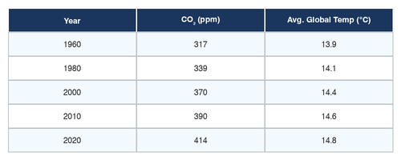
#31 TEKS 8.9C
The graph shows carbon dioxide levels and average global temperature over 60 years. What relationship is BEST supported by the data?
A) As CO₂ increases, temperature decreases
B) CO₂ levels and temperature are not related
C) As CO₂ increases, average global temperature also increases
D) Temperature controls CO₂ levels

Slide 33
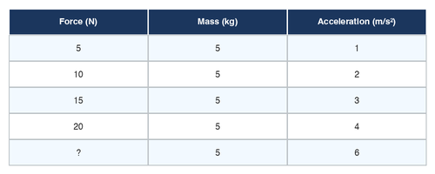
#32 TEKS 8.6A
A student places a 5 kg object on a frictionless surface and applies different forces. The data is shown below. Based on Newton's Second Law, what force is needed to accelerate the object at 6 m/s²?
A) 11 N
B) 25 N
C) 30 N
D) 35 N

