Slide 1
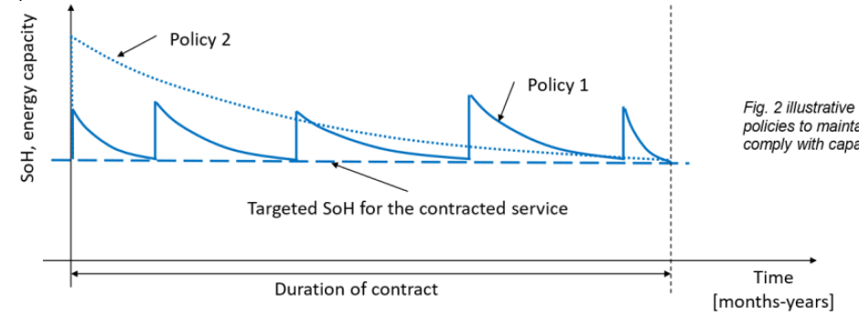
1. GREEDY SOH RECOVERY → keep constant SOH by replacing the cells when needed

Slide 2

























$${E(t=1)}_{100}$$
$${E(t)}_{100}$$
$${E(T−1)}_{100}$$
$${SOC}_{100}$$
$${E(t=1)}_{75}$$
$${E(T−2)}_{75}$$
$${E(T−1)}_{75}$$
$${SOC}_{75}$$
$${E(0)}_{target}$$
$${E(t=1)}_{tg}$$
$${E(t)}_{tg}$$
$${E(T−1)}_{tg}$$
$${E(t=1)}_{25}$$
$${E(t)}_{25}$$
$${E(T−1)}_{25}$$
$${SOC}_{25}$$
$${E(t=1)}_{0}$$
$${E(t)}_{0}$$
$${E(T−1)}_{1}$$
$${SOC}_{0}$$
$$t=0$$
$t=$1
$t=$1
$$t=T−1$$
$$t=T$$

Slide 3






DAY T=365
${s\left(k=1\right)}_{}$= E(366)
s$(k−1)$
s$(k)$
$${s(k=1)}_{}=E(T=365)$$
$${s(k=49)}_{E(T=365)}={s(k=1)}_{E(T=366)}$$
$${s(k=1)}_{E(T=365)}={s(k=49)}_{E(T=364)}$$

Slide 4
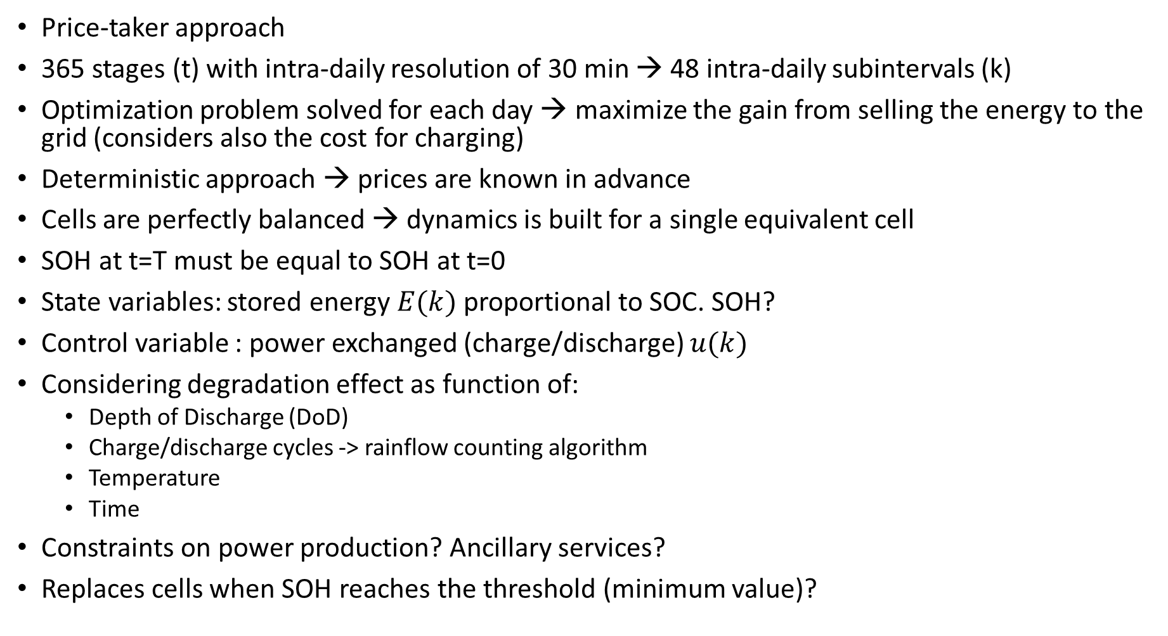
Price-taker approach
365 stages (t) with intra-daily resolution of 30 min → 48 intra-daily subintervals (k)
Optimization problem solved for each day → maximize the gain from selling the energy to the grid (considers also the cost for charging)
Deterministic approach → prices are known in advance
Cells are perfectly balanced → dynamics is built for a single equivalent cell
SOH at t=T must be equal to SOH at t=0
State variables: stored energy $E(k)$proportional to SOC. SOH?
Control variable : power exchanged (charge/discharge) $u(k)$
Considering degradation effect as function of:
Depth of Discharge (DoD)
Charge/discharge cycles -> rainflow counting algorithm
Temperature
Time
Constraints on power production? Ancillary services?
Replaces cells when SOH reaches the threshold (minimum value)?

Slide 5

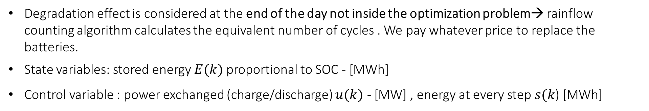

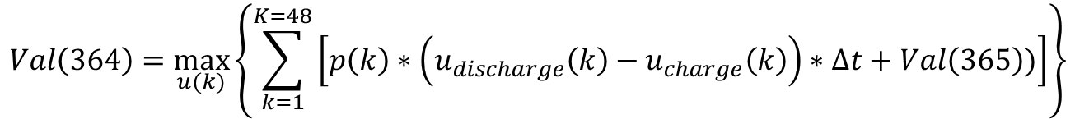
ASSUMPTIONS
Price-taker approach → prices are known in advance (deterministic)
Cells are perfectly balanced → dynamics is built for a single equivalent cell
365 stages (t) with intra-daily resolution of 30 min → 48 intra-daily subintervals (k)
Optimization problem solved for each day → maximize the gain from selling the energy to the grid (considers also the cost for charging) + considers the value at next stage
$$Val\left(364\right)=\max_{u(k)}\left\{\sum_{k=1}^{K=48}{\left[p\left(k\right)∗\left(u_{discharge}\left(k\right)−u_{charge}\left(k\right)\right)∗∆t+Val\left(365\right))\right]}\right\}$$
$$Val\left(t+1\right)=E\left(t+1\right)∗p(t+1)$$
Degradation effect is considered at the end of the day not inside the optimization problem→ rainflow counting algorithm calculates the equivalent number of cycles . We pay whatever price to replace the batteries.
State variables: stored energy $E(k)$proportional to SOC - [MWh]
Control variable : power exchanged (charge/discharge) $u(k)$ - [MW] , energy at every step $s(k$) [MWh]

Slide 6
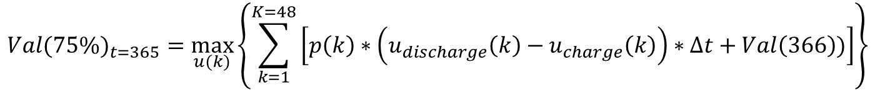

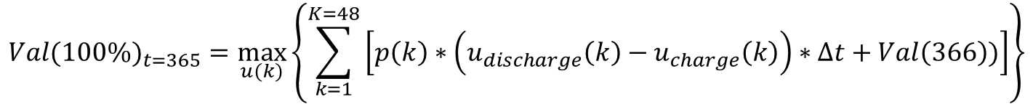
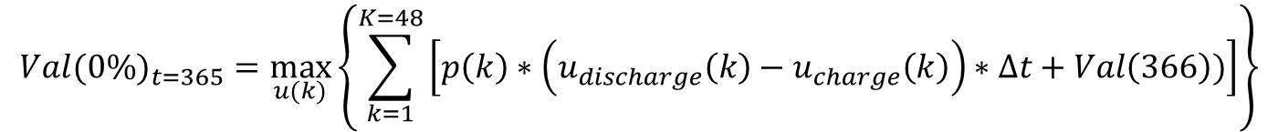
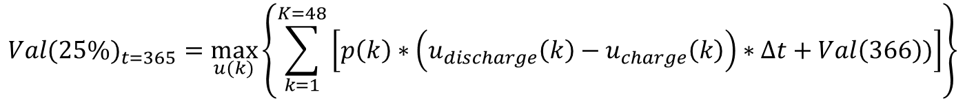
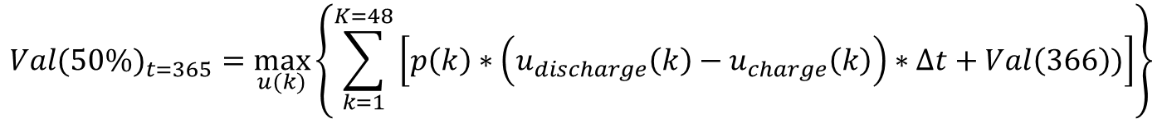
5 states of charge :
$${Val(100\%)}_{t=365}=\max_{u(k)}\left\{\sum_{k=1}^{K=48}{\left[p\left(k\right)∗\left(u_{discharge}\left(k\right)−u_{charge}\left(k\right)\right)∗∆t+Val\left(366\right))\right]}\right\}$$
$${Val(75\%)}_{t=365}=\max_{u(k)}\left\{\sum_{k=1}^{K=48}{\left[p\left(k\right)∗\left(u_{discharge}\left(k\right)−u_{charge}\left(k\right)\right)∗∆t+Val\left(366\right))\right]}\right\}$$
$${Val(50\%)}_{t=365}=\max_{u(k)}\left\{\sum_{k=1}^{K=48}{\left[p\left(k\right)∗\left(u_{discharge}\left(k\right)−u_{charge}\left(k\right)\right)∗∆t+Val\left(366\right))\right]}\right\}$$
$${Val(25\%)}_{t=365}=\max_{u(k)}\left\{\sum_{k=1}^{K=48}{\left[p\left(k\right)∗\left(u_{discharge}\left(k\right)−u_{charge}\left(k\right)\right)∗∆t+Val\left(366\right))\right]}\right\}$$
$${Val(0\%)}_{t=365}=\max_{u(k)}\left\{\sum_{k=1}^{K=48}{\left[p\left(k\right)∗\left(u_{discharge}\left(k\right)−u_{charge}\left(k\right)\right)∗∆t+Val\left(366\right))\right]}\right\}$$

Slide 7
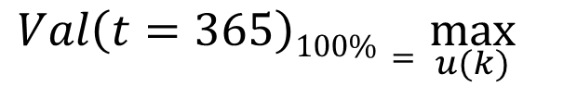
5 states of charge :
$${gain}_{soc365=100\%}$$
$${gain}_{soc365=75\%}$$
$$Val\left(t=365\right)100\%=\max_{u(k)}{}$$
$${gain}_{soc365=50\%}$$
$${gain}_{soc365=25\%}$$
$${gain}_{soc35=0\%}$$

Slide 8
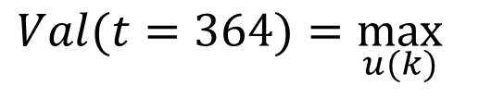
5 states of charge :
$${gain}_{soc364=100\%}+Val\left(365\right)$$
$${gain}_{soc364=75\%}+Val\left(365\right)$$
$$Val(t=364)=\max_{u(k)}{}$$
$${gain}_{soc364=50\%}+Val\left(365\right)$$
$${gain}_{soc364=25\%}+Val\left(365\right)$$
$${gain}_{soc364=0\%}+Val\left(365\right)$$

Slide 9
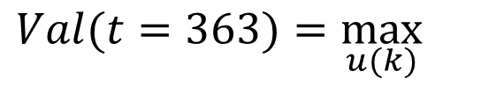
5 states of charge :
$${gain}_{soc363=100\%}+Val\left(364\right)$$
$${gain}_{soc363=75\%}+Val\left(364\right)$$
$$Val(t=363)=\max_{u(k)}{}$$
$${gain}_{soc363=50\%}+Val\left(364\right)$$
$${gain}_{soc363=25\%}+Val\left(364\right)$$
$${gain}_{soc363=0\%}+Val\left(364\right)$$

Slide 10




K=1_{T=365}
DAY T=365
Potenza installata 10 MW- Capacità energetica 40 MWh
K=49_{T=365}
SOC (100%)
= 40 MWH
$${s(k=1)}_{E2(T=365)}={s(k=49)}_{E2(T=364)}$$
SOC (75%)
= 30 MWH
$${charge}_{k}$$
$${discharge}_{k}$$
SOC (55%)
= 20 MWH
$$s_{k}$$
$$s_{k+1}$$
SOC (75%)
= 10 MWH
SOC (75%)
= 0 MWH
$${s(k=49)}_{E4(T=365)}={s(k=1)}_{E4\left(T=366\right)}=ValoreDato$$

Slide 11


































$${E(t=1,k=1)}_{100}$$
$${E(t=2,k=1)}_{100}$$
$${E(t=364,k=1)}_{100}$$
$${E(t=365,k=1)}_{100}$$
$${E(t=366,k=1)}_{100}=E(t=365, k=49)$$
$${SOC}_{100}$$
$${Val(t=366,k=1)}_{100}=416.62$$
$${E(t=1,k=1)}_{75}$$
$${E(t=2,k=1)}_{75}$$
$${E(t=364,k=1)}_{75}$$
$${E(t=365,k=1)}_{75}$$
$${E(t=366,k=1)}_{75}=$$
$${SOC}_{75}$$
$${E(t=1,k=1)}_{50}$$
$${E(t=2,k=1)}_{50}$$
$${E(t=364,k=1)}_{50}$$
$${E(t=365,k=1)}_{50}$$
$${E(t=366,k=1)}_{50}$$
$${SOC}_{75}$$
$${E(t=1,k=1)}_{25}$$
$${E(t=2,k=1)}_{25}$$
$${E(t=364,k=1)}_{25}$$
$${E(t=365,k=1)}_{25}$$
$${E(t=366,k=1)}_{25}$$
$${SOC}_{25}$$
$${E(t=1,k=1)}_{0}$$
$${E(t=2,k=1)}_{0}$$
$${E(t=364,k=1)}_{0}$$
$${E(t=365,k=1)}_{0}$$
$${SOC}_{0}$$
${E(t=366,k=1)}_{0}$=0
$$t=1$$
$t=$2
$t=36$4
$$t=365$$

Slide 12
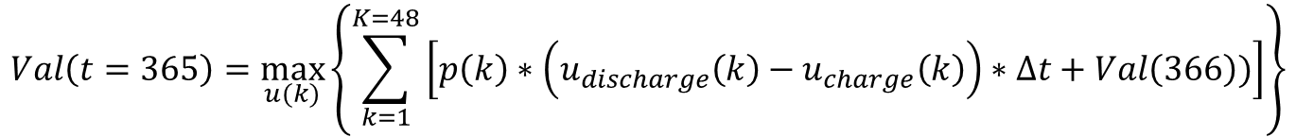
Objective function : for each stage $t$ minimize the cost function
$$Val\left(t=365\right)=\max_{u(k)}\left\{\sum_{k=1}^{K=48}{\left[p\left(k\right)∗\left(u_{discharge}\left(k\right)−u_{charge}\left(k\right)\right)∗∆t+Val\left(366\right))\right]}\right\}$$
Subject to:
$s\left(k\right)+ \left[λ_{charge}u_{charge}\left(k\right)−{λ_{discharge}u}_{discharge}\left(k\right)\right] ∗∆k =s(k+1) ∀t$
$${s\left(k=1\right)}_{t=366}={s\left(k=49\right)}_{t=365}=E(366)$$
$${s\left(k=49\right)}_{t=364}={s\left(k=1\right)}_{t=365}=E(365)$$
${u_{min}≤u}_{charge}\left(k\right) ≤ u_{max}$ MW
${u_{min}≤u}_{discharge}\left(k\right) ≤ u_{max}$ MW
$s_{min}≤s\left(k\right) ≤ s_{max}$ MWh
$E_{min}≤E\left(t\right) ≤ E_{max}$ MWh

Slide 13
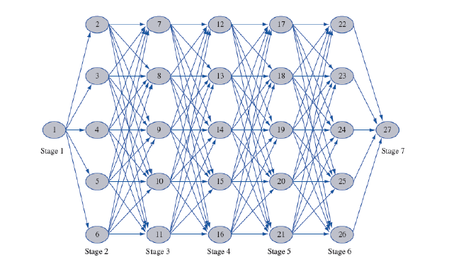

Slide 14







State 1, stage t
$${val}_{t}^{100\%}$$
$${val}_{t+1}^{100\%}={cap}_{100\%}∗price(t+1)$$
$${val}_{t+1}^{75\%}={cap}_{75\%}∗price(t+1)$$
$${val}_{t}^{100\%→100\%}=p\left(t\right)∗t∗\left[dis\left(t\right)−ch\left(t\right)\right]+ {val}_{t+1}^{100\%}$$
$${val}_{t}^{100\%→75\%}=p\left(t\right)∗t∗\left[dis\left(t\right)−ch\left(t\right)\right]+ {val}_{t+1}^{75\%}$$
$${val}_{t}^{100\%}=$$
$${val}_{t+1}^{50\%}={cap}_{50\%}∗price(t+1)$$
max
$${val}_{t}^{100\%→50\%}=p\left(t\right)∗t∗\left[dis\left(t\right)−ch\left(t\right)\right]+{val}_{t+1}^{50\%}$$
$${val}_{t}^{100\%→25\%}=p\left(t\right)∗t∗\left[dis\left(t\right)−ch\left(t\right)\right]+ {val}_{t+1}^{25\%}$$
$${val}_{t+1}^{25\%}={cap}_{25\%}∗price(t+1)$$
$${val}_{t}^{100\%→0\%}=p\left(t\right)∗t∗\left[dis\left(t\right)−ch\left(t\right)\right]+{val}_{t+1}^{0\%}$$
$${val}_{t+1}^{0\%}={cap}_{0\%}∗price(t+1)$$
${val}_{t}^{0\%}=p\left(t\right)∗t∗\left[dis\left(t\right)−{ch}_{grid}\left(t\right)\right]−\deg\left(t\right)∗cost−penalty+$ ${val}_{t+1}^{75\%}$

Slide 15



State 2, stage t
$${val}_{t}^{100\%}$$
$${val}_{t+1}^{100\%}={cap}_{100\%}∗price(t+1)$$
$${val}_{t}^{75\%}$$
$${val}_{t+1}^{75\%}={cap}_{75\%}∗price(t+1)$$
$${val}_{t}^{75\%→100\%}=p\left(t\right)∗t∗\left[dis\left(t\right)−ch\left(t\right)\right]+ {val}_{t+1}^{100\%}$$
$${val}_{t+1}^{50\%}={cap}_{50\%}∗price(t+1)$$
$${val}_{t}^{75\%→75\%}=p\left(t\right)∗t∗\left[dis\left(t\right)−ch(t)\right] {+val}_{t+1}^{75\%}$$
$${val}_{t}^{75\%}=$$
max
$${val}_{t}^{75\%→50\%}=p\left(t\right)∗t∗\left[dis\left(t\right)−ch\left(t\right)\right]+ {val}_{t+1}^{50\%}$$
$${val}_{t+1}^{25\%}={cap}_{25\%}∗price(t+1)$$
$${val}_{t}^{75\%→25\%}=p\left(t\right)∗t∗\left[dis\left(t\right)−ch\left(t\right)\right]+ {val}_{t+1}^{25\%}$$
$${val}_{t}^{75\%→0\%}=p\left(t\right)∗t∗\left[dis\left(t\right)−ch(t)\right] {+val}_{t+1}^{0\%}$$
$${val}_{t+1}^{0\%}={cap}_{0\%}∗price(t+1)$$

Slide 16


State 5, stage t
$${val}_{t}^{100\%}$$
$${val}_{t+1}^{100\%}={cap}_{100\%}∗price(t+1)$$
$${val}_{t}^{0\%→100\%}=p\left(t\right)∗t∗\left[dis\left(t\right)−ch(t)\right] {val}_{t+1}^{100\%}$$
$${val}_{t}^{0\%→75\%}=p\left(t\right)∗t∗\left[dis\left(t\right)−ch(t)\right] {val}_{t+1}^{75\%}$$
$${val}_{t+1}^{75\%}={cap}_{75\%}∗price(t+1)$$
$${val}_{t}^{0\%}=$$
max
$${val}_{t}^{0\%→50\%}=p\left(t\right)∗t∗\left[dis\left(t\right)−ch(t)\right] {val}_{t+1}^{50\%}$$
$${val}_{t+1}^{50\%}={cap}_{50\%}∗price(t+1)$$
$${val}_{t}^{0\%→25\%}=p\left(t\right)∗t∗\left[dis\left(t\right)−ch(t)\right] {val}_{t+1}^{25\%}$$
$${val}_{t}^{0\%}=p\left(t\right)∗t∗\left[dis\left(t\right)−ch(t)\right] {val}_{t+1}^{0\%}$$
$${val}_{t+1}^{25\%}={cap}_{25\%}∗price(t+1)$$
$${val}_{t+1}^{0\%}={cap}_{0\%}∗price(t+1)$$
$${val}_{t}^{0\%}$$

Slide 17


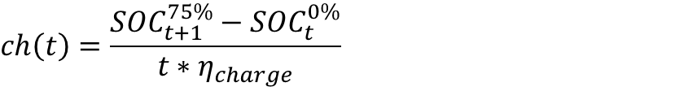
CHARGE
$$ch\left(t\right)=\frac{{SOC}_{t+1}^{75\%}−{SOC}_{t}^{0\%}}{t∗η_{charge}}$$
$${SOC}_{t+1}^{75\%}$$
$$deg\left(t\right)=\left|\frac{1}{N.cy({DOD}_{100\%})}∗0.5−\frac{1}{N.cy({DOD}_{25\%})}∗0.5\right|$$
$$dis\left(t\right)=0$$
$${ch}_{grid\left(t\right)}=ch\left(t\right)−pv(t)$$
$$penalty=10E7 if ch\left(t\right)>power_capacity$$
$$penalty=0 if ch\left(t\right)≤power_capacity$$
${val}_{t}^{0\%}=p\left(t\right)∗t∗\left[dis\left(t\right)−{ch}_{grid}\left(t\right)\right]−\deg\left(t\right)∗cost−penalty+$ ${val}_{t+1}^{75\%}$
$${gain}_{t}^{0\%}=p\left(t\right)∗t∗\left[dis\left(t\right)−{ch}_{grid}\left(t\right)\right]−\deg\left(t\right)∗cost$$
$${SOC}_{t}^{0\%}$$

Slide 18



DISCHARGE
$${SOC}_{t}^{100\%}$$
$$dis\left(t\right)=\frac{{SOC}_{t}^{100\%}−{SOC}_{t+1}^{50\%}}{t}∗η_{discharge}$$
$$deg\left(t\right)=\left|\frac{1}{N.cy({DOD}_{0\%})}∗0.5−\frac{1}{N.cy({DOD}_{50\%})}∗0.5\right|$$
$$ch\left(t\right)=0$$
$${SOC}_{t+1}^{50\%}$$
$${ch}_{grid\left(t\right)}=ch\left(t\right)−pv(t)$$
${val}_{t}^{100\%}=p\left(t\right)∗t∗\left[dis\left(t\right)−{ch}_{grid}\left(t\right)\right]−\deg\left(t\right)∗cost−penalty+$ ${val}_{t+1}^{50\%}$
$${gain}_{t}^{100\%}=p\left(t\right)∗t∗\left[dis\left(t\right)−{ch}_{grid}\left(t\right)\right]−\deg\left(t\right)∗cost$$

Slide 19
ASSUMPTIONS : PV allocates power to battery whenever it is available (when charging is needed) otherwise it sells the power to the grid when in discharge phase
BATTERY
PV
$${ch}_{pv\left(t\right)}=power from PV to charge completely the battery$$
4 CASES:
$${gain}_{t}^{0\%}=λ\left(t\right)∗Δt∗\left[dis\left(t\right)+pv(t)\right]−\deg\left(t\right)∗cost$$
DISCHARGE PHASE = from Battery and from PV
$${gain}_{t}^{0\%}=−λ\left(t\right)∗Δt∗\left[ch\left(t\right)\right]−\deg\left(t\right)∗cost$$
CHARGING PHASE = from grid -> negative revenue
CHARGING PHASE = from PV, what is left is sold to the grid -> gain
$${gain}_{t}^{0\%}=λ\left(t\right)∗Δt∗\left[pv\left(t\right)−{ch}_{bat}\left(t\right)\right]−\deg\left(t\right)∗cost$$
CHARGING PHASE = from both PV(available) and from grid (remaining part)-> negative revenues
$${gain}_{t}^{0\%}=−λ\left(t\right)∗Δt∗\left[ch\left(t\right)−pv(t)\right]−\deg\left(t\right)∗cost$$
$${ch}_{grid\left(t\right)}{=ch}_{bat\left(t\right)}−pv\left(t\right)$$

Slide 20


























$${Val}_{5,t}$$
$${Val}_{5,T}$$
$${SOH}_{5}$$
$${SOH}_{5}$$
$$Cost_5$$
$${Val}_{4,t}$$
$${Val}_{4,T}$$
$${SOH}_{4}$$
$${SOH}_{4}$$
$$Cost_4$$
$${Val}_{3,t}$$
$${Val}_{3,T}$$
$${SOH}_{3}$$
$${SOH}_{3}$$
$$Cost_3$$
$${Val}_{2,t}$$
$${Val}_{2,T}$$
$${SOH}_{2}$$
$${SOH}_{2}$$
$$Cost_2$$
$${Val}_{1,t}$$
$${SOH}_{1}=min$$
$${SOH}_{1}=min$$
$${Val}_{1,T}$$
8064 step da mezz’ora -> 6 mesi da 28 giorni
$$t=T=8064+1$$
$$t=0$$

Slide 21
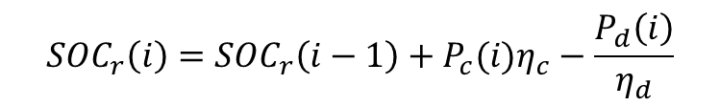


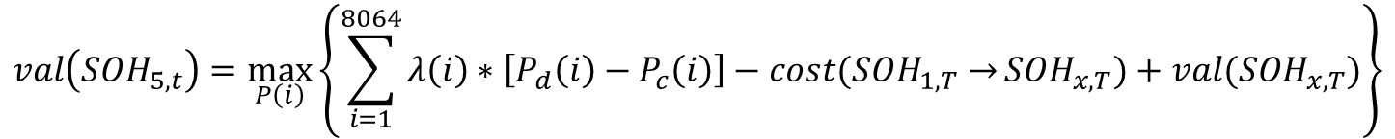



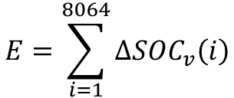

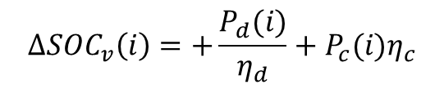
VARIABLES:
Variabile ausiliaria
$$0 ≤P_{c}(i)≤P_{c}^{max}$$
$0 ≤{SOC}_{r}(i)≤{SOC}_{r}^{max}({SOH}_{i=1})$
$${SOC}_{v}(i)≥0$$
$$0 ≤P_{d}(i)≤P_{d}^{max}$$
$$0 ≤SOH(i)≤{SOH}^{max}$$
Variablie di stato (optimal disretization)
OBJECTIVE FUNCTION:
$$val\left({SOH}_{5,t}\right)=\max_{P\left(i\right)}\left\{\sum_{i=1}^{8064}{λ\left(i\right)∗\left[P_{d}\left(i\right)−P_{c}\left(i\right)\right]−cost({SOH}_{1,T}→}{SOH}_{x,T})+val({SOH}_{x,T})\right\}$$
SUBJECT TO:
SOC virtuale che tiene in conto l’energia accumulata/scambiata
Se carico/scarico della stessa quantità, la degradazione non cambia
$${SOC}_{r}\left(i\right)={SOC}_{r}\left(i−1\right)+P_{c}(i)η_{c}−\frac{P_{d}\left(i\right)}{η_{d}}$$
$${ΔSOC}_{v}\left(i\right)=+\frac{P_{d}(i)}{η_{d}}+P_{c}(i)η_{c}$$
$$E=\sum_{i=1}^{8064}{{ΔSOC}_{v}\left(i\right)}$$
$$N=\frac{E}{{SOC}_{r}^{max}({SOH}_{i=0})}$$
$$SOH\left(i=8065\right)=SOH\left(i=1\right)−f(N)$$

Slide 22
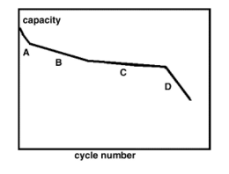
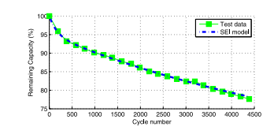

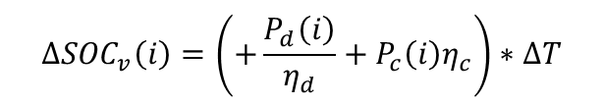




$$SOC(i=1)=SOH(t)$$
soc$(i−1)$
$$SOC(i=8065)=SOH(T)$$
Soc(i)
$${SOC}_{r}\left(i\right)={SOC}_{r}\left(i−1\right)+\left(\frac{P_{c}\left(i\right)}{η_{c}}−P_{d}\left(i\right)η_{d}\right)∗∆T$$
$${ΔSOC}_{v}\left(i\right)=\left(+\frac{P_{d}\left(i\right)}{η_{d}}+P_{c}\left(i\right)η_{c}\right)∗∆T$$
$$N=\frac{\sum_{i=1}^{8064}{{ΔSOC}_{v}\left(i\right)}}{{SOC}_{r}^{max}({SOH}_{i=0})}$$
$$SOH\left(T\right)=SOH\left(t\right)−f(N)$$
$$f\left(N\right)= k_{3}∗N^{3}+k_{2}∗N^{2}+k_{1}∗N+k_{0}$$
$$f\left(N\right)= k_{2}∗N+k_{1}$$

Slide 23







$${Val}_{5,t}$$
$${Val}_{5,T}$$
$${SOH}_{5}$$
$${SOH}_{5}$$
$${Val}_{4,t}$$
$${Val}_{4,T}$$
$${SOH}_{4}$$
$${SOH}_{4}$$
$${Val}_{3,t}$$
$${Val}_{3,T}$$
$${SOH}_{3}$$
$${SOH}_{3}$$
$${Val}_{2,t}$$
$${Val}_{2,T}$$
$${SOH}_{2}$$
$${SOH}_{2}$$
$${Val}_{1,t}$$
$${SOH}_{1}=min$$
$${SOH}_{1}=min$$
$${Val}_{1,T}$$
8064 step da mezz’ora -> 6 mesi da 28 giorni
$$t=T=8064+1$$
$$t=0$$

Slide 24


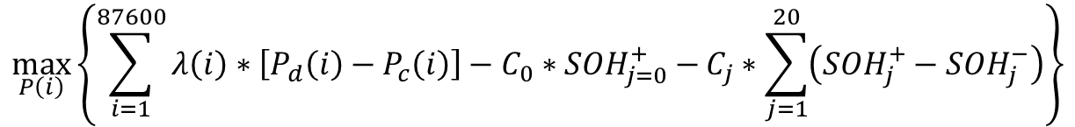













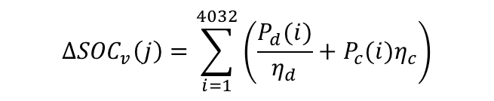



$${SOH}_{j=0}^{+}$$
$${SOH}_{j=1}^{+}$$
$${SOH}^{min}$$
$$j=0$$
$${SOH}_{j=1}^{−}$$
$$j=2$$
$$j=3$$
$$j=18$$
$j=$19
$$j=20$$
$$j=1$$
$$\max_{P\left(i\right)}\left\{\sum_{i=1}^{87600}{λ\left(i\right)∗\left[P_{d}\left(i\right)−P_{c}\left(i\right)\right]−C_{0}∗{SOH}_{j=0}^{+}−}C_{j}∗\sum_{j=1}^{20}{\left({SOH}_{j}^{+}−{SOH}_{j}^{−}\right)}\right\}$$
$$0 ≤P_{c}(i)≤P_{c}^{max}$$
$$0 ≤P_{d}(i)≤P_{d}^{max}$$
$0 ≤{SOC}_{r}(i)≤S_{r}^{max}$
$${ΔSOC}_{v}\left(j\right)=\sum_{i=1}^{4032}{\left(\frac{P_{d}(i)}{η_{d}}+P_{c}(i)η_{c}\right)}$$
$${SOH}^{min} ≤SOH(j)≤{SOH}^{max}$$
$${SOH}_{j=1}^{+}≥{SOH}_{j=1}^{−}$$
$${SOC}_{v}(i)≥0$$
$${{SOH}_{j+1}^{−}=SOH}_{j}^{+}−f\left[\frac{{ΔSOC}_{v}\left(j\right)}{S_{r}^{max}}\right]$$

Slide 25
VARIABLES:
Variabile ausiliaria
$$0 ≤P_{c}(i)≤P_{c}^{max}$$
$0 ≤{SOC}_{r}(i)≤{SOC}_{r}^{max}({SOH}_{i=1})$
$${SOC}_{v}(i)≥0$$
$$0 ≤P_{d}(i)≤P_{d}^{max}$$
$$0 ≤SOH(i)≤{SOH}^{max}$$
Variablie di stato (optimal disretization)
OBJECTIVE FUNCTION:
$$val\left({SOH}_{5,t}\right)=\max_{P\left(i\right)}\left\{\sum_{i=1}^{8064}{λ\left(i\right)∗\left[P_{d}\left(i\right)−P_{c}\left(i\right)\right]−cost({SOH}_{1,T}→}{SOH}_{x,T})+val({SOH}_{x,T})\right\}$$
SUBJECT TO:
SOC virtuale che tiene in conto l’energia accumulata/scambiata
Se carico/scarico della stessa quantità, la degradazione non cambia
$${SOC}_{r}\left(i\right)={SOC}_{r}\left(i−1\right)+P_{c}(i)η_{c}−\frac{P_{d}\left(i\right)}{η_{d}}$$
$${ΔSOC}_{v}\left(i\right)=+\frac{P_{d}(i)}{η_{d}}+P_{c}(i)η_{c}$$
$$E=\sum_{i=1}^{8064}{{ΔSOC}_{v}\left(i\right)}$$
$$N=\frac{E}{{SOC}_{r}^{max}({SOH}_{i=0})}$$
$$SOH\left(i=8065\right)=SOH\left(i=1\right)−f(N)$$

