Slide 1
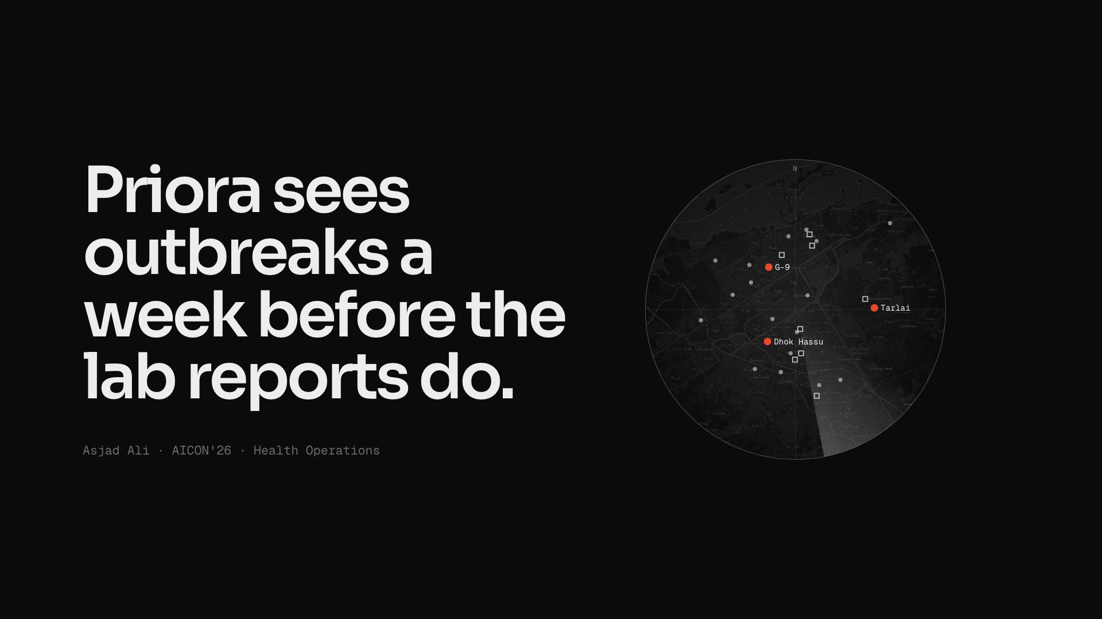
Notes:
title
"Hi, I'm Asjad, and I built this solo. Priora sees outbreaks a week before the lab reports do. That radar is live: the three red dots are clusters it flagged today across Islamabad and Rawalpindi."

Slide 2
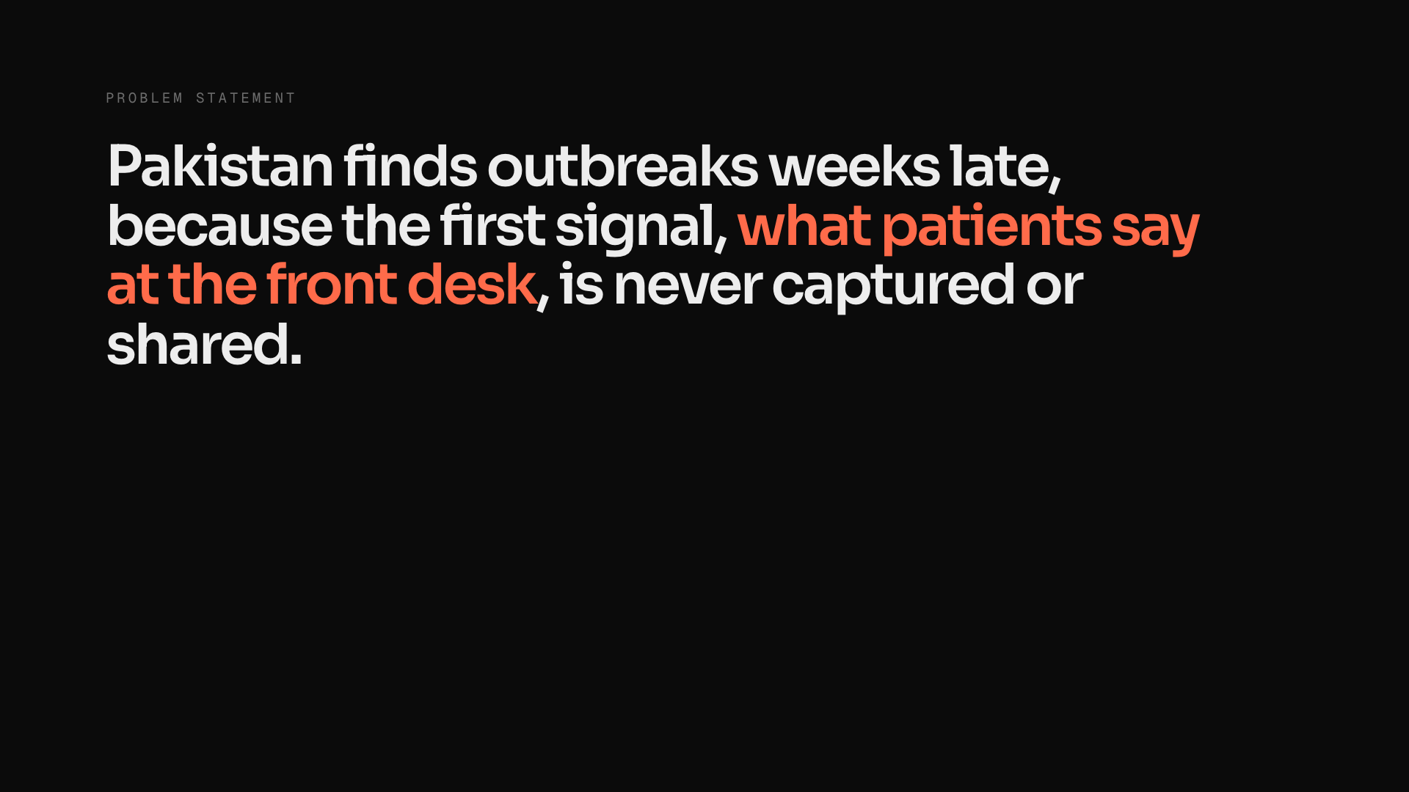
Notes:
problem-statement (click 1 of 3)
~20s · three clicks
"Here's the problem we chose. Pakistan finds outbreaks weeks late, because the very first signal, what patients say at the hospital front desk, is never captured and never shared between hospitals. In Sindh last year, 819 dengue cases were reported officially while hospitals saw over twelve thousand. Rawalpindi and Islamabad hospitals have no information systems at any level, and PIMS alone sees eight thousand patients a day on paper. So this isn't a queue problem or a records problem. It's a blind spot for the whole district."
Why this matters vs other teams: triage and hospital-management systems optimise one hospital. Nobody is solving the district's view across hospitals.

Slide 3
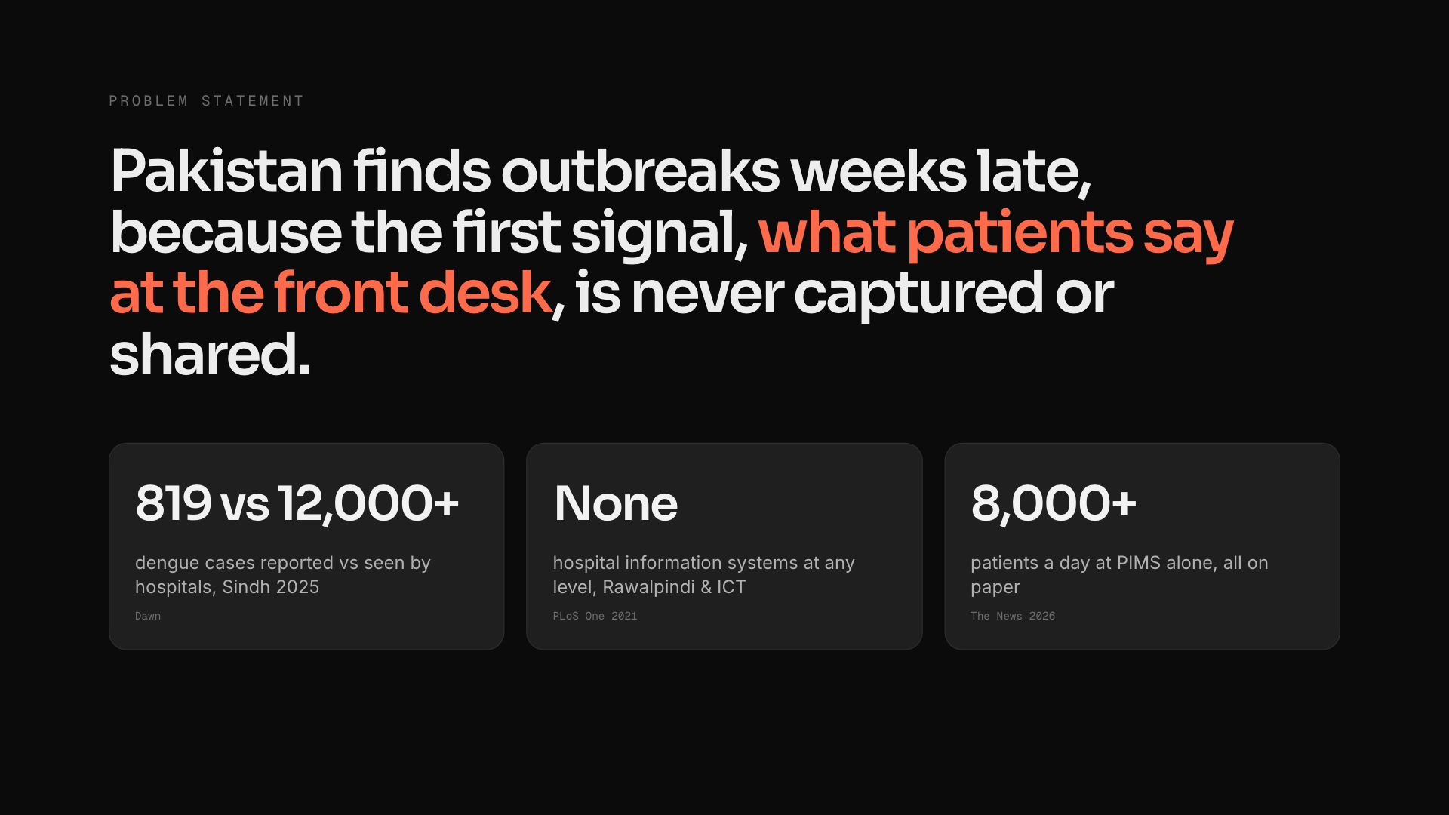
Notes:
problem-statement (click 2 of 3)
~20s · three clicks
"Here's the problem we chose. Pakistan finds outbreaks weeks late, because the very first signal, what patients say at the hospital front desk, is never captured and never shared between hospitals. In Sindh last year, 819 dengue cases were reported officially while hospitals saw over twelve thousand. Rawalpindi and Islamabad hospitals have no information systems at any level, and PIMS alone sees eight thousand patients a day on paper. So this isn't a queue problem or a records problem. It's a blind spot for the whole district."
Why this matters vs other teams: triage and hospital-management systems optimise one hospital. Nobody is solving the district's view across hospitals.

Slide 4
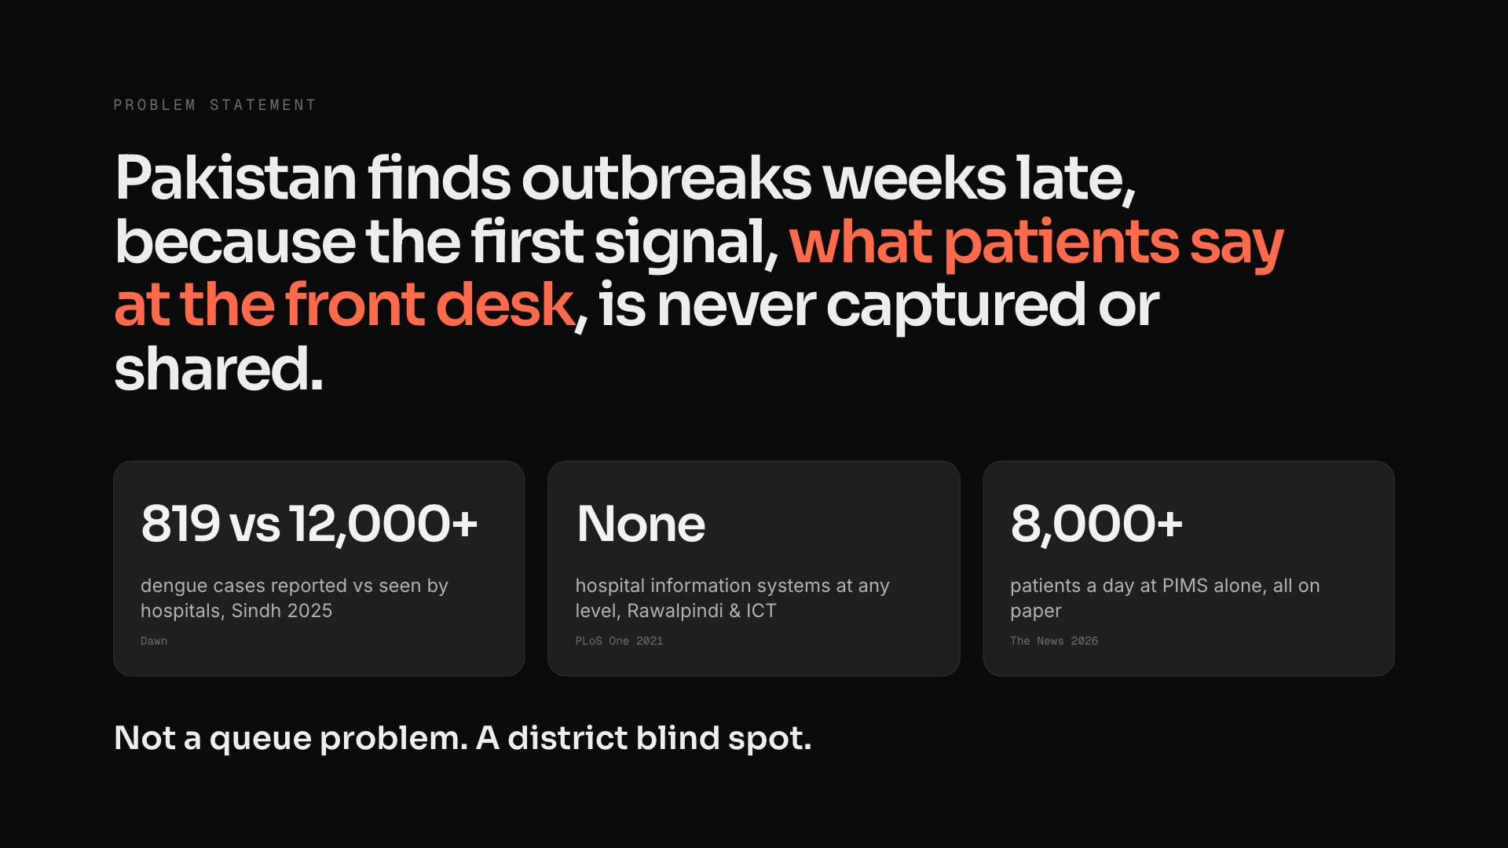
Notes:
problem-statement (click 3 of 3)
~20s · three clicks
"Here's the problem we chose. Pakistan finds outbreaks weeks late, because the very first signal, what patients say at the hospital front desk, is never captured and never shared between hospitals. In Sindh last year, 819 dengue cases were reported officially while hospitals saw over twelve thousand. Rawalpindi and Islamabad hospitals have no information systems at any level, and PIMS alone sees eight thousand patients a day on paper. So this isn't a queue problem or a records problem. It's a blind spot for the whole district."
Why this matters vs other teams: triage and hospital-management systems optimise one hospital. Nobody is solving the district's view across hospitals.

Slide 5
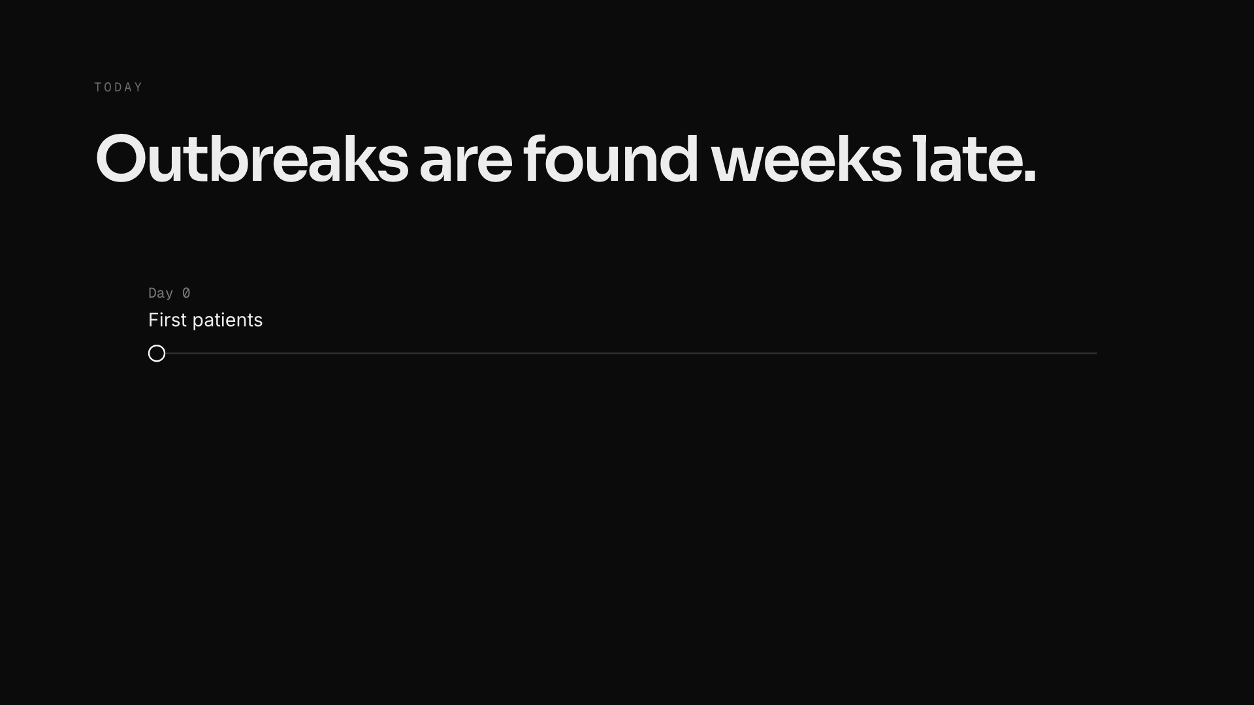
Notes:
problem (click 1 of 5)
five quick clicks
1 "Day zero: the first patients with fever reach the OPDs."
2 "Only about a third get a lab test, days later."
3 "The week closes and the report is compiled about three days after that."
4 "And only 75% of those weekly reports even arrive (NIH Pakistan, 2025)."
5 "So the district notices around day 17 (median, in our simulation). In Sindh last year, 819 dengue cases were reported officially while hospitals and labs saw over 12,000 (Dawn)."
If a doctor asks: you see the first fever patients on day zero; the system sees them weeks later.
If a business judge asks: beds, kits and fogging are bought on the wrong number, too late.

Slide 6
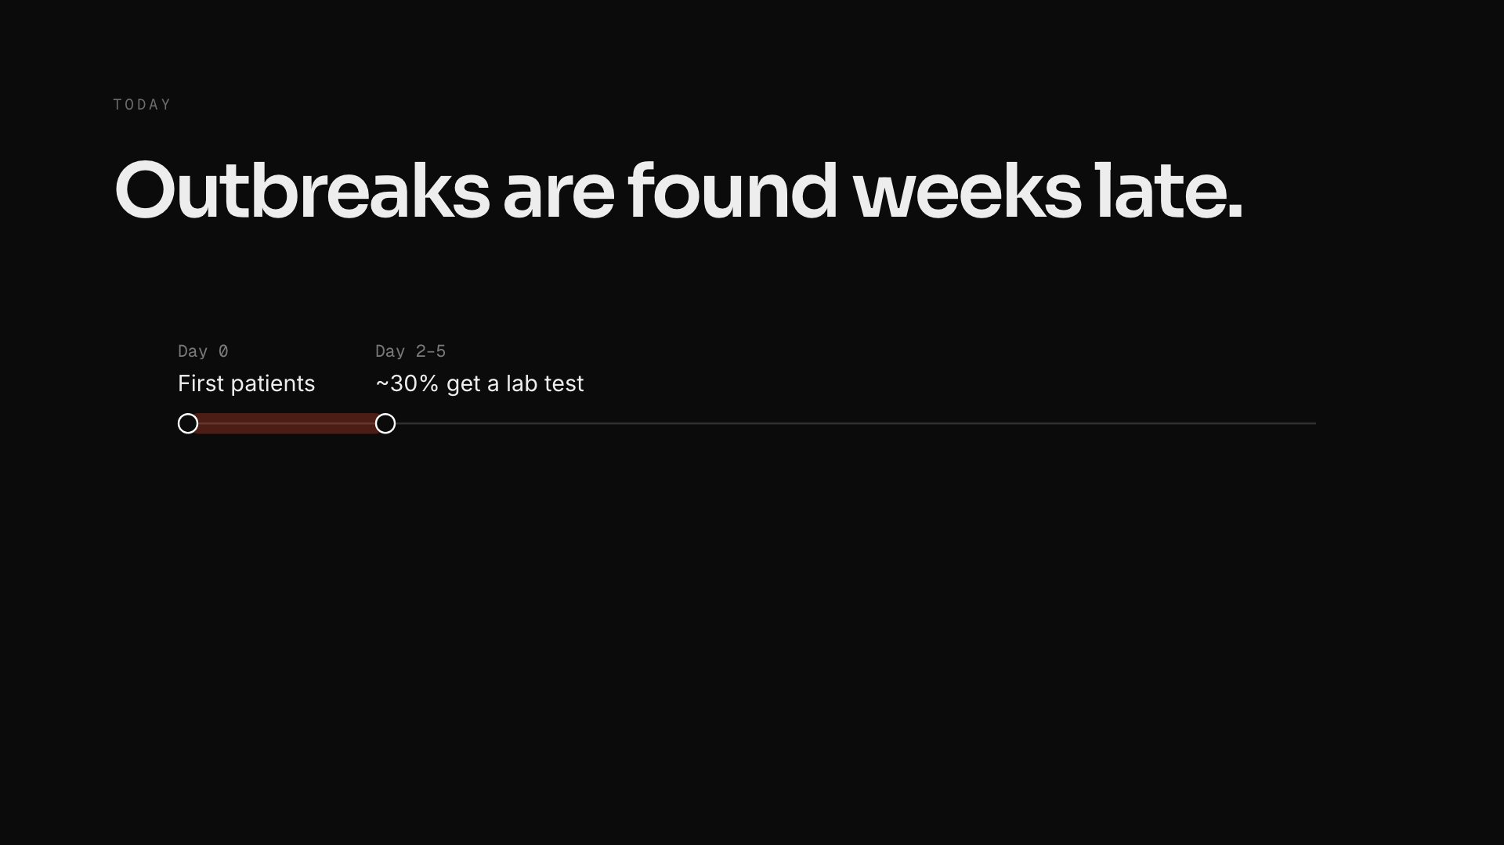
Notes:
problem (click 2 of 5)
five quick clicks
1 "Day zero: the first patients with fever reach the OPDs."
2 "Only about a third get a lab test, days later."
3 "The week closes and the report is compiled about three days after that."
4 "And only 75% of those weekly reports even arrive (NIH Pakistan, 2025)."
5 "So the district notices around day 17 (median, in our simulation). In Sindh last year, 819 dengue cases were reported officially while hospitals and labs saw over 12,000 (Dawn)."
If a doctor asks: you see the first fever patients on day zero; the system sees them weeks later.
If a business judge asks: beds, kits and fogging are bought on the wrong number, too late.

Slide 7
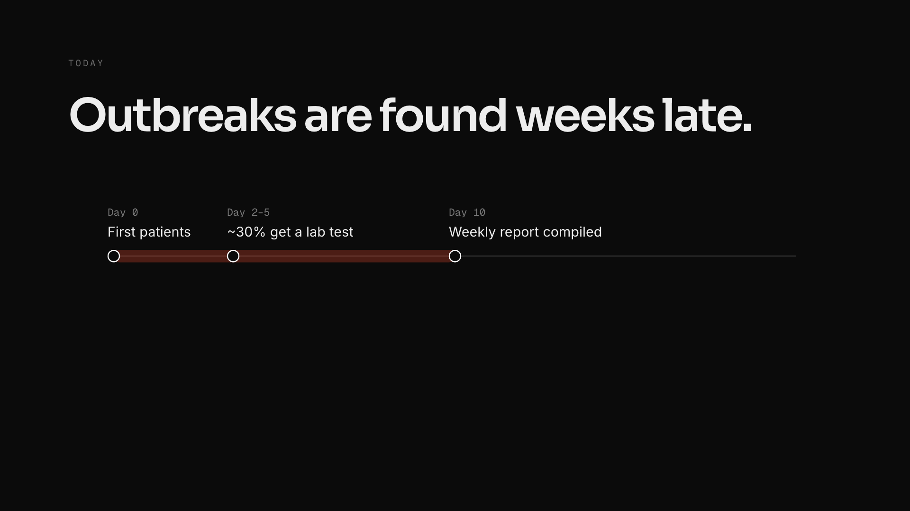
Notes:
problem (click 3 of 5)
five quick clicks
1 "Day zero: the first patients with fever reach the OPDs."
2 "Only about a third get a lab test, days later."
3 "The week closes and the report is compiled about three days after that."
4 "And only 75% of those weekly reports even arrive (NIH Pakistan, 2025)."
5 "So the district notices around day 17 (median, in our simulation). In Sindh last year, 819 dengue cases were reported officially while hospitals and labs saw over 12,000 (Dawn)."
If a doctor asks: you see the first fever patients on day zero; the system sees them weeks later.
If a business judge asks: beds, kits and fogging are bought on the wrong number, too late.

Slide 8
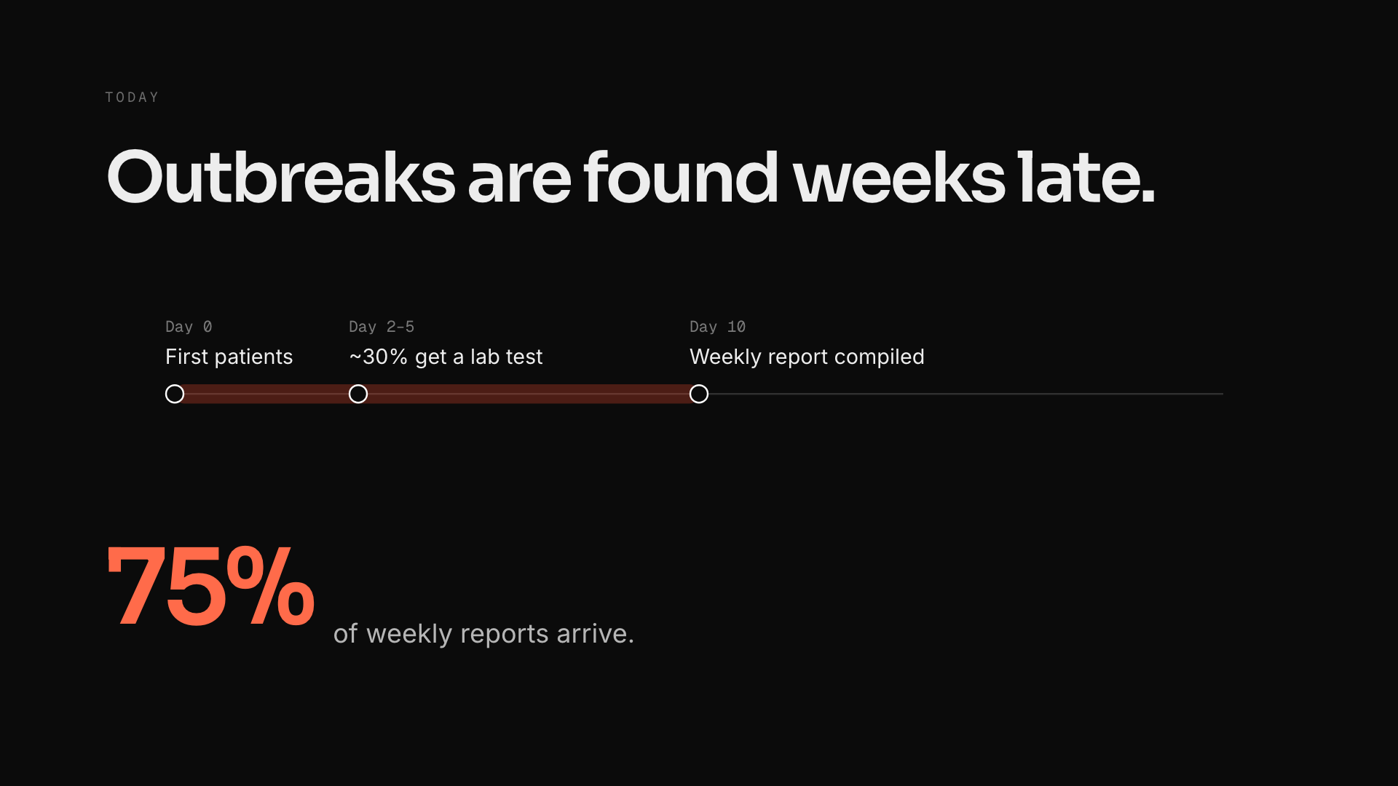
Notes:
problem (click 4 of 5)
five quick clicks
1 "Day zero: the first patients with fever reach the OPDs."
2 "Only about a third get a lab test, days later."
3 "The week closes and the report is compiled about three days after that."
4 "And only 75% of those weekly reports even arrive (NIH Pakistan, 2025)."
5 "So the district notices around day 17 (median, in our simulation). In Sindh last year, 819 dengue cases were reported officially while hospitals and labs saw over 12,000 (Dawn)."
If a doctor asks: you see the first fever patients on day zero; the system sees them weeks later.
If a business judge asks: beds, kits and fogging are bought on the wrong number, too late.

Slide 9
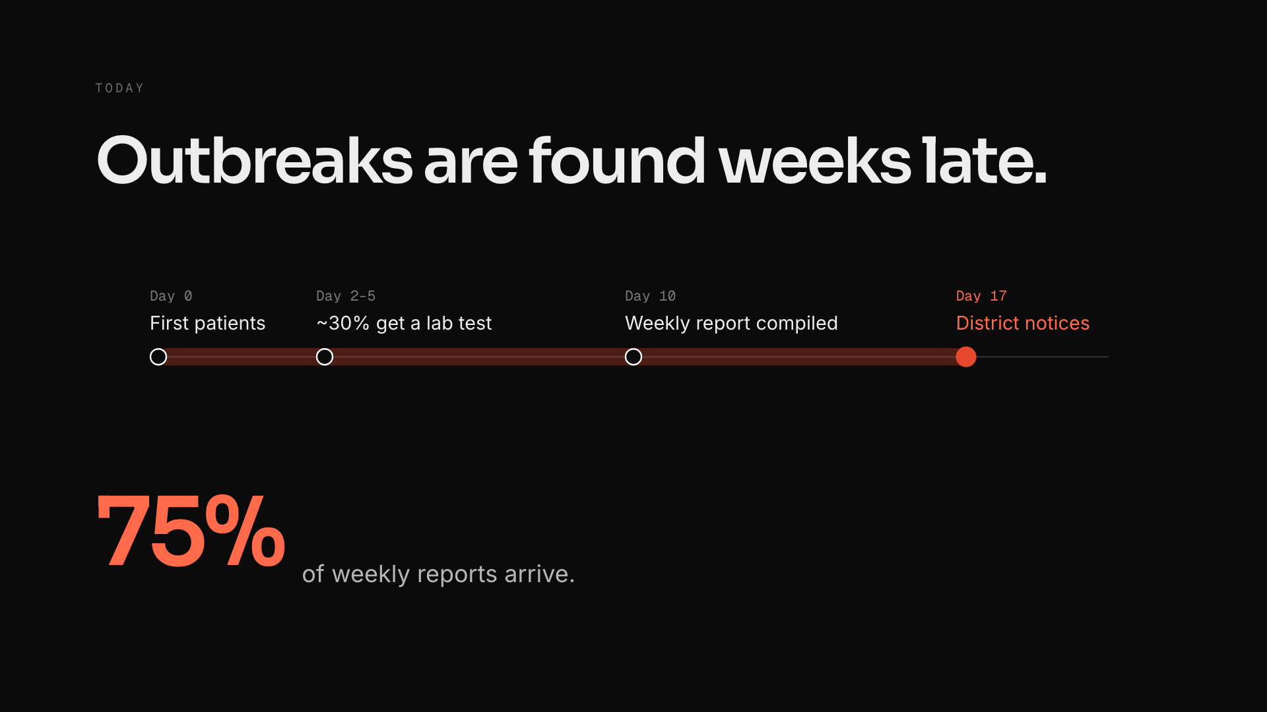
Notes:
problem (click 5 of 5)
five quick clicks
1 "Day zero: the first patients with fever reach the OPDs."
2 "Only about a third get a lab test, days later."
3 "The week closes and the report is compiled about three days after that."
4 "And only 75% of those weekly reports even arrive (NIH Pakistan, 2025)."
5 "So the district notices around day 17 (median, in our simulation). In Sindh last year, 819 dengue cases were reported officially while hospitals and labs saw over 12,000 (Dawn)."
If a doctor asks: you see the first fever patients on day zero; the system sees them weeks later.
If a business judge asks: beds, kits and fogging are bought on the wrong number, too late.

Slide 10
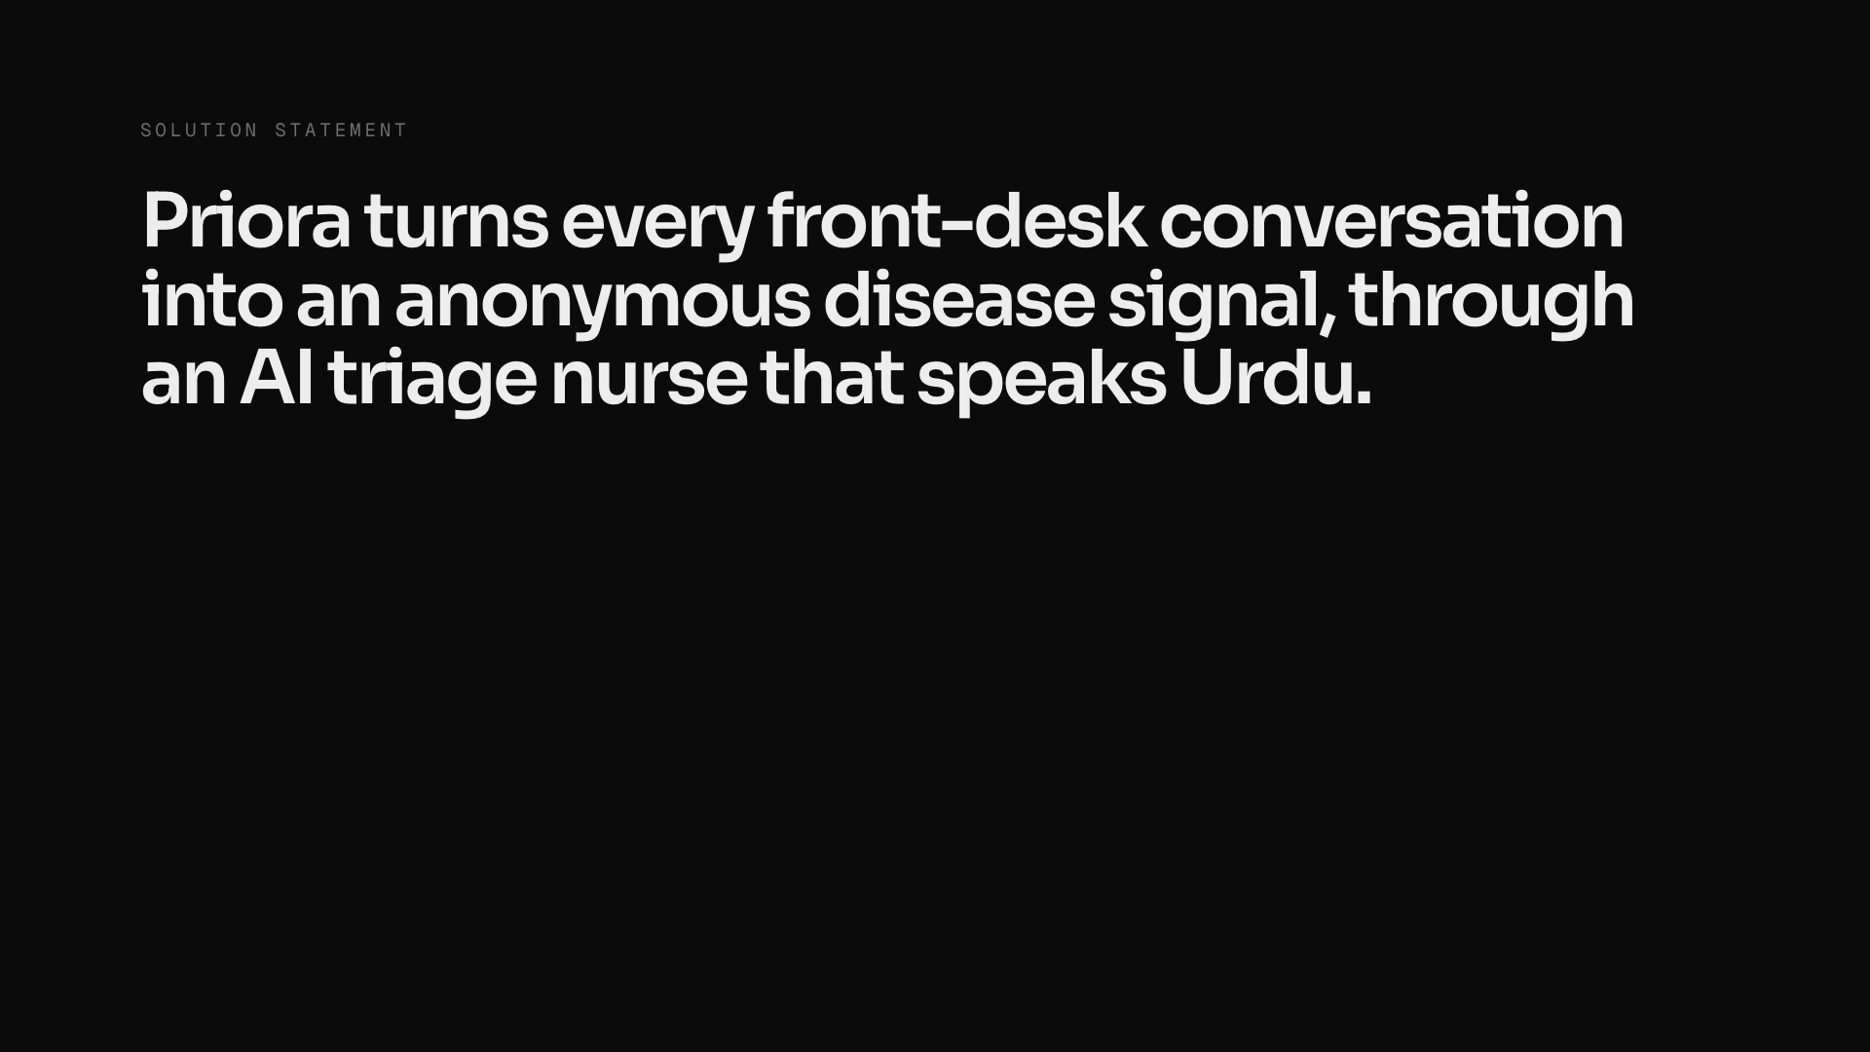
Notes:
solution (click 1 of 2)
~15s · two clicks
"Our solution: Priora turns every front-desk conversation into an anonymous disease signal, through an AI triage nurse that speaks Urdu. The hospital gets safer queues today, which is why it gets installed. The district gets outbreak warnings a week earlier, which is why it matters."

Slide 11
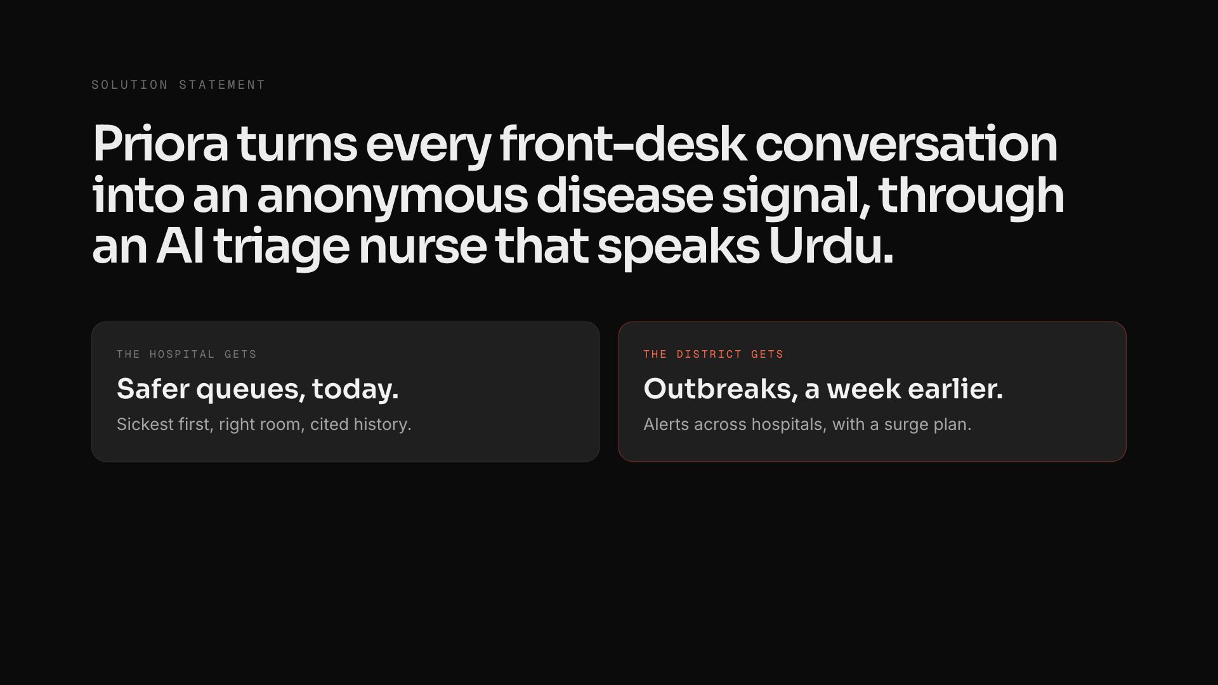
Notes:
solution (click 2 of 2)
~15s · two clicks
"Our solution: Priora turns every front-desk conversation into an anonymous disease signal, through an AI triage nurse that speaks Urdu. The hospital gets safer queues today, which is why it gets installed. The district gets outbreak warnings a week earlier, which is why it matters."

Slide 12
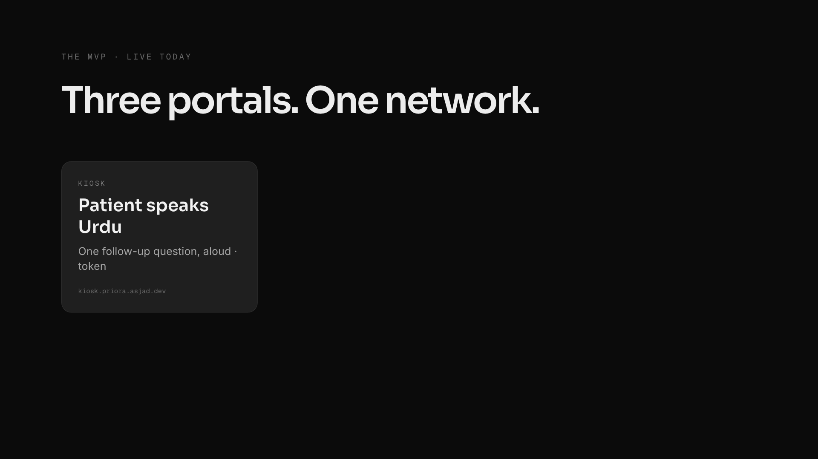
Notes:
mvp (click 1 of 4)
~20s · four clicks
"What we built, live today: three portals on one network. The patient talks to a kiosk in Urdu and gets a token. The nurse and doctor get SATS triage, a severity-sorted queue and a cited history brief. And the district health officer gets a live map across eight hospitals and twenty areas, with AI alerts and surge plans. It even keeps working offline."

Slide 13
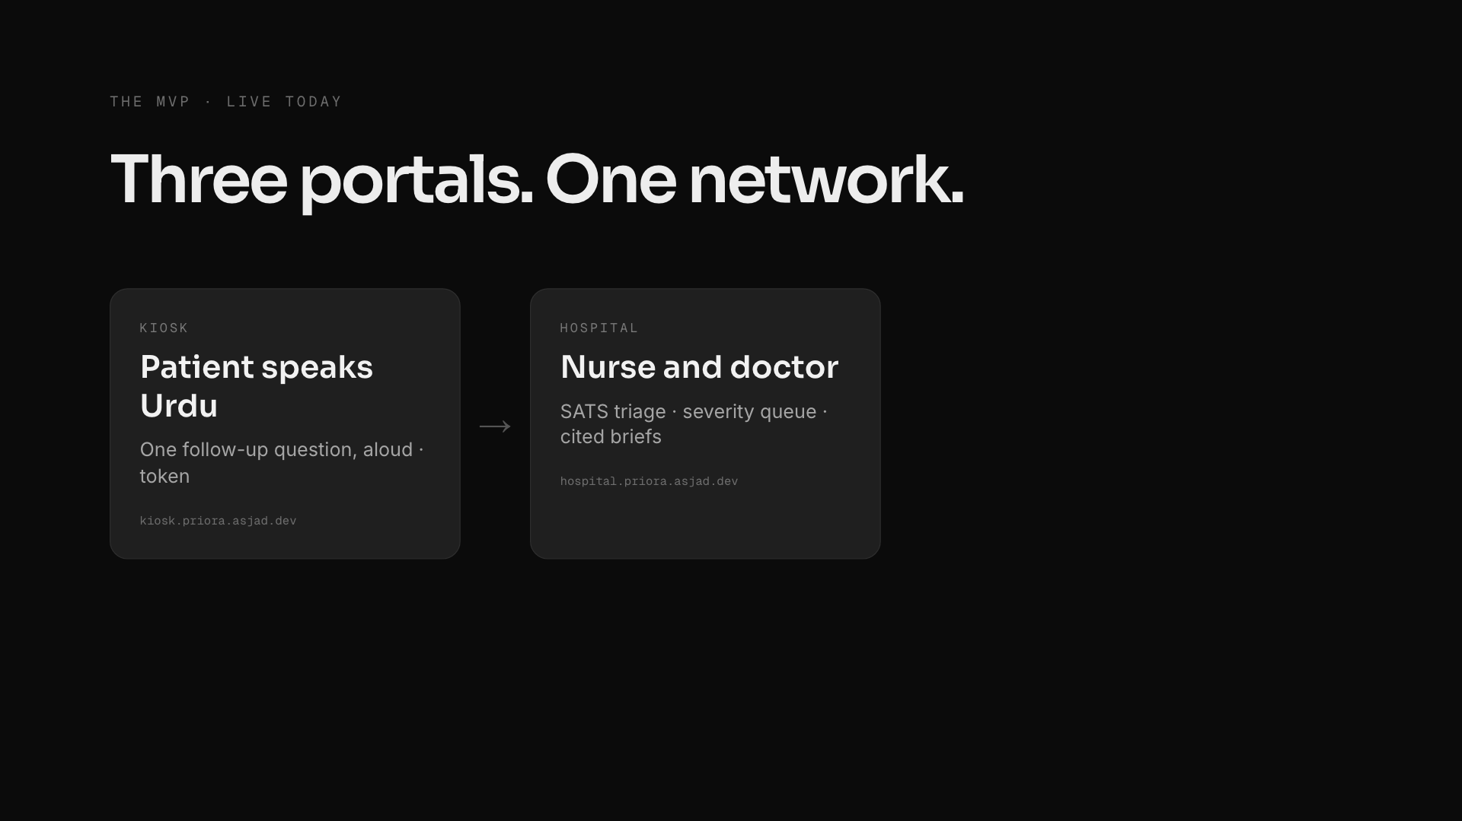
Notes:
mvp (click 2 of 4)
~20s · four clicks
"What we built, live today: three portals on one network. The patient talks to a kiosk in Urdu and gets a token. The nurse and doctor get SATS triage, a severity-sorted queue and a cited history brief. And the district health officer gets a live map across eight hospitals and twenty areas, with AI alerts and surge plans. It even keeps working offline."

Slide 14
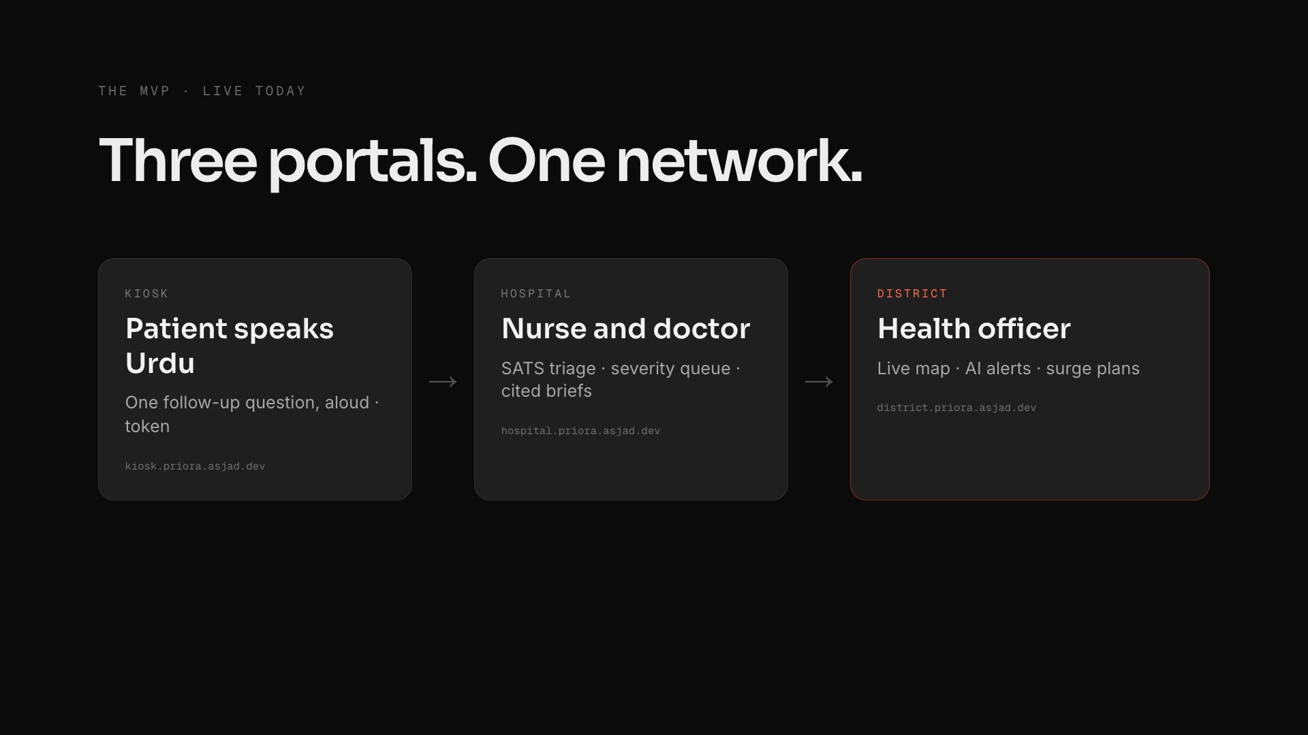
Notes:
mvp (click 3 of 4)
~20s · four clicks
"What we built, live today: three portals on one network. The patient talks to a kiosk in Urdu and gets a token. The nurse and doctor get SATS triage, a severity-sorted queue and a cited history brief. And the district health officer gets a live map across eight hospitals and twenty areas, with AI alerts and surge plans. It even keeps working offline."

Slide 15

Notes:
mvp (click 4 of 4)
~20s · four clicks
"What we built, live today: three portals on one network. The patient talks to a kiosk in Urdu and gets a token. The nurse and doctor get SATS triage, a severity-sorted queue and a cited history brief. And the district health officer gets a live map across eight hospitals and twenty areas, with AI alerts and surge plans. It even keeps working offline."

Slide 16
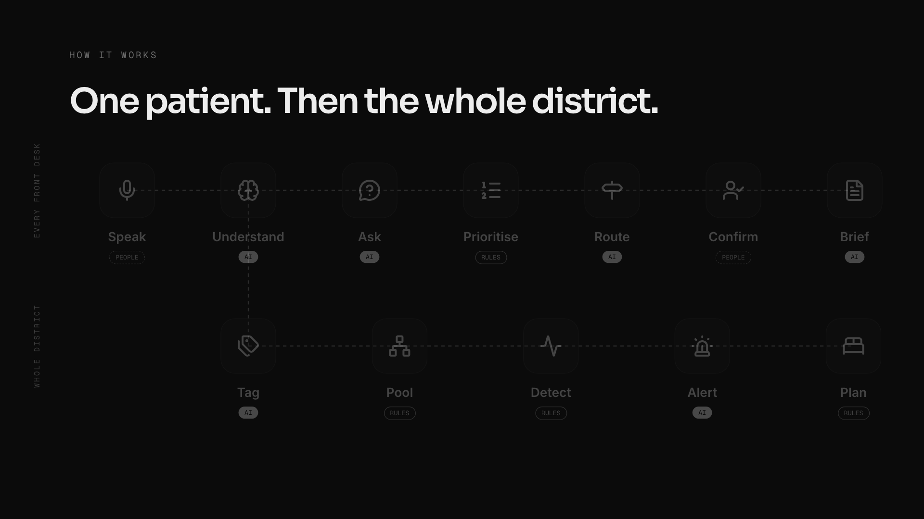
Notes:
pipeline (click 1 of 14)
one click per step, keep moving
Speak: "The patient speaks in Urdu at the kiosk."
Understand: "Gemini understands, reading twice for safety."
Ask: "It asks one follow-up question, aloud."
Prioritise: "The South African Triage Scale, plain rules, sets the priority, not the AI."
Route: "It sends them to the right department."
Confirm: "The nurse confirms, recording her own colour first."
Brief: "The doctor gets a cited brief from old reports."
Tag: "The same conversation is tagged with a syndrome, like dengue-like fever."
Pool: "Pooled anonymously across eight hospitals."
Detect: "A standard CDC statistical check flags unusual clusters."
Alert: "The health officer gets an AI-written, cited alert."
Plan: "And a three-day surge plan: beds, test kits, ORS."
Last click: "AI reads. Rules decide. People confirm."
If a doctor asks: severity is always SATS; the nurse records her own colour blind first; only an anonymous syndrome tag and area leave the hospital.
If an AI expert asks: Gemini 2.5 Flash and Flash-Lite on Vertex; schema-validated structured output; two readings at different temperatures; brief lines without a real citation are dropped; our own offline model (n-gram classifier, 8 ms) when the internet drops; outbreak detection is CDC EARS C2, deterministic.
If a business judge asks: one install, two products. Hospitals adopt it for safer queues; districts pay for the early warning. Each new hospital makes every alert faster.

Slide 17
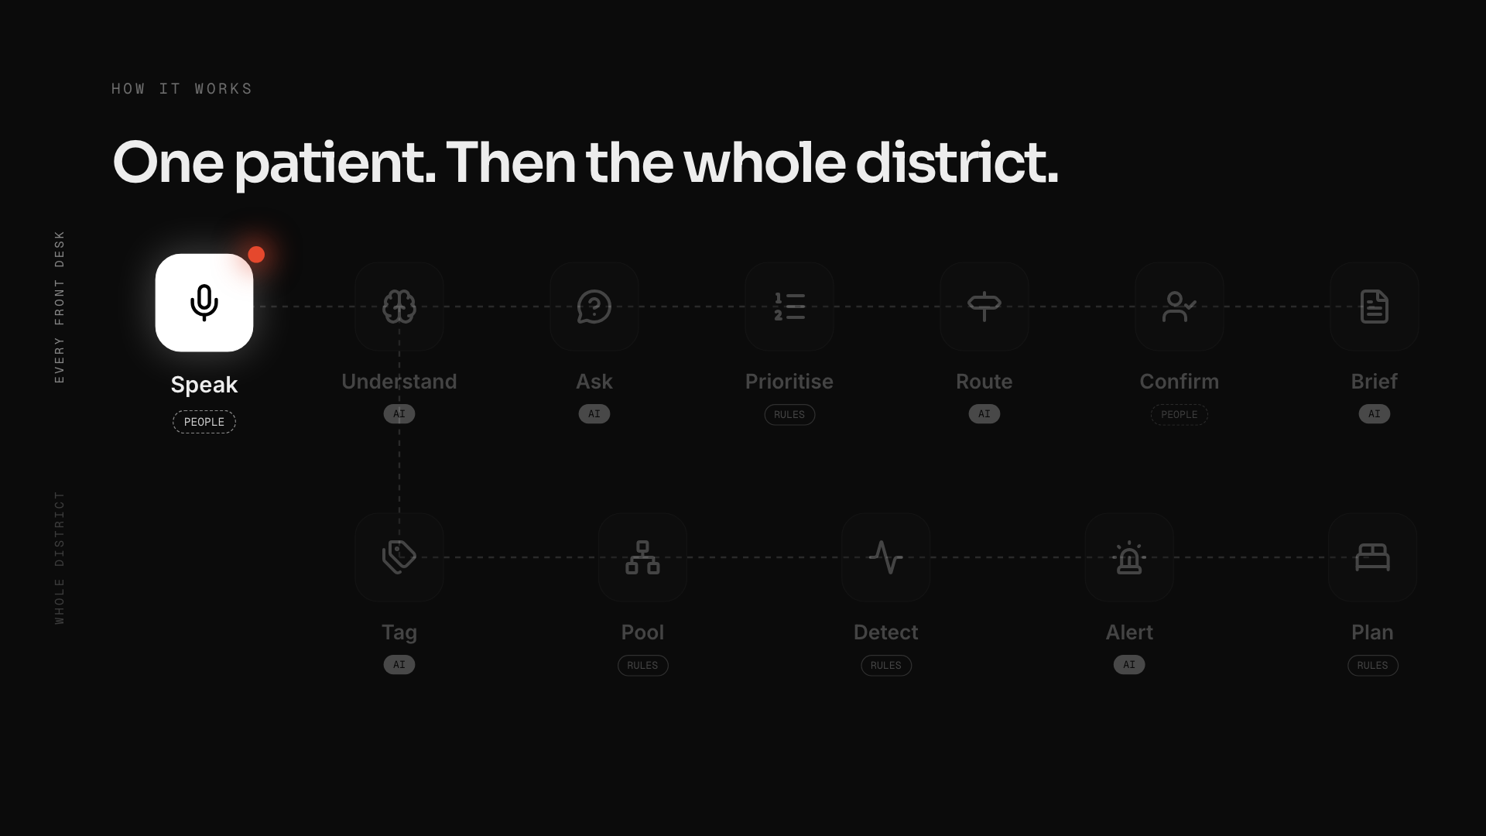
Notes:
pipeline (click 2 of 14)
one click per step, keep moving
Speak: "The patient speaks in Urdu at the kiosk."
Understand: "Gemini understands, reading twice for safety."
Ask: "It asks one follow-up question, aloud."
Prioritise: "The South African Triage Scale, plain rules, sets the priority, not the AI."
Route: "It sends them to the right department."
Confirm: "The nurse confirms, recording her own colour first."
Brief: "The doctor gets a cited brief from old reports."
Tag: "The same conversation is tagged with a syndrome, like dengue-like fever."
Pool: "Pooled anonymously across eight hospitals."
Detect: "A standard CDC statistical check flags unusual clusters."
Alert: "The health officer gets an AI-written, cited alert."
Plan: "And a three-day surge plan: beds, test kits, ORS."
Last click: "AI reads. Rules decide. People confirm."
If a doctor asks: severity is always SATS; the nurse records her own colour blind first; only an anonymous syndrome tag and area leave the hospital.
If an AI expert asks: Gemini 2.5 Flash and Flash-Lite on Vertex; schema-validated structured output; two readings at different temperatures; brief lines without a real citation are dropped; our own offline model (n-gram classifier, 8 ms) when the internet drops; outbreak detection is CDC EARS C2, deterministic.
If a business judge asks: one install, two products. Hospitals adopt it for safer queues; districts pay for the early warning. Each new hospital makes every alert faster.

Slide 18
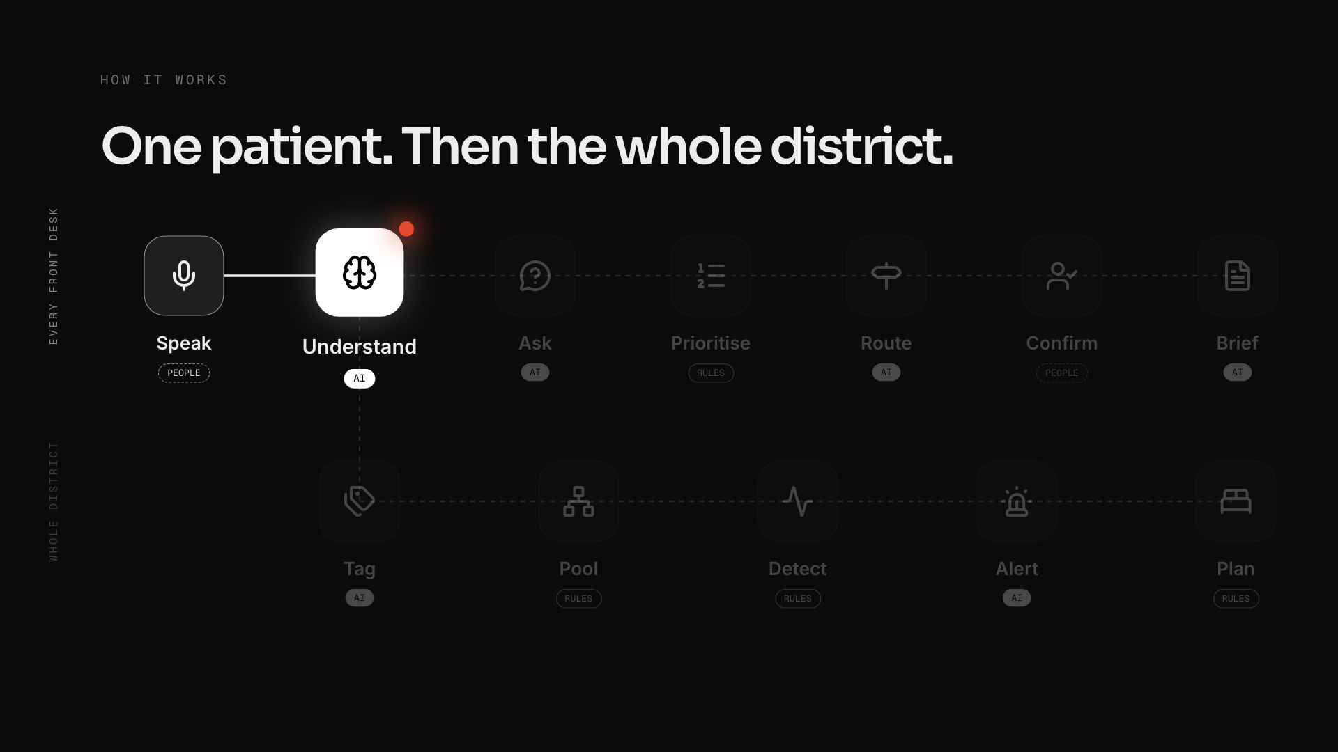
Notes:
pipeline (click 3 of 14)
one click per step, keep moving
Speak: "The patient speaks in Urdu at the kiosk."
Understand: "Gemini understands, reading twice for safety."
Ask: "It asks one follow-up question, aloud."
Prioritise: "The South African Triage Scale, plain rules, sets the priority, not the AI."
Route: "It sends them to the right department."
Confirm: "The nurse confirms, recording her own colour first."
Brief: "The doctor gets a cited brief from old reports."
Tag: "The same conversation is tagged with a syndrome, like dengue-like fever."
Pool: "Pooled anonymously across eight hospitals."
Detect: "A standard CDC statistical check flags unusual clusters."
Alert: "The health officer gets an AI-written, cited alert."
Plan: "And a three-day surge plan: beds, test kits, ORS."
Last click: "AI reads. Rules decide. People confirm."
If a doctor asks: severity is always SATS; the nurse records her own colour blind first; only an anonymous syndrome tag and area leave the hospital.
If an AI expert asks: Gemini 2.5 Flash and Flash-Lite on Vertex; schema-validated structured output; two readings at different temperatures; brief lines without a real citation are dropped; our own offline model (n-gram classifier, 8 ms) when the internet drops; outbreak detection is CDC EARS C2, deterministic.
If a business judge asks: one install, two products. Hospitals adopt it for safer queues; districts pay for the early warning. Each new hospital makes every alert faster.

Slide 19
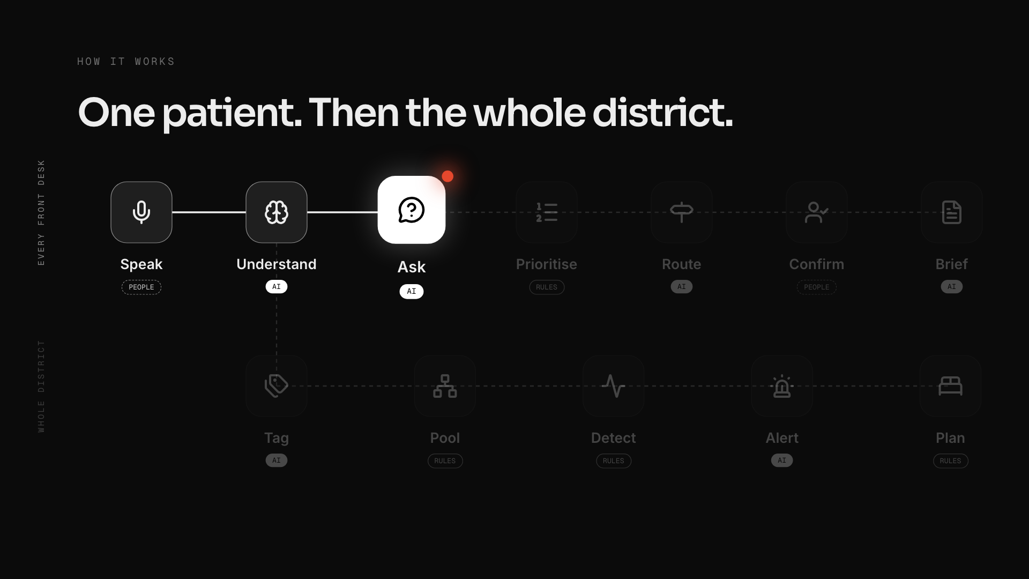
Notes:
pipeline (click 4 of 14)
one click per step, keep moving
Speak: "The patient speaks in Urdu at the kiosk."
Understand: "Gemini understands, reading twice for safety."
Ask: "It asks one follow-up question, aloud."
Prioritise: "The South African Triage Scale, plain rules, sets the priority, not the AI."
Route: "It sends them to the right department."
Confirm: "The nurse confirms, recording her own colour first."
Brief: "The doctor gets a cited brief from old reports."
Tag: "The same conversation is tagged with a syndrome, like dengue-like fever."
Pool: "Pooled anonymously across eight hospitals."
Detect: "A standard CDC statistical check flags unusual clusters."
Alert: "The health officer gets an AI-written, cited alert."
Plan: "And a three-day surge plan: beds, test kits, ORS."
Last click: "AI reads. Rules decide. People confirm."
If a doctor asks: severity is always SATS; the nurse records her own colour blind first; only an anonymous syndrome tag and area leave the hospital.
If an AI expert asks: Gemini 2.5 Flash and Flash-Lite on Vertex; schema-validated structured output; two readings at different temperatures; brief lines without a real citation are dropped; our own offline model (n-gram classifier, 8 ms) when the internet drops; outbreak detection is CDC EARS C2, deterministic.
If a business judge asks: one install, two products. Hospitals adopt it for safer queues; districts pay for the early warning. Each new hospital makes every alert faster.

Slide 20
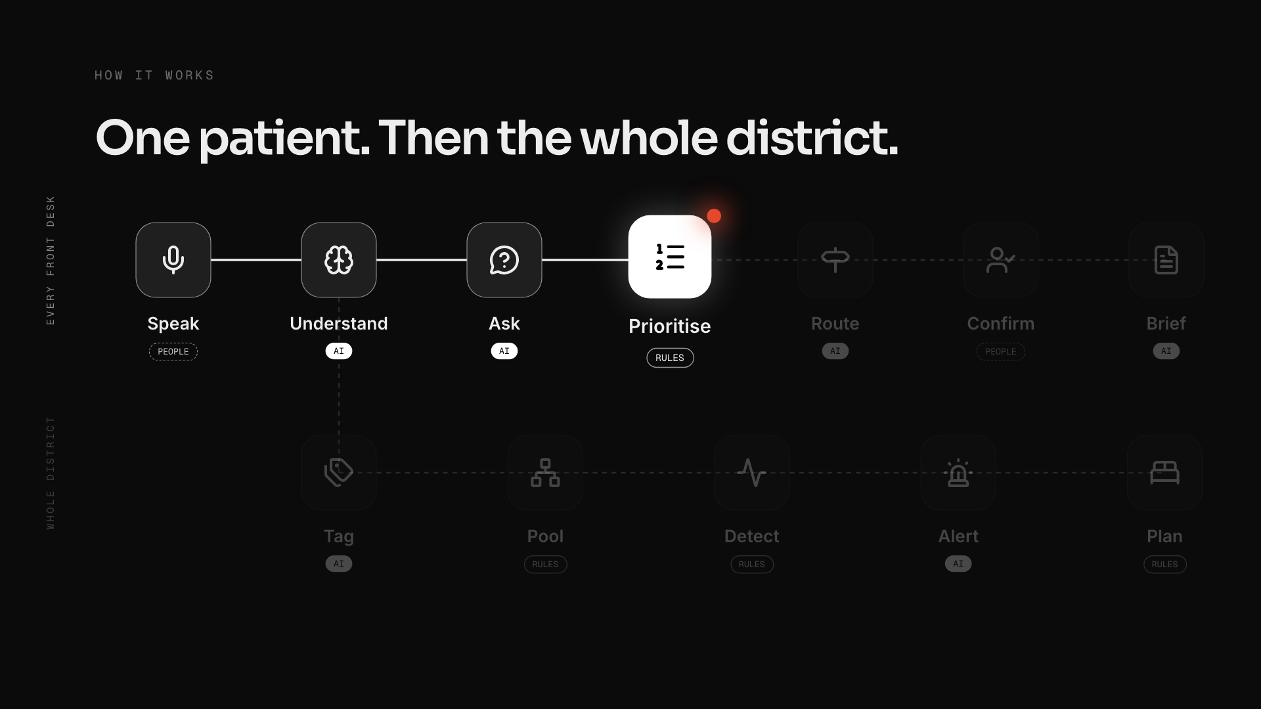
Notes:
pipeline (click 5 of 14)
one click per step, keep moving
Speak: "The patient speaks in Urdu at the kiosk."
Understand: "Gemini understands, reading twice for safety."
Ask: "It asks one follow-up question, aloud."
Prioritise: "The South African Triage Scale, plain rules, sets the priority, not the AI."
Route: "It sends them to the right department."
Confirm: "The nurse confirms, recording her own colour first."
Brief: "The doctor gets a cited brief from old reports."
Tag: "The same conversation is tagged with a syndrome, like dengue-like fever."
Pool: "Pooled anonymously across eight hospitals."
Detect: "A standard CDC statistical check flags unusual clusters."
Alert: "The health officer gets an AI-written, cited alert."
Plan: "And a three-day surge plan: beds, test kits, ORS."
Last click: "AI reads. Rules decide. People confirm."
If a doctor asks: severity is always SATS; the nurse records her own colour blind first; only an anonymous syndrome tag and area leave the hospital.
If an AI expert asks: Gemini 2.5 Flash and Flash-Lite on Vertex; schema-validated structured output; two readings at different temperatures; brief lines without a real citation are dropped; our own offline model (n-gram classifier, 8 ms) when the internet drops; outbreak detection is CDC EARS C2, deterministic.
If a business judge asks: one install, two products. Hospitals adopt it for safer queues; districts pay for the early warning. Each new hospital makes every alert faster.

Slide 21
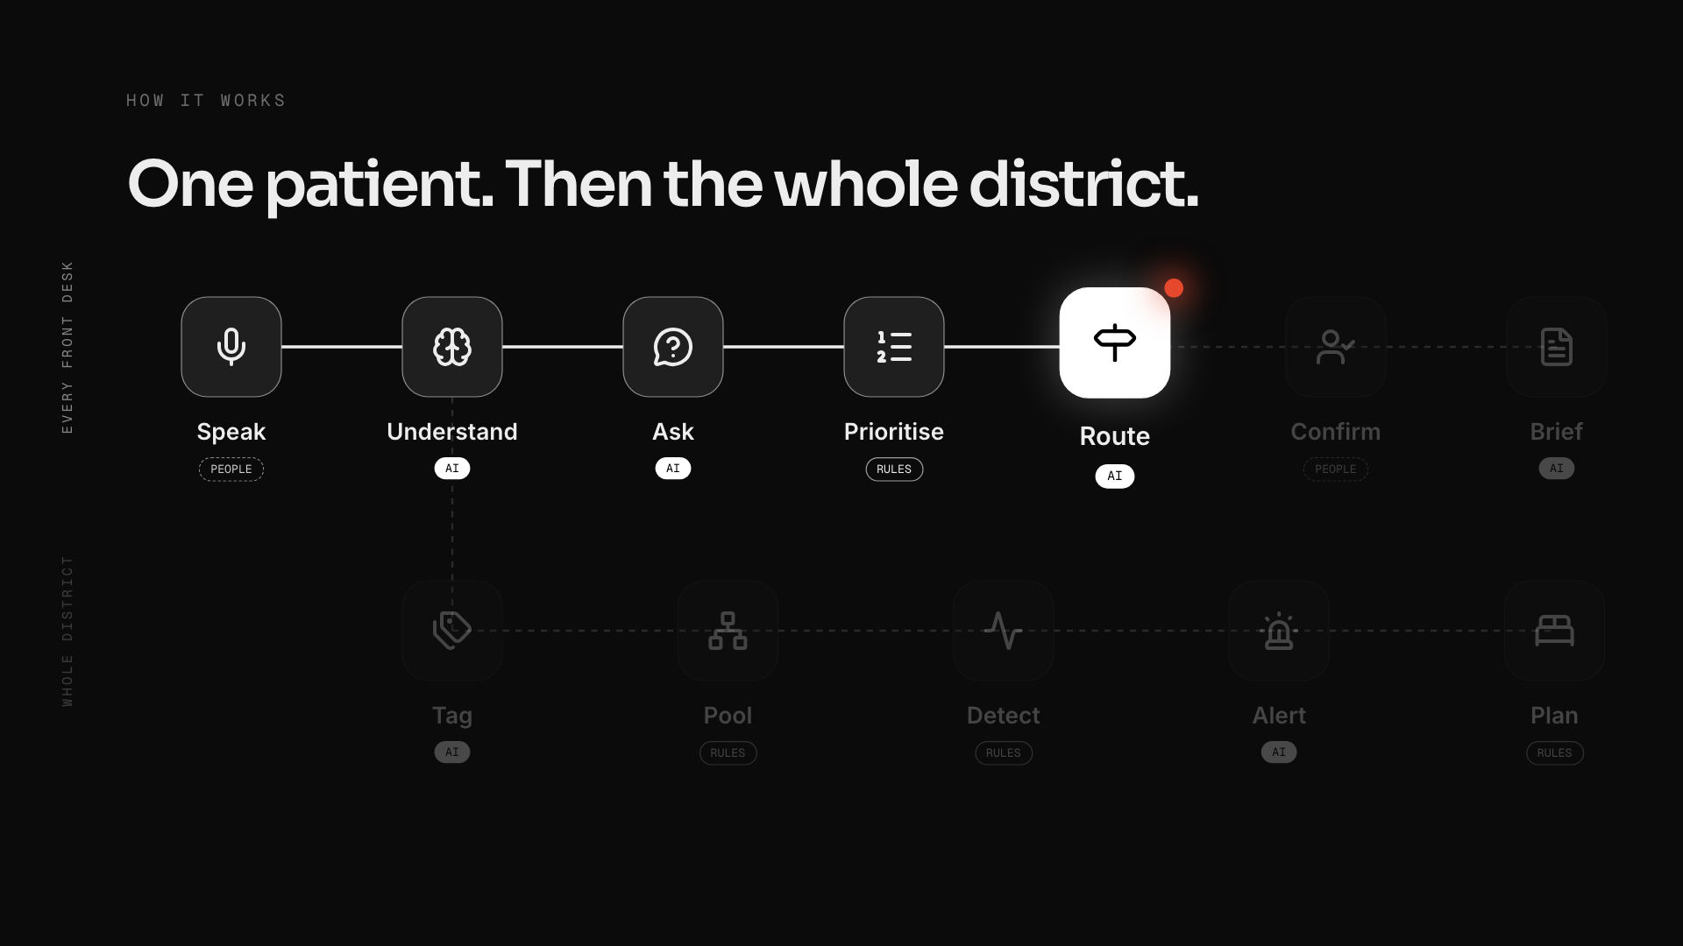
Notes:
pipeline (click 6 of 14)
one click per step, keep moving
Speak: "The patient speaks in Urdu at the kiosk."
Understand: "Gemini understands, reading twice for safety."
Ask: "It asks one follow-up question, aloud."
Prioritise: "The South African Triage Scale, plain rules, sets the priority, not the AI."
Route: "It sends them to the right department."
Confirm: "The nurse confirms, recording her own colour first."
Brief: "The doctor gets a cited brief from old reports."
Tag: "The same conversation is tagged with a syndrome, like dengue-like fever."
Pool: "Pooled anonymously across eight hospitals."
Detect: "A standard CDC statistical check flags unusual clusters."
Alert: "The health officer gets an AI-written, cited alert."
Plan: "And a three-day surge plan: beds, test kits, ORS."
Last click: "AI reads. Rules decide. People confirm."
If a doctor asks: severity is always SATS; the nurse records her own colour blind first; only an anonymous syndrome tag and area leave the hospital.
If an AI expert asks: Gemini 2.5 Flash and Flash-Lite on Vertex; schema-validated structured output; two readings at different temperatures; brief lines without a real citation are dropped; our own offline model (n-gram classifier, 8 ms) when the internet drops; outbreak detection is CDC EARS C2, deterministic.
If a business judge asks: one install, two products. Hospitals adopt it for safer queues; districts pay for the early warning. Each new hospital makes every alert faster.

Slide 22
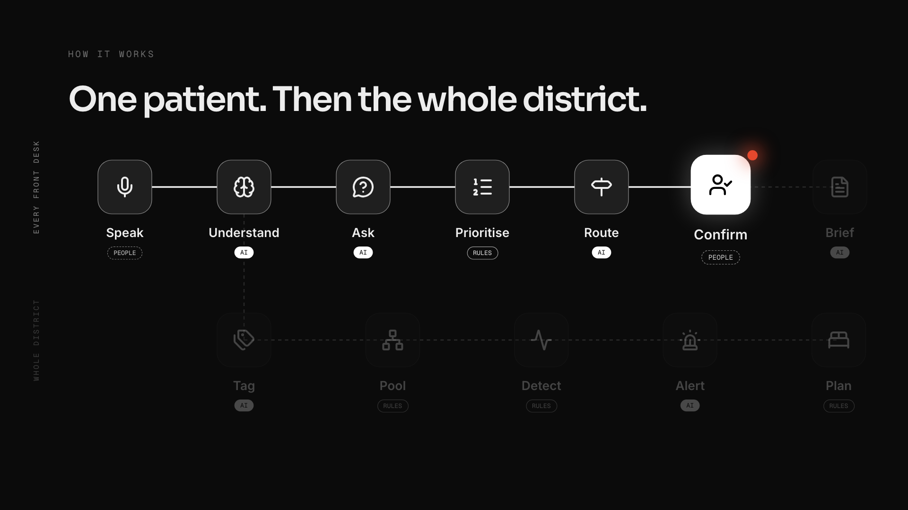
Notes:
pipeline (click 7 of 14)
one click per step, keep moving
Speak: "The patient speaks in Urdu at the kiosk."
Understand: "Gemini understands, reading twice for safety."
Ask: "It asks one follow-up question, aloud."
Prioritise: "The South African Triage Scale, plain rules, sets the priority, not the AI."
Route: "It sends them to the right department."
Confirm: "The nurse confirms, recording her own colour first."
Brief: "The doctor gets a cited brief from old reports."
Tag: "The same conversation is tagged with a syndrome, like dengue-like fever."
Pool: "Pooled anonymously across eight hospitals."
Detect: "A standard CDC statistical check flags unusual clusters."
Alert: "The health officer gets an AI-written, cited alert."
Plan: "And a three-day surge plan: beds, test kits, ORS."
Last click: "AI reads. Rules decide. People confirm."
If a doctor asks: severity is always SATS; the nurse records her own colour blind first; only an anonymous syndrome tag and area leave the hospital.
If an AI expert asks: Gemini 2.5 Flash and Flash-Lite on Vertex; schema-validated structured output; two readings at different temperatures; brief lines without a real citation are dropped; our own offline model (n-gram classifier, 8 ms) when the internet drops; outbreak detection is CDC EARS C2, deterministic.
If a business judge asks: one install, two products. Hospitals adopt it for safer queues; districts pay for the early warning. Each new hospital makes every alert faster.

Slide 23
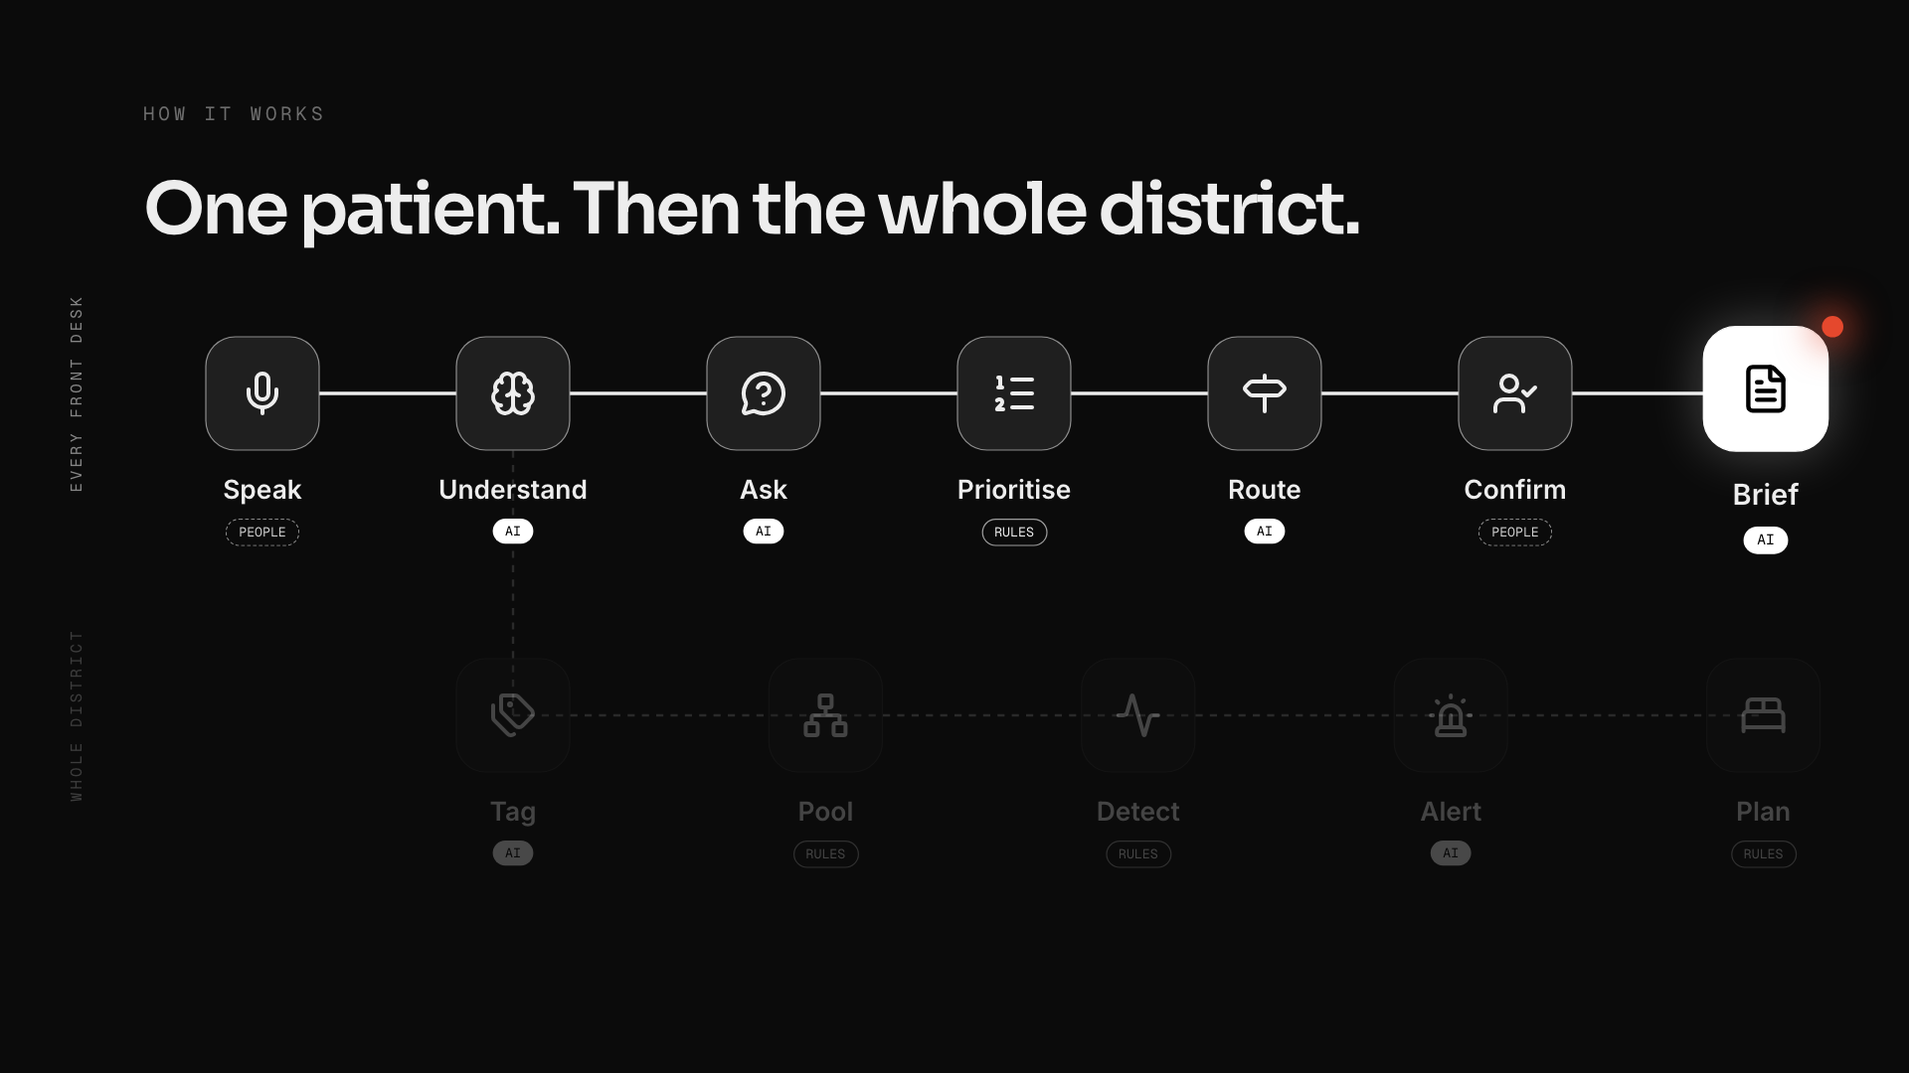
Notes:
pipeline (click 8 of 14)
one click per step, keep moving
Speak: "The patient speaks in Urdu at the kiosk."
Understand: "Gemini understands, reading twice for safety."
Ask: "It asks one follow-up question, aloud."
Prioritise: "The South African Triage Scale, plain rules, sets the priority, not the AI."
Route: "It sends them to the right department."
Confirm: "The nurse confirms, recording her own colour first."
Brief: "The doctor gets a cited brief from old reports."
Tag: "The same conversation is tagged with a syndrome, like dengue-like fever."
Pool: "Pooled anonymously across eight hospitals."
Detect: "A standard CDC statistical check flags unusual clusters."
Alert: "The health officer gets an AI-written, cited alert."
Plan: "And a three-day surge plan: beds, test kits, ORS."
Last click: "AI reads. Rules decide. People confirm."
If a doctor asks: severity is always SATS; the nurse records her own colour blind first; only an anonymous syndrome tag and area leave the hospital.
If an AI expert asks: Gemini 2.5 Flash and Flash-Lite on Vertex; schema-validated structured output; two readings at different temperatures; brief lines without a real citation are dropped; our own offline model (n-gram classifier, 8 ms) when the internet drops; outbreak detection is CDC EARS C2, deterministic.
If a business judge asks: one install, two products. Hospitals adopt it for safer queues; districts pay for the early warning. Each new hospital makes every alert faster.

Slide 24
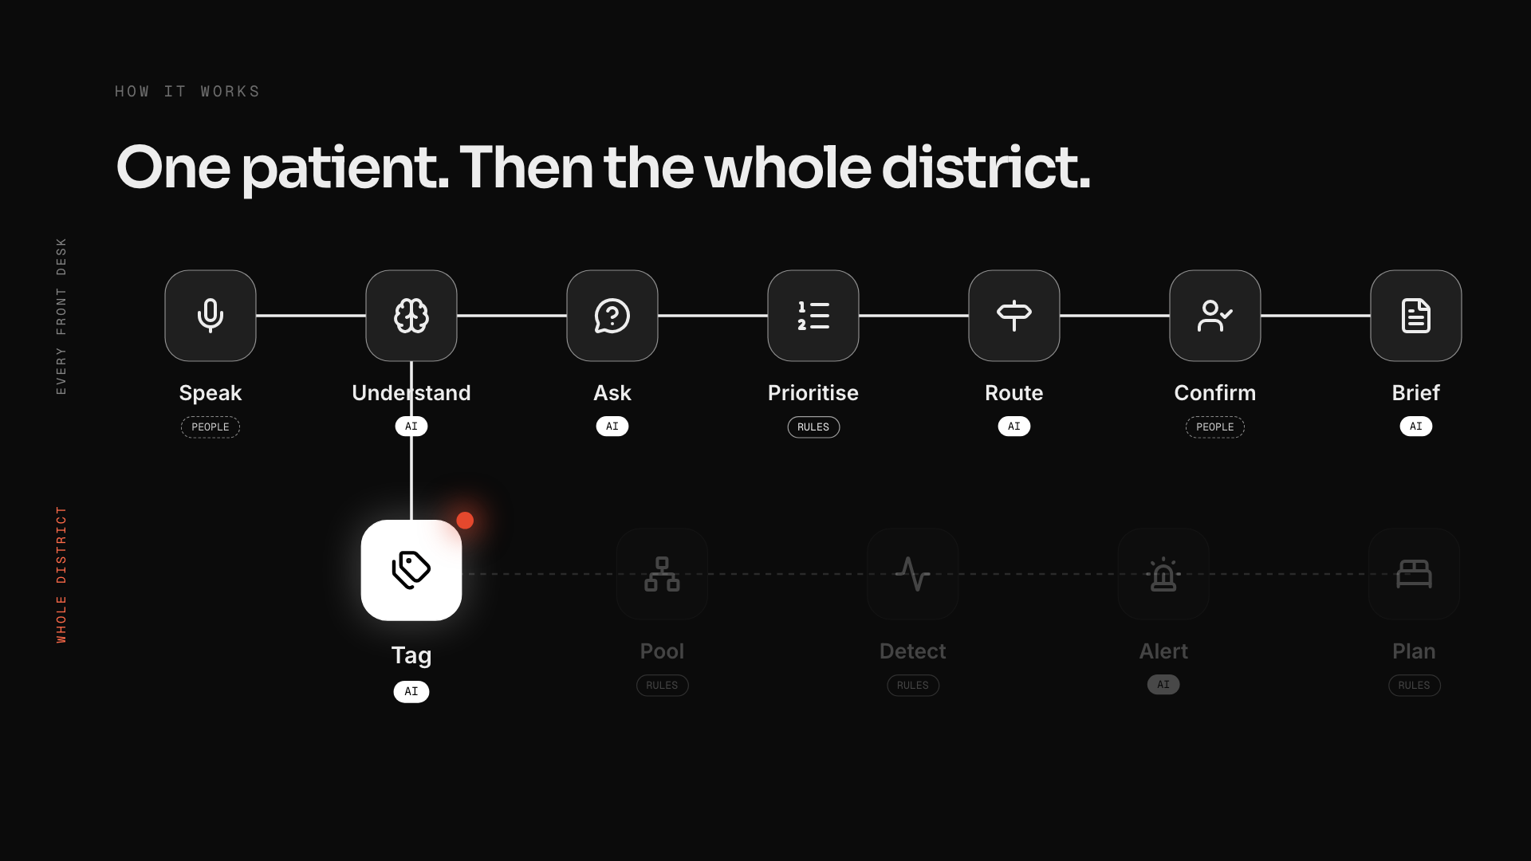
Notes:
pipeline (click 9 of 14)
one click per step, keep moving
Speak: "The patient speaks in Urdu at the kiosk."
Understand: "Gemini understands, reading twice for safety."
Ask: "It asks one follow-up question, aloud."
Prioritise: "The South African Triage Scale, plain rules, sets the priority, not the AI."
Route: "It sends them to the right department."
Confirm: "The nurse confirms, recording her own colour first."
Brief: "The doctor gets a cited brief from old reports."
Tag: "The same conversation is tagged with a syndrome, like dengue-like fever."
Pool: "Pooled anonymously across eight hospitals."
Detect: "A standard CDC statistical check flags unusual clusters."
Alert: "The health officer gets an AI-written, cited alert."
Plan: "And a three-day surge plan: beds, test kits, ORS."
Last click: "AI reads. Rules decide. People confirm."
If a doctor asks: severity is always SATS; the nurse records her own colour blind first; only an anonymous syndrome tag and area leave the hospital.
If an AI expert asks: Gemini 2.5 Flash and Flash-Lite on Vertex; schema-validated structured output; two readings at different temperatures; brief lines without a real citation are dropped; our own offline model (n-gram classifier, 8 ms) when the internet drops; outbreak detection is CDC EARS C2, deterministic.
If a business judge asks: one install, two products. Hospitals adopt it for safer queues; districts pay for the early warning. Each new hospital makes every alert faster.

Slide 25
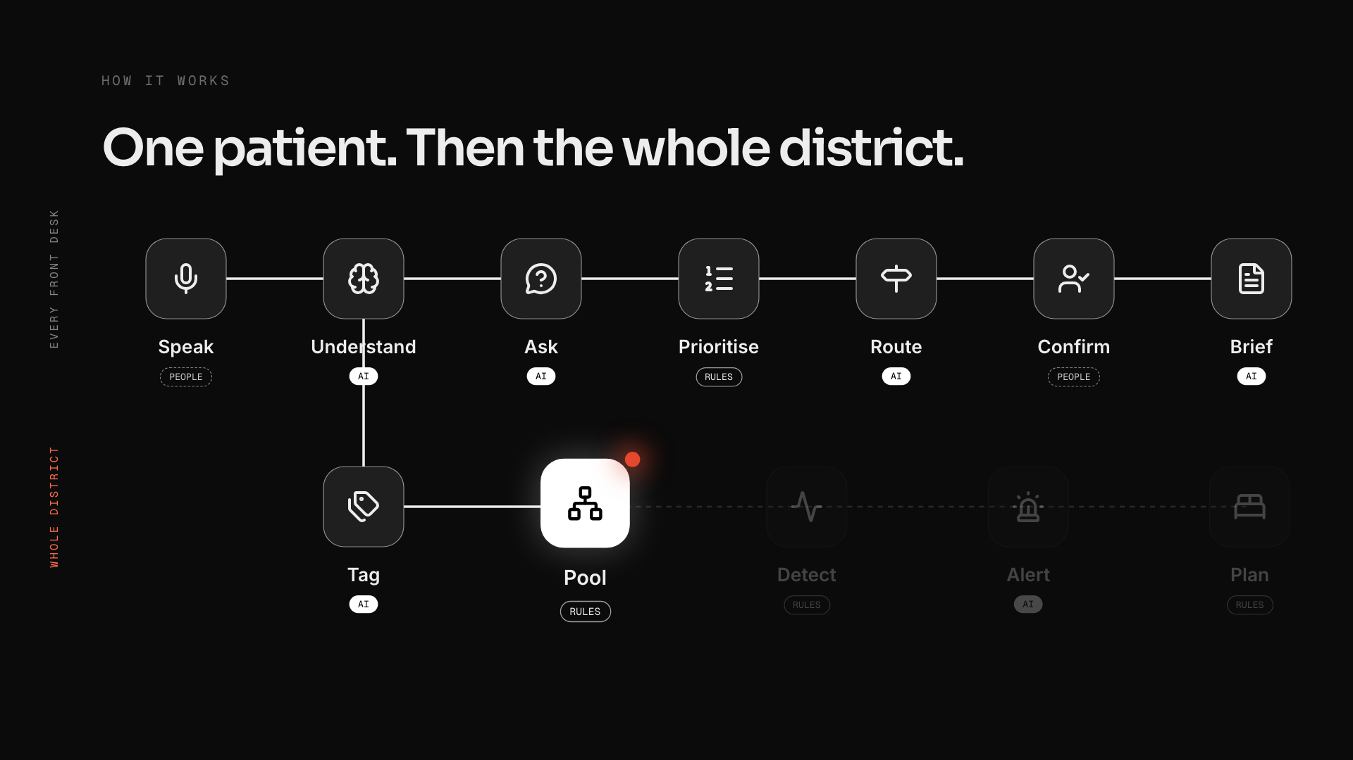
Notes:
pipeline (click 10 of 14)
one click per step, keep moving
Speak: "The patient speaks in Urdu at the kiosk."
Understand: "Gemini understands, reading twice for safety."
Ask: "It asks one follow-up question, aloud."
Prioritise: "The South African Triage Scale, plain rules, sets the priority, not the AI."
Route: "It sends them to the right department."
Confirm: "The nurse confirms, recording her own colour first."
Brief: "The doctor gets a cited brief from old reports."
Tag: "The same conversation is tagged with a syndrome, like dengue-like fever."
Pool: "Pooled anonymously across eight hospitals."
Detect: "A standard CDC statistical check flags unusual clusters."
Alert: "The health officer gets an AI-written, cited alert."
Plan: "And a three-day surge plan: beds, test kits, ORS."
Last click: "AI reads. Rules decide. People confirm."
If a doctor asks: severity is always SATS; the nurse records her own colour blind first; only an anonymous syndrome tag and area leave the hospital.
If an AI expert asks: Gemini 2.5 Flash and Flash-Lite on Vertex; schema-validated structured output; two readings at different temperatures; brief lines without a real citation are dropped; our own offline model (n-gram classifier, 8 ms) when the internet drops; outbreak detection is CDC EARS C2, deterministic.
If a business judge asks: one install, two products. Hospitals adopt it for safer queues; districts pay for the early warning. Each new hospital makes every alert faster.

Slide 26
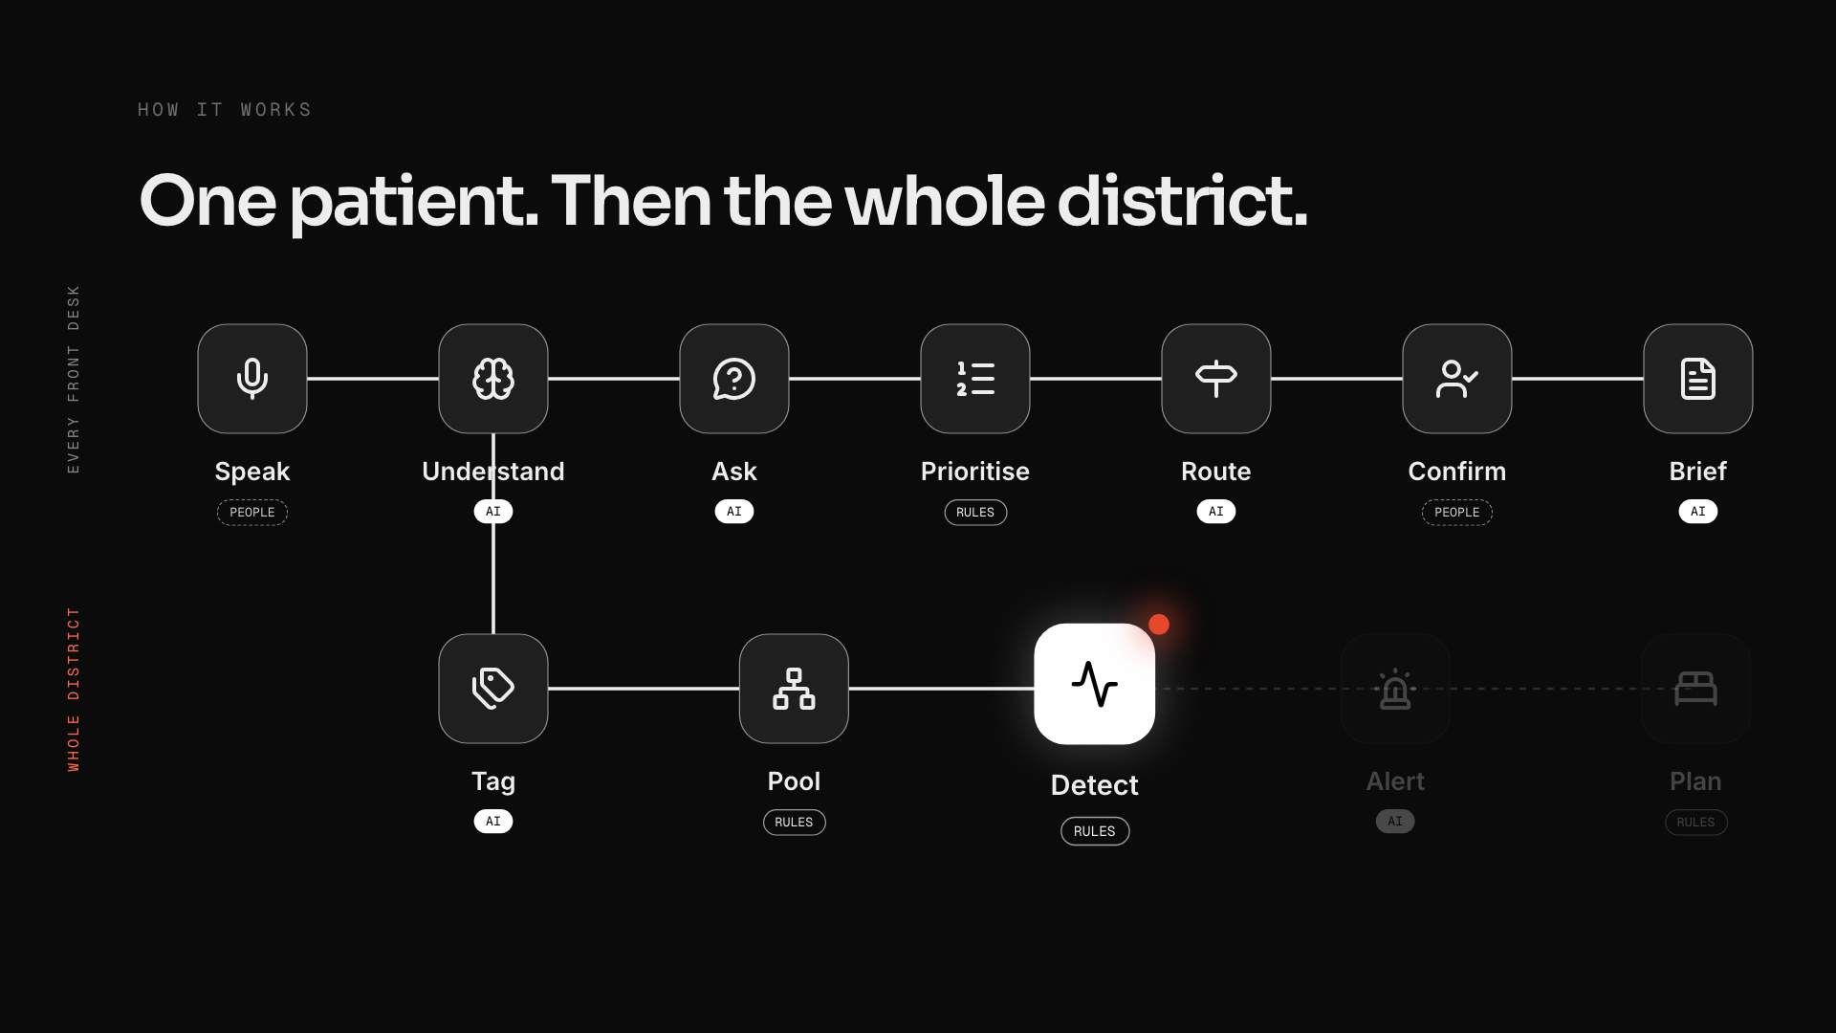
Notes:
pipeline (click 11 of 14)
one click per step, keep moving
Speak: "The patient speaks in Urdu at the kiosk."
Understand: "Gemini understands, reading twice for safety."
Ask: "It asks one follow-up question, aloud."
Prioritise: "The South African Triage Scale, plain rules, sets the priority, not the AI."
Route: "It sends them to the right department."
Confirm: "The nurse confirms, recording her own colour first."
Brief: "The doctor gets a cited brief from old reports."
Tag: "The same conversation is tagged with a syndrome, like dengue-like fever."
Pool: "Pooled anonymously across eight hospitals."
Detect: "A standard CDC statistical check flags unusual clusters."
Alert: "The health officer gets an AI-written, cited alert."
Plan: "And a three-day surge plan: beds, test kits, ORS."
Last click: "AI reads. Rules decide. People confirm."
If a doctor asks: severity is always SATS; the nurse records her own colour blind first; only an anonymous syndrome tag and area leave the hospital.
If an AI expert asks: Gemini 2.5 Flash and Flash-Lite on Vertex; schema-validated structured output; two readings at different temperatures; brief lines without a real citation are dropped; our own offline model (n-gram classifier, 8 ms) when the internet drops; outbreak detection is CDC EARS C2, deterministic.
If a business judge asks: one install, two products. Hospitals adopt it for safer queues; districts pay for the early warning. Each new hospital makes every alert faster.

Slide 27
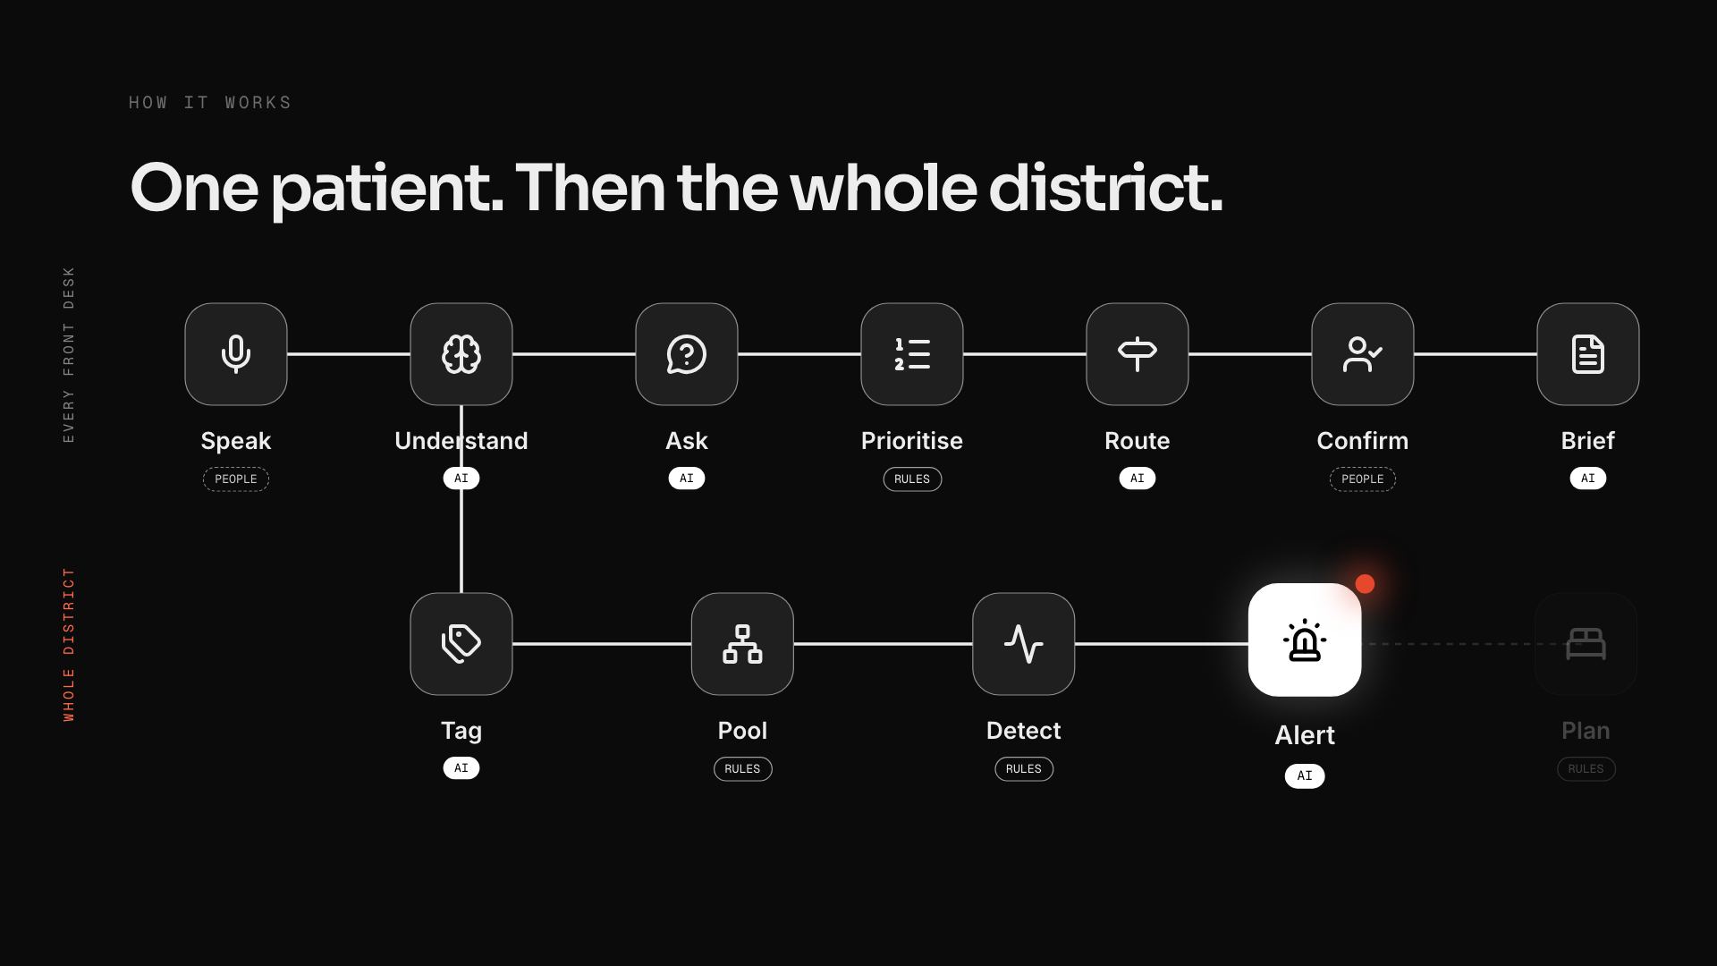
Notes:
pipeline (click 12 of 14)
one click per step, keep moving
Speak: "The patient speaks in Urdu at the kiosk."
Understand: "Gemini understands, reading twice for safety."
Ask: "It asks one follow-up question, aloud."
Prioritise: "The South African Triage Scale, plain rules, sets the priority, not the AI."
Route: "It sends them to the right department."
Confirm: "The nurse confirms, recording her own colour first."
Brief: "The doctor gets a cited brief from old reports."
Tag: "The same conversation is tagged with a syndrome, like dengue-like fever."
Pool: "Pooled anonymously across eight hospitals."
Detect: "A standard CDC statistical check flags unusual clusters."
Alert: "The health officer gets an AI-written, cited alert."
Plan: "And a three-day surge plan: beds, test kits, ORS."
Last click: "AI reads. Rules decide. People confirm."
If a doctor asks: severity is always SATS; the nurse records her own colour blind first; only an anonymous syndrome tag and area leave the hospital.
If an AI expert asks: Gemini 2.5 Flash and Flash-Lite on Vertex; schema-validated structured output; two readings at different temperatures; brief lines without a real citation are dropped; our own offline model (n-gram classifier, 8 ms) when the internet drops; outbreak detection is CDC EARS C2, deterministic.
If a business judge asks: one install, two products. Hospitals adopt it for safer queues; districts pay for the early warning. Each new hospital makes every alert faster.

Slide 28
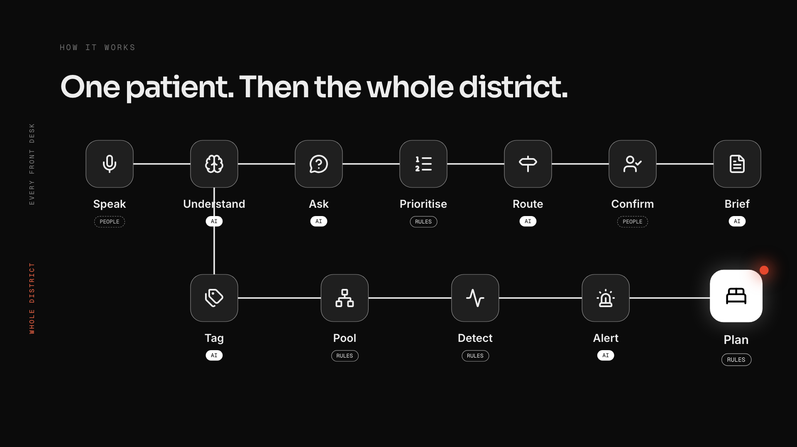
Notes:
pipeline (click 13 of 14)
one click per step, keep moving
Speak: "The patient speaks in Urdu at the kiosk."
Understand: "Gemini understands, reading twice for safety."
Ask: "It asks one follow-up question, aloud."
Prioritise: "The South African Triage Scale, plain rules, sets the priority, not the AI."
Route: "It sends them to the right department."
Confirm: "The nurse confirms, recording her own colour first."
Brief: "The doctor gets a cited brief from old reports."
Tag: "The same conversation is tagged with a syndrome, like dengue-like fever."
Pool: "Pooled anonymously across eight hospitals."
Detect: "A standard CDC statistical check flags unusual clusters."
Alert: "The health officer gets an AI-written, cited alert."
Plan: "And a three-day surge plan: beds, test kits, ORS."
Last click: "AI reads. Rules decide. People confirm."
If a doctor asks: severity is always SATS; the nurse records her own colour blind first; only an anonymous syndrome tag and area leave the hospital.
If an AI expert asks: Gemini 2.5 Flash and Flash-Lite on Vertex; schema-validated structured output; two readings at different temperatures; brief lines without a real citation are dropped; our own offline model (n-gram classifier, 8 ms) when the internet drops; outbreak detection is CDC EARS C2, deterministic.
If a business judge asks: one install, two products. Hospitals adopt it for safer queues; districts pay for the early warning. Each new hospital makes every alert faster.

Slide 29
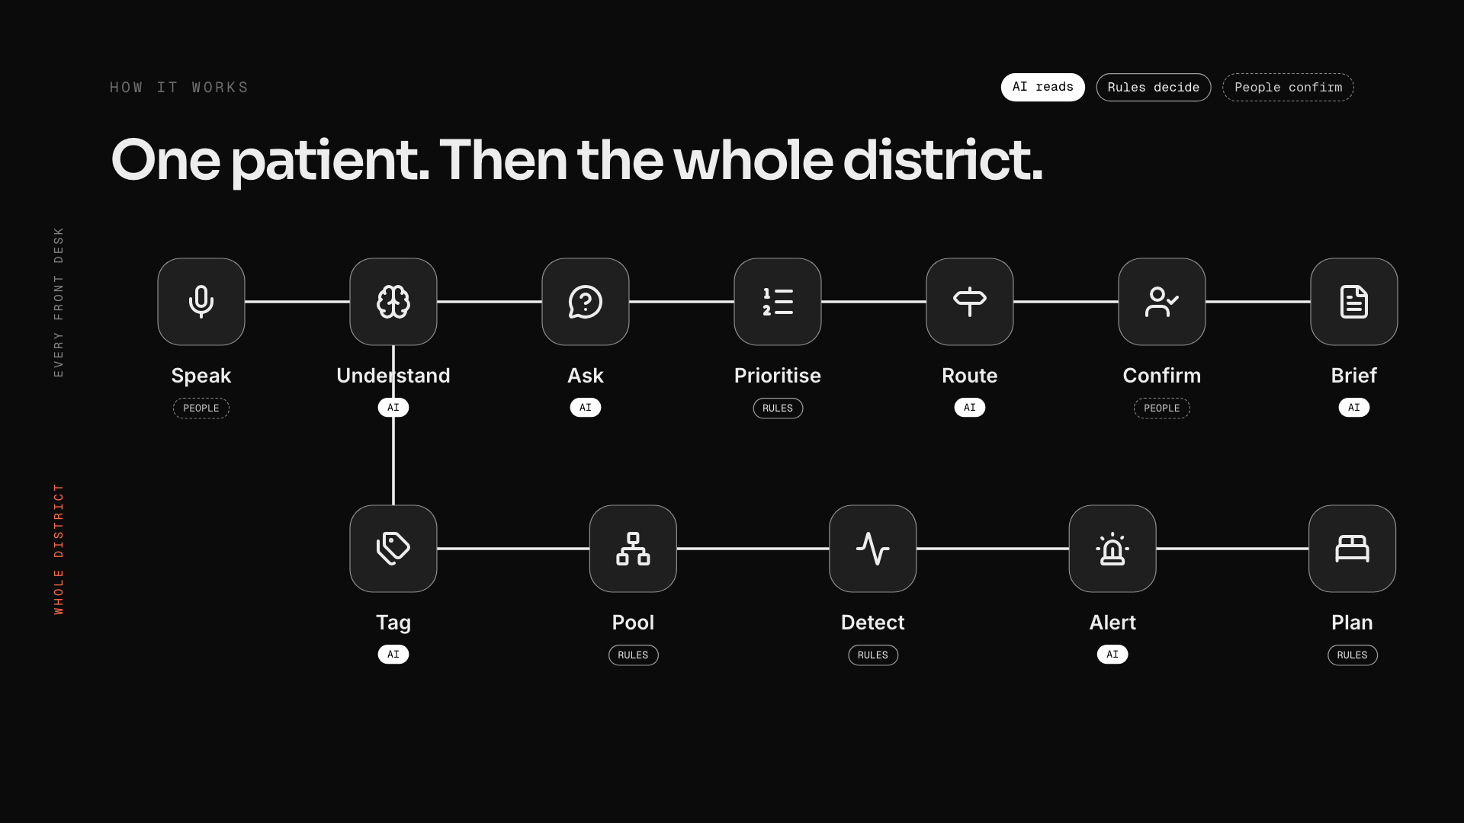
Notes:
pipeline (click 14 of 14)
one click per step, keep moving
Speak: "The patient speaks in Urdu at the kiosk."
Understand: "Gemini understands, reading twice for safety."
Ask: "It asks one follow-up question, aloud."
Prioritise: "The South African Triage Scale, plain rules, sets the priority, not the AI."
Route: "It sends them to the right department."
Confirm: "The nurse confirms, recording her own colour first."
Brief: "The doctor gets a cited brief from old reports."
Tag: "The same conversation is tagged with a syndrome, like dengue-like fever."
Pool: "Pooled anonymously across eight hospitals."
Detect: "A standard CDC statistical check flags unusual clusters."
Alert: "The health officer gets an AI-written, cited alert."
Plan: "And a three-day surge plan: beds, test kits, ORS."
Last click: "AI reads. Rules decide. People confirm."
If a doctor asks: severity is always SATS; the nurse records her own colour blind first; only an anonymous syndrome tag and area leave the hospital.
If an AI expert asks: Gemini 2.5 Flash and Flash-Lite on Vertex; schema-validated structured output; two readings at different temperatures; brief lines without a real citation are dropped; our own offline model (n-gram classifier, 8 ms) when the internet drops; outbreak detection is CDC EARS C2, deterministic.
If a business judge asks: one install, two products. Hospitals adopt it for safer queues; districts pay for the early warning. Each new hospital makes every alert faster.

Slide 30
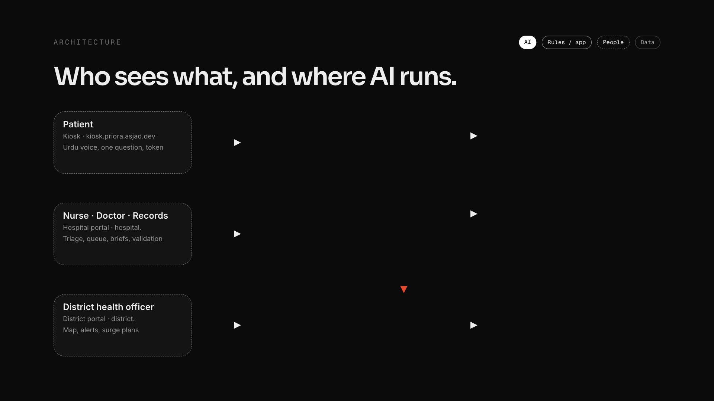
Notes:
architecture (click 1 of 4)
~20s · four clicks
1 "Three audiences, three front doors: the patient at the kiosk, hospital staff on the hospital portal, the district health officer on the district portal."
2 "Behind them, one app. The decisions are deterministic: SATS rules for severity, the CDC EARS check for outbreaks."
3 "AI runs here: Gemini Flash for speech, symptoms, documents, briefs and alerts; Flash-Lite for routing and the follow-up question; and our own model, Priora Lite, offline in the browser."
4 "Data stays in Postgres and private storage. Only anonymous syndrome tags flow to the district."

Slide 31
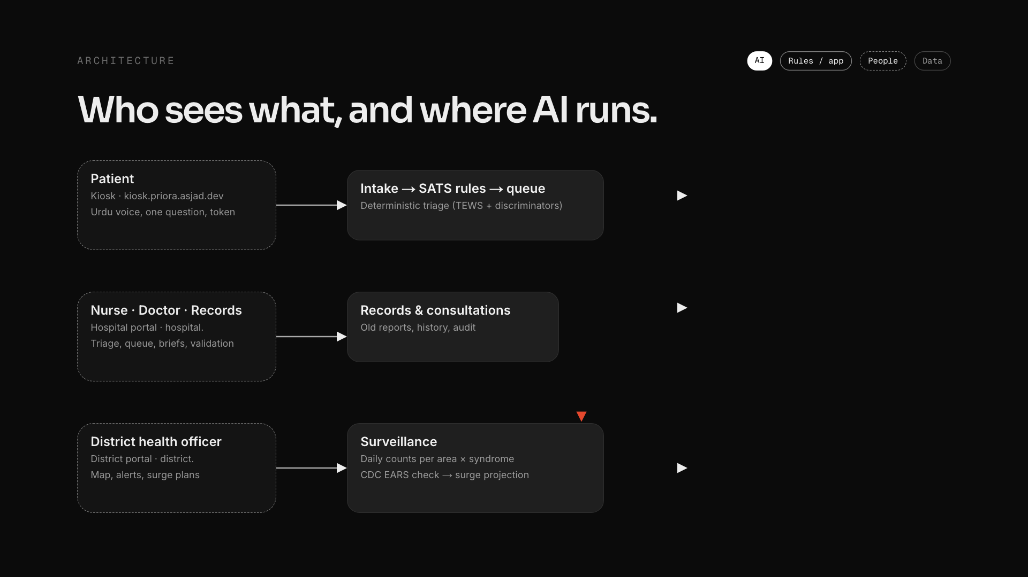
Notes:
architecture (click 2 of 4)
~20s · four clicks
1 "Three audiences, three front doors: the patient at the kiosk, hospital staff on the hospital portal, the district health officer on the district portal."
2 "Behind them, one app. The decisions are deterministic: SATS rules for severity, the CDC EARS check for outbreaks."
3 "AI runs here: Gemini Flash for speech, symptoms, documents, briefs and alerts; Flash-Lite for routing and the follow-up question; and our own model, Priora Lite, offline in the browser."
4 "Data stays in Postgres and private storage. Only anonymous syndrome tags flow to the district."

Slide 32
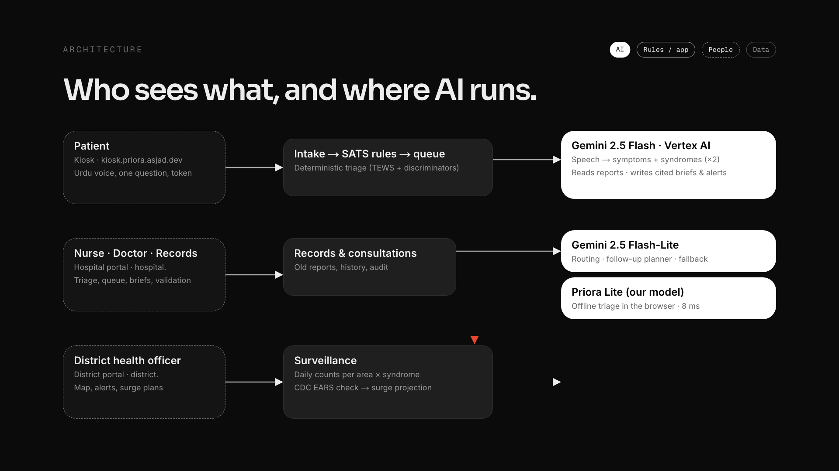
Notes:
architecture (click 3 of 4)
~20s · four clicks
1 "Three audiences, three front doors: the patient at the kiosk, hospital staff on the hospital portal, the district health officer on the district portal."
2 "Behind them, one app. The decisions are deterministic: SATS rules for severity, the CDC EARS check for outbreaks."
3 "AI runs here: Gemini Flash for speech, symptoms, documents, briefs and alerts; Flash-Lite for routing and the follow-up question; and our own model, Priora Lite, offline in the browser."
4 "Data stays in Postgres and private storage. Only anonymous syndrome tags flow to the district."

Slide 33
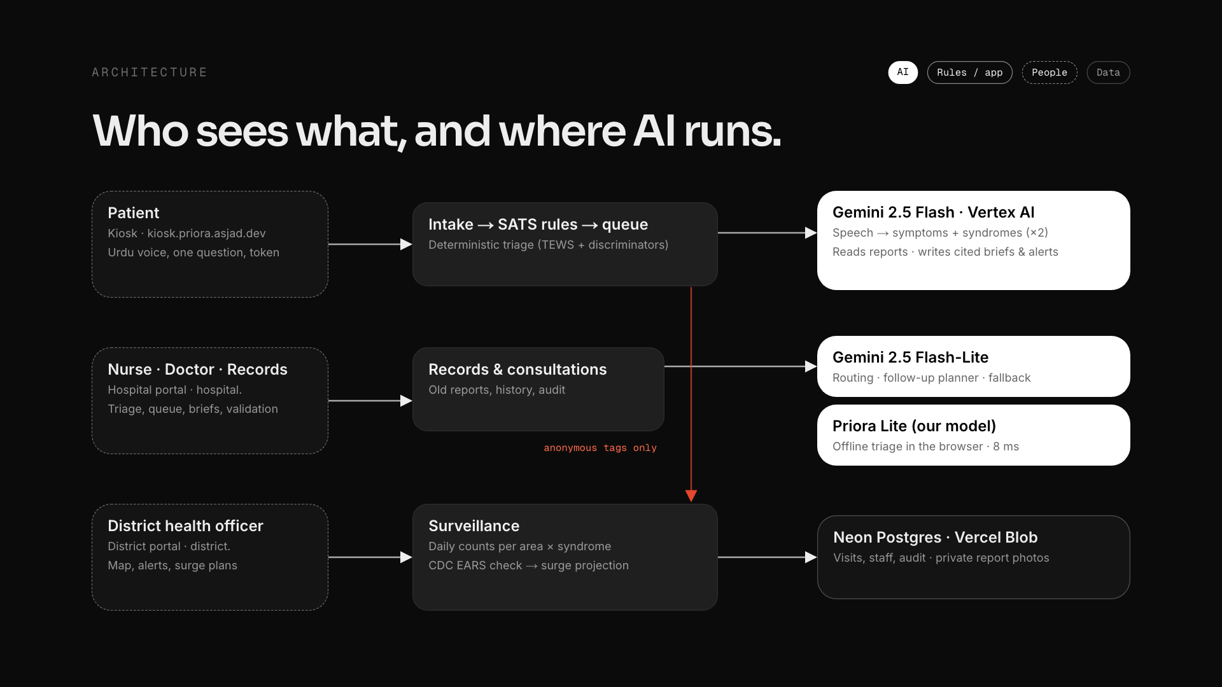
Notes:
architecture (click 4 of 4)
~20s · four clicks
1 "Three audiences, three front doors: the patient at the kiosk, hospital staff on the hospital portal, the district health officer on the district portal."
2 "Behind them, one app. The decisions are deterministic: SATS rules for severity, the CDC EARS check for outbreaks."
3 "AI runs here: Gemini Flash for speech, symptoms, documents, briefs and alerts; Flash-Lite for routing and the follow-up question; and our own model, Priora Lite, offline in the browser."
4 "Data stays in Postgres and private storage. Only anonymous syndrome tags flow to the district."

Slide 34
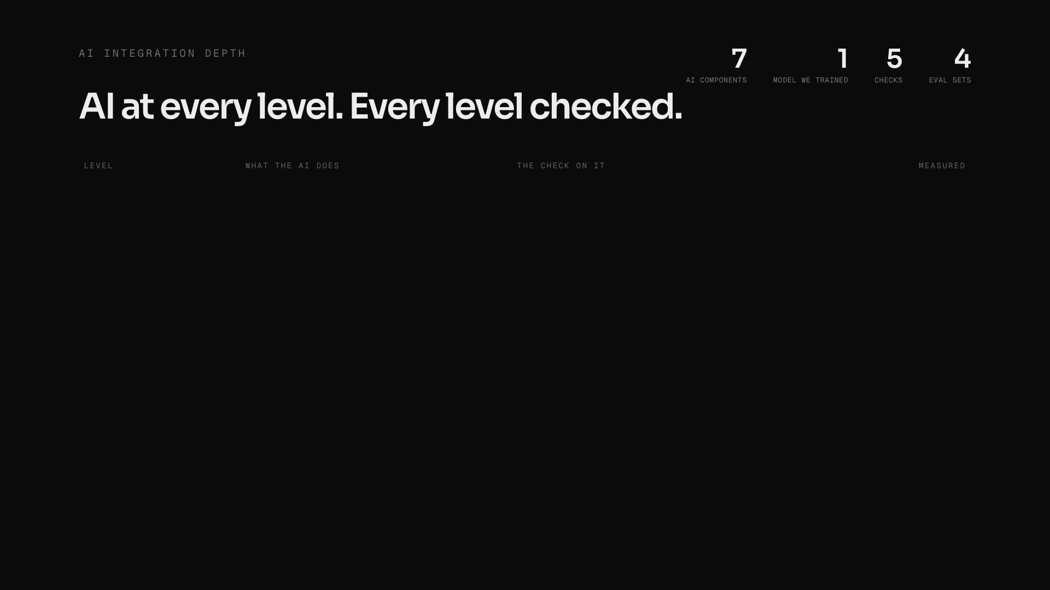
Notes:
ai-depth (click 1 of 6)
~30s · one row per click, from the patient to the district
"Most projects put AI in one box. Ours runs at five levels, and every level has a check and a measured number.
Listen: Gemini turns Urdu speech into symptoms and syndromes. It reads twice and keeps the more urgent reading: zero missed emergencies on 110 hard cases.
Ask and route: it plans the one question that could change priority, from a fixed bank of 45 reviewed Urdu questions. 30 of 30 real voice clips triaged right.
Read: it reads photographed old reports and writes the doctor's brief, and any line without a real source is dropped.
Watch: it tags syndromes for the district and writes the officer's alert, but the outbreak call itself is CDC statistics and the actions come from a fixed checklist. 93% precision.
Survive: when the internet drops, our own model, distilled from five thousand Gemini-labelled examples, triages in 8 milliseconds in the browser.
Seven AI components, one model we trained ourselves, five checks, four evaluation sets."
Rulebook mapping if asked: each row is Data → AI → Output (the small line under each level), and the whole stack ends in the impact numbers on the proof slide.
If an AI expert asks: structured output from Zod schemas, validated and retried on a fallback model; self-consistency at two temperatures; Gemini 2.5 Flash + Flash-Lite on Vertex AI; Lite is char+word n-gram logistic regression re-implemented in TypeScript.

Slide 35
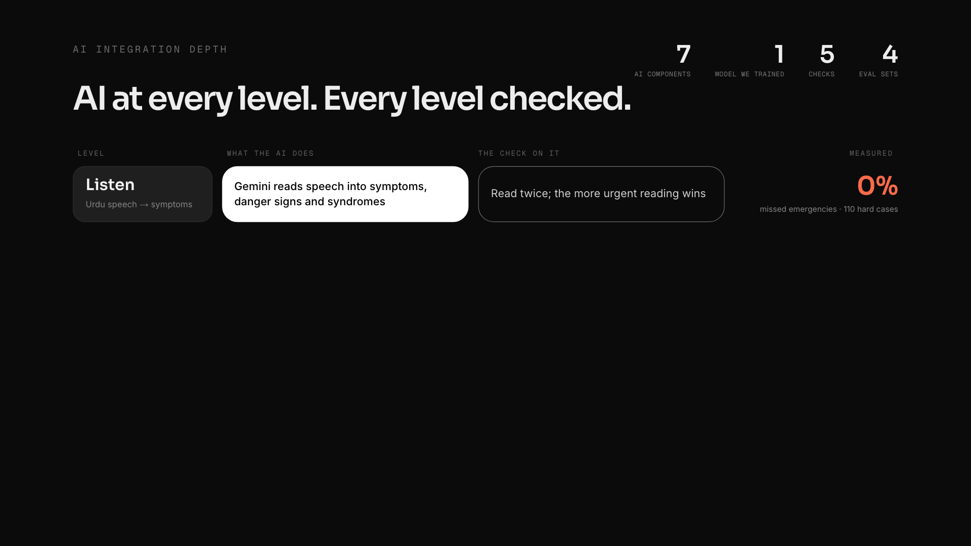
Notes:
ai-depth (click 2 of 6)
~30s · one row per click, from the patient to the district
"Most projects put AI in one box. Ours runs at five levels, and every level has a check and a measured number.
Listen: Gemini turns Urdu speech into symptoms and syndromes. It reads twice and keeps the more urgent reading: zero missed emergencies on 110 hard cases.
Ask and route: it plans the one question that could change priority, from a fixed bank of 45 reviewed Urdu questions. 30 of 30 real voice clips triaged right.
Read: it reads photographed old reports and writes the doctor's brief, and any line without a real source is dropped.
Watch: it tags syndromes for the district and writes the officer's alert, but the outbreak call itself is CDC statistics and the actions come from a fixed checklist. 93% precision.
Survive: when the internet drops, our own model, distilled from five thousand Gemini-labelled examples, triages in 8 milliseconds in the browser.
Seven AI components, one model we trained ourselves, five checks, four evaluation sets."
Rulebook mapping if asked: each row is Data → AI → Output (the small line under each level), and the whole stack ends in the impact numbers on the proof slide.
If an AI expert asks: structured output from Zod schemas, validated and retried on a fallback model; self-consistency at two temperatures; Gemini 2.5 Flash + Flash-Lite on Vertex AI; Lite is char+word n-gram logistic regression re-implemented in TypeScript.

Slide 36
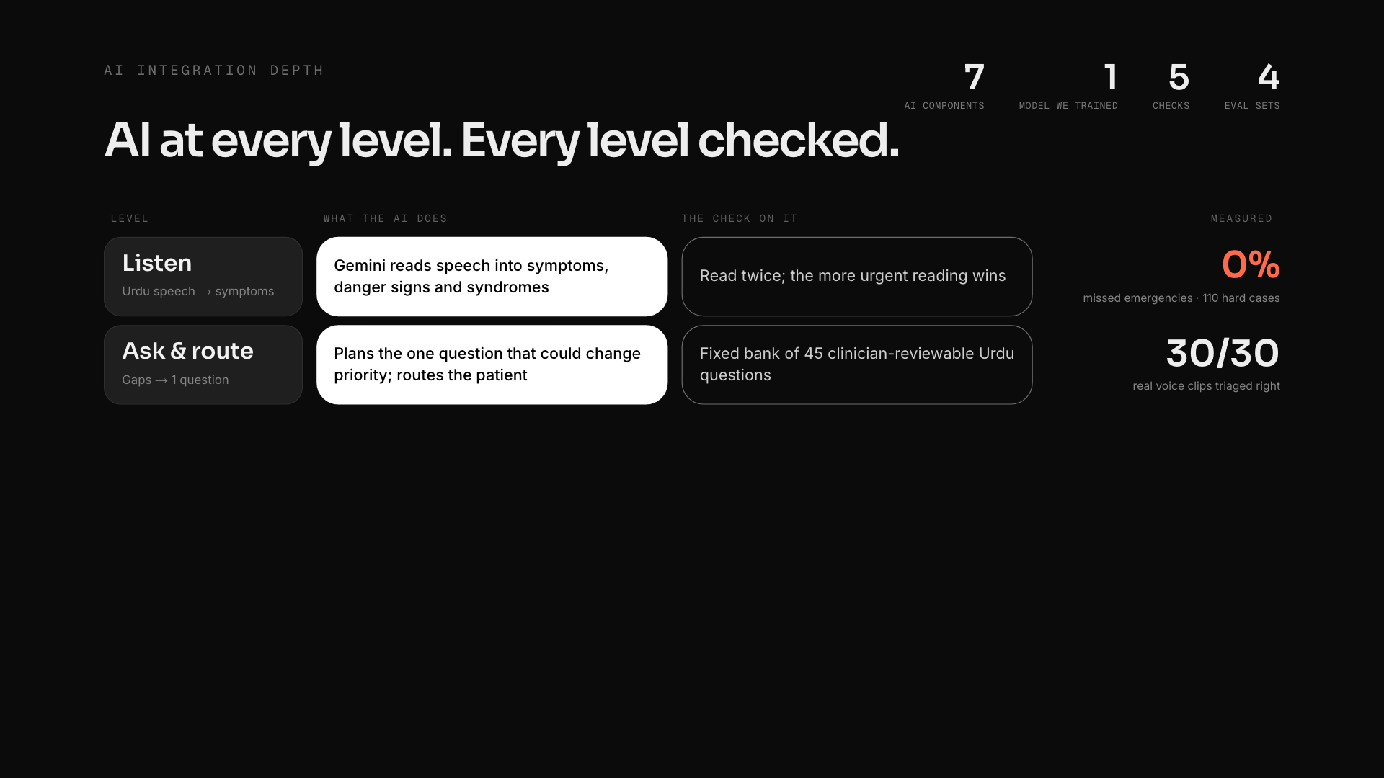
Notes:
ai-depth (click 3 of 6)
~30s · one row per click, from the patient to the district
"Most projects put AI in one box. Ours runs at five levels, and every level has a check and a measured number.
Listen: Gemini turns Urdu speech into symptoms and syndromes. It reads twice and keeps the more urgent reading: zero missed emergencies on 110 hard cases.
Ask and route: it plans the one question that could change priority, from a fixed bank of 45 reviewed Urdu questions. 30 of 30 real voice clips triaged right.
Read: it reads photographed old reports and writes the doctor's brief, and any line without a real source is dropped.
Watch: it tags syndromes for the district and writes the officer's alert, but the outbreak call itself is CDC statistics and the actions come from a fixed checklist. 93% precision.
Survive: when the internet drops, our own model, distilled from five thousand Gemini-labelled examples, triages in 8 milliseconds in the browser.
Seven AI components, one model we trained ourselves, five checks, four evaluation sets."
Rulebook mapping if asked: each row is Data → AI → Output (the small line under each level), and the whole stack ends in the impact numbers on the proof slide.
If an AI expert asks: structured output from Zod schemas, validated and retried on a fallback model; self-consistency at two temperatures; Gemini 2.5 Flash + Flash-Lite on Vertex AI; Lite is char+word n-gram logistic regression re-implemented in TypeScript.

Slide 37
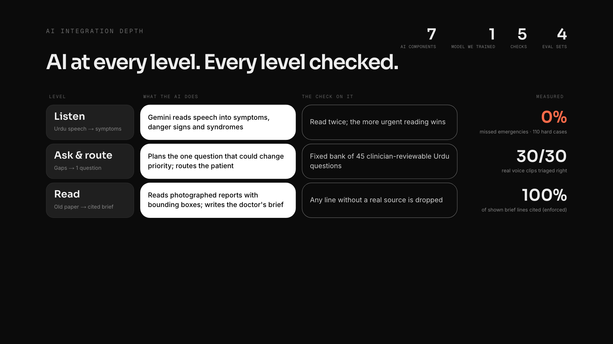
Notes:
ai-depth (click 4 of 6)
~30s · one row per click, from the patient to the district
"Most projects put AI in one box. Ours runs at five levels, and every level has a check and a measured number.
Listen: Gemini turns Urdu speech into symptoms and syndromes. It reads twice and keeps the more urgent reading: zero missed emergencies on 110 hard cases.
Ask and route: it plans the one question that could change priority, from a fixed bank of 45 reviewed Urdu questions. 30 of 30 real voice clips triaged right.
Read: it reads photographed old reports and writes the doctor's brief, and any line without a real source is dropped.
Watch: it tags syndromes for the district and writes the officer's alert, but the outbreak call itself is CDC statistics and the actions come from a fixed checklist. 93% precision.
Survive: when the internet drops, our own model, distilled from five thousand Gemini-labelled examples, triages in 8 milliseconds in the browser.
Seven AI components, one model we trained ourselves, five checks, four evaluation sets."
Rulebook mapping if asked: each row is Data → AI → Output (the small line under each level), and the whole stack ends in the impact numbers on the proof slide.
If an AI expert asks: structured output from Zod schemas, validated and retried on a fallback model; self-consistency at two temperatures; Gemini 2.5 Flash + Flash-Lite on Vertex AI; Lite is char+word n-gram logistic regression re-implemented in TypeScript.

Slide 38
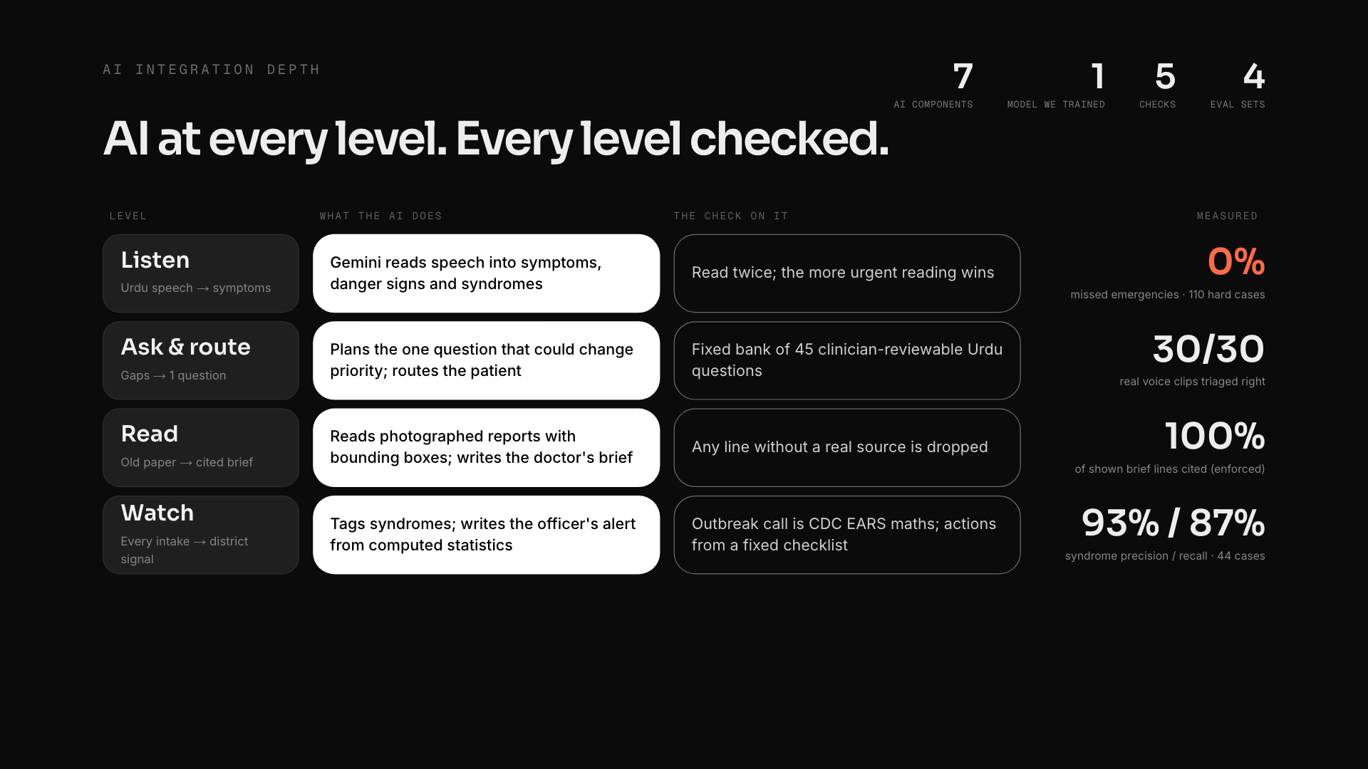
Notes:
ai-depth (click 5 of 6)
~30s · one row per click, from the patient to the district
"Most projects put AI in one box. Ours runs at five levels, and every level has a check and a measured number.
Listen: Gemini turns Urdu speech into symptoms and syndromes. It reads twice and keeps the more urgent reading: zero missed emergencies on 110 hard cases.
Ask and route: it plans the one question that could change priority, from a fixed bank of 45 reviewed Urdu questions. 30 of 30 real voice clips triaged right.
Read: it reads photographed old reports and writes the doctor's brief, and any line without a real source is dropped.
Watch: it tags syndromes for the district and writes the officer's alert, but the outbreak call itself is CDC statistics and the actions come from a fixed checklist. 93% precision.
Survive: when the internet drops, our own model, distilled from five thousand Gemini-labelled examples, triages in 8 milliseconds in the browser.
Seven AI components, one model we trained ourselves, five checks, four evaluation sets."
Rulebook mapping if asked: each row is Data → AI → Output (the small line under each level), and the whole stack ends in the impact numbers on the proof slide.
If an AI expert asks: structured output from Zod schemas, validated and retried on a fallback model; self-consistency at two temperatures; Gemini 2.5 Flash + Flash-Lite on Vertex AI; Lite is char+word n-gram logistic regression re-implemented in TypeScript.

Slide 39
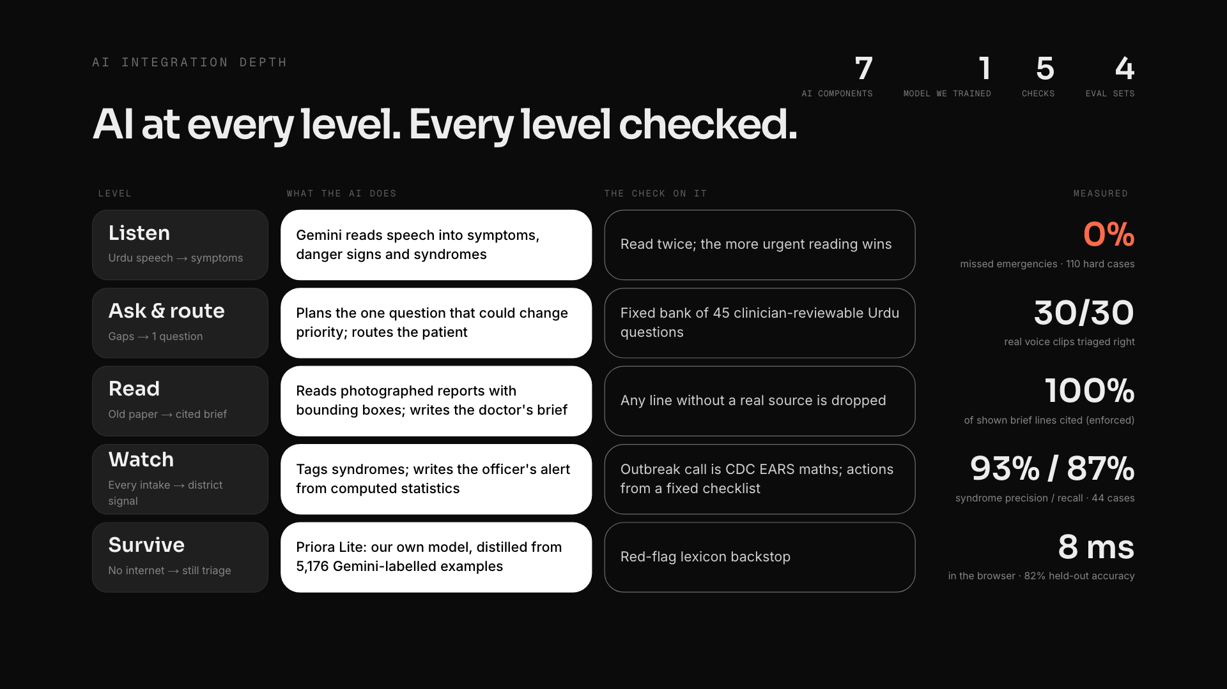
Notes:
ai-depth (click 6 of 6)
~30s · one row per click, from the patient to the district
"Most projects put AI in one box. Ours runs at five levels, and every level has a check and a measured number.
Listen: Gemini turns Urdu speech into symptoms and syndromes. It reads twice and keeps the more urgent reading: zero missed emergencies on 110 hard cases.
Ask and route: it plans the one question that could change priority, from a fixed bank of 45 reviewed Urdu questions. 30 of 30 real voice clips triaged right.
Read: it reads photographed old reports and writes the doctor's brief, and any line without a real source is dropped.
Watch: it tags syndromes for the district and writes the officer's alert, but the outbreak call itself is CDC statistics and the actions come from a fixed checklist. 93% precision.
Survive: when the internet drops, our own model, distilled from five thousand Gemini-labelled examples, triages in 8 milliseconds in the browser.
Seven AI components, one model we trained ourselves, five checks, four evaluation sets."
Rulebook mapping if asked: each row is Data → AI → Output (the small line under each level), and the whole stack ends in the impact numbers on the proof slide.
If an AI expert asks: structured output from Zod schemas, validated and retried on a fallback model; self-consistency at two temperatures; Gemini 2.5 Flash + Flash-Lite on Vertex AI; Lite is char+word n-gram logistic regression re-implemented in TypeScript.

Slide 40
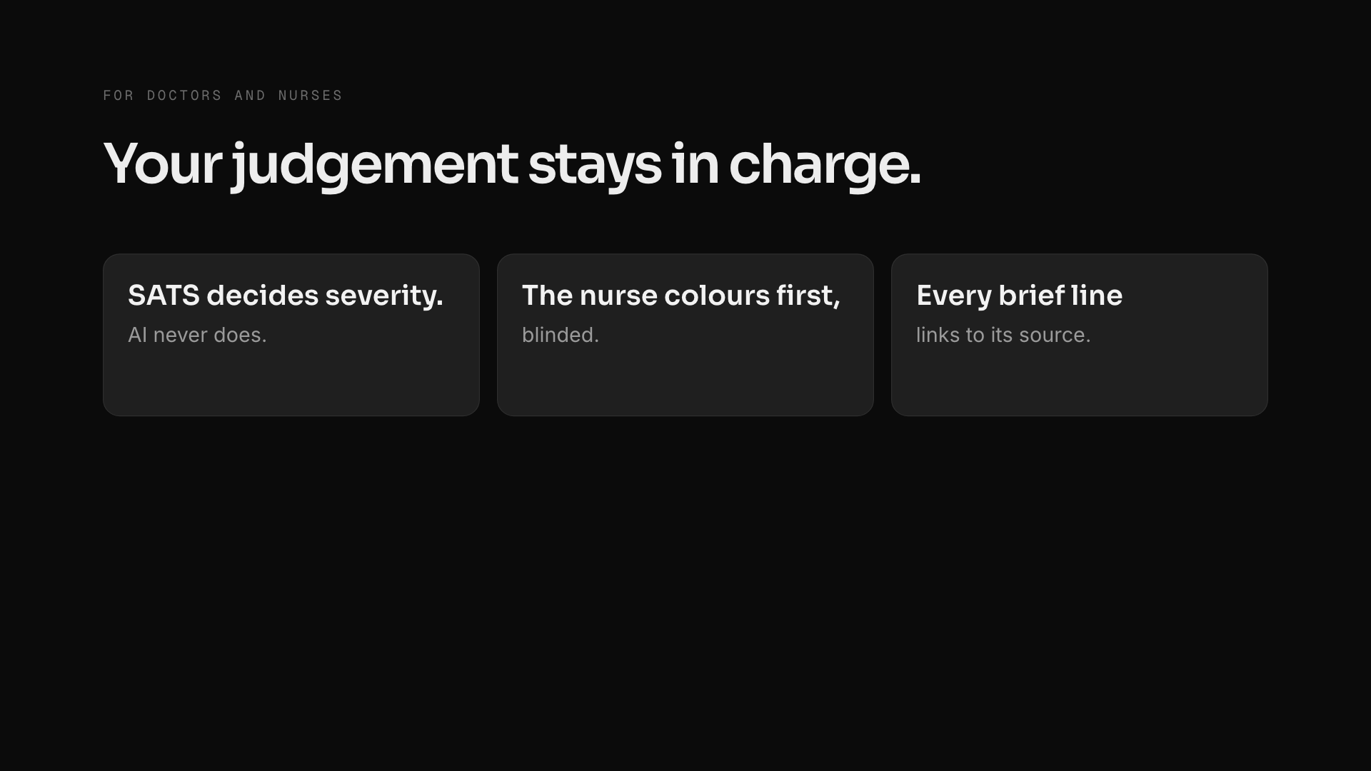
Notes:
clinicians (click 1 of 2)
~20s · two clicks
"For clinicians: severity comes from the South African Triage Scale, never from the AI. The nurse records her own colour before seeing the system's, so we measure agreement every day. Every line in the doctor's brief links to the original report, and lines without a real source are dropped. Under-twelves go straight to paediatric review. In our simulated OPD morning, a RED patient waits about a minute instead of over an hour. And it keeps working offline, with no new staff."
If a doctor asks: in a KP district hospital study, nurses using SATS under-triaged 66% of emergency vignettes (Dalwai 2014); Priora is a consistent second reader, not a replacement.

Slide 41
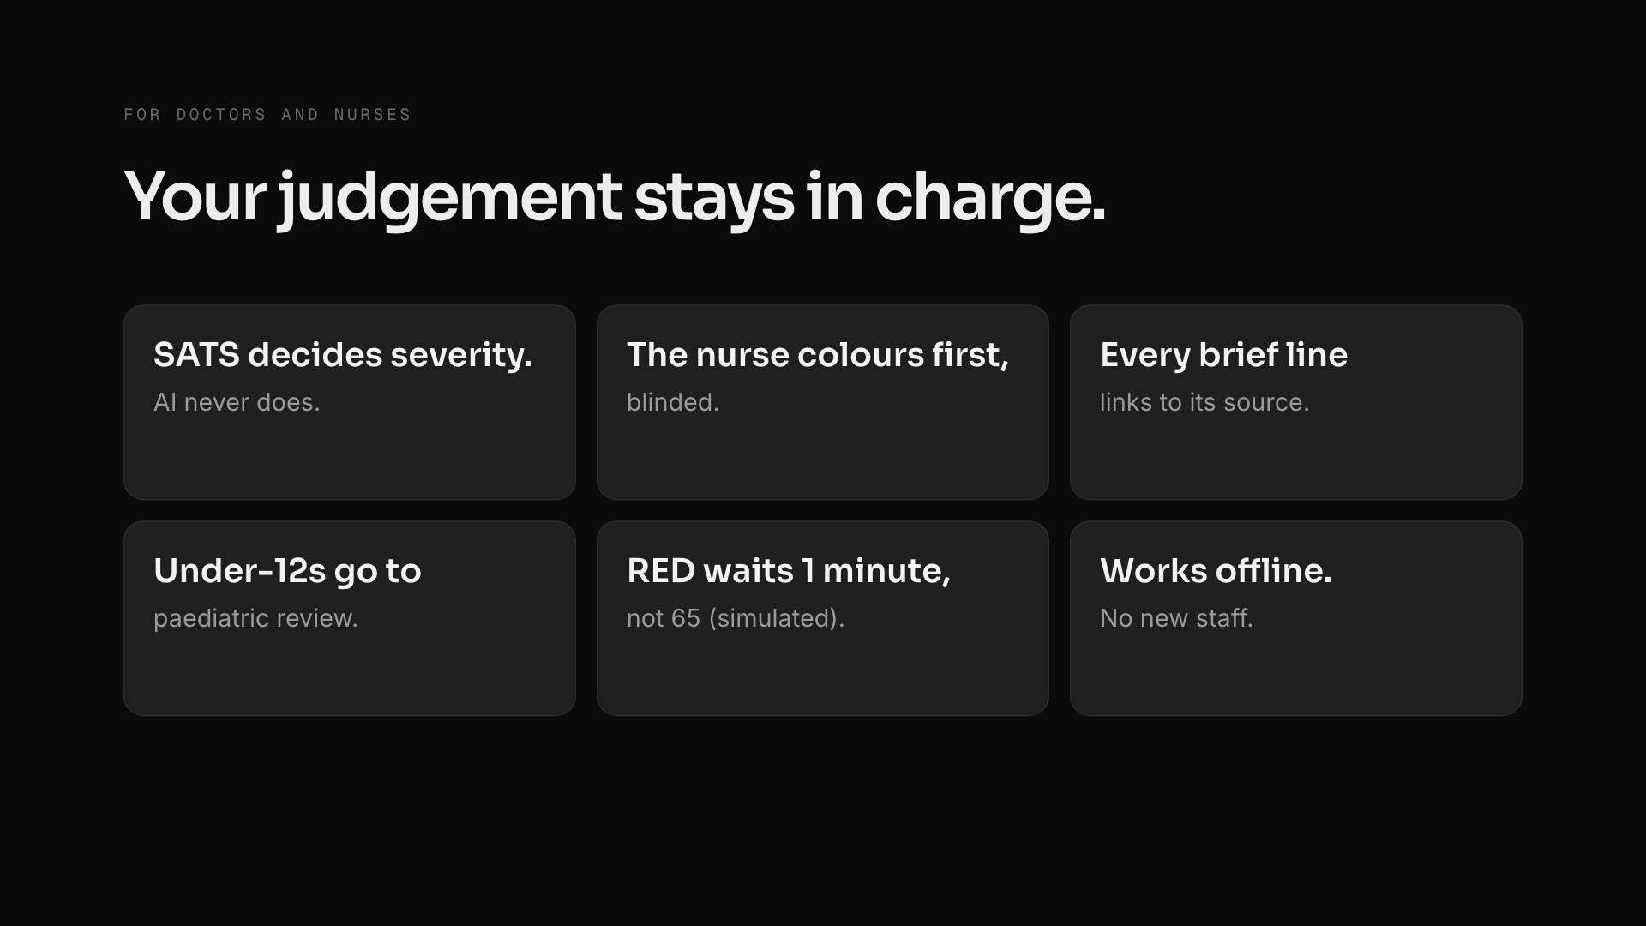
Notes:
clinicians (click 2 of 2)
~20s · two clicks
"For clinicians: severity comes from the South African Triage Scale, never from the AI. The nurse records her own colour before seeing the system's, so we measure agreement every day. Every line in the doctor's brief links to the original report, and lines without a real source are dropped. Under-twelves go straight to paediatric review. In our simulated OPD morning, a RED patient waits about a minute instead of over an hour. And it keeps working offline, with no new staff."
If a doctor asks: in a KP district hospital study, nurses using SATS under-triaged 66% of emergency vignettes (Dalwai 2014); Priora is a consistent second reader, not a replacement.

Slide 42

Notes:
demo
switch to the browser tabs
1. Kiosk: code AHMED54K7Q → Find me → mic: "Seenay mein dard hai, baayen baazu tak ja raha hai, paseena aa raha hai." Answer the follow-up → Correct.
2. Nurse: open his token → HR 130 · RR 30 · BP 95 · Temp 37 → pick ORANGE yourself → system says RED → Confirm.
3. Doctor (/doctor/emergency): Ahmed on top → open the brief → click one citation.
4. District: click the G-9 dengue alert → chart, hospitals, AI brief, surge plan.
If anything fails, go straight to the next slide.

Slide 43
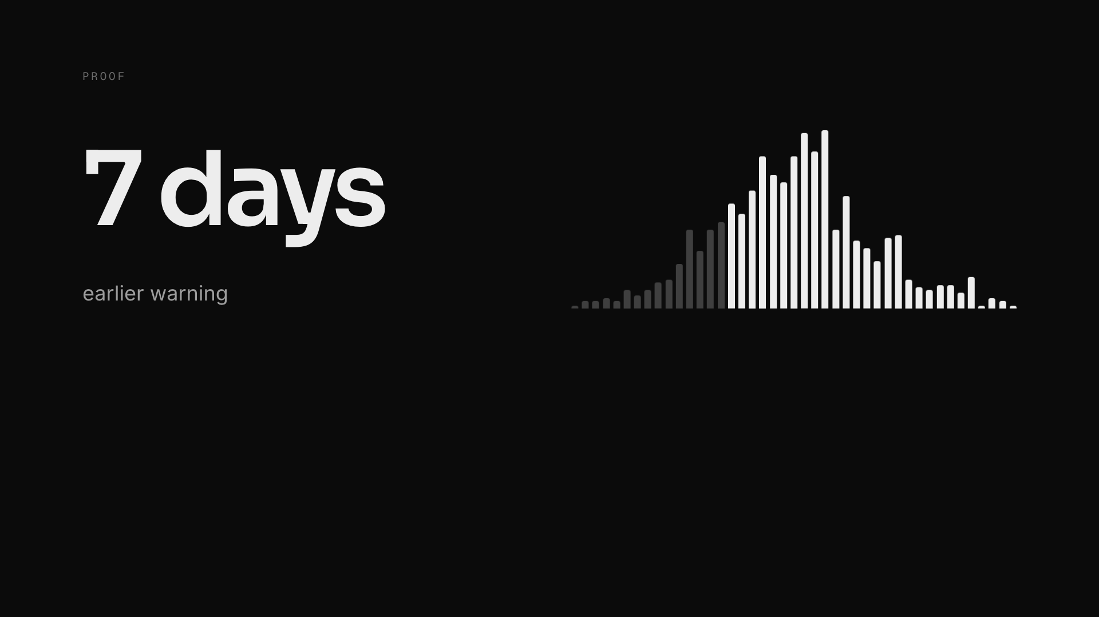
Notes:
proof (click 1 of 3)
"Across a thousand simulated outbreaks, Priora warns a median seven days earlier, and catches 87% within two weeks versus 39% today. On 110 cases written to trick it, it missed zero emergencies, and it triaged 30 out of 30 real Urdu and English voice clips correctly."
Be honest if asked: the lead time is a simulation; it needs about 40% of patients passing a kiosk. Only the 75% report figure is sourced; the rest are stated assumptions you can change at /impact.
If an AI expert asks: single reading 93.6% accuracy with 0.9% under-triage; two readings 0% under-triage for 1.8 points more over-triage; syndrome tagging 93% precision, 87% recall; our offline model 68% on the hard set, so it's the fallback, not the primary.

Slide 44
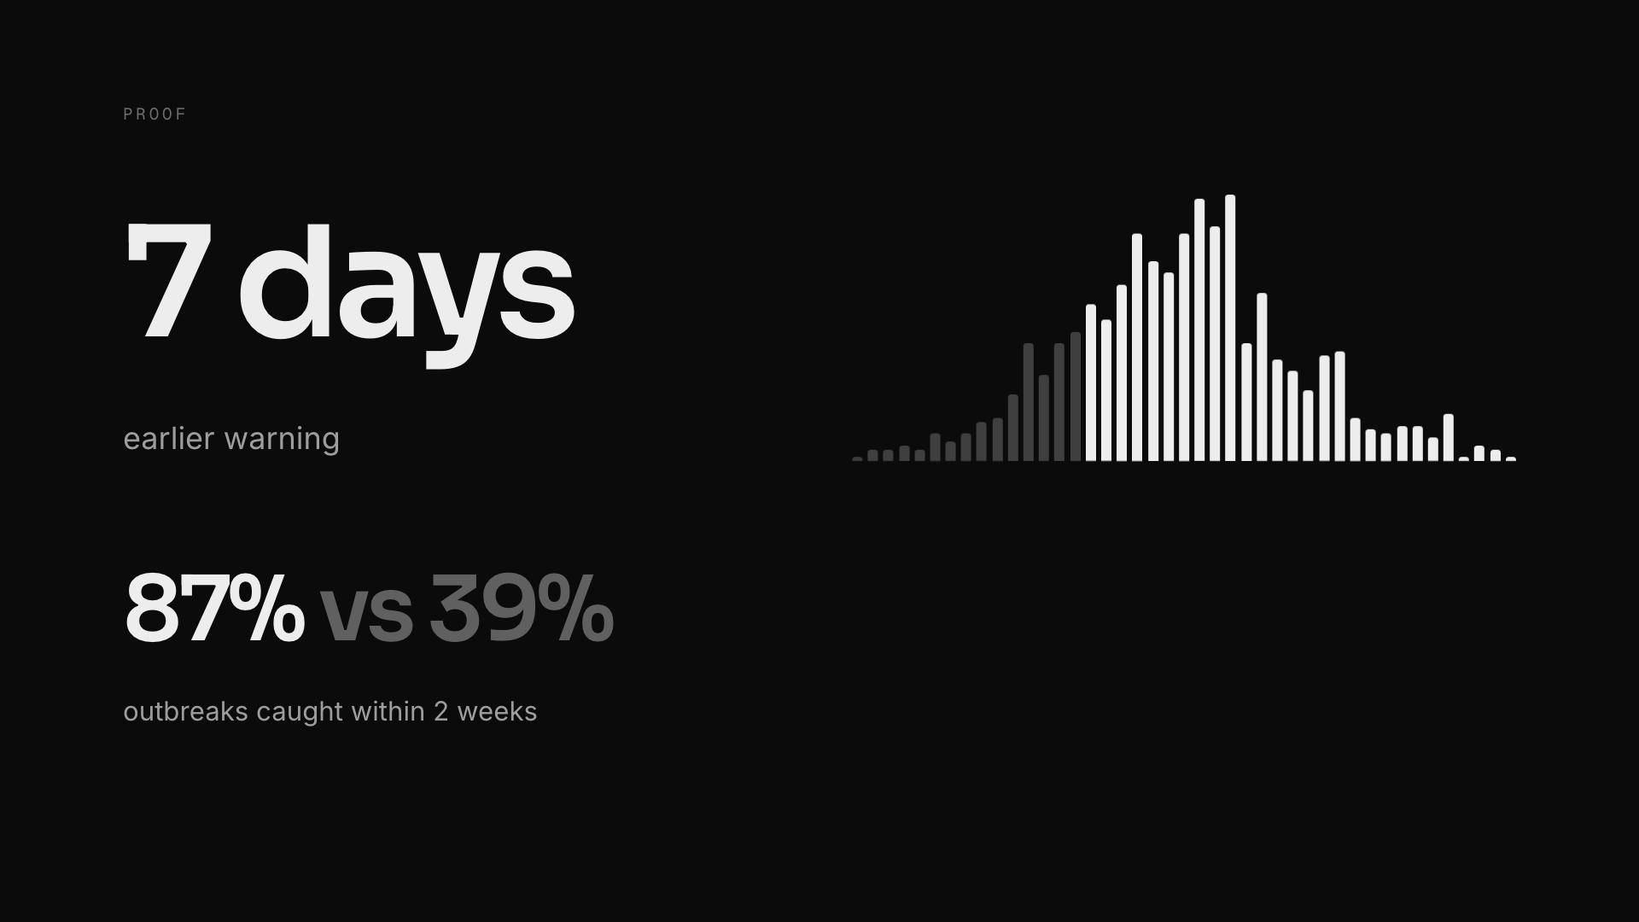
Notes:
proof (click 2 of 3)
"Across a thousand simulated outbreaks, Priora warns a median seven days earlier, and catches 87% within two weeks versus 39% today. On 110 cases written to trick it, it missed zero emergencies, and it triaged 30 out of 30 real Urdu and English voice clips correctly."
Be honest if asked: the lead time is a simulation; it needs about 40% of patients passing a kiosk. Only the 75% report figure is sourced; the rest are stated assumptions you can change at /impact.
If an AI expert asks: single reading 93.6% accuracy with 0.9% under-triage; two readings 0% under-triage for 1.8 points more over-triage; syndrome tagging 93% precision, 87% recall; our offline model 68% on the hard set, so it's the fallback, not the primary.

Slide 45
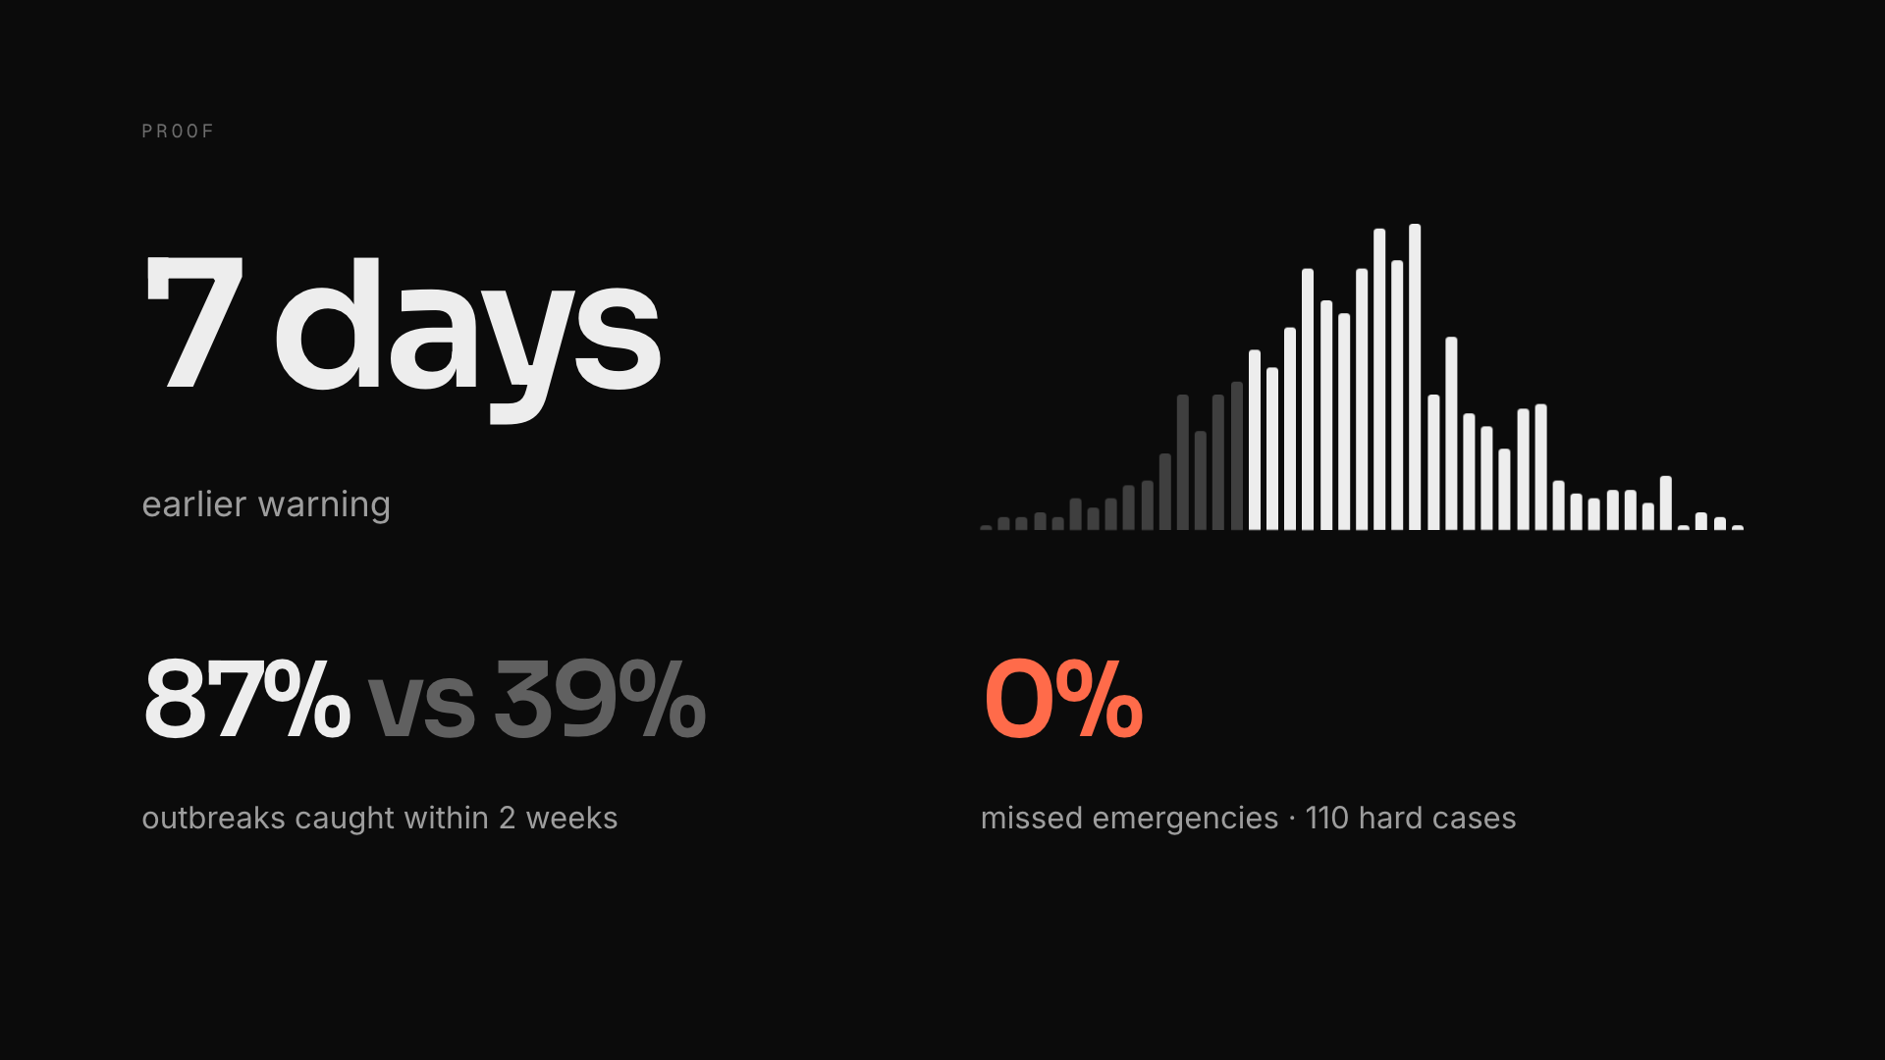
Notes:
proof (click 3 of 3)
"Across a thousand simulated outbreaks, Priora warns a median seven days earlier, and catches 87% within two weeks versus 39% today. On 110 cases written to trick it, it missed zero emergencies, and it triaged 30 out of 30 real Urdu and English voice clips correctly."
Be honest if asked: the lead time is a simulation; it needs about 40% of patients passing a kiosk. Only the 75% report figure is sourced; the rest are stated assumptions you can change at /impact.
If an AI expert asks: single reading 93.6% accuracy with 0.9% under-triage; two readings 0% under-triage for 1.8 points more over-triage; syndrome tagging 93% precision, 87% recall; our offline model 68% on the hard set, so it's the fallback, not the primary.

Slide 46
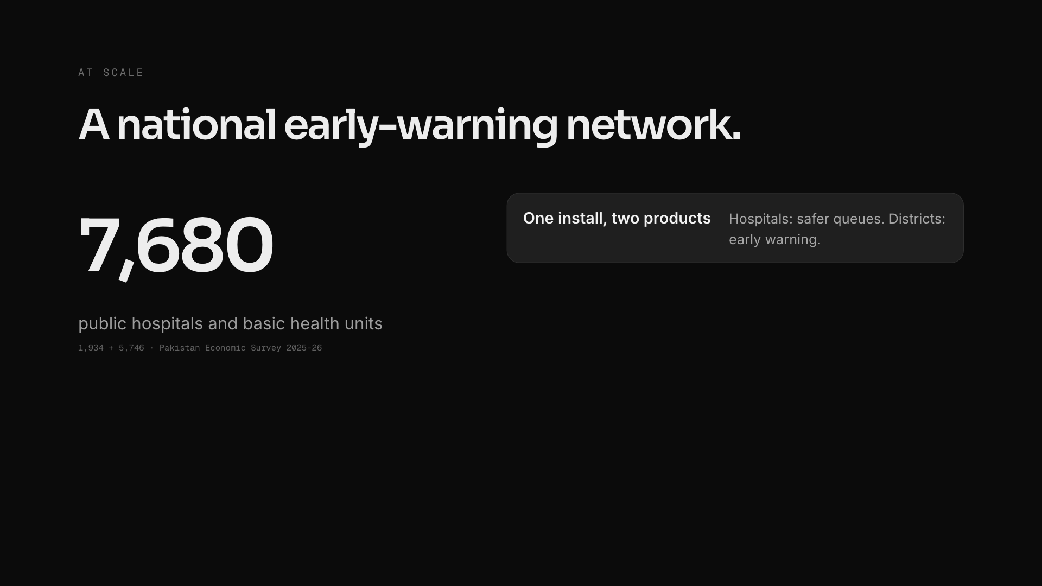
Notes:
value (click 1 of 3)
~20s · three clicks
"At scale, this is a national early-warning network. Pakistan has about 7,700 public hospitals and basic health units. One install gives two products: hospitals adopt it for safer queues, which gets it onto the desk; districts and provinces pay for the early warning. Every hospital that joins makes every alert faster: that's the network effect and the moat. It costs a tablet and a printer, and it maps directly onto SDG target 3.d: early warning for national health risks."
If a business judge asks who pays: district health authorities and provincial health departments, who own disease surveillance, with partners like NIH and WHO. Pilot: the 3 largest OPDs, then all 8 network hospitals, then integration with national IDSR reporting.

Slide 47
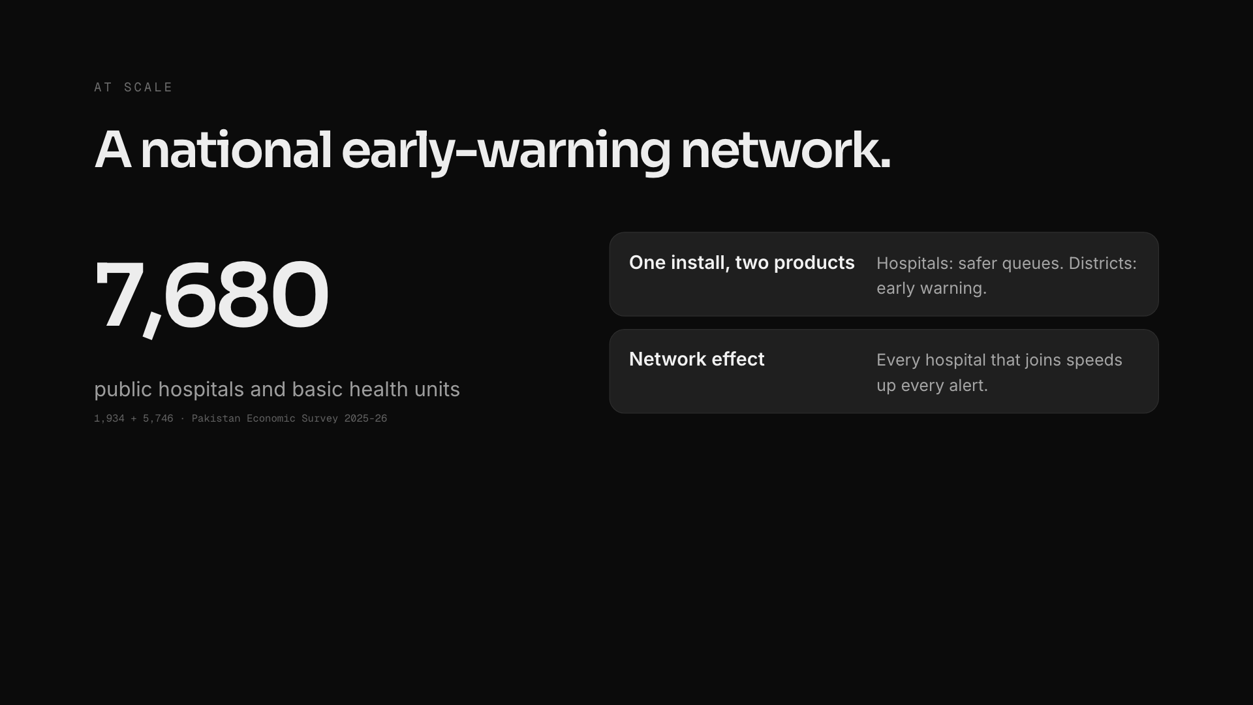
Notes:
value (click 2 of 3)
~20s · three clicks
"At scale, this is a national early-warning network. Pakistan has about 7,700 public hospitals and basic health units. One install gives two products: hospitals adopt it for safer queues, which gets it onto the desk; districts and provinces pay for the early warning. Every hospital that joins makes every alert faster: that's the network effect and the moat. It costs a tablet and a printer, and it maps directly onto SDG target 3.d: early warning for national health risks."
If a business judge asks who pays: district health authorities and provincial health departments, who own disease surveillance, with partners like NIH and WHO. Pilot: the 3 largest OPDs, then all 8 network hospitals, then integration with national IDSR reporting.

Slide 48
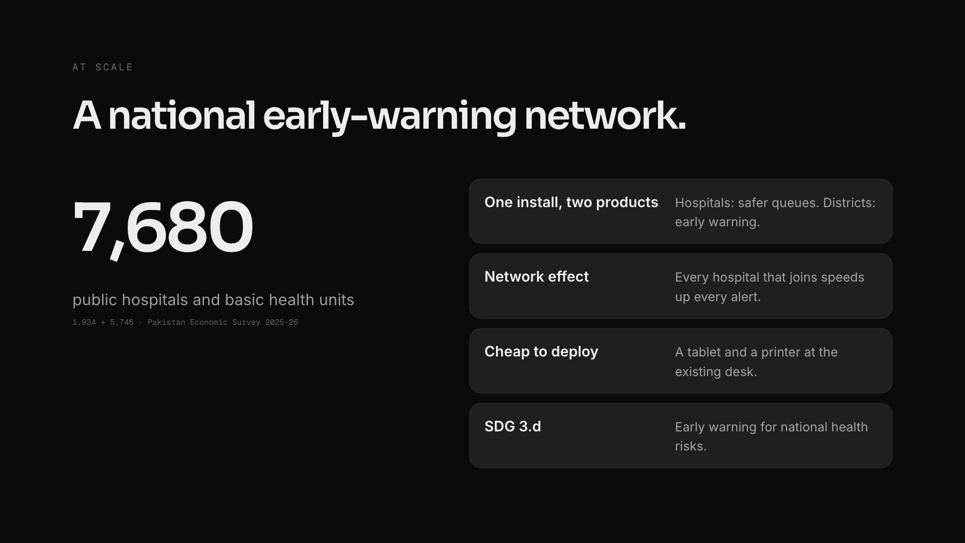
Notes:
value (click 3 of 3)
~20s · three clicks
"At scale, this is a national early-warning network. Pakistan has about 7,700 public hospitals and basic health units. One install gives two products: hospitals adopt it for safer queues, which gets it onto the desk; districts and provinces pay for the early warning. Every hospital that joins makes every alert faster: that's the network effect and the moat. It costs a tablet and a printer, and it maps directly onto SDG target 3.d: early warning for national health risks."
If a business judge asks who pays: district health authorities and provincial health departments, who own disease surveillance, with partners like NIH and WHO. Pilot: the 3 largest OPDs, then all 8 network hospitals, then integration with national IDSR reporting.

Slide 49
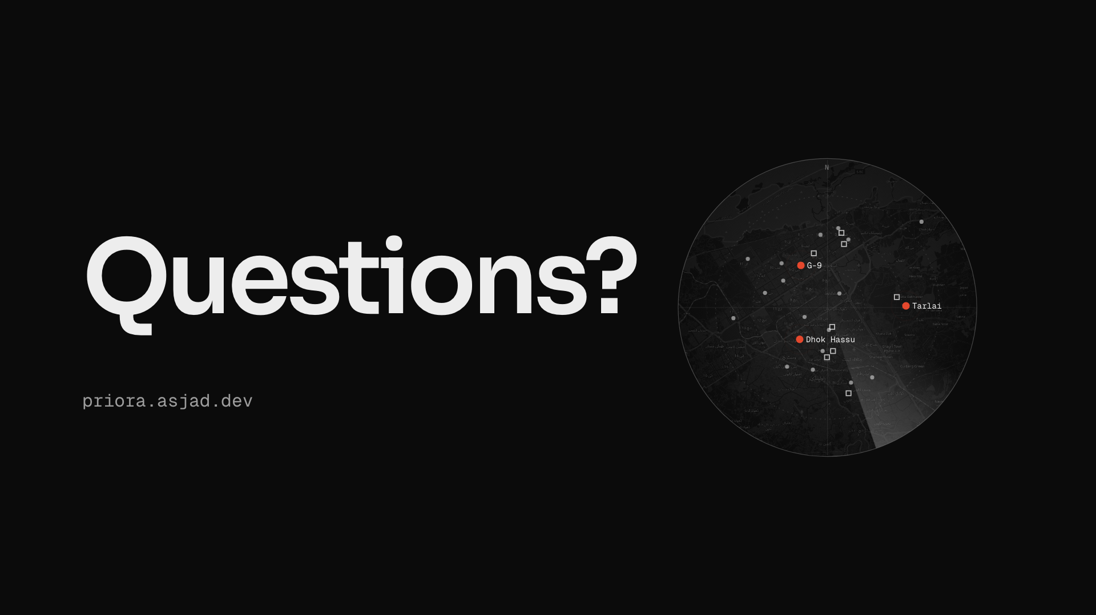
Notes:
questions
"It's live today. The next step is an eight-week pilot in the three biggest OPDs: PIMS, Holy Family and Benazir Bhutto. Three teams triage a patient. Priora triages a district. Thank you. Happy to take questions."

