Slide 1
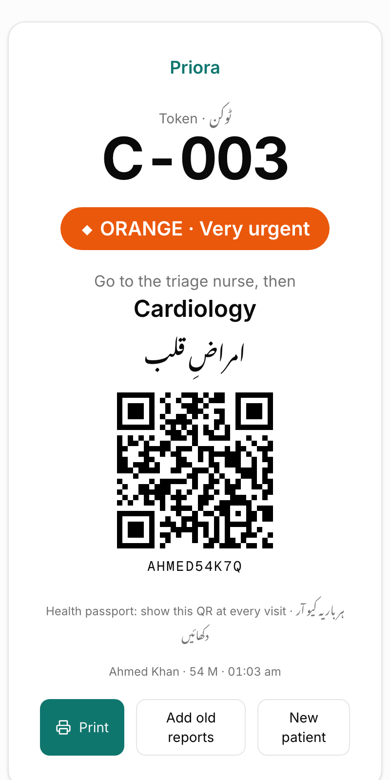
Priora
The right patient, first.
AI triage, routing and cited patient history for Pakistan's government hospital OPDs, before anyone joins a queue.
AICON'26 · Build With AI · Health Operations · Asjad Ali
Notes:
Hook: In a government OPD in Pakistan, a man with chest pain waits in the same line as someone with a skin rash, carrying a plastic bag of old reports nobody will read. Priora fixes what happens before the queue. I'm Asjad, and I built this solo during AICON.

Slide 2



In a government OPD, chest pain waits behind a rash
Wrong door
Flat queues
A bag of files
Patients don't know which OPD treats their symptoms. They queue in the wrong line, get redirected, and queue again.
First come, first served. No severity sorting before the queue, so critical patients wait like everyone else.
Years of paper reports. With 3–5 minutes per patient, doctors can't read them: the old ECG and the allergy get missed.
Validated with a medical student: severity-based routing is the core value, SATS is the triage scale in use, and an AI history brief helps route, with a proper checkup always following.
Notes:
Three problems compound, all before the doctor even sees the patient. My sister, a medical student, described these from government hospitals, and reviewed the solution: SATS is the triage scale they use, and routing is the core value.

Slide 3






Priora sorts patients before they join a queue
AI #1
SATS rules
AI #2
AI #3
AI #4
Speak
Triage
Route
Read files
Brief
Voice or text in Urdu, Roman Urdu or English → structured findings, quoting the patient
Deterministic South African Triage Scale. Nurse adds vitals and confirms
Findings + known history → the right OPD department
Photos of old reports → facts with flags and their exact location on the page
One-page brief for today's complaint. Every line cites its source
Output: a token slip with colour, department and a QR health passport → severity-sorted queues per department → a cited brief on the doctor's screen.
Notes:
Five steps. Four of them use AI, and the one that decides severity deliberately does not: SATS rules decide, AI only extracts. The patient walks out with a token, colour, department and a QR that replaces the bag of files.

Slide 4
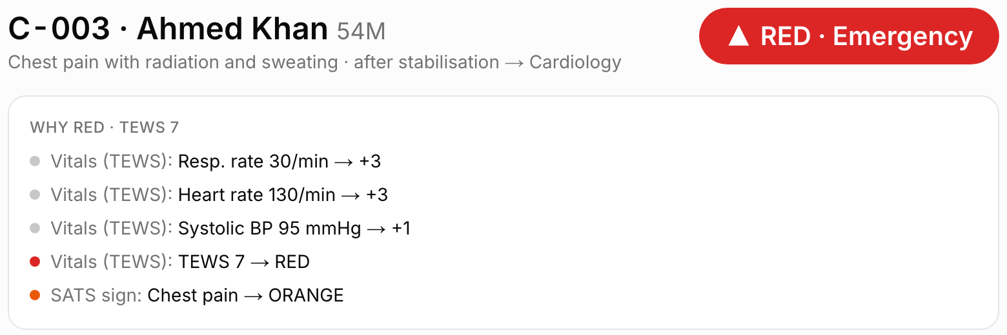



AI extracts, rules decide, clinicians confirm
Deterministic triage
The colour comes from SATS rules, never from the LLM. Any emergency sign forces RED.
Human in the loop
The nurse confirms every colour; overrides need a reason and are logged.
Every triage shows its reason trail: which vital added which points, and which SATS sign set the floor.
Cited, verifiable brief
Lines without a valid source are removed. One click opens the original scan.
Escalate under doubt
Low-confidence extraction or a child → never GREEN; flagged for review.
Gemini on Google Cloud Vertex AI: enterprise data controls, prompts not used for training. Decision support only.
Notes:
Judges will ask: what if the AI is wrong? The answer is built in. AI extracts findings with the patient's own words as evidence; deterministic SATS rules assign the colour; the nurse confirms. Every brief line is cited and checkable.

Slide 5
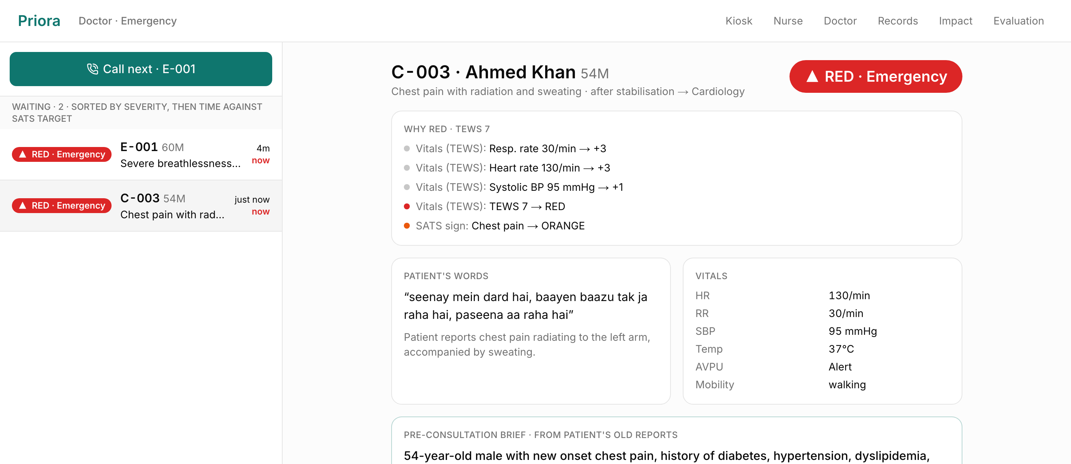
Live demo: Ahmed, 54, chest pain
1
Kiosk Passport code → he says “seenay mein dard hai…” → ORANGE, Cardiology (history used)
2
Nurse HR 130, RR 30, SBP 95 → TEWS 7 → RED, moved to Emergency
3
Doctor Top of the queue, with a cited brief from 5 old reports
Notes:
Switch to the live site: priora.asjad.dev. Kiosk: enter AHMED54K7Q, speak the complaint in Roman Urdu. Show ORANGE and Cardiology, then the token. Nurse: enter vitals, watch it turn RED live. Doctor Emergency: he is at the top; open the brief, click a citation. If the network fails, use these screenshots.

Slide 6
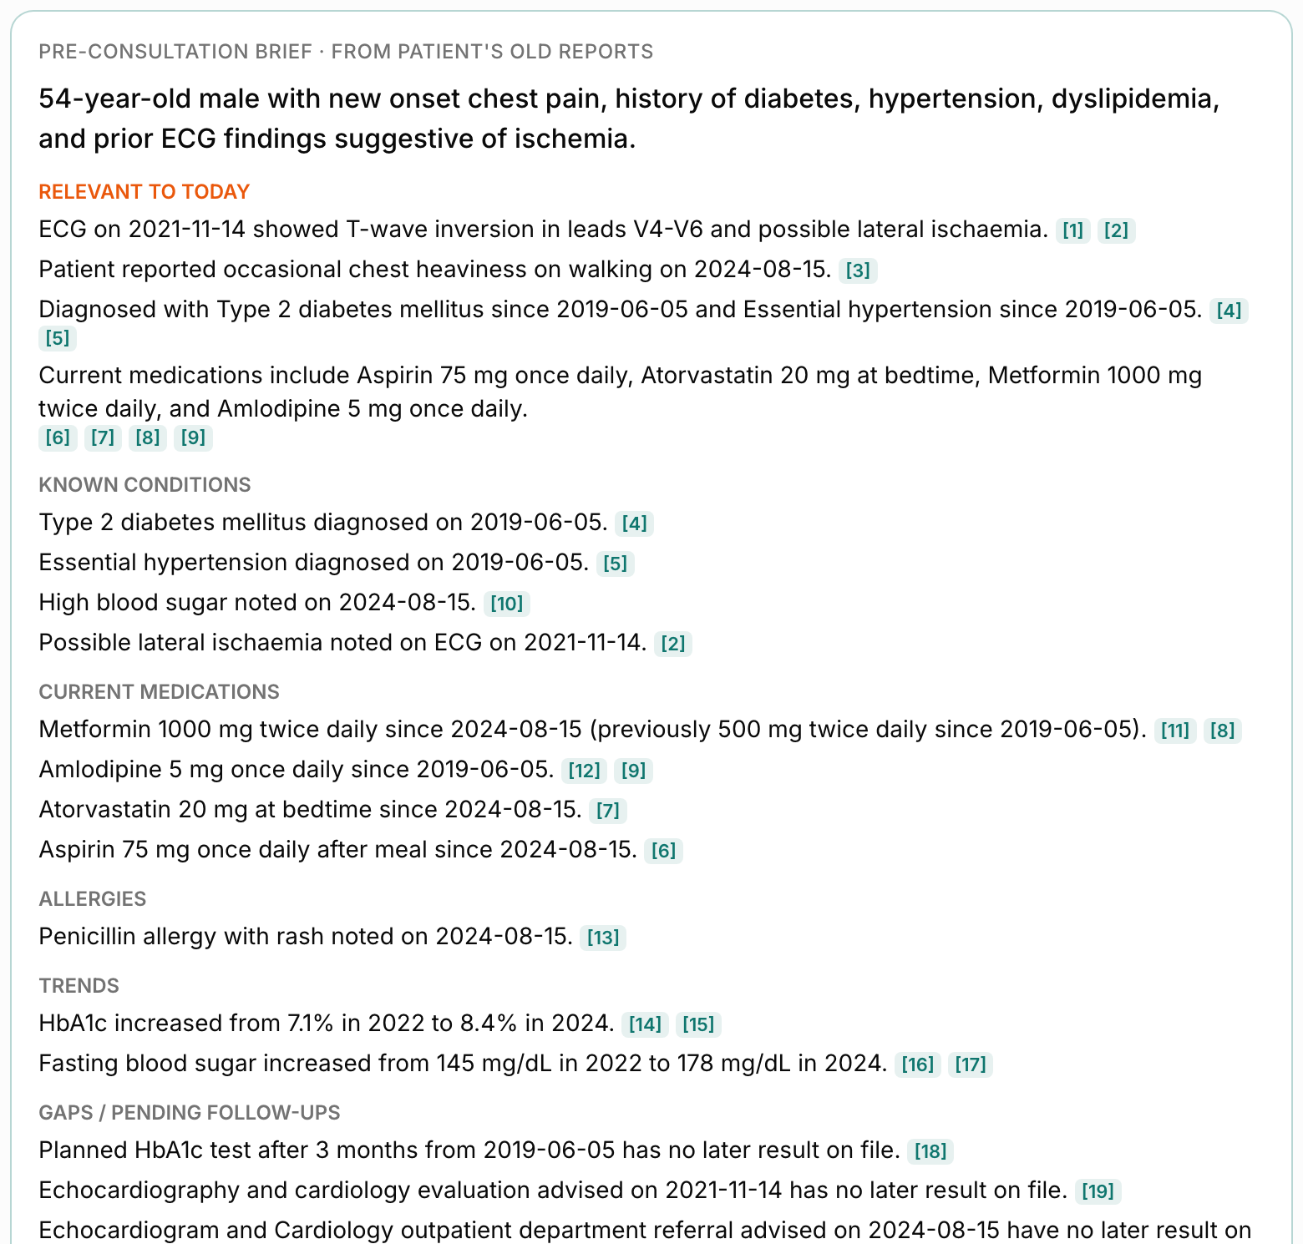
From a bag of files to a cited one-page brief
5 old reports → ~40 facts
Lab reports, a handwritten prescription, an ECG and a discharge summary, read by AI with exact locations on each page.
What matters for today
Chest pain → the 2021 ECG with T-wave inversion V4–V6 comes first, then risk factors and cardiac medications.
Trends a busy doctor misses
HbA1c 7.1% → 8.4%, fasting sugar 145 → 178, metformin dose doubled.
The gap
An echocardiogram was advised in 2021 and again in 2024. There is no result on file.
Notes:
This is the moment: from a bag of paper, AI builds a brief focused on today's chest pain. It even found that an echo was advised twice and never done, something no doctor finds in 3 minutes. Every line cites its source; click and you see the highlighted spot on the original report.

Slide 7
Critical patients seen in minutes, not hours
65 → 1 min
RED median wait
14% → 100%
ORANGE seen within the 10-min target
48 → 10
3.8 h
wrong-line redirects per morning
doctor time saved on paper files
Simulated OPD morning: 300 patients, 4 hours, 4 doctors, same synthetic patients in both runs. Trade-off: GREEN waits longer (68 → 97 min) but stays within its 4-hour target.
Notes:
I didn't want to just claim impact, so I built a simulator. Same 300 synthetic patients, same morning, only the process changes. RED patients wait 1 minute instead of 65. Redirects drop because AI routing is right 96% of the time. Doctors get almost 4 hours back. And I show the trade-off honestly: green patients wait a bit longer, but all within the SATS target.

Slide 8
Tested before trusted: zero under-triage
100%
0%
96.4%
6 s
triage colour accuracy
under-triage: a serious case marked less urgent
exact department · 100% clinically acceptable
median AI time per patient
The test set
Engineering for a live hospital
28 synthetic patient descriptions in English, Roman Urdu and Urdu script
Expected colour and department fixed before running, never edited after
Runs the real pipeline: AI extraction → SATS rules → AI routing
Reproducible: npm run eval · results on /eval
Benchmarked 6 model setups: newest previews swung 2–37 s, so the real-time path uses stable Gemini 2.5
Same 100% accuracy at ~6× lower latency
Timeouts + automatic fallback model; 48 unit tests on triage, queue and simulator
Notes:
In triage, the error that matters is under-triage: calling a serious case mild. On 28 test cases in three languages, it's zero. I also measured model latency: the newest preview models swung up to 37 seconds, so I switched to stable models and kept 100% accuracy at 6 times the speed.

Slide 9



Built for adoption in Pakistan's public hospitals
SDG 3 · Good health
SDG 10 · Fairer access
Industry value
Critical patients treated sooner; missed history caught before the consult.
Urdu voice for low-literacy patients; a fairness rule so routine cases aren't starved.
Runs on a tablet and a printer: no new hardware. Frees doctor hours and cuts redirects.
Adoption path
Pilot
Validate
Scale
District view
One district hospital OPD: kiosk + nurse station
Compare waits and triage agreement with nurses
Integrate with hospital HMIS; SMS token updates
Aggregate symptoms for outbreak signals
Notes:
Why it matters beyond the demo: it targets SDG 3 and 10, and it's cheap to adopt: a tablet and a printer, cloud AI, no new hardware. The path is a single-OPD pilot, measure against nurses, then HMIS integration and district-level outbreak signals.

Slide 10

The right patient, first.
4 AI components, deterministic SATS triage, human confirmation
Cited history brief with one-click source verification
Measured impact and evaluated accuracy, 0% under-triage
Built solo at AICON'26, live and deployed
Try it now
priora.asjad.dev
github.com/asjad2401/aicon
Notes:
Close: Priora puts the right patient first. Four AI jobs, safe deterministic triage, cited history, measured impact, and it's live right now at priora.asjad.dev. Thank you. Happy to take questions.

