Slide 1
Virtual Teams - Role of ICT in managing globally distributed Projects
Amulya gollapudi
Roahani Parekh aka sharma
Adarsha Upparkoppalu Annaiah
Muhammad Asjad

Slide 2
Project Scope
Research question: How can a project managers leverage information and communication technologies(ICT)effectively to mitigate a high level of risk that is inherent in remote IT projects ?
Why virtual or remote teams are becoming popular?
What benefits can they provide to the organizations?
What are some of the problems faced by the virtual teams?
What role ICT Technologies can play in bringing team members together?
What major factors lead to failure of remote projects?

Slide 3
Outline
Background/Introduction
Common problems faced by remote teams
Establishing a Communication Framework
Risk Management of remote Projects
Conclusion

Slide 4
Background
Outsourcing:
Intense Competition and tight project budgets
Rise of Knowledge based economy
Minimize Operational Cost
Emergence of Cloud based communication technologies
Leverage global talent
Notes:
- we are entering an era of fast paced knowledge based economy where competition is intense and firms are scrambling to get project done with limited budget.
This has led to outsourcing of projects or projects that are done in a distributed setting
Cloud based communication models Service This drastically reduced the costs of communication tools.
There are people issues that need to addressed.

Slide 5
Virtual Teams
Definition:
“a group of geographically, organizationally and/or time dispersed workers brought together by information technologies to accomplish one or more organization tasks” (Powell et al. 2004, p. 7).

Slide 6
Virtual Teams
Benefits
Cost Reduction
Cultural diversity
flexibility in building cross-functional teams
Business value
Notes:
Virtual teams allow organizations to build teams with lowers costs as compared to the co-located teams
Then we have the Cultural diversity aspect which if leveraged properly can bring fresh perspective or new ideas to the table.
So the old approach was bring everyone to some location and have a hierarchy of people. With remote teams you can quickly build cross functional teams where you can build teams based on the skill rather than just experience.

Slide 7





Input-process-output model
Outputs
Task Process
Socio-Emotional Process
Issues
Inputs

Slide 8
INPUTS
Design
Culture
Technical Expertise
Training
Figure 1: Issues arising in initial stages of team formation

Slide 9
Relationship Building
Socio-Emotional Process
Cohesion
Trust
Figure 2: Processes that enable successful functioning of the team

Slide 10
Task-Technology Structure Fit
Coordination
Communication
Task Process
Figure 3: Task Processes enable collaborative work environment

Slide 11
Performance
OUTPUT
Satisfaction
Figure 4: Output category of issues focuses on the performance of the virtual team

Slide 12
Establishing a Communication Framework
Our focus in this project was management of remote IT projects
Global IT projects cannot function without sufficient ICT involvement.
Due to low product visibility and changing requirements IT projects are perceived as challenging and High risk.
Meeting deadlines of projects requires a high degree of communication amongst the team members.

Slide 13
Information overload:
High information overload load can occur due to excessive volume of e-mails or text based communication.
This leads to
overlooking of critical information
Delays in decion making
Co-ordination Problems
- Communicaiton framework should allow the ability to prioritize certain type of communications.
Notes:
-Another problem that remote teams face is of information overload.
On the one hand, ICT enables communication in distributed teams. On the other hand however, heavy use of ICT and a strong dependence of project team members on technology represent another reason for communication problems in globally dispersed projects.
--------------To be added
Roles and responsibilites should m
* add one point tasks once added should be followed through.

Slide 14
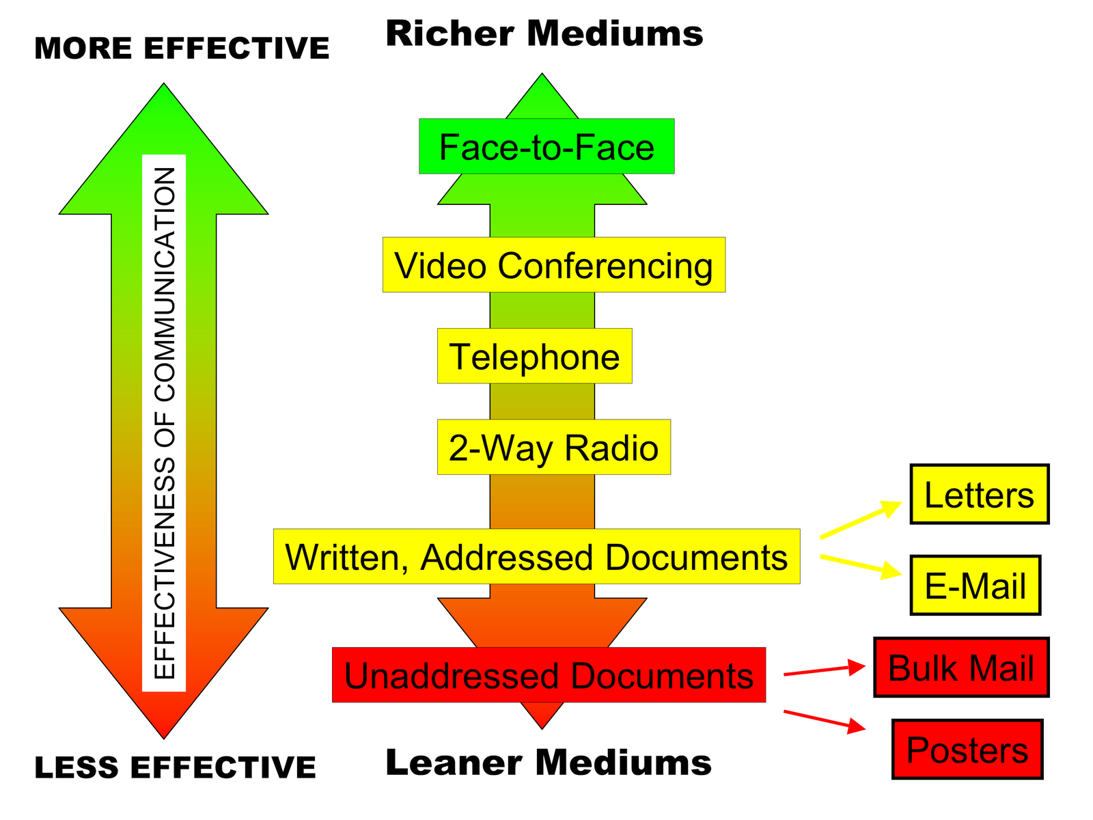
Ranking Communication Tools:
Media Richness Theory (MRT), proposed by Daft and Lengel (1986), can be used by organiation to judge communication abilities of different communication media.
Notes:
1. The communications medium with the highest level of richness
2. We can rank different communicaiton technologies based on the richness that they provide:
- face-to-face communication,
video conferencing,
- phone,
online chat respectively.
The lowest richness level is represented by e-mail, text messaging, and written documents.
3. A loss of communication richness is considered to be one of the major communication problems and one of the main collaboration challenges facing typical global software development projects.
4. MRT can help guide remote teams to develop establish a communication framwork before the beginning of work .
Read more: https://en.wikipedia.org/wiki/Media_richness_theory
We also seeing a trend towards trend toward the use of more instantaneous communication tools..

Slide 15
Social Media
Social networks can diminish the cognitive distance between project team members.
They can allow:
Increased Knowledge sharing
informal communication between members of the team
establish a sense of oneess (To be said: amongst the team mmebers and has a positive influence on team dynamics. )
Boast overall team morale
Notes:
allows informal communication (like sharing of photos etc.)

Slide 16
Risk Management of Remote Projects

Slide 17
Lack of Communication- Associated risks
miscommunication can lead to:
Risk of Redundant work
Incorrect understanding of project requirements
Project Failure
Mitigation Strategy:
ICT technologies
Create a Symbiotic Relationship
Facilitate Transfer of Knowledge

Slide 18
Heterogeneous culture
Preferred mode of communication
Cultural arrangements
Manager Training
Infusing Cultural sensitivity

Slide 19
Collaboration Tools - Associated Risks:
Selection of Tools
Low usage frequency
Tool’s Training
TTF Model
Five trigger Model
Task-oriented communications
It will influence expertise location and cognition-based trust in virtual teams.

Slide 20
Lack of collaboration – associated risks
Introvert and extrovert members
Characteristics of team members
Size of Project team
Reduced efficiency of virtual team

Slide 21
Key takeaways
Sophisticated communication technologies can go in vain if the team is lacks trust or is not willing share knowledge.
Certain ICT technologies can reduce the communication gaps better than others and richness of the information needed to establish strong social relationships.
Internal social communication tools that allow informal commination can go a long way in establishing bonds or oneness amongst team members.
Notes:
If a sense of oneness is missing from the team then projects run a very high risk of failure
Based on the MRT we observed that we can rank different technologies vary in terms of the communication richenss that they can provide. If right ones are being used from the beginning then that can quickly establish oneness in the team. Even during the one team members know which of them should be used for priority communication and which one then that reduces a lot of risk that can arise due to miscommunicaiton or information overload.
Furthermore we have these internal communication tools available which allow team members to do informal communication.

Slide 22
Key takeaways (continued)
Overall even though globally distributed teams face a lot of challenges, they have the capability to provide organizations with great opportunities and benefits in terms of adding business value(Akemi et. al,2013 ).

Slide 23

References
BARDHAN, I., KRISHNAN, V. V. & LIN, S. 2013. Team Dispersion, Information Technology, and Project Performance. Production and Operations Management, 22, 1478-1493.
BJØRN, P. & NGWENYAMA, O. 2009. Virtual team collaboration: Building shared meaning, resolving breakdowns and creating translucence. Information Systems Journal, 19, 227-253.
ESPINOSA, J. A., SLAUGHTER, S. A., KRAUT, R. E. & HERBSLEB, J. D. 2007. Team Knowledge and Coordination in Geographically Distributed Software Development. Journal of Management Information Systems, 24, 135-169.
POWELL, A., PICCOLI, G. & IVES, B. 2004. Virtual teams: A review of current literature and directions for future research. Data Base for Advances in Information Systems, 35, 6-23.
SARKER, S., SARKER, S., NICHOLSON, D. B. & JOSHI, K. D. 2005. Knowledge transfer in virtual systems development teams: an exploratory study of four key enablers. IEEE Transactions on Professional Communication, 48, 201-218.
SHRIVASTAVA, S. V. & RATHOD, U. 2015. Categorization of risk factors for distributed agile projects. Information and Software Technology, 58, 373-387.
STAWNICZA, O. 2014. Information and Communication Technologies – Creating Oneness in Globally Distributed IT Project Teams. Procedia Technology, 16, 1057-1064.

