Slide 1
Datafest
File created on: 5/15/2020 12:04:47 PM

Slide 2
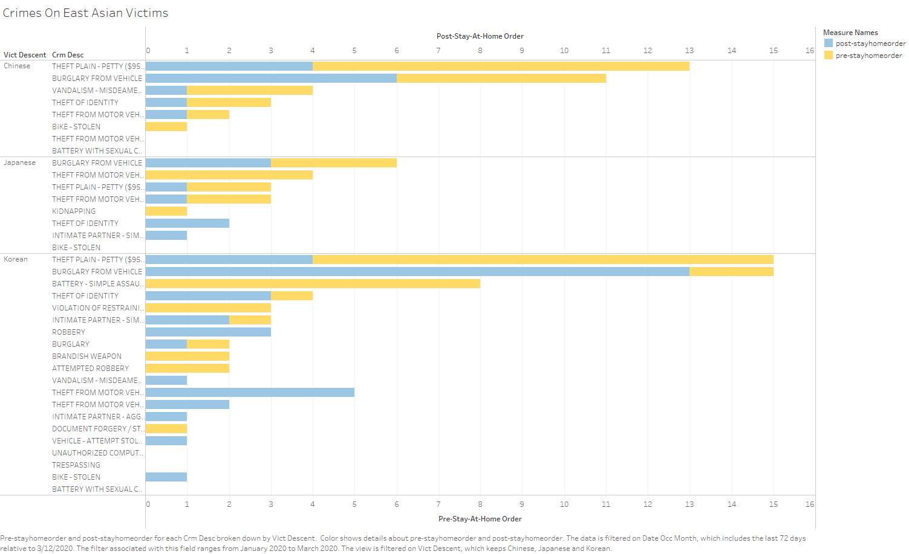

Slide 3
