Slide 1
Hotel Room Reservation System
Almas Askarov
Daniyar Kushkinbayev

Slide 2
Overview
Our goal is to create a database which keeps track of information about people who reserved room in particular hotel.
The user will be allowed to fill in their personal information and chose the room which they want.
Our interface will be a web page

Slide 3
Used Technology
We will do our project using SQL, PHP, HTML, JavaScript and CSS of course.
The template of hotel booking service web site will be used.

Slide 4
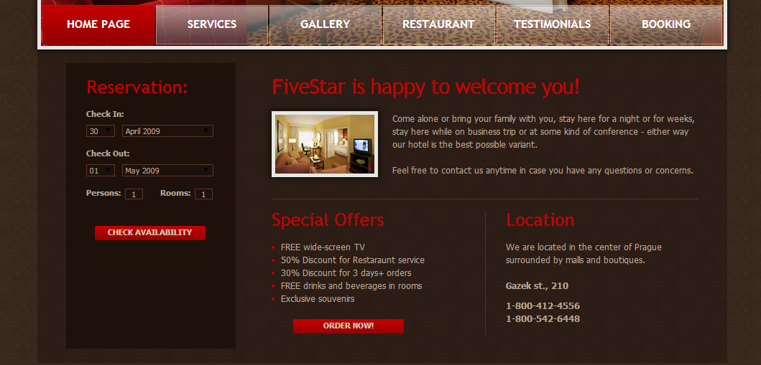
Interface

Slide 5
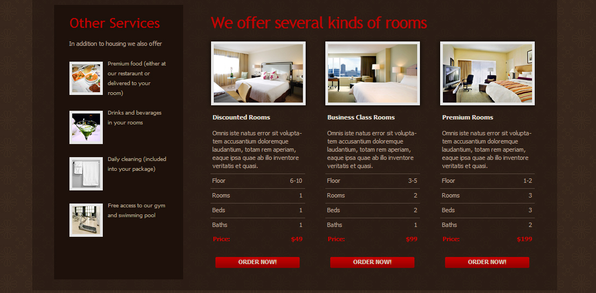
Interface

Slide 6
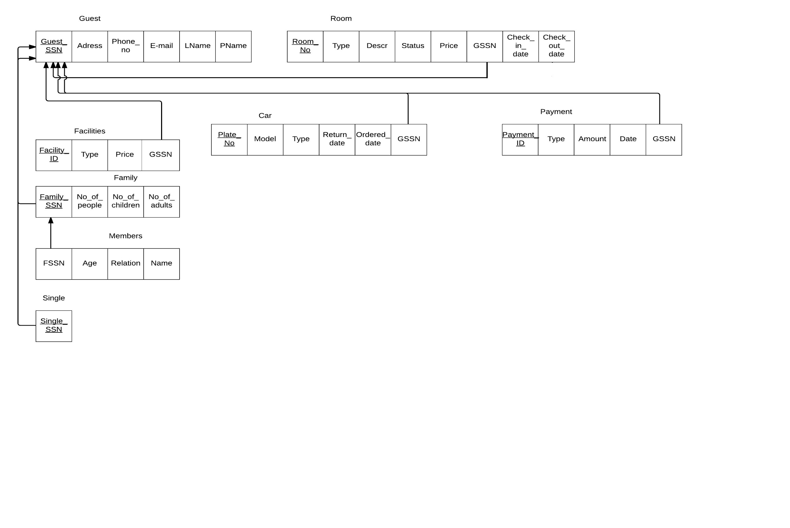
ER Model

Slide 7
Progress and Difficulties
Created Database
Found useful template
Problems with foreign key

Slide 8
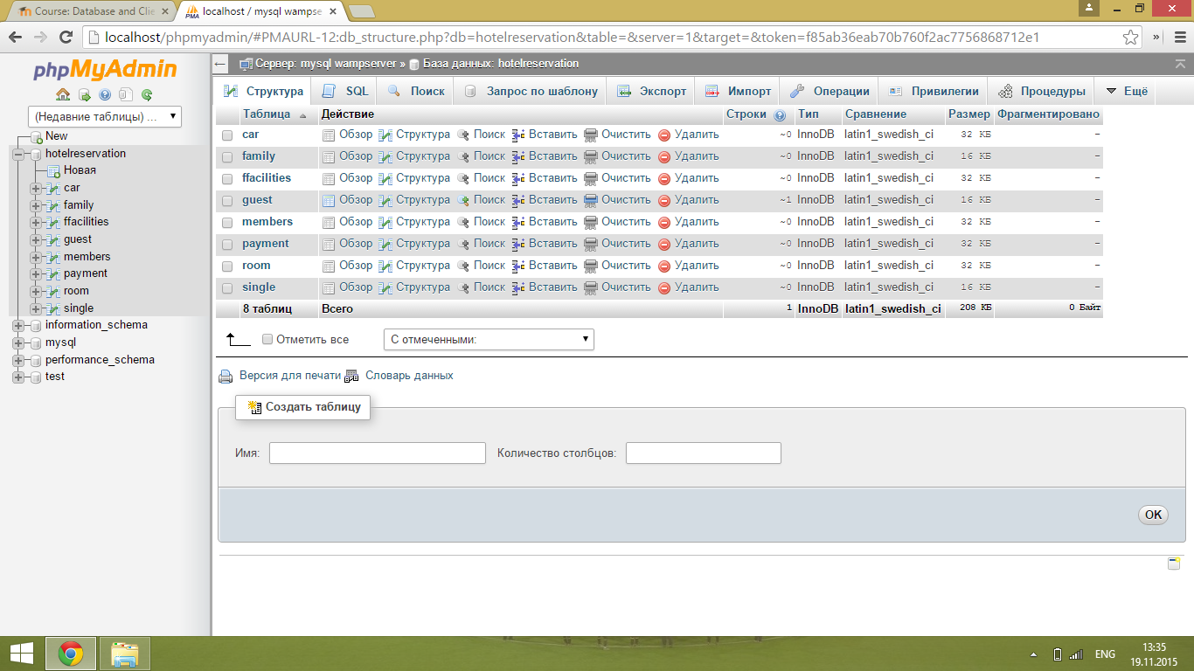
Database

