Slide 1

EDA – IPL Match
Dhananjay Bhandarkar

Slide 2
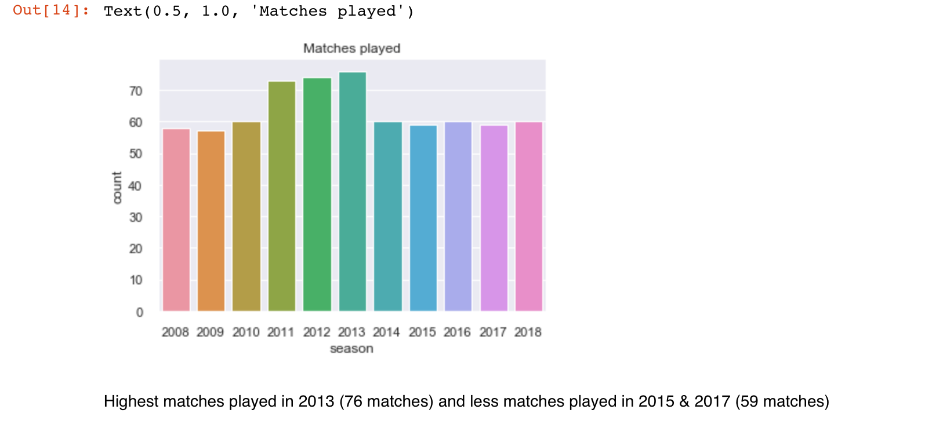
Most matches played
Dhananjay Bhandarkar

Slide 3
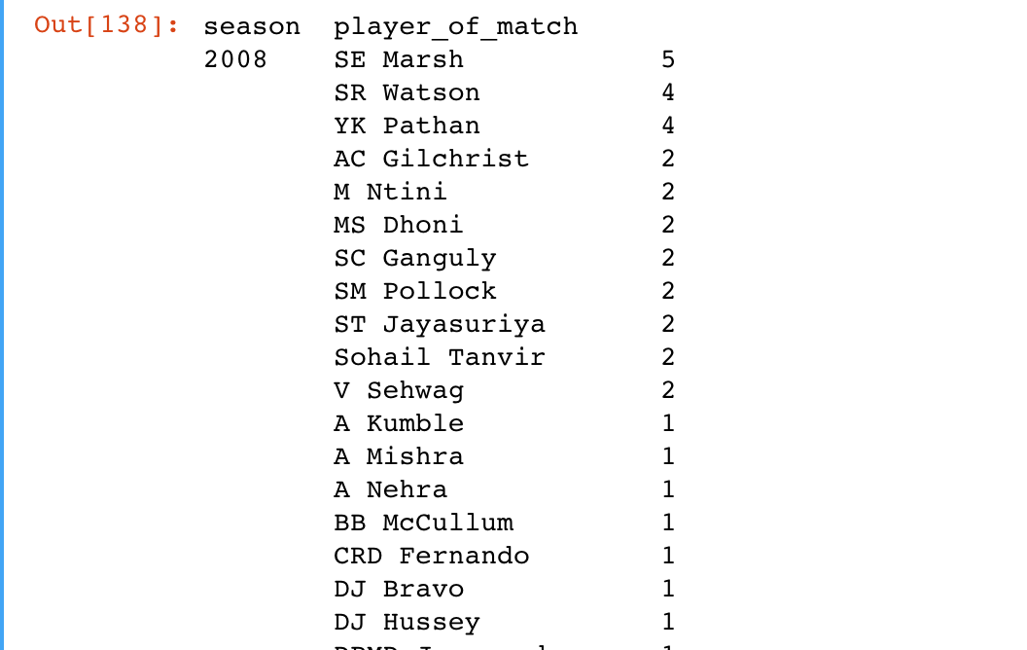
Player of the match
SE Marsh, SR Watson, YK Pathan are top 3 consistent players in Season 2008
Dhananjay Bhandarkar

Slide 4
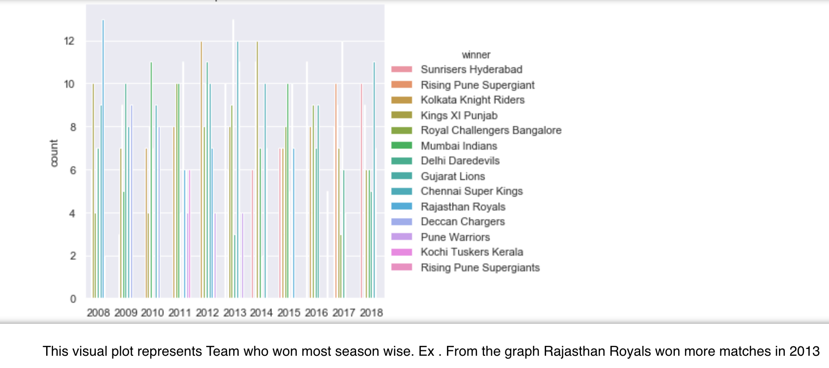
Team performance – season wise
Dhananjay Bhandarkar

Slide 5
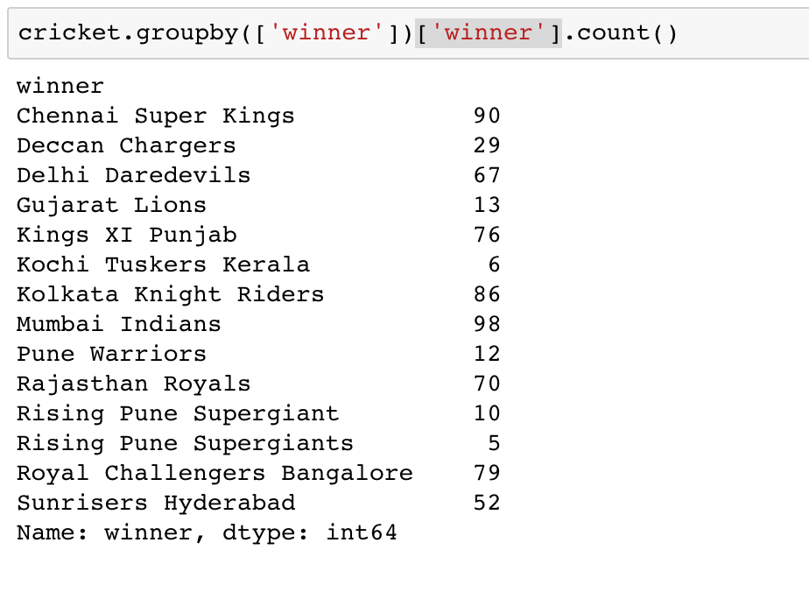
Team performance
Mumbai Indians won most of the matches throughout all season.
Dhananjay Bhandarkar

Slide 6
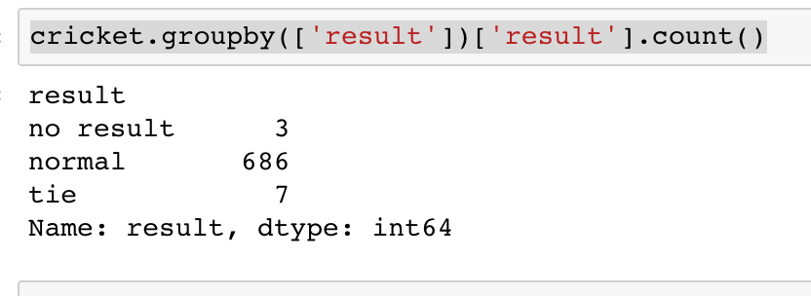
Match result analysis
Out of 696 matches played throughout all seasons , 7 matches ends in tie and for 3 matches there is no result.
Dhananjay Bhandarkar

Slide 7
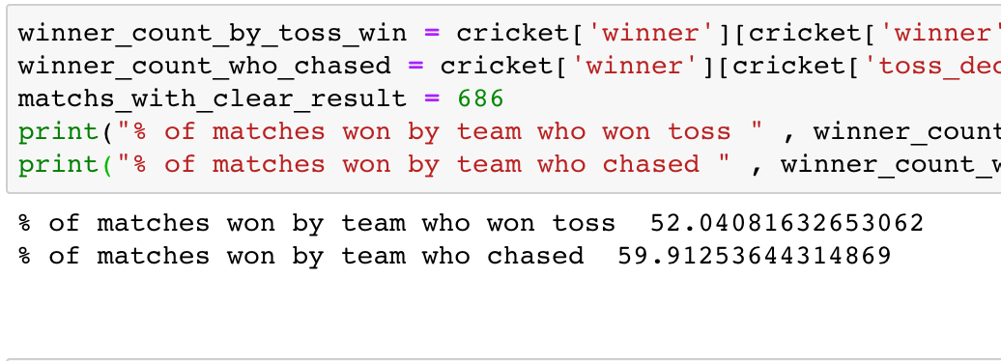
Winners analysis
Dhananjay Bhandarkar

Slide 8
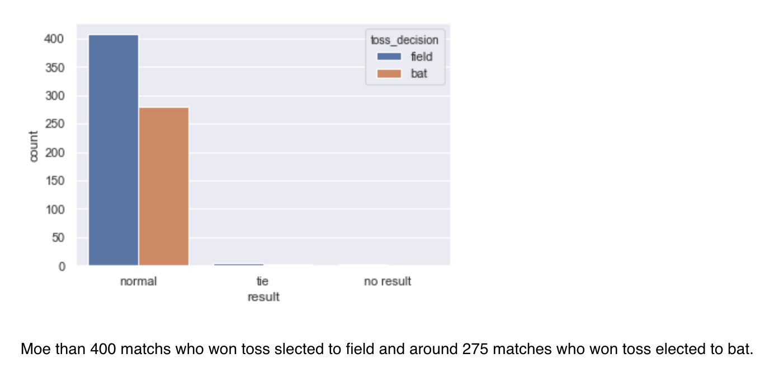
Toss decision analysis
Dhananjay Bhandarkar

Slide 9
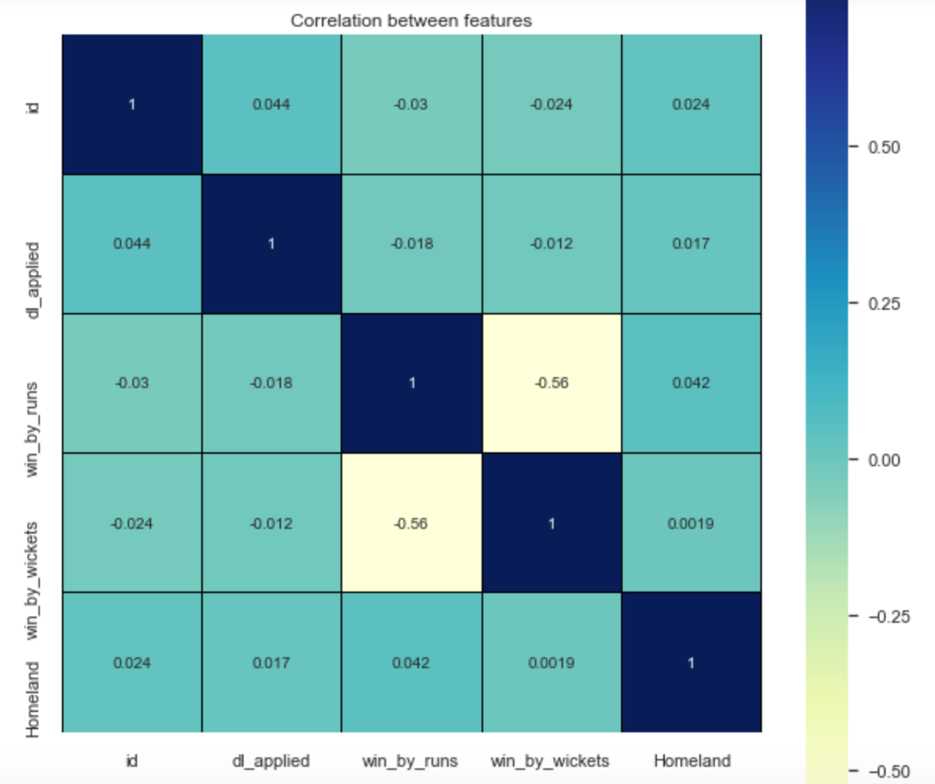
Correlation table
From correlation table, it is observed that more number of matches who won by big run gaps are played in India.
Dhananjay Bhandarkar

