Slide 1
Mini Project
Transformer models
TIES4911 Deep-Learning for Cognitive Computing for Developers
Serhii Fedosov, Shengheng Yan

Slide 2
Review Transformer model in general and study some of the particular Transformer based language models. Chose some problem domain, and try to fine-tune the chosen model based on specific custom dataset in the context of some NLP related problem (e.g. text classification, text summarization, question/answer task, sentiment analysis, language translation, etc.). Implement your solution, describe the process and demonstrate the result. Write a kind of step-by-step tutorial of your solution implementation.

Slide 3
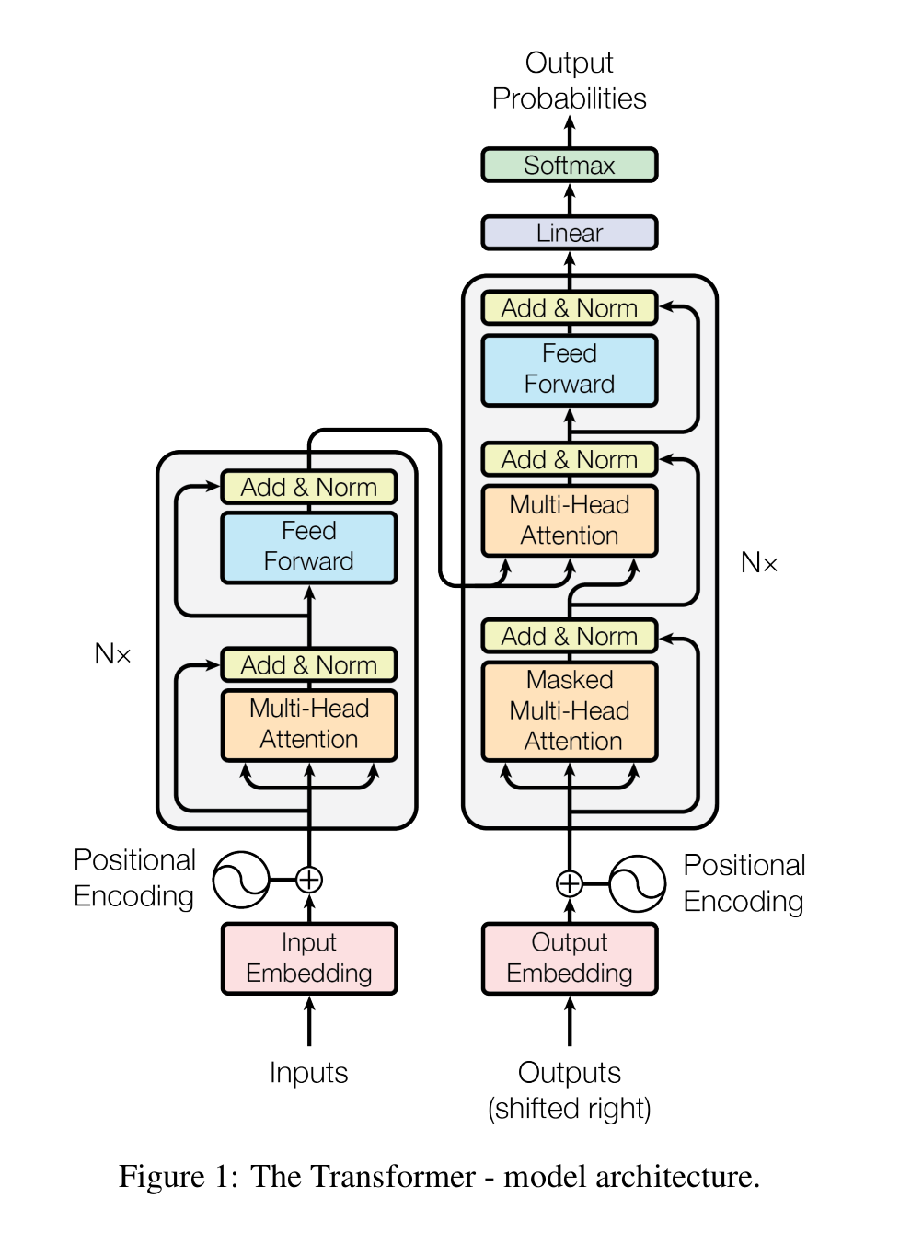
Attention is all you need - Transformer
Encoder :captures the meaning of the entire input sequence.
Decoder: takes the context vector as input and generates the output sequence, word by word.
Query
Key
Value
Add word position ‘identifier’ matrix| size=(n,3)
Turn words to (number)vectors| size=( n, 1 )
Promt
Completion
Ref: https://arxiv.org/abs/1706.03762

Slide 4
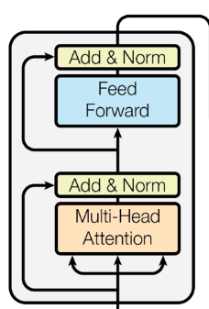
Bidirectional Encoder Representations from Transformers - BERT
BERT:
Only encoders
BERT is a stack of encoders of the Transformer

Slide 5
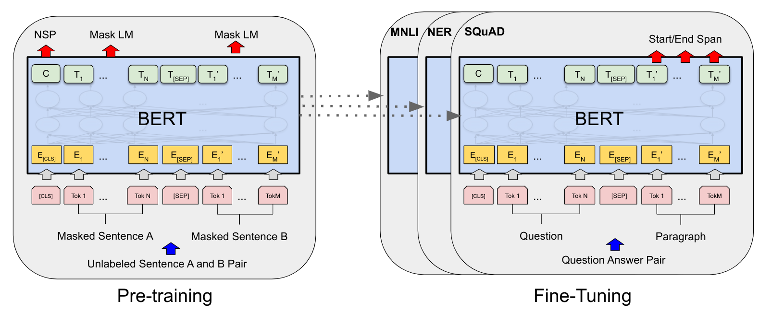
Bidirectional Encoder Representations from Transformers - BERT
Ref: https://aclanthology.org/N19-1423.pdf

Slide 6
Bidirectional examples
I am studying for my deep-learning
Left to right: I am studying for __
Deep-learning my for studying am i
Right to Left : Deep-learning __

Slide 7
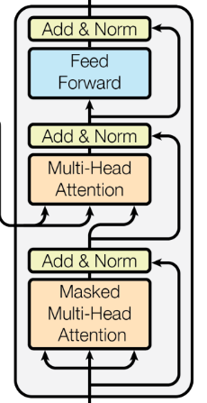
Generative Pre-Training - GPT
GPT
Only Decoders
GPT is a stack of decoder of the Transformer

Slide 8
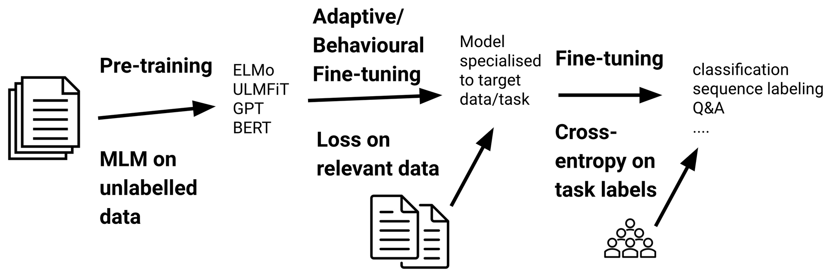
Generative Pre-Training - GPT
Ref:https://s3-us-west-2.amazonaws.com/openai-assets/research-covers/language-unsupervised/language_understanding_paper.pdf

Slide 9

Problem Domain: Hospitality
The customers ask me “What is the wifi password” thousand times a day.
If someone could help me to answer those question, that would be wonderful.

Slide 10
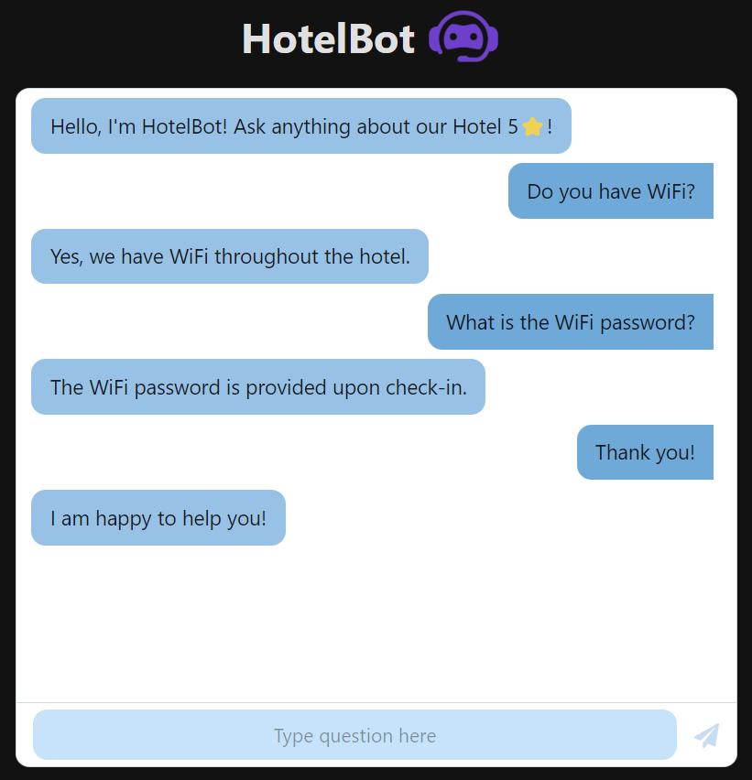
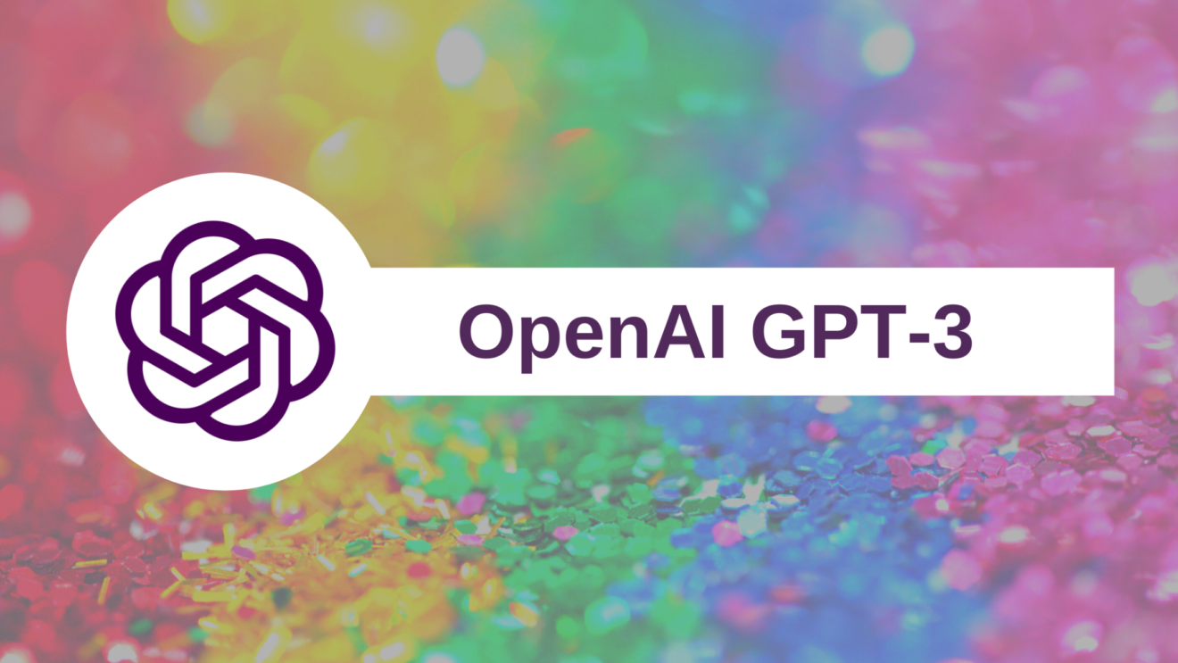
HotelBot - ChatBot for a hotel

Slide 11
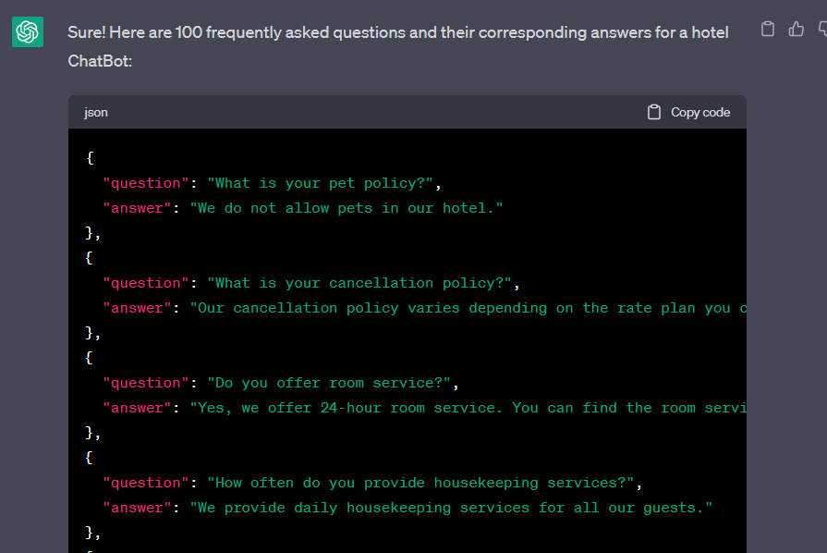
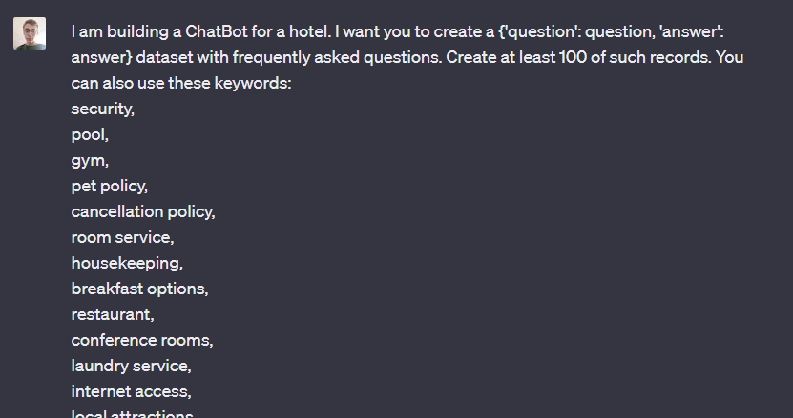
HotelBot - ChatBot for a hotel
Dataset

Slide 12

GPT-3 Fine-tuning

Slide 13
Thank you for your attention!

