Slide 1
Task 2
Serhii Fedosov

Slide 2
Task 2-1
Compare performance (loss, accuracy, and examples of predictions of trained model) of several implementations for MNIST dataset classification mentioned in the lecture materials: single-layer neural network and Multi-Layer Perceptron (MLP) (in both, TF1 and TF2). But this time, use Fashion-MNIST dataset instead. Play with training hyper-parameters (e.g. network architecture, learning rates, optimizers, etc.) and compare performance… Present comparison results in a table (including corresponding hyper-parameters settings).

Slide 3
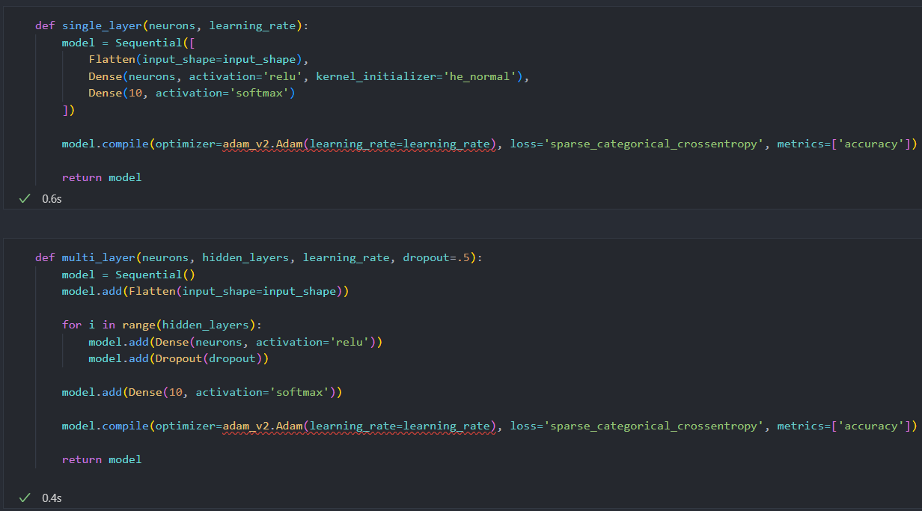
Model creation

Slide 4
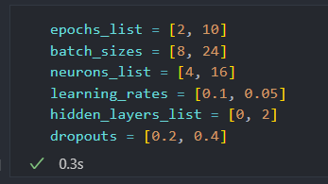
Parameters to play with

Slide 5

TF1

Slide 6
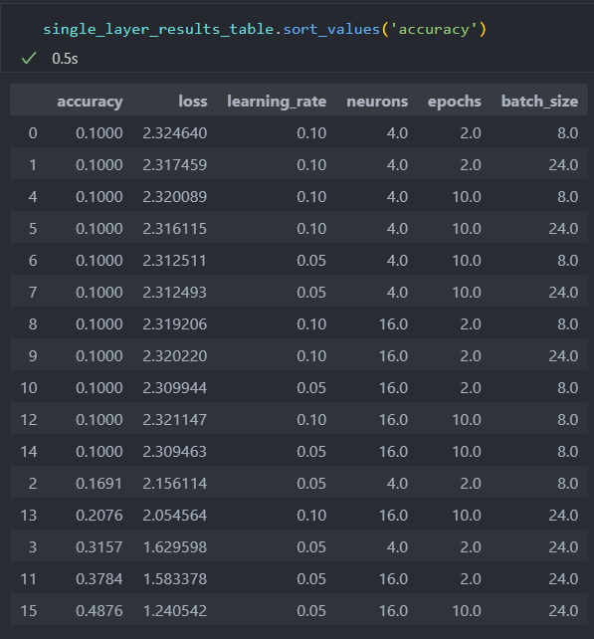
TF1. Single layer

Slide 7
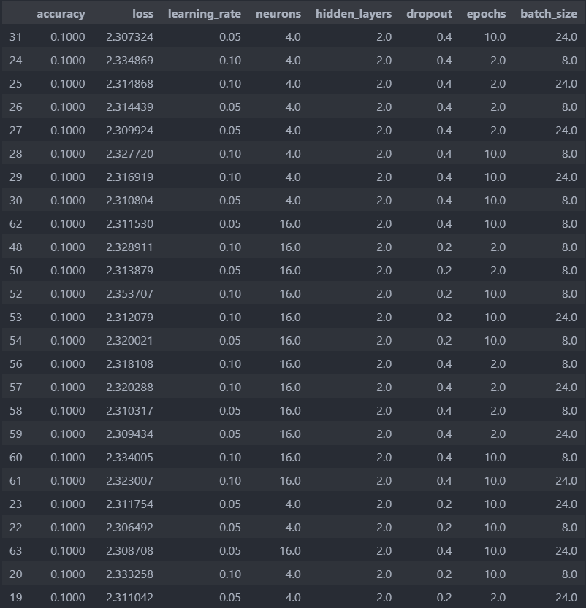
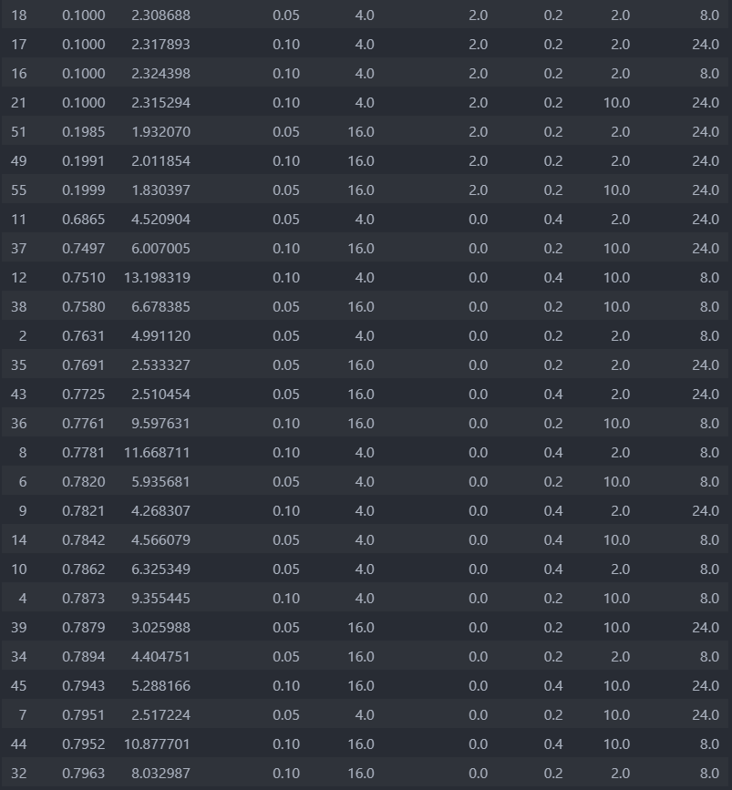
TF1. Multi-layer

Slide 8
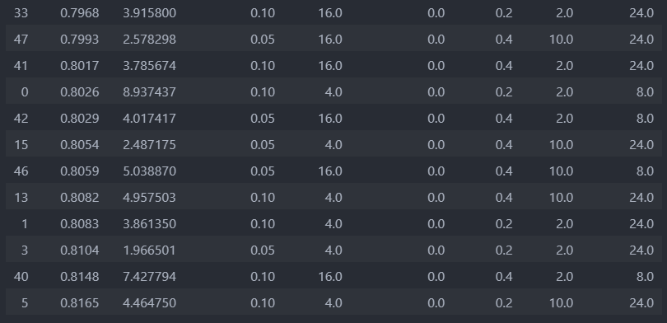
TF1. Multi-layer

Slide 9
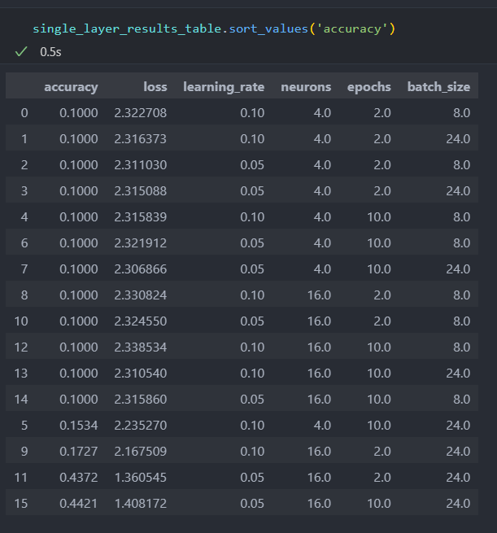
TF2. Single layer

Slide 10
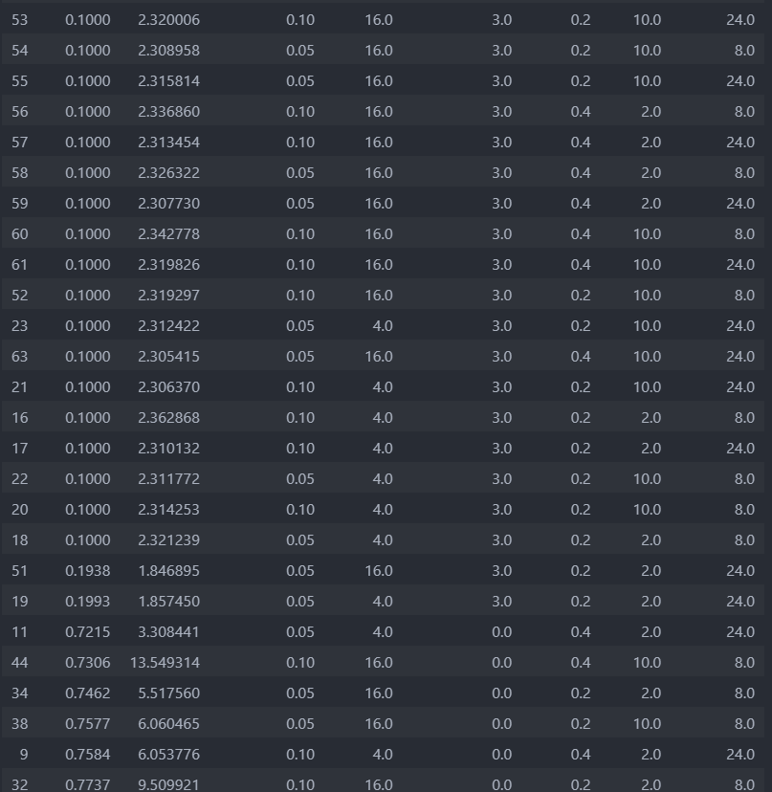
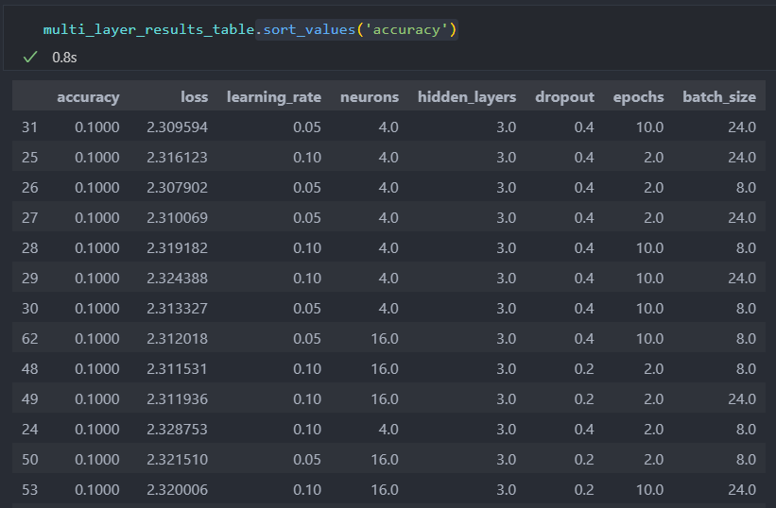
TF2. Multi-layer

Slide 11
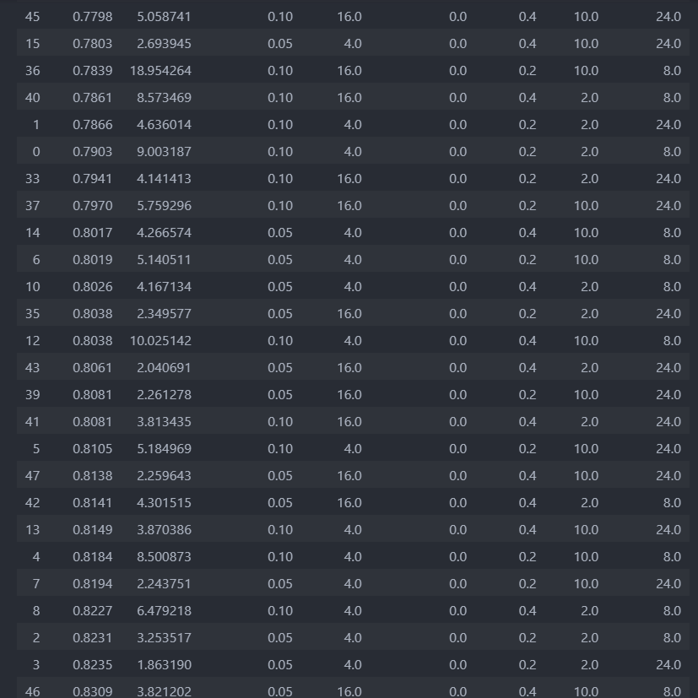
TF2. Multi-layer

Slide 12
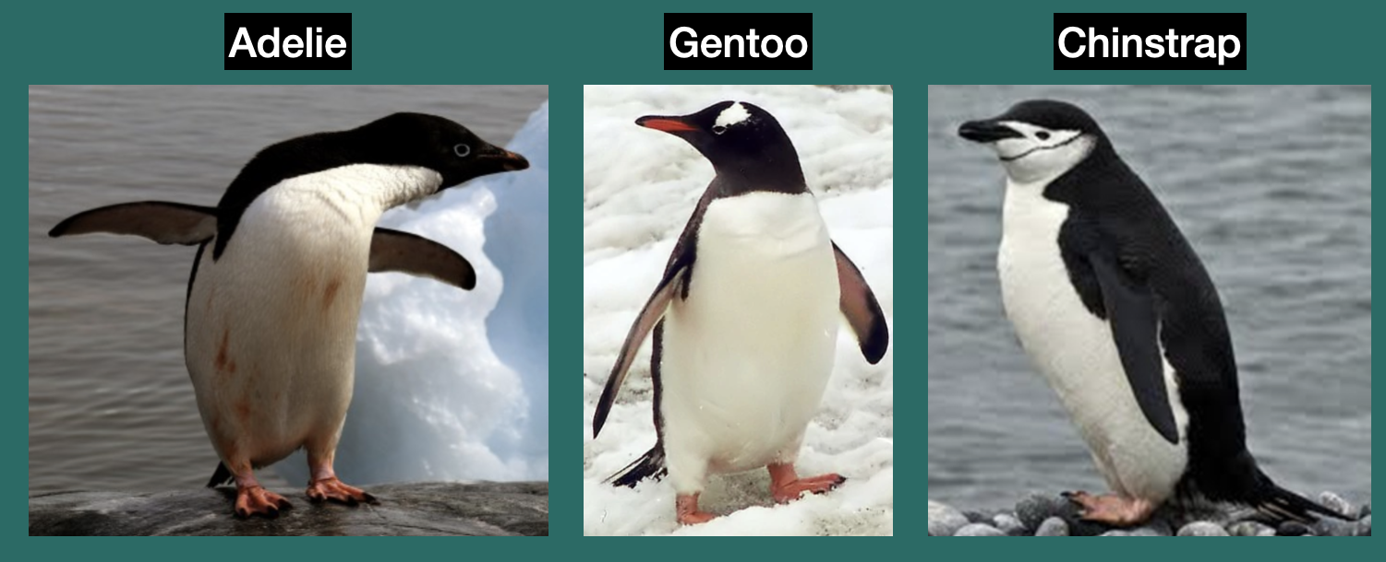
Task 2-2
Taking Iris dataset classification as an example, implement classification for some other similar dataset (find existing dataset). Play with data preprocessing, training hyper-parameters and network architecture to gain better performance (place corresponding settings and performance results into a table).
https://www.kaggle.com/datasets/pancaldi/palmerpenguins

Slide 13
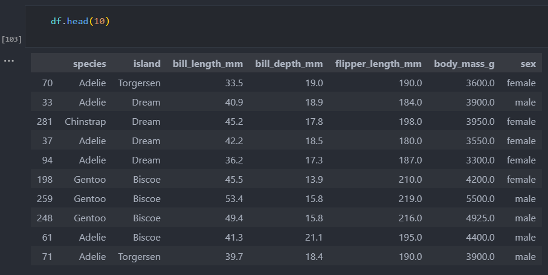

Slide 14
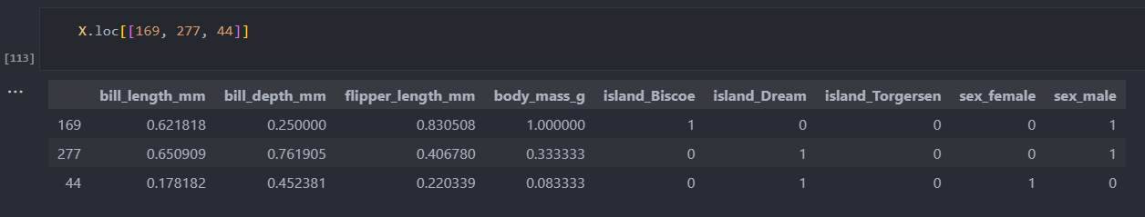
Data preprocessing

Slide 15
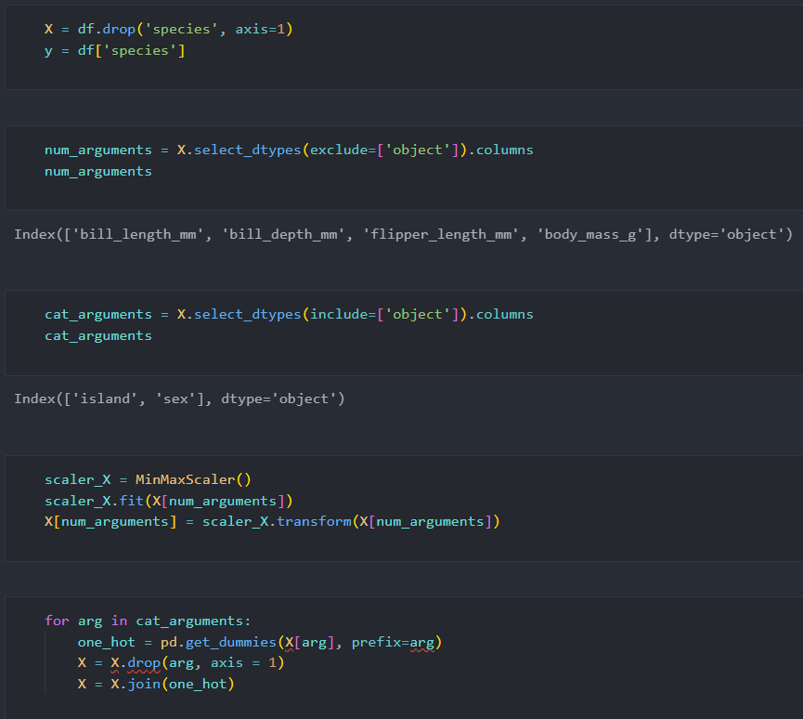
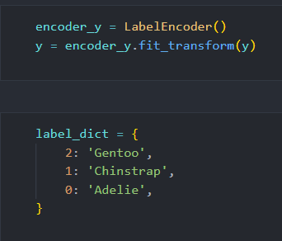
Data preprocessing

Slide 16
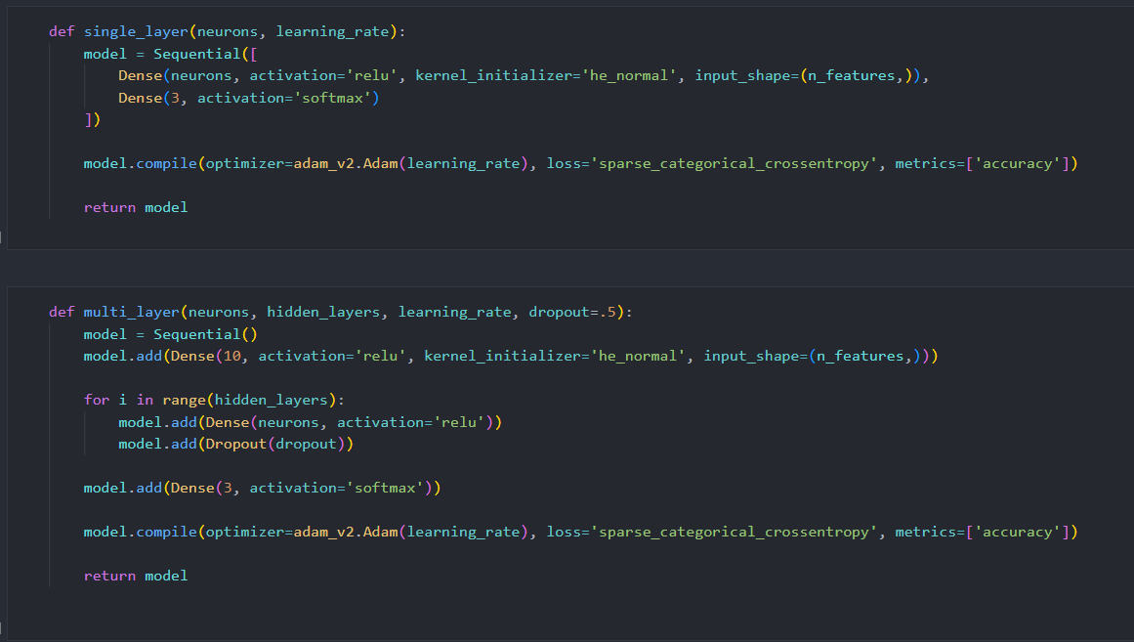
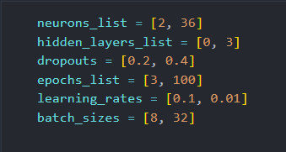
Model creation

Slide 17
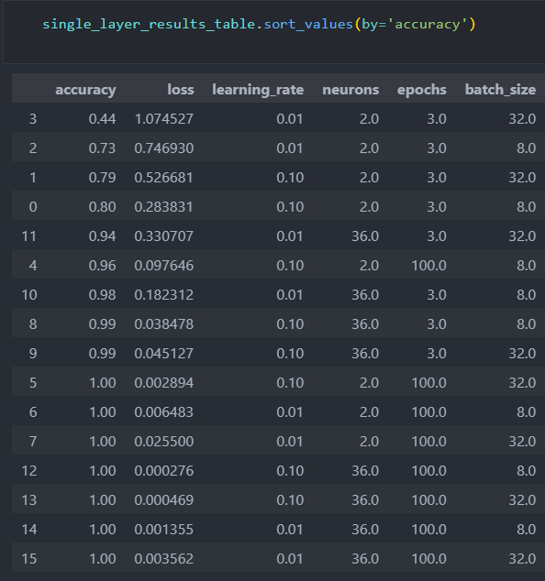
Accuracy results. Single layer neural network

Slide 18
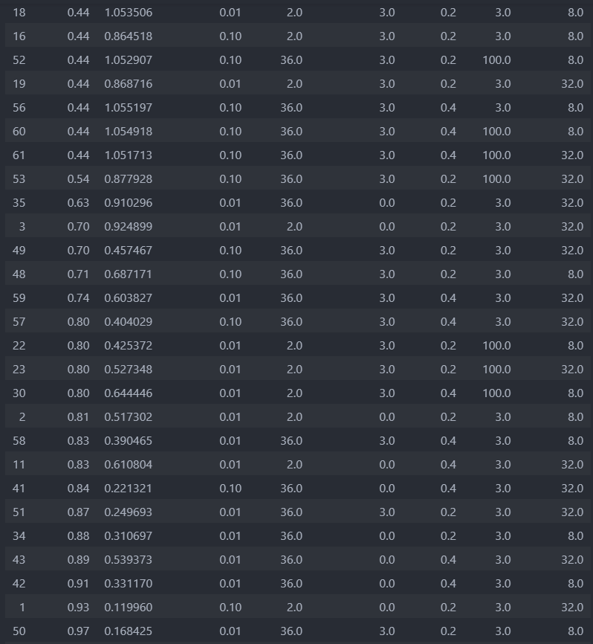
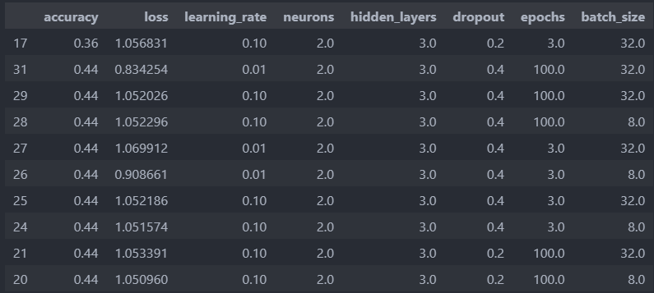
Accuracy results. Multi-layer Perceptron

Slide 19
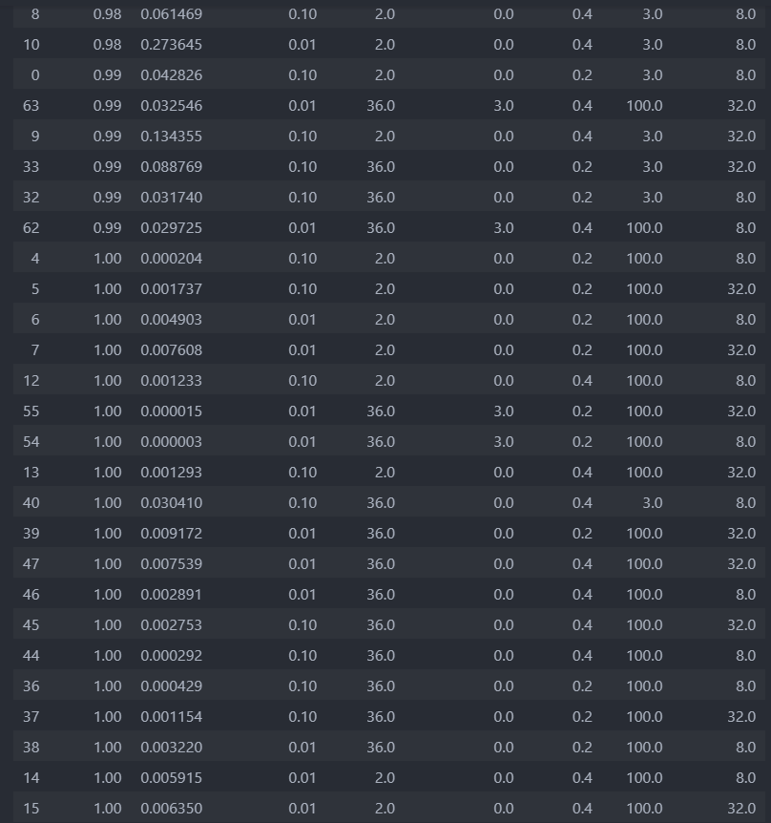
Accuracy results. Multi-layer Perceptron

Slide 20
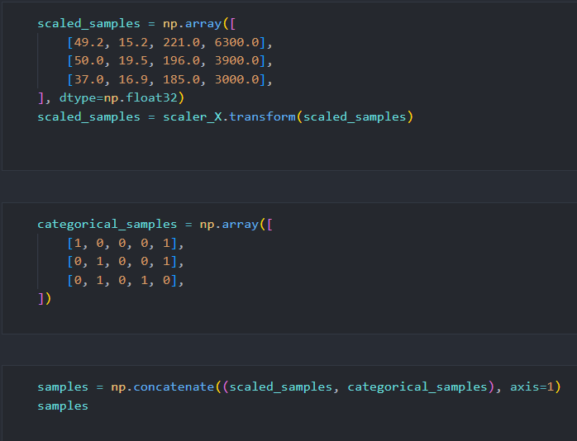
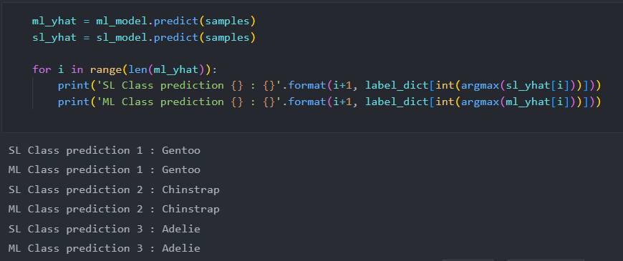
Prediction results. Multi-layer Perceptron

Slide 21
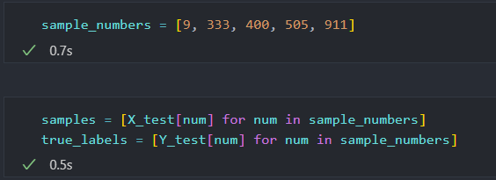
Task 2-3
Take Fashion-MNIST Classification example from the lecture materials and make a predictions of 5 input samples (on your chose) from the test set using simple “Single layer with 1 unit” and improved “Multiple layers” (with and without dropout) models. Use TensorBoard to detect possible overfitting. Visualize input images and show corresponding predicted categories (e.g. T-shirt, Trouser, Pullover, etc.)

Slide 22
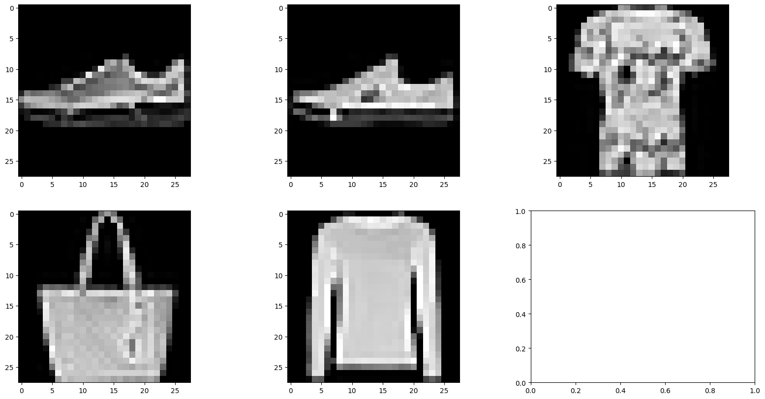

Slide 23
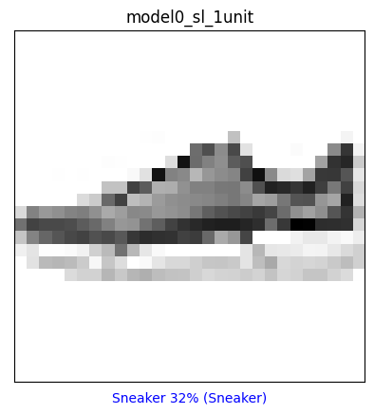
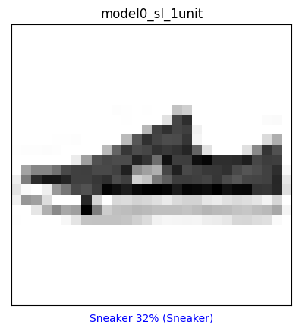
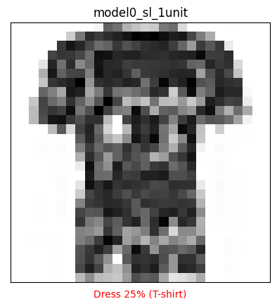
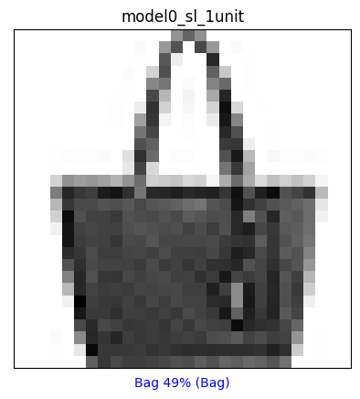
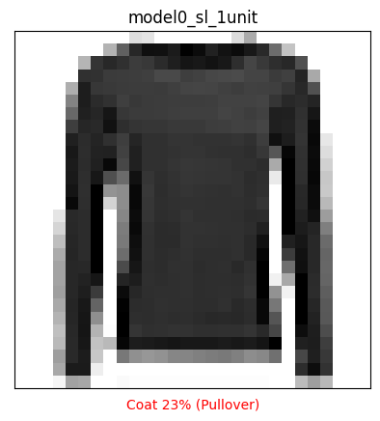
Prediction results. Single layer 1 unit

Slide 24

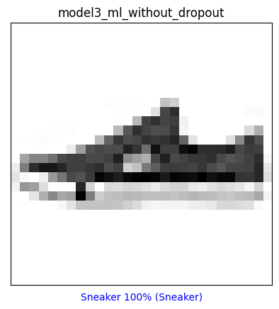
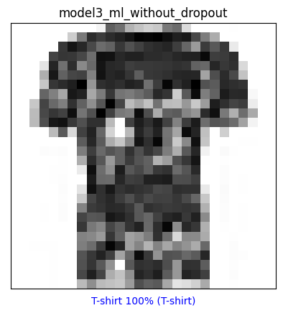
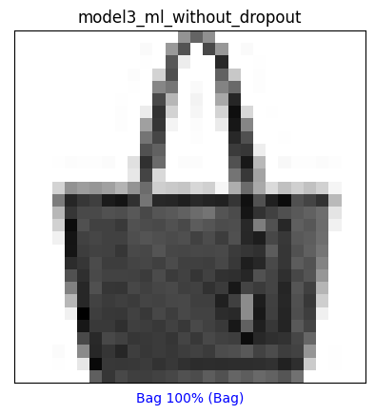
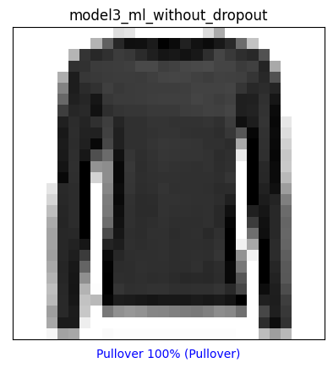
Prediction results. Multi-layer without dropout

Slide 25
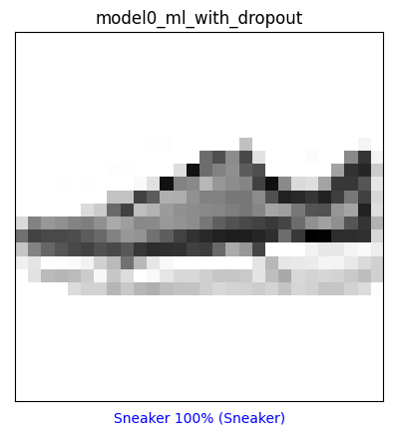
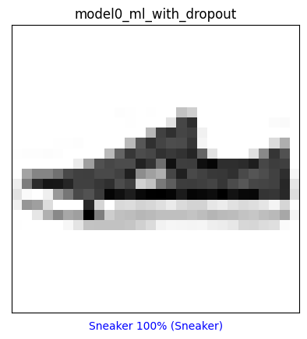



Prediction results. Multi-layer with dropout

