Slide 1
Task 3
Serhii Fedosov

Slide 2
Task 3-1
Build “vanilla” and “deep” autoencoders on Fashion MNIST dataset. Play with architecture and training hyper-parameters. Compare performance and visualize the results (based on several test samples).

Slide 3
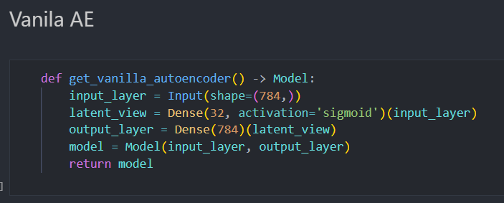
Model creation

Slide 4

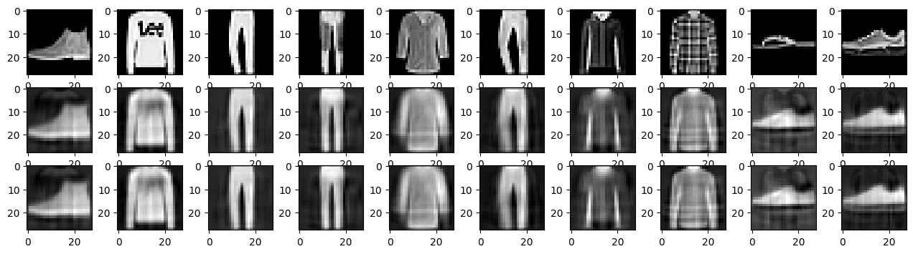

Slide 5
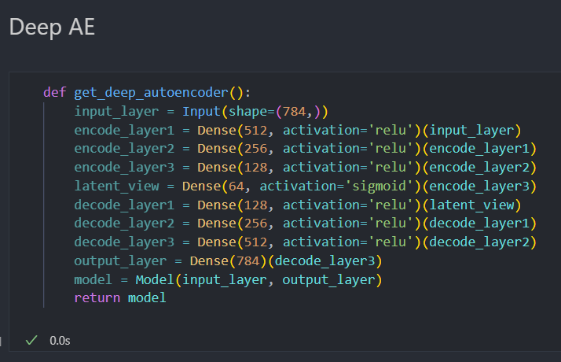
Model creation

Slide 6

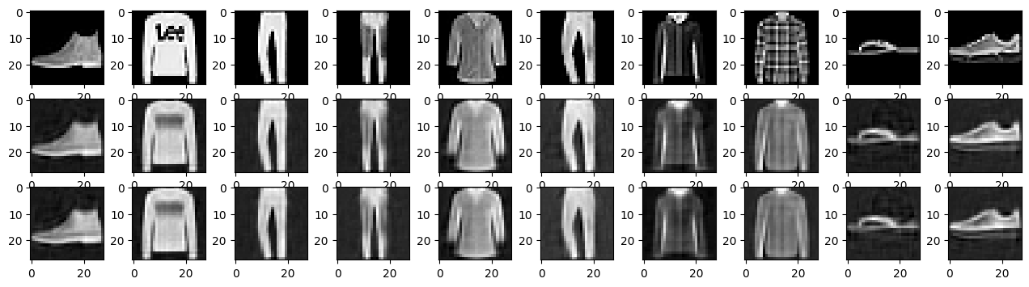

Slide 7
Task 3-2
Try various implementations of CNNs that are present in lecture materials using MNIST or Fashion MNIST (or any other you wish) dataset. You may try other examples you find in the web as well. Play with training hyper-parameters and network architecture, with dropouts, batch normalization and data generation. Build the table where compare performance (loss, accuracy) of the combinations you made.

Slide 8
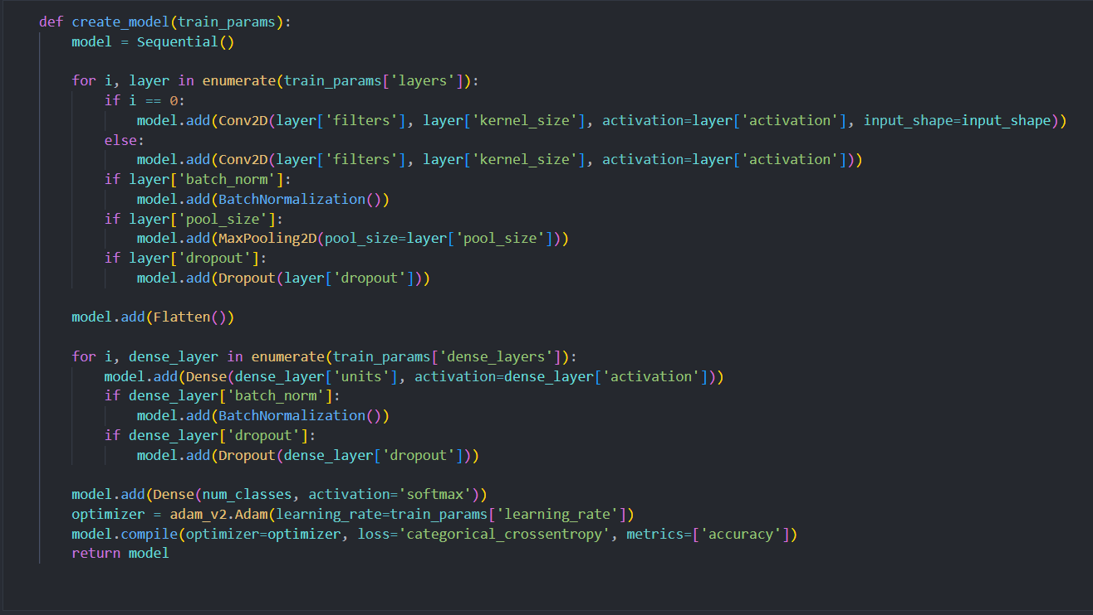
Model creation

Slide 9
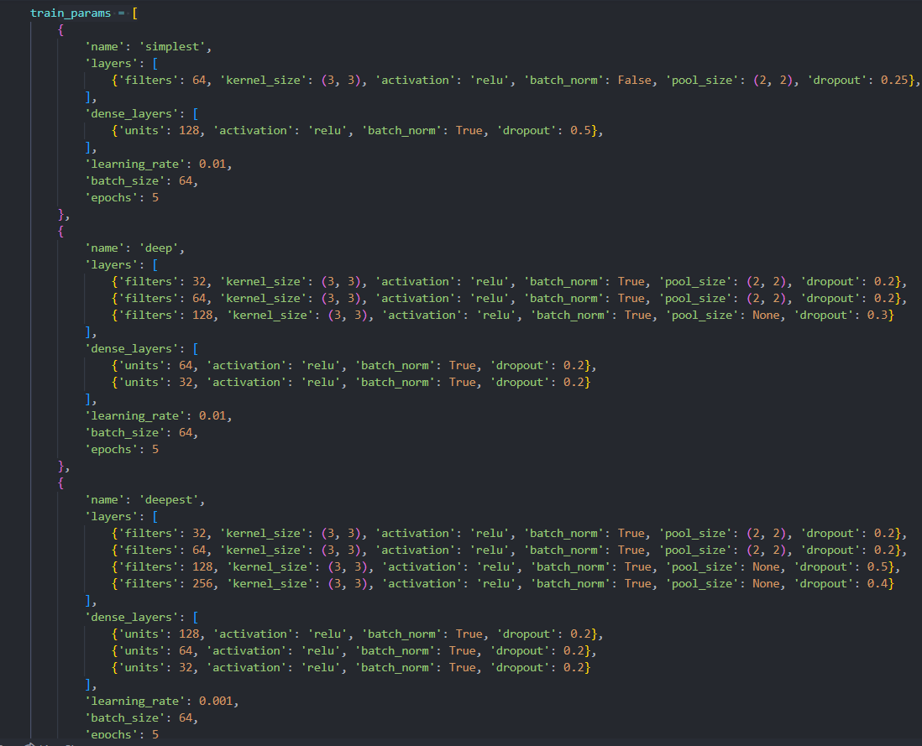

Slide 10
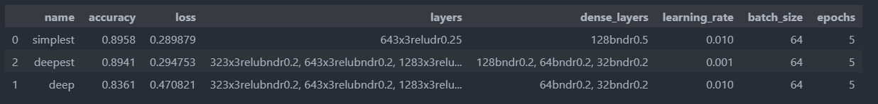
Results

Slide 11
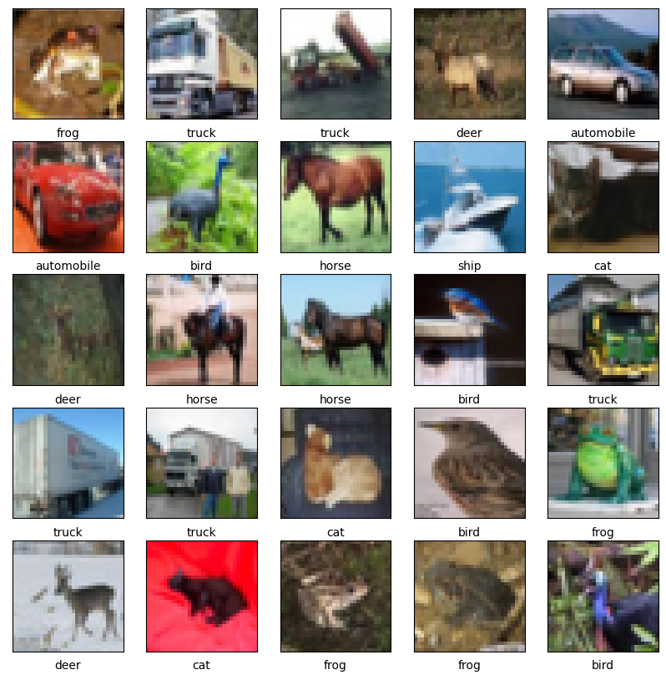
Task 3-3
Check the CNN tutorials on CIFAR-10 dataset with code from the following link: https://www.tensorflow.org/tutorials/images/cnn. Similarly, to the previous sub-task, try to play with hyper-parameters and network architecture, and present performance comparison.

Slide 12
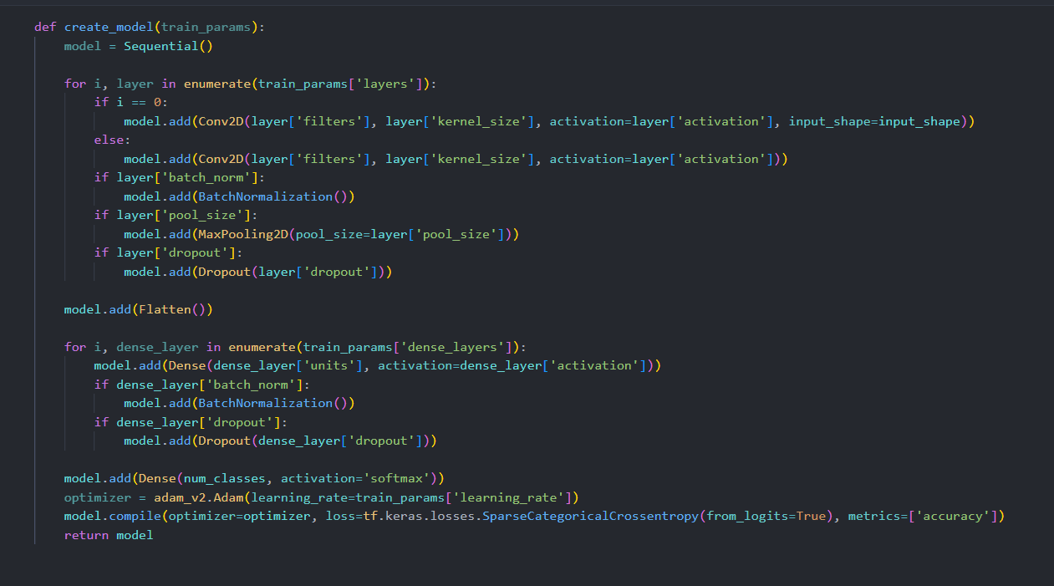
Model creation

Slide 13
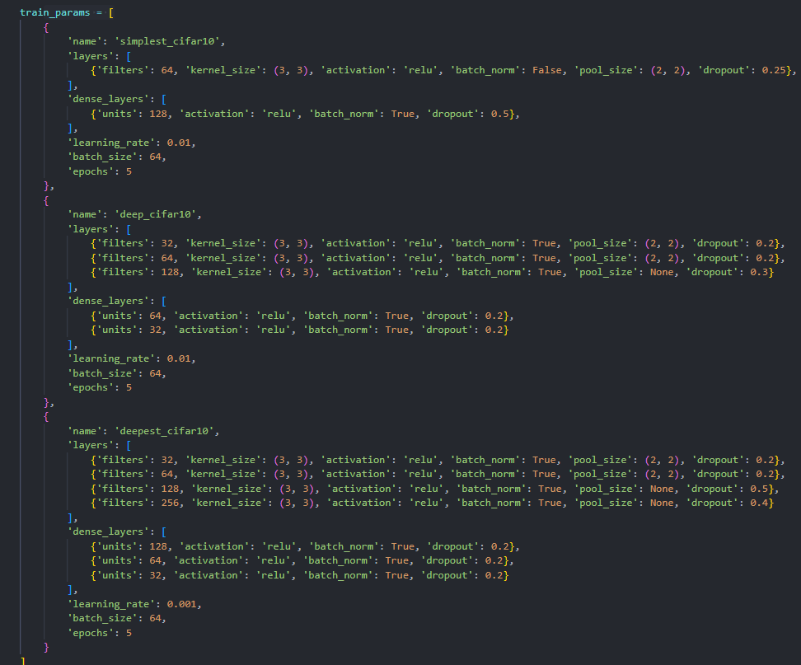

Slide 14
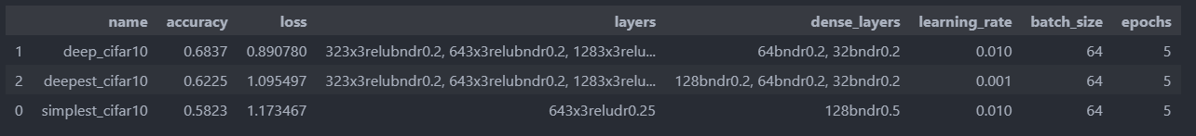
Results

Slide 15
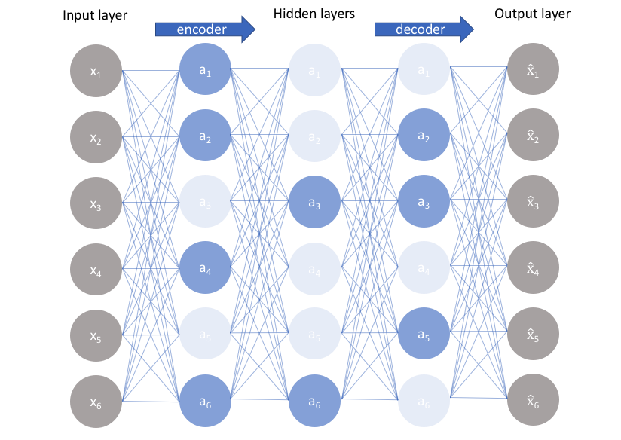
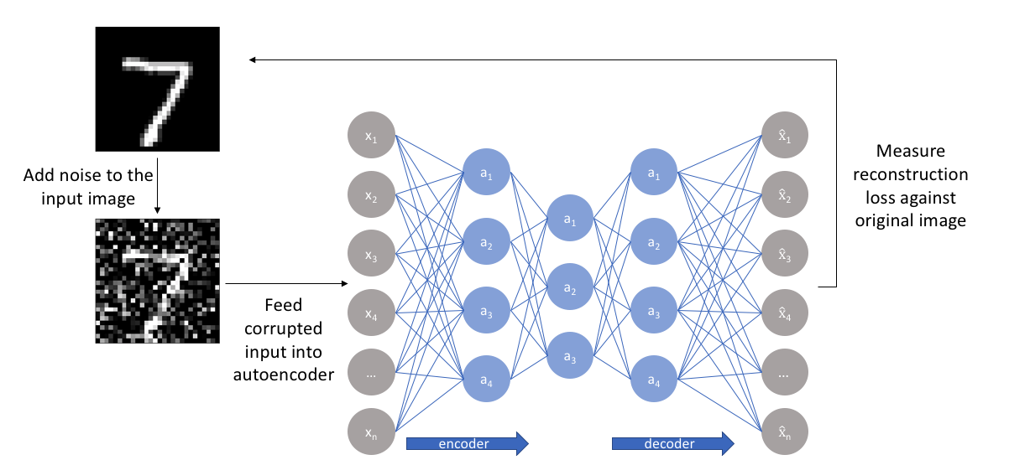
Task 3-4
Implement “sparse” and “denoising” autoencoders. Play with architecture (try both undercomplete and overcomplete, shallow and deep) and training hyper-parameters. Compare performance and visualize the results (based on several test samples).

Slide 16
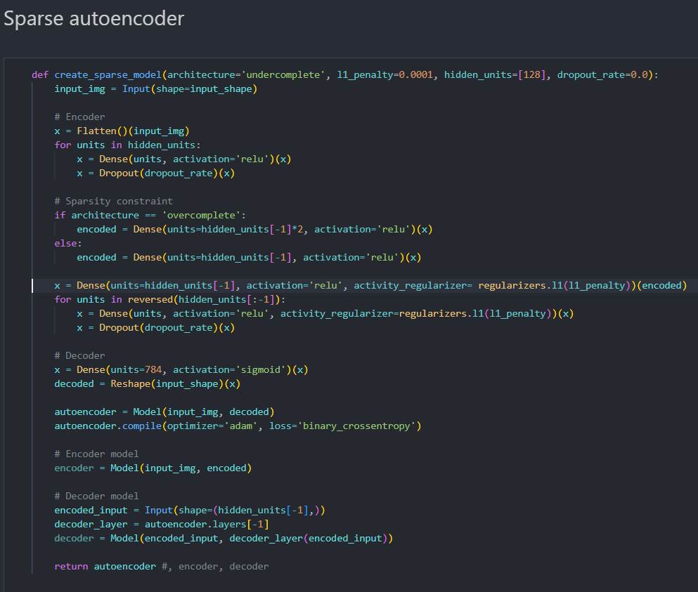

Slide 17
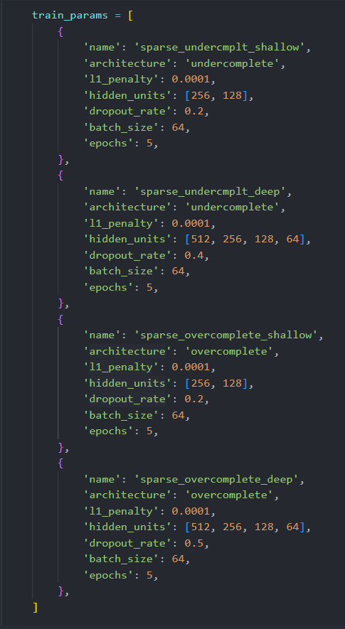

Slide 18
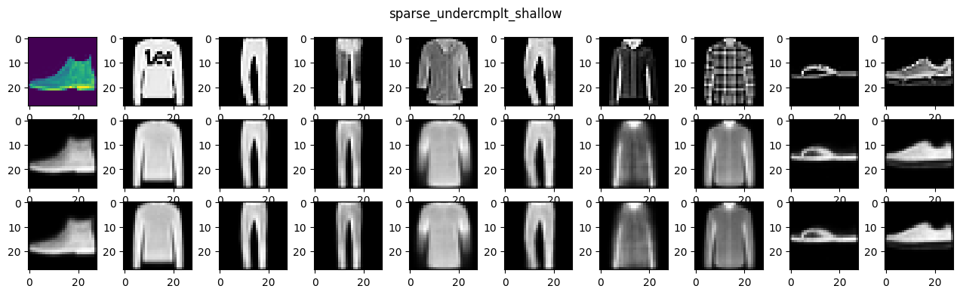
Results

Slide 19
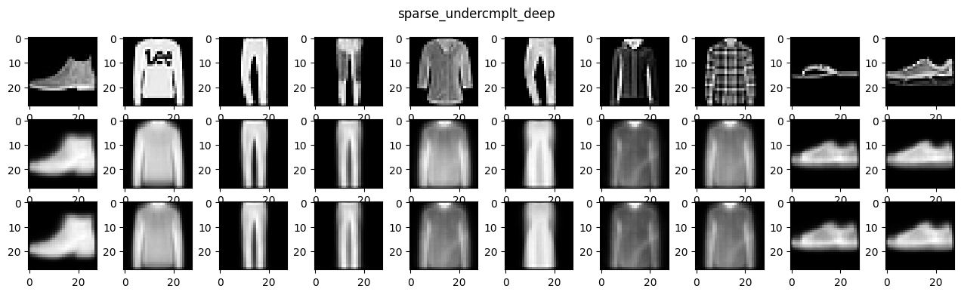
Results

Slide 20
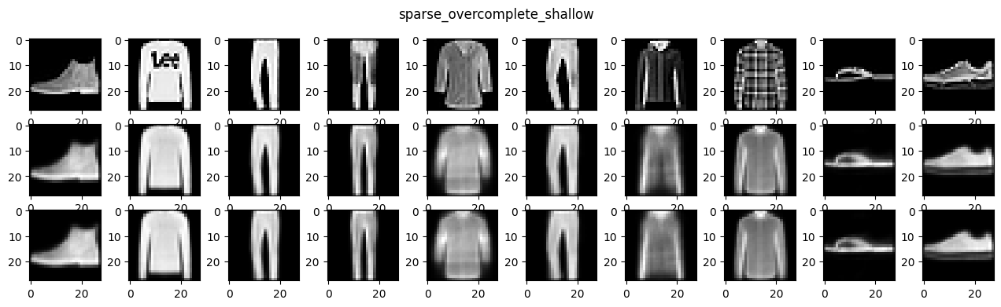
Results

Slide 21
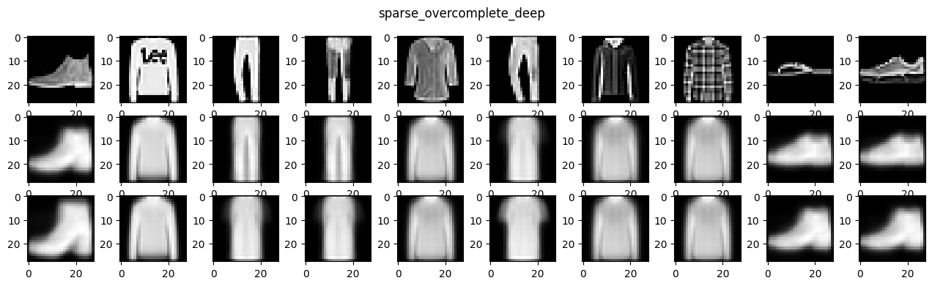
Results

