Slide 1
Development of a Heart Disease Diagnosis Technique Using ECG (Electrocardiogram) Signals
CANDIDATE
Askar Anafin
Applied Data Analytics (7M06103) School of Artificial Intelligence & Data Science Astana IT University
SCIENTIFIC SUPERVISOR
Minsoo Hahn, PhD

Slide 2
RELEVANCE
02
Relevance of Thesis Topic
▸ Global Mortality: CVDs are the leading cause of death worldwide, causing 17.9M deaths/year.
▸ Clinical Bottleneck: Manual ECG interpretation is slow, subjective, and prone to fatigue.
▸ High Variability: Inter-observer diagnostic error exceeds 20% in emergency departments.
▸ Fragile Handcrafted Features: Traditional ML relies on noise-sensitive peak detection.
▸ Spatial Gap: Standard 1D CNNs ignore the 3D anatomical geometry of electrode placement.
The Research Need:
Develop deep learning systems that model local wave morphology and spatial lead projections for real-time, explainable triage.
Askar Anafin | Master Thesis Defense | June 2026

Slide 3
RESEARCH AIM
03
Research Aim
FORMAL STATEMENT OF THE RESEARCH AIM:
The main aim of this research is to develop and evaluate deep learning methods for automated multi-lead electrocardiogram classification to provide clinical decision support and patient triage.
▸ Clinical Impact: Targets reducing the 20% emergency room observer error rate.
▸ Model Scope: Focuses on standard 12-lead digital ECG time-series signals.
▸ Deployment: Lightweight web application delivering inferences in milliseconds.
Askar Anafin | Master Thesis Defense | June 2026

Slide 4
OBJECTIVES
04
Objectives
① Build a zero-phase preprocessing pipeline to filter baseline wander and high-frequency noise.
⑤ Formulate a Spatio-Temporal Hybrid combining convolutional morphology with transformer rhythm.
② Develop a 1D ResNet-18 model as a baseline for wave morphology extraction.
⑥ Calibrate boundaries via post-hoc validation search and soft-voting ensembling.
③ Design ST-ReGE GNN with a learnable adjacency matrix to capture spatial lead projections.
⑦ Build a real-time FastAPI web dashboard for triage upload and wave visualization.
④ Develop a 1D Vision Transformer model to capture long-range rhythm dependencies.
Askar Anafin | Master Thesis Defense | June 2026

Slide 5
LITERATURE REVIEW
05
Literature Review
Publication Authors & Year | Data Acquisition Method | Dataset Size | Model(s) Used | Accuracy / Performance
Kiranyaz et al. (2016) | Bipolar ECG (MIT-BIH) | 48 records | 1D CNN (patient-specific) | 98.9% (beat-wise acc)
Rajpurkar et al. (2017) | Single-lead (Zio Patch) | 91,232 records | 34-layer deep 1D CNN | F1-score: 0.837
Ribeiro et al. (2020) | 12-lead (Telehealth Minas) | 2,322,513 records | 1D ResNet-based CNN | F1-score > 0.80
Zhang et al. (2021) | 12-lead (CPSC 2018) | 6,877 records | ECG-GNN (fixed spatial) | F1-score: 0.812
Vaid et al. (2023) | 12-lead (Mount Sinai) | 1,077,137 records | 1D Vision Transformer | AUROC: 0.940
Strodthoff et al. (2021) | 12-lead (PTB-XL benchmark) | 21,837 records | 1D ResNet-18 benchmark | Macro F1: 0.705–0.720
This Thesis (June 2026) | 12-lead (PTB-XL, filtered) | 21,388 records | ST-ReGE GNN (learnable) + Ensemble & Calibration | Macro F1: 0.7506 / AUROC: 0.9344
Research Choice: ST-ReGE GNN and ensembling model lead geometry and rhythms, outperforming static convolutional baselines.
Askar Anafin | Master Thesis Defense | June 2026

Slide 6
NOVELTY OF THE RESEARCH
06
Novelty of the Research
01 METHODOLOGY
Dynamic Lead Graph
Models standard leads as graph nodes rather than independent stacked channels. A learnable, sigmoid-activated adjacency matrix dynamically discovers anatomical pathways and electrical correlations during training.
02 EVALUATION
Multi-Paradigm Comparison
Provides a fair, standardized benchmark evaluating local convolutional morphology, lead-spatial propagation, and global attention models on the same filtered dataset to isolate true architectural benefits.
03 CALIBRATION
Decision Boundary Tuning
Applies validation-set threshold grid search to calibrate decision boundaries for minority classes. This handles severe label imbalances and optimizes clinical recall in seconds without retraining.
Addresses three key gaps: physical lead layout modeling, model comparison fairness, and screening threshold calibration.
Askar Anafin | Master Thesis Defense | June 2026

Slide 7
PROBLEM STATEMENT: INPUT/OUTPUT
07
Problem Statement: Input/Output Tensors
Input Data (ECG Signal)
Digital Signal Tensor: X in R^(B x 12 x 5000)
B: Batch size of records.
12 Leads: Standard chest and limb electrode recordings.
5000 Steps: 10 seconds of signal sampled at 500 Hz.
Output Data (Diagnostic Labels)
Binary Multi-Label Vector: y in {0, 1}^(B x 5)
5 Superclasses: NORM, MI, STTC, CD, HYP
Co-occurring diagnoses: Allowed (e.g. MI + CD co-exist).
Askar Anafin | Master Thesis Defense | June 2026

Slide 8
PROBLEM STATEMENT: INPUT/OUTPUT
08
ECG Signal Data Table (12 Leads)
Sample values of ECG signal tensor X (values in mV, sampled at 500 Hz):
Time Step | I | II | III | aVR | aVL | aVF | V1 | V2 | V3 | V4 | V5 | V6
0 ms (t1) | -0.08 | 0.15 | 0.23 | -0.04 | -0.16 | 0.19 | -0.05 | 0.12 | 0.35 | 0.82 | 0.55 | 0.21
2 ms (t2) | -0.07 | 0.18 | 0.25 | -0.05 | -0.16 | 0.21 | -0.04 | 0.15 | 0.38 | 0.88 | 0.58 | 0.23
4 ms (t3) | -0.05 | 0.22 | 0.27 | -0.07 | -0.16 | 0.24 | -0.03 | 0.18 | 0.42 | 0.95 | 0.62 | 0.26
6 ms (t4) | -0.03 | 0.26 | 0.29 | -0.09 | -0.16 | 0.27 | -0.02 | 0.21 | 0.46 | 1.02 | 0.66 | 0.29
8 ms (t5) | -0.01 | 0.30 | 0.31 | -0.11 | -0.16 | 0.30 | -0.01 | 0.24 | 0.50 | 1.08 | 0.70 | 0.32
Tensor Interpretation:
Each row represents a single time step separated by 2 ms.
The columns represent standard 12-lead potential differences in millivolts (mV).
A single 10-second ECG record contains 5000 such rows (B x 12 x 5000 tensor shape).
Askar Anafin | Master Thesis Defense | June 2026

Slide 9
COLLECTION, ANALYSIS AND PROCESSING OF INPUT DATA
09
Initial Dataset Overview
▸ Database: PTB-XL corpus containing 21,799 clinical 12-lead ECG records from 18,869 patients.
▸ Demographics: 52% are male and 48% are female. Ages cover 0 to 95 years (median 62, interquartile range of 22).
▸ Patient Stratification: Fold column (strat_fold 1-10) isolates patient records to prevent leakage and preserves diagnostic label ratios across splits.
▸ Class Imbalance: Severe ~4:1 ratio (Normal vs. Hypertrophy) requires post-hoc boundary calibration to optimize minority diagnostic recall.
Class-wise Distribution
NORM (Normal): 9,528 records
MI (Myocardial Infarction): 5,486 records
STTC (ST/T Changes): 5,250 records
CD (Conduction Disturbance): 4,907 records
HYP (Hypertrophy): 2,655 records
Total diagnostic statements: 71
Askar Anafin | Master Thesis Defense | June 2026

Slide 10
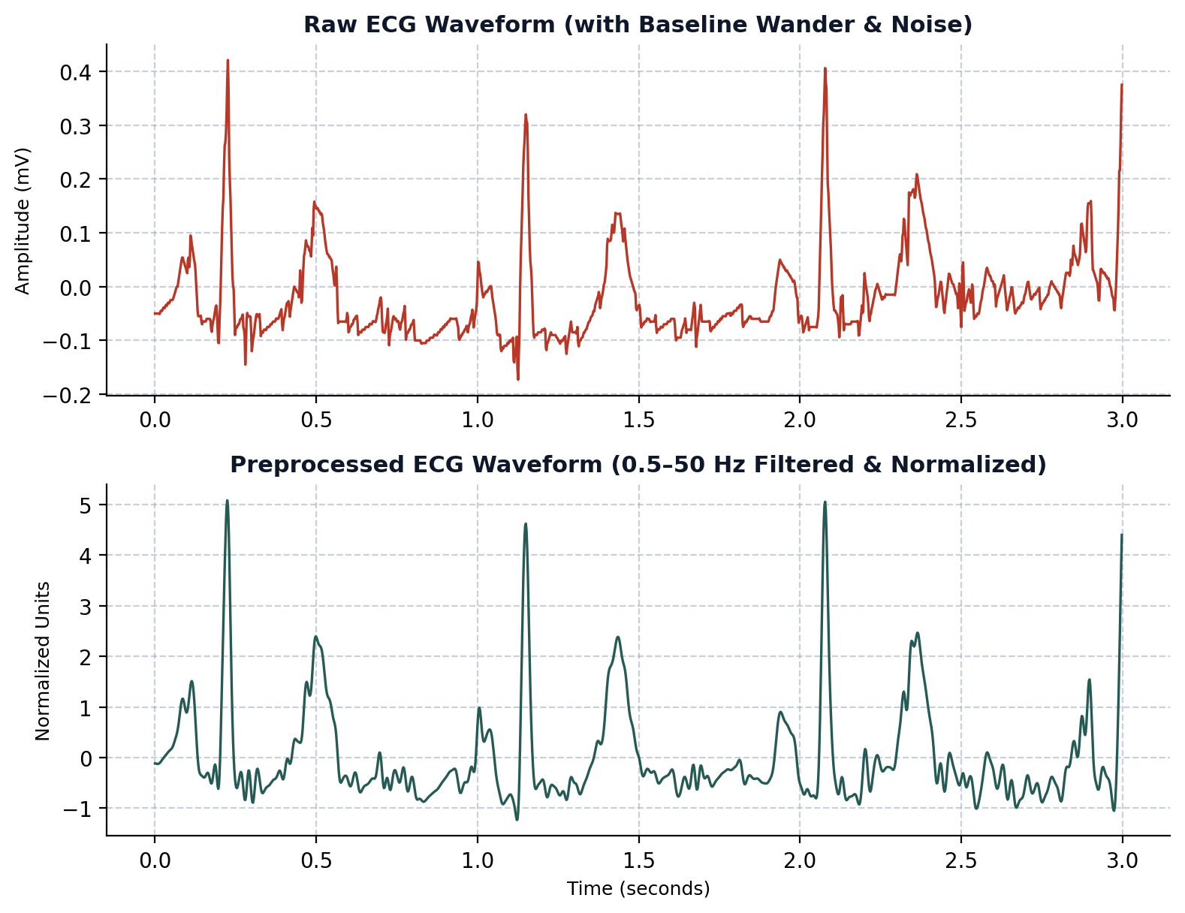
COLLECTION, ANALYSIS AND PROCESSING OF INPUT DATA
10
Zero-Phase Signal Preprocessing
▸ Noise Sources: Baseline wander (<0.5 Hz) from breathing and high-frequency EMG muscle noise.
▸ Bandpass Filter: 4th-order Butterworth digital filter (0.5 to 50 Hz).
▸ Zero-Phase Delay: Forward-backward filtering (filtfilt) cancels out phase shifts and prevents wave distortion.
▸ Normalization: Lead-wise Z-score scaling standardizes amplitudes across records.
Askar Anafin | Master Thesis Defense | June 2026

Slide 11
COLLECTION, ANALYSIS AND PROCESSING OF INPUT DATA
11
Diagnostic Label Filtering
▸ Diagnostic Filtering: Retains only records with active diagnostic statement labels.
▸ All-Zeros Bias: 411 records (1.89%) have only rhythm/form codes, yielding all-zero labels.
▸ Metric Inflation: Keeping all-zero records creates optimistic bias, artificially inflating F1 and AUPRC.
▸ Final Dataset: Removing all-zero records leaves 21,388 records, matching standard benchmarks.
▸ Class Totals: Positive class counts are unaffected (removed records were completely empty).
Category | Raw Count | Filtered
Full Corpus | 21,799 | 21,388
Normal (NORM) | 9,514 | 9,514
Infarction (MI) | 5,469 | 5,469
ST/T Changes | 5,235 | 5,235
Blocks (CD) | 4,898 | 4,898
Hypertrophy | 2,649 | 2,649
All-Zero Target | 411 | 0
Askar Anafin | Master Thesis Defense | June 2026

Slide 12
MODELS AND METHODS FOR SOLVING THE PROBLEM
12
Baseline Models: CNN & ViT
1D Adapted ResNet-18 (CNN)
Temporal Morphology: Convolutions capture wave shapes along the temporal axis.
Inductive Bias: Weight-sharing and translation invariance make CNNs highly data-efficient.
Architecture: Stacks four residual stages with shortcut projections to prevent gradient degradation.
1D Vision Transformer (ViT-1D)
Sequential Rhythm: Models long-range temporal dependencies and cardiac rhythms using self-attention.
Tokenization: Splits temporal sequence into 100 non-overlapping patches, prepending a [CLS] token.
Constraint: Lacks spatial and temporal locality biases, making it data-hungry and prone to overfitting.
Askar Anafin | Master Thesis Defense | June 2026

Slide 13
MODELS AND METHODS FOR SOLVING THE PROBLEM
13
Spatio-Temporal ReGE GNN
▸ Lead-Spatial Graph: Models 12 physical leads as graph nodes to capture spatial correlations.
▸ Shared Backbone: Independent 1D CNN processes each lead to extract 256-D morphological features.
▸ Learnable Adjacency: Trainable A = Sigmoid(W_adj) in R^12x12 dynamically discovers functional electrical pathways.
▸ Message Passing: Two GCN layers propagate features over the discovered pathways.
ST-ReGE Concept & Tuning
Tuning & Optimization Approach:
• Hyperparameters: Batch size = 32, patience = 10 epochs
• Optimizer: Adam (LR = 10^-3, Weight Decay = 10^-4)
• Scheduler: Cosine Annealing learning rate schedule
GCN Feature Propagation Formula:
H(l+1) = BatchNorm( ReLU( A * H(l) * W(l) ) ) + H(l)
• A: Learnable Adjacency, W(l): Trainable weights
Theoretical Concept:
• Learnable Adjacency: Discovers functional connections directly from data, rather than assuming physical lead geometry is rigid.
• Simple Analogy: A social network where leads learn to talk directly to anyone whose signals correlate, rather than only to neighbors.
Askar Anafin | Master Thesis Defense | June 2026

Slide 14
MODELS AND METHODS FOR SOLVING THE PROBLEM
14
Spatio-Temporal Hybrid Model
▸ CNN Front-End: 3 ResNet stages compress raw signals to 313 steps to extract local QRS morphology.
▸ Squeeze-and-Excitation: SE channel attention blocks recalibrate lead importance before temporal modeling.
▸ Transformer Back-End: 3-layer Encoder (8 heads, d_model = 256) models global rhythm context.
Hybrid Concept & Tuning
Regularization & Tuning Approach:
• Hyperparameters: Batch size = 32, patience = 10 epochs
• Classifier: 2-layer MLP with 0.2 dropout
• Optimizer: Adam (LR = 10^-3, Weight Decay = 10^-4)
• Scheduler: Cosine Annealing learning rate schedule
Spatio-Temporal Integration Synergy:
• Combines local morphology bias of CNN with global temporal rhythm checks of Self-Attention.
• Calibrates lead attention (SE blocks) prior to sequence modeling.
Analogy (Spellchecker vs. Speed-Reader):
• CNN front-end acts as a spellchecker to verify individual beat shapes.
• Transformer back-end speed-reads overall rhythm patterns.
Askar Anafin | Master Thesis Defense | June 2026

Slide 15
MODELS AND METHODS FOR SOLVING THE PROBLEM
15
Core Outcomes: ST-ReGE & Hybrid
ST-ReGE GNN Outcomes
How it Works: Models 12 leads as graph nodes and dynamically learns physical adjacency A = Sigmoid(W_adj) combined with 2 GCN feature propagation layers.
What it Solves: The spatial lead propagation gap of traditional 1D CNNs, discovering functional electrical pathways across different cardiac walls.
Theoretical Value: Captures joint electrical changes across leads (e.g. inferior leads II, III, aVF) instead of treating leads as independent channels.
Limitations: Assumes lead geometry fits a learnable static graph; increased model complexity compared to standard baseline convolutions.
Spatio-Temporal Hybrid Outcomes
How it Works: Stacks a 3-stage ResNet morphological front-end, SE channel lead attention block, and a 3-layer Transformer Encoder rhythm back-end.
What it Solves: The data-hunger and overfitting constraints of pure 1D Vision Transformers on medium-sized database splits.
Theoretical Value: Blends the local temporal inductive bias of CNNs (beat shape details) with the global rhythm sequence attention of Transformers.
Limitations: Higher computational memory and parameter counts; multi-head self-attention adds latency compared to simple convolutions.
Askar Anafin | Master Thesis Defense | June 2026

Slide 16
MODELS AND METHODS FOR SOLVING THE PROBLEM
16
Ensemble & Boundary Calibration
SOFT ENSEMBLING
Joint Probability Voting
Blends CNN morphology, GNN spatial routing, and Hybrid attention predictions by averaging their output probabilities. This stabilizes final classifications and mitigates model-specific bias.
THRESHOLD CALIBRATION
Validation-Set Grid Search
Replaces default 0.5 boundaries with class-specific thresholds: [NORM: 0.48, MI: 0.42, STTC: 0.34, CD: 0.47, HYP: 0.39]. Shifting boundaries down boosts recall on minority classes.
CLINICAL UTILITY
On-the-Fly Adaptability
Allows clinicians to tune screening sensitivity dynamically to match ICU triage requirements. Grid search runs in seconds on CPU without retraining network weights.
Why Calibration over Loss-Weighting? It preserves probability rank-ordering capability (AUPRC) and runs in seconds without altering model gradients.
Askar Anafin | Master Thesis Defense | June 2026

Slide 17
MODELS AND METHODS FOR SOLVING THE PROBLEM
17
Why Multi-Label Evaluation Metrics Matter
▸ Class Imbalance Handling: ECG datasets like PTB-XL are highly imbalanced (e.g. NORM vs. HYP is ~4:1). Accuracy is misleading; predicting all negative for HYP gets 88% accuracy but is clinically useless.
▸ Macro F1-Score: Calculates the balanced harmonic mean of Precision and Recall for each class independently, then averages them. Treats rare but critical pathologies (such as Hypertrophy) with equal weight.
▸ AUROC (Area Under ROC): Evaluates threshold-independent discriminative capacity; the probability that the model ranks a random positive case higher than a random negative.
▸ AUPRC (Area Under PR Curve): Focuses heavily on the positive class (pathology), preventing false positive/negative inflation from large true negative pools.
Clinical Metric Alignment
Clinical Triage Implications:
• High Recall (Sensitivity): Crucial for triage screening to ensure no active cardiac pathology (e.g., MI) is missed (False Negative = 0).
• High Precision: Required to prevent false alarms that overwhelm emergency room staff (False Positive = 0).
Alignment with Clinical Utility:
• PhysioNet Challenge Score uses a clinical weight matrix to penalize high-risk misclassifications (e.g., calling MI Normal) more severely than low-risk ones.
• Threshold grid search allows clinicians to adjust the model's operating point on-the-fly to balance recall and precision.
Askar Anafin | Master Thesis Defense | June 2026

Slide 18
RESULTS
18
Quantitative Model Benchmarks
Metric | CNN (ResNet-18) | GNN (ST-ReGE) | ViT-1D | S-T Hybrid | Ensemble (Default) | Ensemble (Opt.)
Macro F1-Score | 0.7285 | 0.7444 | 0.6820 | 0.7226 | 0.7435 | 0.7506 (+0.71%)
Macro AUROC | 0.9266 | 0.9269 | 0.8939 | 0.9221 | 0.9344 | 0.9344
Macro AUPRC | 0.8125 | 0.8218 | 0.7484 | 0.8064 | 0.8354 | 0.8354
Exact Match Acc | 63.58% | 64.42% | 59.51% | 62.41% | 65.59% | 64.24%
Training Time | 22.5 min | 23.9 min | 19.5 min | 16.7 min | N/A | N/A
Result Summary: ST-ReGE GNN is the top single model. The calibrated soft ensemble achieves the highest overall score (0.7506 F1).
Askar Anafin | Master Thesis Defense | June 2026

Slide 19
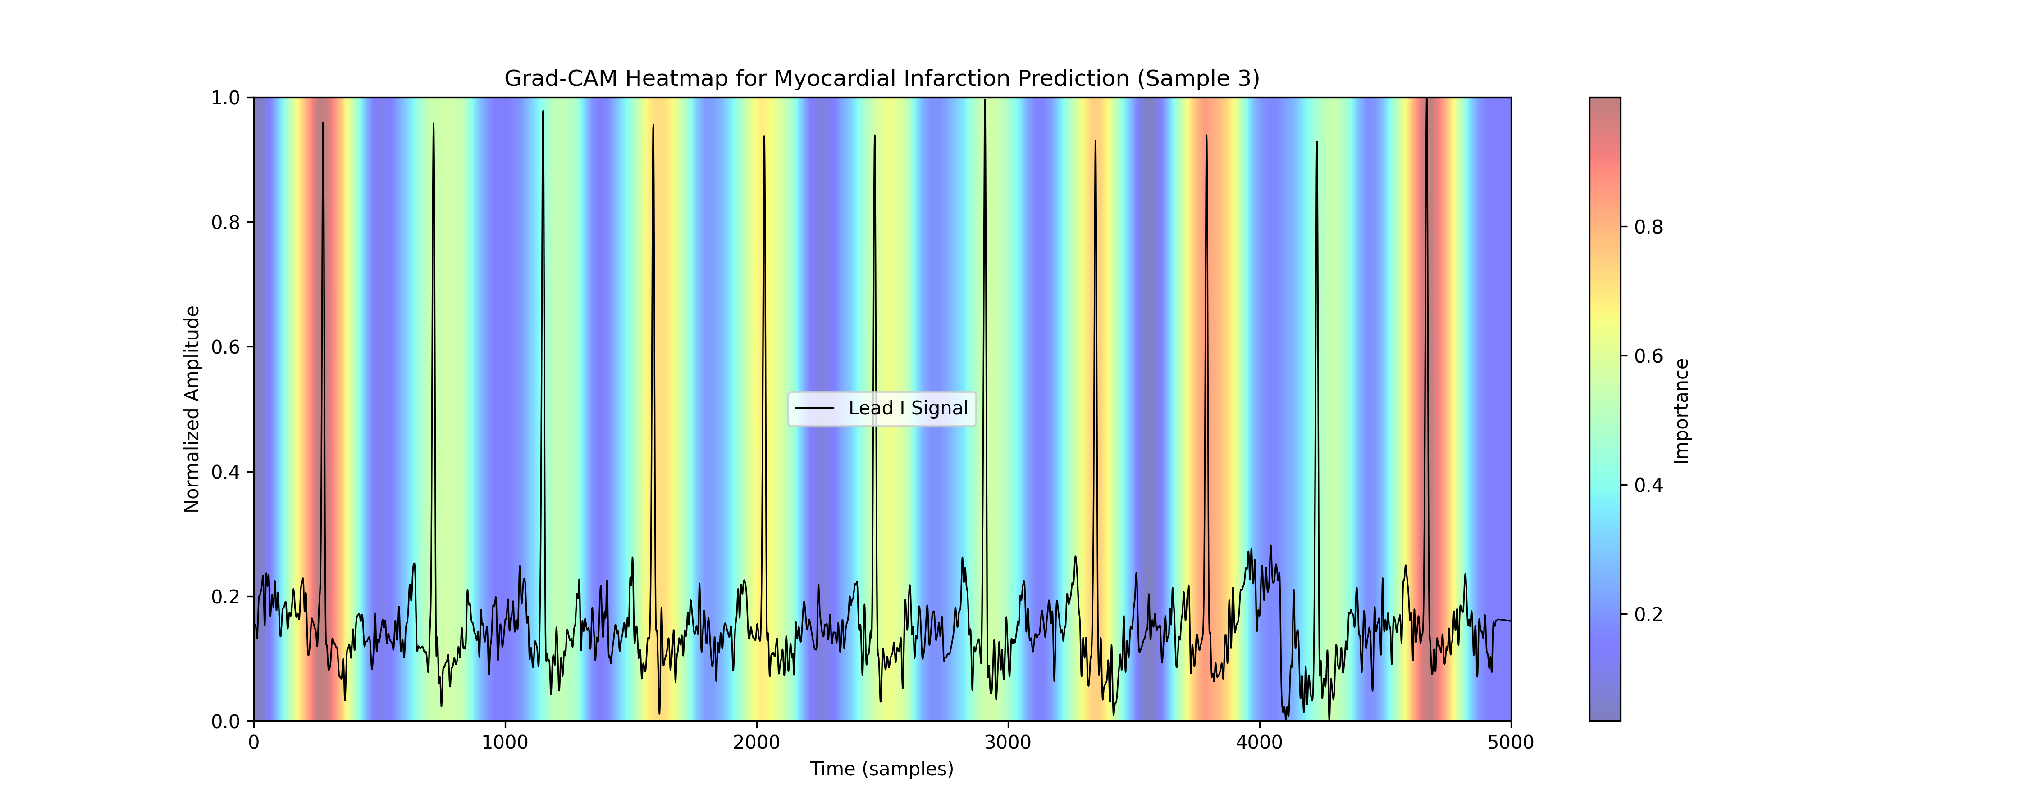
RESULTS
19
Model Interpretability (1D Grad-CAM)
▸ 1D Grad-CAM: Computes gradients of target class scores relative to activation maps of the last convolutional layer.
▸ MI Localization: For Myocardial Infarction predictions, the peak activation is localized directly on the ST-segment elevation in Lead V2.
▸ Clinical Integration: Heatmap peaks focus on diagnostic wave morphology rather than noise, confirming the model acts as an interpretable diagnostic assistant.
Askar Anafin | Master Thesis Defense | June 2026

Slide 20
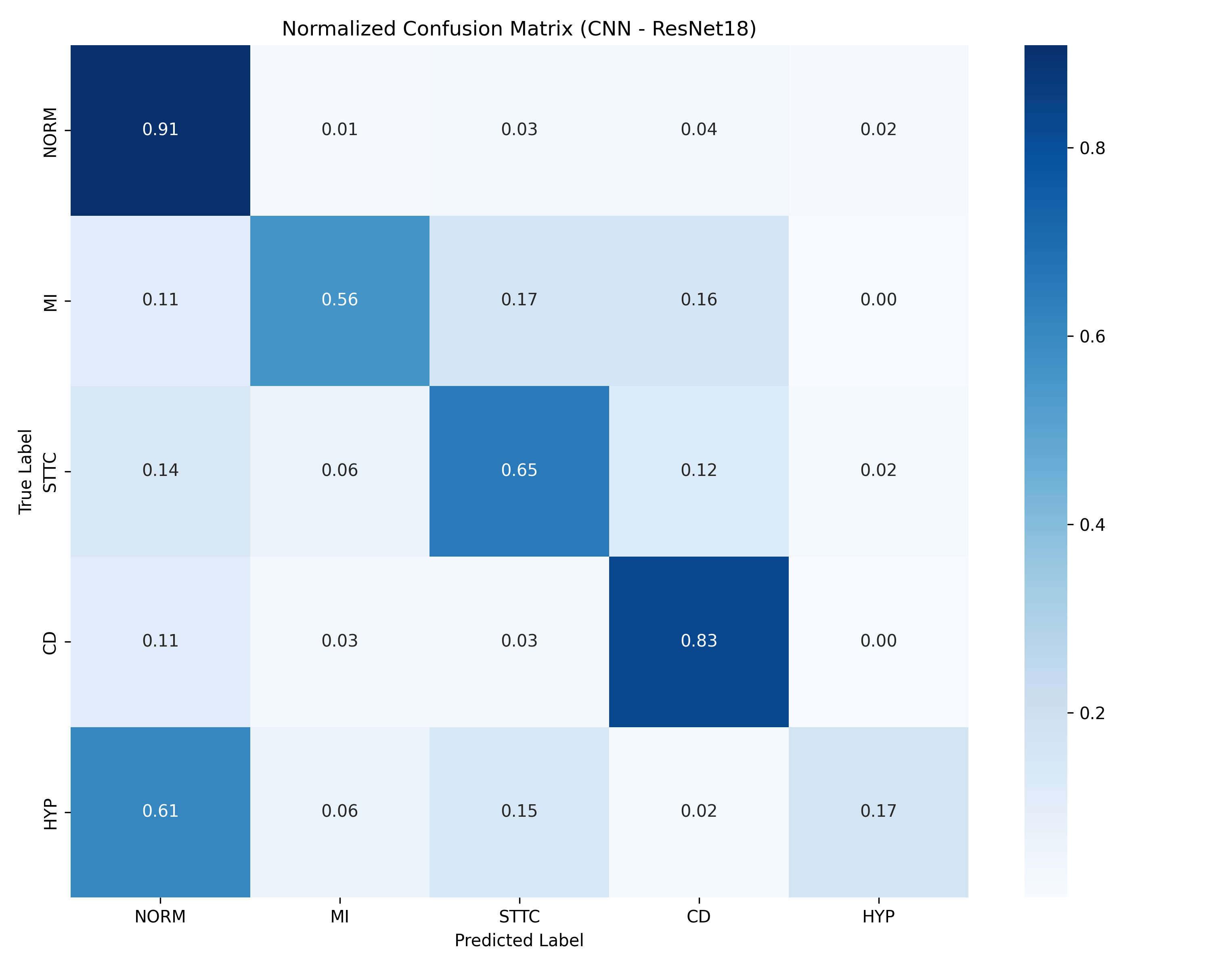
RESULTS
20
Clinical Error Analysis (Confusion Matrix)
▸ Healthy Patient Filtering: Normal Sinus Rhythms (NORM) are correctly filtered with a high 91% sensitivity.
▸ HYP vs. STTC Mimicry: 15% of Hypertrophy (HYP) cases are misclassified as ST/T changes (STTC).
▸ Ventricular Strain Justification: Left Ventricular Hypertrophy (LVH) causes mechanical strain on the heart wall, resulting in lateral ST-segment depression and T-wave inversion. This mimics primary ischemic ST/T changes, causing logical overlap.
Askar Anafin | Master Thesis Defense | June 2026

Slide 21
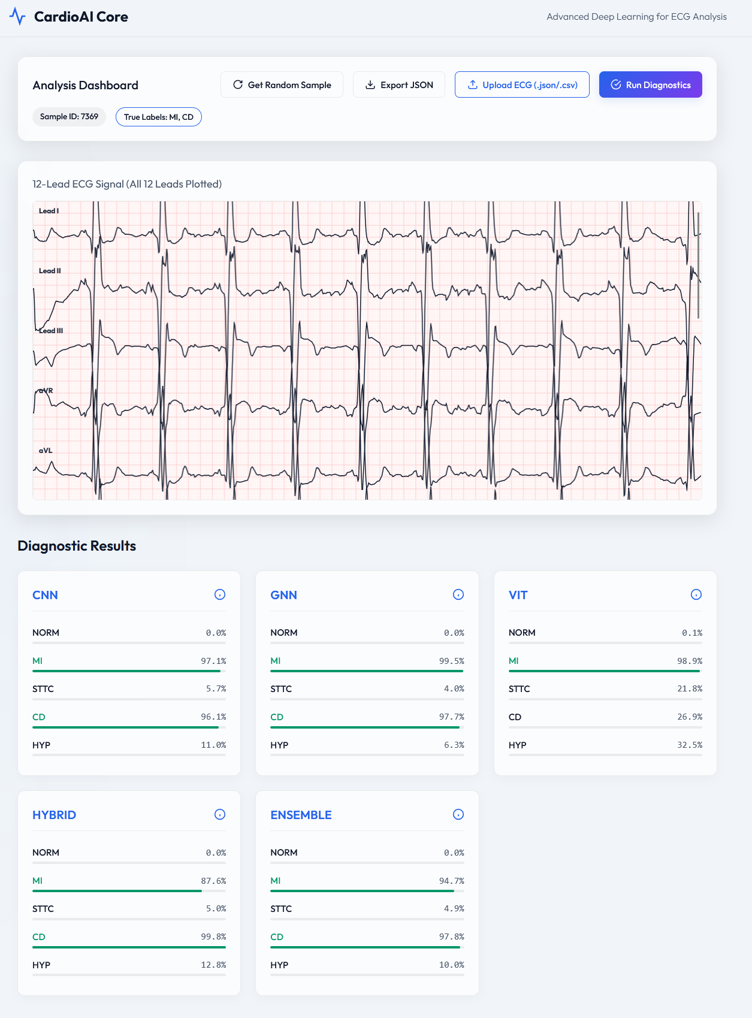
RESULTS
21
FastAPI Diagnostic Triage Dashboard
▸ Async Backend: FastAPI server utilizing Pydantic for validation and fast inference.
▸ File Ingestion: Validates and accepts digital ECG input files in JSON or CSV formats.
▸ Triage Dashboard: Clean light-theme interface with slate gray panels to prevent eye strain.
▸ Waveform Plots: Plots lead waveforms dynamically on pink ECG thermal grid layouts.
▸ Triage Output: Displays ensemble class probabilities and flags critical cases.
Askar Anafin | Master Thesis Defense | June 2026

Slide 22
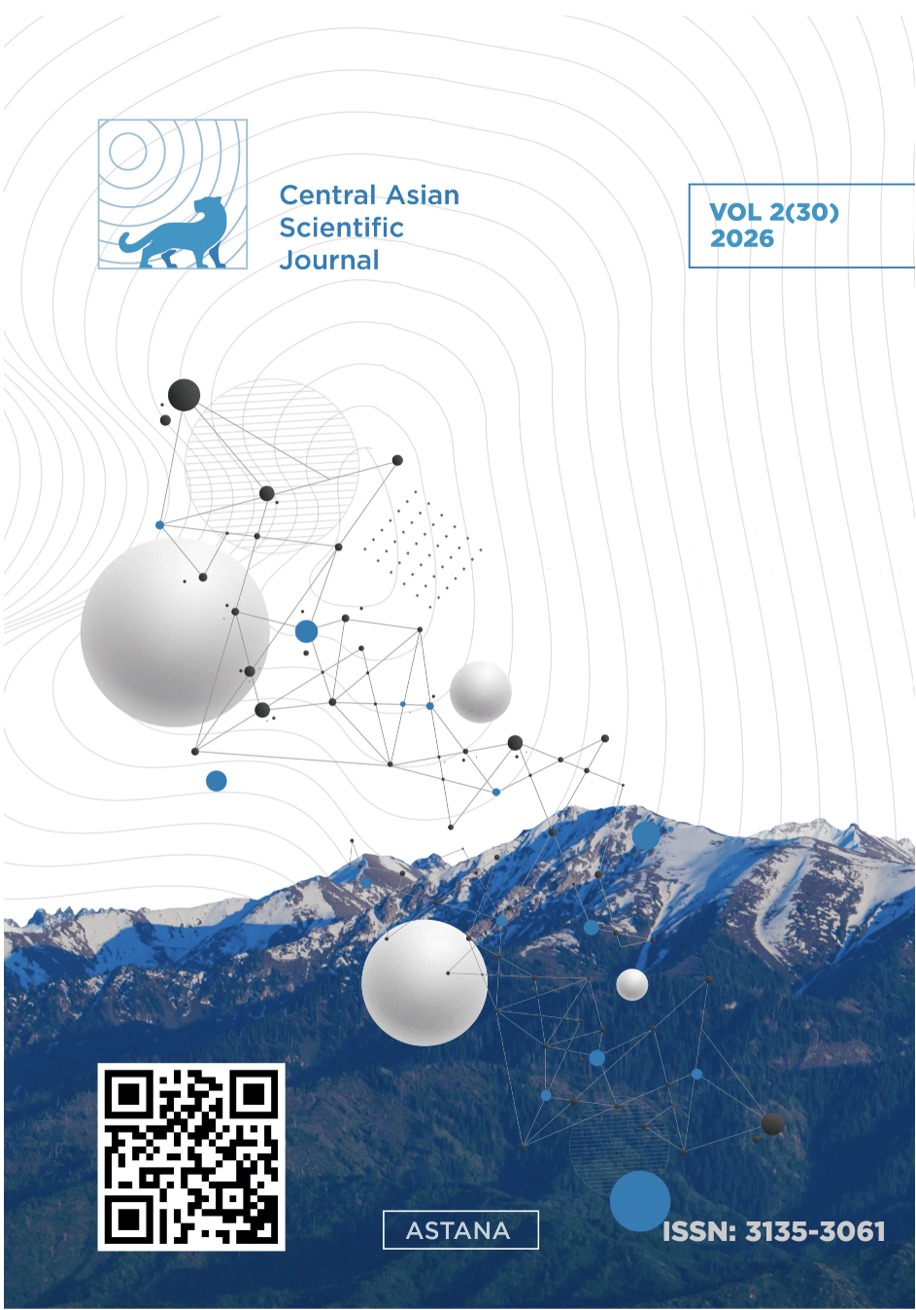
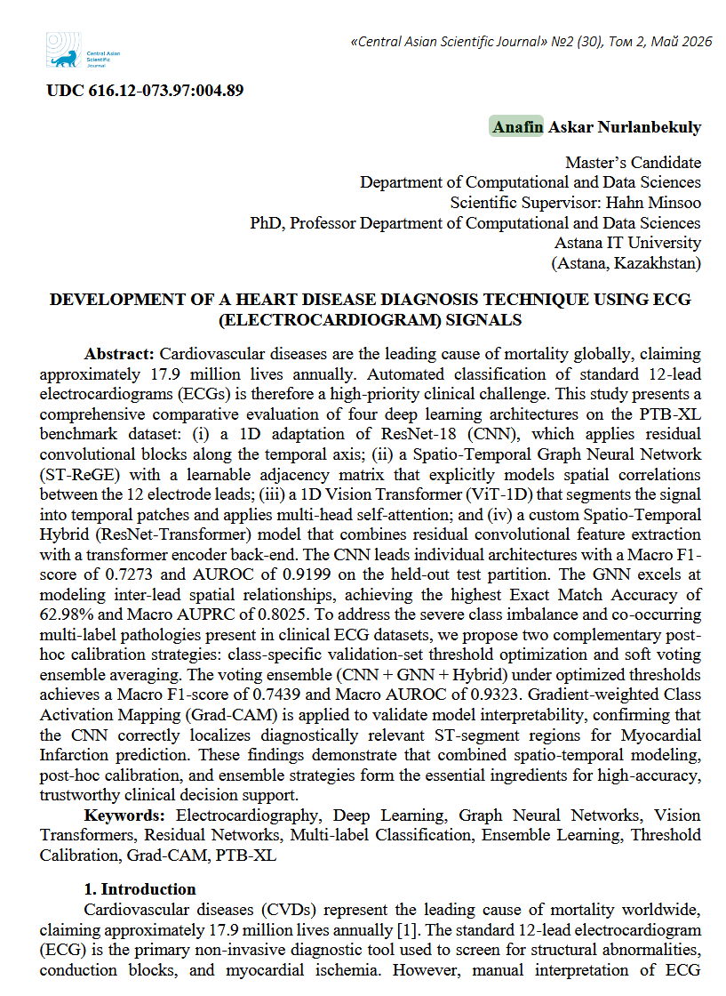
RESULTS
22
Scholarly Publication
SCHOLARLY CITATION
“Development of a Heart Disease Diagnosis Technique Using ECG Signals”
Askar Anafin, Minsoo Hahn
Journal: Central Asian Journal (CAJ), 2026
Askar Anafin | Master Thesis Defense | June 2026

Slide 23
CONCLUSION
23
Conclusion
1. Implemented zero-phase Butterworth filter and Z-score scaling to remove noise.
2. Built 1D ResNet-18 baseline, achieving a strong 0.7285 Macro F1-score.
3. Developed ST-ReGE GNN with learnable adjacency, capturing lead spatial correlations (F1: 0.7444).
4. Evaluated 1D ViT, showing it underperforms on medium databases due to inductive bias gaps.
5. Built Spatio-Temporal Hybrid combining convolutional morphology with attention rhythm.
6. Calibrated decision boundaries and ensembled models to reach 0.7506 F1 and 0.9344 AUROC.
7. Built async FastAPI prototype and dashboard GUI for real-time triage demo.
Askar Anafin | Master Thesis Defense | June 2026

Slide 24
CONCLUSION
24
Future Directions
▸ Model Ensembling: Blend 1D ResNet-18, ST-ReGE GNN, and Hybrid models to combine morphological features, spatial relationships, and temporal contexts.
▸ Self-Supervised Pre-training: Investigate self-supervised pre-training (like Masked Auto-Encoders) on massive datasets (e.g., MIMIC-IV-ECG) to improve Transformer performance.
▸ Multi-Modal Integration: Integrate patient demographics (age, sex, clinical history) into the model inputs to build a multi-modal decision support system.
Askar Anafin | Master Thesis Defense | June 2026

Slide 25
THANK YOU
Thank you for your attention.
I welcome your questions and discussion.
CANDIDATE
Askar Anafin
SCIENTIFIC SUPERVISOR
Minsoo Hahn, PhD

