Slide 1
Henry Hub Natural Gas Price Forecasting
1-, 2-, and 3-Month-Ahead Forecast | Walk-Forward Backtest, Sep 2020 - Aug 2024
Askar Shamshidinov, 2026.07.18

Slide 2
Problem & Data
• Forecast Henry Hub spot price 1, 2, and 3 months ahead for each date in a 48-month test window (Sep 2020 – Aug 2024)
• Walk-forward constraint: at date t, only data up to and including t may be used — no information from the future
• Evaluation metric: MAPE, computed separately for each horizon
• Data: 204 monthly training rows (Sep 2003 – Aug 2020), 114 candidate variables — energy prices, macro/FX indicators, PMIs, storage, temperature
• Core risk: far more candidate features (114) than training rows (204) — overfitting, not model capacity, is the main threat
2

Slide 3
Data Cleaning
• Services_PMI and Construction_PMI are 100% missing in training data → dropped
• 6 further columns exceed 40% missing (Comprehensive_PMI, EU gas storage & LNG inventories, Heating_Oil_Price_USA, related PMI sub-components) → dropped rather than imputed
- With only 204 rows, imputing a column that is missing more than 40% of its history manufactures signal that isn't really there
• No external data sources added — a deliberate scope decision given the timeframe, not an oversight (see Next Steps)
3

Slide 4
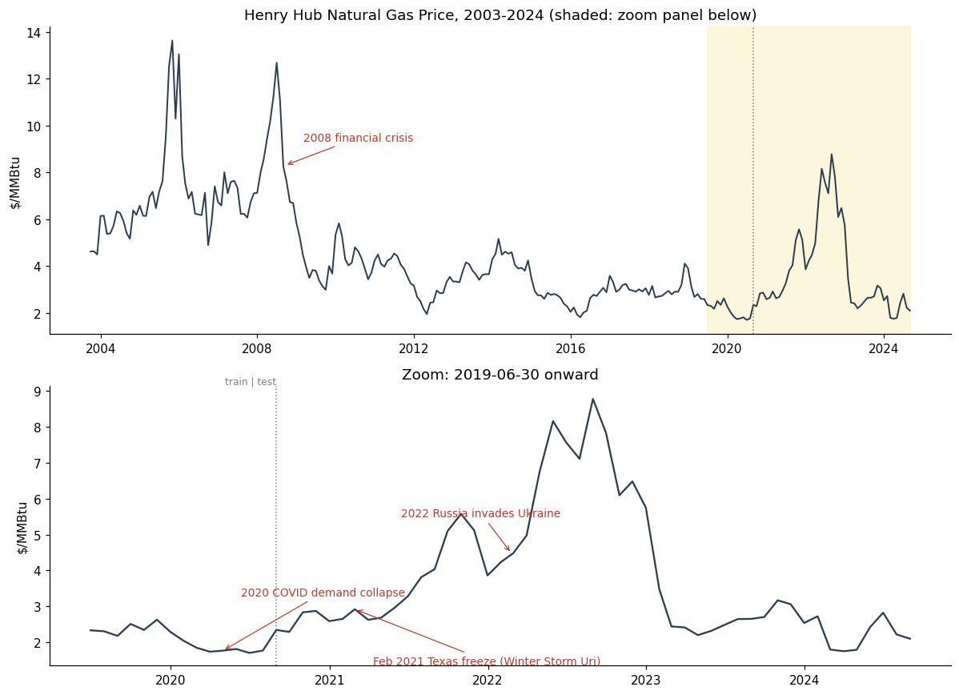
Price History & Regimes
• Four regimes: the 2005–08 run-up and crash, a long 2012–2019 range around $2–4, the 2021 Texas freeze into the 2022 Ukraine-driven spike, and the 2023 unwind
• The test window (shaded) captures both of the sharpest, least-precedented moves in the entire 21-year series
4

Slide 5
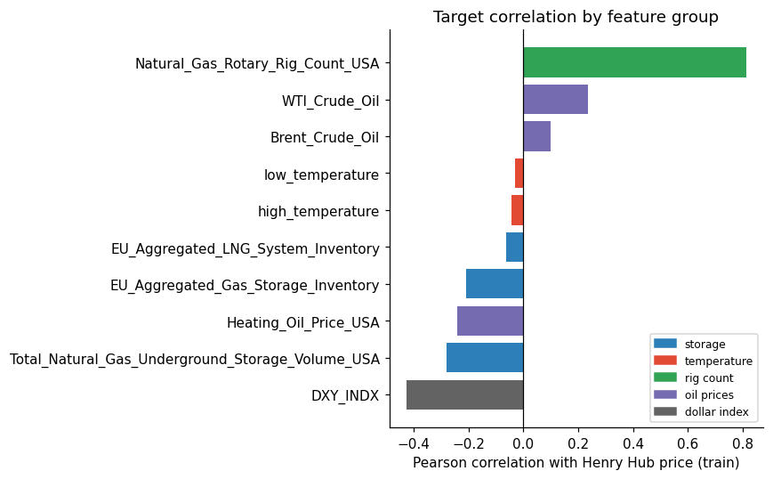
Variable Selection
• DXY_INDX: -0.43 correlation — the dollar-index relationship called out in the brief
• Rig count: +0.81, but contemporaneous — it reacts to price rather than leading it
• Storage & temperature: correct sign, weak in raw monthly levels
• Final feature set (8 features): target lags (1,2,3,6,12), calendar seasonality (sin/cos of month), US storage month-over-month delta
- Target and US storage are 100%-populated in train — this set needs no imputation
5

Slide 6
Modeling Approach
• Naive random-walk baseline (carry the last value forward) — the number every model has to beat
• Direct strategy: one model per horizon (h=1, h=2, h=3), not recursive — avoids compounding errors
• Candidates: Ridge & Lasso (time-series-aware CV) and LightGBM (Optuna, 30 trials per horizon)
• Key fix: every model predicts the change in price, not its level — a first pass at Ridge on raw price levels lost to the naive baseline because of collinearity among the 5 lag features
• All tuning and model selection uses a 2017–2020 validation window inside train; the test period is never touched until the final backtest
6

Slide 7
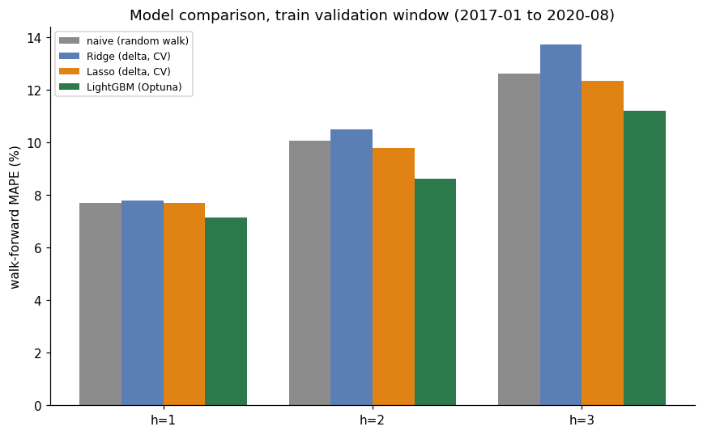
2017-01 to 2020-08, train only Validation Results
• MAPE by horizon (h=1 / h=2 / h=3):
- naive: 7.71% / 10.07% / 12.61%
- Ridge: 7.77% / 10.48% / 13.71%
- Lasso: 7.70% / 9.79% / 12.33%
- LightGBM: 7.15% / 8.63% / 11.20%
• LightGBM beats the naive baseline at every horizon; the margin widens with horizon
• Lasso's sparsity gets it to roughly naive-or-better; Ridge, which can't zero out weak features, trails slightly at h=2/h=3
7

Slide 8
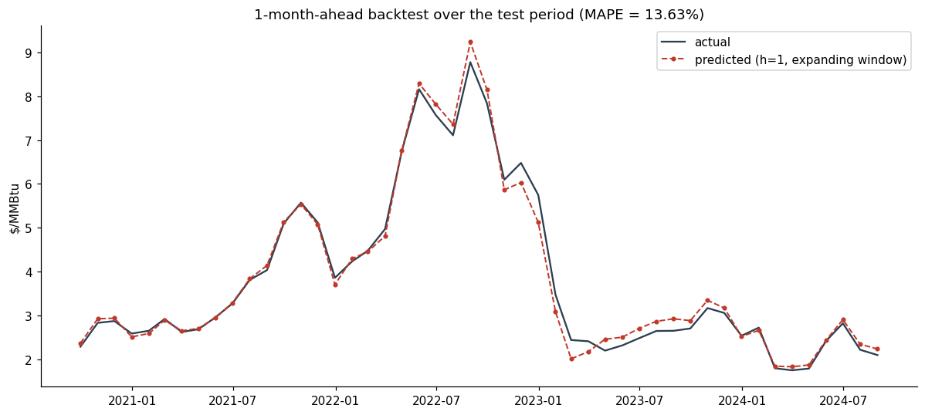
Test backtest, 2020-09 to 2024-08 Final Accuracy
• Expanding-window backtest: retrain monthly on train + test-to-date, exactly the walk-forward rule
• Test MAPE (h=1/2/3): naive 13.65% / 22.92% / 29.18% vs. LightGBM 13.63% / 20.63% / 27.03% — LightGBM wins at every horizon
• Error roughly doubles vs. validation — the test period includes two regime shifts (Texas freeze, Ukraine spike) absent from training history
8

Slide 9
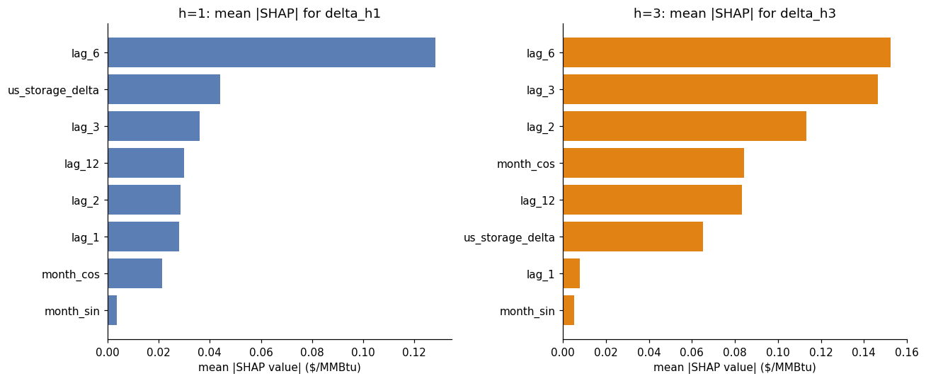
Error Analysis & Inflection Points
• Lag features dominate SHAP importance at both horizons; seasonality contributes least; storage delta is a real secondary signal
• Texas freeze (Jan→Feb 2021): model predicted a decline (2.65→2.59); actual rose to 2.92 (-11.3%) — a large storage withdrawal read as bearish, while the freeze cut supply and spiked demand at once
• Ukraine invasion (Jan→Feb 2022): smaller miss (-4.0%) — the US move was indirect, via LNG exports, and lagged the invasion itself
• Freeport LNG fire (May→Jun 2022): model overshoots (+9.5%), extrapolating the ongoing rally right as a discrete outage reversed it
9

Slide 10
Limitations & Next Steps
• Momentum-based model: strong at trend continuation, structurally blind to turning points caused by discrete supply/demand shocks
• Feature set intentionally minimal (8 features) for 204 training rows — the right tradeoff for this sample size, but it caps the ceiling
• Next steps: forward-looking weather/degree-day data, LNG terminal utilization & outage indicators, explicit event flags, ensemble with regime-detection
• Deliverables: solution.ipynb (full pipeline, executed end-to-end), submission.csv (validated format), this report
10

