Slide 1


Testing of 8 production cards
Raman Khurana, B. Gomber, S. Mukherjee, D. Roy, M. Sharan
SINP Kolkata, INDIA
(11th April 2014)

Slide 2
Status of testing at SINP
8 μHTR cards v1.3 assembled in India.
    used machine assembly now.
Testing of cards is ongoing at SINP.
  Firmare used for Front FPGA = 00.0b.20
  Firmare used for Back FPGA = 00.0d.40
Following tests are performed :
  I2C communication(with small issue initially with 2 cards)
  working fine.
  For PPODs
    IBER Test @ 4.8 Gbps and 6.4 Gbps using μTCA crate.
    Worked fine in 7 cards
    Random behaviour in 1 card : Ibert console not coming
        Front Link works upto 6.4 Gbps

Slide 3
Resistance Problem
2 cards were not showing correct I2C information for 1V PM.
Card 106 – Resistance near C402 was dry soldered ( 33 Kohm )
Card 104 – Resistance near C503 was dry soldered ( 33 Kohm )
These resistors were connected with 1V PM.
After doing the soldering properly, I2c communation was
working fine.
Next Steps :
    SFPs and front-back link testing.

Slide 4
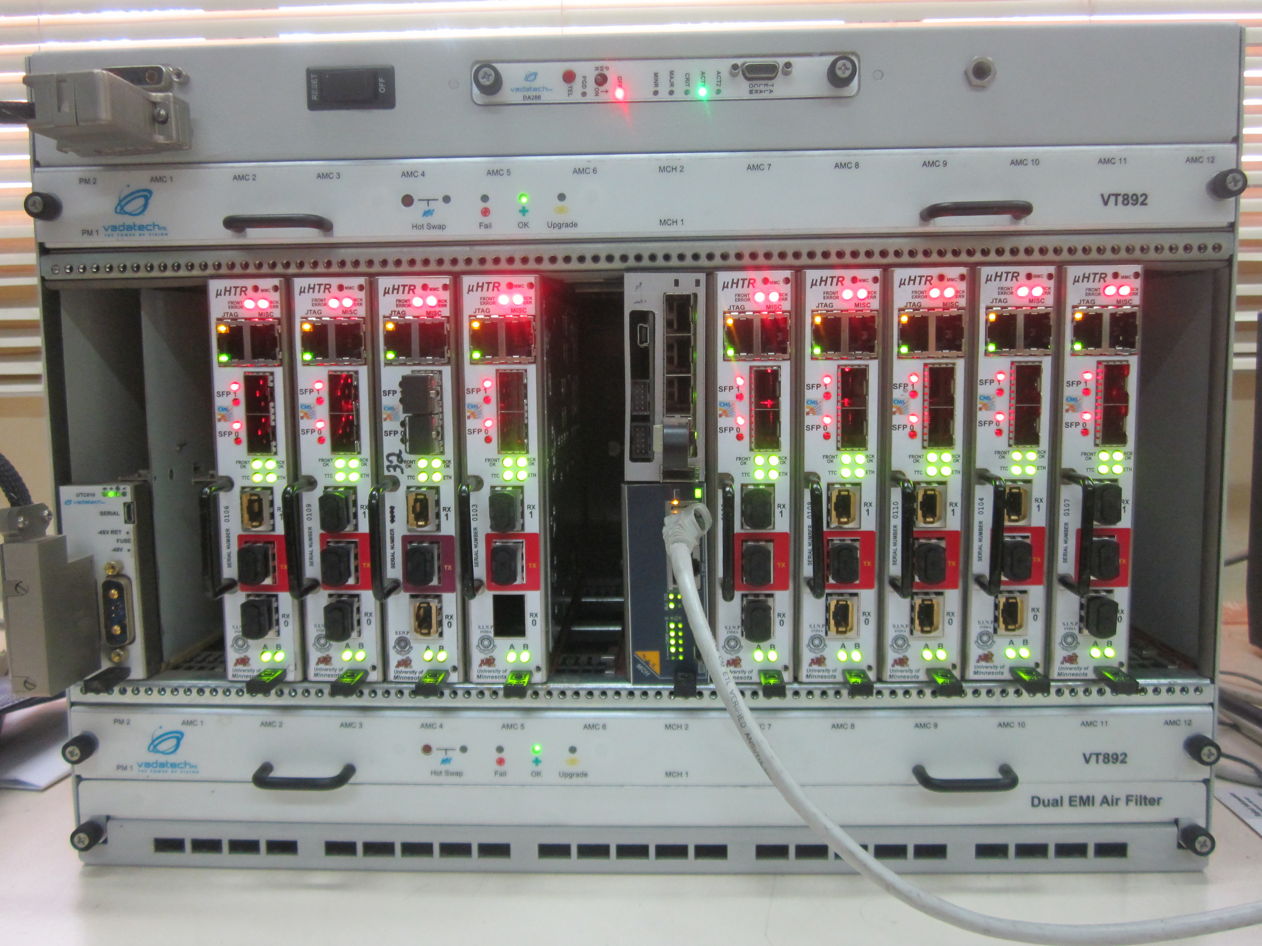

Slide 5
I2C communication
pm_1VA -- 00:1e:c0:80:e4:38 (S/N = 1015)
Id-Version = 1 Mezz Type = 1 / 1 (PM1.0)
Tested 7-2-2014 at 'SINP-INDIA' by 'Raman' using release 1.0.2
pm_1VB -- 00:1e:c0:81:6f:af (S/N = 1006)
Id-Version = 1 Mezz Type = 1 / 1 (PM1.0)
Tested 15-1-2014 at 'SINP-INDIA' by 'Debarati' using release 1.0.2
pm_3_3V -- 00:1e:c0:80:fa:7e (S/N = 1006)
Id-Version = 1 Mezz Type = 1 / 3 (PM3.3)
Tested 3-2-2014 at 'SINP-INDIA' by 'Debarati' using release 1.0.2
apm_1_8V -- 00:04:a3:a5:f8:7a (S/N = 1009)
Id-Version = 1 Mezz Type = 2 / 1 (APM1.8)
Tested 28-1-2014 at 'SINP-INDIA' by 'Bhawna' using release 1.0.2
Layer 1 : asked for 8 , found 8
apm_2_5V -- 00:1e:c0:81:01:c3 (S/N = 1003)
Id-Version = 1 Mezz Type = 2 / 1 (APM1.8)
Tested 3-2-2014 at 'SINP-INDIA' by 'Debarati' using release 1.0.2
cpld_mezz -- 00:04:a3:8f:15:46 (S/N = 65535)
Invalid ID block observed

Slide 6
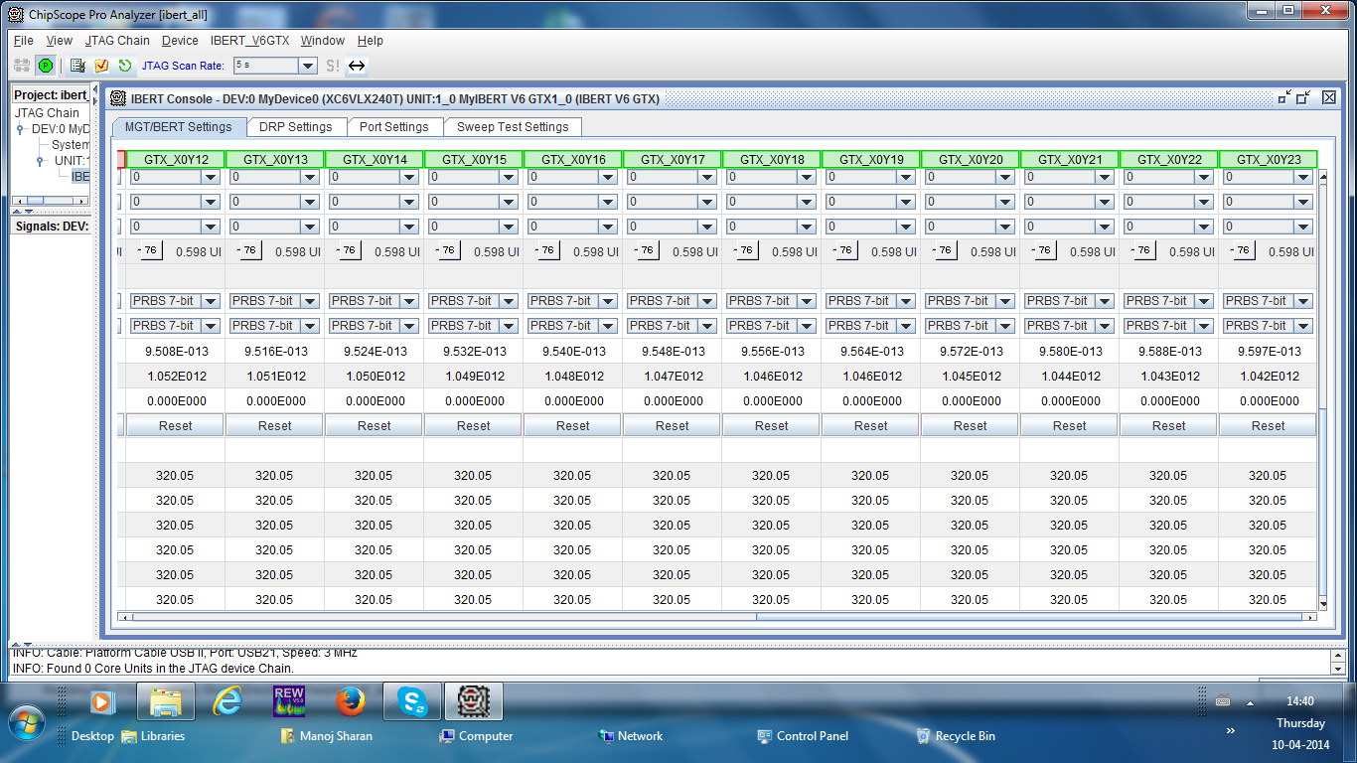
IBER Test 6.4 Gbps :: PPODs

Slide 7
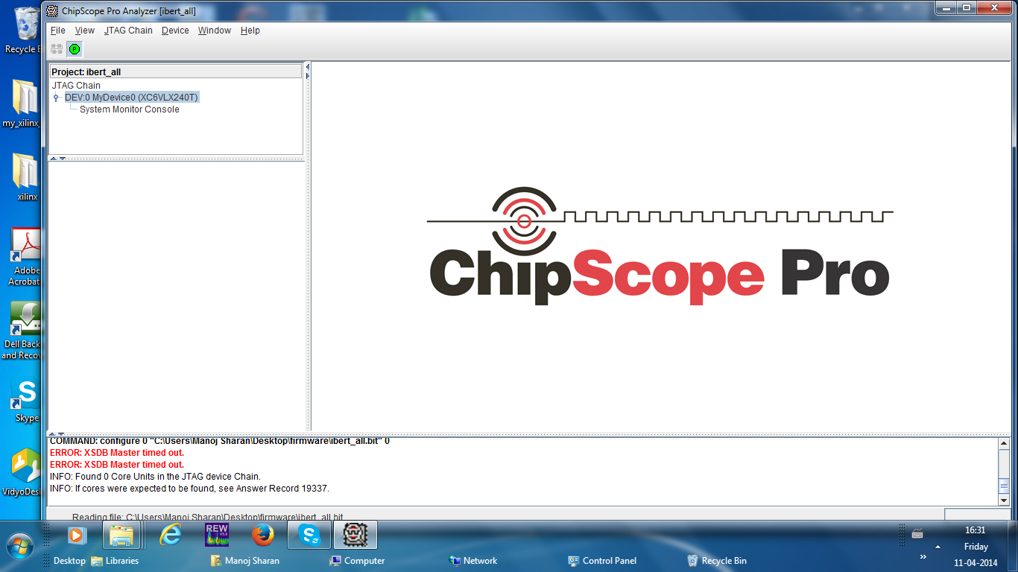
IBER Test 4.8 Gbps :: Error for 1 card

Slide 8
Summary
8 μHTR cards v1.3 assembled in India.
Preliminary testing at SINP shows good results.
I2C communication passed for all mezzanines.
IBER Test using crate worked for 7 production cards.
IBER Test randomly working with 1 card (104)
Comments & Suggestions

Slide 9
Backup

Slide 10
I2C communication
back FPGA (sysmon) -- 0.98 V 2.53 V 47.0 degC
front FPGA (sysmon) -- 0.99 V 2.52 V 46.8 degC
pm_1VA -- 1.01 V 40.9 degC
pm_1VB -- 1.01 V 38.9 degC
pm_3_3V -- 3.35 V 37.6 degC
apm_1_8V -- 1.62 V 45.8 degC
Layer 1 : asked for 8 , found 8
apm_2_5V -- 2.53 V 53.0 degC
ppod_rx0 -- 2.51 V 3.27 V 28.6 degC
Layer 1 : asked for 8 , found e8
ppod_rx1 -- 2.51 V 3.28 V 26.5 degC
ppod_tx -- 2.43 V 3.23 V 39.2 degC

