Slide 1


Power Mezzenine testing for
HCAL backend
upgrade during LS1
Raman Khurana
SINP Kolkata, INDIA
India CMS Meeting , 4th - 6th April 2013

Slide 2
Need of upgrade
With increase in LHC Energy & luminosity large amount of data has to be processed.
Number of channels will increase
  To store information of more depth in the detector.
Very high speed DAQ needed.
  Problem : Current VME based system doesn't support data transfer rate which we will need after LS1.
  No industrial support available.
  Solution : μTCA based system.
This lead to change of electronics also.

Slide 3
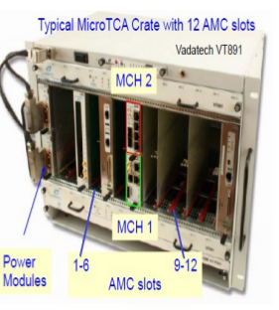
μTCA
Consist of 12 AMC (μHTR) cards.
  recieves data from FEE.
2 MCH Modules
  MCH1 (commercial): to provide power to all AMC cards, backplane & general house keeping of the crate.
  MCH2 (customised for CMS): distribution of LHC clock and fast control signal
Power Modules

Slide 4
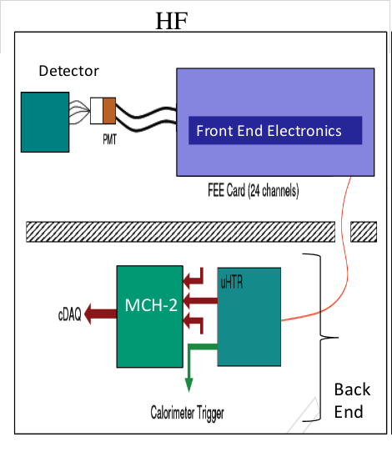
Data flow in HF
Role of backend electronics :
Receive a continuous stream of ADC and TDC (raw optical data rate 4.8 Gbps).
Calculate trigger primitives.
Transmit the trigger primitives over optical fiber to the calorimeter trigger system.
Pipeline the ADC, TDC, and trigger primitive data for the full Level 1 trigger latency period.
use the occupancy of the forward calorimeter to measure of the LHC luminosity

Slide 5
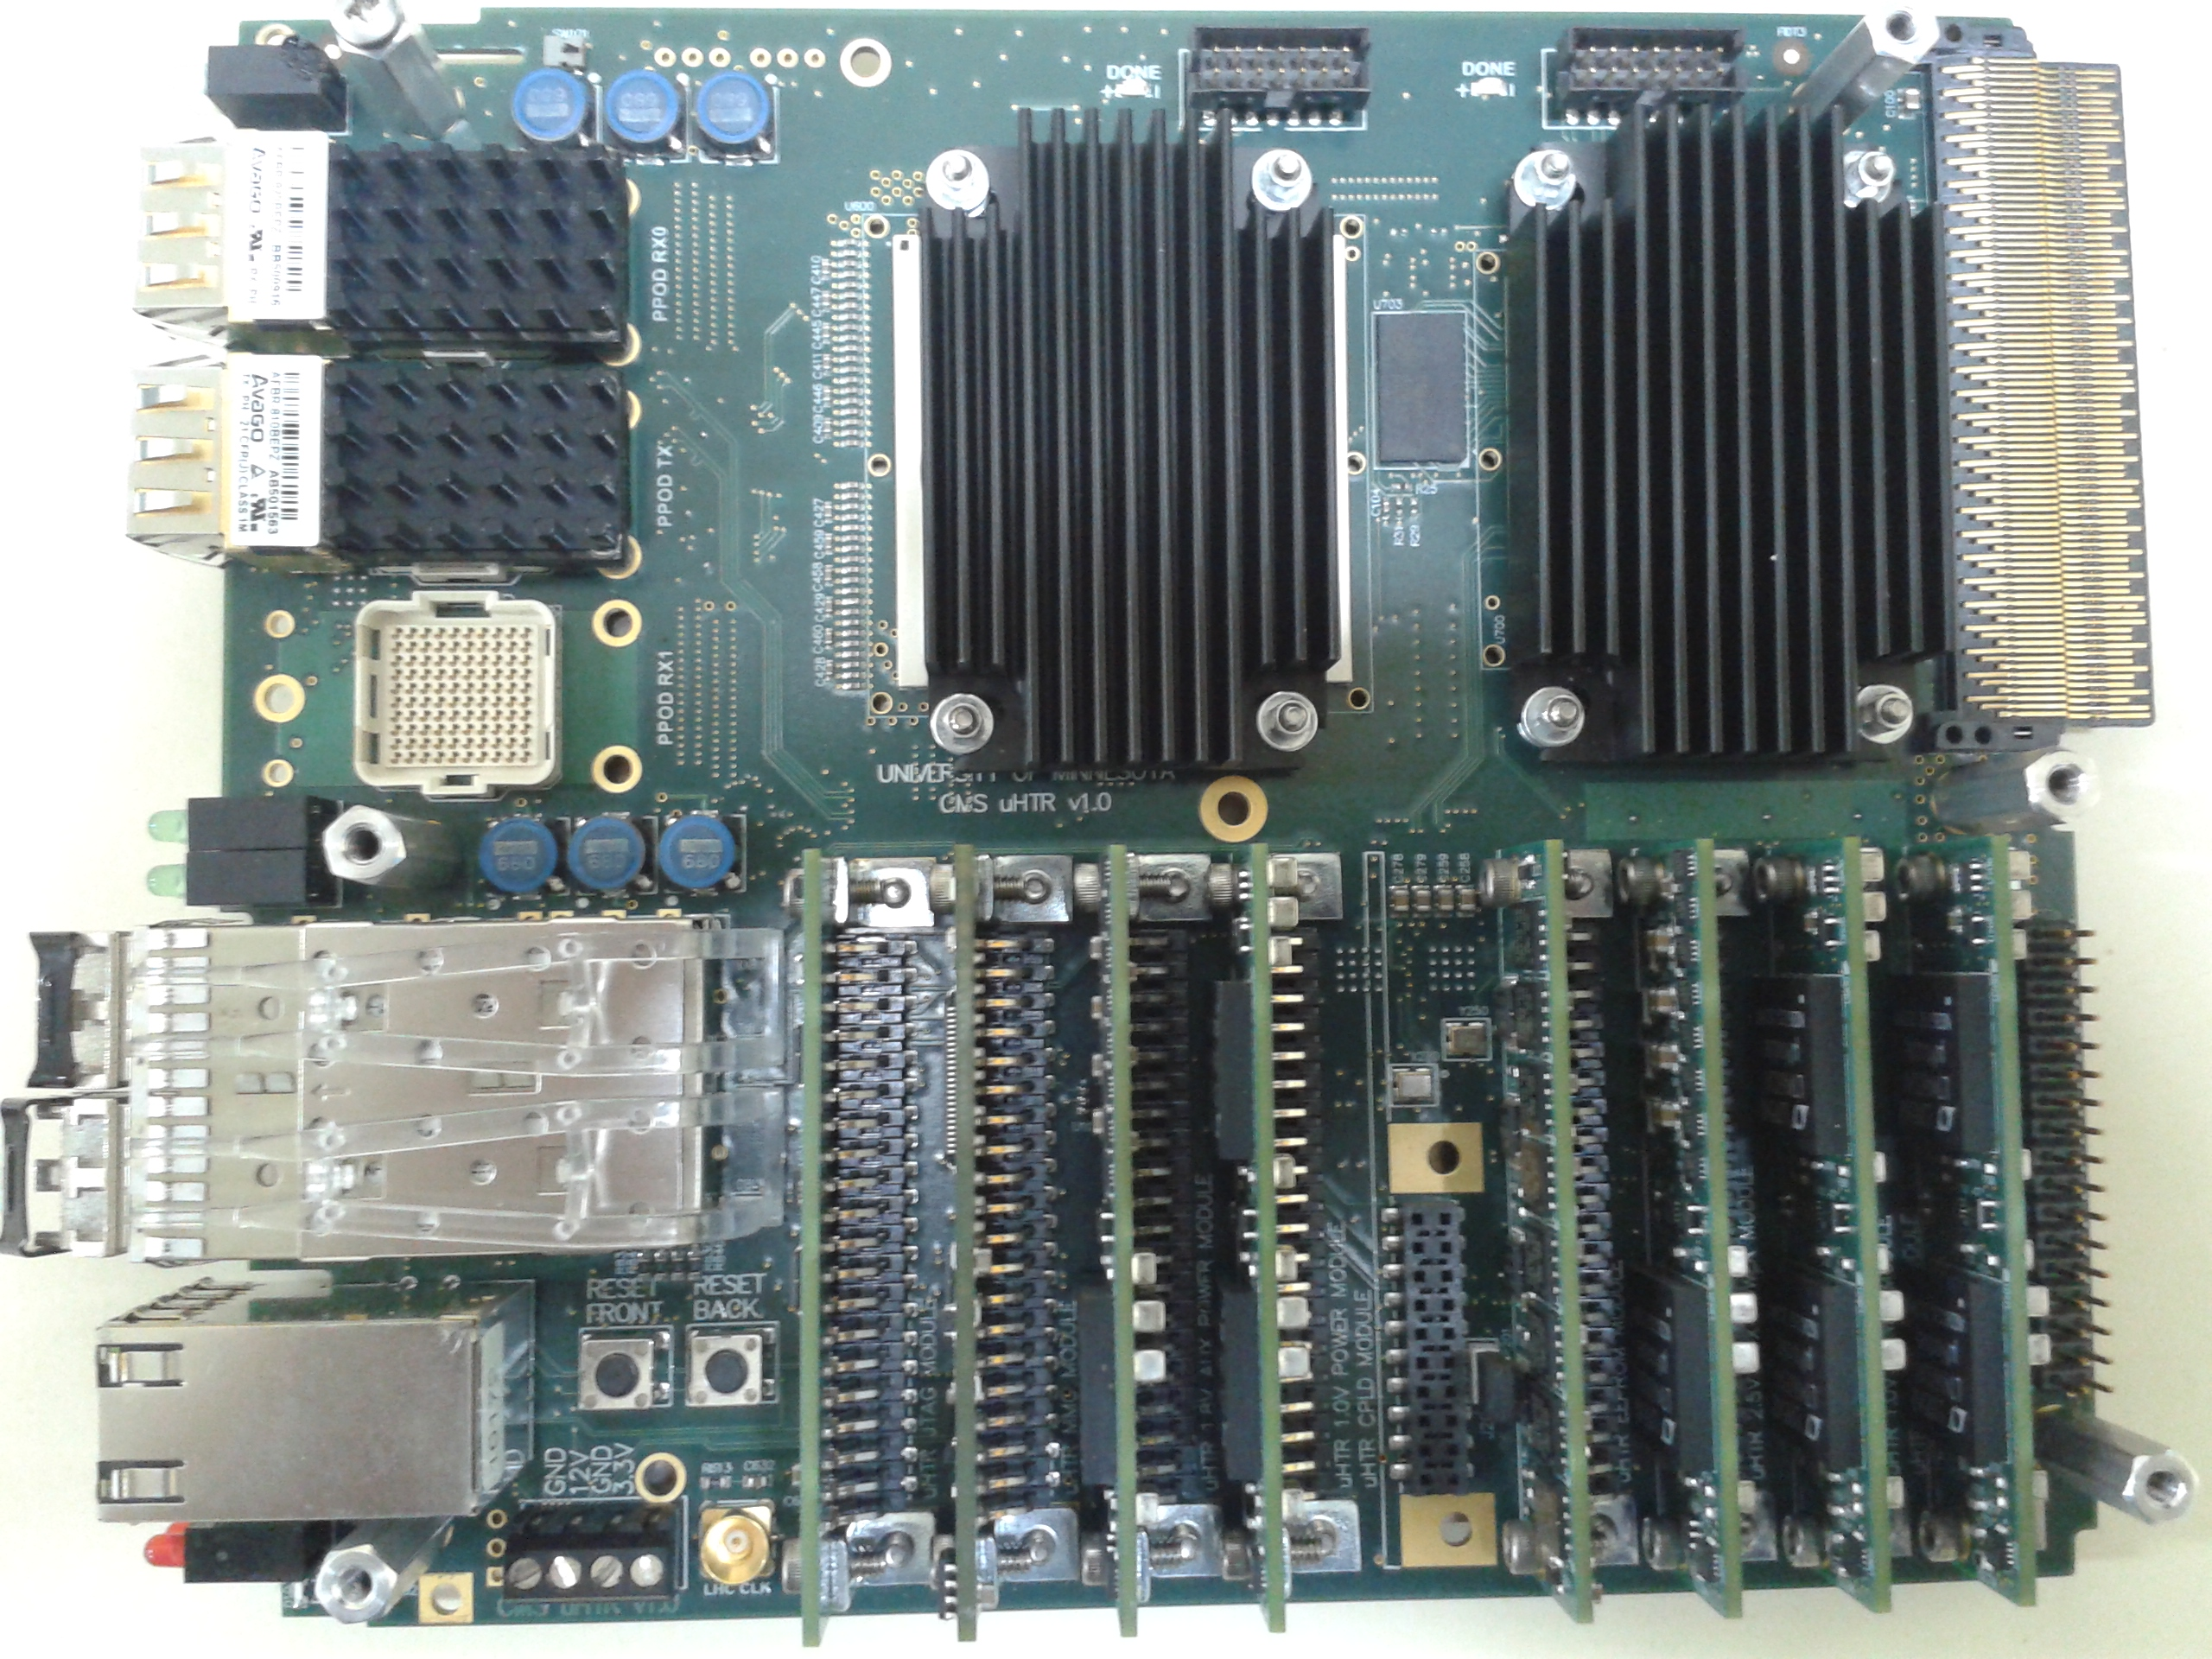
What is AMC ?
PPOD RX
PPOD TX
Front
FPGA
Back
FPGA
Optical
connector
PM 3.3 V
PM 1.0 V
PM 1.0 V
APM 1.8 V
APM 2.5 V
JTAG
MMC
EPROM

Slide 6
Need of PM test
Power mezzanine provide required volatages to various parts of the μHTR.
In any experiment power supply is the part which fails often or have problem.
  If PM fails or malfunctions then we loose data collection efficiency
  So, all power modules of the μHTR card will be tested for 20 hours.
Each PM/APM have I2C chip on it which provides a unique id to the PM/APM.
  Useful in maintaining database.
I2C allow serial communication to other devices via two lines.
  In our case SUB-20 is accessing the PM via I2C bus.
2 ADC continuously monitors T, V, I and digital I/O of the chip.
Goal is to test all PM/APM @ SINP before mounting on μHTR.
Current design of μHTR allows replacing the PM/APM in case of failure.
via I2C
μUSB
PC
Power Module
LCD
SUB-20 Module

Slide 7
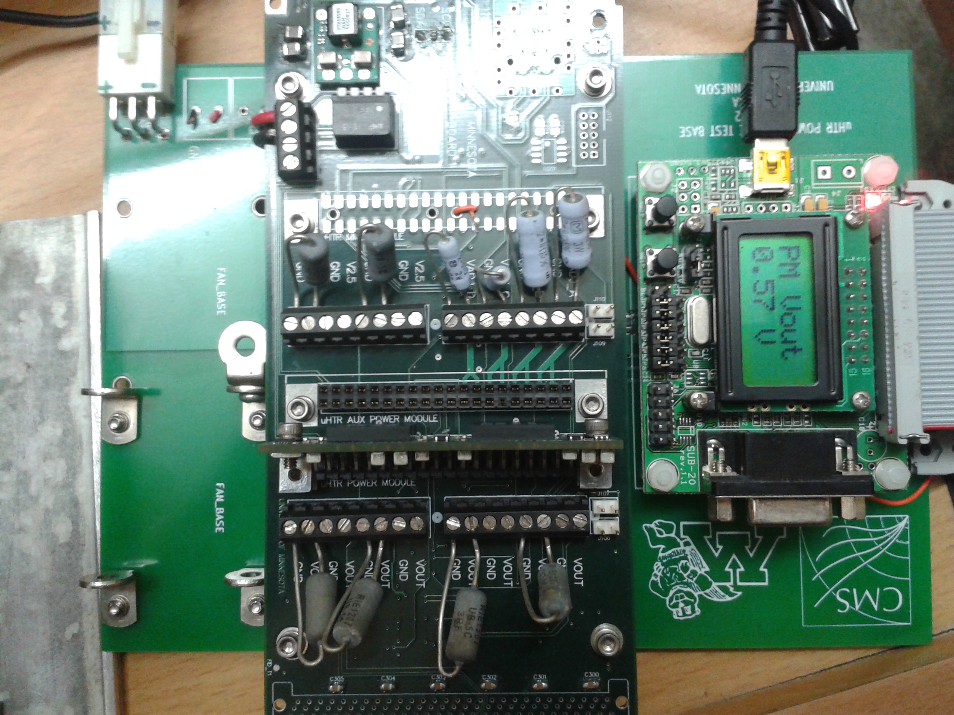
Test Setup @ SINP
PM is mounted on the test board as shown on left.
Test board conneted to 12 V supply (~100W).
SUB-20 is connected to PC via micro USB cable
SUB-20 can talk to PM/APM via I2C chip on them.
This configuration allows us to monitor the temperature, voltage and current drawn by the PM/APM.
test carried out for 20 hrs for each PM/APM to monitor its stability.
Input
voltage
SUB20 Module
APM tester
display
PM tester

Slide 8
How test is conducted ?
Connect the test board to power supply
Switch on the cooling fan.
Connect the SUB-20 module and PC via μUSB cable.
If this is done : ready for test !!
Test is conducted by a C++ code using already implemented functions inside libsub and libusb.
Code structure :
  (A) Interface SUB-20 & PC
    To check if SUB-20 module is connected
    How many SUB-20 are connected
  (B) Interface PM to SUB-20
    Check connections and communicate with I2C bus inside PM
  Main
    Running & steering A & B
    Which test to run
    For how long
    Debugging .,...

Slide 9
How test is conducted ?
Start
Stop
Continue taking data from PM
Sub -20
device
connected
false
DEVICE FAILED TO OPEN
false
true
If P > 30 W
Or
T > 90 C
true
STOP
Sub-20
Able to read
PM EEPROM
false
No PM Found
Collect data from
PM every 10 sec
true

Slide 10
Plans
All needed setup is now available for testing.
We will test all PM/APM @ SINP before mounting them on μHTR card.
Test new μHTR cards at P5 once they are ready for pre-production review.

Slide 11
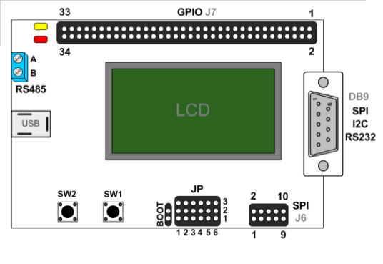
SUB-20
SUB-20 is a versatile and efficient bridge device providing simple interconnect between PC (USB host) and different HW devices.
Connect to HW via popular interfaces such as I2C, SPI, MDIO, RS232, RS485, SMBus, ModBus, IR
It is also a full "any to any" converter between all supported interfaces and I/O features.
SUB-20 is a powerful I/O controller with 32 GPIO, 8 Analog Inputs, PWM Outputs, Edge DEtectors, LCD, Leds and push buttons.

Slide 12
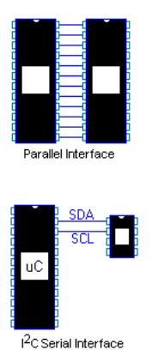
I2C Bus
The Inter-integrated circuit bus
Two wire , low-medium speed communication bus developed by Philips Semiconductors in the early 1980s.
  Bus = a path for electronic signal
Aim : reduce the manufacturing costs of electronic products
  provides a low-cost, powerful, chip-to-chip communication link.
Old days :
  chip-to-chip communications used many wires in a parallel interface
  often requiring ICs to have 24, 28, or more pins.
  Many of these pins were used for inter-chip addressing, selection, control, and data transfers
  In a parallel interface, 8 data bits are typically transferred from a sender IC to a receiver IC in a single operation
Now :
  performs chip-to-chip communications using only two wires in a serial interface
  allowing ICs to communicate with fewer pins
  The two wires in the I2C Bus are called Clock (SCL) and Data (SDA)
  These two wires carry addressing, selection, control, and data, one bit at a time.
  The SDA wire carries the data, while the SCL wire synchronizes the sender and receiver during the transfer.

Slide 13
Cheat Sheet
VME | VERSAbus Memory card
uTCA | Micro Telecommunications Computing Architecture
AMC | Advanced Mezzanine Card
MCH | UTCA carrier Hub
MMC | Mezzanine micro-controller card.
uHTR | Micro HCAL trigger & readout card
FEE | Front end electronics
I2C | IIC = inter integrated circuit
FPGA | Field programable gated array
PM/APM | Power module/Auxilary power module

Slide 14
Cheat Sheet
PPOD | Pluggable, Parallel-Fiber-Optic Transmitter / Receiver
MTP | Multi-fiber Termination Push-on : optical fibre connector

Slide 15
MCH1
Support for 12 AMCs, 2 cooling units, 1-4 power modules
GigaBit Ethernet switching
PCI Express switching
Management Controller (MCMC)

