Slide 1
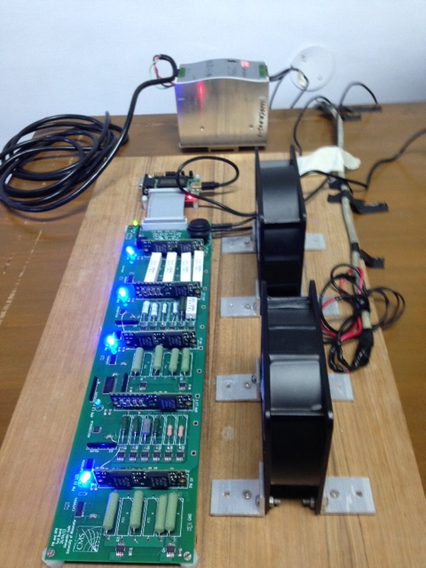
Power Supply
Sub-20
μUSB
34 Wire
Ribbon
PMs/APMs
Fans
Testing Board

