Slide 1
Text Summarization with BERT
Ashish Kayastha
Department of Computer Science
Central Michigan University

Slide 2
Background
Extractive Summarization
task of selecting important sentences from a piece of text and showing them together as a summary.
Abstractive Summarization
task of generating an abstract of the text; i.e., instead of picking sentences from within the text, a new summary is generated.
Pretrained language models have become popular recently for text summarizations tasks.
Extension of word embeddings by learning contextual representations from large-scale corpora. e.g., ELMO, BERT, etc.
Historically, text summarization done with sequence-to-sequence models with RNNs employed on both the encoder and the decoder.

Slide 3
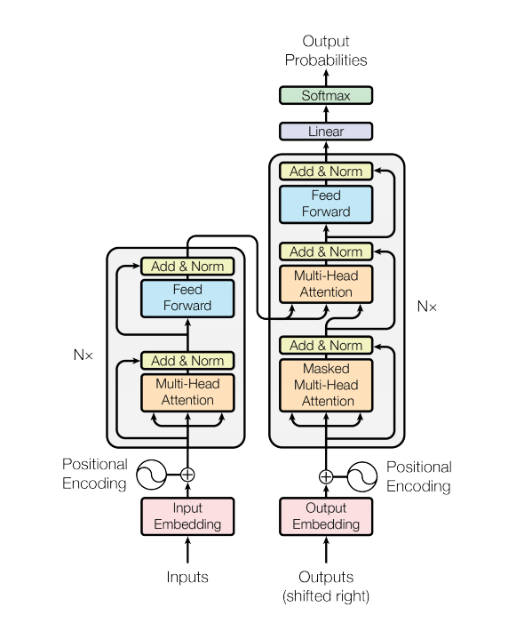
Transformers
New model architecture for natural language processing tasks
Non-recurrent Sequence-to-Sequence: Encoder-Decoder model
Attention is all you need (Vaswani et al.)
Based on neural self-attention
Originally designed for translation
Predict each translated word

Slide 4
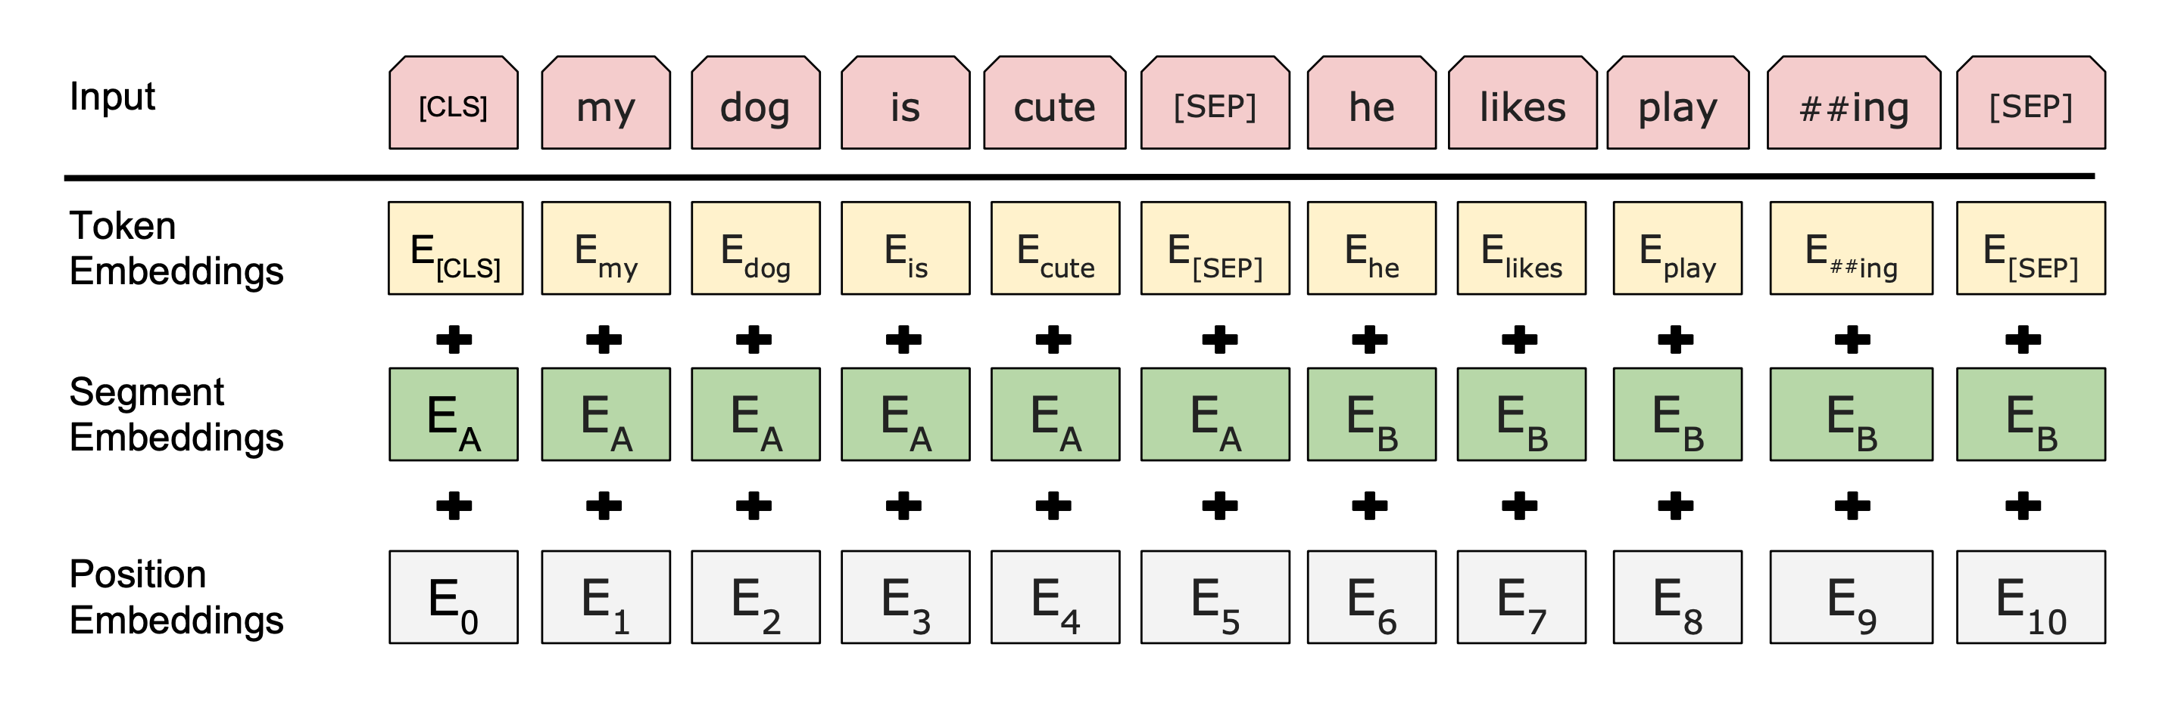
BERT: Bidirectional Encoder Representations from Transformers

Slide 5
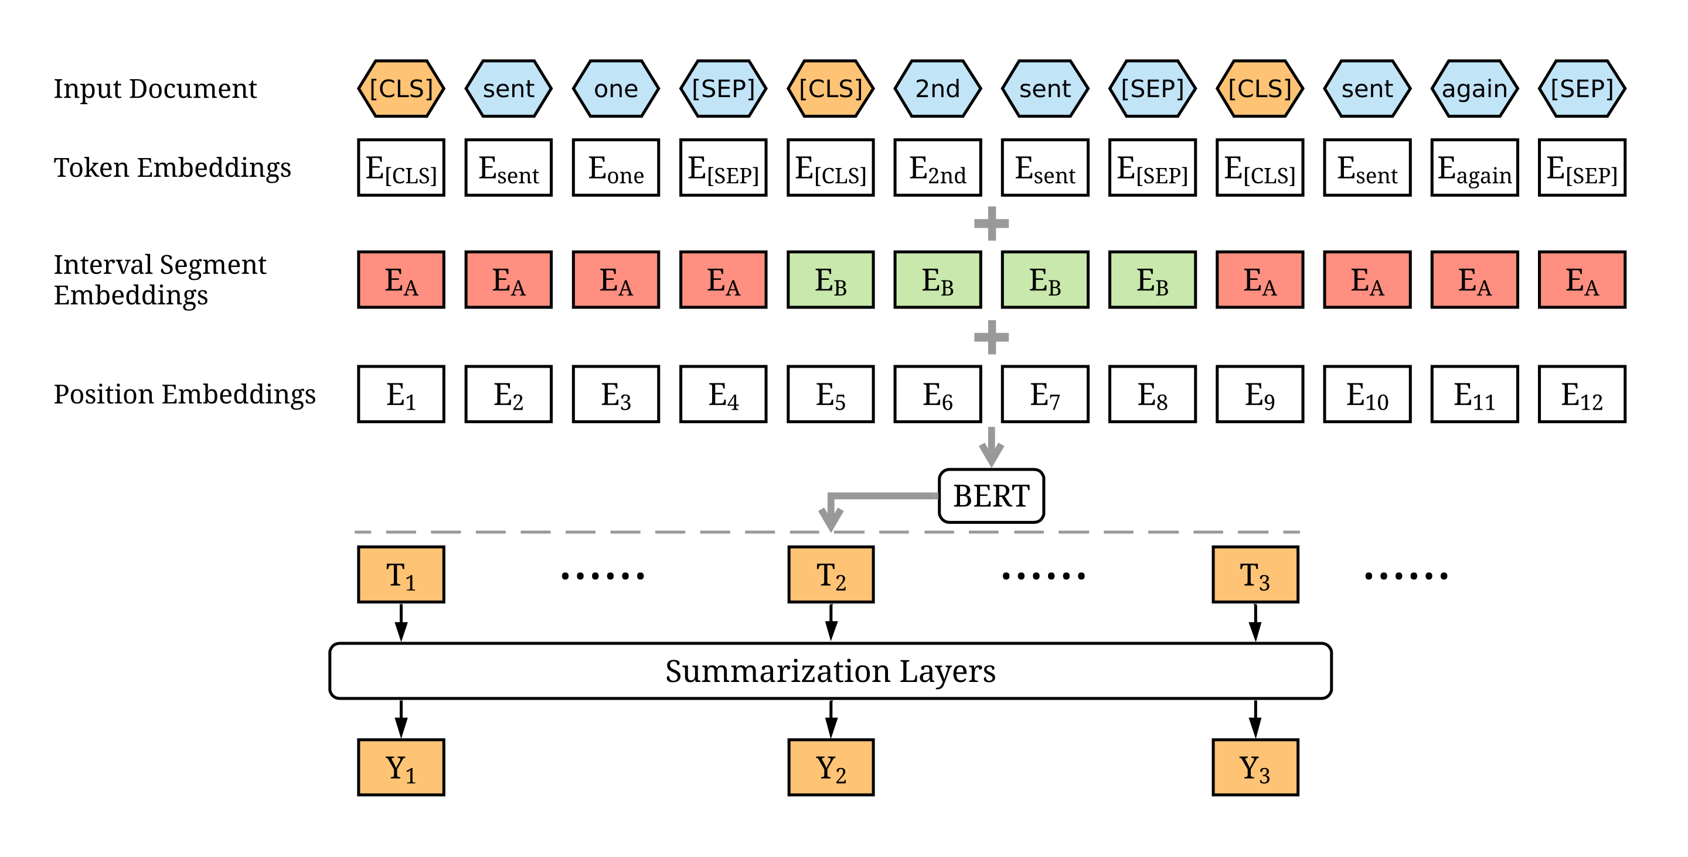
BERTSUM Method

Slide 6
ROUGE Evaluation Metric
Recall-Oriented Understudy for Gisting Evaluation
A common set of metrics based on n-gram overlaps used for evaluating text summarization systems.
ROUGE-N: N-gram Co-Occurrence Statistics (Assess Information)
ROUGE-1: unigram recall between a candidate summary and a reference summary
ROUGE-2: bigram recall between a candidate summary and a reference summary
ROUGE-L: Longest Common Subsequence (Assess Fluency)
the ratio of LCS between the candidate and reference summary to the total number of words in the reference summary

Slide 7
Datasets
CNN/DailyMail
Standard benchmark dataset for text summarization.
Collection of news articles and their associated highlights, i.e., a few bullet points giving a brief overview of the article.
Used the standard train/validation/test splits of Hermann et. al (2015).
Dataset | # Docs (Train/Val/Test) | Avg. Doc Length (words | sentences) | Avg. Summary Length (words | sentences)
CNN | 90,266 | 1,220 | 1,093 | 760.50 | 33.98 | 45.70 | 3.59
DailyMail | 196,961 | 12,148 | 10,397 | 653.33 | 29.33 | 54.65 | 3.86
Total | 287,227 | 13,368 | 11,490 | 706.91 | 31.65 | 50.17 | 3.72

Slide 8
Extractive Preprocessing
Clean and split sentences with the Stanford CoreNLP toolkit.
Insert external [CLS] tokens at the start of each sentence to represent individual sentences.
Use interval segment embeddings to distinguish multiple sentences within a document.
e.g. [1 1 1 1 1 1 1 1 0 0 0 0 0 0 0 0 1 1 1 1 1 1 1 1 0 0 0 0 0 0 0 0 ]
Necessary modifications for learning the document representations in a hierarchical manner.
Add extra [PAD] tokens if source tokens are less than the maximum source length.
Use BERT tokenizer to generate the token ids (512 tokens) but generate the necessary word and sentence masks manually.
Generate the sentence labels using a greedy algorithm, which maximize the ROUGE-2 score against the gold summary.

Slide 9
Extractive BERTSUM Model
BERTSUM
Segment IDs
Token IDs
BERT
Transformer Layers
Sentence 1
Sentence 2
Binary Labels
Sentence 3
Sentence N
Mask

Slide 10
Extractive BERTSUM with Keras
Implemented with Keras/TensorFlow.
Followed the same preprocessing steps as the BERTSUM paper, which was implemented in PyTorch.
Implemented the same model architecture with transformer layers to get the predicted binary sentence labels.
Trained with the almost the same hyperparameters and dataset.
Training converges after 2 epochs. Each epoch takes around 1.5 hours.
The best model weights are saved as checkpoints every epoch.
Trained in Google Colab Pro+ environment with NVIDIA V100 SXM2 data center GPU.

Slide 11




Training Environment

Slide 12
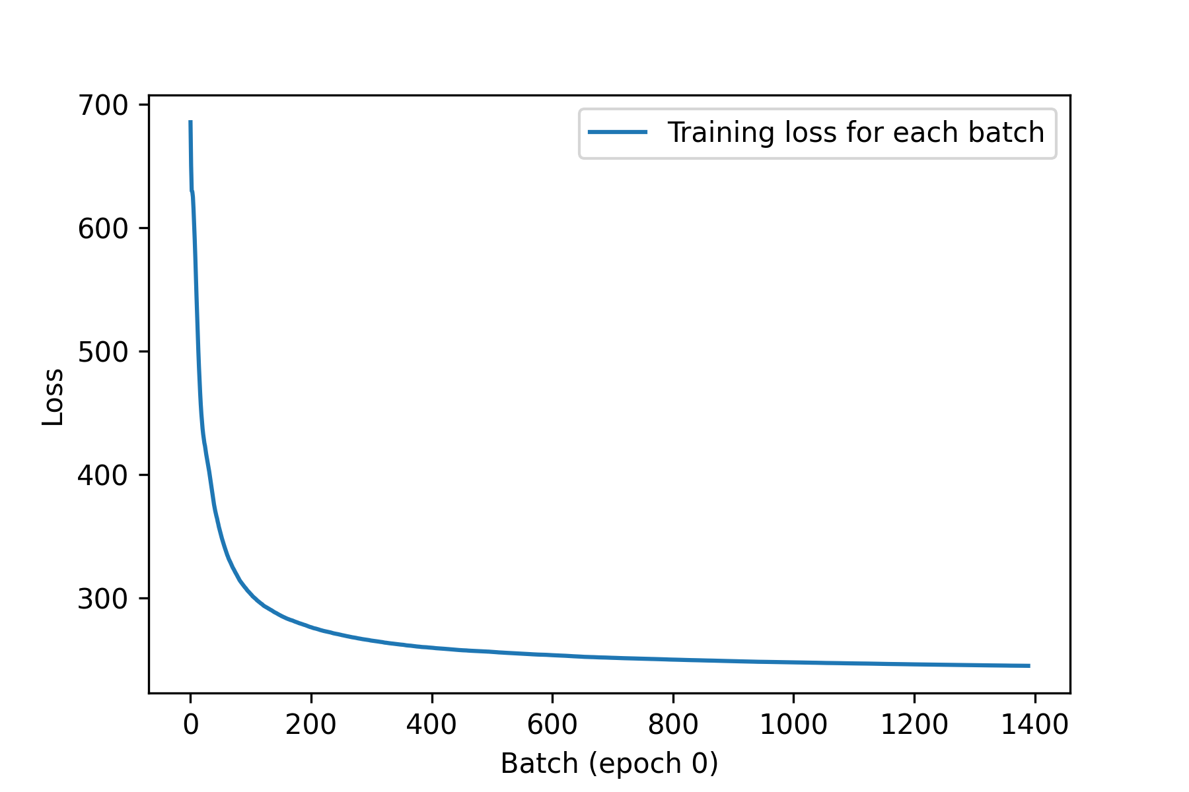
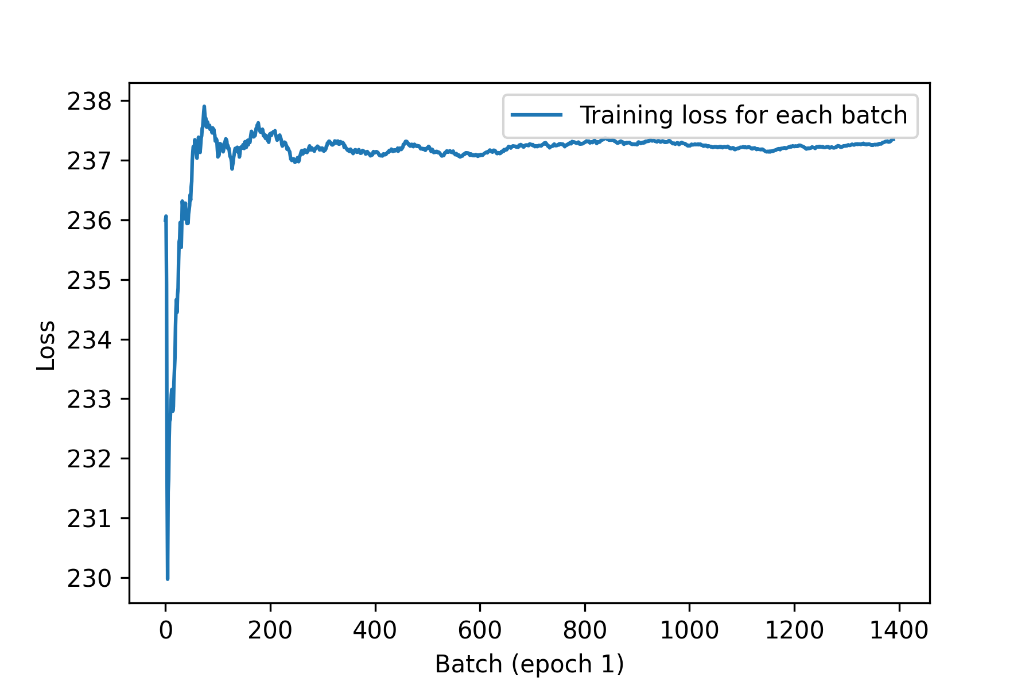
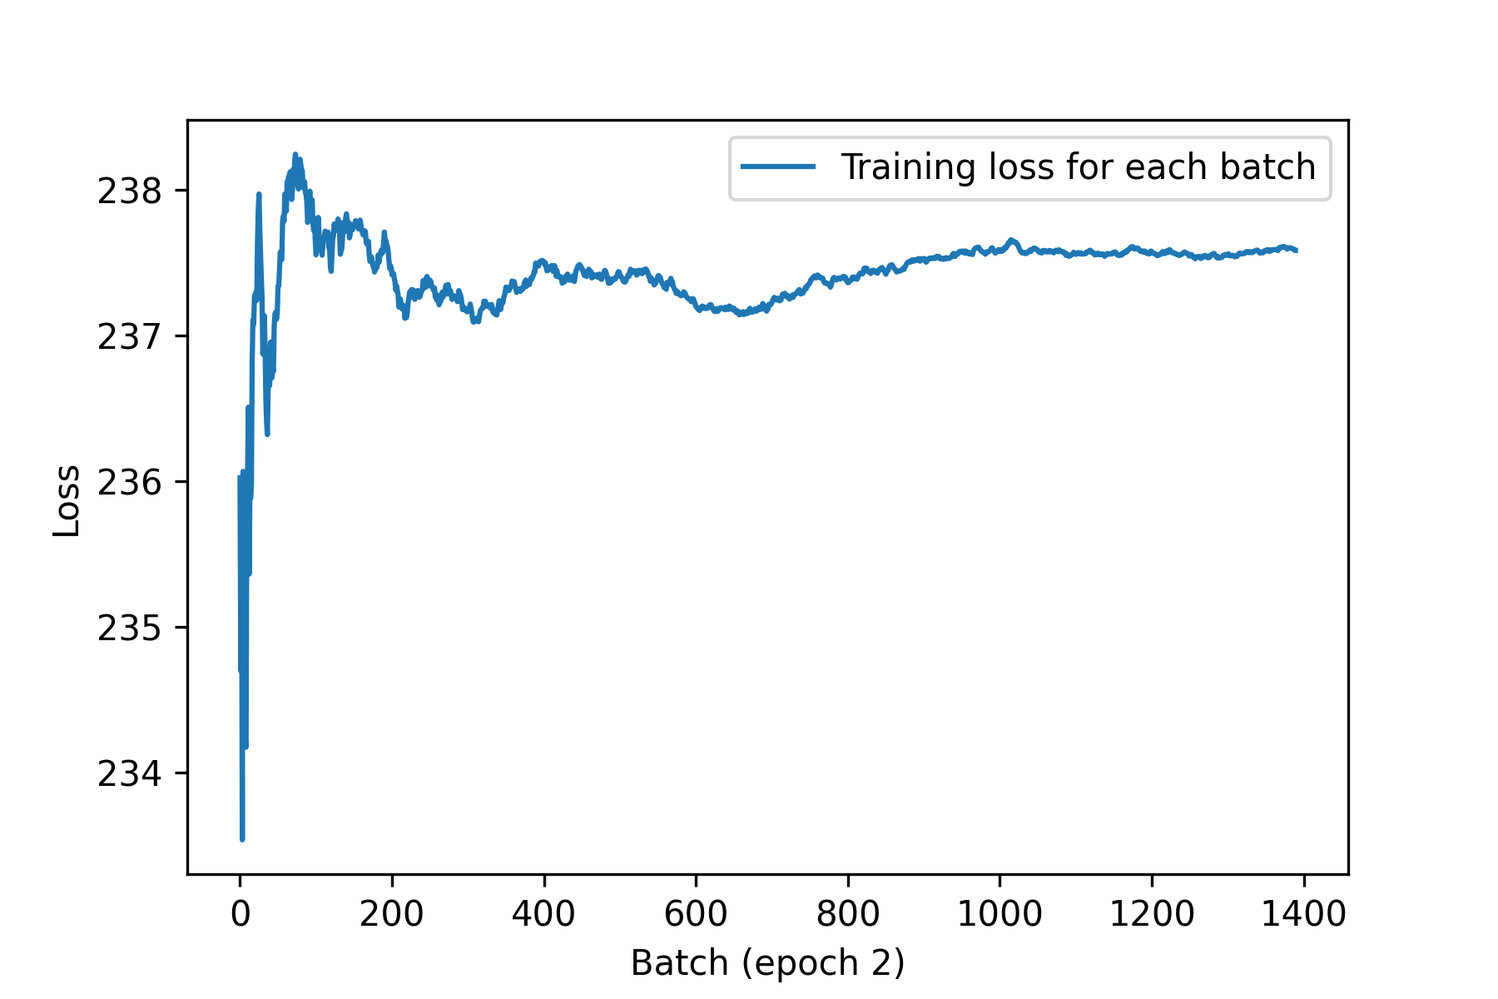
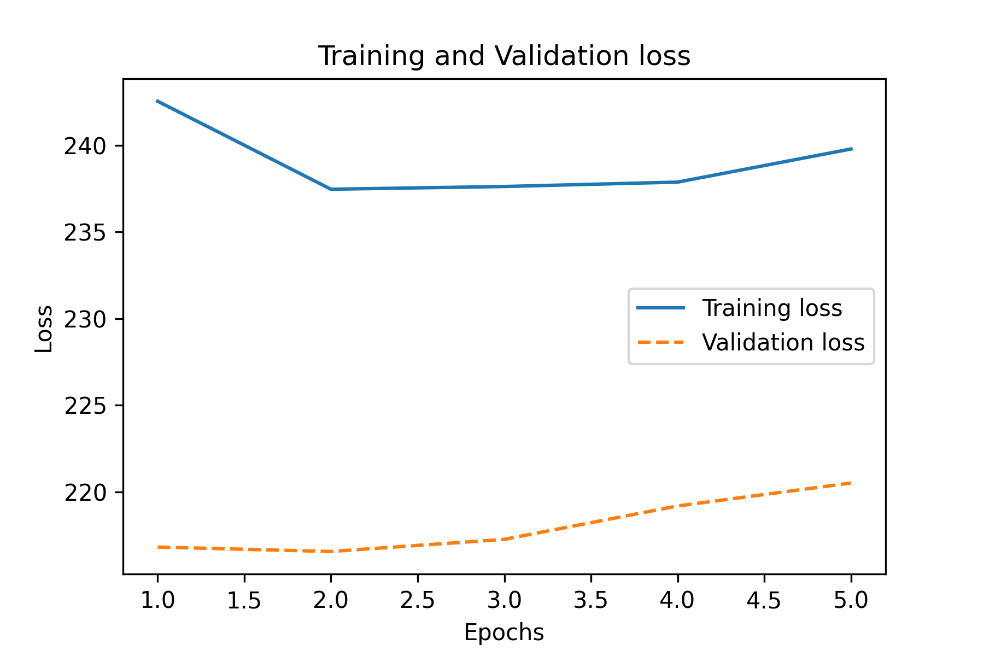
Training Loss: Extractive BERTSUM
Fig. Loss Comparison for Extractive BERTSUM with Keras

Slide 13
Results: Extractive BERTSUM
Model | R1 | R2 | RL
Oracle | 52.59 | 31.24 | 48.87
Oracle (pyrouge) | 50.81 | 28.73 | 47.09
Lead-3 | 40.42 | 17.62 | 36.67
SummaRunner | 39.60 | 16.20 | 35.30
Refresh | 40.00 | 18.20 | 36.60
Latent | 41.05 | 18.77 | 37.54
NeuSum | 41.59 | 19.01 | 37.98
Sumo | 41.00 | 18.40 | 37.20
TransformerExt | 40.90 | 18.02 | 37.17

Slide 14
Results: Extractive BERTSUM
BERTSUM with Keras | R1 | R2 | RL
ROUGE-F | 40.03 | 17.38 | 36.32
ROUGE-R | 51.37 | 22.40 | 46.57
BERTSUM (Fine-tuned Pretrained Weights) with Keras | R1 | R2 | RL
ROUGE-F | 32.59 | 11.56 | 29.42
ROUGE-R | 39.25 | 14.07 | 35.41
BERTSUM from Liu et al. | R1 | R2 | RL
ROUGE-F | 43.05 | 20.16 | 39.45
ROUGE-R | 53.38 | 24.96 | 48.85

Slide 15
Abstractive Preprocessing
Insert [START] and [END] special tokens at the start and end of the gold summaries.
Insert [SEP] tokens between the sentences for predicting the sentence boundaries.
Add extra [PAD] tokens if target tokens are less than the maximum target length; presented results are for the target length of 50.
Use BERT tokenizer to generate the token ids for the target summaries.

Slide 16
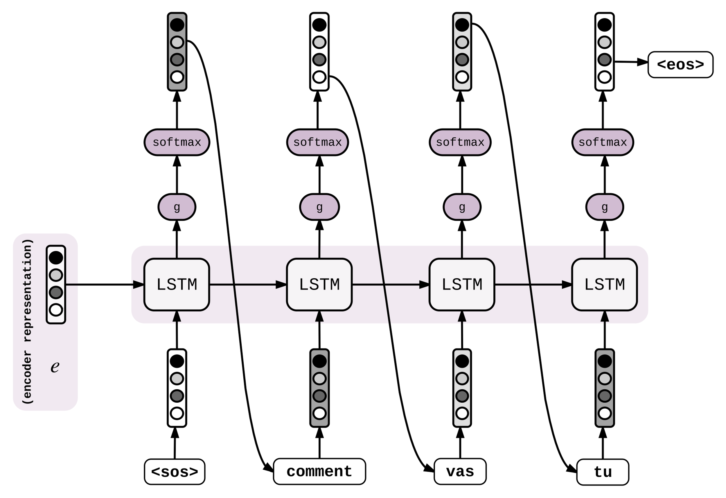
BERTSUM-RNN Sequence-to-Sequence Model
BERTSUM
Segment IDs
Token IDs
BERT
Mask
Encoder
Decoder

Slide 17
Abstractive BERTSUM with Attentional RNNs
Use BERTSUM as the encoder and RNNs as the decoder with neural attention.
During training and inference, feed the source token ids, segment ids and token mask into the encoder.
Feed the outputs (last hidden state) from the BERTSUM encoder into the attentional RNN decoder.
During training, feed all the target token ids except the last token — [END] — as inputs into the decoder. The outputs would be the target token ids shifted one timestep ahead of the inputs.

Slide 18
Abstractive BERTSUM with Attentional RNNs
During inference, feed the [START] token as the initial token to start generating the summary. Stop at the [END] token or max target length.
At each time-step the decoder's output is combined with a weighted sum over the encoded input, to predict the next word.
Tried out two implementations of neural attention:
TensorFlow add-ons API (2.5 hours / epoch)
TensorFlow sample tutorial (1.5 hours / epoch)
Tried out greedy search and beam search decoding for generating abstractive summary with little success.
Greedy search decoding ⇒ suboptimal solution but computationally inexpensive
Beam search decoding ⇒ globally optimal solution but computationally expensive

Slide 19
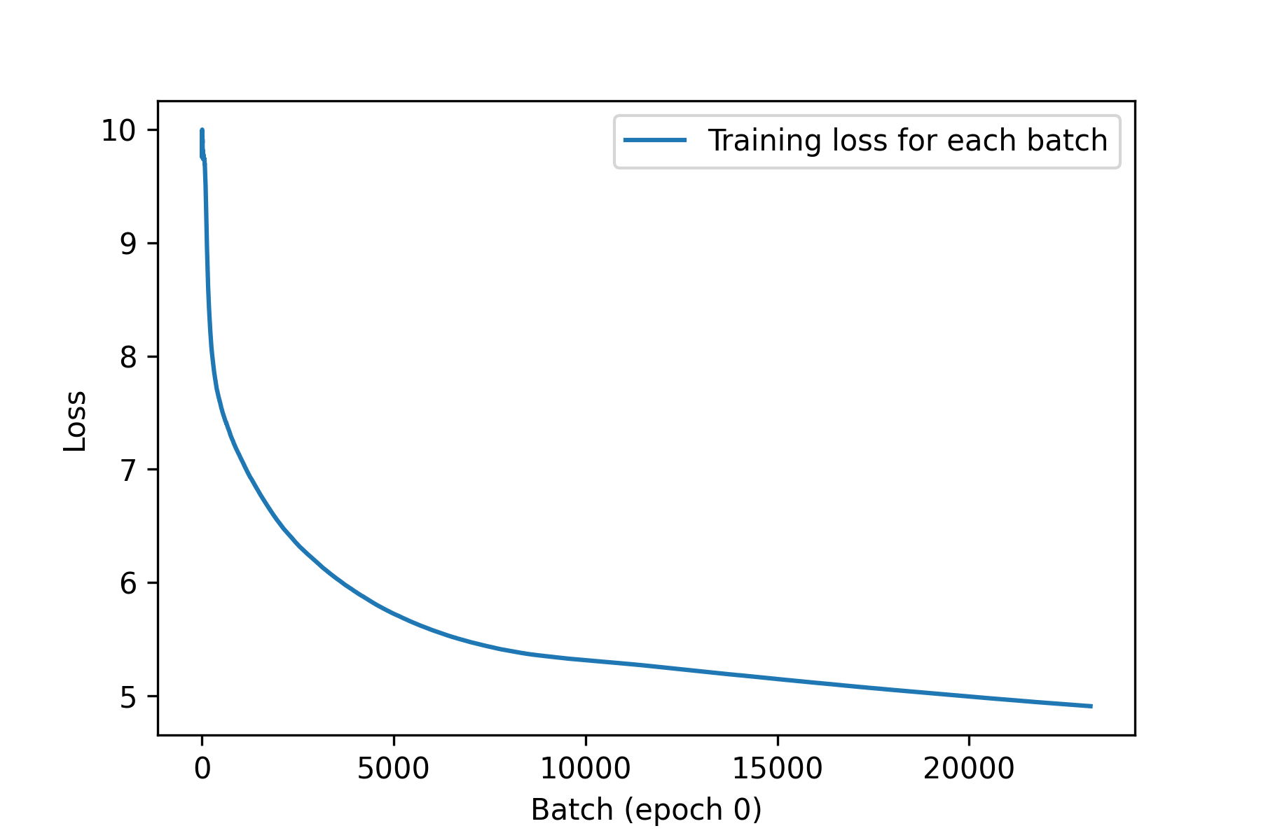
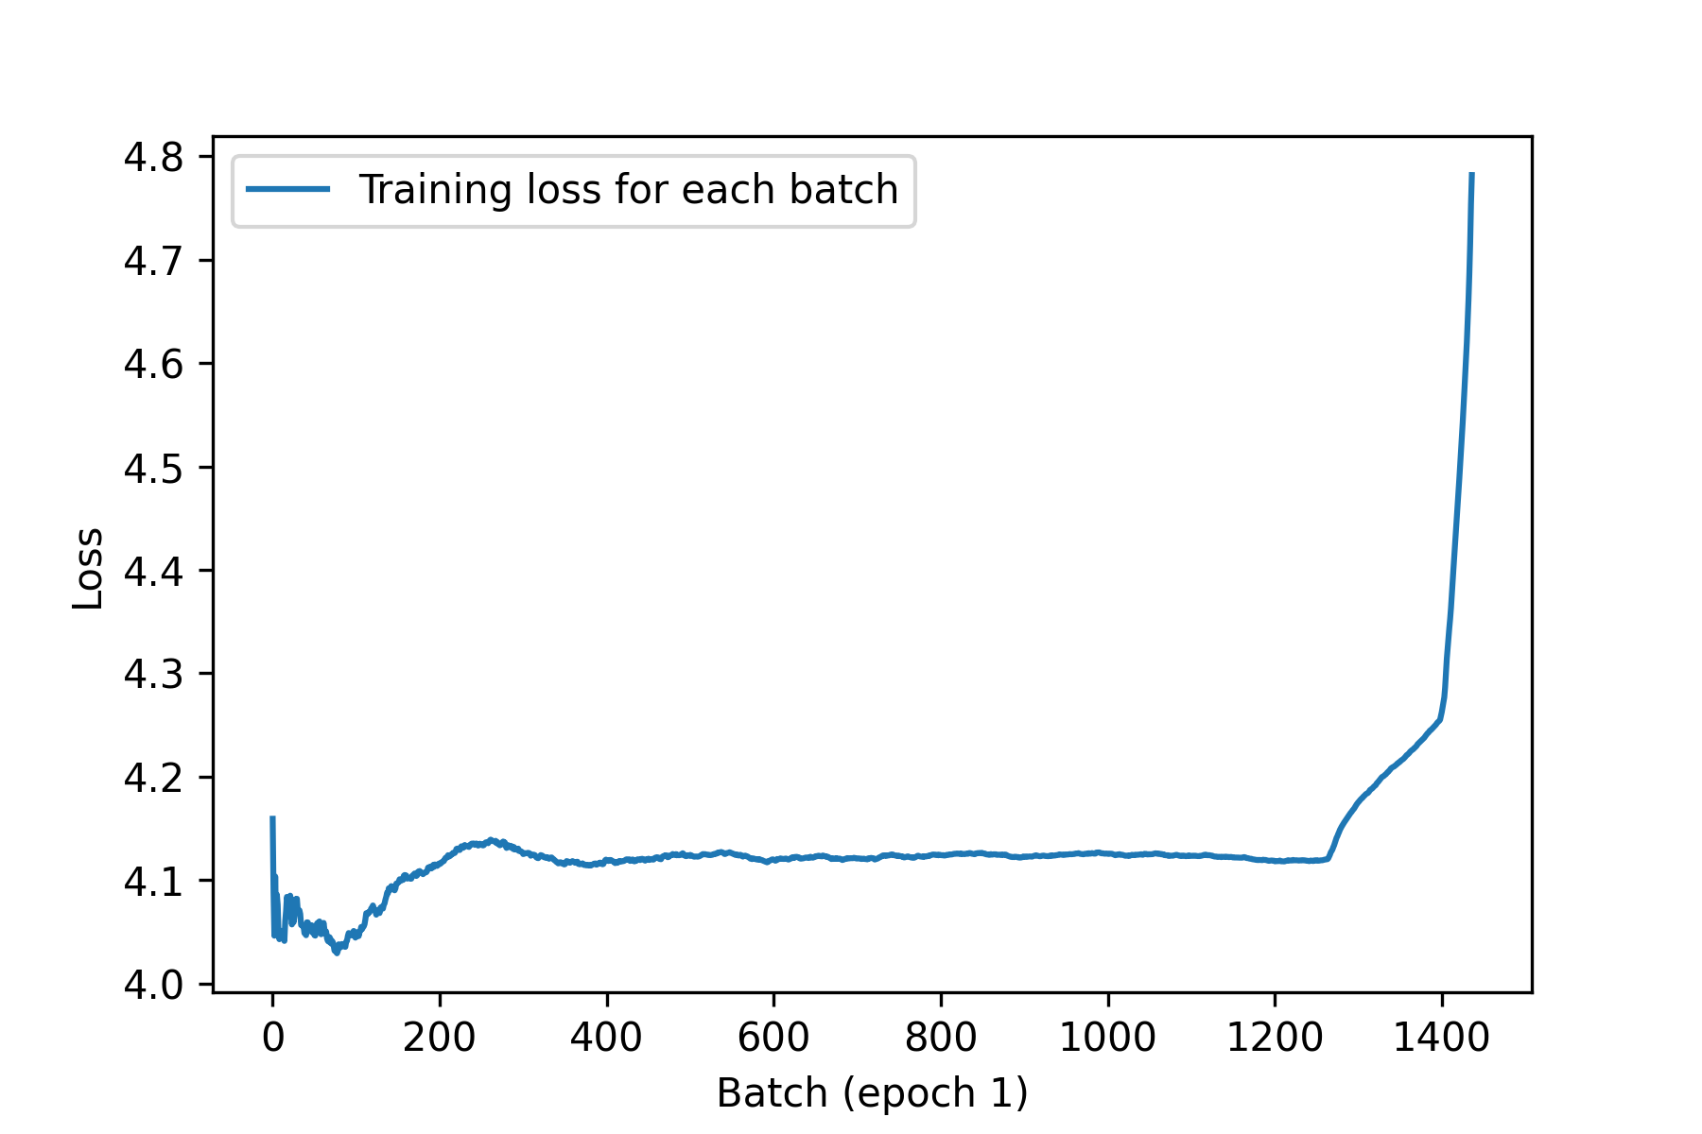
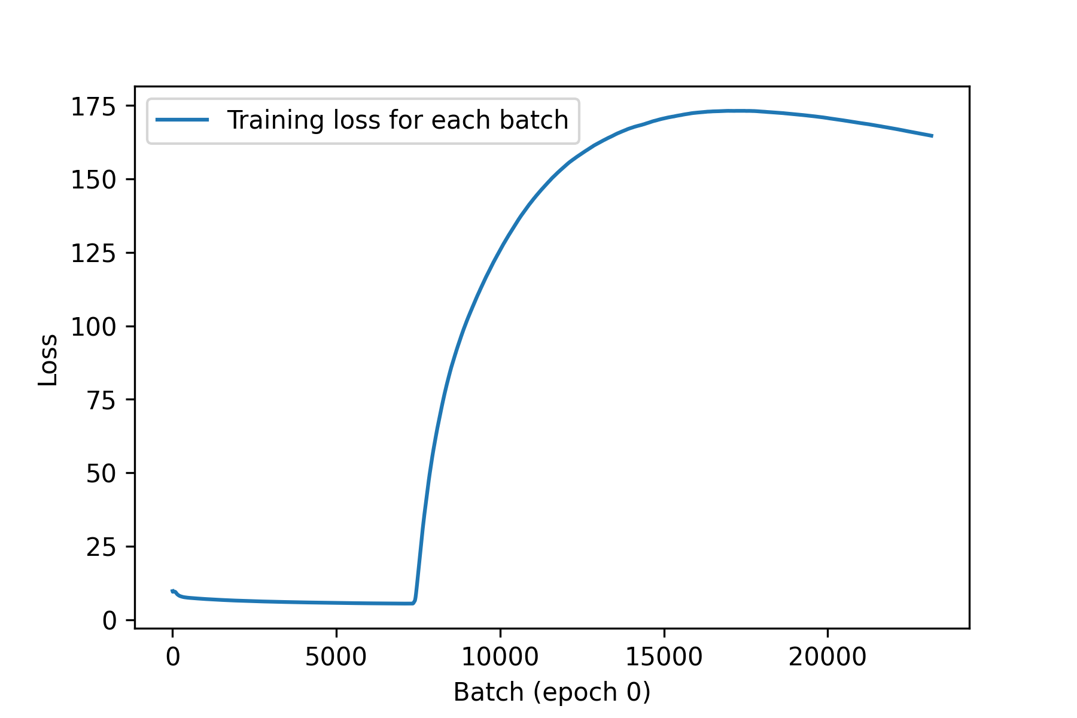
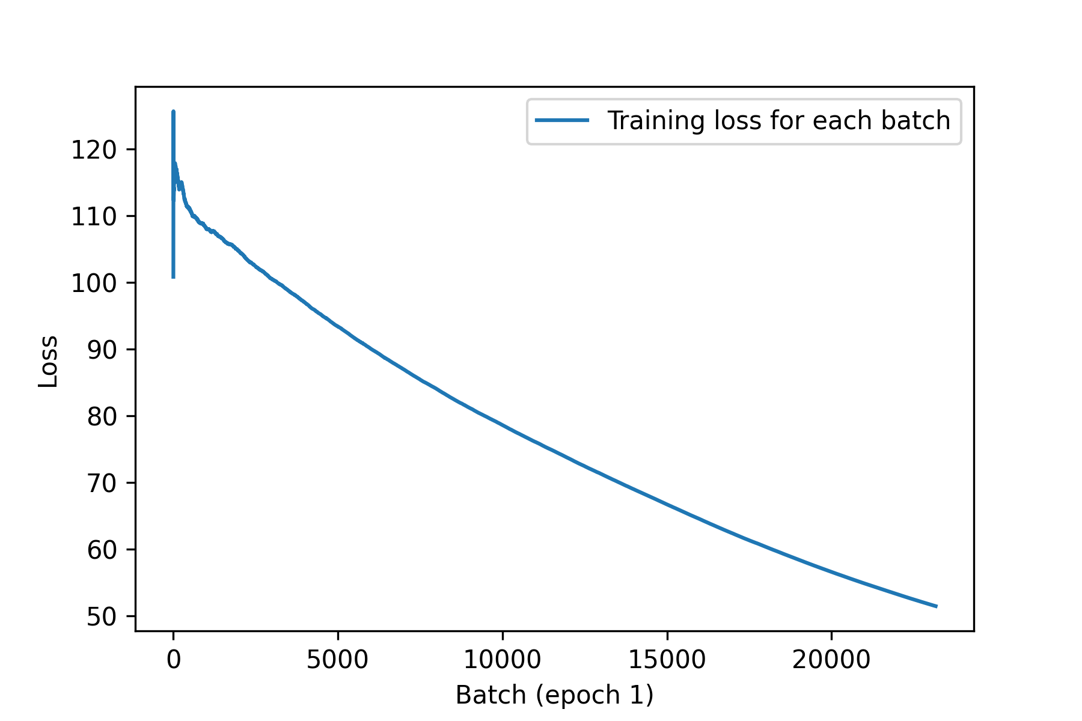
Training Loss: BERTSUM-RNN
Fig. Training Comparison for Neural Attention using TensorFlow
Add-ons
(a) Initial Hidden State: Zero Initialized
(b) Initial Hidden State: Pooler outputs from the BERTSUM Encoder

Slide 20
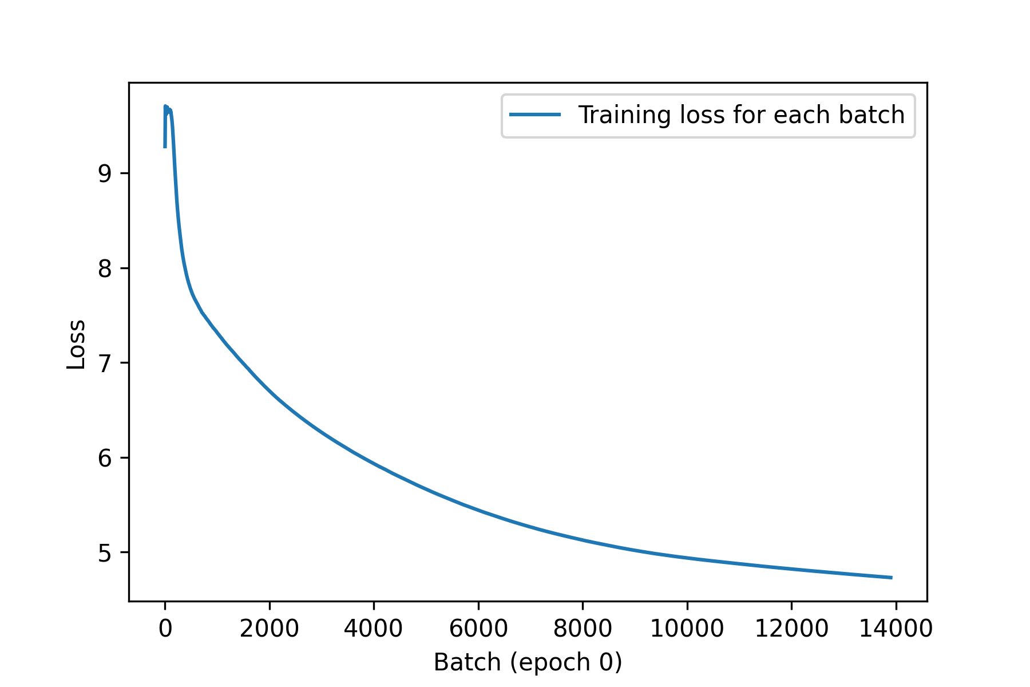
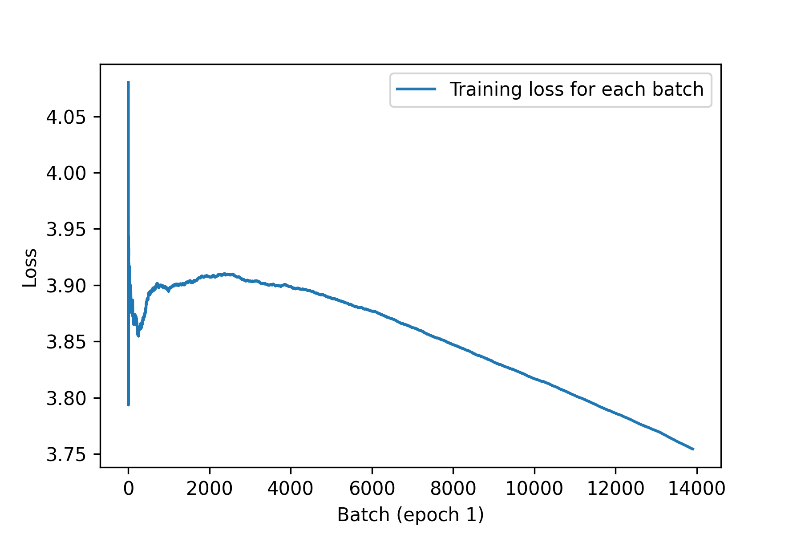
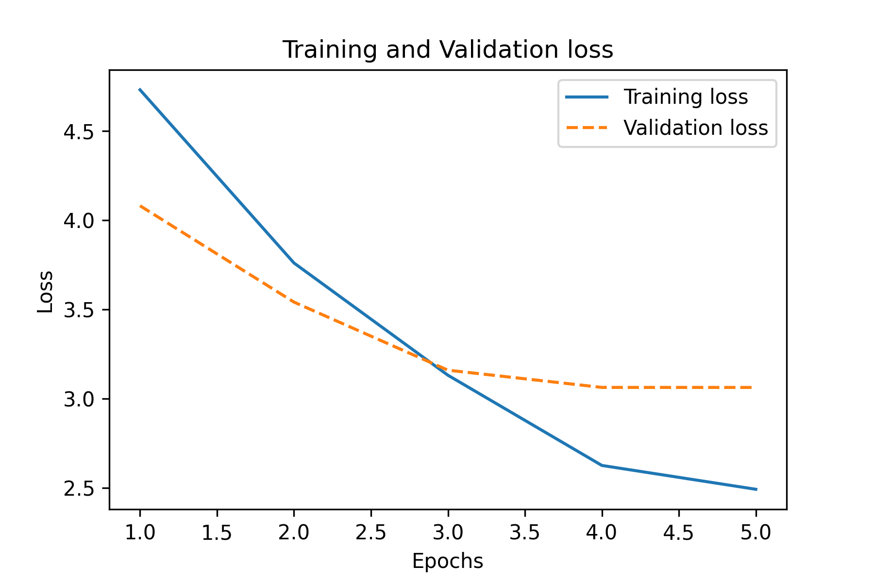
Training Loss: BERTSUM-RNN
Fig. Training Comparison for Neural Attention using TensorFlow sample tutorial

Slide 21
Results: Reference Summary
mammoth bones found in russia suggest new theory for their demise<q>a major mineral deficiency was found in the 23,500-year-old bones<q>suggest mammoths may have been riddled with osteoporosis<q>animals would have eventually collapsed to the ground under own weight
trey moses , a kentucky high school student who has committed to ball state next year , surprised ellie meredith during her p.e. class on thursday<q>he asked her to prom with flowers and a sign reading : ` let 's party like it 's 1989 ' - a reference to an album by taylor swift , ellie 's favorite singer<q>she accepted and is now looking forward to going dress shopping<q>moses works with teenagers with developmental disabilities through a volunteer program in louisville
lihi yona filmed the black lab at a public play area in brooklyn , new york , over the weekend<q>after almost a minute the dog shows no sign of slowing down and he continues to bounce around
win a pair of nike magista obra boots signed by city and england no1<q>prize winner will receive band new gillette fusion proglide razor worth # 12<q>and we 'll also throw in some fusion proglide shave gel worth # 4.99<q>click here to enter the competition
luis suarez scored twice in barcelona 's 3-1 win over psg on wednesday<q>uruguay international posed with team-mate lionel messi after victory<q>barcelona have now scored 1,001 goals in european competition

Slide 22
Results: Candidate Summary
the skeleton of the bones had been found out of the ancient ancient species of the ancient <q> the skeleton was found in the region of the region of the region of the region <q> the skeleton was found in the region of the region of the
trey moses, who was ` the top of the prom ', ` she can't wait to prom <q> the song was ` the'of the club, the girl, the girl, says she was ` [unused1]'<q> the [unused1] was ` [unused1]'[unused1] [unused1] [unused1] [unused1] [unused1] [unused1] [unused1]
lihi yona filmed the dog in the air in brooklyn <q> the dog was filmed by the dog in the air [unused1] <q> the dog was filmed by the dog and the dog
sportsmail will receive nike nike nike nike nike nike nike nike nike nike nike nike nike nike nike nike nike nike nike nike nike nike nike nike nike nike joe hart <q> the winner will receive nike nike nike nike nike nike nike nike nike nike nike <q> the winner will receive nike nike nike nike nike
luis suarez scored twice as barcelona's first of the world's top of the club <q> luis suarez scored twice as barcelona's top of the club's top of the match <q> luis suarez scored twice as he crossed the club's 2 - 1 win

Slide 23
Challenges
More challenging than I originally thought in terms of the scope.
Diving deep beyond the Functional APIs provided by Keras.
Striking the right balance between leveraging the existing high-level APIs and having more flexibility in implementing models.
Dealing with unstable training and running out-of-memory issues.
Getting pyrouge library to work in Google Colab was tricky.

Slide 24
Conclusion
Extractive BERTSUM with Keras doesn’t achieve the same ROUGE scores as the paper. This is most likely due to the ROUGE library differences, ML framework differences (TensorFlow & PyTorch) and loss optimization tricks employed by the author.
Abstractive BERTSUM-RNN was tricky to connect everything together. Tried out two different implementations of neural attention: TensorFlow sample tutorial and TensorFlow add-ons API.
Training loss was unstable across epochs using the TensorFlow add-ons API.
Training loss was stable across epochs using the TensorFlow sample tutorial.
Limited success in abstractive summarization. However, more loss and memory optimization necessary.

Slide 25
Thank You!

