Slide 1
Capstone Presentation

Slide 2
Best place to open new restaurant in Toronto
Project plan
Gather the data on the Postal Codes
Merge with the geo spatial data
Run K-means clustering to split the data into clusters
Find the best cluster, that is suitable to open new business

Slide 3
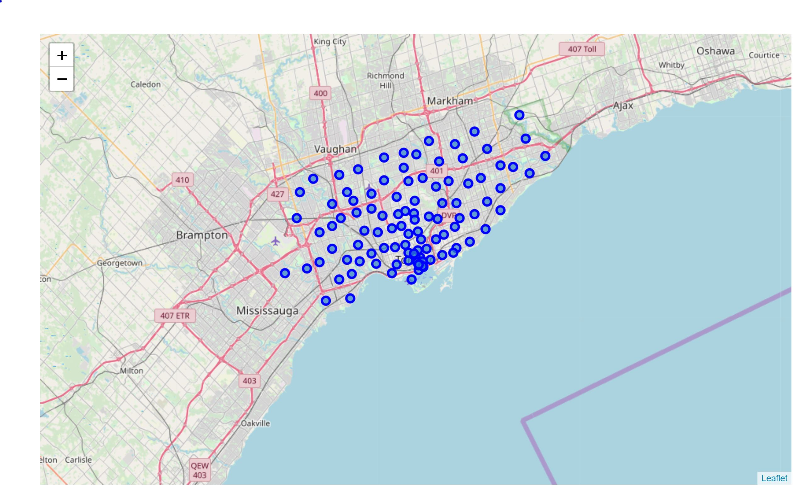
Toronto neighborhoods viz

Slide 4
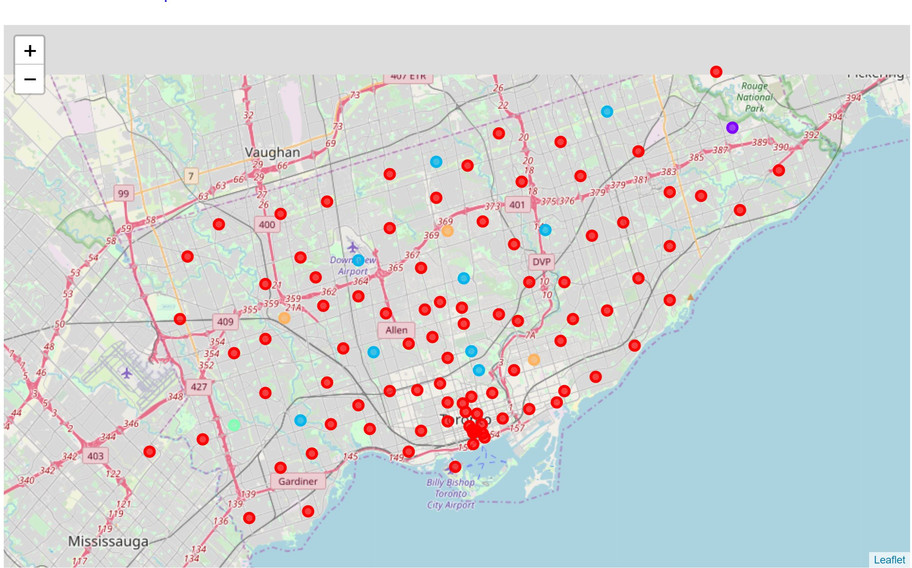
Toronto neighborhood clusters viz
Our bad boy right here

