Slide 1
Interacting modules and their control principals

Slide 2
Outline
Biological networks are modular, but can this modularity meaningfully sustain in large networks and help predict the behavior of the phentoypic landscape?
Recently, Regan’s group built a collection of GRNs underlying EMT that explain this

Slide 3
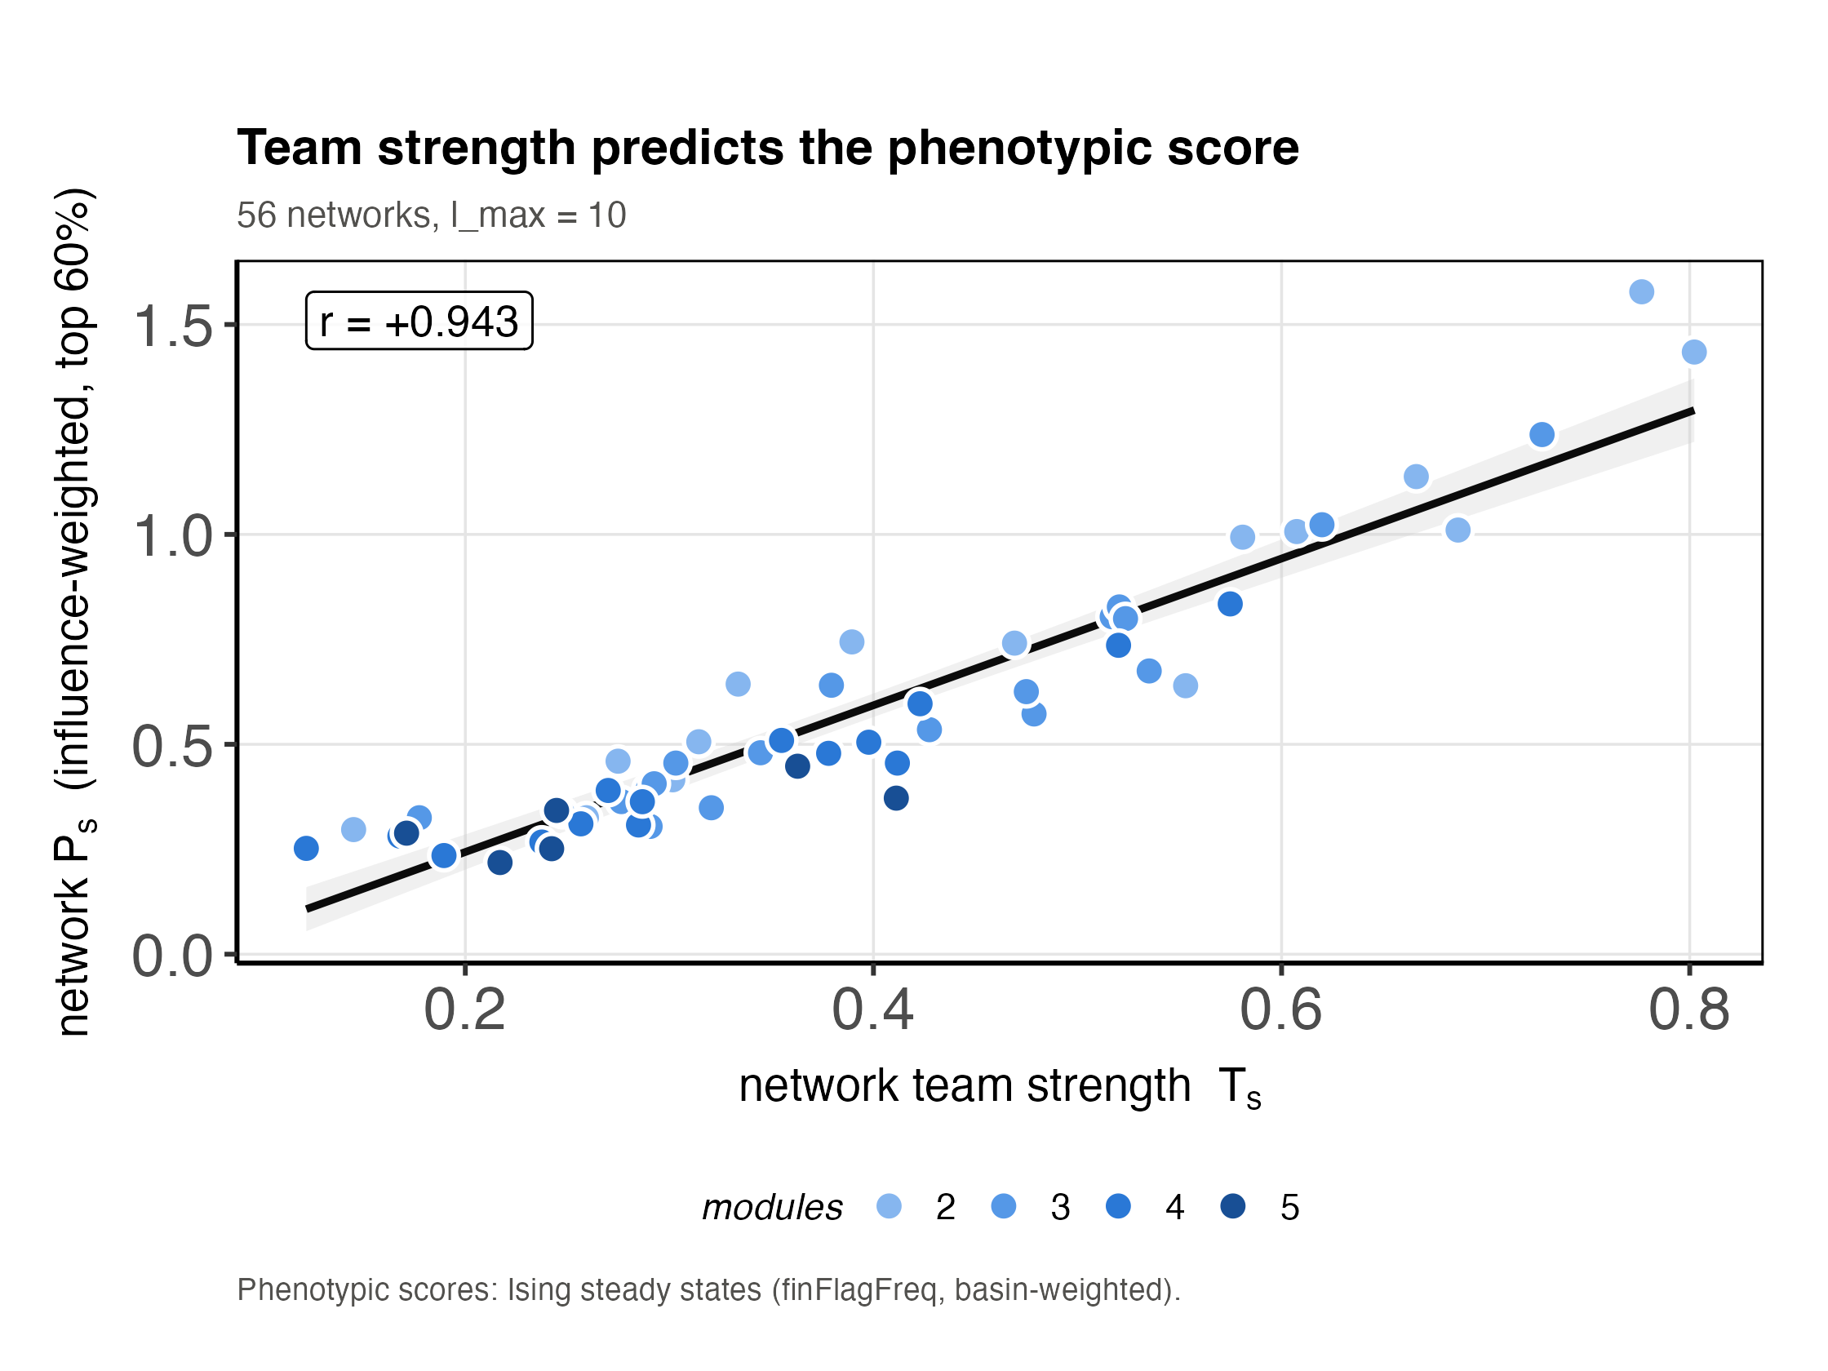
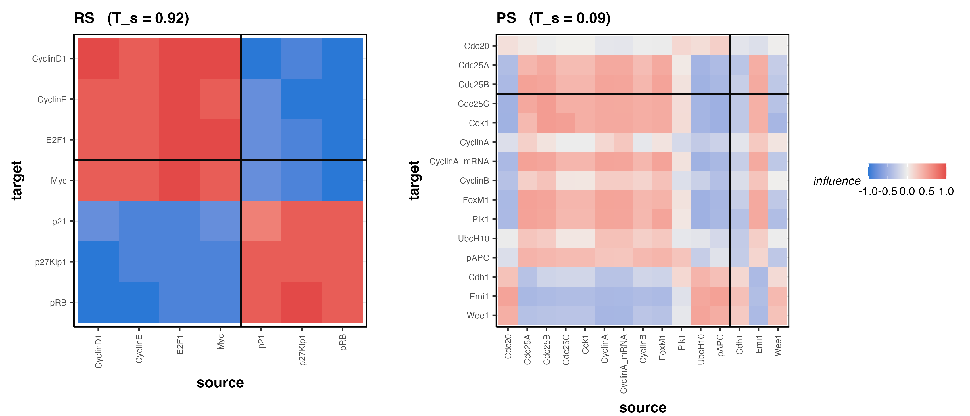
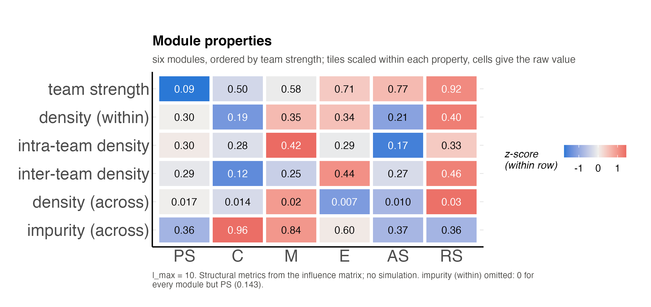
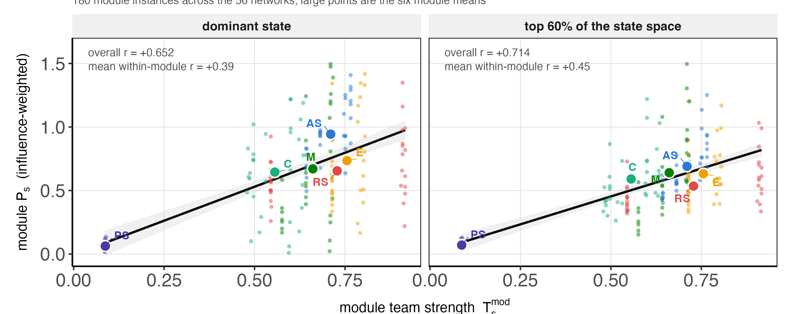
Figure 1 – Team strength is a good predictor of phenotypic outcome

Slide 4
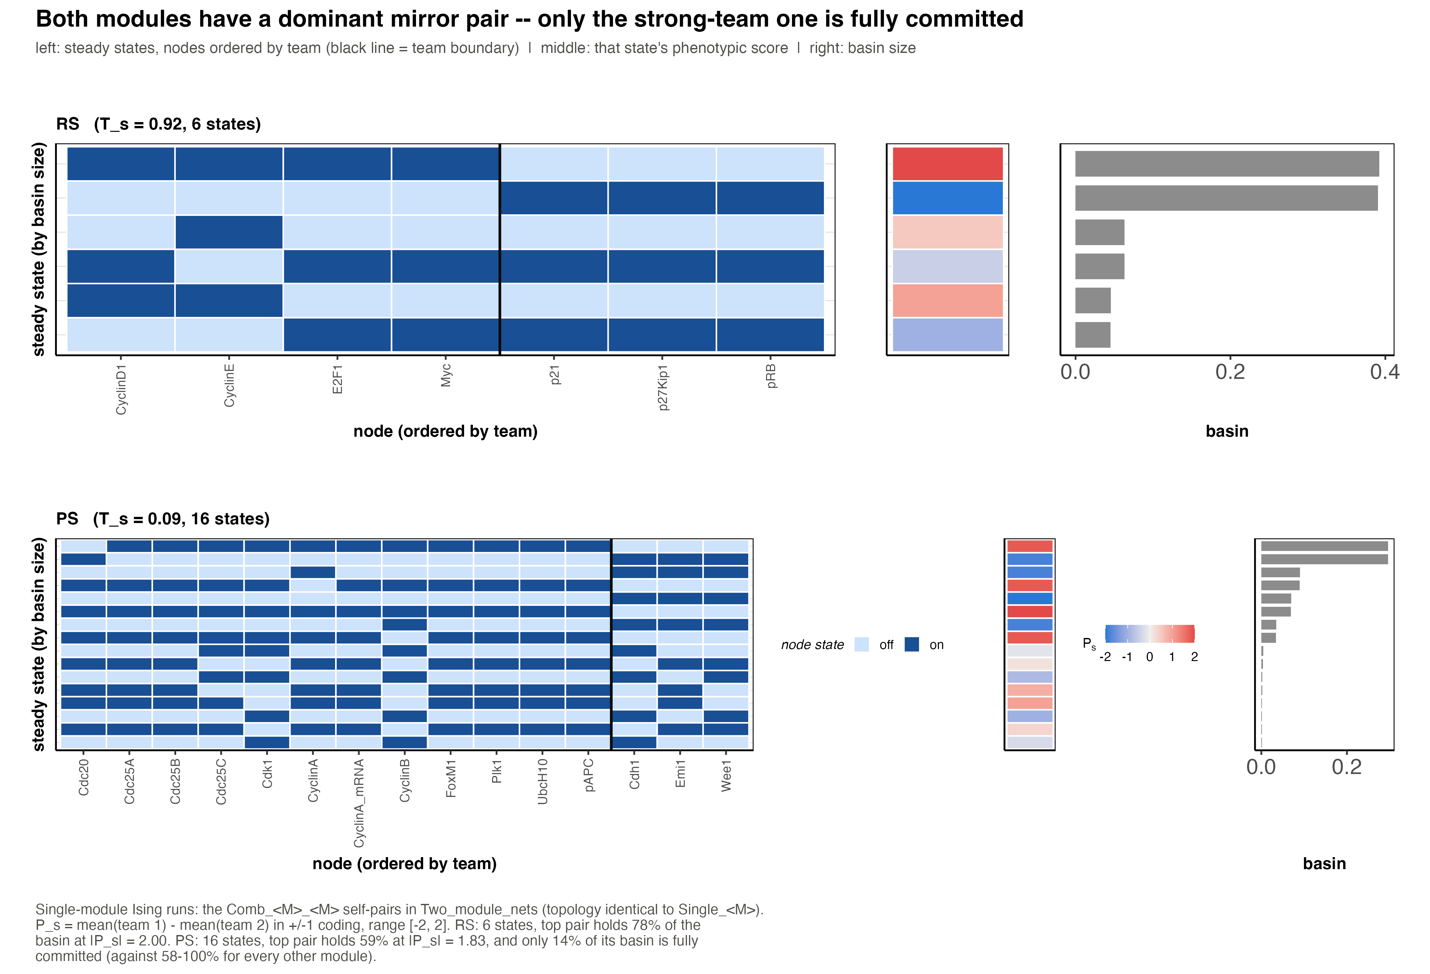
Figure S1

