Slide 1
Stochastic modeling of GAL system in Saccharomyces cerevisiae
H A S Shri Kishore

Slide 2
Outline
Objective
Stochasticity
Modeling
GAL system
Approaches
Results
References

Slide 3
Objective
To build a stochastic model for GAL system and reproduce the experimental data.
Understand the system at molecular level.
Identify effect of various parameters on system characterstics

Slide 4
Stochasticity
Omnipresent
Randomness driven by event probabilities.
Noise
Prominent in microsystems
Collision theory of chemical reactions

Slide 5
Monte-carlo simulation

Slide 6
Stochastic vs Deterministic modeling

Slide 7
Other models
Importance sampling- calculating all the energies is cumbersome. Hence random sampling.

Slide 8
The GAL system
The enzymes of leloir pathway + regulatory proteins
Structural proteins: Gal1p, Gal2p, Gal5p, Gal7p, Gal10p
Regulatory proteins: Gal3p, Gal4p, Gal80p
Except for Gal5p, all these proteins are regulated by galactose.

Slide 9
The Leloir pathway
Gal10p
Gal1p
β-gal
α-gal
gal-1-P
+
UDP-glu
Gal7p
Gal10p
GAL Regulation
UDP-gal
+
glu-1-P
Gal5p
Glycolysis
glu-6-P

Slide 10
The regulatory network
gal
Gal2p
gal
Gal1p*
Gal1p
Gal3p*
Gal3p
Gal80p
P_{GAL80}
GAL80
Gal4p
P_{GAL3}
GAL3
Leloir Pathway
Galactose
Glu-1-P
P_{GAL2}
Gal1p
Gal7p
Gal10p
GAL2
GAL7
GAL10
P_{GAL1-10}
GAL1

Slide 11
Sugar dependent regulation
Sugar | Gal1p | Gal3p | Gal4p | Gal80p
Galactose | ++++ | +++ | + | +++
Glycerol | - | + | + | ++
Glucose | --- | - | - | +
Low basal expression (+), High basal expression(++), Induction(+++), Rapid induction(++++), supression(-) and rapid supression(---)

Slide 12
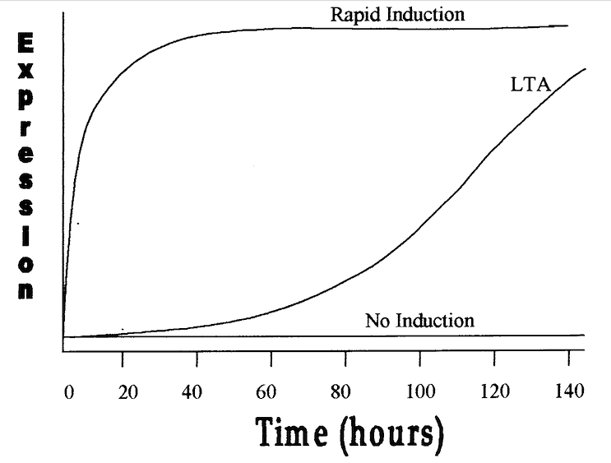
Long-term adaptation
gal3 strain shows induction after long time. Double mutants don’t.
Reasons: ~3/1000 cells have Gal1p. Gal80p bifurcation during replication.

Slide 13
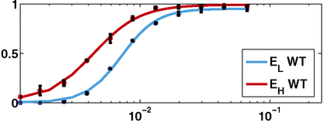
Hysteresis
Response dependance on the previous growth sugar.
An underlying bistability is observed.
E_{H –} galactose hystory
E_{L –} No galactose hystory
Normalized expression levels
Galactose concentration(%)

Slide 14
The Venturelli model

