Slide 1
Pointers
int x = 5;
int y = 7;
int *p, *q;
Set the integers x to 5 and y to 7
Create the integer pointer variables p and q
p = &x;
Set the pointer p to the address of x
q = p;
Set the pointer q to the same address p contains
x
5
y
7
p
*
q
*

Slide 2
Pointer Dereferencing
*p = 9;
Set the value at the address pointed to by p to 9
y = *q;
Set y to the value at the address pointed to by q
x
5
9
y
7
9
p
*
q
*

Slide 3
Pointer Arithmetic
int *p, *q;
char *cp,*cq;
p = q + 2;
Set pointer p to 2 ints beyond the address in q
cp = cq + 3;
Set the pointer cp to 3 chars beyond the address in cq
The meaning of the arithmetic depends on the type of the pointer

Slide 4
Pointer vs. Array Syntax
int xarr[5];
Declaring the array xarr is very much like creating an integer pointer xarr, that points to the first of 5 contiguous integer-sized slots in memory. However, unlike a pointer, xarr cannot be changed.
xarr[1] = 8;
Think: put the value 8 into slot 1 of the array xarr
*(xarr+3) = 7;
Think: put the value 7 into the memory address that is 3 integer-sized slots past the address contained in xarr
0 1 2 3 4
xarr
*
8
7

Slide 5
Pointers and Arrays
Equivalent:
void encrypt( FILE *fin, FILE *fout,
char keyenc[], char pass[] );
void encrypt( FILE *fin, FILE *fout,
char *keyenc, char *pass );
Also equivalent:
char str[] = “Hello”;
char *str = “Hello”;

Slide 6
Pointer vs. Array Syntax
int xarr[5];
int *p;
int i = 0;
for ( i = 0, p = xarr; i < 5; i++, p++ )
*p = 4;
for ( i = 0; i < 5; i++ )
xarr[i] = 3;
for ( i = 0; i < 5; i++ )
*(xarr+i) = 2;
xarr
*
0 1 2 3 4
i
5
0
1
2
3
4
3
2
3
2
3
2
4
4
3
4
4
2
3
2
4
p
*

Slide 7
Dynamic Memory Allocation: Why?
Static memory allocation
Must know how much space you need at the time you write the program
Data structures like arrays are difficult to update
struct contact {
char name[64];
char address[64];
char mobile_phone[12];
// more data …
}
struct contact friends[???];

Slide 8
Allocating memory
void *malloc(size_t size);
Returns pointer to newly allocated size bytes
void *calloc(size_t n, size_t size);
Returns pointer to an array of n elements of size size
void free(void *ptr);
Takes a pointer to previously allocated space and deallocates it (returns it back to the OS)

Slide 9
malloc
typedef struct vitals
{
int height;
int weight;
} VITALS;
VITALS *p;
p = (VITALS *) malloc( sizeof(VITALS) );
p->height = 68;
p->weight = 160;
68
160
p
*

Slide 10
calloc
typedef struct vitals
{
int height;
int weight;
} VITALS;
VITALS *p;
p = (VITALS *) calloc( 4, sizeof(VITALS) );
p[1].height = 68;
p[1].weight = 160;
68
160
p
*

Slide 11
free
typedef struct vitals
{
int height;
int weight;
} VITALS;
VITALS *p;
p = (VITALS *) calloc( 4, sizeof(VITALS) );
p[1].height = 68;
p[1].weight = 160;
free( p );
68
160
p
*

Slide 12
Illegal memory access
typedef struct vitals
{
int height;
int weight;
} VITALS;
VITALS v[4];
v[1].height = 68;
v[1].weight = 160;
v[4].height = 72;
68
160
v
*
72

Slide 13
Stack and Heap memory
Stack
Area of memory for local variables
Memory allocated for local variables only stays allocated during the time their scope is active.
Implemented as a stack data structure (LIFO)
Heap
Area of memory for dynamic allocation
Memory remains allocated for the duration of the program, or until it is explicitly freed

Slide 14
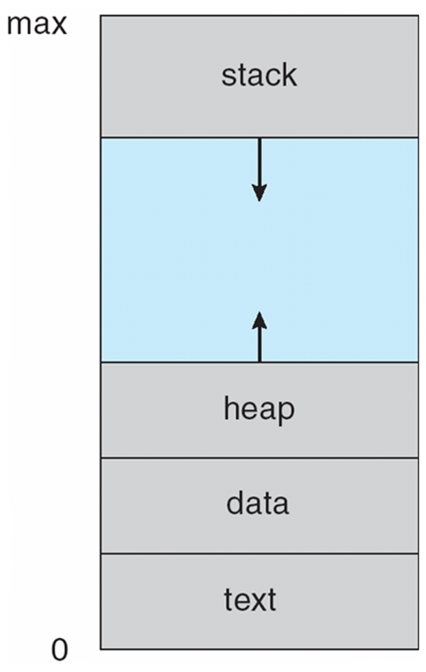
A Process in Memory
* Silberschatz, Galvin & Gagne, Operating Systems Concepts

Slide 15
Example
int main()
{
int x = 5;
int *p = &x;
int *q = (int *)
malloc(sizeof(int));
*q = f1( x, p );
}
int f1( int a, int *b )
{
int c = 3;
*b = c + a;
return c;
}
Stack
Heap
x
8
5
3
p
*
q
*
a
5
b
*
c
3

Slide 16
Example: pass by value
int main()
{
int x = 5;
int *p = &x;
int *q = (int *)
malloc(sizeof(int));
*q = f1( x, p );
}
int f1( int a, int *b )
{
int c = a*a;
b = &c;
a = 9;
return a*2;
}
Stack
Heap
x
5
18
p
*
q
*
a
9
5
b
*
c
25

Slide 17
Example: memory leak
int main()
{
int x = 5;
int *p = &x;
int *q = (int *)
malloc(sizeof(int));
*q = f1( x, p );
}
int f1( int a, int *b )
{
int c = 12;
b = (int *)
malloc(sizeof(int));
*b = c;
return c*2;
}
Stack
Heap
x
5
24
p
*
q
*
a
5
12
b
*
c
12

Slide 18
Example: pointer to pointer
int main()
{
int x = 5;
int *p = &x;
int *q = (int *)
malloc(sizeof(int));
*q = f1( x, &p );
}
int f1( int a, int **b )
{
int c = 12;
*b = (int *)
malloc(sizeof(int));
**b = c;
return c*2;
}
Stack
Heap
x
5
24
p
*
q
*
a
5
12
b
*
c
12

Slide 19
Example: stack memory
int main()
{
int x = 5;
int *p = &x;
int *q = (int *)
malloc(sizeof(int));
*q = f1( x, &p );
}
int f1( int a, int **b )
{
int c = 12;
*b = &c;
**b = 14;
return c*2;
}
Stack
Heap
x
5
24
p
*
q
*
a
5
b
*
14
14
c
12

Slide 20
heapoverflow.c
#include <stdio.h>
#include <stdlib.h>
int main(){
int i;
char *p;
for ( i = 0; i < 10000000; i++ )
{
printf( "%d\n", i );
p = (char *) malloc( 1024*1024 );
}
}

Slide 21
stackoverflow.c
#include <stdio.h>
#include <stdlib.h>
void recurse_func( int i );
int main(){
recurse_func(0);
}
void recurse_func( int i ){
char buf[2048];
printf( "%d\n", i );
if ( i > 500000 )
return;
else
recurse_func( ++i );
}

Slide 22
Command-line arguments
int main( char *argv[], int argc )
argv is an array of strings (the args)
argc is the number of args
argv[0] is the name of the program itself
Example: a.out
argv[0] is “a.out”
argc is 1
Example: chmod +x myprog.sh yourprog.sh
argv[0] is “chmod”
argv[1] is “+x”
argv[2] is “myprog.sh”
argv[3] is “yourprog.sh”
argc is 4

Slide 23
Strings & string functions
In C, a string is a null-terminated character array
The null value can be written as:
‘\0’ – the null character
0 – the null integer
NULL – the null pointer
String functions from <string.h>
strlen
strcpy (strncpy)
strcat (strncat)
strcmp (strncmp)
Other useful string functions
atoi
sprintf

Slide 24
Initializing a string
This:
char s[4];
strcpy( s, “cat” );
Or this:
char s[] = “cat”;
Can I do this?
char s[4];
s = “dog”;
c | a | t | \0

Slide 25
Copying strings
char s1[5], s2[5];
strcpy( s1, “dog” );
strcpy( s2, s1 );
strncpy( s2, “cat”, 2 );
s1
s2
d | o | g | \0
s1
s2
d | o | g | \0
s1
d | o | g | \0
s2
d | o | g | \0
s1
c | a | g | \0
s2

Slide 26
Comparing strings
char s1[] = “cat”;
char s2[] = “cat”;
char s3[] = “dog”;
( s1 == s2 )
false
( strcmp( s1, s2 ) == 0 )
true
( strcmp( s1, s3) < 0 )
true

Slide 27
Converting strings
char str[5];
int num;
strcpy( str, “53” );
num = atoi( str );
num += 111;
sprintf( str, “%i”, num );
5 | 3 | \0
53
5 | 3 | \0
164
5 | 3 | \0
164
1 | 6 | 4 | \0

Slide 28



Input/Output
Executable Program
stdin
stdout
stderr
FILE 1
FILE 2
. . .
FILE n

Slide 29
Formatted I/O
printf
Writes formatted text to stdout
scanf
Reads formatted data from stdin
fprintf
fprintf( fp, “Hello %d\n”, 2 );
fscanf
fscanf( fp, “%i”, &x );
(you’ve got sprintf and sscanf too)

Slide 30
Character I/O
Read a character from stdin
getchar
Write a character to stdout
putchar
Read a char from a FILE: getc or fgetc
char c = getc( fp );
Write a char to a FILE: putc or fputc
putc( c, fp );

Slide 31
String/line I/O
Read a string/line (until newline, inclusive) from stdin
gets( str );
Not safe – do not use
Write a string to stdout
puts( str );
Read a line from a FILE, until newline, eof, or size is reached
fgets( buf, 20, fp );
Write a line to a file
fputs( “Hello”, fp );

Slide 32
Most flexible - fgets
char buf[20];
while (fgets(buf, 20, stdin)!= NULL){
buf[strlen(buf)-1]= ‘\0’;
printf( “Line <%s>”, buf );
}
The size is controlled
The string is automatically null-terminated
What does this code do?

Slide 33
Compiling
GNU C Compiler gcc
gcc file.c
Produces default executable named a.out
gcc file.c –o prog
Produces executable named prog
gcc file1.c file2.c –o prog
Links the source files into one executable
gcc file1.c –lm –lpthread
Links in some libraries (math and pthread)

