Slide 1
CSCI-332
1
Instructors
Mona Rizvi
TAs: Ondassyn Abdrakhmanov, Anuar Otynshin
Format
Lecture 1-2 times a week
Labs 1-2 times a week
Format
Operating Systems Concepts
Systems Programming

Slide 2
Resources/References
2
Operating Systems Concepts
by Silberschatz, Galvin and Gagne
Modern Operating Systems
by Tanenbaum
Advanced Programming in the UNIX Environment
by Stevens

Slide 3
Lab Structure
3
Active lab attendance is required
10% of course grade
Lab work itself will usually not be graded
You will be graded by your attendance and work in class, as judged by the instructor and/or TA in the lab
Lab work should always be completed
You are responsible for the content of labs on tests
Often related to or included in homeworks, then tests

Slide 4
Coursework
4
Many of the concepts can be difficult
Best understood through the practical examples
Many of the programming assignments will be demanding
Lots of frustration, testing, debugging
Cannot do them the night before they are due

Slide 5
Work independently
5
Collaborate with your peers in labs …
But do the homeworks yourself
If you use an online resource for some section of code in a homework
Comment the code to say what part(s) came from where
Put a note in your homework report/README
Tests will heavily focus on knowledge you gained by doing the lab exercises and homework

Slide 6
Prepare
6
Load a UNIX-flavor OS on your own computer (if you don’t run one already)
Dual boot
Virtual machine
Boot from USB
Get used to using a shell
Learn to understand man pages
Learn to use a terminal-based text editor
vi/vim
nano

Slide 7
Operating System
7
The software that controls the hardware and resources of a computer system:
Controls access to CPU(s), allowing multiple programs to run at the same time
Manages access to the memory and other hardware/devices
Provides a consistent interface to OS functionality
System calls – functions that directly invoke the operating system, e.g. read(), malloc()

Slide 8
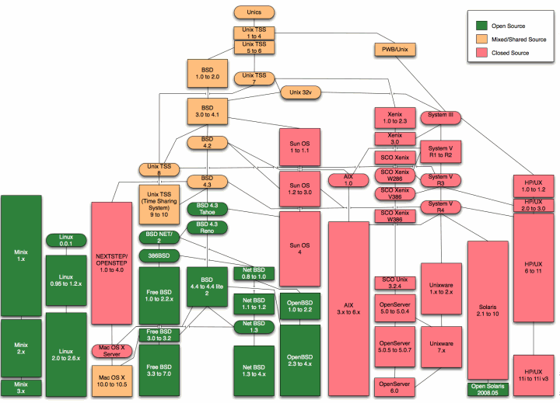
Unix
Family
Tree
(Wikipedia)

Slide 9
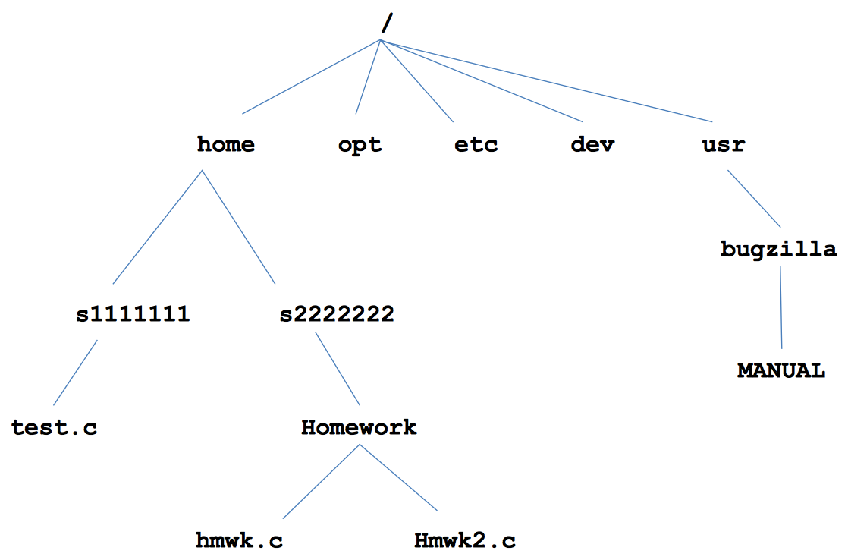
UNIX File System
9

Slide 10
UNIX File System
10
Absolute path
The path to a file starting from root (/)
Example: /home/maerizvi/OS/file.c
Relative path
The path to a file starting from the current working directory
Example: OS/file.c
. (the current directory)
Example: ./a.out
.. (the parent directory)
Example: ../user2/homework.c
~ (the user’s home directory)
File names are case sensitive

Slide 11
Shells
11
A shell is a special type of program that runs in the terminal
Executes programs
Commands such as ls, cd, pwd are simply programs
Shells include sh, csh, bash, ksh, etc.
Programming language constructs
E.g., loops, if/else, variables (syntax varies by shell)

Slide 12
Shells
12
Shell script
A shell program in a file
A script can be executed directly (with the right permissions)
A script can also be run by passing it as an argument to the shell program

Slide 13
Shell special characters
13
< redirect input (stdin)
myprog < file1
Calls to scanf, fgets, etc. in myprog will read from file1
> redirect output (stdout)
echo “Hello world” > file2
Hello, world will become the contents of file2
file2 will be created or overwritten
Calls to printf, puts, etc. in a program will be written to the specified file

Slide 14
Shell special characters
14
>> redirect stdout to the end of a file (append)
| pipe
redirect stdout of a program to stdin of another program
cat file3.c | grep “if” | wc -l

Slide 15
UNIX commands
15
Programs, distinct from the OS, commonly included with the OS
Practiced with the common ones in the lab
cd, pwd, ls, rm, cp, mkdir, etc.

Slide 16
UNIX commands
16
On the command-line (i.e., in a shell), run a program/command by typing its filename followed by any command-line arguments
If the program is not found in the PATH, then the path to the executable file must be used
PATH is a special variable that lists all the directories that should be searched for programs

Slide 17
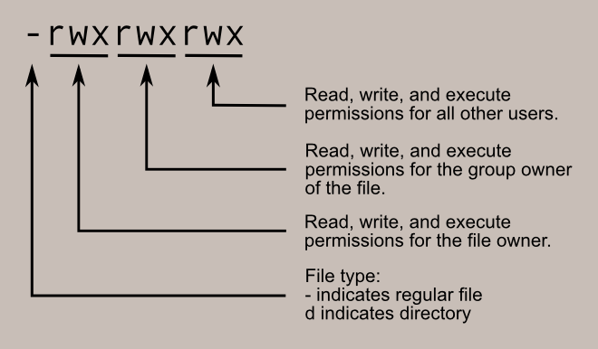
UNIX commands
17
UNIX files have a set of a permissions
Directories, devices, etc. are also files
Files with execute permission can be run
Actual executable nature does not matter
File extension does not matter
Image from linuxcommand.org

Slide 18
UNIX commands
18
Change file permissions with chmod
Interpret each triple (owner, group, all) as 3 bits
Example: chmod 640 file.c
Give the file owner read and write permission 110
Give the group just read permission 100
Give everyone else no permissions 000
chmod +x file.c
This style adds execute permission to every triple

Slide 19
What Is An Operating System (1)
A modern computer consists of:
One or more processors
Main memory
Disks
Printers
Various input/output devices
Managing all these components requires a layer of software – the operating system
Tanenbaum, Modern Operating Systems 3 e, (c) 2008 Prentice-Hall, Inc. All rights reserved. 0-13-6006639

Slide 20
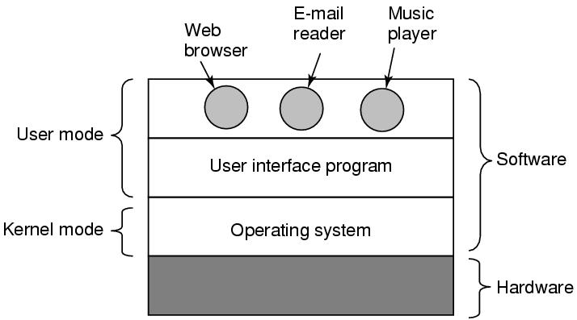
What Is An Operating System (2)
Figure 1-1. Where the operating system fits in.
Tanenbaum, Modern Operating Systems 3 e, (c) 2008 Prentice-Hall, Inc. All rights reserved. 0-13-6006639

Slide 21
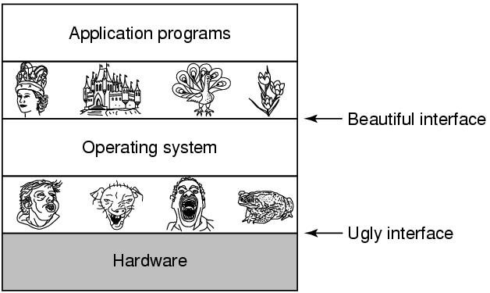
The Operating System as an Extended Machine
Figure 1-2. Operating systems turn ugly hardware into beautiful abstractions.
Tanenbaum, Modern Operating Systems 3 e, (c) 2008 Prentice-Hall, Inc. All rights reserved. 0-13-6006639

Slide 22
The Operating System as a Resource Manager
Allow multiple programs to run at the same time
Manage and protect memory, I/O devices, and other resources
Includes multiplexing (sharing) resources in two different ways:
In time
In space
Tanenbaum, Modern Operating Systems 3 e, (c) 2008 Prentice-Hall, Inc. All rights reserved. 0-13-6006639

Slide 23
Coming up …
23
Processes
Or system-call level I/O
Or shell scripts

Slide 24
History of Operating Systems
Generations:
(1945–55) Vacuum Tubes
(1955–65) Transistors and Batch Systems
(1965–1980) Integrated Circuits (ICs)and Multiprogramming
(1980–Present) Personal Computers
Tanenbaum, Modern Operating Systems 3 e, (c) 2008 Prentice-Hall, Inc. All rights reserved. 0-13-6006639

Slide 25
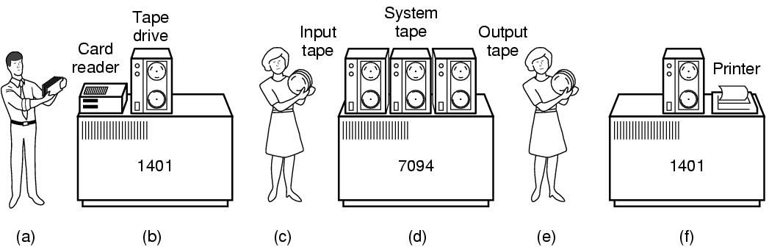
Transistors and Batch Systems (1)
Figure 1-3. An early batch system. (a) Programmers bring cards to 1401. (b)1401 reads batch of jobs onto tape.
Tanenbaum, Modern Operating Systems 3 e, (c) 2008 Prentice-Hall, Inc. All rights reserved. 0-13-6006639

Slide 26
Transistors and Batch Systems (2)
Figure 1-3. (c) Operator carries input tape to 7094. (d) 7094 does computing. (e) Operator carries output tape to 1401. (f) 1401 prints output.
Tanenbaum, Modern Operating Systems 3 e, (c) 2008 Prentice-Hall, Inc. All rights reserved. 0-13-6006639

Slide 27
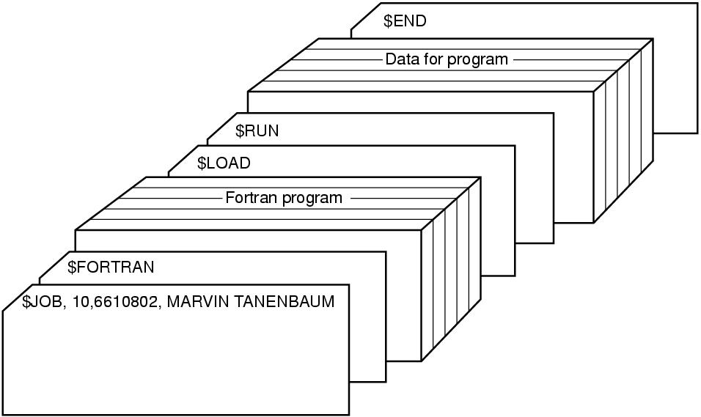
Transistors and Batch Systems (4)
Figure 1-4. Structure of a typical FMS job.
Tanenbaum, Modern Operating Systems 3 e, (c) 2008 Prentice-Hall, Inc. All rights reserved. 0-13-6006639

Slide 28
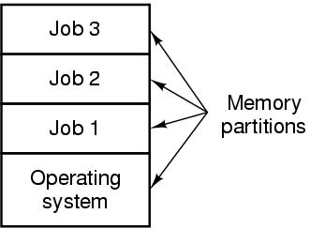
ICs and Multiprogramming
Figure 1-5. A multiprogramming system with three jobs in memory.
Tanenbaum, Modern Operating Systems 3 e, (c) 2008 Prentice-Hall, Inc. All rights reserved. 0-13-6006639

Slide 29
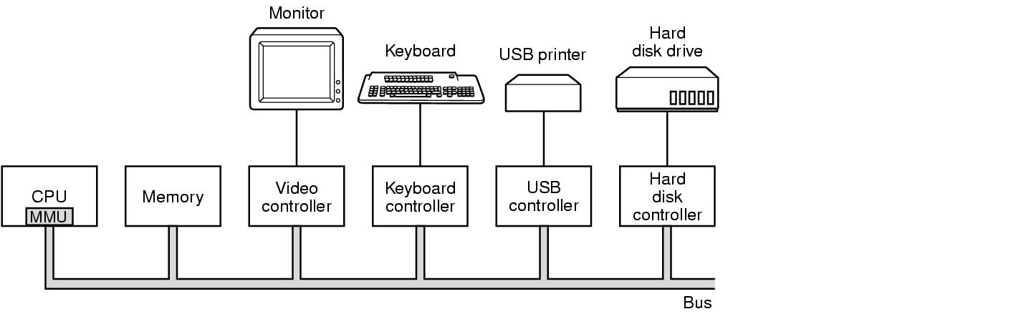
Computer Hardware Review
Figure 1-6. Some of the components of a simple personal computer.
Tanenbaum, Modern Operating Systems 3 e, (c) 2008 Prentice-Hall, Inc. All rights reserved. 0-13-6006639

Slide 30
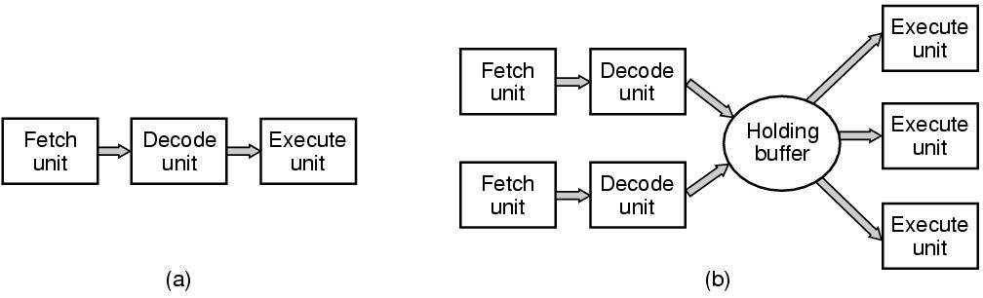
CPU Pipelining
Figure 1-7. (a) A three-stage pipeline. (b) A superscalar CPU.
Tanenbaum, Modern Operating Systems 3 e, (c) 2008 Prentice-Hall, Inc. All rights reserved. 0-13-6006639

Slide 31
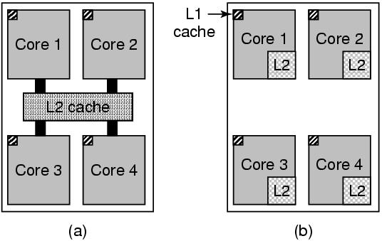
Multithreaded and Multicore Chips
Figure 1-8. (a) A quad-core chip with a shared L2 cache. (b) A quad-core chip with separate L2 caches.
Tanenbaum, Modern Operating Systems 3 e, (c) 2008 Prentice-Hall, Inc. All rights reserved. 0-13-6006639

Slide 32
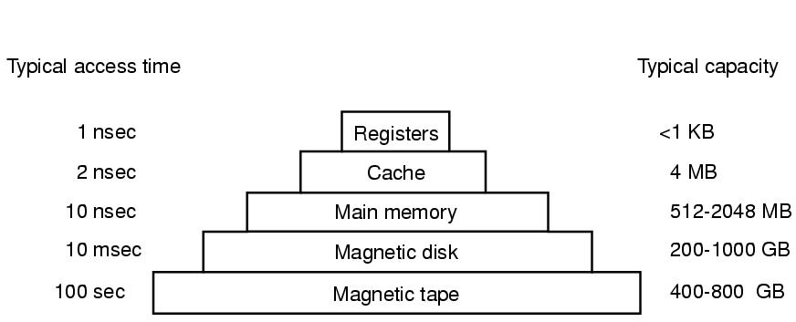
Memory (1)
Figure 1-9. A typical memory hierarchy. The numbers are very rough approximations.
Tanenbaum, Modern Operating Systems 3 e, (c) 2008 Prentice-Hall, Inc. All rights reserved. 0-13-6006639

Slide 33
Memory (2)
Questions when dealing with cache:
When to put a new item into the cache.
Which cache line to put the new item in.
Which item to remove from the cache when a slot is needed.
Where to put a newly evicted item in the larger memory.
Tanenbaum, Modern Operating Systems 3 e, (c) 2008 Prentice-Hall, Inc. All rights reserved. 0-13-6006639

Slide 34
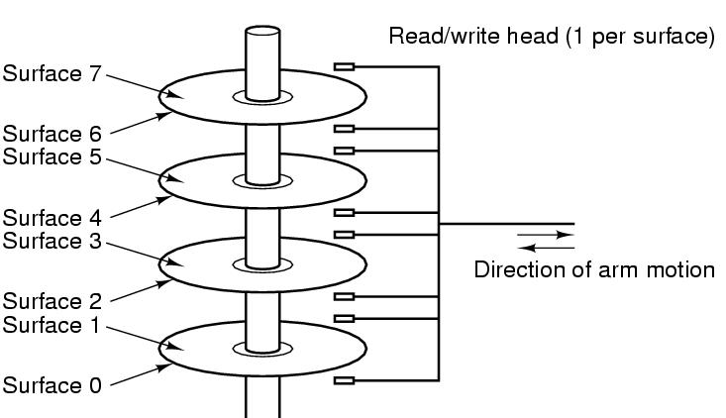
Disks
Figure 1-10. Structure of a disk drive.
Tanenbaum, Modern Operating Systems 3 e, (c) 2008 Prentice-Hall, Inc. All rights reserved. 0-13-6006639

Slide 35
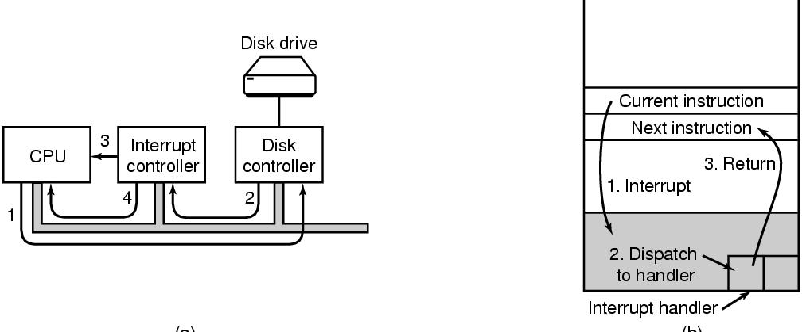
I/O Devices
Figure 1-11. (a) The steps in starting an I/O device and getting an interrupt.
Tanenbaum, Modern Operating Systems 3 e, (c) 2008 Prentice-Hall, Inc. All rights reserved. 0-13-6006639

Slide 36
1.4 The Operating System Zoo
Mainframe operating systems
Server operating systems
Multiprocessor operating systems
Personal computer operating systems
Handheld operating systems
Embedded operating systems
Sensor node operating systems
Real-time operating systems
Smart card operating systems
Tanenbaum, Modern Operating Systems 3 e, (c) 2008 Prentice-Hall, Inc. All rights reserved. 0-13-6006639

Slide 37
1.5 Operating System Concepts
Processes
Address spaces
Files
Input/Output
Protection (Security)
The shell
Tanenbaum, Modern Operating Systems 3 e, (c) 2008 Prentice-Hall, Inc. All rights reserved. 0-13-6006639

Slide 38
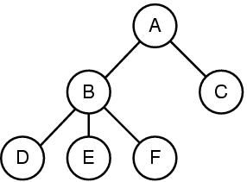
1.5.1 Processes
Figure 1-13. A process tree. Process A created two child processes, B and C. Process B created three child processes, D, E, and F.
Tanenbaum, Modern Operating Systems 3 e, (c) 2008 Prentice-Hall, Inc. All rights reserved. 0-13-6006639
Notes:
38

Slide 39
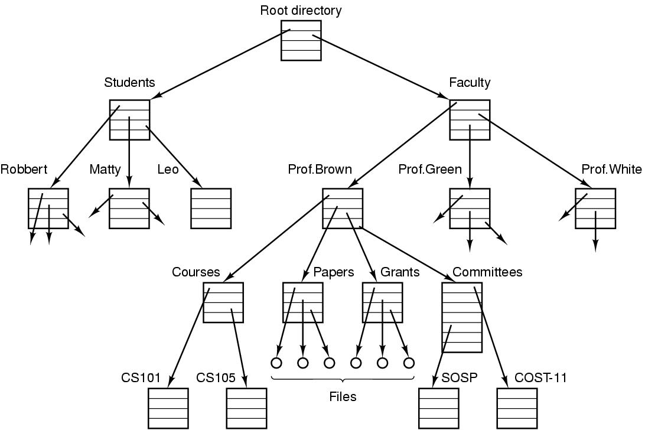
1.5.3 Files (1)
Figure 1-14. A file system for a university department.
Tanenbaum, Modern Operating Systems 3 e, (c) 2008 Prentice-Hall, Inc. All rights reserved. 0-13-6006639

Slide 40
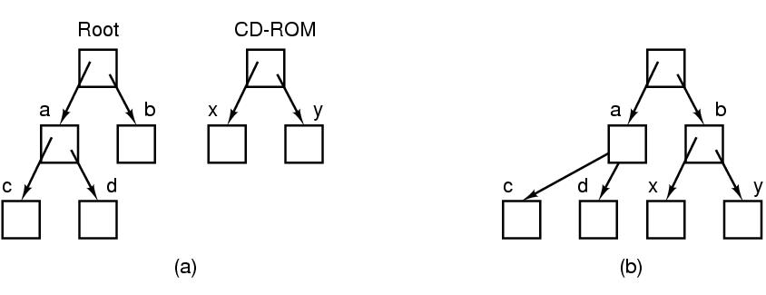
Files (2)
Figure 1-15. (a) Before mounting, the files on the CD-ROM are not accessible. (b) After mounting, they are part of the file hierarchy.
Tanenbaum, Modern Operating Systems 3 e, (c) 2008 Prentice-Hall, Inc. All rights reserved. 0-13-6006639

Slide 41
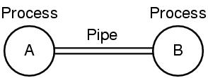
Files (3)
Special files make I/O devices look like files
A pipe is another special kind of file
Figure 1-16. Two processes connected by a pipe.
Tanenbaum, Modern Operating Systems 3 e, (c) 2008 Prentice-Hall, Inc. All rights reserved. 0-13-6006639

