Slide 1
File I/O
UNIX system calls

Slide 2
The file abstraction
Many things in UNIX are represented as files
Normal files (documents, programs, images, etc.)
Directories
Network connections (sockets)
Devices (printers, monitors, keyboards, etc.)
The interface to all of these things is the same (at least similar)
Same/similar system calls used on different kinds of things

Slide 3
Standard I/O library
C library
The library functions add a layer of functionality over the system calls
FILE structure (FILE *fp)
stdio.h
stdin, stdout, stderr

Slide 4
System calls
The system calls switch directly to the OS, which manages all the I/O for the computer
File descriptors (int fd)
Special file descriptors 0, 1 & 2
STDIN_FILENO, STDOUT_FILENO, STDERR

Slide 5
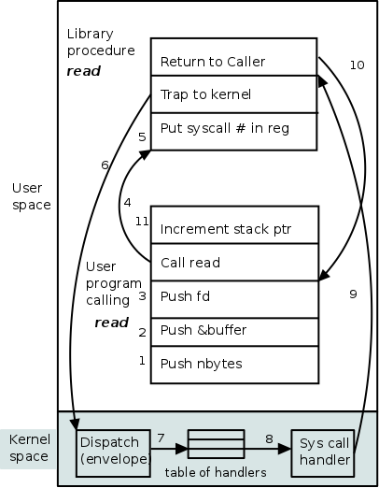
System call process
http://cs.nyu.edu/courses/spring13/CSCI-UA.0202-001/diagrams/syscall.png

Slide 6
File descriptors
A file descriptor is an index into an array of pointers to entries in the open file table
Each file table entry has some information about the status and offset in this file, then a pointer to a vnode representing the actual file
Different processes can have file descriptors for the same file.
A single process can have several file descriptors for the same file through different open file table entries.
A single process can have different file descriptors for the same file table entry.
Different processes (with specific relationships) can have different file descriptors for the same file table entry.

Slide 7
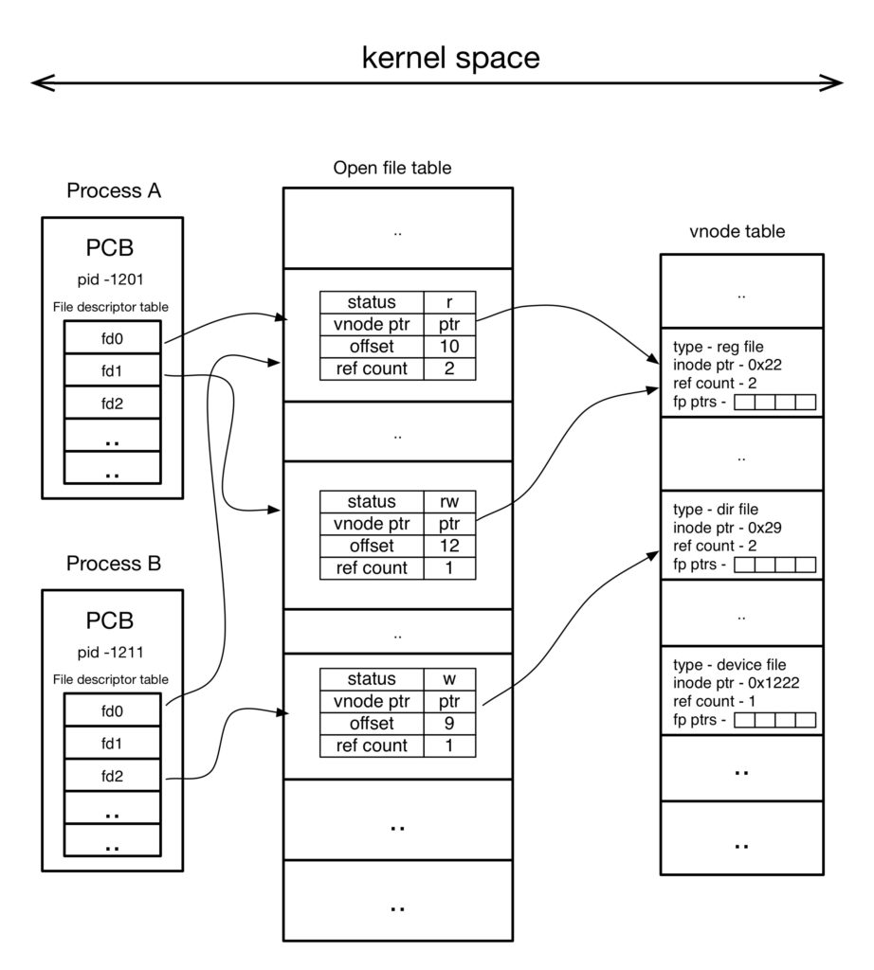
lijubjohn.com/index.php/2017/02/04/file-descriptor-and-inode/

Slide 8
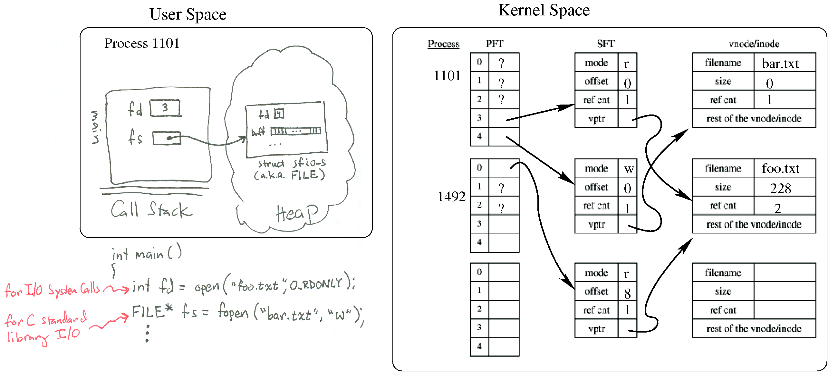
https://www.usna.edu/Users/cs/wcbrown/courses/IC221/classes/L09/Class.html

Slide 9
Basic I/O system calls
open
close
read
write
lseek
dup, dup2
More information at: www.classes.cs.uchicago.edu/archive/2014/winter/51081-1/LabFAQ/lab3/fileio.html

Slide 10
open
Purpose | open or create a file for reading or writing
Include | #include<fcntl.h> If the optional third argument is used also include: #include<sys/types.h> #include<sys/stat.h>
Usage | int open(const char *path, int flags[, mode_t mode]); (The third argument is optional.)
Arguments | path: the (relative) path to the file flags: the file status flags mode: file permissions, used when creating a new file
Returns | -1 on error file descriptor on success
Errors | Too numerous to list all: see man 2 open ENOTDIR: A component of the path prefix is not a directory. EACCES: Permissions do not permit reading or writing EISDIR: The named file is a directory and it is to opened for writing. EMFILE: The process has already reached its limit for open file descriptors.

Slide 11
read
Purpose | read input from file
Include | #include<unistd.h>
Usage | ssize_t read(int d, void *buf, size_t nbytes);
Arguments | d: a file descriptor buf: buffer for storing bytes read nbytes: maximum number of bytes to read
Returns | -1 on error number of bytes read and placed in buf or 0 if end of file
Errors | EBADF: d is not an active descriptor.. EFAULT: buf points outside the allocated address space. EAGAIN: The file was marked for non-blocking I/O, and no data were ready to be read. EINVAL: The pointer associated with d was negative. EIO: An I/O error occurred while reading from the file system.

Slide 12
write
Purpose | write output to file
Include | #include<unistd.h>
Usage | ssize_t write(int d, void *buf, size_t nbytes);
Arguments | d: a file descriptor buf: buffer for storing bytes to be written nbytes: maximum number of bytes to write
Returns | -1 on error number of bytes written
Errors | Too numerous to list all: see man 2 write EBADF: d is not an active descriptor. EFAULT: Data to be written to the file points outside the allocated address space. EINVAL: The pointer associated with d was negative. EFBIG: An attempt was made to write a file that exceeds the process's file size limit or the maximum file size. ENOSPC: There is no free space remaining on the file system containing the file.. EAGAIN: The file was marked for non-blocking I/O, and no data were ready to be read. EINTR: A signal interrupted the write before it could be completed. EIO: An I/O error occurred while reading from the file system.

Slide 13
lseek
Purpose | reposition read/write file offset
Include | #include<unistd.h>
Usage | off_t lseek(int d, off_t offset, int base);
Arguments | d: a file descriptor offset: the number of bytes to be offset base: the position from which the bytes will be offset: SEEK_SET: offset bytes from beginning of the file. SEEK_CUR: offset bytes from current value of offset. SEEK_END: offset bytes from end of the file.
Returns | -1 on error The resulting offset location as measured in bytes from the beginning of the file.
Errors | EBADF: d is not an active descriptor.. EINVAL: basenot a proper value. ESPIPE: base associated with a non-regular file (pipe, socket or FIFO.)

Slide 14
dup and dup2
Purpose | duplicate an existing file descriptor
Include | #include<unistd.h>
Usage | int dup(int oldd); int dup2(int oldd, int newd);
Arguments | oldd: an existing file descriptor newd: the value of the new descriptor newd
Returns | -1 on error the value of newd
Errors | EBADF: oldd or newd is not a valid active descriptor EMFILE: Too many descriptors are active.

Slide 15
int tick = 0, i, j, n;
char buf[1024];
int fdin, fdout;
int bytes_read, offset;
// Open the files
fdin = open( "M1", O_RDONLY );
fdout = open( "outfile", O_WRONLY | O_CREAT | O_TRUNC, S_IRWXU );
// Go to the last place you were
lseek( fdin, p->stop_offset, SEEK_SET );
// Do the work copying bytes
for ( j = 0; j < max && p->time_left > 0; j++ ) {
for ( i = 0; i < KBYTES; i++ ) {
n = read( fdin, buf, 1024 );
if ( n == 0 ) {
lseek( fdin, 0, SEEK_SET );
n = read( fdin, buf, 1024 );
}
write( fdout, buf, n );
}
p->time_left--; tick++;
simtime++;
}
p->stop_time = simtime;
p->stop_offset = lseek( fdin, 0, SEEK_CUR );
close( fdin );
close( fdout );

