Slide 1
Decision Optimization + Planning Analytics for Optimizing Nurses Scheduling

Slide 2
Nurses Scheduling: Problem Description
Hospital Administration to assign Nurses work schedule
Resources: 32 Nurses with different pay rate, skills set
Demand: 36 shifts, 2 departments, require certain skill set and headcount
Goal / Objective:
Primary: Reduce operation cost
Maintain shift allocation balance
Business Rules / Constraints:
Match competencies, restrict max number of hours, account for vacation schedules etc
Data:
Nurses: Skill set, seniority, salary, vacation
Departments: Minimum and Maximum requirements, Skill set requirement…. etc

Slide 3
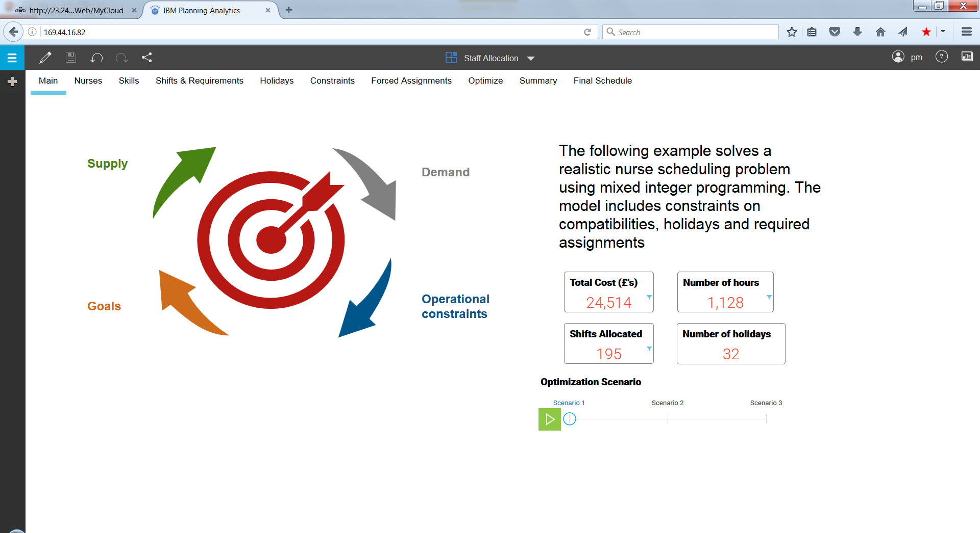
Demo Script: Nurses Scheduling
Other KPIs
Optimization Objective / KPI
Select scenario (different optimization runs with different input data and constraints) to see and compare KPIs

Slide 4
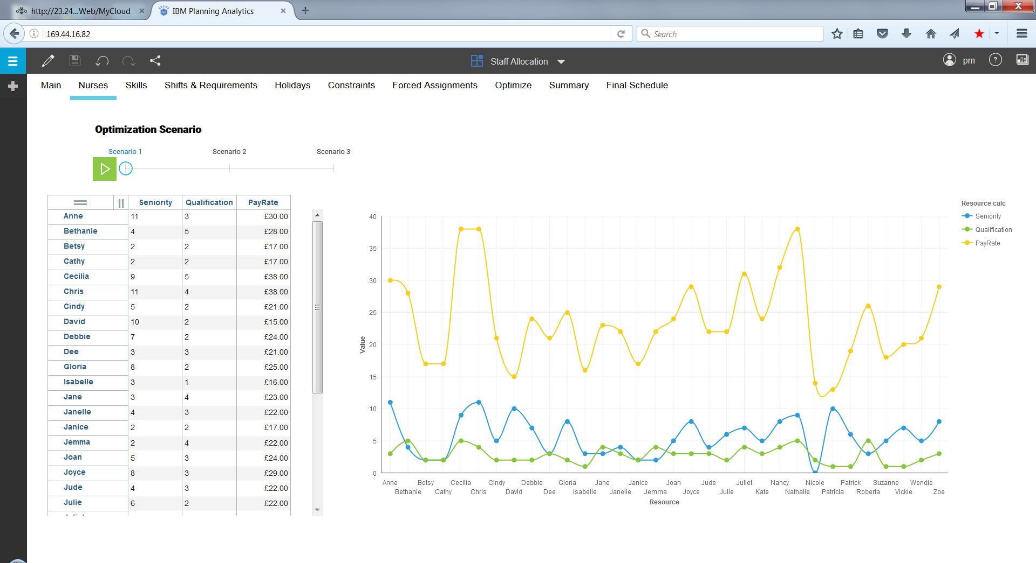
Demo Script: Nurses Scheduling
Nurses Input data page: Shows all Nurses with their Seniority, Qualification, Pay Rate
Select scenario to edit view / edit input data

Slide 5
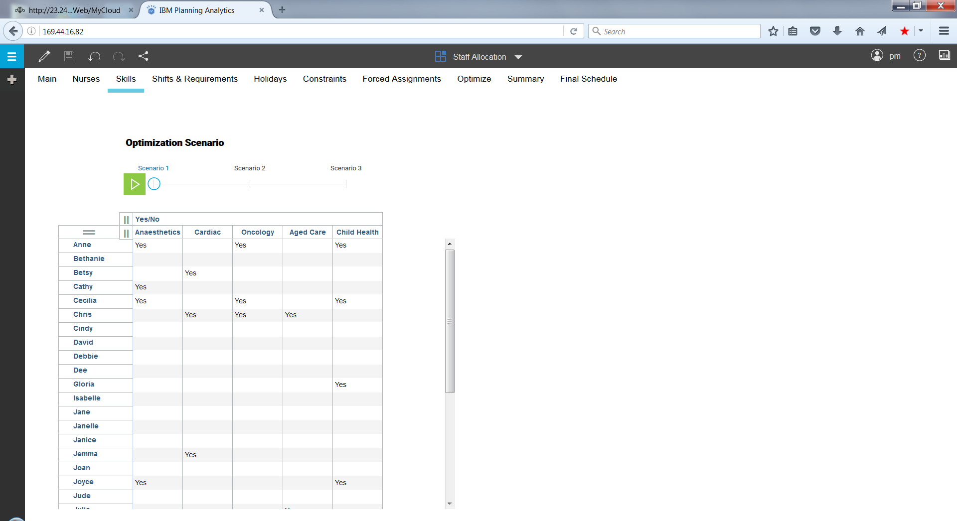
Demo Script: Nurses Scheduling
Skills data page: Shows all Nurses with their Skills.
Select scenario to edit view / edit input data

Slide 6
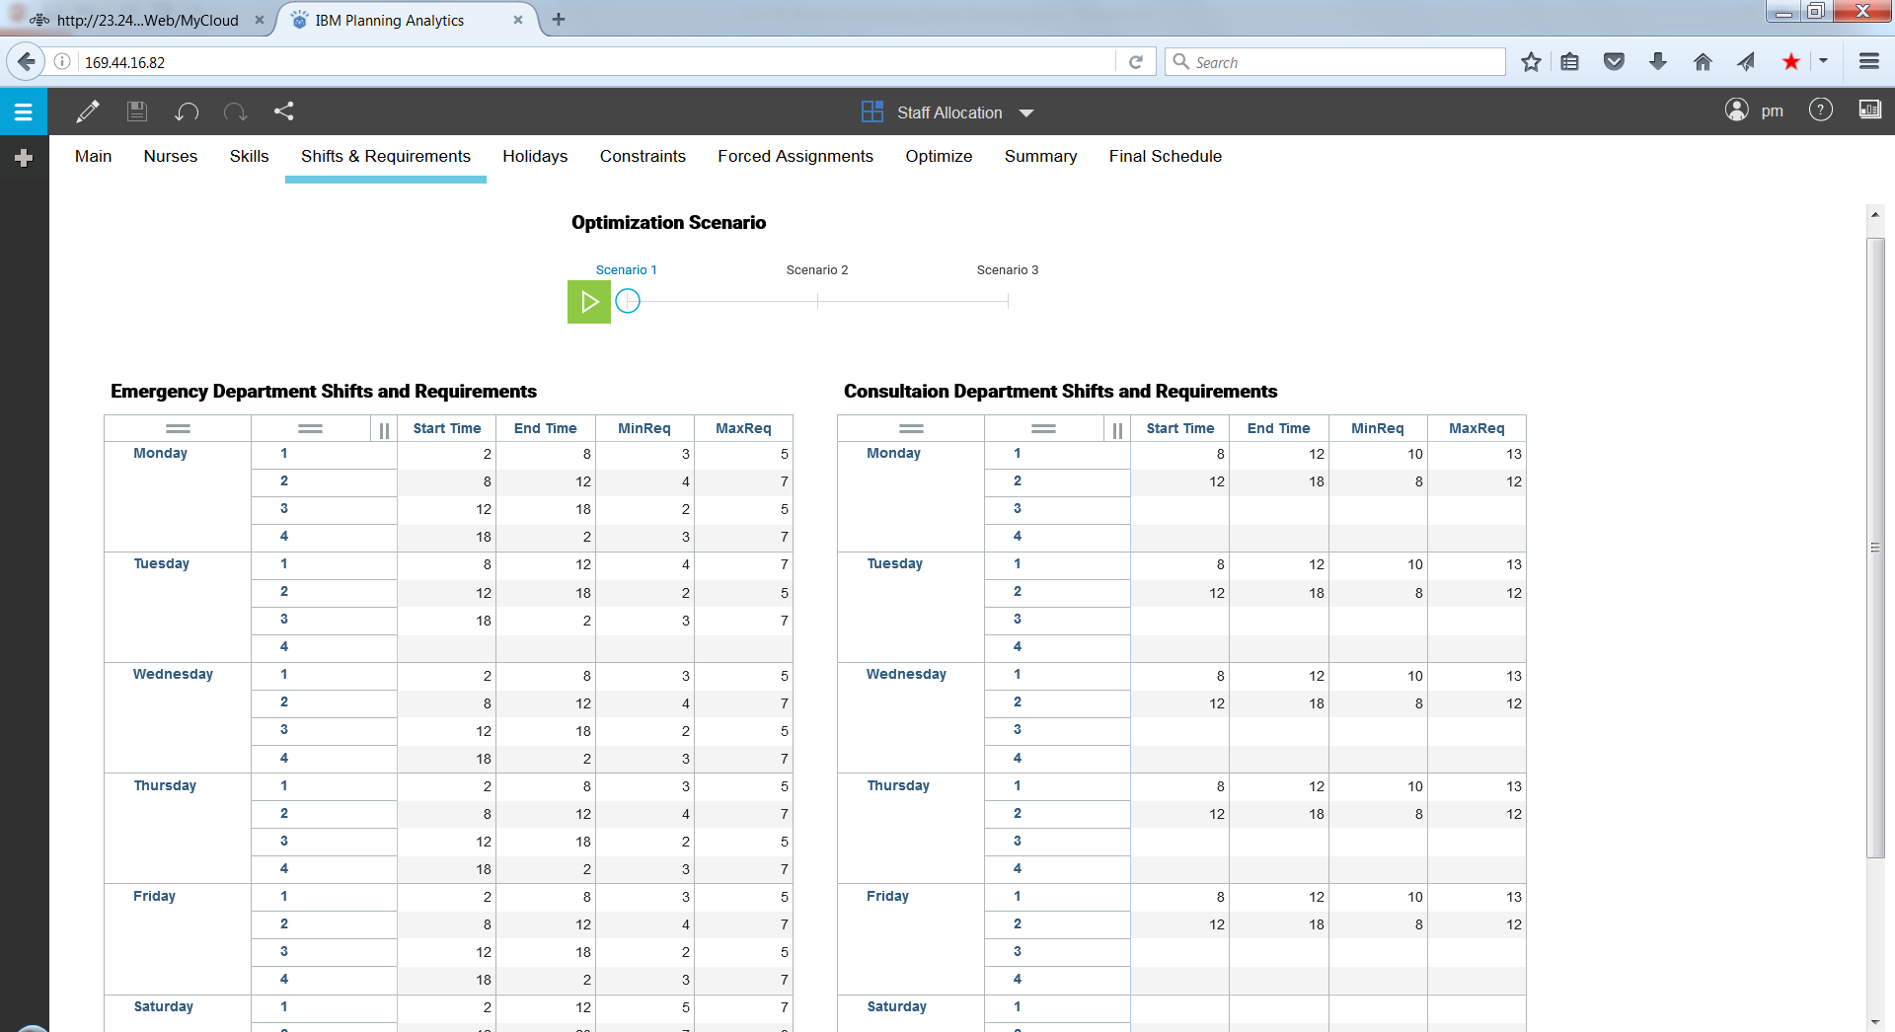
Demo Script: Nurses Scheduling
Shifts and Requirements data page: Shows shifts timings, Minimum and Maximum nurse requirements for each department.
Emergency is open 24 x 7, while Consultation is open only 8 am to 6 pm Monday - Friday

Slide 7
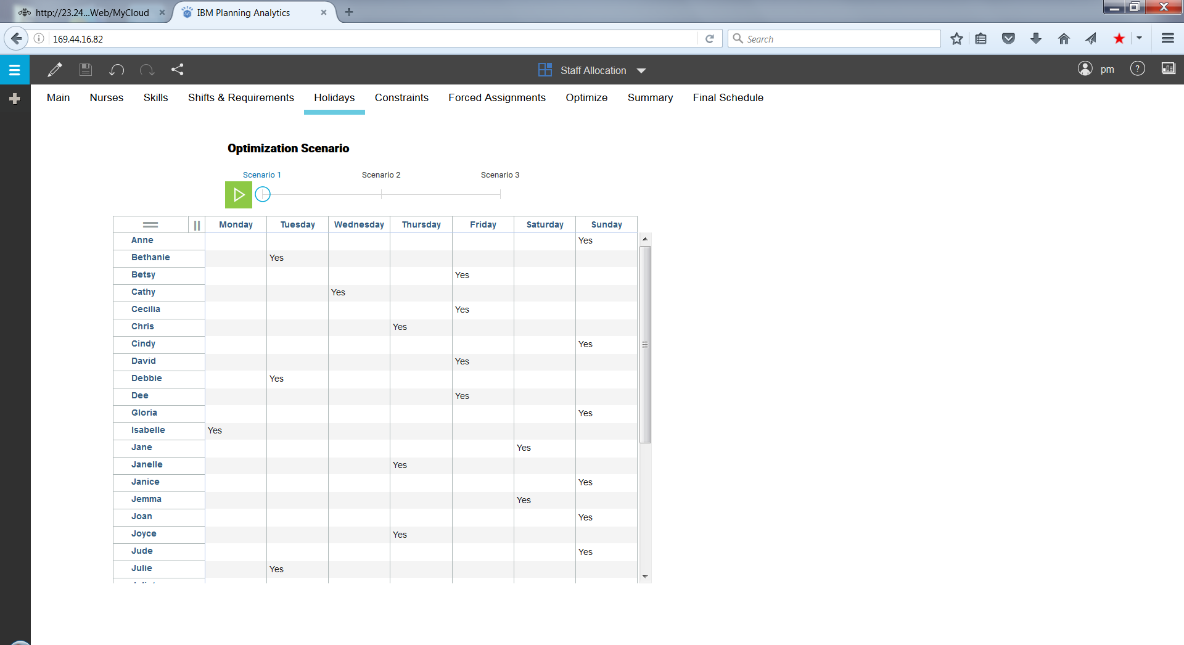
Demo Script: Nurses Scheduling
Personal Vacation schedule for Nurses
Select scenario to edit view / edit input data

Slide 8
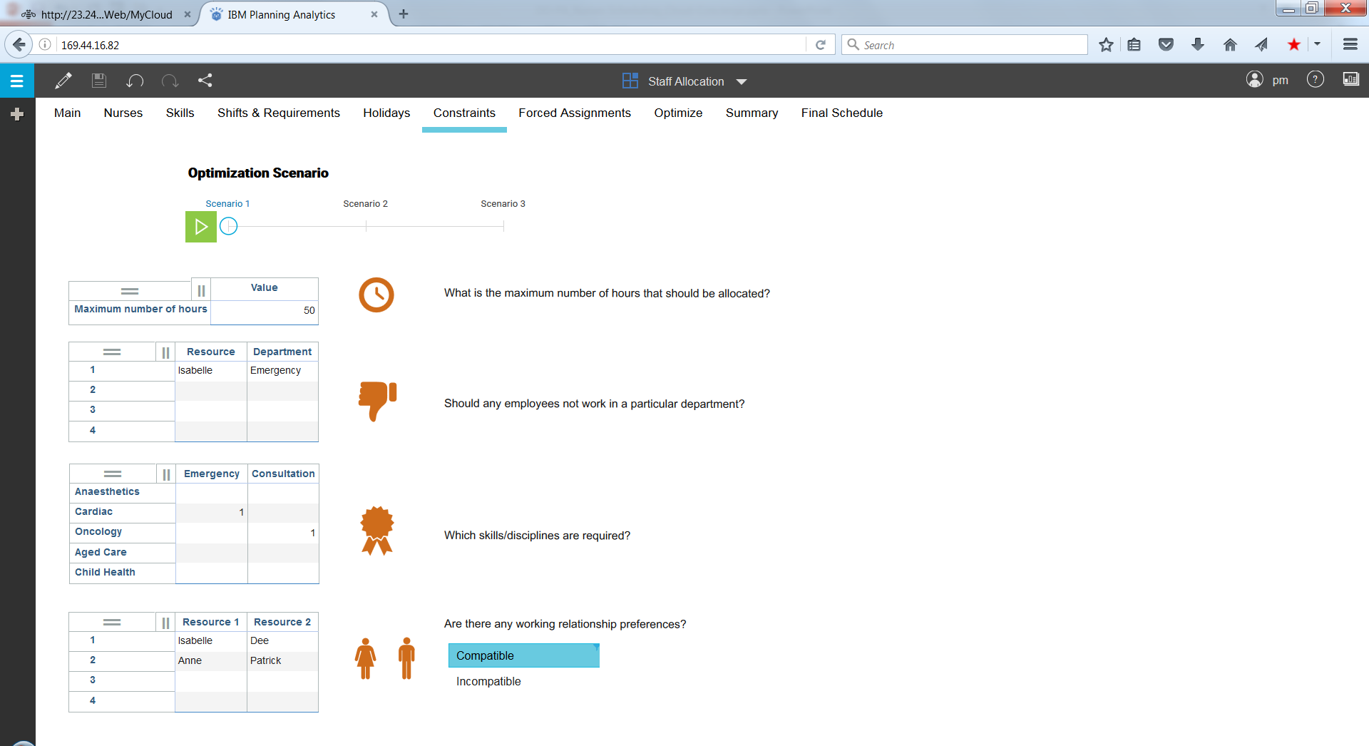
Demo Script: Nurses Scheduling
Constraints Page to set high level requirements
Select scenario to edit constraints
Set max hours for per nurse per week. For e.g, here it is set to max 50 hrs for any nurse
Set Nurses not to be assigned to certain department
Set minimum number of nurses with specific skills to be available all shifts
Set pairs which are preferred to be together (compatible) or preferred not to be together (incompatible) in any given shift

Slide 9
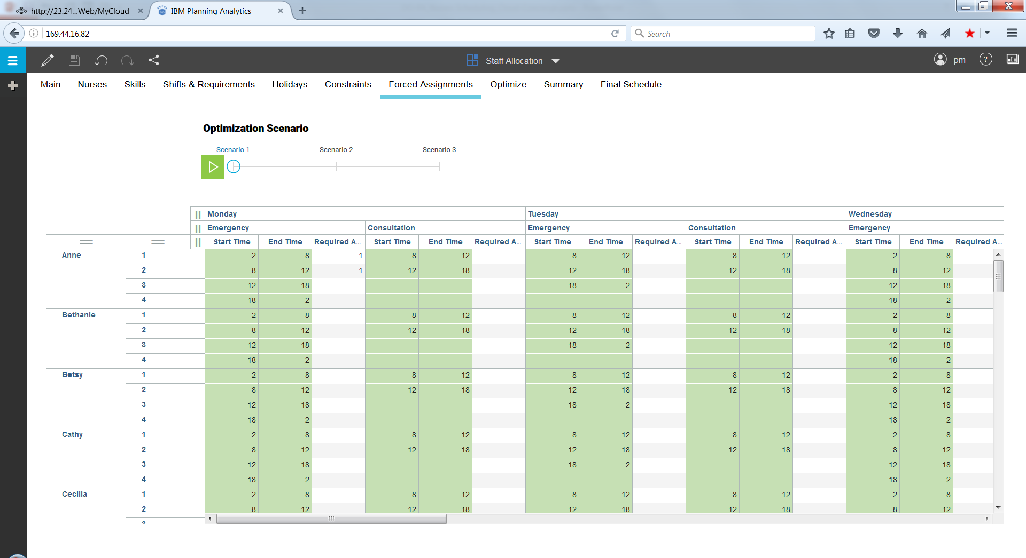
Demo Script: Nurses Scheduling
Forced assignments: If you want to specifically assign certain nurse to specific shift/s
Anne being specifically assigned to cover 1st and 2nd shift on Monday for Emergency dept. Optimization will try to keep the assignment, but not guaranteed.

Slide 10
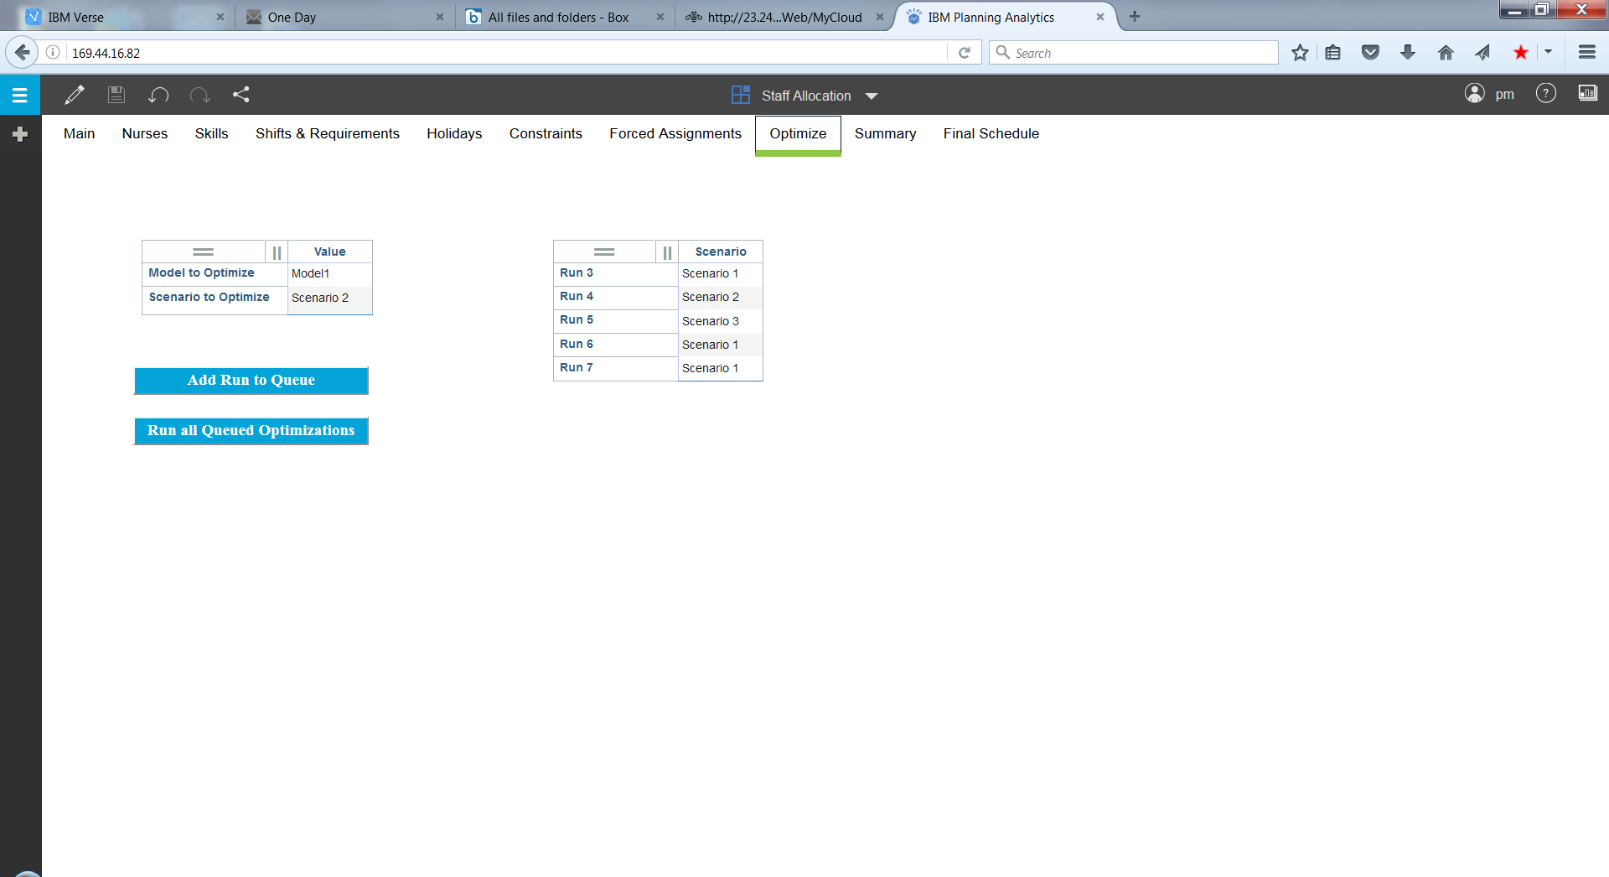
Demo Script: Nurses Scheduling
Optimize
Step 1. Select scenario to run from the drop down list
Step 2. Click “Add Run to Queue”. This will add a new run to queue shown in other table. Repeat to add other scenarios.
Step 3. Click “Run …Optimization”.

Slide 11
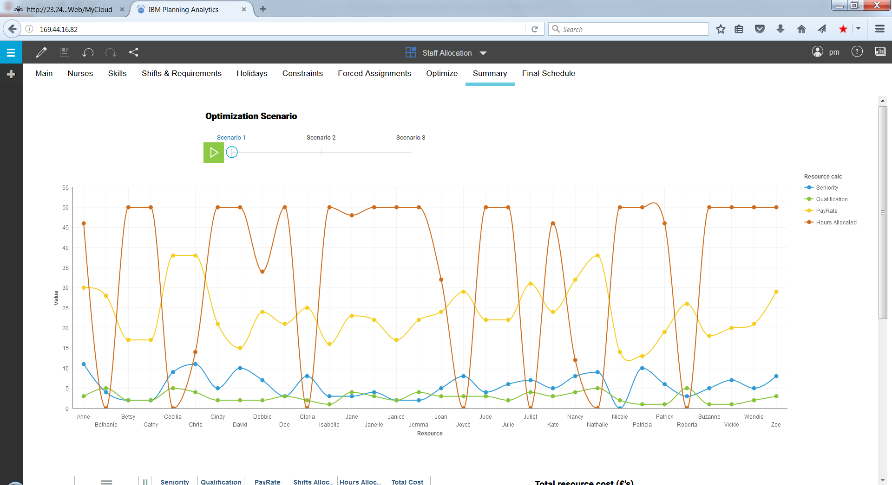
Demo Script: Nurses Scheduling
Summary of Optimized schedule
Select scenario to view results
No nurse working more that 50 hrs, since that was set as high level constraint
Can be seen that nurses with higher pay rate getting fewer hours since minimizing cost is an objective

Slide 12
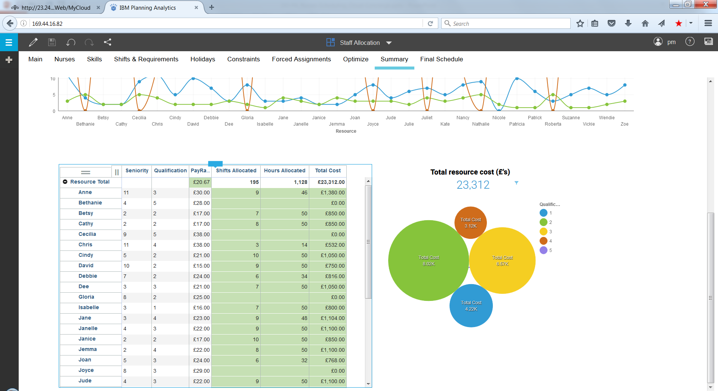
Demo Script: Nurses Scheduling
Summary of Optimized schedule
Tabular view of results on same page
Total hours, shifts and cost per nurse assignment

Slide 13
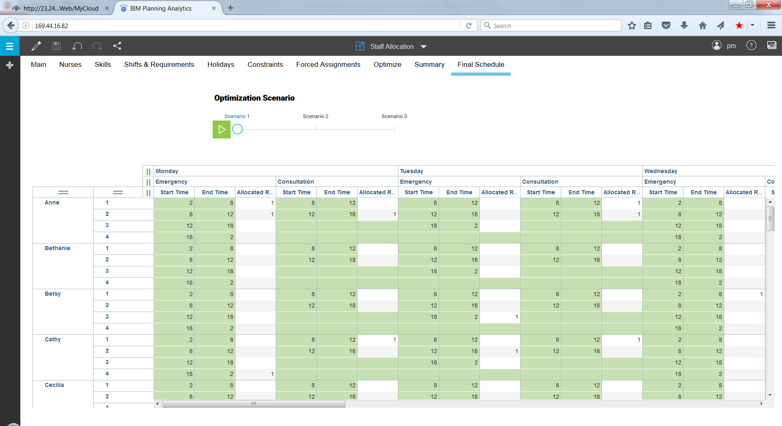
Demo Script: Nurses Scheduling
Detailed Optimized schedule
Select scenario to view results
View detailed nurses assignments to each shift, day and department.

Slide 14
THANK YOU !!
Notes:
14

